Slide 1
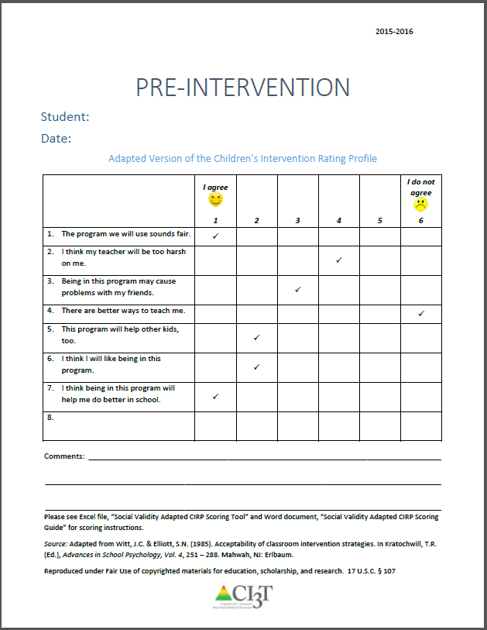
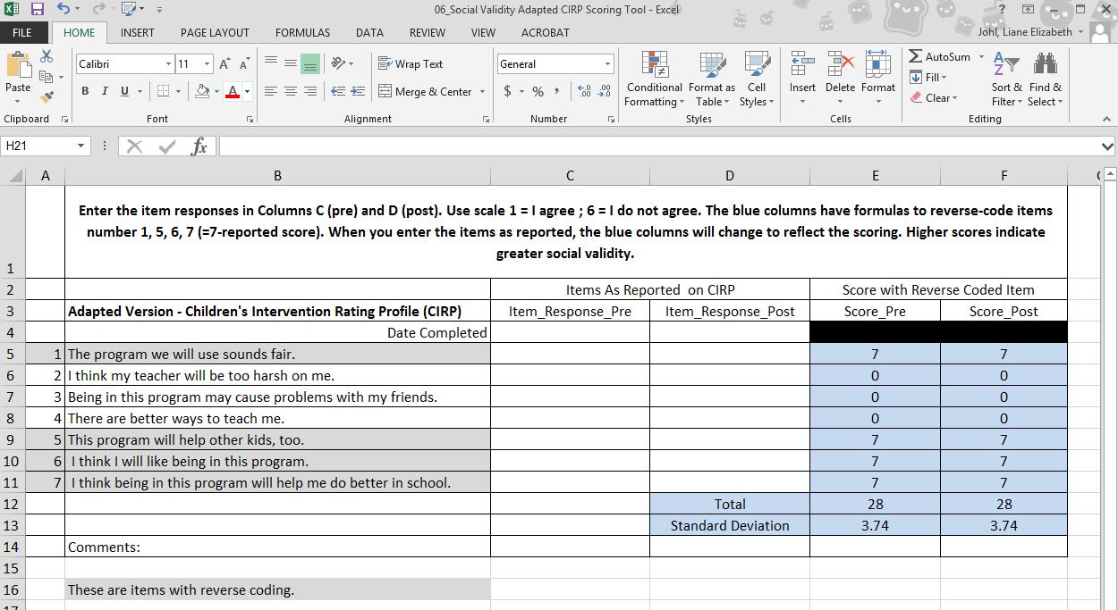
Overview of Adapted Version Children’s Intervention Rating Profile Scoring Tool
For further support, please see the document Social Validity Adapted Scoring Guide for a visual step-by-step breakdown of using the CIRP Scoring Tool.

