Slide 1
Low-Intensity Strategies:
Using Behavior Specific Praise to Support Instruction

Slide 2
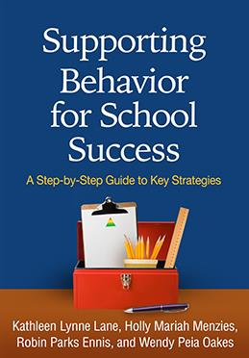


Low-Intensity Strategies for Academics and Behavior
Opportunities to Respond
Behavior Specific Praise
Active Supervision
Instructional Feedback
High p Requests
Precorrection
Incorporating Choice
Self-monitoring
Behavior Contracts
Notes:
Lane, K. L., Oakes, W. P., Ennis, R. P., & Hirsch, S. E. (2014). Identifying students for secondary and tertiary prevention efforts: How do we determine which students have Tier 2 and Tier 3 needs? Preventing School Failure, 58, 171-182, DOI: 10.1080/1045988X.2014.895573

Slide 3


Agenda
What is behavior specific praise (BSP)?
Why is BSP effective?
What does the supporting research for BSP say?
What are the benefits and challenges?
How do I implement behavior specific praise in my in my classroom?
  Checklist for Success
How well is it working? Examining the Effects

Slide 4
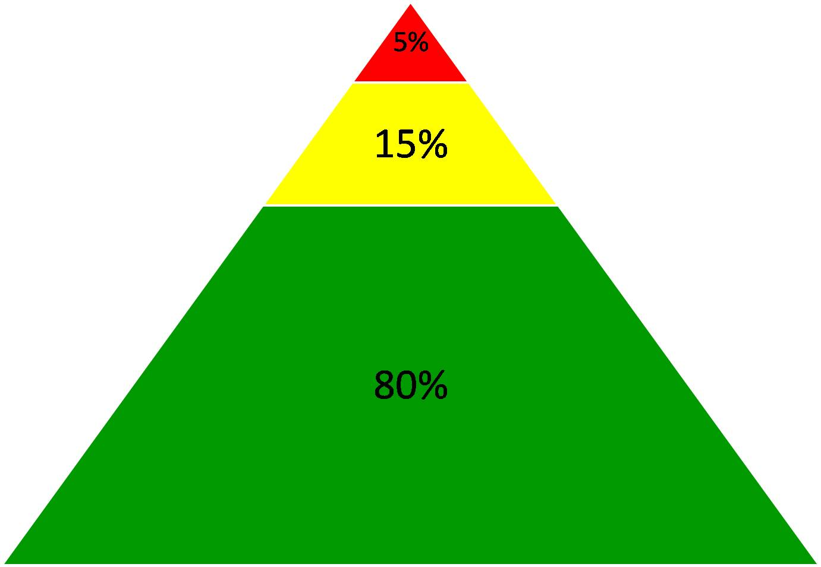
Comprehensive, Integrated, Three-Tiered Model of Prevention
Goal: Reduce Harm
Specialized individual systems for students with high-risk
(Lane, Kalberg, & Menzies, 2009)
≈5%
Tertiary Prevention (Tier 3)
Goal: Reverse Harm
Specialized group systems
for students at-risk
≈15%
Secondary Prevention (Tier 2)
Goal: Prevent Harm
School/classroom-wide systems for all students, staff, & settings
PBIS Framework
≈80%
Validated Curricula
Primary Prevention (Tier 1)
Academic Behavioral Social

Slide 5
Schoolwide Positive Behavior
Support
Comprehensive, Integrative,
Three-tiered (CI3T)
Models of Support
Low Intensity Strategies
Basic Classroom Management
Effective Instruction
Low Intensity Strategies
Behavior Contracts
Self-Monitoring
- -
Functional Assessment-Based
Interventions
Higher Intensity Strategies
Assess, Design, Implement, and
Evaluate
Assessment

Slide 6
What is Behavior Specific Praise?
Behavior Specific Praise (BSP): Praise statements that include reference to the specific behavior for which the student is being recognized (Brophy, 1981; Sutherland, Wehby, & Copeland, 2000)
Key Components
  Praise statement must be linked to a behavior
  Provide feedback specific to the behavior
  Be sincere
  Reflect skill level
  Evaluate effectiveness
  Praise effort – not ability
  (Haydon, Musti-Rao, 2011, p. 31)
General v. Specific

Slide 7
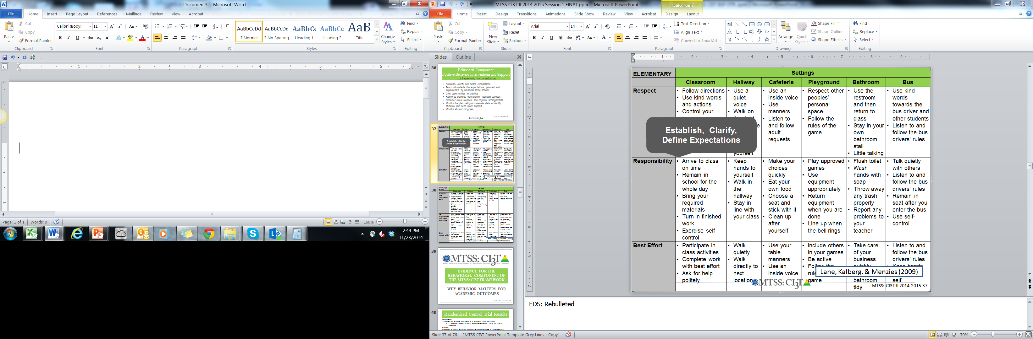
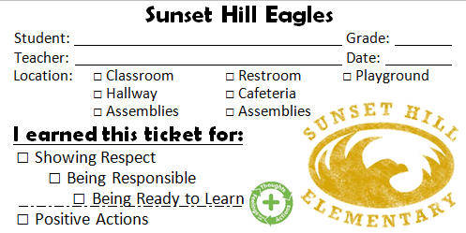
Examples
“Bob, great job showing your work on your math homework.”
“I appreciate how you pushed in your chair on the way to line up for lunch. That keeps the walkways safe.”
BSP is a form of positive reinforcement

Slide 8
Why is Behavior Specific Praise effective?
More effective when
  it is behavior specific rather than general praise
  teachers use strategies to intentionally increase their rate of BSP and target their delivery of BSP to identified students (Thompson, Marchant, Anderson, Prater, & Gibb, 2012).
Simple, effective, requires minimal effort
Instructional feedback delivered at a rate of four positive to one negative (4:1 ratio; Myers, Simonsen, & Sugai, 2011)
Most effective when delivered consistently and immediately after desired behavior
Establishes supportive and positive classroom environment
(Marchant & Anderson, 2012; Kennedy & Jolivette, 2008 ; Stormont & Reinke, 2009)
IFEED-AV
Immediately,
Frequently,
Enthusiasm,
Eye Contact,
Describe,
Anticipation,
Variety
(Rhode, Jenson, & Reavis, 1992)

Slide 9
What does the supporting research for BSP say?
Increasing preschool student’s on-task behavior during transitions in inclusion classrooms (Fullerton, Conroy, & Correa, 2009)
Increasing teachers’ use of behavior specific praise in self-contained classrooms (Hawkins & Helfin, 2011)
Increasing time spent inside the classroom in a residential facility (Kennedy & Jolivette, 2008)

Slide 10
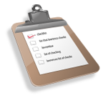
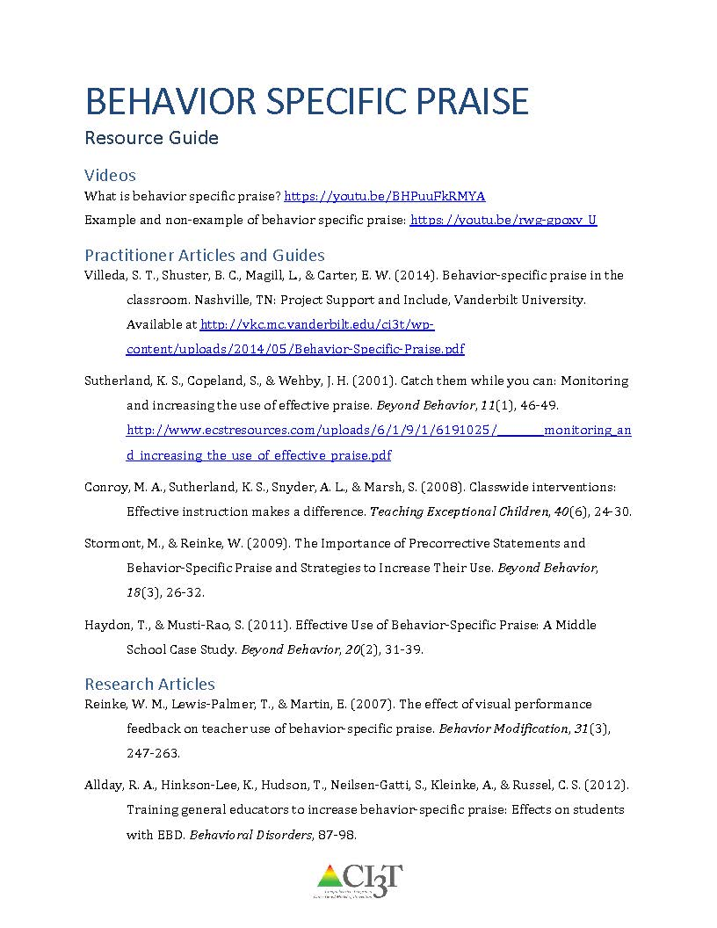
Supporting Research
See “Behavior Specific Praise Resource Guide” for additional supporting research and information.

Slide 11
What are the benefits and challenges?
Benefits
Challenges
Takes little effort and costs nothing
Improves student- teacher relationships
Not time consuming or intrusive
Increases on-task behavior and reduces problem behavior
Increases positive social and academic behaviors
(Lampi, Fenty, & Beaunae, 2005; Marchant & Anderson, 2012; Stormont & Reinke, 2009)
Determine students’ preferred method of praise – public or private
Consider the needs of students who are more motivated by escaping tasks or activities rather than accessing teacher attention

Slide 12

How do I implement behavior specific praise in my classroom? Checklist for Success
Step 1
Evaluate current rates of general and behavior specific praise.
Step 2
Identify behaviors to reinforce.
Step 3
Practice delivery of BSP.
Step 4
Observe student behavior.

Slide 13
How do I implement behavior specific praise in my classroom? Checklist for Success
Step 5
Provide BSP.
Step 6
Monitor BSP delivery.
Step 7
Seek student input.

Slide 14
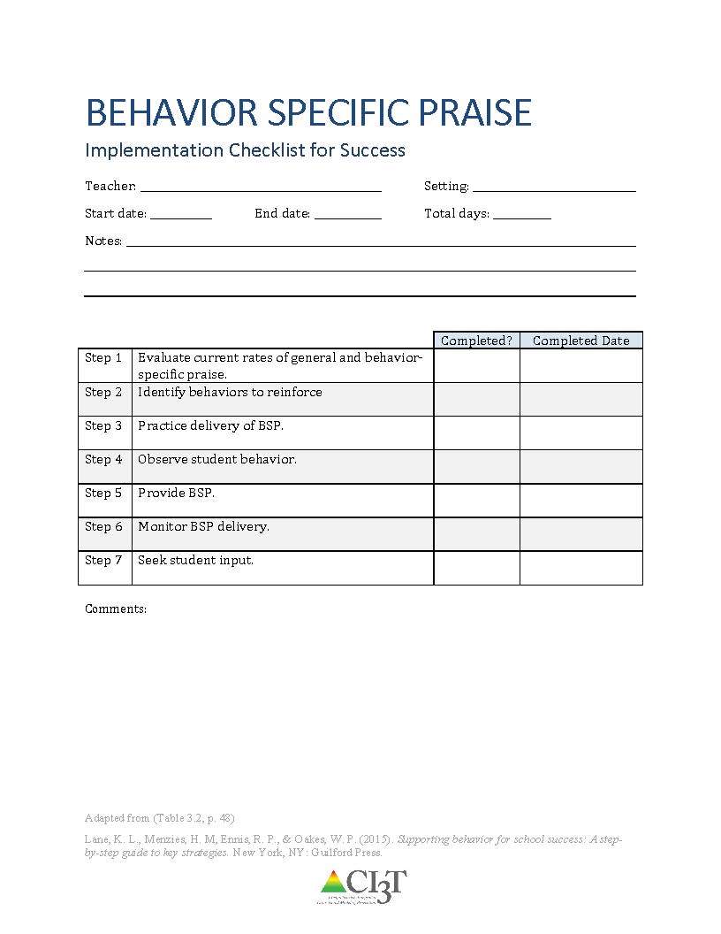
How do I increase BSP in my classroom? Checklist for Success
Step 1: Evaluate current rates of general and behavior specific praise
Step 2: Identify behaviors to reinforce
Step 3: Practice delivery of BSP
Step 4: Observe student behavior
Step 5: Provide BSP
Step 6: Monitor BSP delivery
Step 7: Seek student input
See “Behavior Specific Praise Implementation Checklist for Success”

Slide 15
How well is it working?
Examining the Effects
Treatment Integrity
Is it happening?
Social Validity
What do stakeholders think about the goals, procedures, and outcomes?
Experimental Design
How well did this support work for this student?

Slide 16
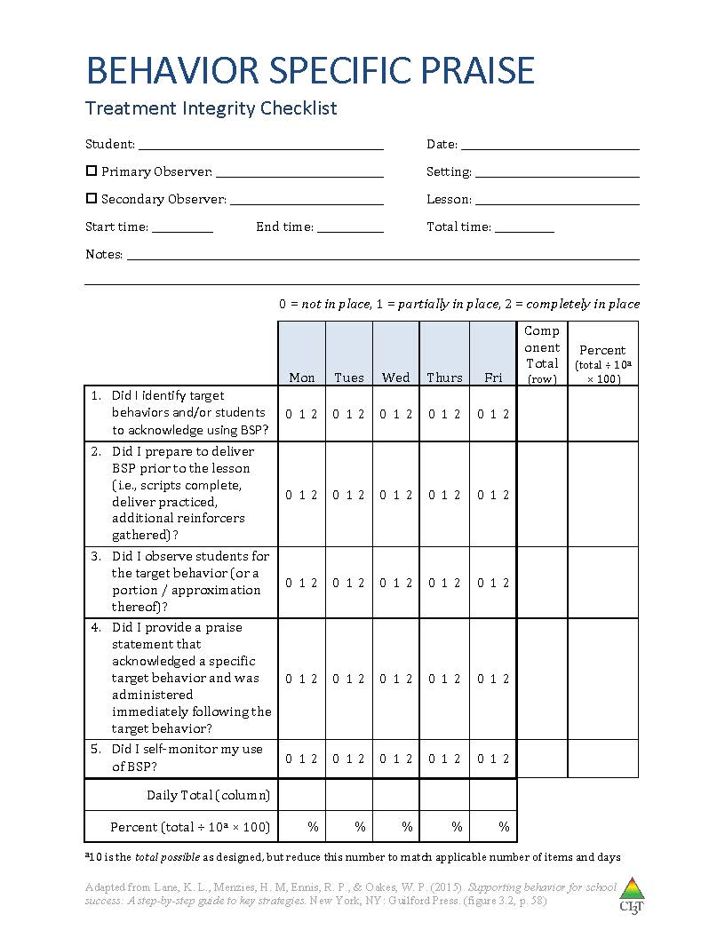
Ensuring the Strategy is in Place: Treatment Integrity
Have structures in place to monitor whether behavior specific praise is carried out as intended.
Treatment integrity checklist items:
Did I identify target behaviors and/or students to acknowledge using BSP?
Did I prepare to deliver BSP prior to the lesson (i.e., scripts complete, deliver practiced, additional reinforcers gathered)?
Did I observe students for the target behavior (or a portion / approximation thereof)?
Did I provide a praise statement that acknowledged a specific target behavior and was administered immediately following the target behavior?
Did I self-monitor my use of BSP?
See “Behavior Specific Praise Treatment Integrity Checklist”

Slide 17
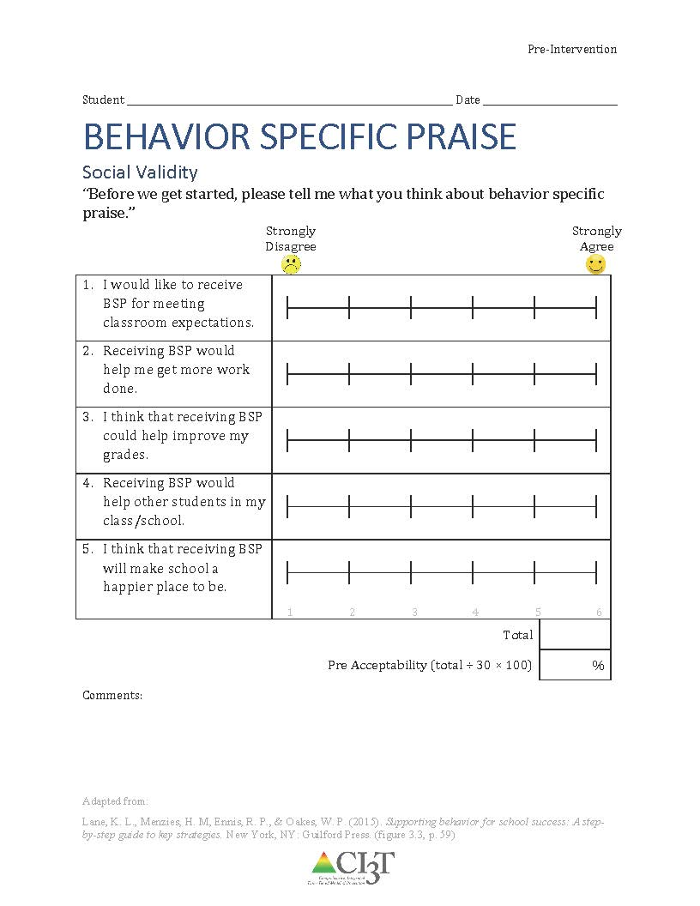
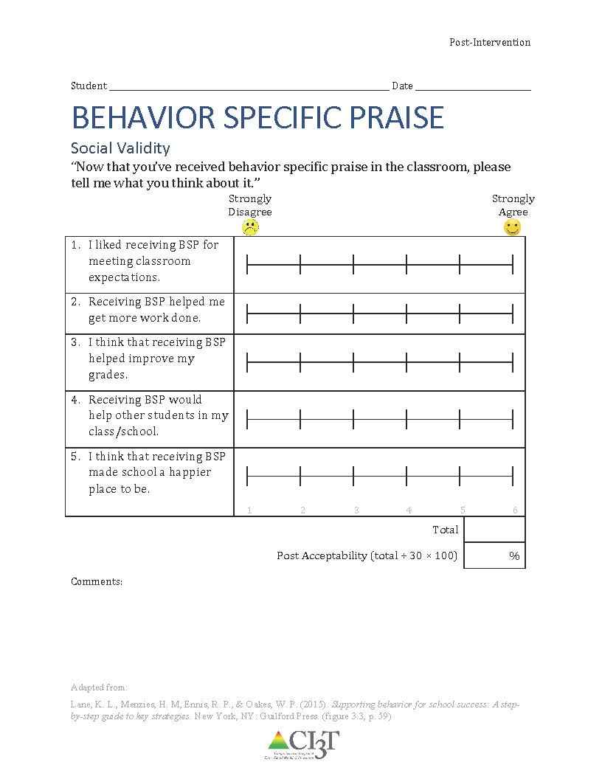
What does the student think about it?
See “Behavior Specific Praise Social Validity Student”
Completed by the student(s) participating in the intervention at two time points:
Pre and Post
Intervention

Slide 18
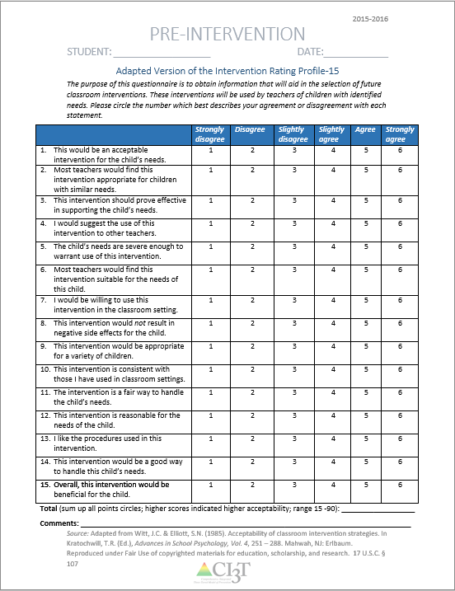
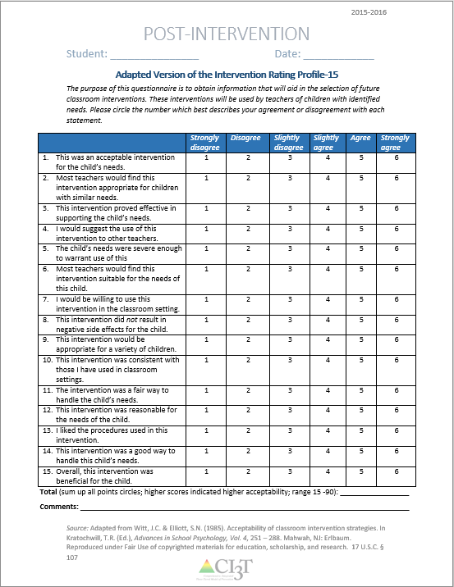
What does the teacher think about it?
See “Social Validity Adapted-IRP15 Adult”
Completed by the teacher(s) and parent(s) involved in the intervention at two time points:
Pre and Post
Intervention

Slide 19
Sample Elementary Intervention Grid
Support | Description | School-wide Data: Entry Criteria | Data to Monitor Progress | Exit Criteria
Behavior specific praise | Behavior specific praise (BSP) refers to sincere praise statements that acknowledge the student and reference specific, desirable behavior being recognized, praising effort (not ability). | One or more of the following: Behavior: SRSS-E7: Moderate (4-8) SRSS-I5: Moderate (2-3) SRSS-E7: High (9-21) SRSS-I5: High (4-15) Ranking of 1, 2, or 3 on the Motivation to Learn subscale of SSiS-PSG 2 or more ODRs within a grading period AND/OR Academic: Two of more missing assignments within a grading period AIMSweb: intensive or strategic level (math or reading) Progress report: Targeted for Growth for academic learning behaviors | Student behavior targeted for improvement (e.g., academic engaged time % of intervals, assignment completion, ODRs). Treatment integrity Implementation checklist Treatment integrity checklist Social validity IRP-15 (teacher) Student-completed survey | 0-1 ODRs in a grading period and Zero missing assignments in a grading period and SRSS-E7: Low (0-3) SRSS-I5: Low (0-1) or Ranking of 4 or 5 on the Motivation to Learn subscale of SSiS-PSG
(Lane, Menzies, Ennis, & Oakes, 2015)

Slide 20
Sample Secondary Intervention Grid
Support | Description | School-wide Data: Entry Criteria | Data to Monitor Progress | Exit Criteria
Behavior specific praise | Behavior specific praise (BSP) refers to sincere praise statements that acknowledge the student and reference specific, desirable behavior being recognized, praising effort (not ability). | One of more of the following: Behavior: SRSS: Moderate (4-8) SRSS: High (9-21) Ranking of 1, 2, or 3 on the Motivation to Learn subscale of the SSiS-PSG 2 office discipline referrals (ODRs) within a grading period AND/OR Academic: Report card: 1 or more course failures Two of more missing assignments within a grading period in a class AIMSweb: intensive or strategic level (math or reading) Below 2.5 GPA | Student behavior targeted for improvement (e.g., academic engaged time % of intervals, assignment completion, ODRs). Treatment integrity Implementation checklist Treatment integrity checklist Social validity IRP-15 (teacher) Student-completed survey | 0-1 ODRs in a grading period and 2.5 GPA or higher Zero missing assignments per class in a grading period and SRSS: Low (0-3) or Ranking of 4 or 5 on the Motivation to Learn subscale of the SSiS-PSG
(Lane, Menzies, Ennis, & Oakes, 2015)

Slide 21
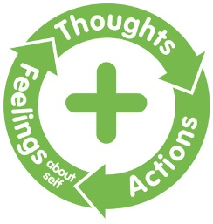
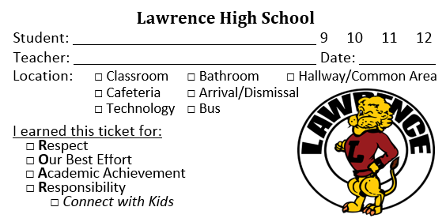
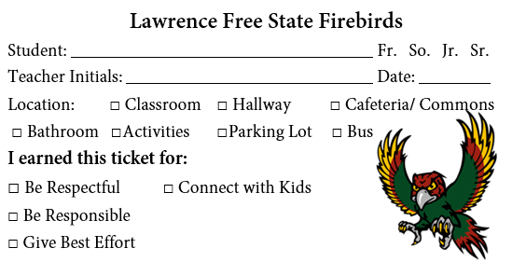
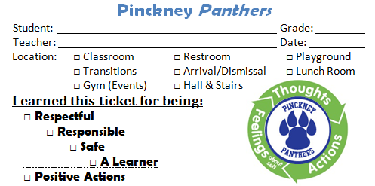
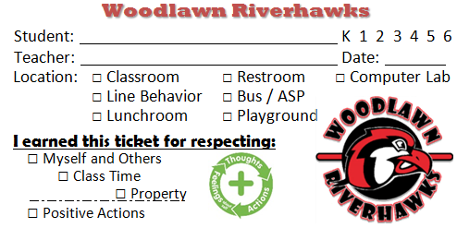
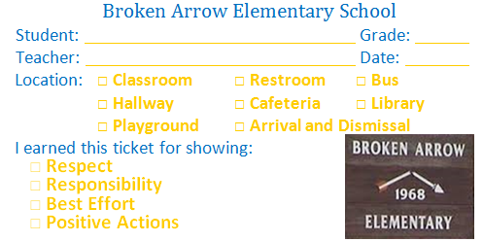
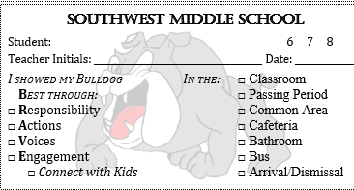
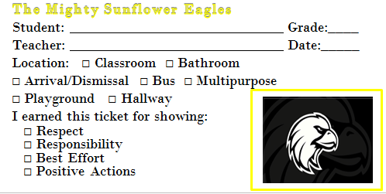
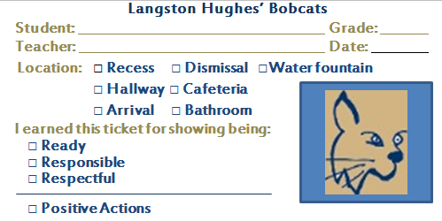
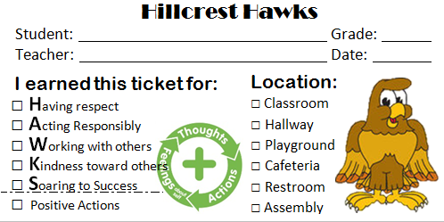
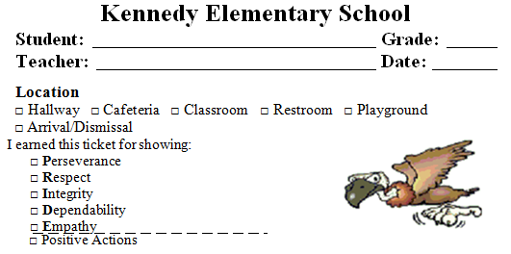
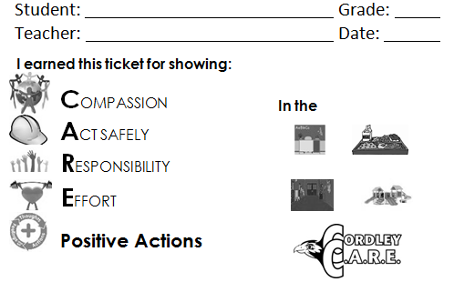
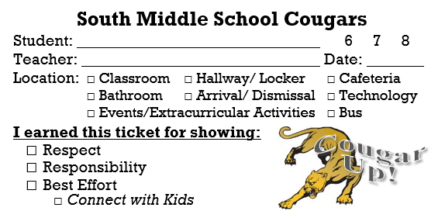
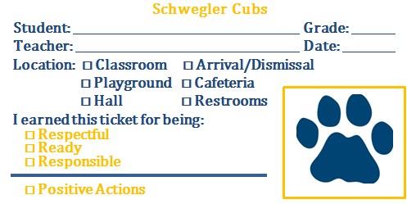
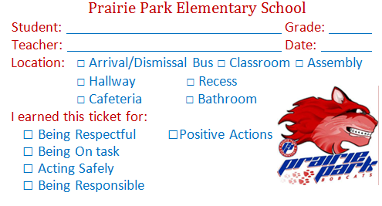
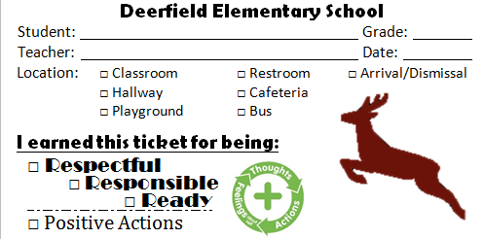

CI₃T Ticket Examples
Notes:
Changed to latest version of ticket SWMS made/modified, and added Connect with Kids logo toward the bottom.

Slide 22



















Will you please ….
Draft a list of behavior specific praise statements you can use …
In your classroom during various instructional activities.
In other key areas in your building (see expectation matrices).
Encourage the use of skills taught during your school-wide social skills program.
Plan …
Implementation Checklist for Success: BSP
Let’s talk …
Notes:
Using this PowerPoint break timer 10 MIN
This PowerPoint slide uses images, custom animation, and timing to provide a countdown timer that you can use in any presentation. When you open the template, you’ll notice that the timer is set at 00:00. However, when you start the slide show, the timer will start at the correct time and count down by 1-minute intervals until it gets to 1 minute. At that point, it will count down in two 30-seconds intervals to 00:00.
To insert this slide into your presentation
Save this template as a presentation (.ppt file) on your computer.
Open the presentation that will contain the timer.
On the Slides tab, place your insertion point after the slide that will precede the timer. (Make sure you don't select a slide. Your insertion point should be between the slides.)
On the Insert menu, click Slides from Files.
In the Slide Finder dialog box, click the Find Presentation tab.
Click Browse, locate and select the timer presentation, and then click Open.
In the Slides from Files dialog box, select the timer slide.
Select the Keep source formatting check box. If you do not select this check box, the copied slide will inherit the design of the slide that precedes it in the presentation.
Click Insert.
Click Close.

Slide 23
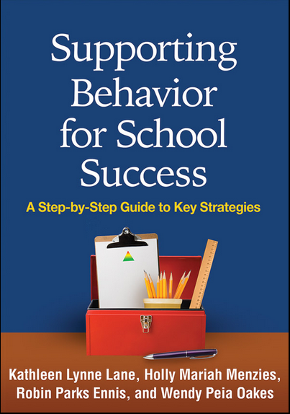
Related Resource
Lane, K. L., Menzies, H. M., Ennis, R. P., & Oakes, W. P. (2015). Supporting behavior for school success: A step-by-step guide to key strategies. New York, NY: Guilford Press.

Slide 24




Resources
Thank you!
Questions:
kathleen.lane@ku.edu

