Slide 1
You’ve Got This!
Using Your Ci3T Structures to Support Positive Behavior
Mark M. Buckman, Ph.D.
Kathleen Lynne Lane, Ph.D., BCBA-D, CF-L1
Wendy Peia Oakes, Ph.D.
Katie S. Austin, M.Ed.
David James Royer, Ph.D., BCBA

Slide 2
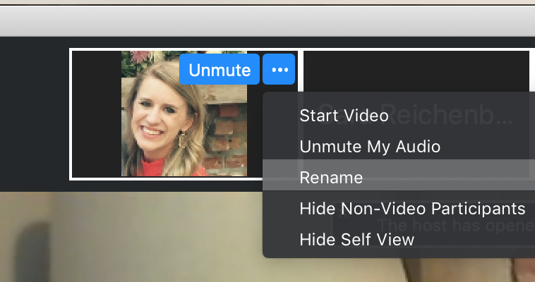
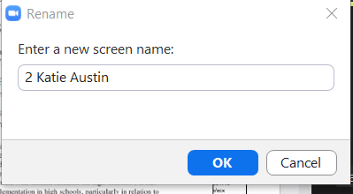
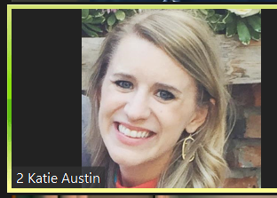
Renaming: Breakout room number + First and Last Name
To help us initially put you in breakout rooms today…
Click the three dots at the top right corner of your video square.
Rename yourself:
1 Name = Exploring Ci3T, not yet implementing
2 Name = Newly implementing Ci3T
3 Name = Experienced Ci3T implementer
4 School Name = Here with my Ci3T Leadership Team
Notes:
https://support.zoom.us/hc/en-us/articles/115005769646 (scroll to self-selecting breakout room)

Slide 3
Agenda
Welcome and introduction
  Classroom management to facilitate instruction
Teaching expectations
Reinforcing students’ behavior for meeting expectations
Responding to challenging behaviors
Providing resources for families
Looking ahead

Slide 4
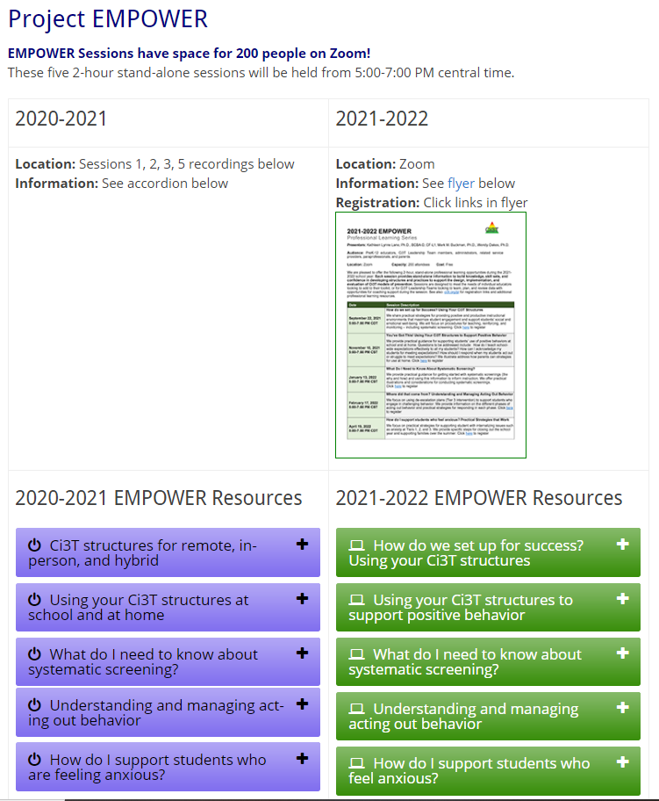
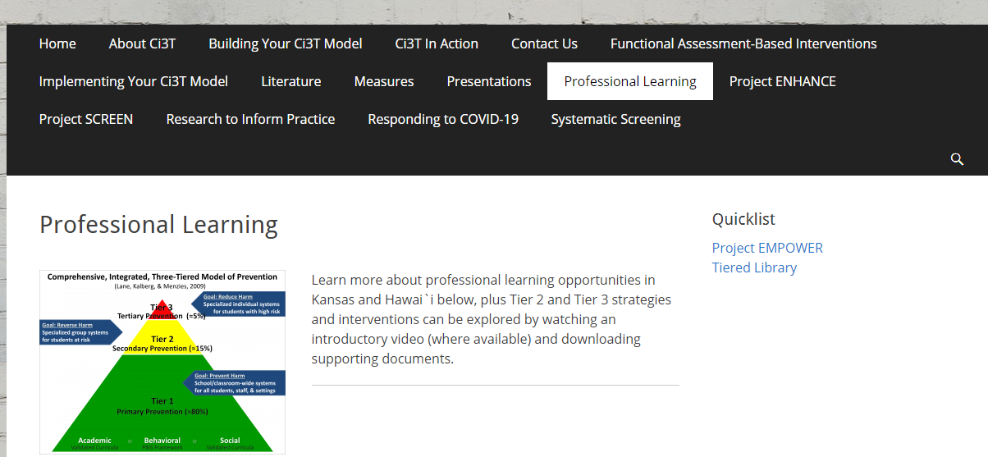
Accessing Project EMPOWER Professional Learning

Slide 5

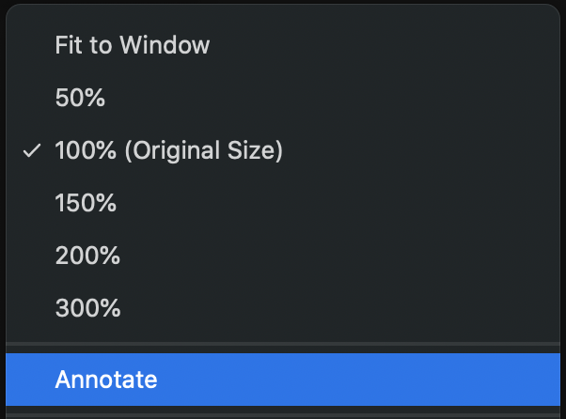
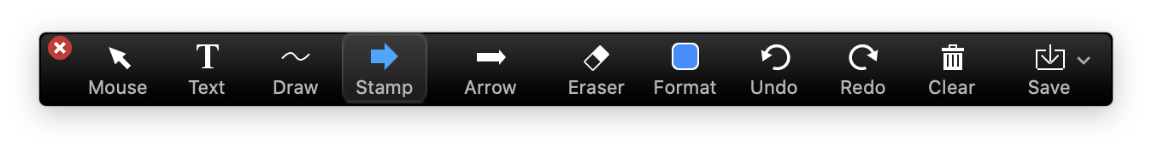
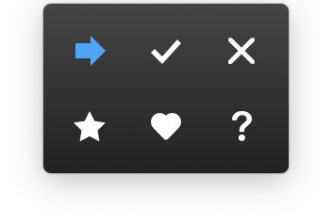
Annotation Tools
Notes:
Zoom expectations

Slide 6
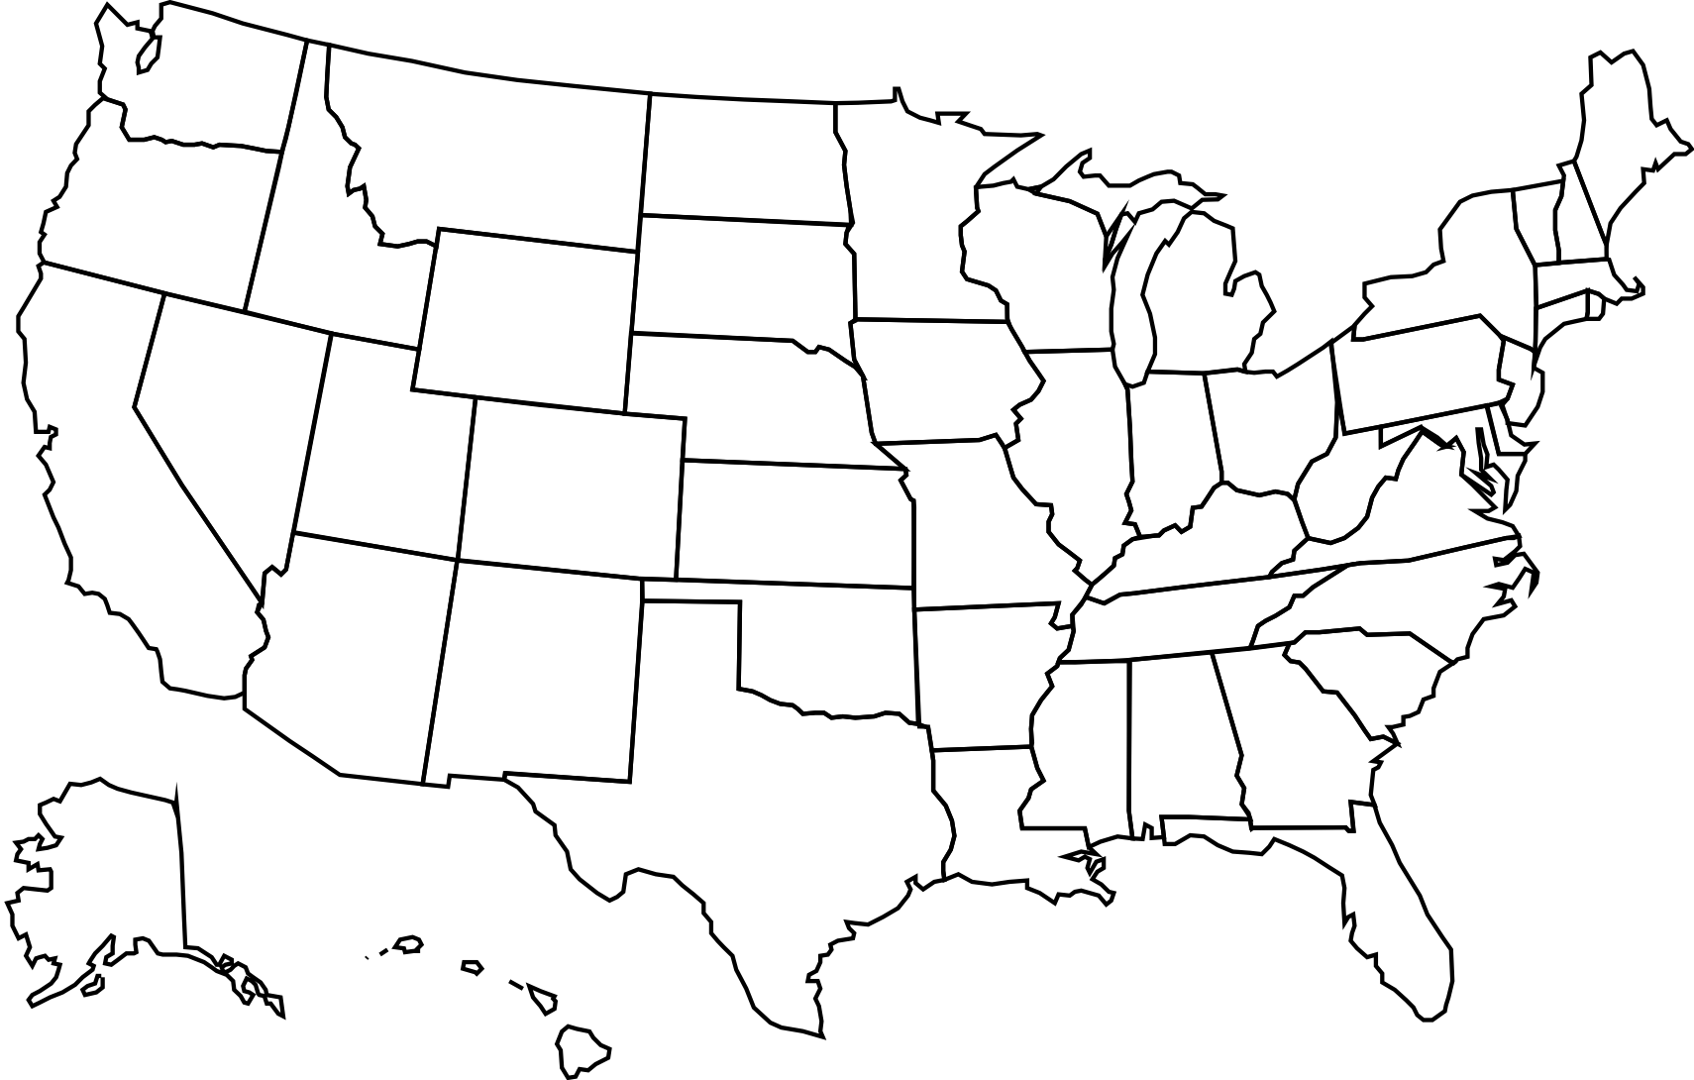
Where is everyone?
Other:

Slide 7
Welcome and Introduction
Classroom management to facilitate instruction

Slide 9
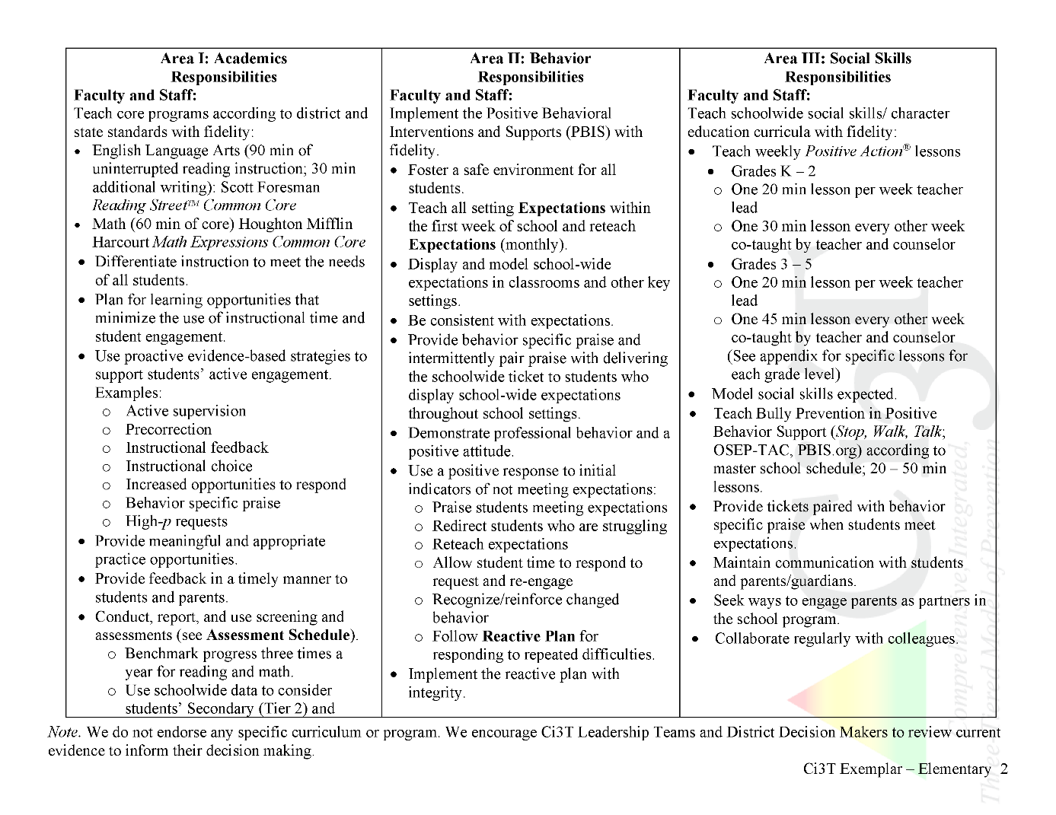
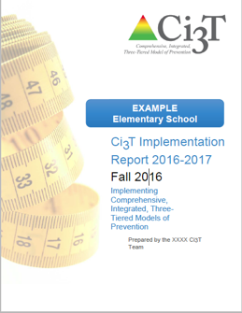
Ci3T Primary Plan: Procedures for Teaching
Ci3T Primary Plan: Procedures for Reinforcing
Ci3T Primary Plan: Procedures for Monitoring

Slide 10
Fall 2021
SRSS-Externalizing Results – School level
n = 34
n = 40
n = 33
n = 10
n = 19
n = 35
n = 34
n = 35
n = 41
n = 52
n = 42
n = 26
n = 35
n = 52
n = 52
n = 61
n = 153
n = 135
n = 127
n = 146
n = 137
n = 109
n = 91
n = 135
Notes:
Fill in <year> based on current academic year. This is located in column A of the data sheet. Edit by right clicking and selecting “Edit data”.

Slide 11
Fall 2021
SRSS-Internalizing Results – School level
n = 31
n = 42
n = 39
n = 49
n = 18
n = 26
n = 61
n = 46
n = 44
n = 37
n = 35
n = 46
n = 27
n = 31
n = 38
n = 30
n = 153
n = 148
n = 128
n = 136
n = 137
n = 134
n = 97
n = 101
Cut scores vary by school level:
Elementary (I5): Low (0-1), Moderate (2-3), High (4-15)
Middle and High (I6): Low (0-3), Moderate (4-5), High (6-18)
Notes:
Fill in <year> based on current academic year. This is located in column A of the data sheet. Edit by right clicking and selecting “Edit data”.
IMPORTANT NOTE: The INTERNALIZING subscale and CUT SCORES are specific to school level.
Elementary: SRSS-I5, Items 8-12, 0-1 = low risk, 2-3 = moderate risk, 4-15 = high risk
Middle and High: SRSS-I6, Items 4, 8-12, 0-3 = low risk, 4-5 = moderate risk, 6-18 = high risk

Slide 12
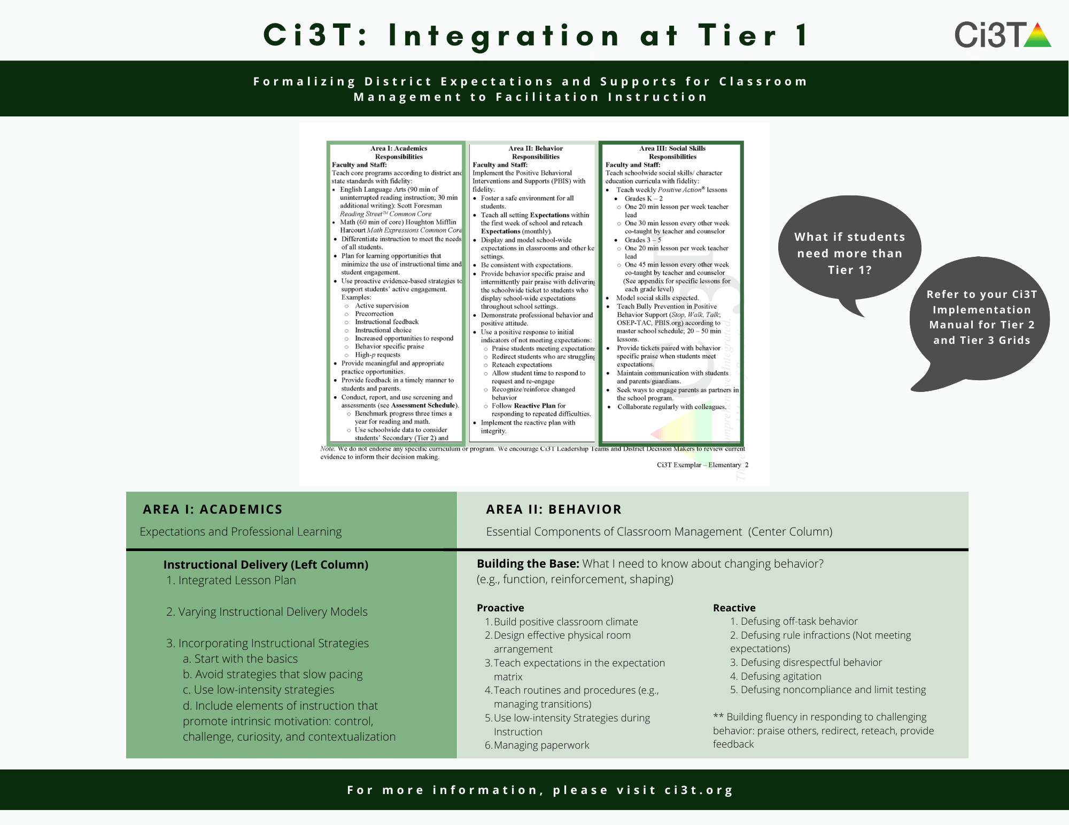
How do I put Ci3T into action in my classroom?

Slide 19
Teaching Expectations
An instructional approach to behavior

Slide 20
Procedures for Teaching
Faculty and Staff: Ci3T Leadership Teams and District Leaders will teach procedures to faculty and staff by: Provide faculty and staff Ci3T Implementation Manual and other materials such as posters, lesson plans, tickets, etc. to teach, implement and support our Ci3T plan Provide training of plan and expectation to staff at the beginning of each school year, with attention to academic, behavior, and social domains Expectation Matrix taught and posted Ci3T session for new staff orientation Weekly tips for teachers and challenges for PBIS
Students: Ci3T Leadership Teams collaborate with faculty and staff to teach procedures to students by: Posting Ci3T expectation posters and using them as an instructional tool for teaching expectations Participating in regularly scheduled lessons on the expectations for each setting Providing behavior-specific praise intermittently paired with school-wide tickets (ROAR Bucks) Participating actively in daily Second Step lesson

Slide 21

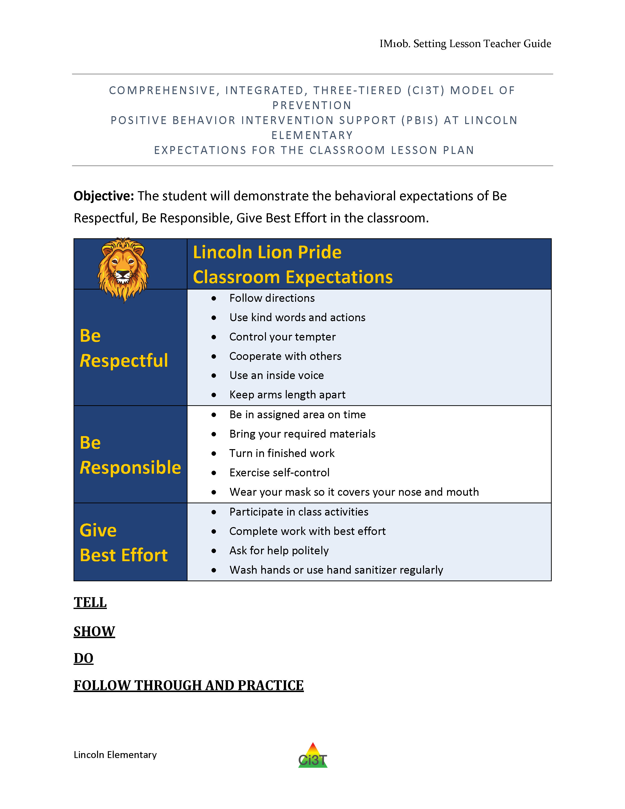
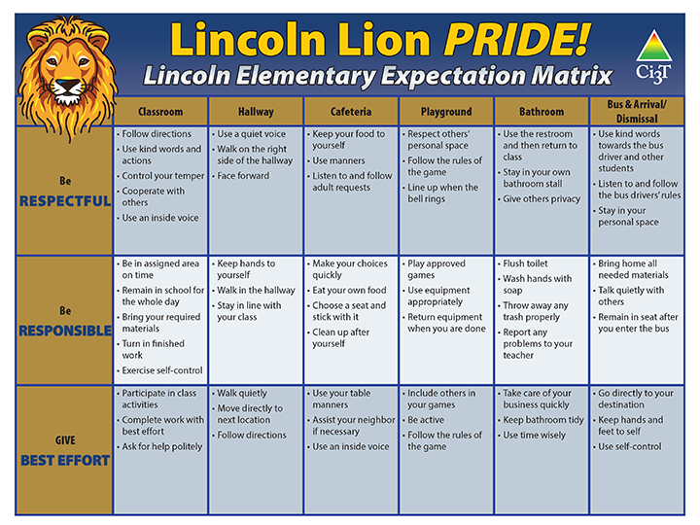
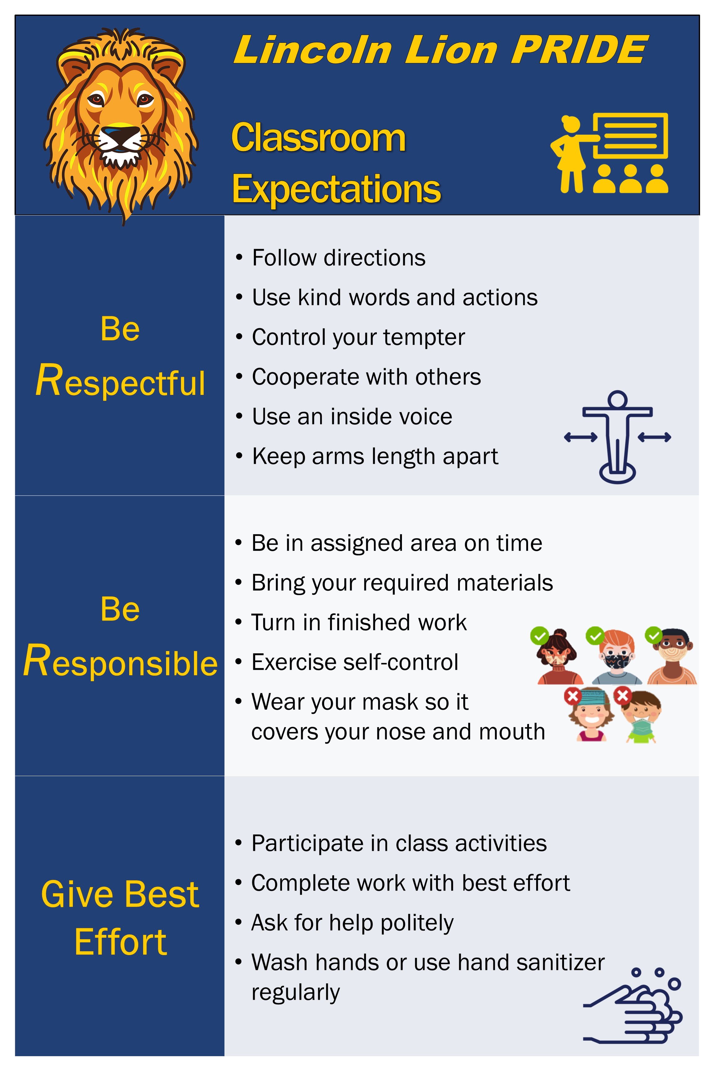
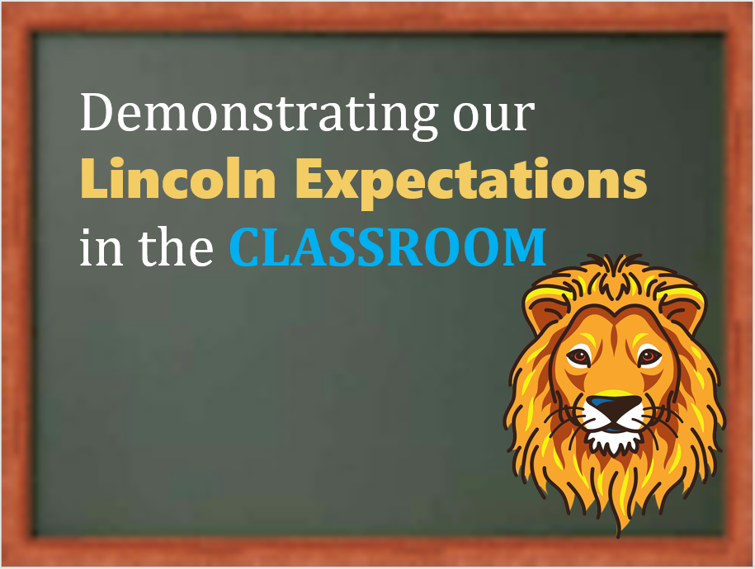
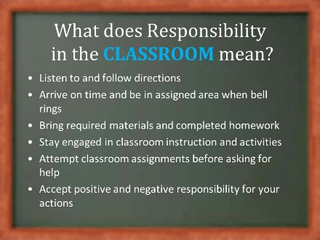
School-wide expectation matrix
Lesson plans for explicit instruction
Supporting materials
Specific setting posters
Notes:
Annotation interaction: Put a stamp on each thing your school has that you’ve seen, used, or know how to access.

Slide 23
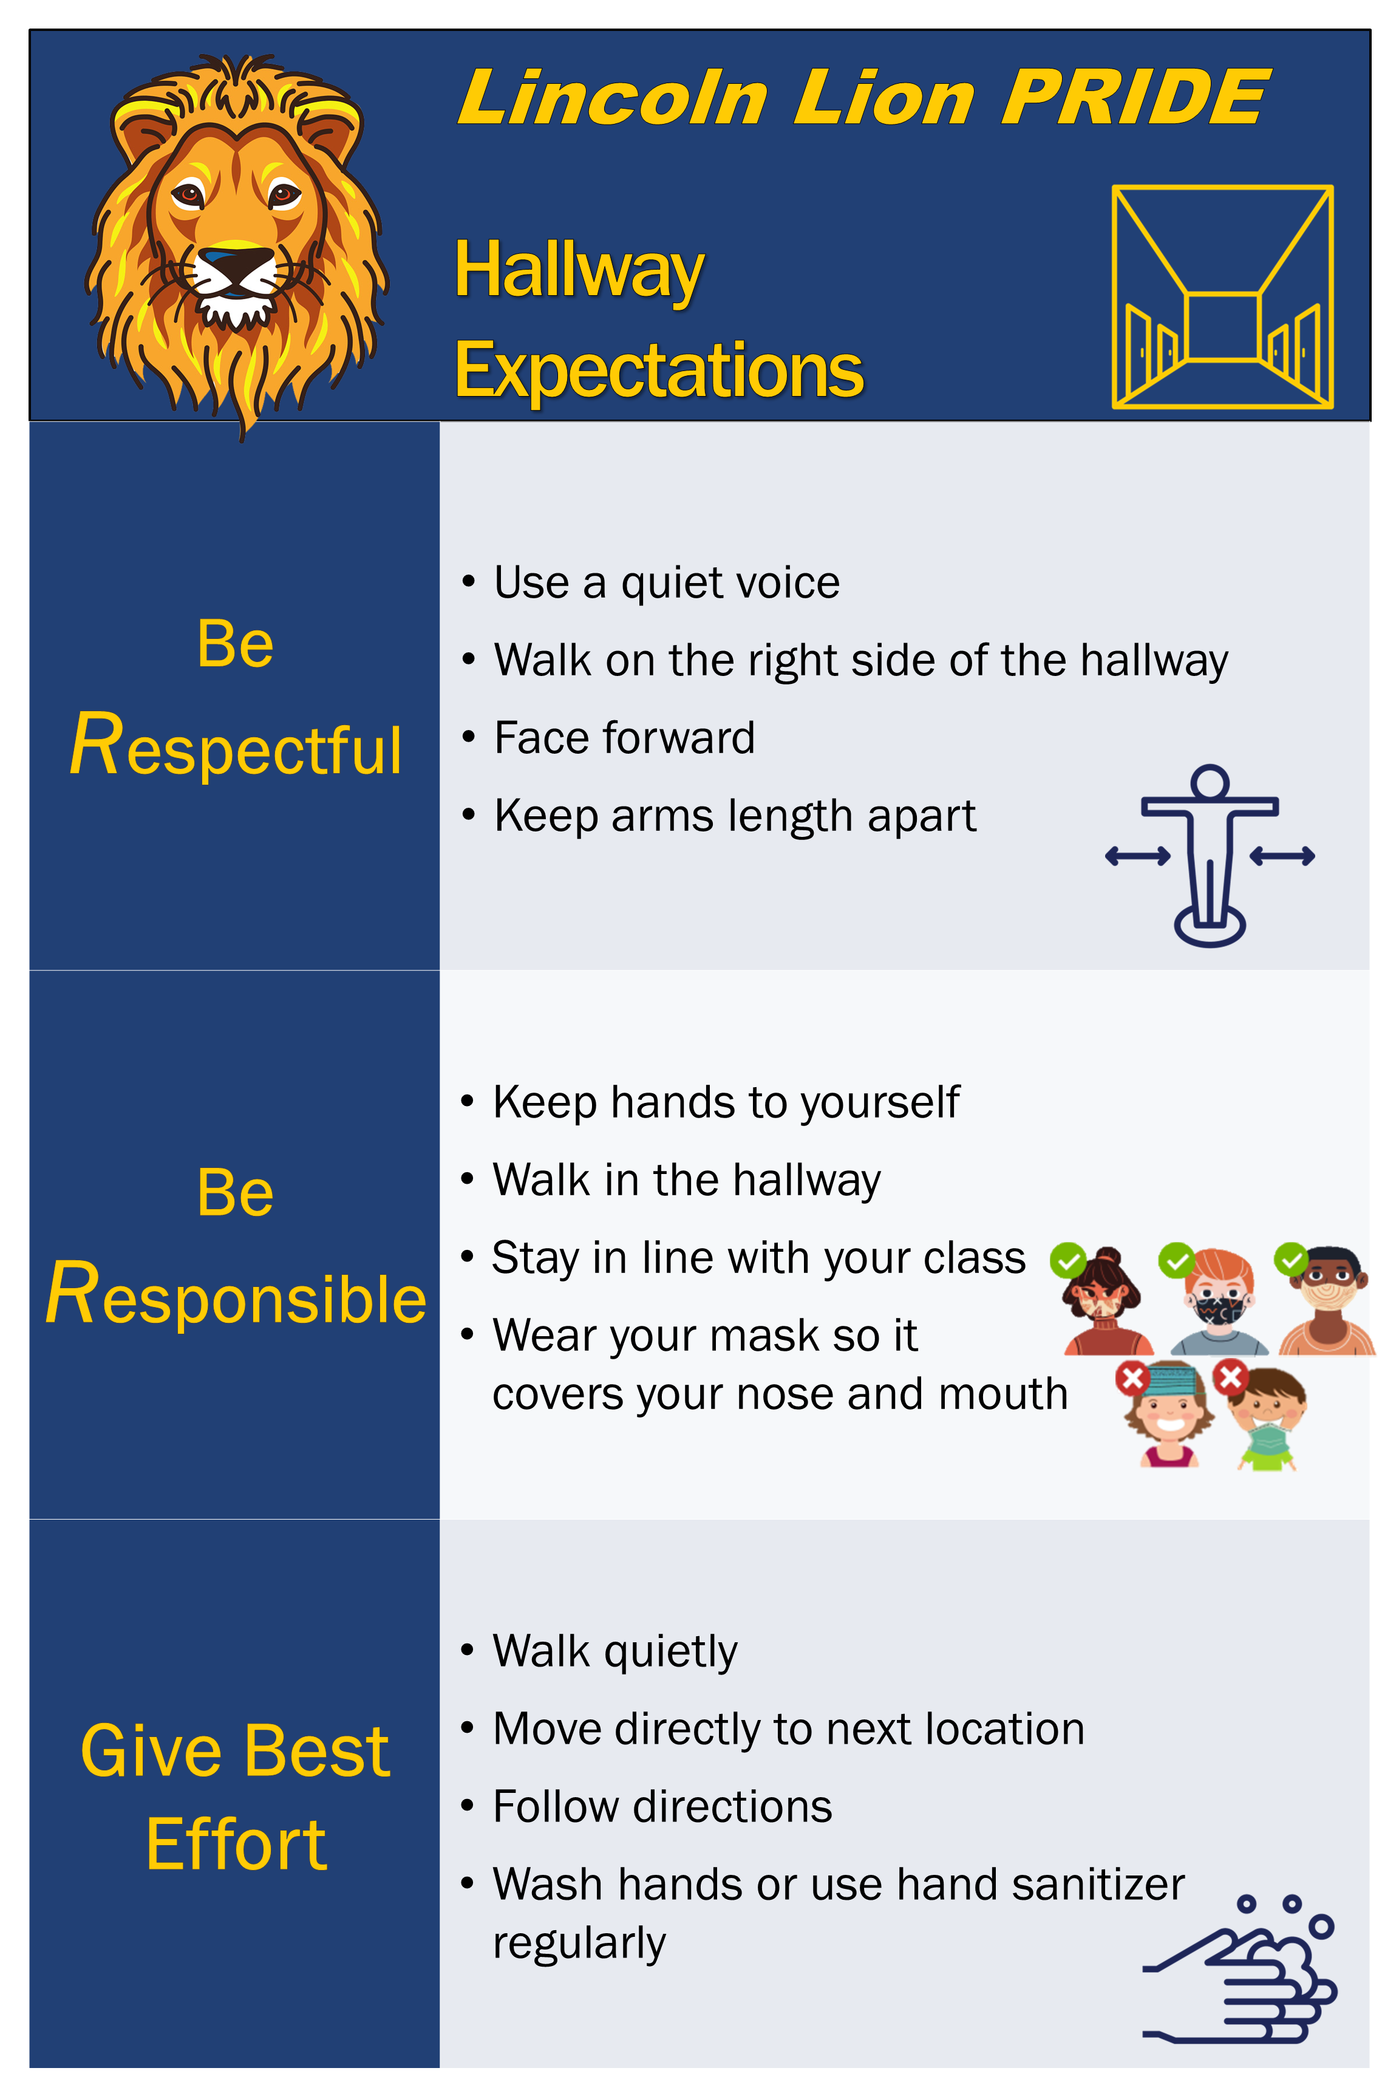

Slide 24
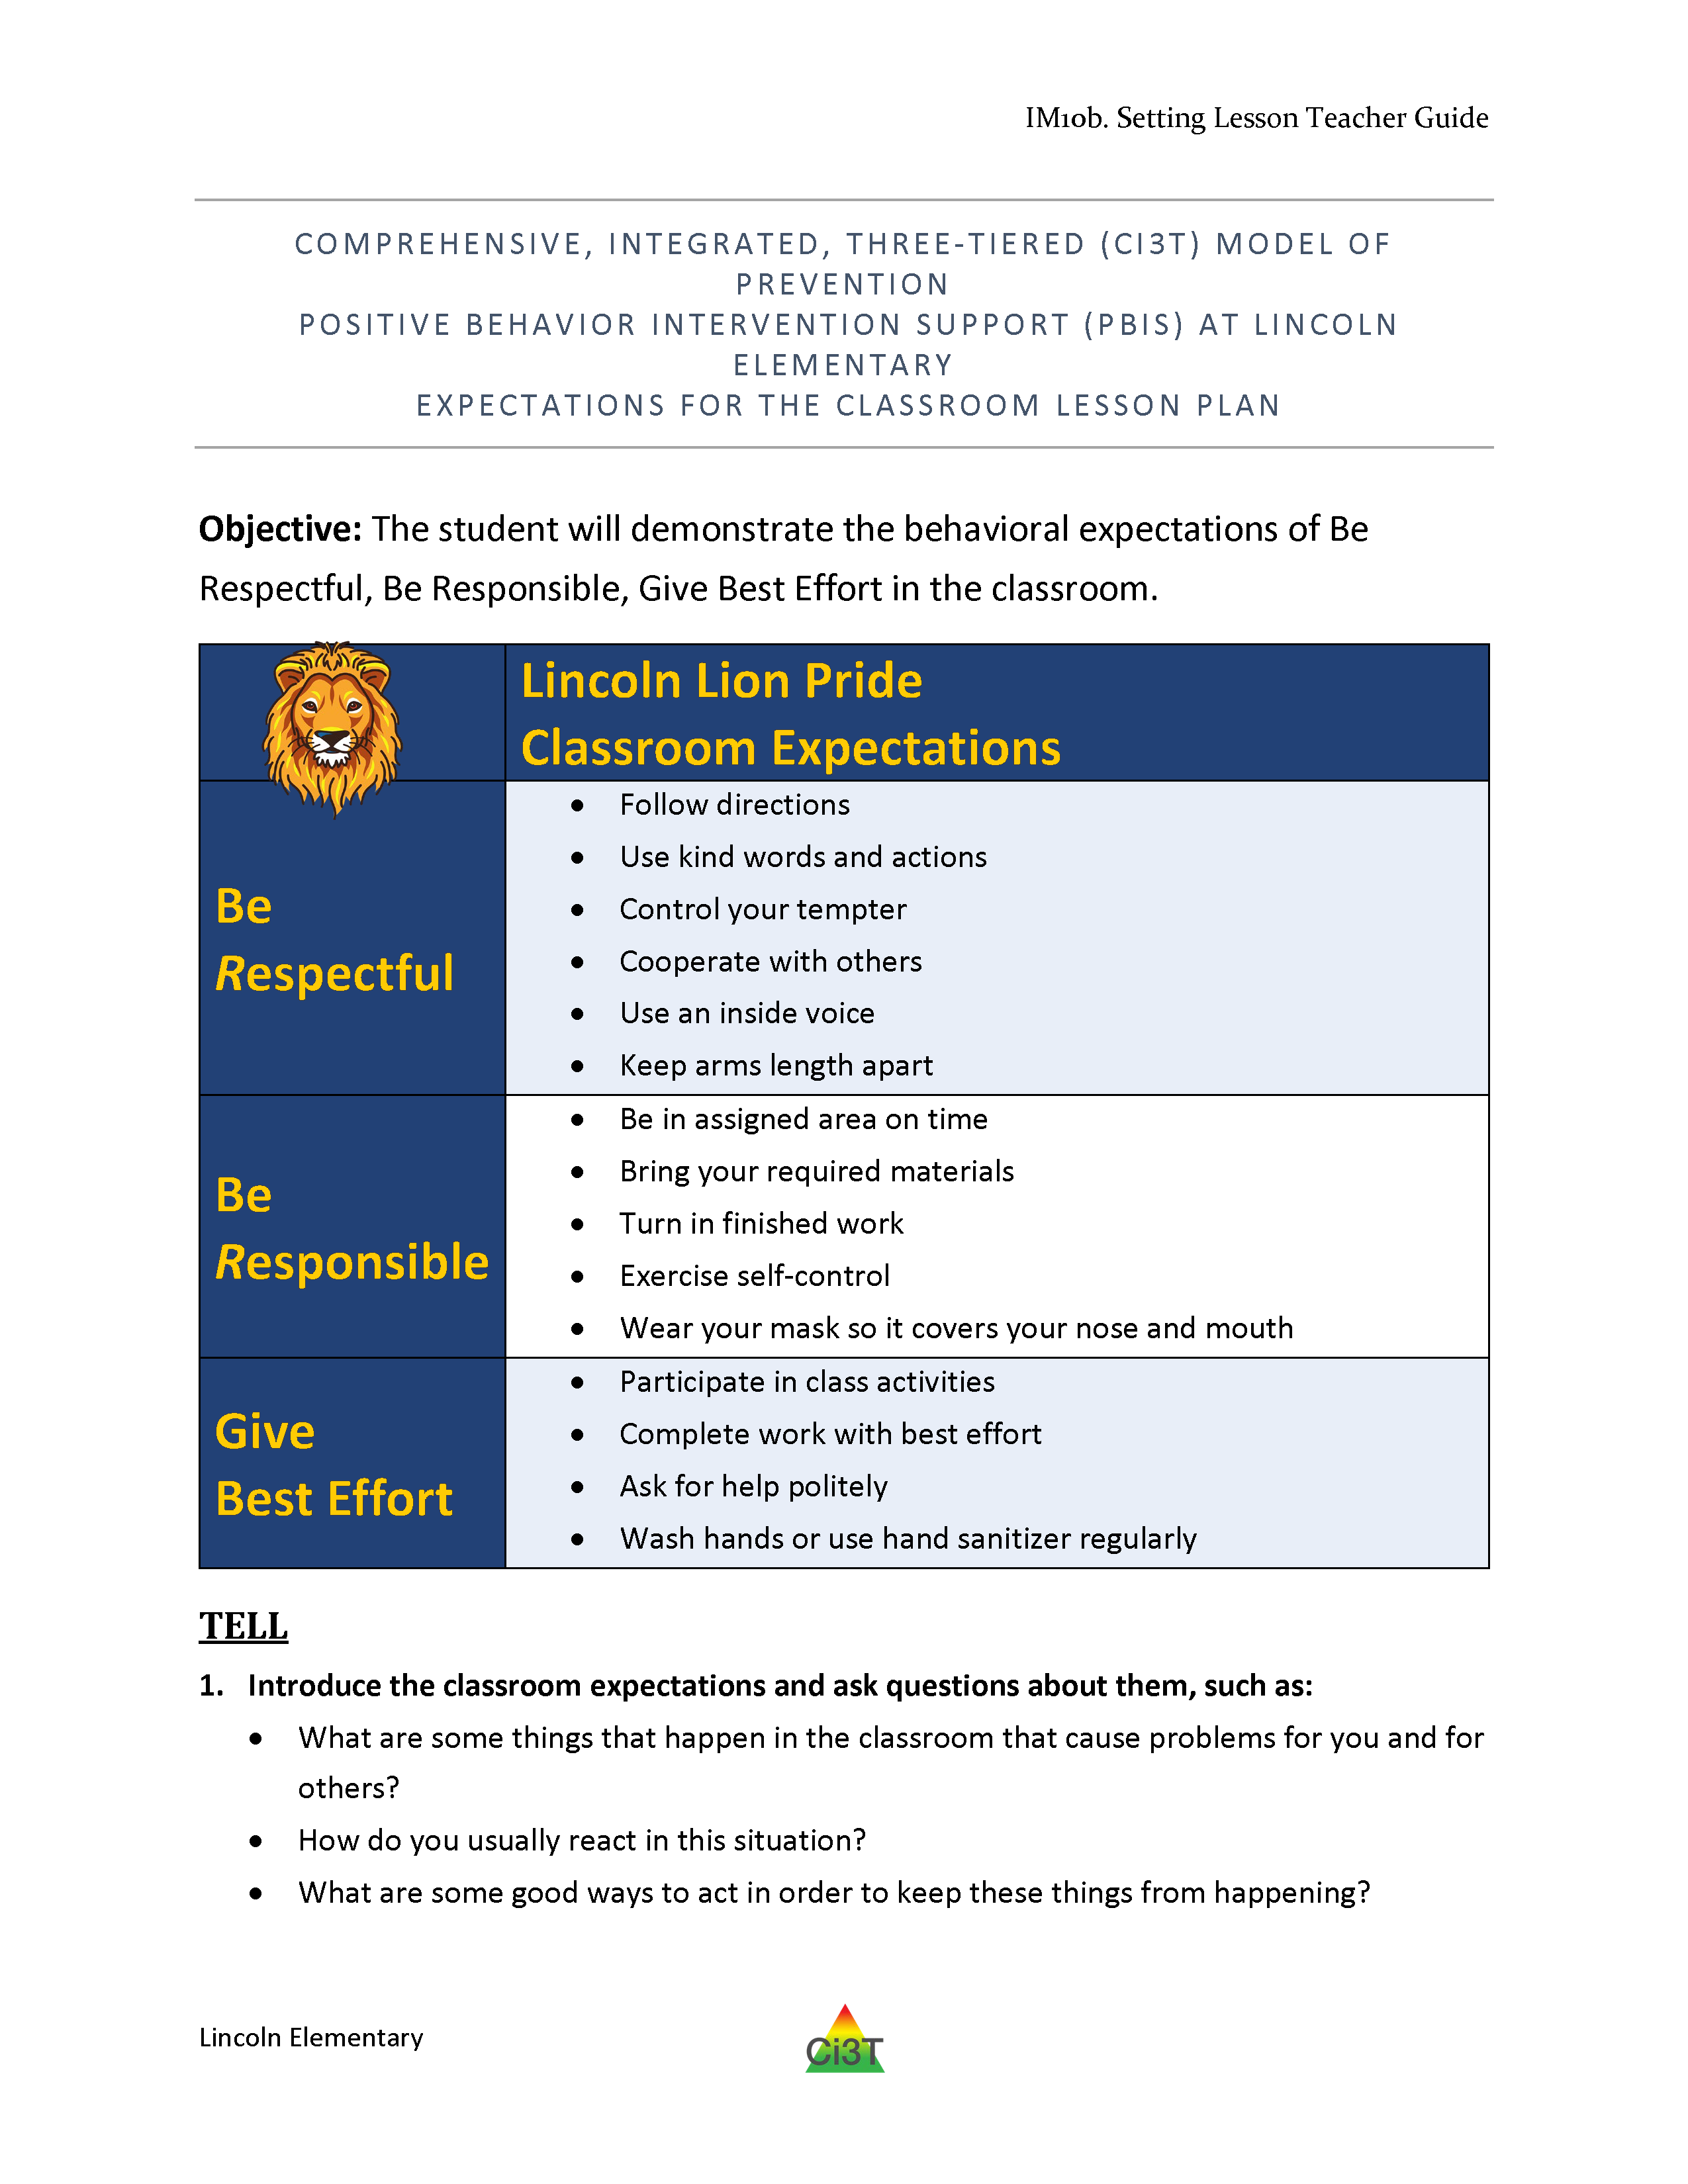
Tell
Show
Do
Practice & Follow Through

Slide 25
Tell
Show
Do
Define behaviors and discuss key terms
Practice & Follow Through
Discuss why behaviors are important

Slide 26
Tell
Show
Do
Practice & Follow Through
Explain and model examples
Explain and model non-examples
Discuss hypothetical situations

Slide 27
Tell
Show
Do
Practice & Follow Through
Students explain why expectations are important
Students think of ways to help them remember expectations
Students restate expectations

Slide 28
Tell
Show
Do
Practice & Follow Through
Students rehearse demonstrating expectations
Students practice in hypothetical situations
Incidental teaching
Reinforce!

Slide 29
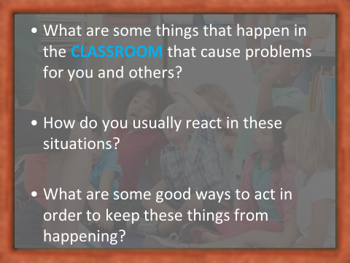
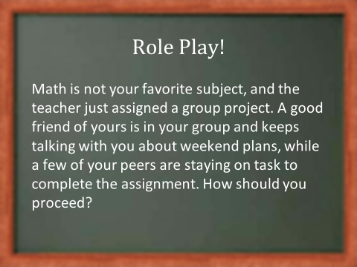
Other ideas…
Videos
Announcements
Virtual assemblies
Link teaching of classroom routines to school-wide expectations

Slide 30

Tips for engaging instruction
Explain the why…
…and help students think about their why
Pacing, pacing, pacing
Active student participation
  Low-intensity strategies
  …opportunities to respond
  …instructional choice
Make it fun!

Slide 31
Tips for engaging instruction
Explain the why…
…and help students think about their why
Pacing, pacing, pacing
Active student participation
  Low-intensity strategies
  …opportunities to respond
  …instructional choice
Make it fun!

Slide 32

Tips for engaging instruction
Explain the why…
…and help students think about their why
Pacing, pacing, pacing
Active student participation
  Low-intensity strategies
  …opportunities to respond
  …instructional choice
Make it fun!

Slide 33

Tips for engaging instruction
Explain the why…
…and help students think about their why
Pacing, pacing, pacing
Active student participation
  Low-intensity strategies
  …opportunities to respond
  …instructional choice
Make it fun!

Slide 34
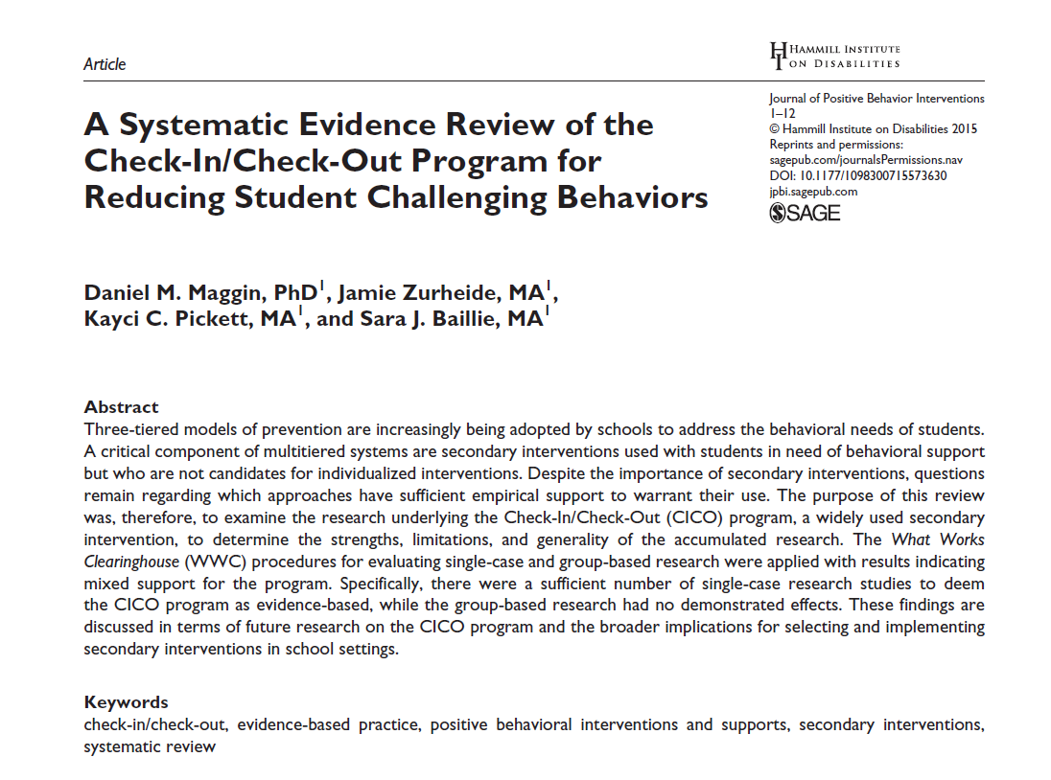




Low-Intensity Strategies
Opportunities to Respond
Behavior-Specific Praise
Active Supervision
Proximity
Overlappingness
Instructional Feedback
With-it-ness
High-p Requests
Pacing
Precorrection
Self-Monitoring
Incorporating Choice
Behavior Contracts

Slide 35
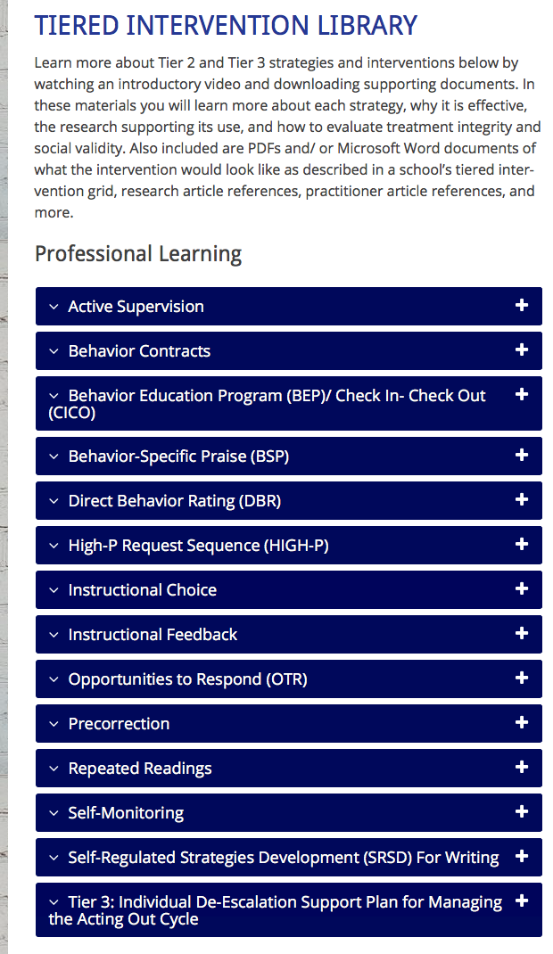
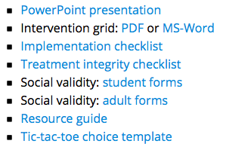
Professional Learning
Resources ci3t.org/pl

Slide 36




Positive Action

Slide 38
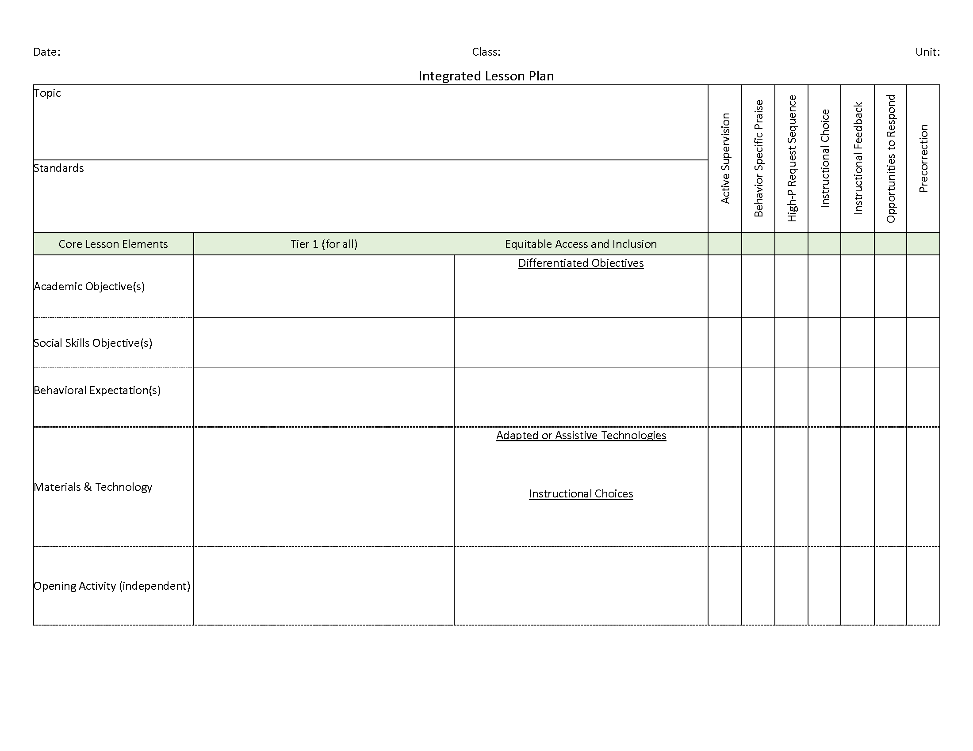
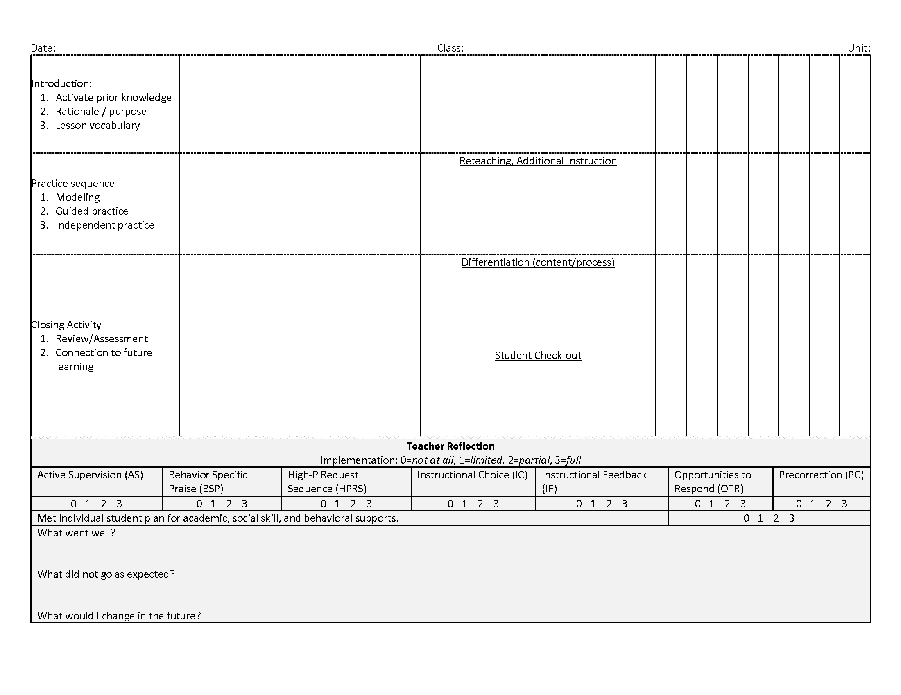
Integrated Lesson Planning

Slide 39
Integrated Lesson Planning

Slide 40
Integrated Lesson Planning

Slide 41
Integrated Lesson Planning

Slide 42
Integrated Lesson Planning

Slide 43
Integrated Lesson Planning

Slide 44
Integrated Lesson Planning

Slide 45
Integrated Lesson Planning

Slide 46
Integrated Lesson Planning

Slide 47
Reinforcing Students’ Behavior for Meeting Expectations

Slide 48
Procedures for Reinforcing
Faculty and Staff: Ci3T Leadership Teams and District Leaders will provide reinforcement to faculty and staff by: Raffle of Ci3T parking spot (awarded to the teacher who provided the ticker to the student raffle winner) School-wide drawings for students – also reward teacher who gave the PBIS ticket to selected student
Students: Ci3T Leadership Teams will collaborate with faculty and staff to provide reinforcement to students by: Students participate in providing feedback for reinforcements Intermittent reinforcement of expectations with behavior specific praise and PBIS tickets PBIS tickets exchanged for donated tangible and non-tangible choices (privileges, time with teachers, art lessons, special PE time, postcards or phone calls home), allowing students to access or avoid attention, tangibles/activities, and sensory experiences Each teacher will have a classroom menu (student choice of items on menu)

Slide 49


Reinforcement and behavior
…what do we mean?

Slide 50
Reinforcement and behavior
…what do we mean?
Reinforcement: “the action of strengthening or encouraging something”
-Merriam Webster
Reinforcement: consequence that “increases the future frequency of that type of behavior under similar conditions”
-Cooper, Heron, & Heward (2020)

Slide 51



Reinforcement and behavior
…what do we mean?
Behavior: “the activity of living organisms; human behavior includes everything that people do”
-Cooper, Heron, & Heward (2020)

Slide 52
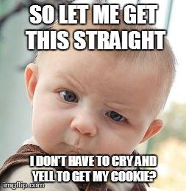
Reinforcement and behavior
…what do we mean?
Behavior is…
Communication
Functional (it serves a purpose!)
 | Access | Avoid
Attention
Activity / tangible
Sensory
Behavior is not…
“Good” or “bad” (though it can be “helpful” or “harmful”)

Slide 53




What is reinforcement?
Consequence
Behavior
Consequence
Increases likelihood of future occurrence
Strengthens behavior

Slide 54
What is reinforcement?
Positive
(Access)
Negative
(Avoid)
ALERT
Negative reinforcement is not punishment

Slide 55
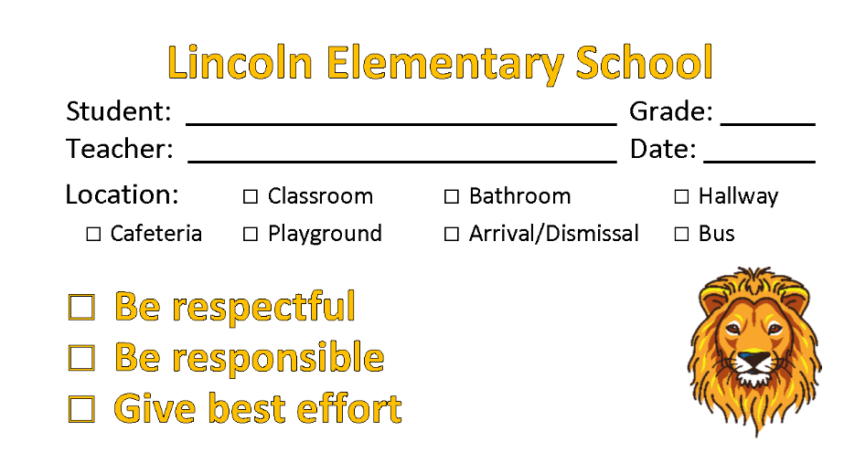
What’s in a ticket?
“An object awarded contingent on appropriate behavior and that serves as the medium of exchange for…reinforcers”
-Cooper, Heron, & Heward (2020)
Tickets are a tool for
communicating
successful use of a behavior

Slide 56
Tips for using tickets
to communicate
effectively

Slide 57
Ticket tips…
Teach expectations
Reinforce behaviors when students meet expectations

Slide 58
Ticket tips…
Pair tickets with behavior-specific praise
Behavior-specific praise: praise statements that include reference to the specific behavior for which the student is being recognized
(Brophy, 1981; Sutherland, Wehby, & Copeland, 2000)
Use as near to the occurrence of the behavior as possible
Notes:
Bob, great job showing your work on your math homework.”
“I appreciate how you pushed in your chair on the way to line up for lunch. That keeps the walkways safe.”

Slide 59
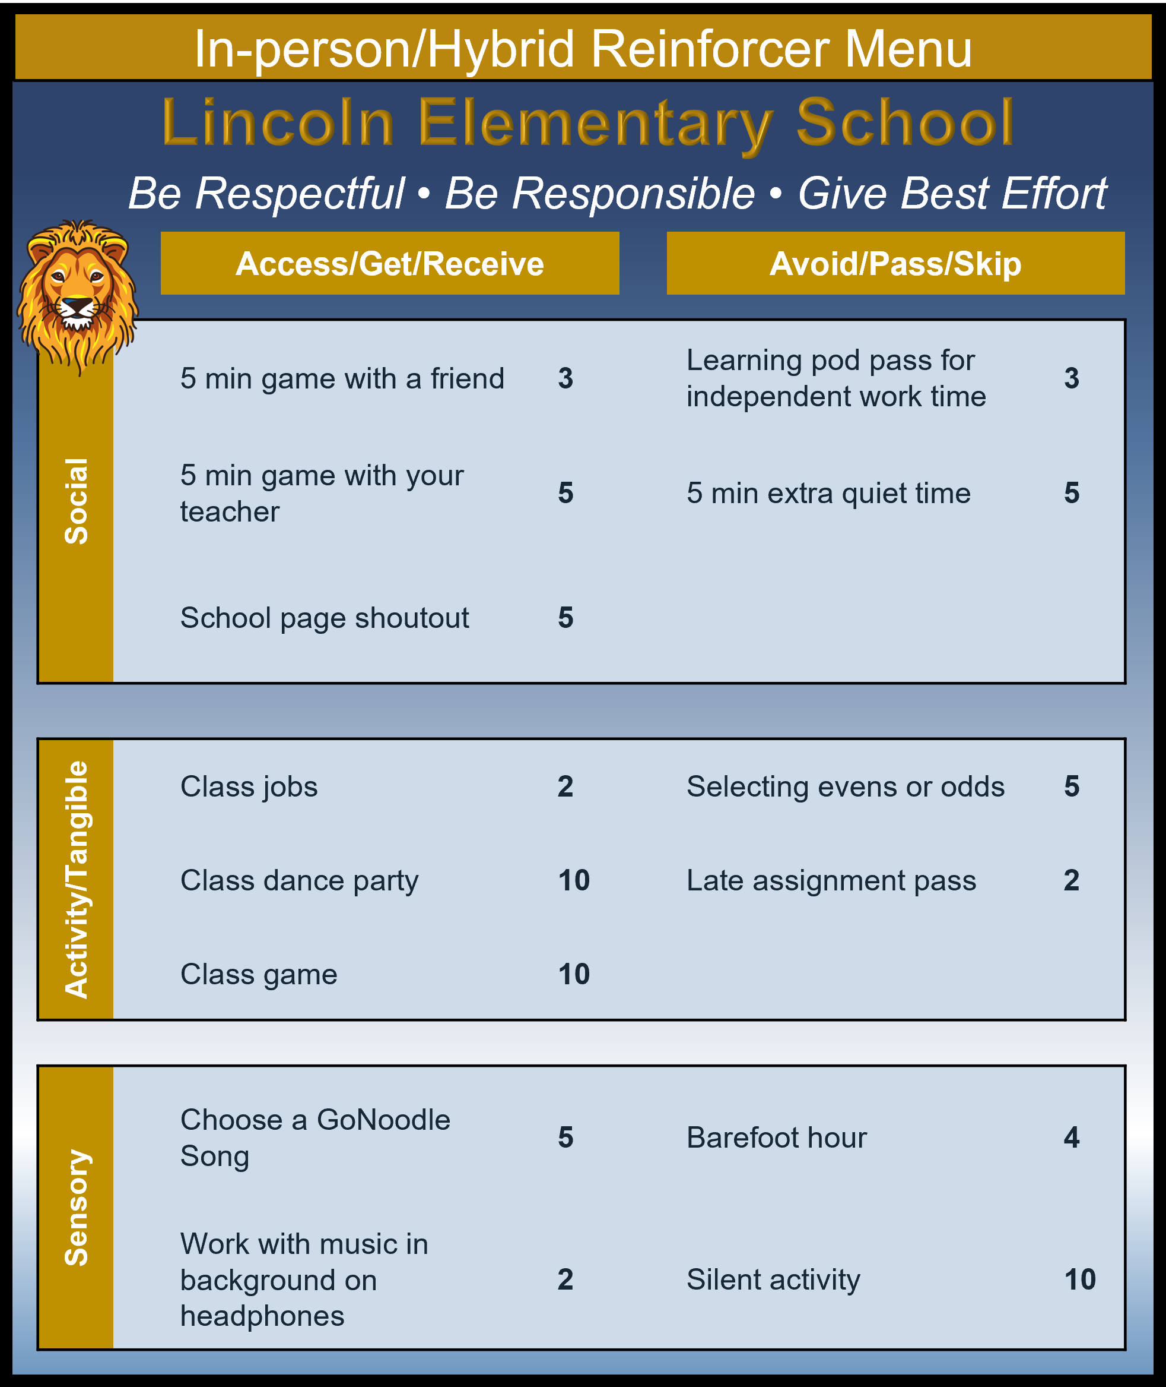
Ticket tips…
Offer a variety of opportunities for students to exchange tickets
Consider mapping opportunities onto a function matrix to ensure all possible functions are considered

Slide 60
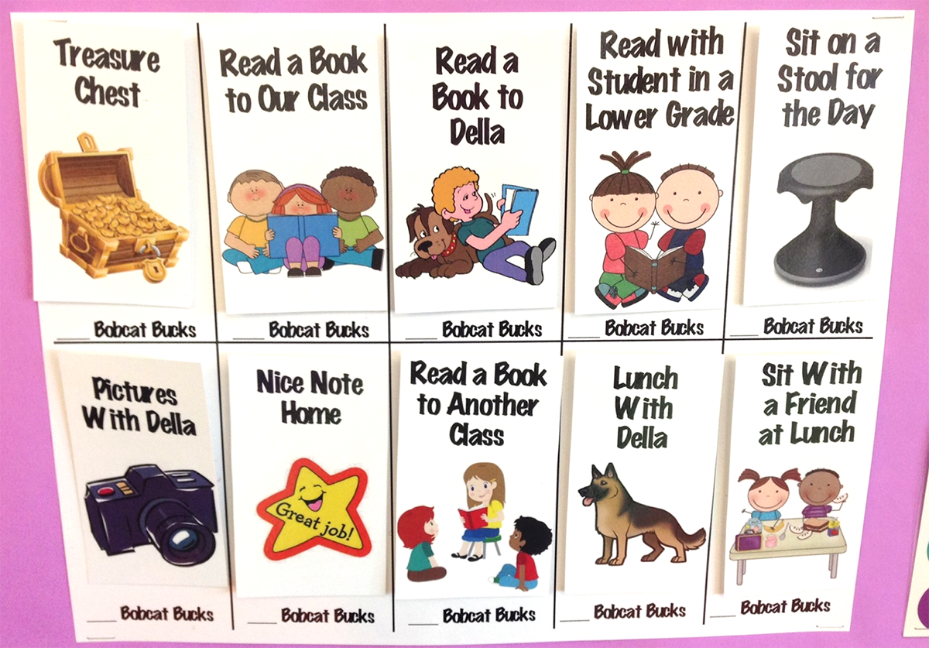

Slide 61
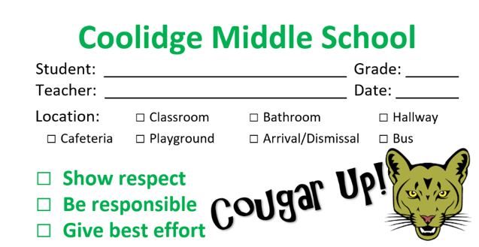
Ticket tips…
How often should I be giving tickets?
4:1 positive to negative feedback ratio
Tickets should be given sporadically so students do not “expect” to get a ticket for meeting expectations
Feedback can be verbal or nonverbal responses contingent on behavior. Feedback is more than a reinforcer or punisher; it is a powerful tool to guide future behavior and learning.
Malott, 2008
+ BSP
BSP
or
Notes:
Tickets paired with BSP, or BSP alone, but never tickets alone.

Slide 62



Ticket tips…
The goal is to fade and transition to natural reinforcers
Faded but not forgotten…even as the rate of reinforcement goes down be sure to keep a functioning system. It’s likely some students will still need high rates!

Slide 63
Ticket tips…some dos and don’ts
Avoid…
Instead, try..
“If you follow directions, I’ll give you a ticket”
“Remember, the expectation is to…”
“You got the correct answer, you get two tickets!”
“I love that participation – and I can tell you’ve been paying attention. Awesome job!”
“You can’t earn tickets behaving that way”
Find a different student who is following expectations. Acknowledge their behavior!

Slide 64
Frequently Asked Questions
Why should we reward students for meeting expectations? People don’t get rewards in ‘real life’…
Does providing reinforcement reduce intrinsic motivation?
Can I just use group rewards?

Slide 65












Talk Time | Talk Time
Teaching | Reinforcing
What are your plans for teaching expectations to your students? What are your plans for utilizing integrated lesson planning? What support do you need from your Ci3T Leadership Team? Signage? Lesson plans? | What are your plans for reinforcing students? Consider the types of reinforcement (social/attention, tangible/activity, sensory)…which ones do you need to do some brainstorming on to provide? How would you support a colleague who requested assistance with procedures for reinforcing?
Consider sharing ideas with colleagues in your buildings!
Notes:
10-min timer

Slide 66
Responding to Challenging Behaviors

Slide 69
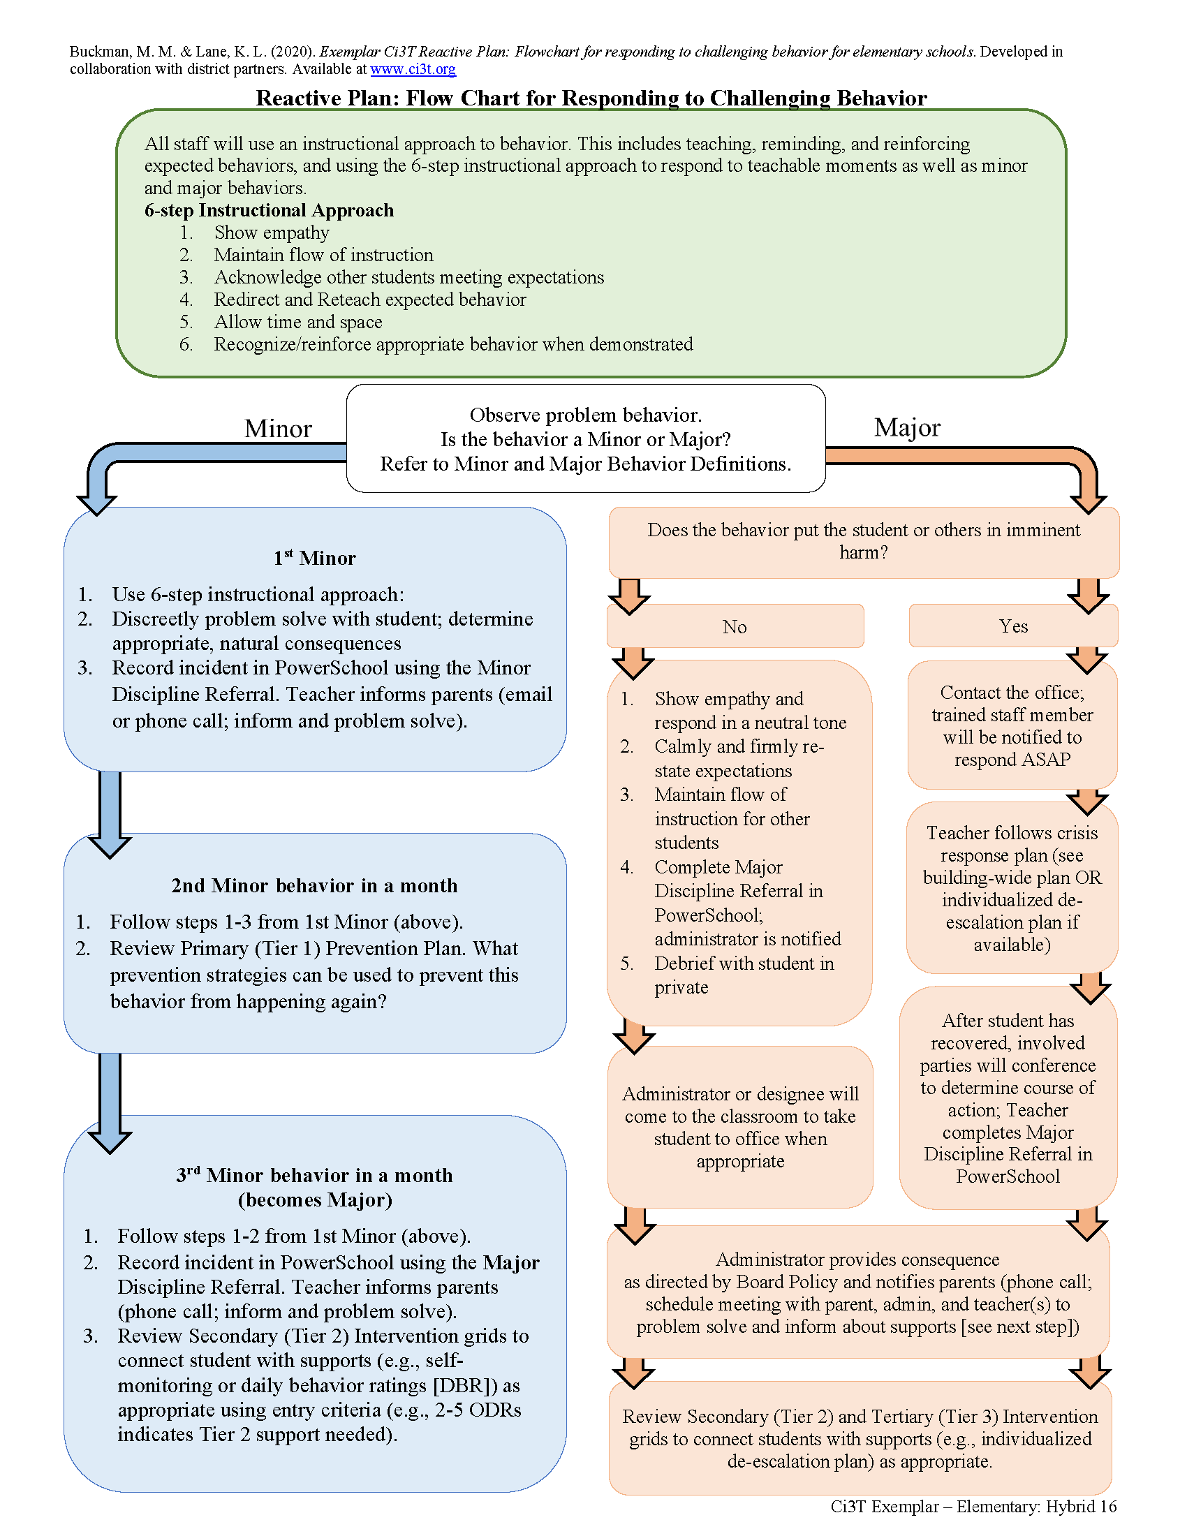
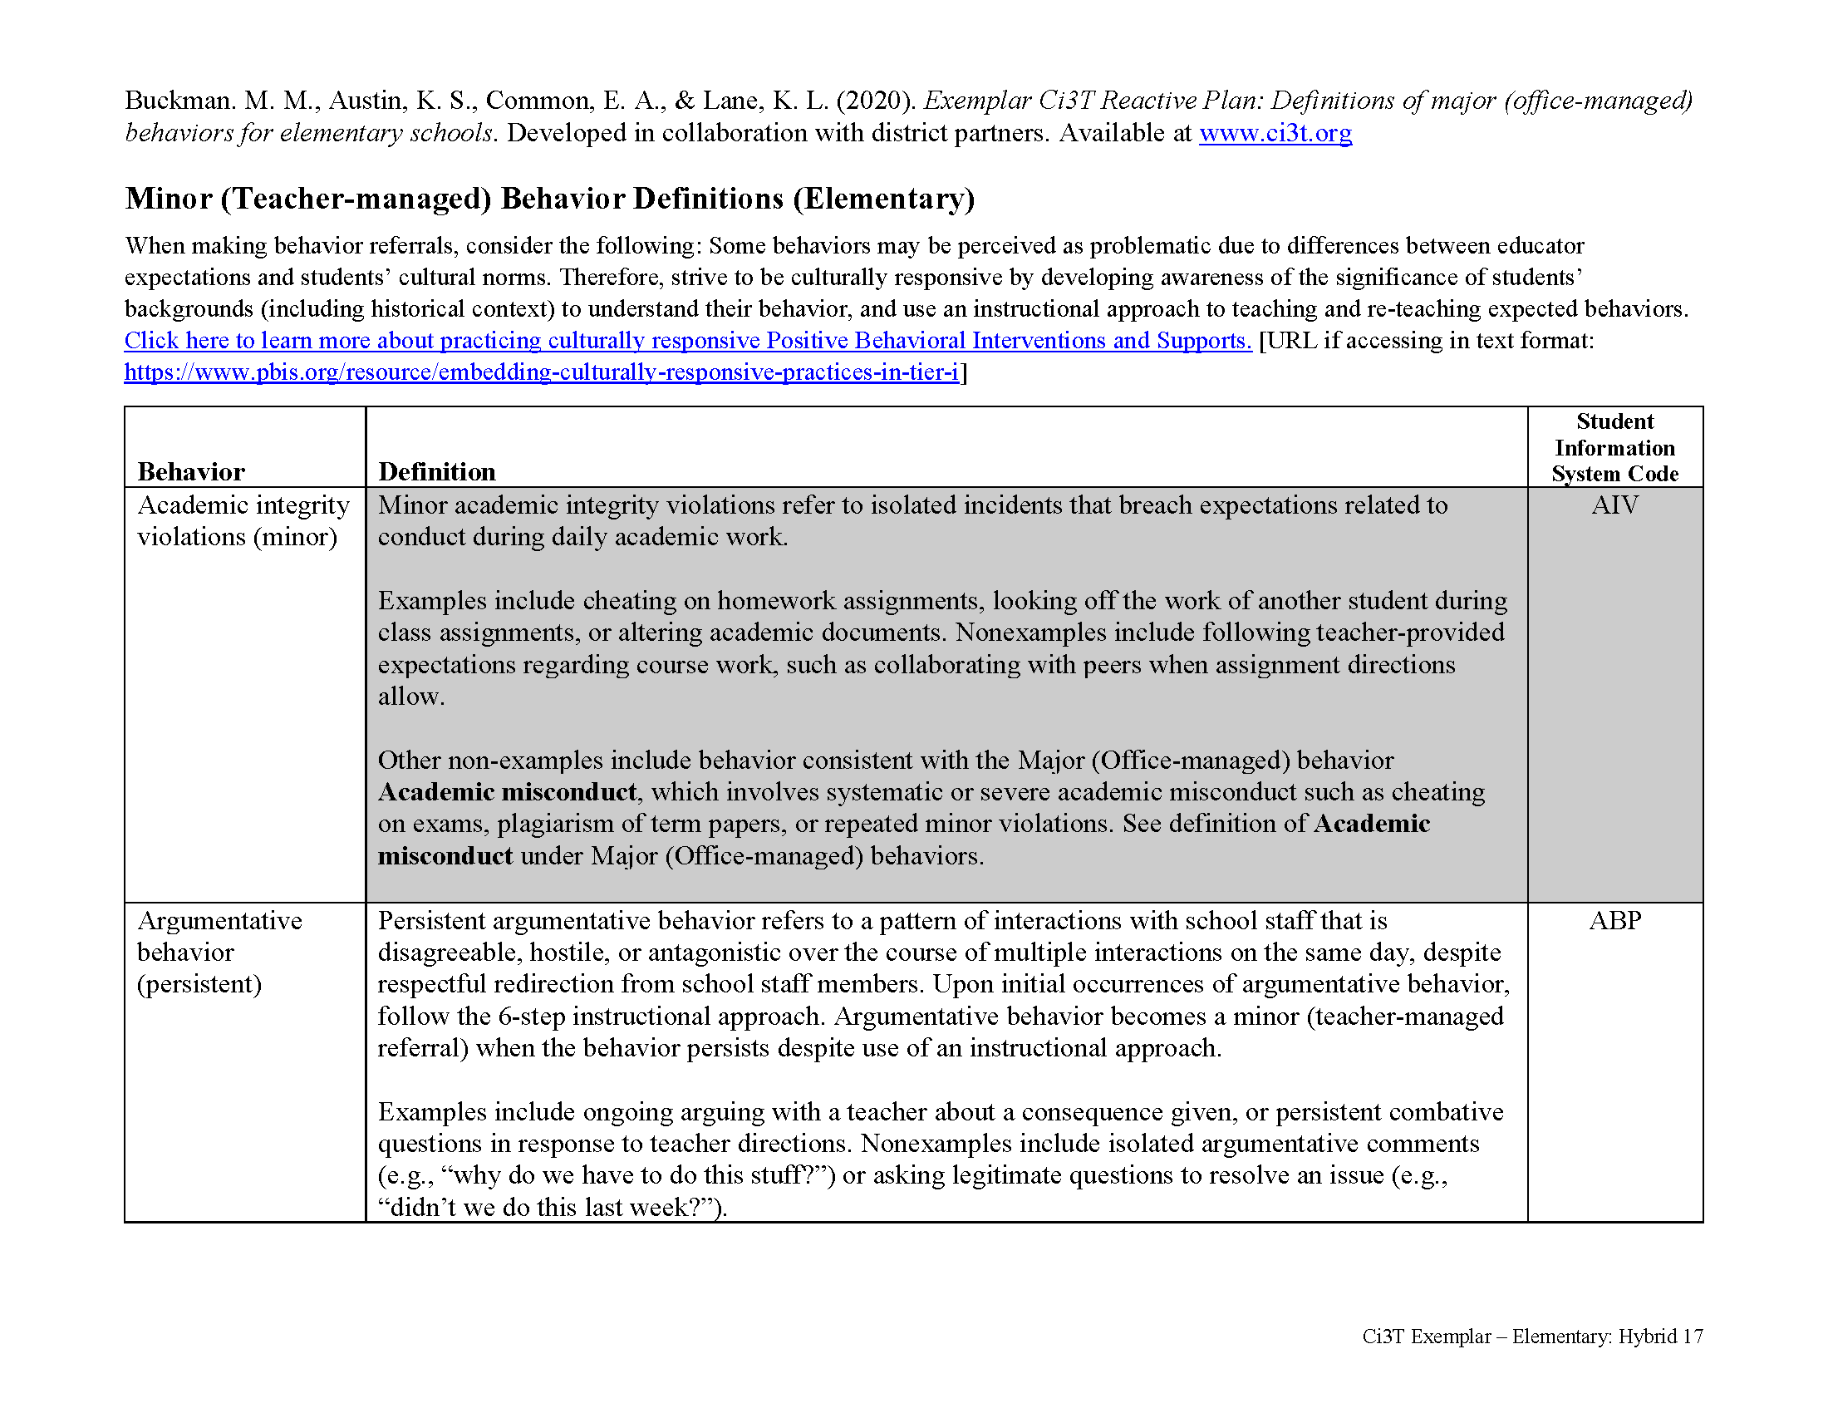
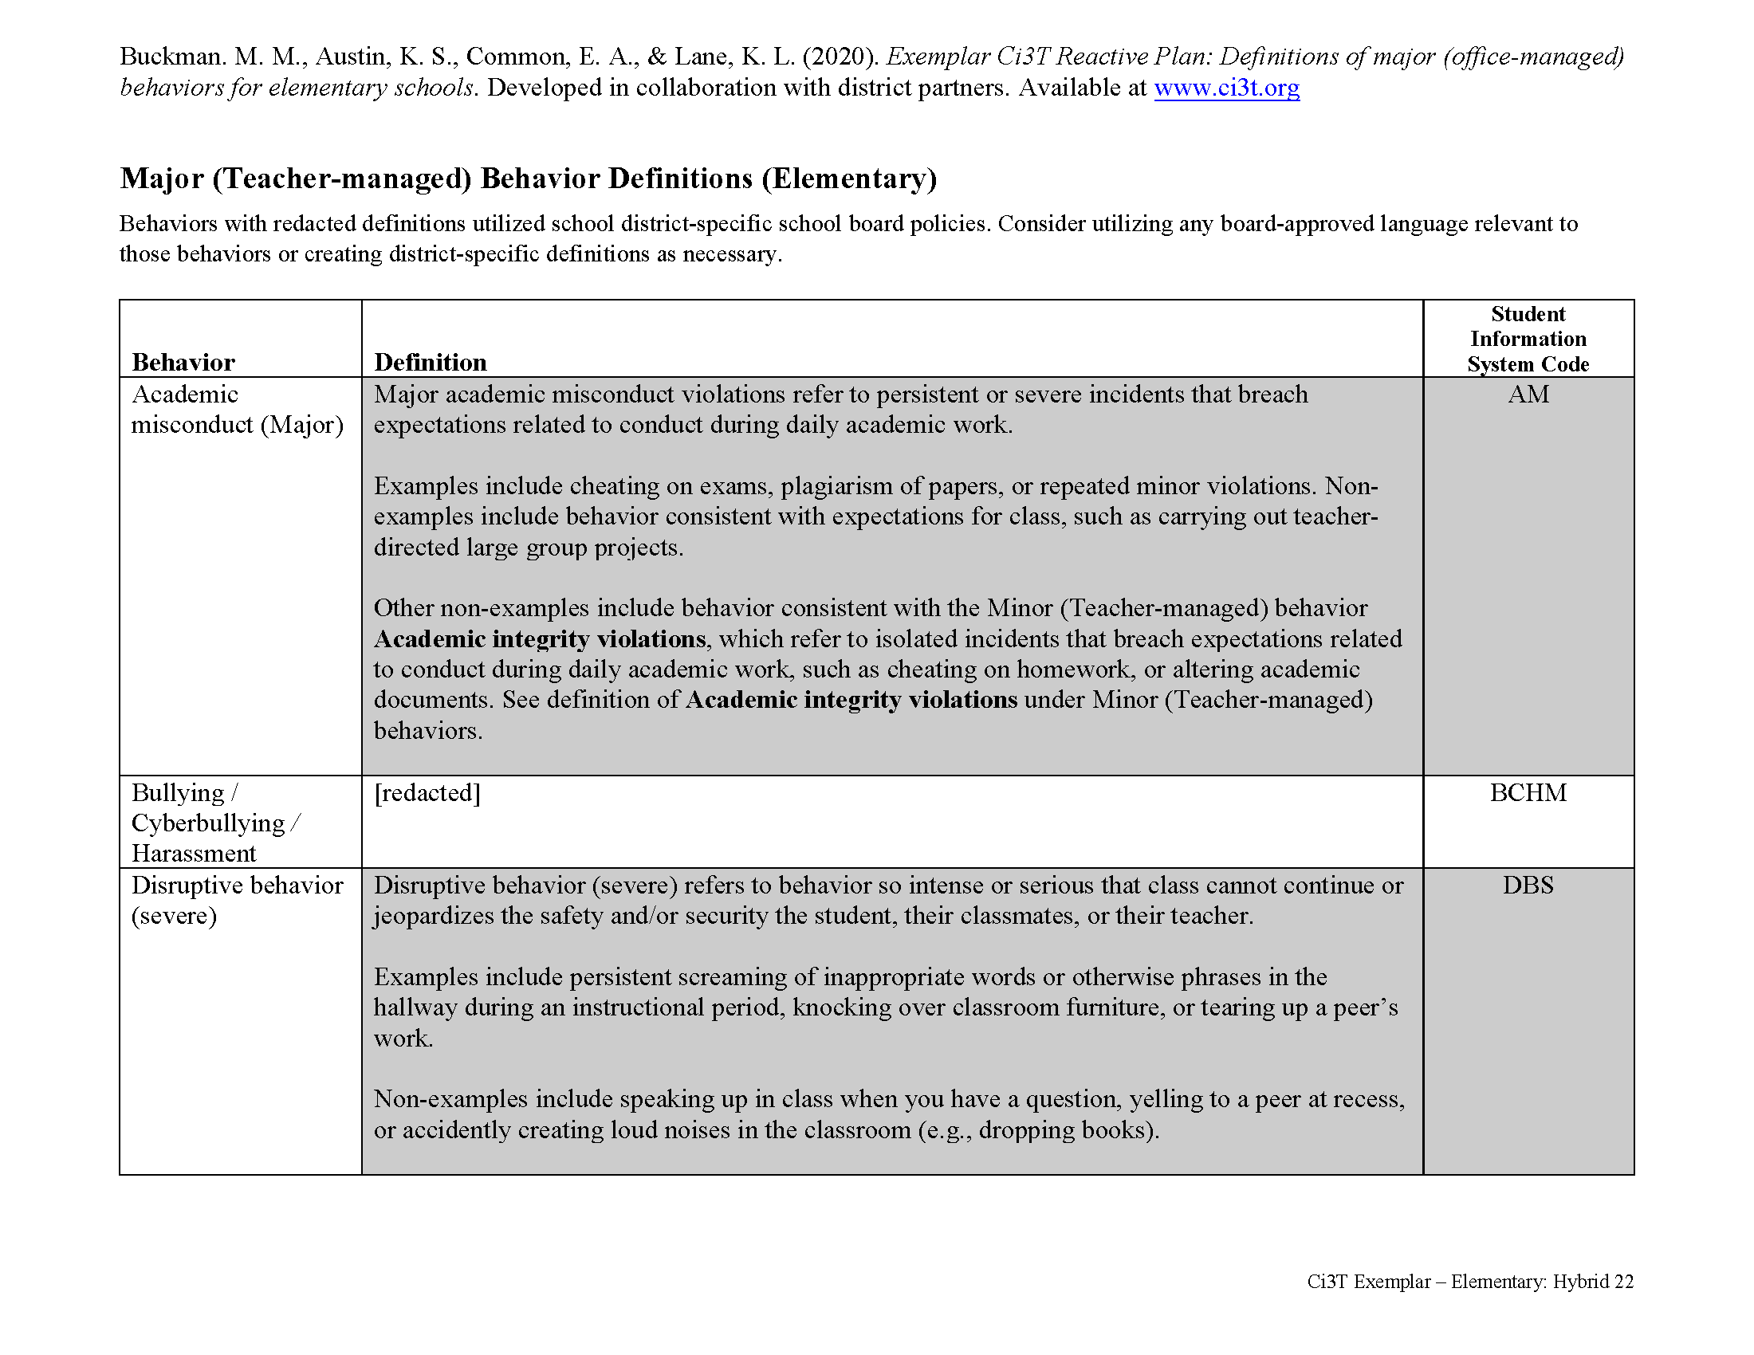

Slide 74
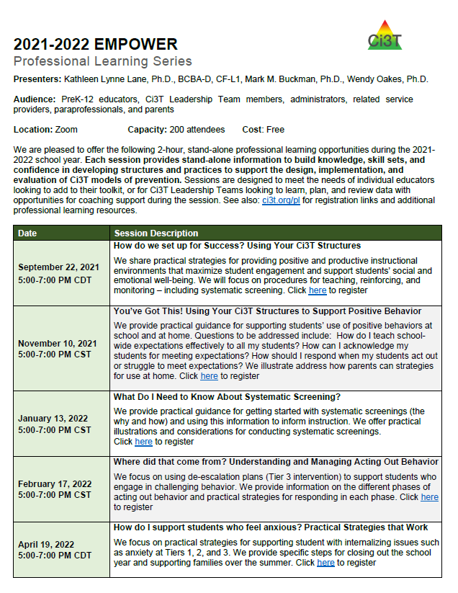

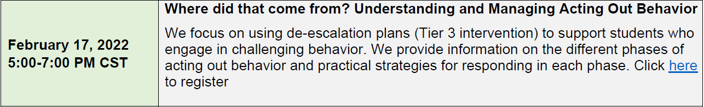

Slide 75

Secondary (Tier 2) Intervention Grids

Slide 76
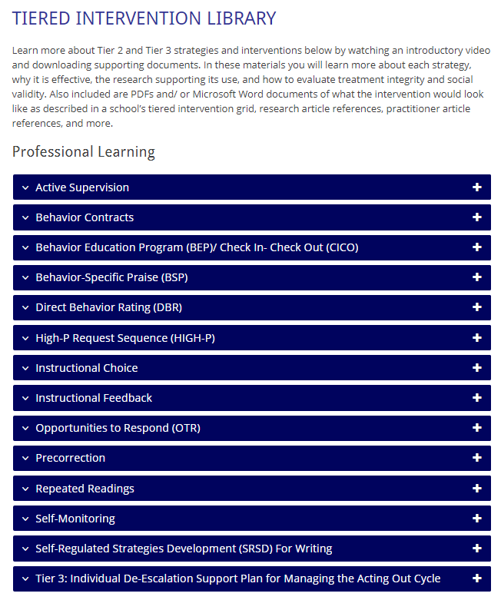
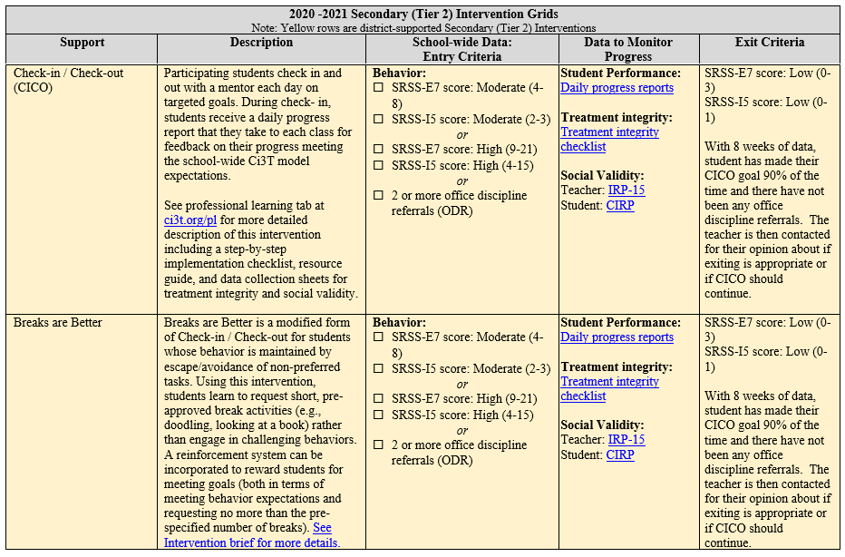
Tier 2
ci3t.org/pl
A support (not a person)
Options available via Ci3T Implementation Manual
(see Secondary (Tier 2) Intervention Grids)
Additional support available via ci3t.org/pl

Slide 77
2020 -2021 District Master: Secondary (Tier 2) Intervention Grids Note: Red rows are district-supported Tertiary (Tier 3) Interventions
Support | Description | School-wide Data: Entry Criteria | Data to Monitor Progress | Exit Criteria
Direct Behavior Rating (DBR) / Daily Behavior Report | DBR is completed daily by teacher or other school staff during daily observation periods and shared with parents or guardians each day. DBR can be used to monitor one or several target behaviors, such as academic engagement or respect, or can be aligned to schoolwide expectations. At the conclusion of each observation period, the teacher indicates the degree to which the student displayed each behavior, conferences briefly with the student, and sends the form home to parents/guardians to sign. Access free training and resources at UConn’s DBR site and at ci3t.org/pl. | Behavior: SRSS-E7 score: Moderate (4-8) SRSS-I5 score: Moderate (2-3) or SRSS-E7 score: High (9-21) SRSS-I5 score: High (4-15) or 2 or more office discipline referrals (ODR) AND/OR Academic AIMSWeb Literacy or Math Composite Score: Tier 2 or District Common Assessments (DCAs): Near Mastery on 3 or more standards | Student Performance: Direct Behavior Rating (DBR; example DBR form is linked; completed daily) Treatment integrity: Implementation Checklist Treatment integrity checklist Social Validity: form/interview Teacher: IRP-15 Student: DBR Student | Meets the following criteria: Behavior Student DBR goals met for 10-12 weeks (team review of progress to determine) or SRSS-E7: Low (0-3) SRSS-I5: Low (0-1) and/or No office discipline referrals (ODRs) over 8 weeks AND/OR Academic AIMSWeb Literacy or Math Composite Score: Tier 1 or District Common Assessments: Mastery on the most recent DCAs

Slide 78

Tertiary (Tier 3) Intervention Grids

Slide 79
2020 -2021 District Master: Tertiary (Tier 3) Intervention Grids Note: Red rows are district-supported Tertiary (Tier 3) Interventions
Support | Description | School-wide Data: Entry Criteria | Data to Monitor Progress | Exit Criteria
Functional Assessment-based Intervention | FABIs are interventions based on the function of the target behavior, as determined by the functional assessment and determined with the aid of the Function Matrix. The Function-Based Intervention Decision Model is used to determine the intervention focus, including: Method 1: Teach the replacement behavior; Method 2: Improve the environment; Method 3: Adjust the contingencies; and a combination of Method 1 and Method 2. A package intervention is designed and implemented, including antecedent adjustments, reinforcement adjustments, and extinction procedures directly linked to the function of the target behavior. See http://www.ci3t.org/fabi for a detailed, step-by-step process for designing, implementing, and evaluating Functional Assessment-based Interventions. | One or more of the following: Behavior: SRSS-E7 score: High (9-21) SRSS-I5 score: High (4-15) 6 or more office discipline referrals (ODRs) within one grading period AND/OR Academic: Report card: 1 or more course failures Below 2.5 GPA | Student Performance: Student behavior targeted for improvement (e.g., target or replacement behavior) using direct observation Treatment Integrity: FABI Step Checklists (see ci3t.org/fabi) Treatment Integrity Checklist Social Validity: IRP-15 (teacher) CIRP (student) | The FABI will be faded once (a) a functional relation is demonstrated using a validated single-case research design (e.g., withdrawal), and (b) the behavior objective for the student is met (See Behavior Intervention Plan [BIP]).

Slide 80
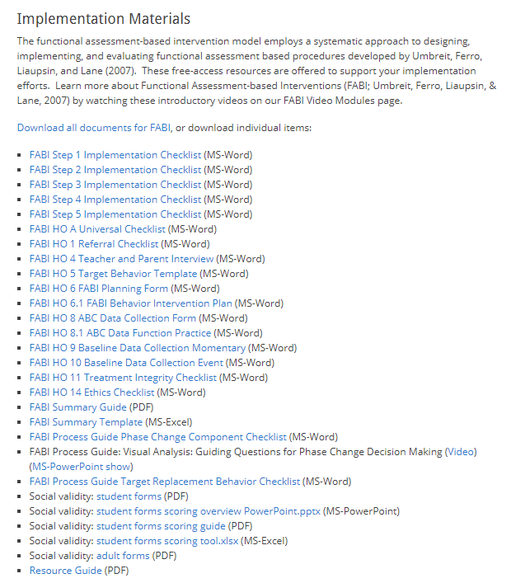
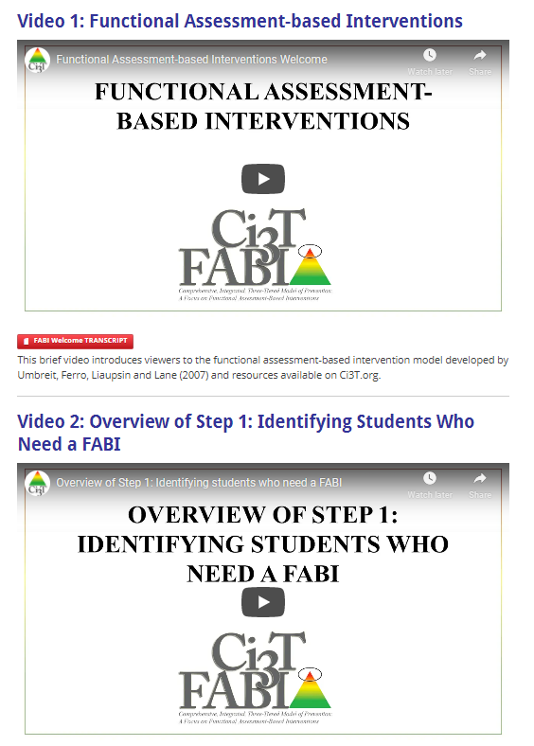
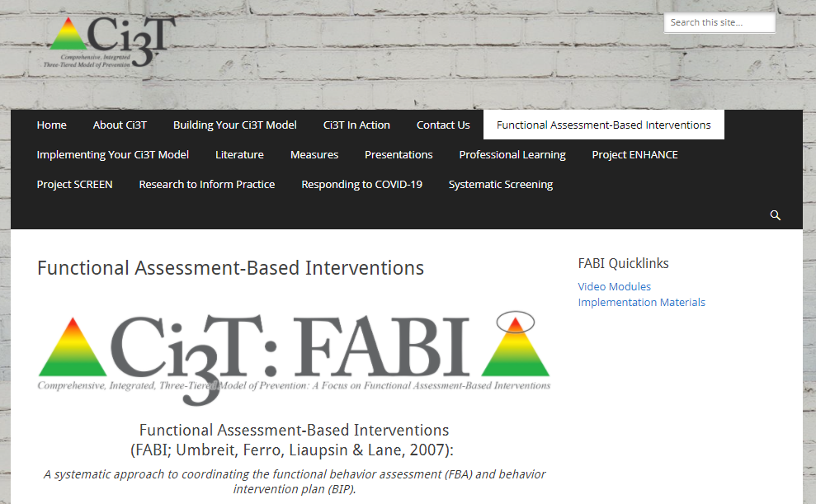
Functional assessment-based interventions (ci3t.org/fabi)

Slide 81
Providing Resources for Families

Slide 82
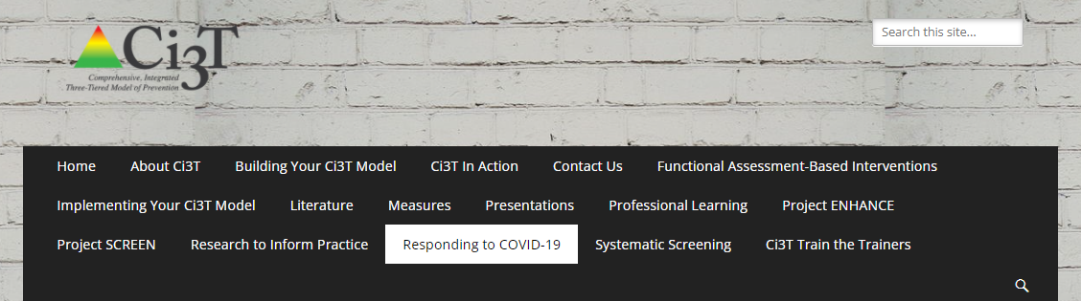
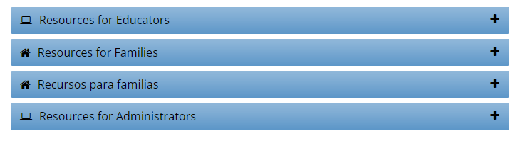
ci3t.org/covid

Slide 83
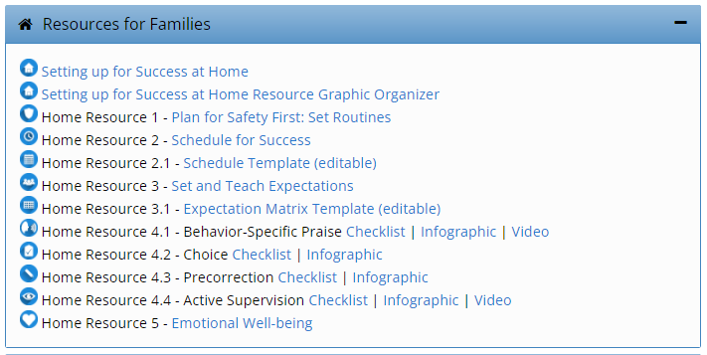
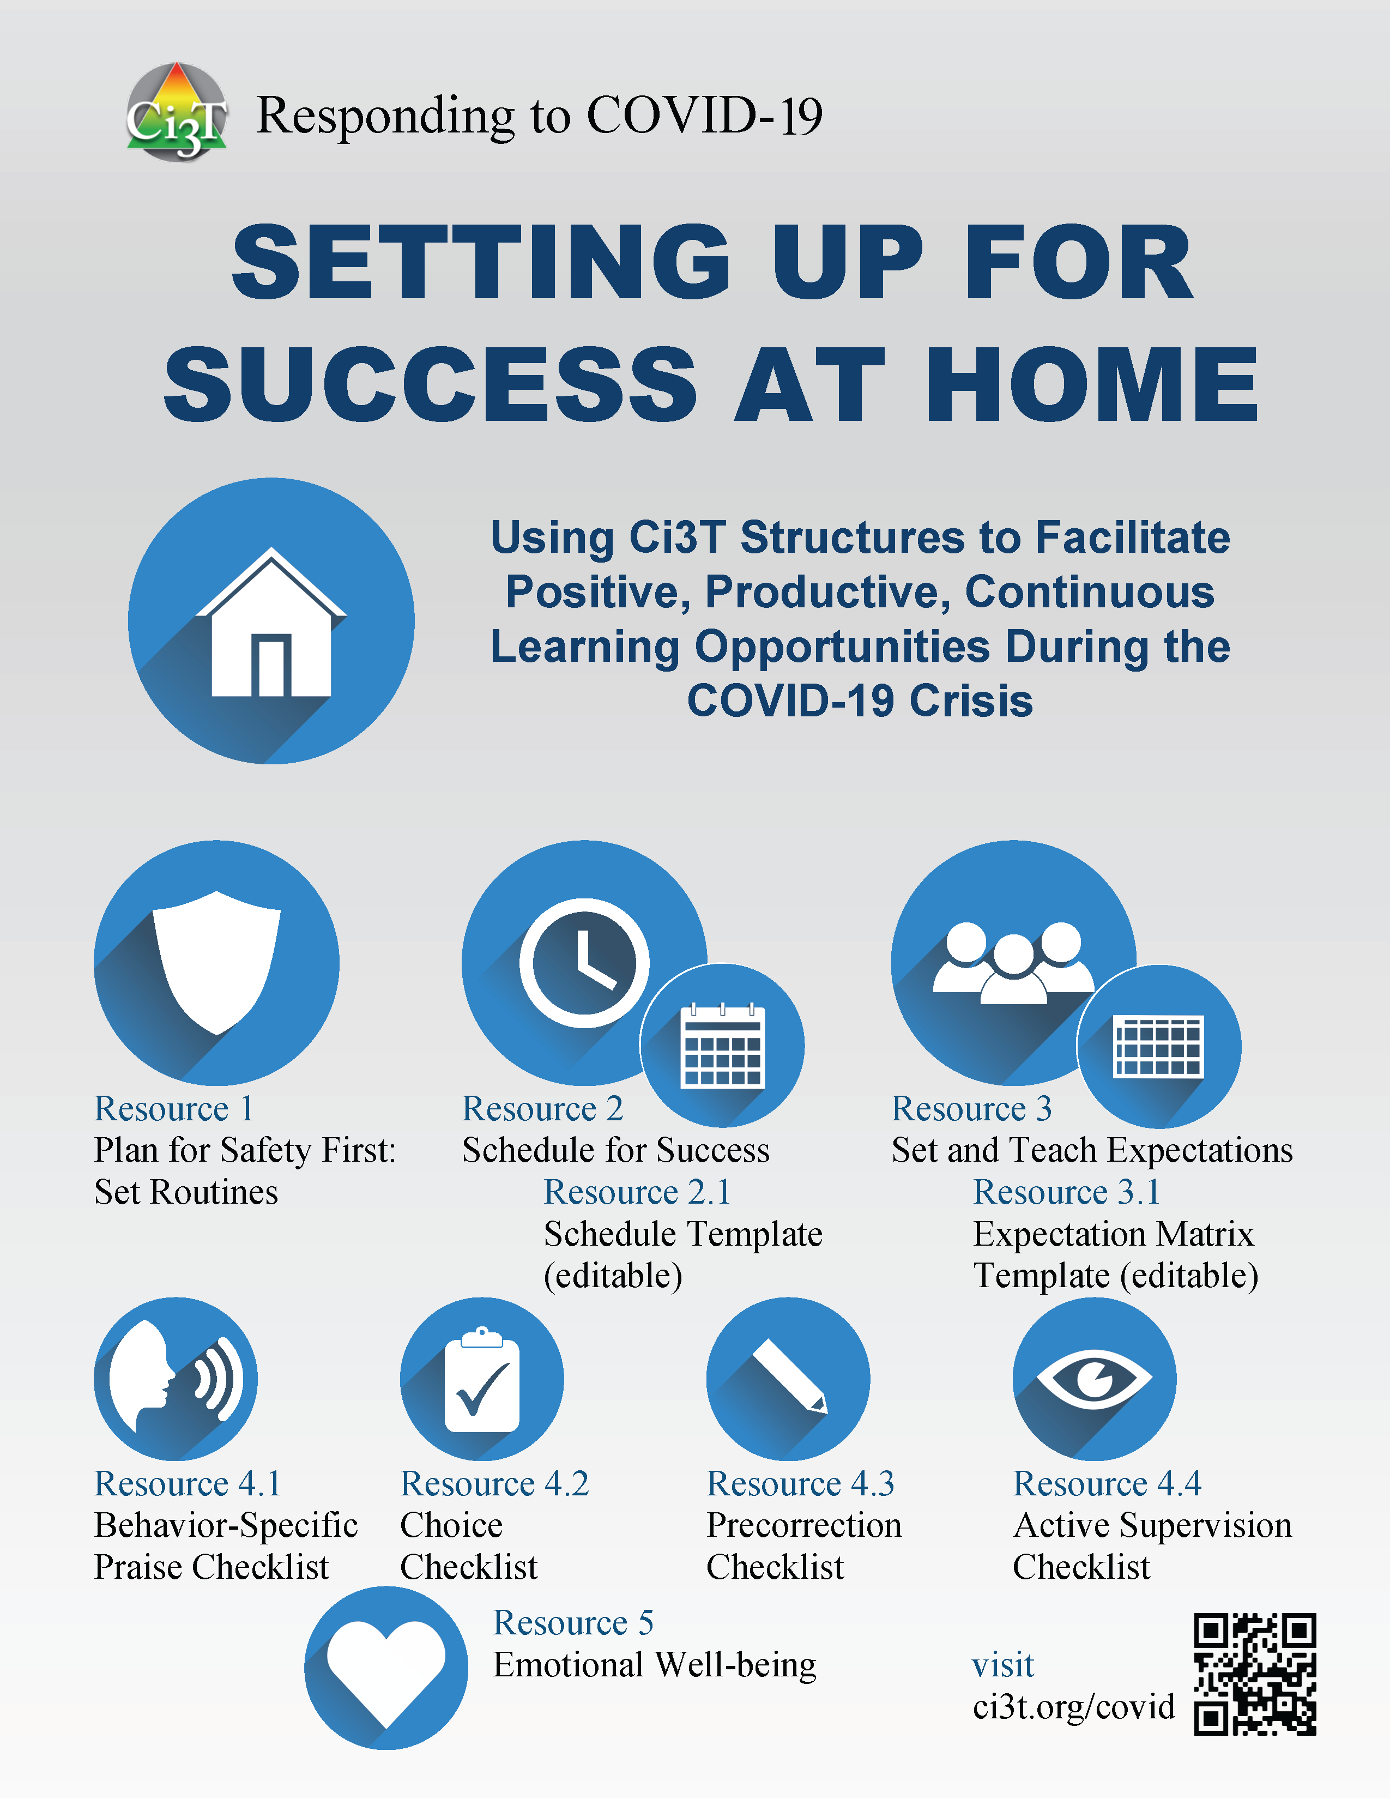
ci3t.org/covid – Resources for Families

Slide 84
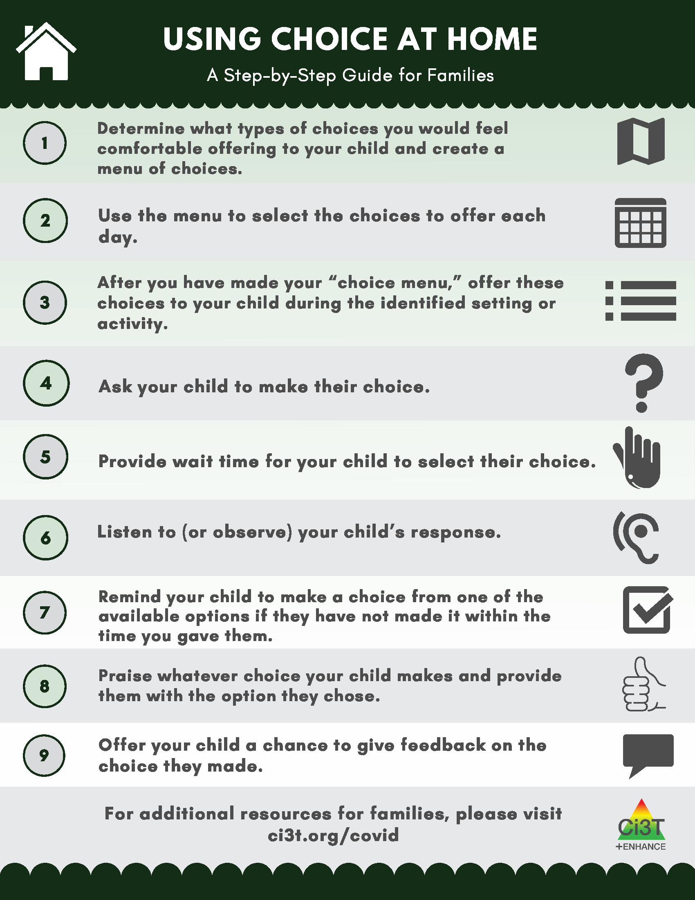
ci3t.org/covid – Resources for Families

Slide 85
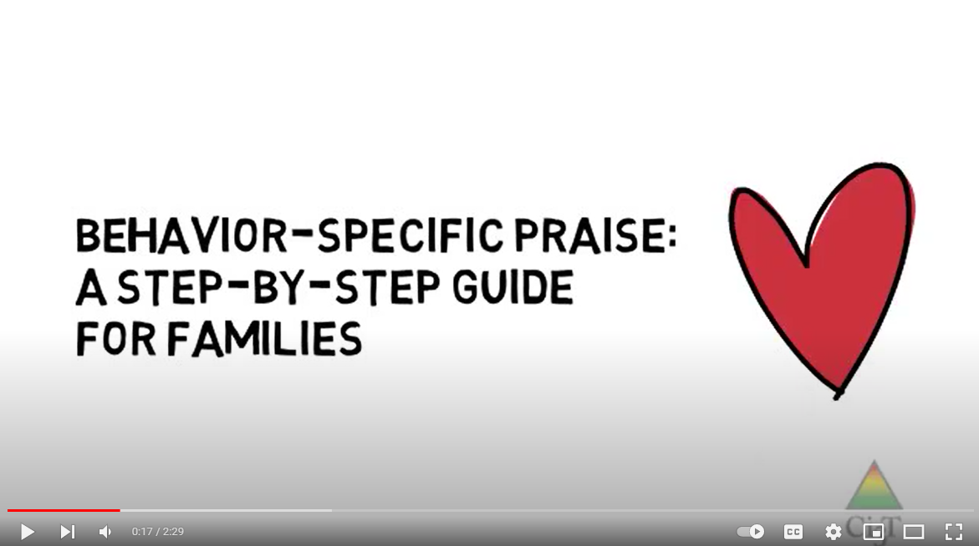
ci3t.org/covid – Resources for Families

Slide 86
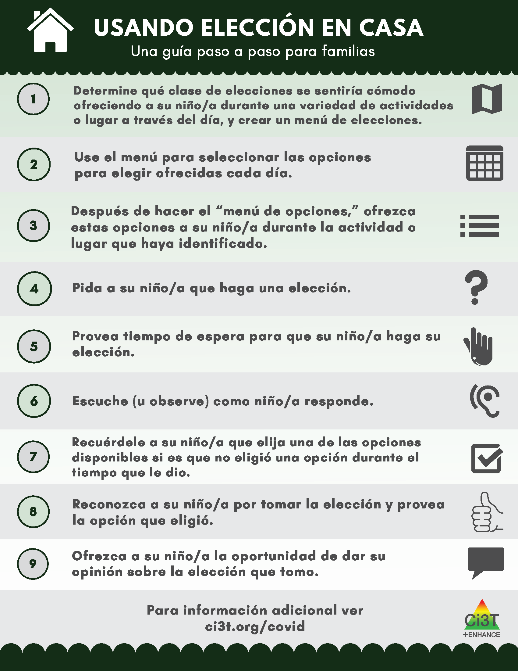
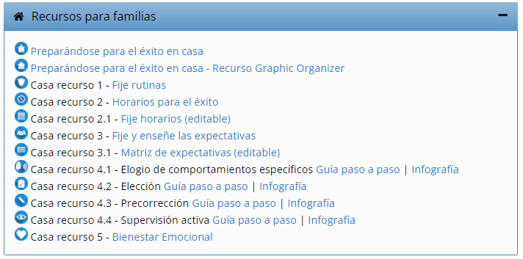
ci3t.org/covid – Recursos para familias

Slide 87
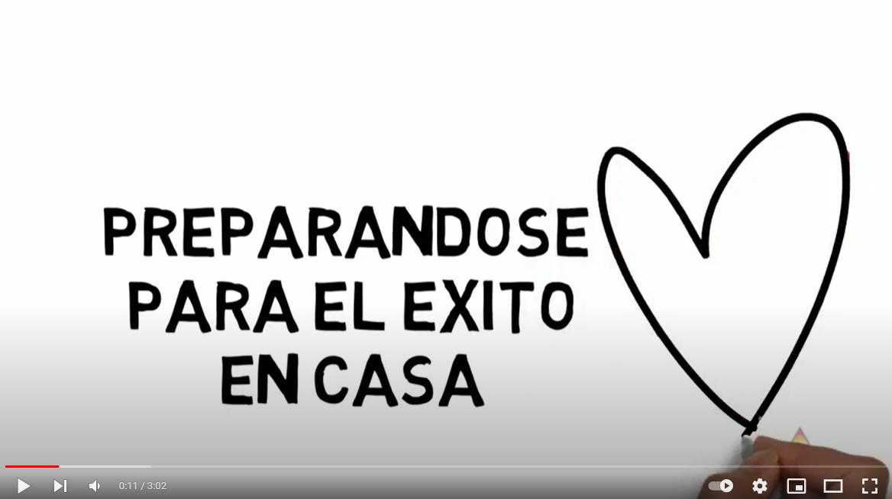
ci3t.org/covid – Recursos para familias

Slide 88
ci3t.org/covid
- Reach

Slide 89
ci3t.org/covid
- Reach

Slide 90
ci3t.org/covid
- Reach

Slide 91
Talk Time | Talk Time
Responding to Challenging Behaviors | Providing Resources for Families
Strengths? Areas in Need? Professional learning resources available? | What structures do you have in place for sharing out resources with families? Which of the resources shared might be beneficial to share with families at your school? How might you share these resources?
Notes:
10-min timer

Slide 92
Looking Ahead

Slide 93



ci3t.org/pl
ci3t.org/covid

Slide 94
Ci3T EMPOWER Sessions Location: Remote via Zoom Attended by: School Ci3T Leadership Teams Ci3T District Trainers and Coaches Faculty and Staff Families (adults only) Community Members |  | Times CST All Times Tentative
How do we set up for Success? Using Your Ci3T Structures | September 22, 2021 | 5:00 p.m. – 7:00 p.m.
You’ve Got This! Using Your Ci3T Structures to Support Positive Behavior | November 10, 2021 | 5:00 p.m. – 7:00 p.m.
What Do I Need to Know About Screening? | January 13, 2022 | 5:00 p.m. – 7:00 p.m.
Where did that come from? Understanding and Managing Acting Out Behavior | February 17, 2022 | 5:00 p.m. – 7:00 p.m.
How do I support students who are feeling anxious? Practical Strategies that Work | April 19, 2022 | 5:00 p.m. – 7:00 p.m.

Slide 95

Ci3T Trainers & Coaches Calls Location: *Held Remotely Attended by: Ci3T Trainers, Coaches, or Leadership Team Members; open to interested parties Zoom link: https://kansas.zoom.us/j/92361953100 |  | Times CST
Ci3T Trainers and Coaches Call 1 | August 05, 2021 | 4:00 p.m. – 5:00 p.m.
Ci3T Trainers and Coaches Call 2 | September 02, 2021 | 4:00 p.m. – 5:00 p.m.
Ci3T Trainers and Coaches Call 3 | October 19, 2021 | 4:00 p.m. – 5:00 p.m.
Ci3T Trainers and Coaches Call 4 | November 17, 2021 | 4:00 p.m. – 5:00 p.m.
Ci3T Trainers and Coaches Call 5 | December 14, 2021 | 4:00 p.m. – 5:00 p.m.
Ci3T Trainers and Coaches Call 6 | January 20, 2022 | 4:00 p.m. – 5:00 p.m.
Ci3T Trainers and Coaches Call 7 | February 22, 2022 | 4:00 p.m. – 5:00 p.m.
Ci3T Trainers and Coaches Call 8 | March 24, 2022 | 4:00 p.m. – 5:00 p.m.
Ci3T Trainers and Coaches Call 9 | April 12, 2022 | 4:00 p.m. – 5:00 p.m.
Ci3T Trainers and Coaches Call 10 | May 04, 2022 | 4:00 p.m. – 5:00 p.m.
Ci3T Trainers and Coaches Call 11 | June 02, 2022 | 4:00 p.m. – 5:00 p.m.

Slide 96

kathleen.lane@ku.edu
Thank you!

