Slide 1
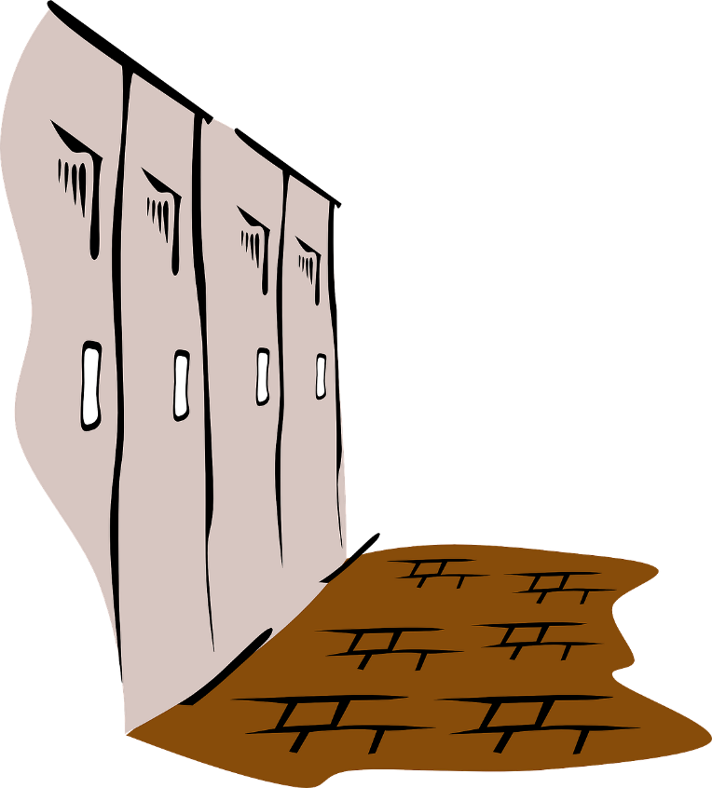
SCHOOL NAME Expectations
ADD SCHOOL MASCOT OR LOGO HERE
ADD SCHOOL MASCOT OR LOGO HERE
 | Classroom | Hallway | Cafeteria | Playground | Bathroom | Bus | Arrival & Dismissal
EXPECTATION 1 | Paste from matrix Paste from matrix Paste from matrix | Paste from matrix Paste from matrix Paste from matrix | Paste from matrix Paste from matrix Paste from matrix | Paste from matrix Paste from matrix Paste from matrix | Paste from matrix Paste from matrix Paste from matrix | Paste from matrix Paste from matrix Paste from matrix | Paste from matrix Paste from matrix Paste from matrix
EXPECTATION 2 | Paste from matrix Paste from matrix Paste from matrix | Paste from matrix Paste from matrix Paste from matrix | Paste from matrix Paste from matrix Paste from matrix | Paste from matrix Paste from matrix Paste from matrix | Paste from matrix Paste from matrix Paste from matrix | Paste from matrix Paste from matrix Paste from matrix | Paste from matrix Paste from matrix Paste from matrix
EXPECTATION 3 | Paste from matrix Paste from matrix Paste from matrix | Paste from matrix Paste from matrix Paste from matrix | Paste from matrix Paste from matrix Paste from matrix | Paste from matrix Paste from matrix Paste from matrix | Paste from matrix Paste from matrix Paste from matrix | Paste from matrix Paste from matrix Paste from matrix | Paste from matrix Paste from matrix Paste from matrix

