Slide 1
Implementing Comprehensive, Integrated, Three-tiered (Ci3T) Models: Setting up for Success
E-Ci3T Implementation Series and Delivery – Session 1
Presenters and Contributors | Contributors
Allison M. Bernard | Wendy Peia Oakes
Mark M. Buckman | Elise Sarasin
Kathleen Lynne Lane | Rebecca L. Sherod

Slide 3
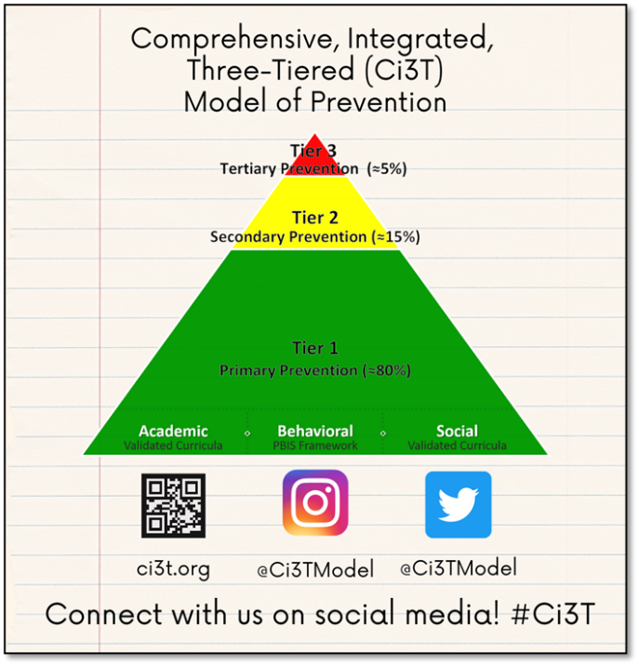
Let’s Connect on Social Media!
Tag us in your Ci3T highlights- we’d love to see Ci3T in action!
Follow us on Twitter or Instagram for updates and links to resources!
  @Ci3TModel

Slide 4
Ci3T Professional Learning Calendar
 | 0 | 1 | 2 | 3 | 4 | 5 | 6 | 7 | 8 | 9 | 10 | 11
 | July | Aug | Sep | Oct | Nov | Dec | Jan | Feb | Mar | Apr | May | Jun
Ci3T Training |  |  |  |  | Ci3T Professional Learning Series Session 1 | Ci3T Professional Learning Series Session 2 | Ci3T Professional Learning Series Session 3 | Ci3T Professional Learning Series Session 4 |  | Ci3T Professional Learning Series Session 5 | Ci3T Professional Learning Series Session 6
Ci3T Implementation Support | Ci3T Implementation Series Prep Session |  | Ci3T Implementation Series Session 1 |  | Ci3T Implementation Series Session 2 |  | Ci3T Implementation Series Session 3 |  | Ci3T Implementation Series Session 4 | Ci3T Implementation Series Session 5
Ci3T EMPOWER |  |  | Ci3T EMPOWER Session 1 | Ci3T EMPOWER Session 2 | Ci3T EMPOWER Session 3 |  | Ci3T EMPOWER Session 4 |  | Ci3T EMPOWER Session 5 | Ci3T EMPOWER Session 6
Ci3T Trainers & Coaches Calls |  | Trainers & Coaches Call Session 1 | Trainers & Coaches Call Session 2 | Trainers & Coaches Call Session 3 | Trainers & Coaches Call Session 4 | Trainers & Coaches Call Session 5 | Trainers & Coaches Call Session 6 | Trainers & Coaches Call Session 7 | Trainers & Coaches Call Session 8 | Trainers & Coaches Call Session 9 | Trainers & Coaches Call Session 10

Slide 5
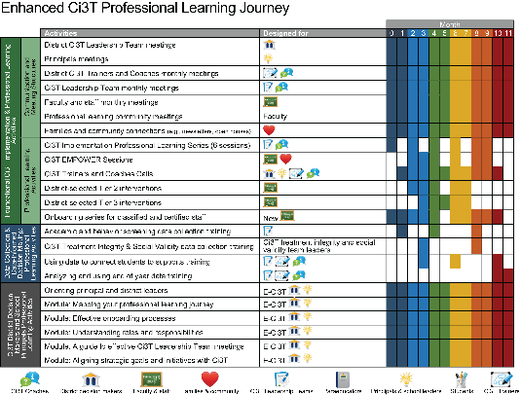
Agenda
Welcome
Scheduling for Success
Implementing Your Primary (Tier 1) Prevention Efforts
Preparing to Collect Treatment Integrity Data
  Preview: Ci3T Treatment Integrity Team Leader Training
Wrapping Up and Moving Forward

Slide 6
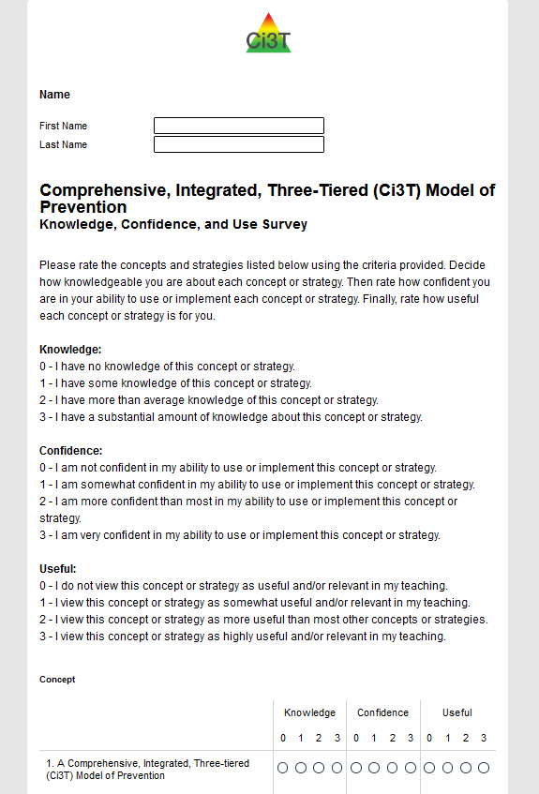
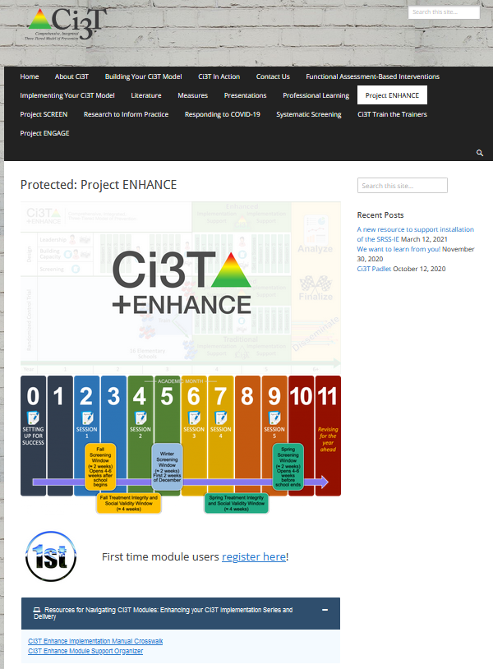
Once you have completed your KCU, we encourage you to check out professional learning resources at ci3t.org/enhance
Notes:
10 minutes to complete KCU
For those who have already finished – explore modules

Slide 7
Welcome
Please pull up your Ci3T Implementation Manual

Slide 8
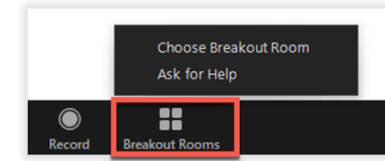
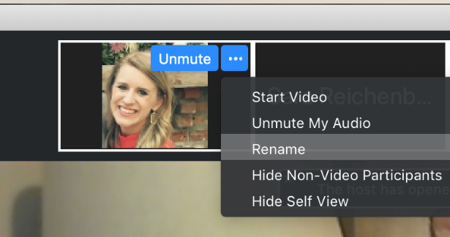
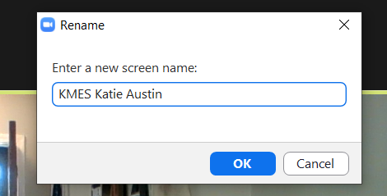
Renaming: School Initials + First and Last Name
For breakout rooms with your colleagues today…
1. Click the three dots at the top
right corner of your video square.
2. Rename yourself with your
school initials then first and last name.
T KAES Katie Austin

Slide 9
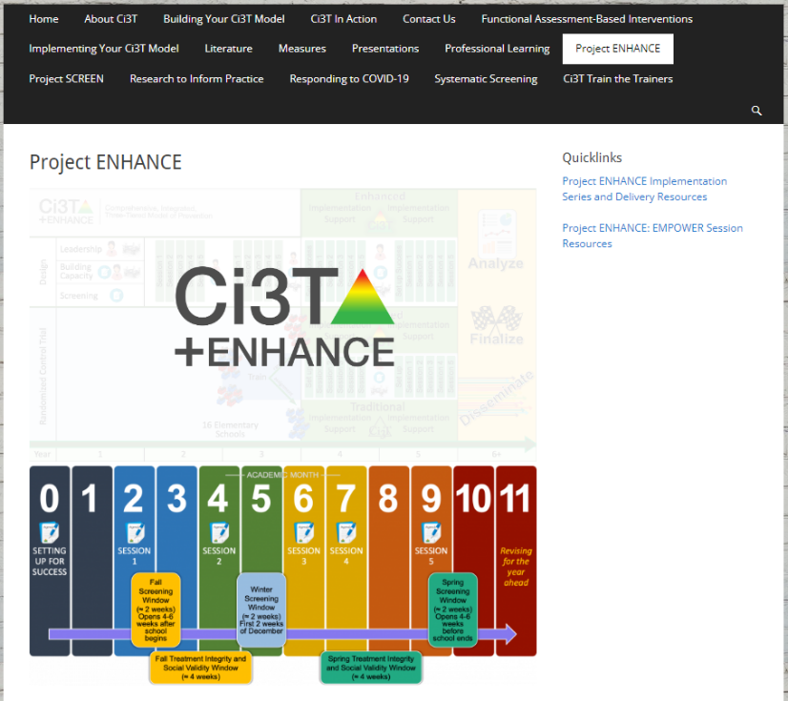
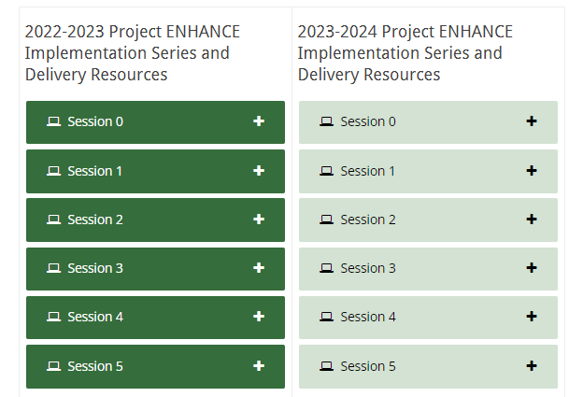
Accessing Professional Learning Materials
Navigate to ci3t.org/enhance
Type password: enhanceci3t!
Access session resources via the Project ENHANCE Implementation Series and Delivery Resources quicklink or by scrolling to the bottom of the page

Slide 10

Goals for this Implementation Year
Establish effective Ci3T leadership structures
Gain a deeper understanding of Ci3T models of prevention
Implement your school’s plan with high fidelity
Collect and use social validity and treatment integrity data to monitor Ci3T plan implementation
Collect student academic and behavioral outcome data to inform Ci3T implementation efforts
Share data with all stakeholders regularly (e.g., monthly, quarterly)
Identify areas of additional professional learning for faculty and staff and support faculty and staff access to professional learning
Address any barriers to implementing your Ci3T model

Slide 11


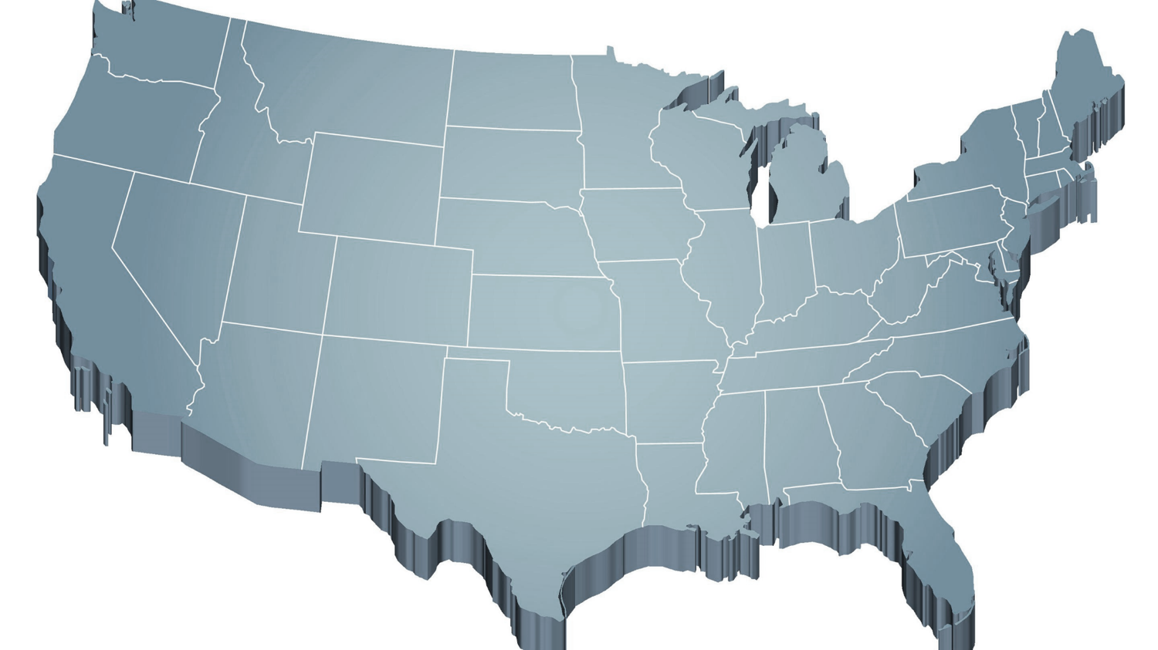


The Journey of Ci3T: Respectful Partnerships
1997
Notes:
CA & AZ start→ Tennessee → North Carolina→ Kansas
Trainings (MO, KANSAS, VERMONT, AZ)
MO, KS, UAB
HI

Slide 13
Primary (Tier 1) Prevention
All students are eligible for participation
(Lane, Robertson et al., 2006)
About 80% of students respond to this level
(Gresham, Sugai, Horner, Quinn, & McInerney, 1998; Sugai & Horner, 2006)
Examples of primary (Tier 1) prevention
  Validated literacy curricula
  Violence prevention
  Conflict resolution programs
  Anti-bullying programs
  Schoolwide social skills instruction
  Character education programs
Sources: Gresham, F. M., Sugai, G., Horner, R. H., Quinn, M. M., & McInerney, M. (1998). Classroom and schoolwide practices that support students’ social competence: A synthesis of research. Washington, DC: Office of Special Education Programs.
Lane, K. L., Robertson, E. J., & Graham-Bailey, M. A. L. (2006). An examination of school-wide interventions with primary level efforts conducted in secondary schools: Methodological considerations. In T. E. Scruggs & M. A. Mastropieri (Eds.) Applications of research methodology: Advances in learning and behavioral disabilities (Vol. 19), pp. 157-199. Oxford, UK: Elsevier.
Sugai, G., & Horner, R.R. (2006). A promising approach for expanding and sustaining school-wide positive behavior support. School psychology review, 35, 245.

Slide 14
Secondary (Tier 2) Prevention
Students who need more than the primary prevention plan, 10-15% of students
Focused intervention to address academic, behavior, and/or social concerns
  Acquisition (can’t do)
  Fluency (trouble doing)
  Performance (won’t do)
Examples of secondary (Tier 2) prevention
  Small group instruction in anger management
  Reading comprehension strategies
Source: Lane, K.L., Oakes, W.P., Ennis, R.P., & Hirsch, S.E. (2014). Identifying students for secondary and tertiary prevention efforts: How do we determine which students have tier 2 and tier 3 needs? Preventing School Failure, 58, 171-182.

Slide 15
Tertiary (Tier 3) Prevention
Students who need more than primary or secondary prevention, 5-7% of students
Intensive individualized interventions
Examples of tertiary (Tier 3) prevention
  Functional assessment-based interventions
  (Umbreit, Ferro, Liaupsin, & Lane, 2007)
  Multisystemic therapy program
  (Schoenwald, Brown, & Henggeler, 2000)
Sources: Lane, K.L., Oakes, W.P., Ennis, R.P., & Hirsch, S.E. (2014). Identifying students for secondary and tertiary prevention efforts: How do we determine which students have Tier 2 and Tier 3 needs? Preventing School Failure, 58, 171-182.
Schoenwald, S. K., Brown, T. L., & Henggeler, S. W. (2000). Inside multisystemic therapy therapist, supervisory, and program practices. Journal of Emotional and Behavioral Disorders, 8, 113-127.
Umbreit, J., Ferro, J.B., Liaupsin, C.J., & Lane, K.L. (2007). Functional behavioral assessment and function-based intervention: An effective, practical approach. Upper Saddle River, NJ: Prentice-Hall.

Slide 16

Core Features

Slide 17

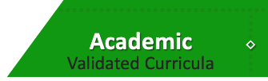
Academic Component
Coordinated instruction within and across grade levels
Instruction linked to College and Career-Ready Standards, early learning standards, state, or district standards
Benchmarking student progress to inform instruction
Progress monitoring for students identified for secondary (Tier 2) and tertiary (Tier 3) supports
Source: Lane, K.L., Oakes, W.P., & Menzies, H.M. (2014). Comprehensive, integrated, three-tiered models of prevention: Why does my school—and district—need an integrated approach to meet students’ academic, behavioral, and social needs? Preventing School Failure: Alternative Education for Children and Youth, 58, 121-128.

Slide 18
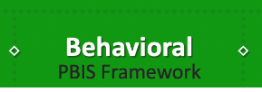
Behavioral Component: Positive Behavioral Interventions and Supports (PBIS)
A Framework, Not a Curriculum
Establish, clarify, and define expectations
Teach all students the expectations, planned and implemented by all adults in the school
Give opportunities to practice
Reinforce students consistently, facilitate success
Consider rules, routines, and physical arrangements
Monitor the plan using school-wide data to identify students who need more support
Monitor student progress
Source: Horner, R.H., & Sugai, G. (2015). School-wide PBIS: An example of applied behavior analysis implemented at a scale of social importance. Behavior Analysis in Practice, 8, 80-85.

Slide 19
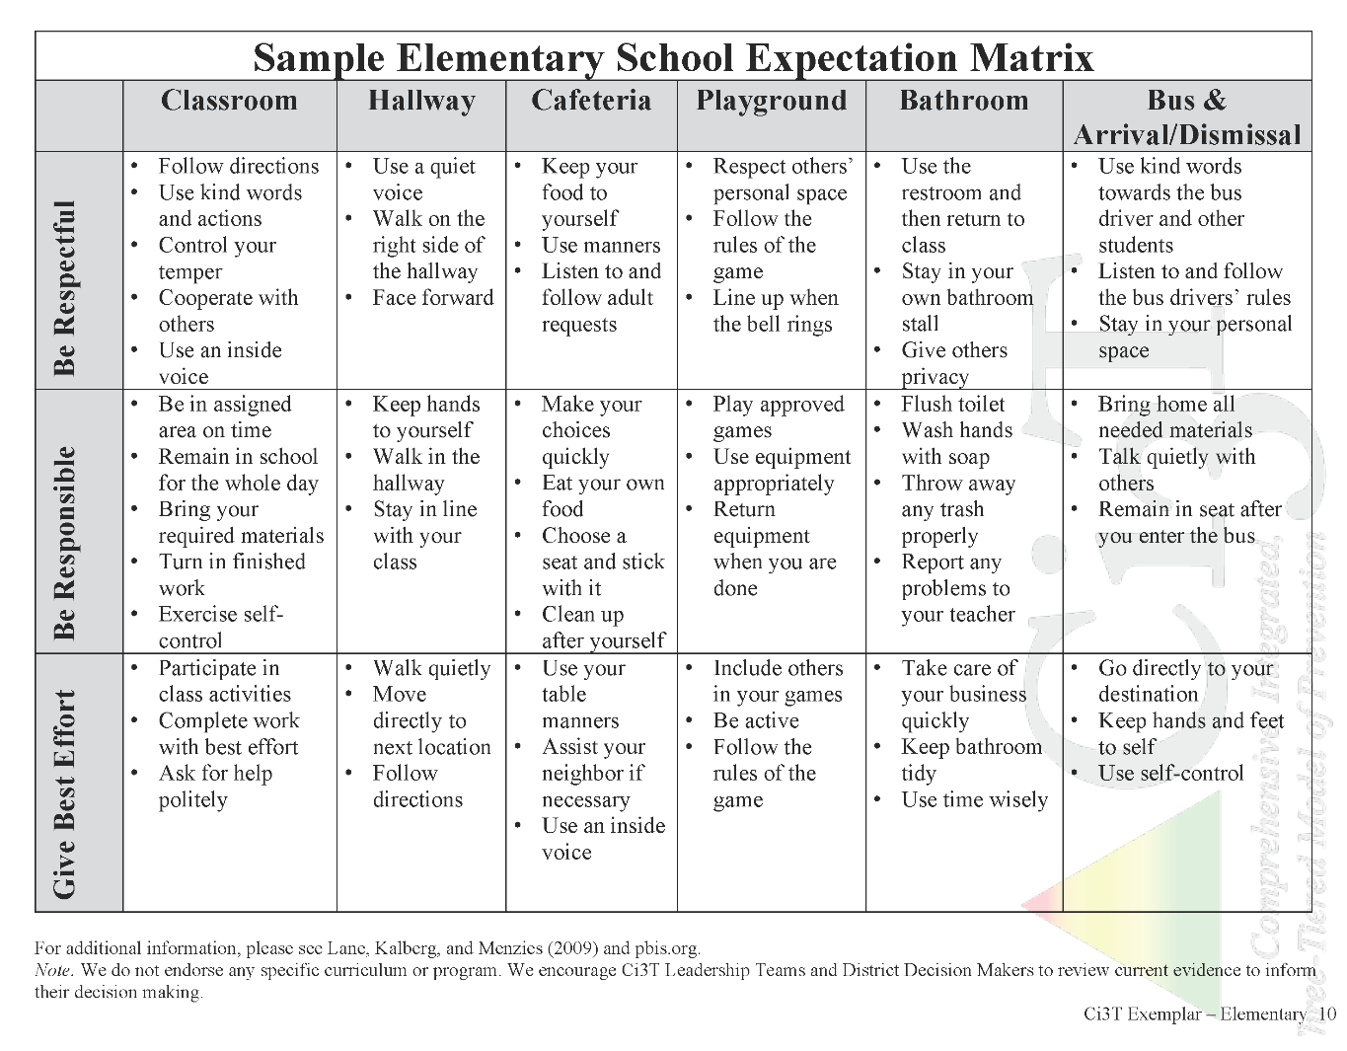
Establish, Teach, Acknowledge

Slide 20
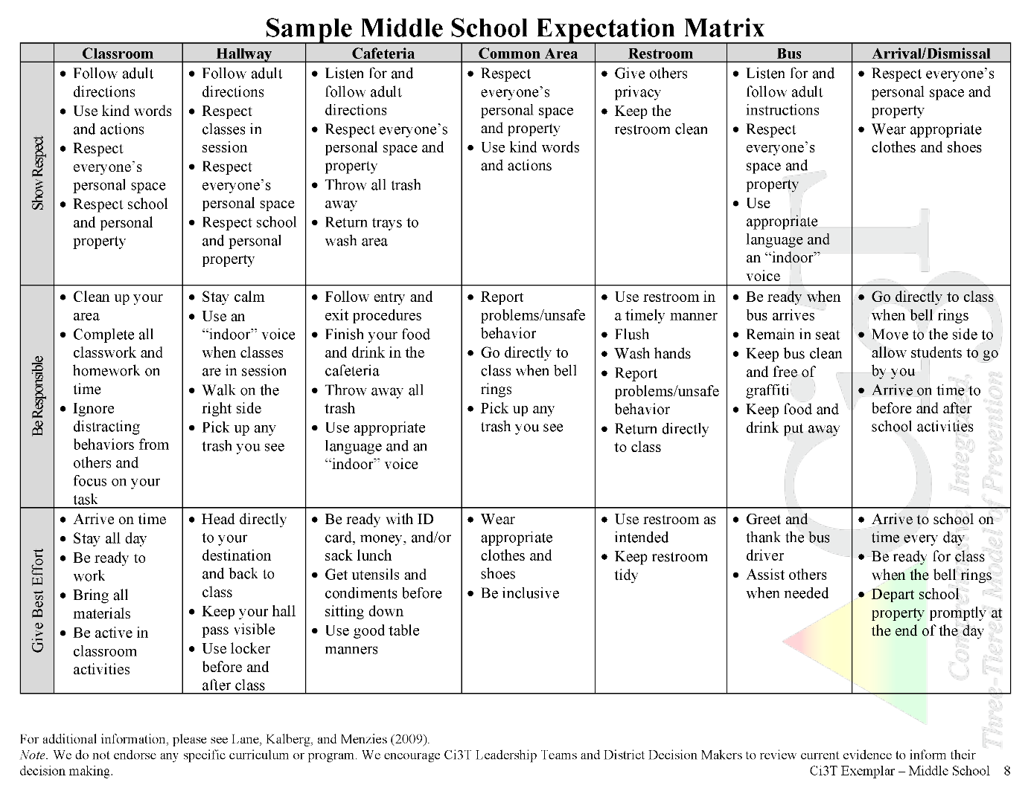
Establish, Teach, Acknowledge

Slide 21
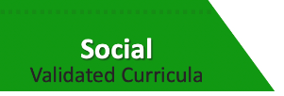
Social Component:
Identifying a Validated Curriculum
Violence Prevention
  Second Step Violence Prevention (www.cfchildren.org)
Character Education
  Positive Action (www.positiveaction.net)
  Caring School Community (www.characterplus.org)
Social Skills
  Social Skills Improvement System: Classwide Intervention Program (Elliott & Gresham, 2007)
Source: Elliott, S. N., & Gresham, F. M. (2007). Social Skills Improvement System: Classwide intervention program teacher’s guide. Pearson Assessments.

Slide 22
Social Component:
Examples of Schoolwide Programs
Character Education
Violence Prevention
    www.characterstrong.com
    Character Strong
Improves engagement, increase belonging, promotes well-being
Curriculum-based approach
Over 100 online lessons for a educators with various backgrounds
Optional components:
  On Demand Professional Development
  Webinars
  Podcast
  Implementation Coaching Packages
    www.cfchildren.org
    The Second Step Violence Prevention Program
    Committee for Children, 1992
    $159 per grade (elementary, middle, high school, families, Spanish)
Sources: Committee for Children (1992). Second Step: A violence prevention curriculum grades 1-3. Author.
Character Strong (n.d.) Character strong: Create a school focused on engagement, well-being, and belonging. www.characterstrong.com

Slide 24



Ci3T Implementation Manual

Slide 25
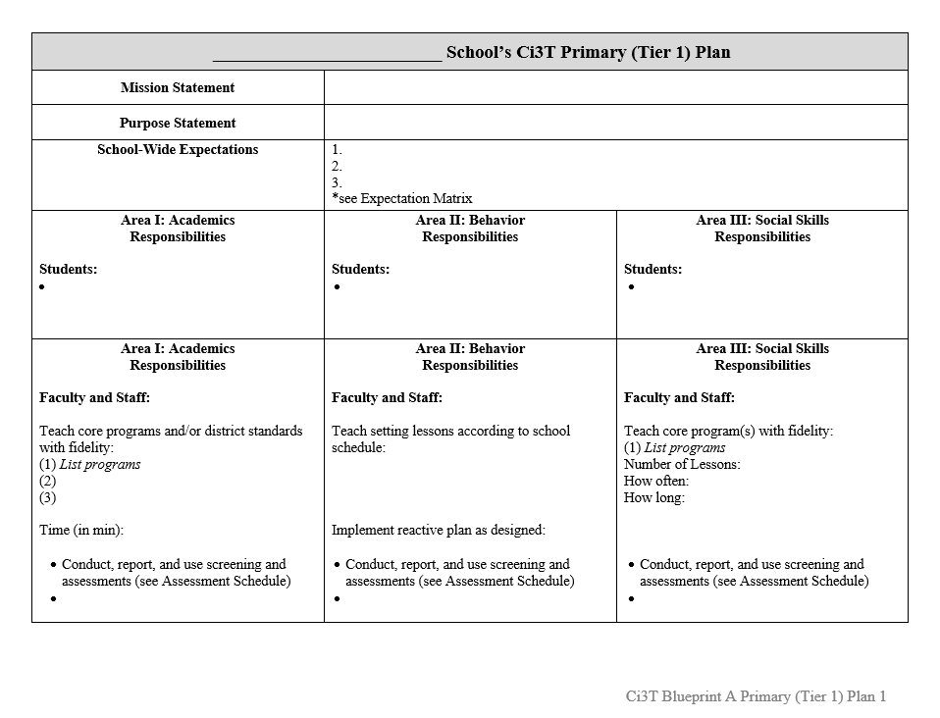
Ci3T Implementation Manual Primary (Tier 1) Plan
What are ALL students accessing?

Slide 26
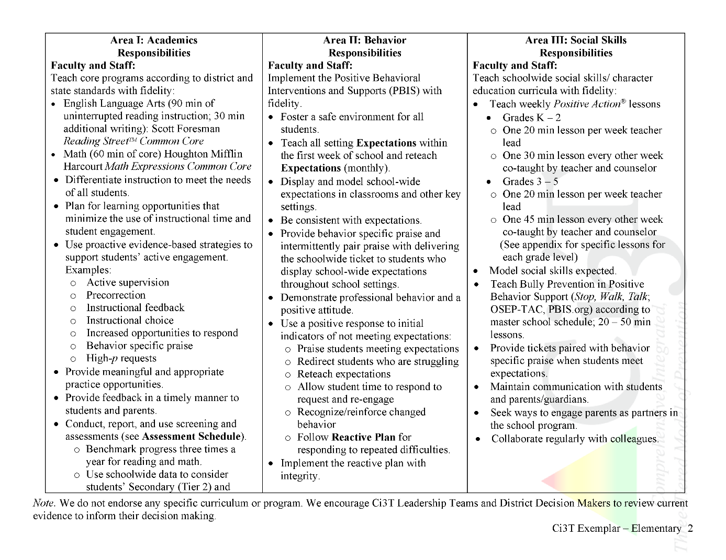
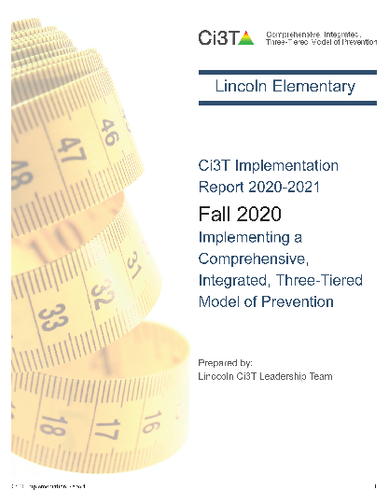

Ci3T Primary Plan: Procedures for Teaching
Ci3T Primary Plan: Procedures for Reinforcing
Ci3T Primary Plan: Procedures for Monitoring

Slide 27

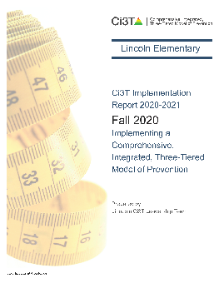
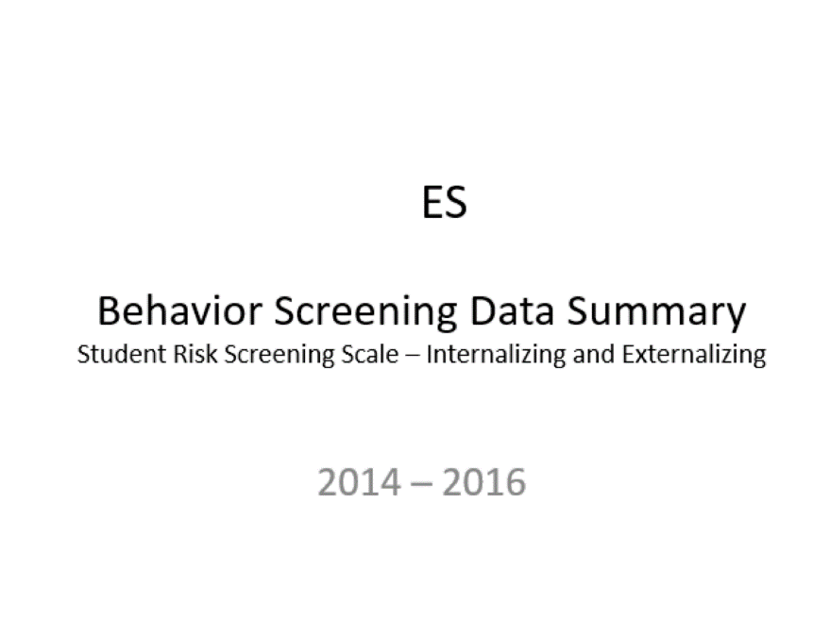
Essential Components of
Primary Prevention Efforts
Social Validity
Systematic Screening
Academic
Behavior
Treatment Integrity

Slide 28


Slide 29


Slide 30
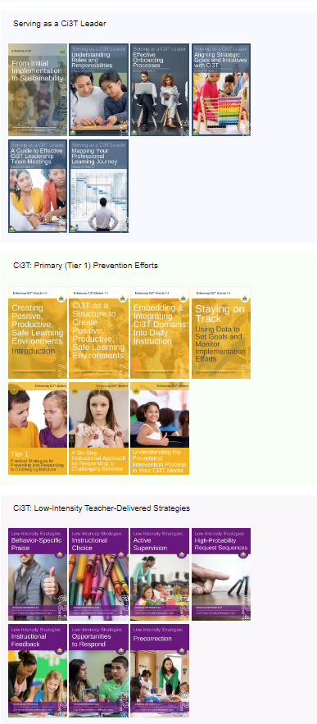
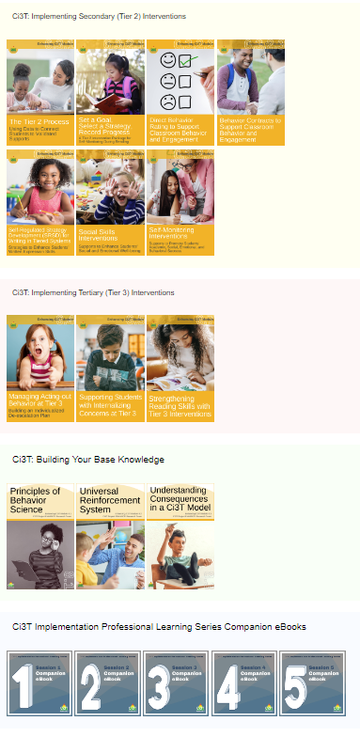
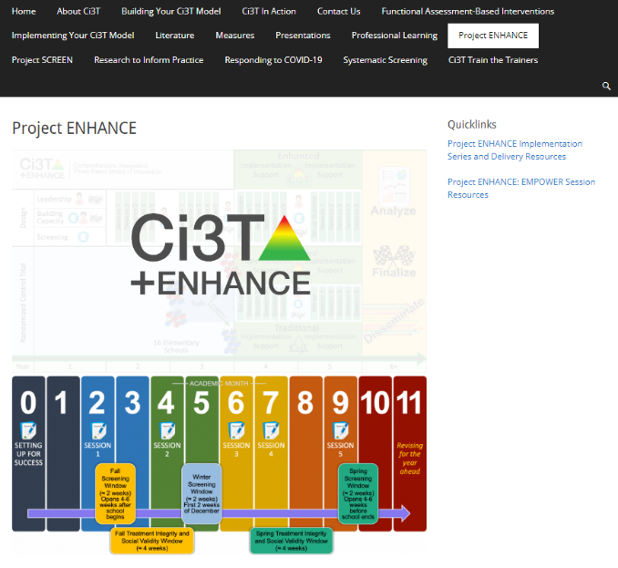
Enhanced Ci3T Professional Learning Modules
Navigate to ci3t.org/enhance
Type password: enhanceci3t!

Slide 31


Scheduling for Success
Long-range Planning: The Importance of Planning Ahead
Structuring your Ci3T Team
Conducting Effective Meetings
Communicating with Your Stakeholders

Slide 32

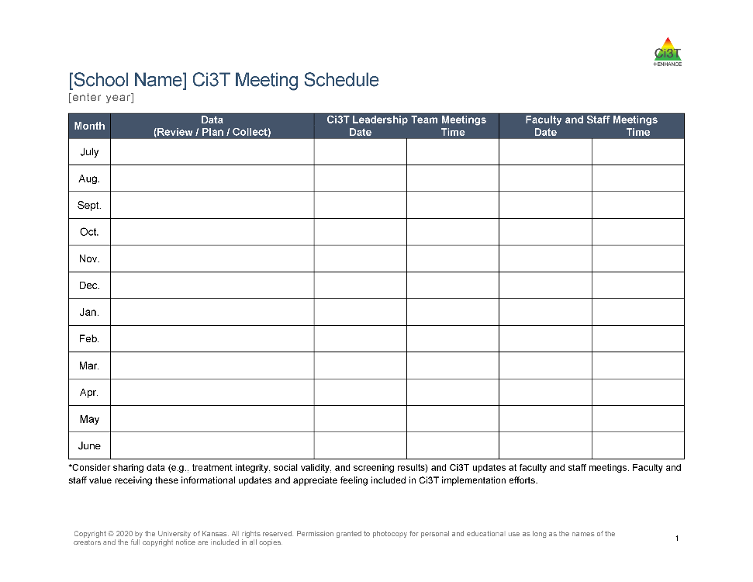

Scheduling Your Ci3T Leadership Team Meetings

Slide 33
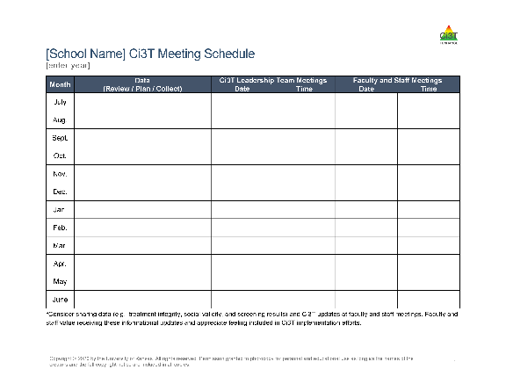
Scheduling Your Ci3T Leadership Team Meetings & Faculty and Meetings
Ci3T Implementation Sessions
Ci3T Leadership Team Meeting
Faculty & Staff Meeting
Notes:
Choosing a regular meeting date (e.g., the second Tuesday of the month) can add predictability to the schedule.
Consider creating the calendar for your faculty and staff meetings at the same time as your Ci3T Leadership Team meetings. For example, you might intentionally schedule staff meetings the week following your Ci3T Leadership Team meetings. This provides an automatic mechanism for sharing Ci3T updates (e.g., sharing data) at your staff meetings.
As you finalize the schedule, send digital calendar invites (e.g., Google Calendar, Outlook, iCal) to all members or post dates on a shared school calendar. Consider setting up the calendar events with week-before and day-before alerts.
If possible, avoid cancelling meetings. Holding meetings consistently communicates the priority of this time and avoids confusion (“Are we meeting this month?”).

Slide 34

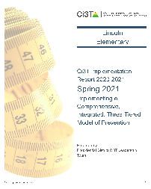
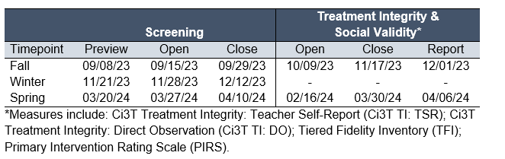
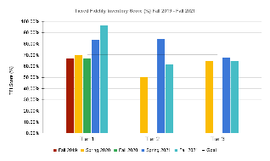
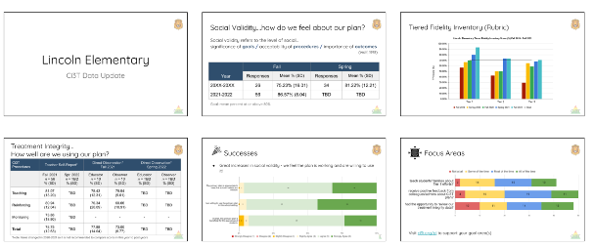


Scheduling Your Ci3T Leadership Team Meetings & Faculty and Meetings
When during this window can we set aside time during a faculty meeting for staff to complete these measures?
When will our Ci3T Leadership team meet to review these data?
When will we share out these data with faculty and staff?
We also need to complete the TFI during this window. When will our Ci3T Leadership Team meet to do this?
Notes:
Reference your Assessment Schedule when scheduling meetings. Note when important data collection activities need to be planned for (e.g., planning for conducting systematic screening, preparing for staff to complete treatment integrity and social validity surveys) or when data collection needs to occur during the meeting (e.g., completion of the Tiered Fidelity Inventory). This will make sure your meetings are timed in a way that will support the use of data.

Slide 35
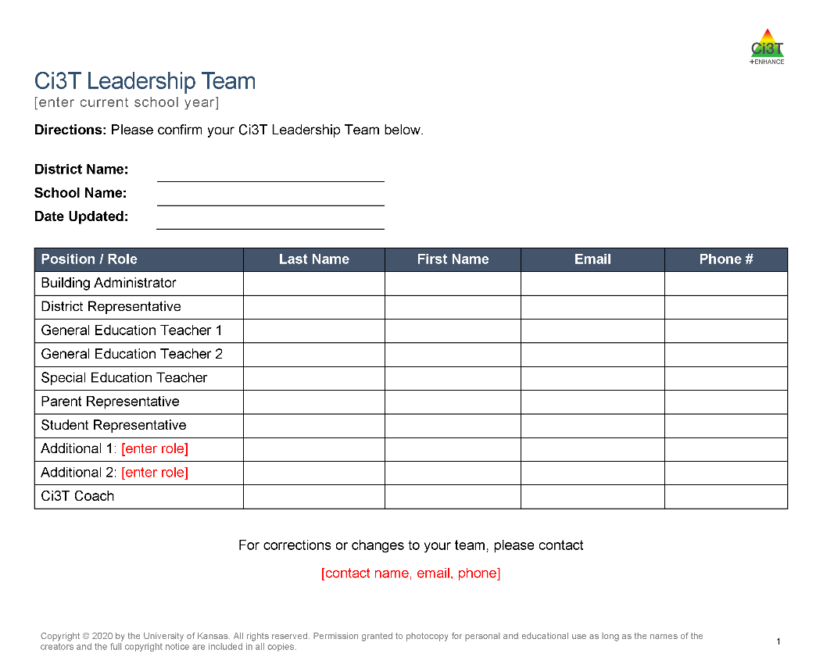
Structuring your Ci3T Team
Notes:
Administrator(s)
General education teachers representative of your school
Elementary: a lower-grades and an upper-grades teacher
Secondary: a teacher from each grade level or department
Special education teacher(s)
Support staff
e.g., counselor, psychologist, social worker
Parent representative(s)
Student representative(s) such as from student council

Slide 36
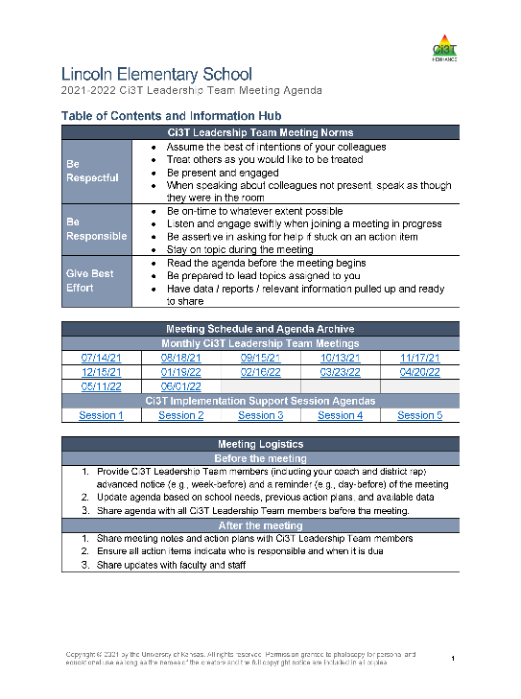
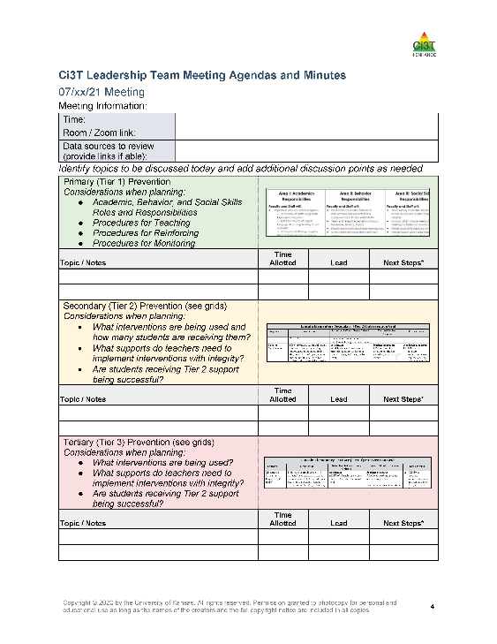
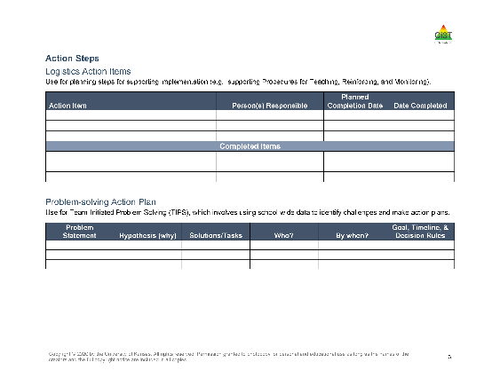
Agenda

Slide 37


1 document for the whole year
Internal document links for easy navigation

Slide 38
Agenda

Slide 39
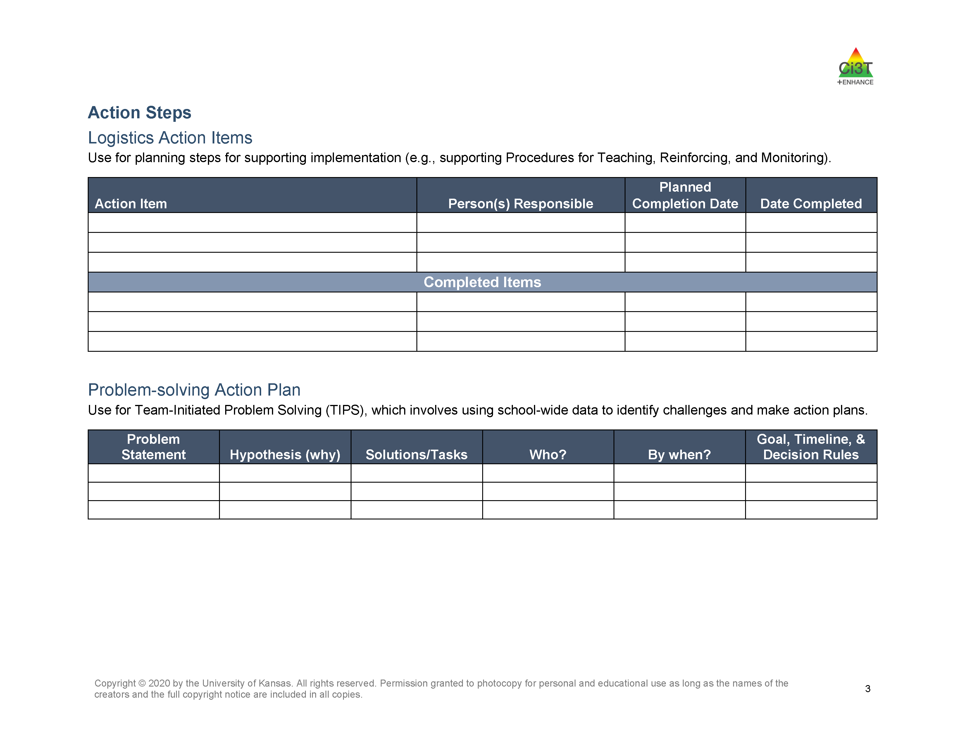

Slide 40
Agenda

Slide 41
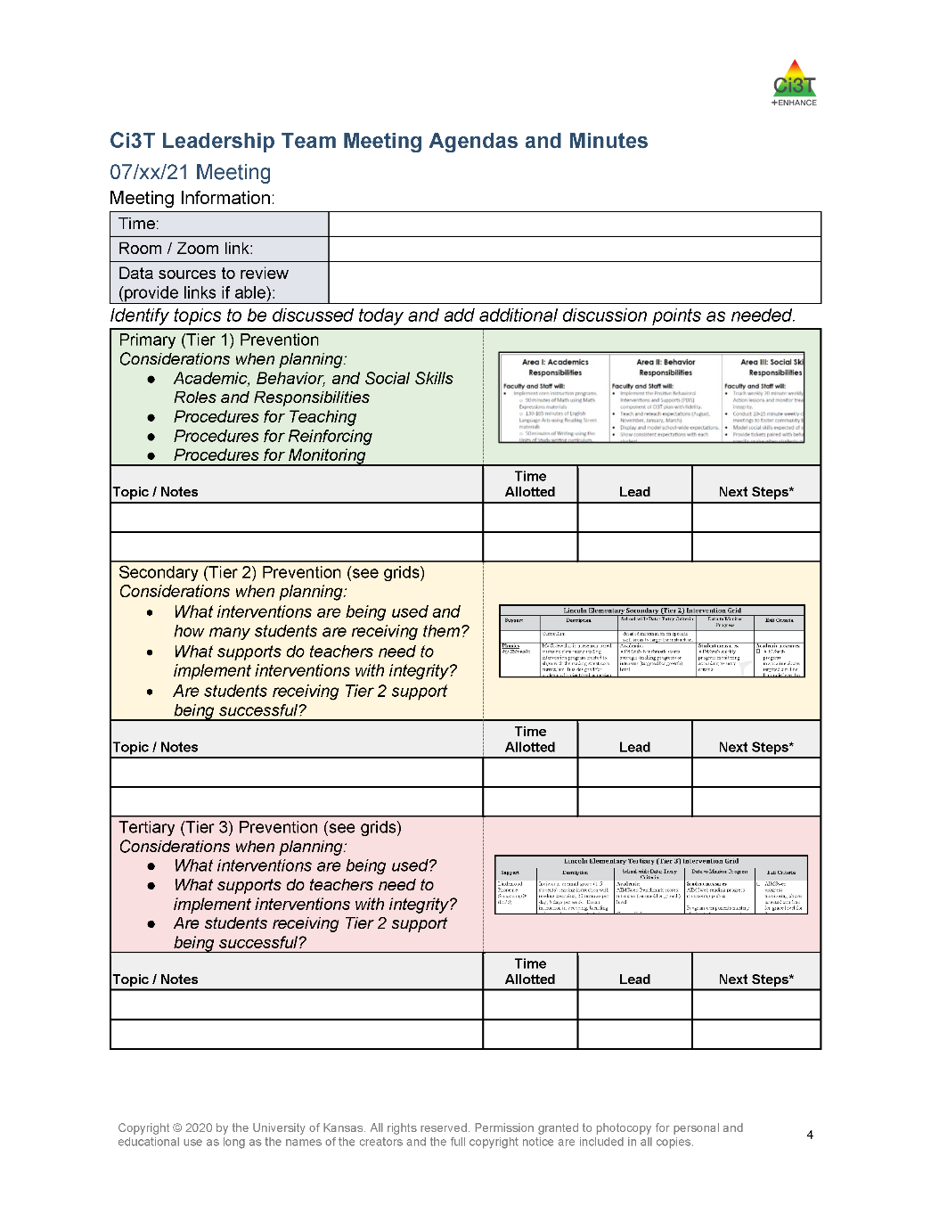

Slide 42
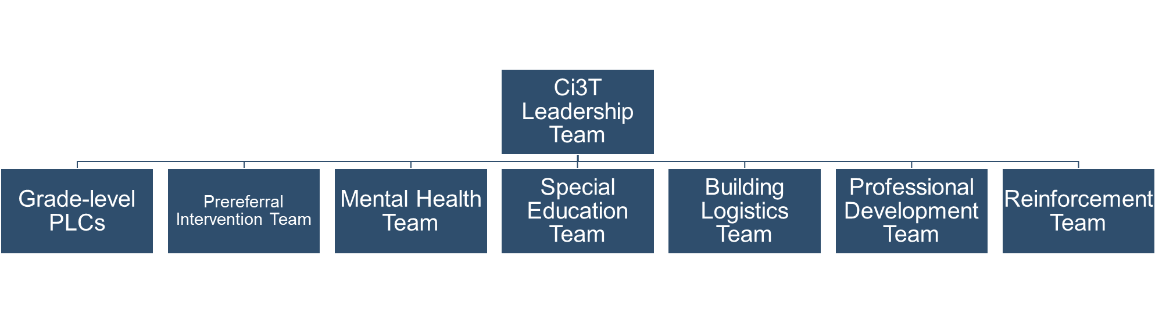
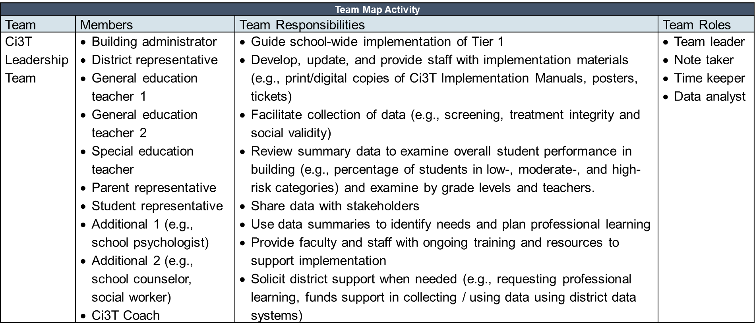

Slide 43
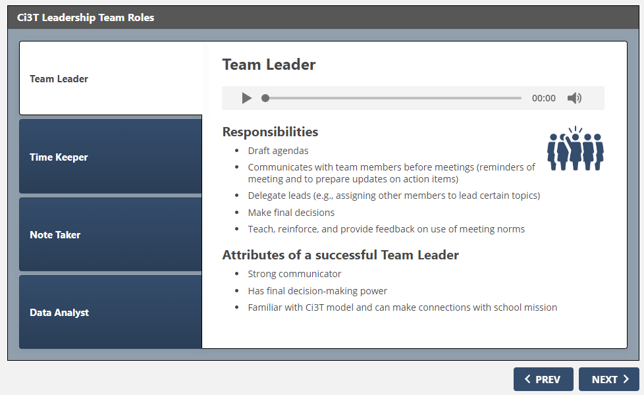

Slide 44
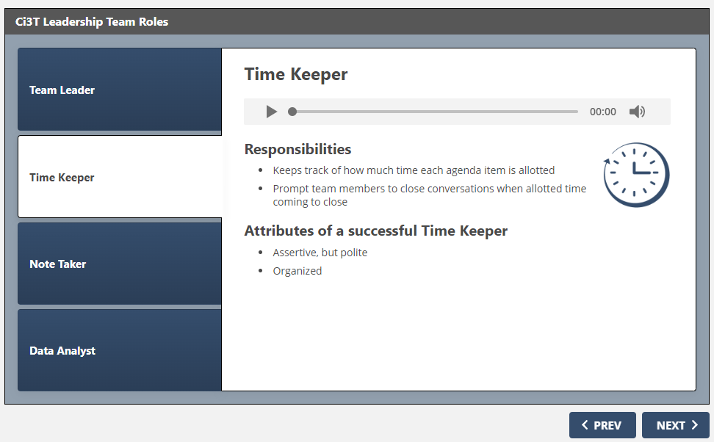

Slide 45
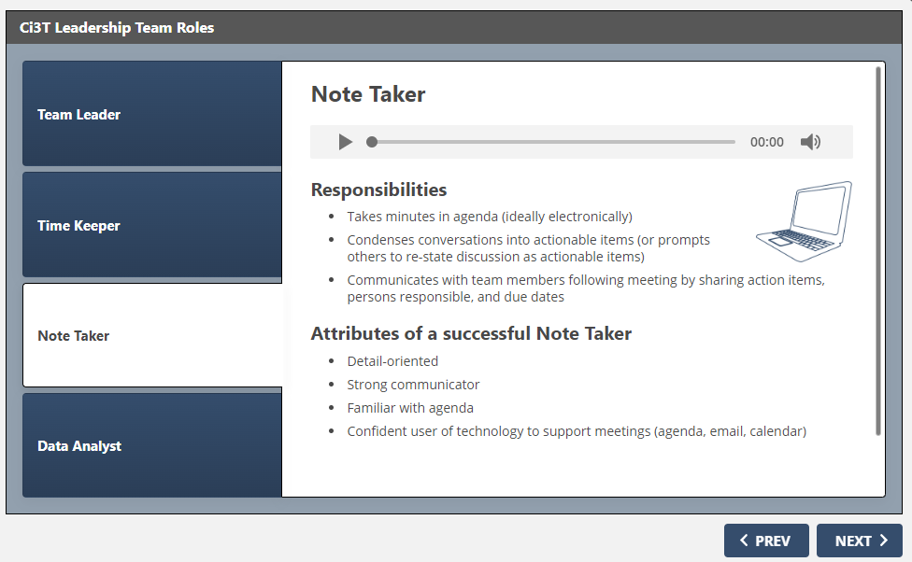

Slide 46
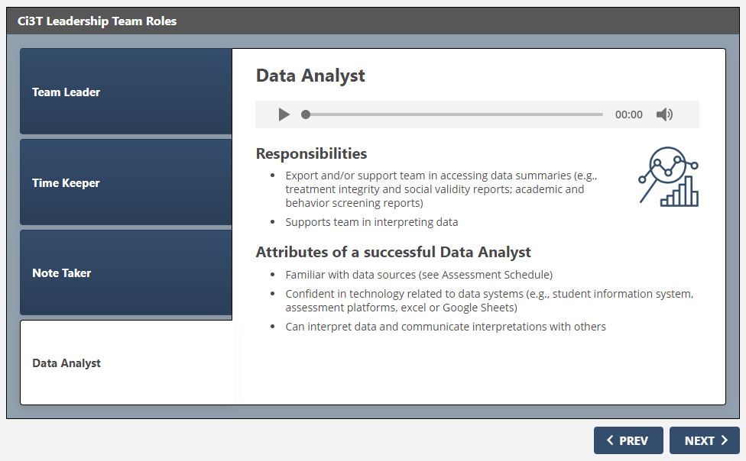

Slide 47

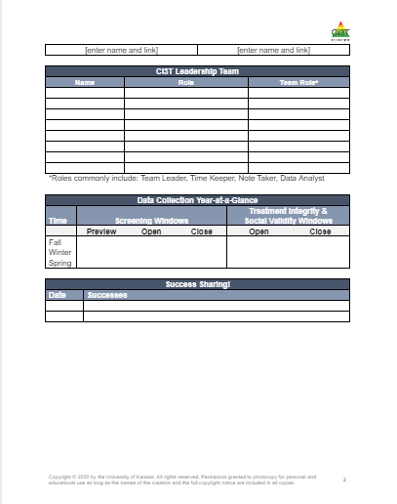
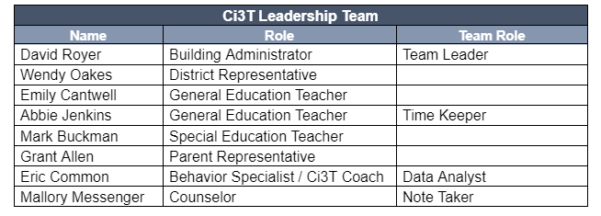
Assigning Team Roles in Your Agenda

Slide 48

Communicating with Your Stakeholders
How will you share data and Ci3T Leadership Team updates with stakeholders?
  Faculty and staff
    Include plans for sharing updates with cafeteria, custodial, transportation, office, paraeducators, itinerant related service providers, and others
  District leaders
  Students
  Parents & Families
  Community
    Consider dedicating space on school website
    to give parents and community members
    access to updates

Slide 49
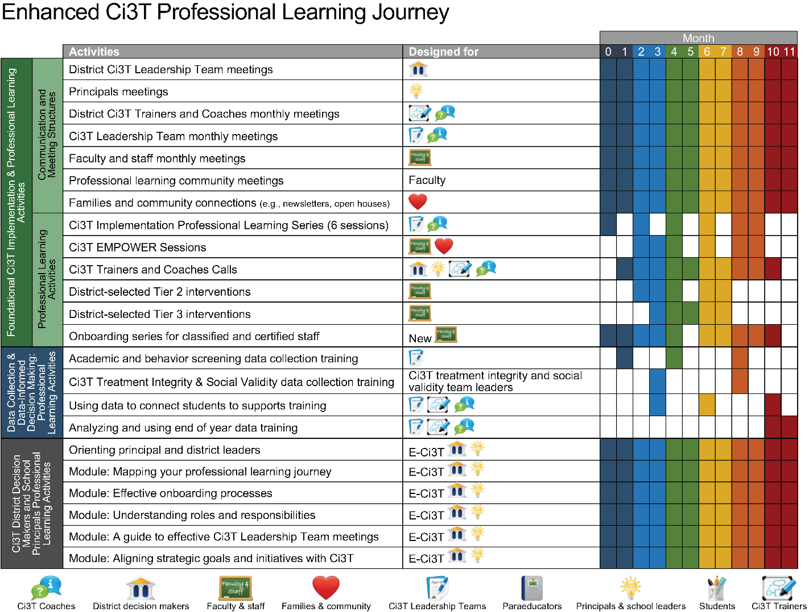

Slide 50


Slide 52
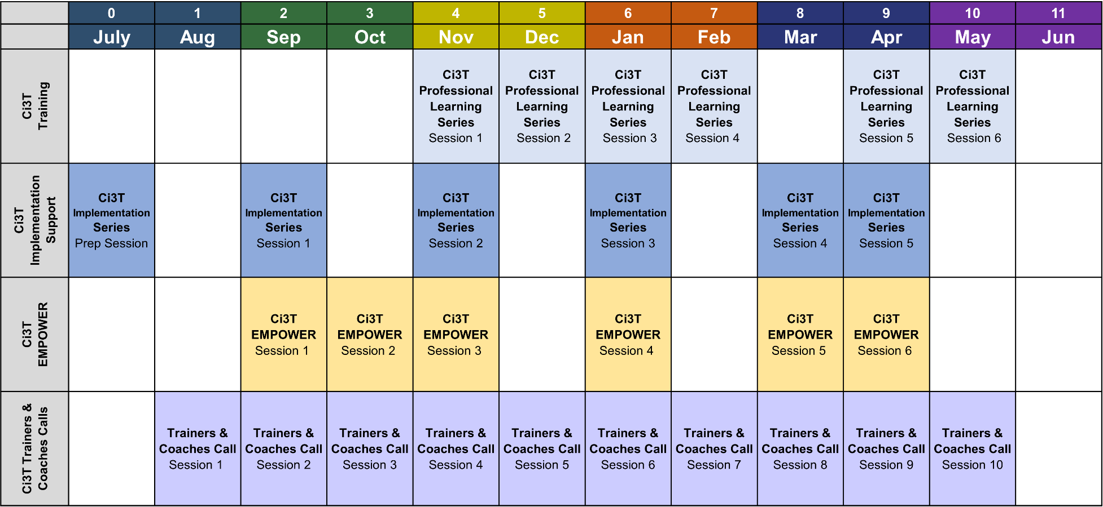
Ci3T Professional Learning Calendar

Slide 53
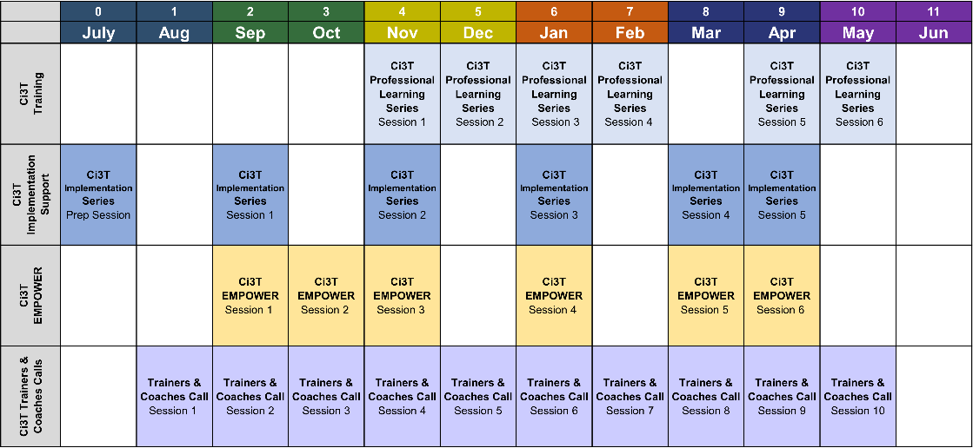
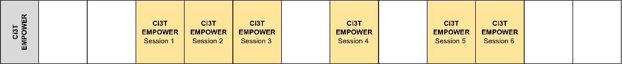
Consider
Creating an instructional calendar to guide implementation of your school’s social and emotional well-being resource
How will faculty and staff access Ci3T professional learning?

Slide 54
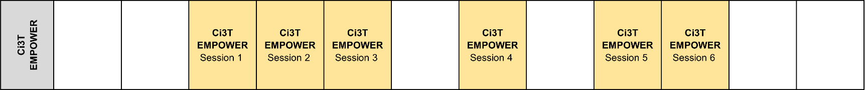
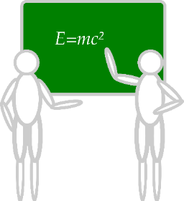
Sustaining and Disseminating Professional Learning
Designate two staff to attend trainings to become on-site coaches
10 min @ next Faculty and Staff meeting
Ci3T Setting Up for Success
Systematic Screening
Low-Intensity Supports
Tier 2
Planning Ahead
Tier 3

Slide 55
Enhanced Ci3T Professional Learning Modules
Content to choose from
Process options
Serving as a Ci3T Leader
Ci3T: Primary (Tier 1) Prevention Efforts
Ci3T: Low-Intensity Teacher-Delivered Strategies
Ci3T: Implementing Secondary (Tier 2) Interventions
Ci3T Implementing Tertiary (Tier 3) Interventions
Ci3T: Building Your Base Knowledge
Asynchronous
Synchronous
Project EMPOWER
Book Studies / PLCs
In-person Presentations
eBooks
Interactive Resources
In-building Experts

Slide 56

















Let’s Talk!
Implementation Calendar Does our central calendar include: Ci3T Leadership Team Meeting Dates Faculty and Staff Meeting Dates Fall, Winter, and Spring screening dates: academic & behavior Treatment integrity & social validity data collection Dates to share data and updates with stakeholders (including families) Master instructional schedule for your school’s social and emotional well-being resource Structures / routines to communicate with stakeholders (e.g., weekly email, newsletter, calendar invites) | Ci3T Leadership Meeting Agenda Set up Ci3T Leadership Team Meeting agenda Ensure agendas are accessible to all Ci3T Leadership Team members (e.g., Google Drive) Specify team roles Consider what data sources our team will review during monthly Ci3T Leadership Meetings Consider how to include our parent member in monthly meetings | Professional Learning How will faculty and staff access Ci3T professional learning? Enhanced Ci3T Professional Learning EMPOWER Sessions Trainers & Coaches Calls Be sure to add professional learning into the implementation calendar How can we connect our families and community members to professional learning on Ci3T
Write any action items in your Ci3T Leadership Team Meeting Agenda
Notes:
15-min timer

Slide 57
Implementing Your Primary (Tier 1) Prevention Efforts
Rolling out Tier 1
Implementing Procedures

Slide 58
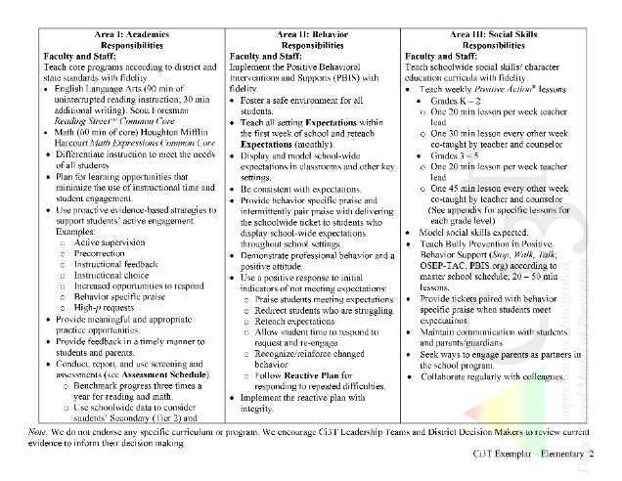
Rolling out at Tier 1: Academic Domain
Teaching
Reinforcing
Monitoring

Slide 59

Ci3T Primary Plan: Faculty and Staff Roles and Responsibilities
Notes:
BCBA Task List K-02 Identify the contingencies governing the behavior of those responsible for carrying out behavior-change procedures and design interventions accordingly – emphasize shift to clearly stating expectations for staff and students

Slide 60

Academics
Area II: Academics Responsibilities Faculty and Staff: Teach core programs according to district and state standards with integrity Use teacher-delivered, low-intensity strategies to support students’ active engagement | Area II: Behavior Responsibilities Faculty and Staff: Implement Positive Behavioral Interventions and Supports (PBIS) with integrity. Teach all setting Expectations within the first week of school and reteach Expectations (monthly). Display and model school-wide expectations in classrooms and other key settings. Implement the reactive plan with integrity. | Area II: Social Responsibilities Faculty and Staff: Teach schoolwide social skills/ character education curricula with integrity: Teach daily Second Step ® lessons (link to grade level instructional schedules) Seek ways to engage parents as partners in the school program

Slide 61

Academics
Area II: Academics Responsibilities Faculty and Staff: Teach core programs according to district and state standards with integrity Use teacher-delivered, low-intensity strategies to support students’ active engagement | Area II: Behavior Responsibilities Faculty and Staff: Implement Positive Behavioral Interventions and Supports (PBIS) with integrity. Teach all setting Expectations within the first week of school and reteach Expectations (monthly). Display and model school-wide expectations in classrooms and other key settings. Implement the reactive plan with integrity. | Area II: Social Responsibilities Faculty and Staff: Teach schoolwide social skills/ character education curricula with integrity: Teach daily Second Step ® lessons (link to grade level instructional schedules) Seek ways to engage parents as partners in the school program

Slide 62
What do I need to know?
Ci3T Exemplar - Elementary

Slide 63
Rolling out at Tier 1: Academics
Reviewing Roles & Responsibilities
  What do I need to know?
Procedures for Teaching
  How am I doing with using low-intensity supports?
Procedures for Reinforcing
  How have I been reinforcing students for meeting expectations?
Procedures for Monitoring
  How am I doing with implementation?
Questions & Considerations?
Successes!

Slide 64
Rolling out at Tier 1: Behavioral Domain
Teaching
Reinforcing
Monitoring

Slide 65
Ci3T Primary Plan: Faculty and Staff Roles and Responsibilities

Slide 66

Behavioral
Area II: Academics Responsibilities Faculty and Staff: Teach core programs according to district and state standards with integrity: Use teacher-delivered, low-intensity strategies to support students’ active engagement | Area II: Behavior Responsibilities Faculty and Staff: Implement Positive Behavioral Interventions and Supports (PBIS) with integrity. Teach all setting Expectations within the first week of school and reteach Expectations (monthly). Display and model school-wide expectations in classrooms and other key settings. Implement the reactive plan with integrity. | Area II: Social Responsibilities Faculty and Staff: Teach schoolwide social skills/ character education curricula with integrity: Teach daily Second Step ® lessons (link to grade level instructional schedules) Seek ways to engage parents as partners in the school program

Slide 67



Behavioral
Area II: Academics Responsibilities Faculty and Staff: Teach core programs according to district and state standards with integrity: Use teacher-delivered, low-intensity strategies to support students’ active engagement | Area II: Behavior Responsibilities Faculty and Staff: Implement Positive Behavioral Interventions and Supports (PBIS) with integrity. Teach all setting Expectations within the first week of school and reteach Expectations (monthly). Display and model school-wide expectations in classrooms and other key settings. Implement the reactive plan with integrity. | Area II: Social Responsibilities Faculty and Staff: Teach schoolwide social skills/ character education curricula with integrity: Teach daily Second Step ® lessons (link to grade level instructional schedules) Seek ways to engage parents as partners in the school program

Slide 68


Slide 70


ENHANCED Resource!
6-Step Instructional Approach for Responding to Challenging Behavior
Step 1
Acknowledge other students meeting expectations
Step 2
Redirect and reteach expected behavior
Step 6
Allow time and space
Step 5
Maintain the flow of instruction
Show empathy
Step 3
Step 4
Recognize and reinforce

Slide 71


ENHANCED Resource!
6-Step Instructional Approach for Responding to Challenging Behavior
eBook
Interactive Resource

Slide 72
What do I need to know?
Ci3T Exemplar - Elementary

Slide 73
Rolling out at Tier 1: Behavior
Reviewing Roles & Responsibilities
  What do I need to know?
Procedures for Teaching
  How am I doing with teaching expectations for specific settings?
Procedures for Reinforcing
  How have I been reinforcing students for meeting expectations?
Procedures for Monitoring
  How am I doing with implementation?
Questions & Considerations?
Successes!

Slide 74
Rolling out at Tier 1: Social Domain
Teaching
Reinforcing
Monitoring

Slide 75
Ci3T Primary Plan: Faculty and Staff Roles and Responsibilities
Notes:
BCBA Task List K-02 Identify the contingencies governing the behavior of those responsible for carrying out behavior-change procedures and design interventions accordingly – Emphasize shift to clearly stating expectations for staff and students

Slide 76



Social-Emotional Well-being
Area II: Academics Responsibilities Faculty and Staff: Teach core programs according to district and state standards with integrity: Use teacher-delivered, low-intensity strategies to support students’ active engagement | Area II: Behavior Responsibilities Faculty and Staff: Implement Positive Behavioral Interventions and Supports (PBIS) with integrity. Teach all setting Expectations within the first week of school and reteach Expectations (monthly). Display and model school-wide expectations in classrooms and other key settings. Implement the reactive plan with integrity. | Area II: Social Responsibilities Faculty and Staff: Teach schoolwide social skills/ character education curricula with integrity: Teach daily Second Step ® lessons (link to grade level instructional schedules) Seek ways to engage parents as partners in the school program

Slide 77




Notes:
Navigate to module: https://kusurvey.ca1.qualtrics.com/jfe/form/SV_0HWM8d2BdorMHDo
Model how to access video (table of contents)
Select a video to play (all 3 videos are less than 2 minutes)

Slide 78
Rolling out at Tier 1: Social Skills
Reviewing Roles & Responsibilities
  What do I need to know?
Procedures for Teaching
  How am I doing with teaching the validated social skills curriculum?
Procedures for Reinforcing
  How have I been reinforcing students for meeting expectations?
Procedures for Monitoring
  How am I doing with implementation?
Questions & Considerations?
Successes!

Slide 79


Treatment Integrity:
Tracking Lessons Taught
Example social skills lesson implementation tracker

Slide 80

















Let’s Talk!
Academic (Tier 1) How are we doing with teaching core academic curricula? How are we doing with using low-intensity supports? How are we doing with procedures for monitoring? Do faculty & staff need further professional learning? What have we communicated to families (e.g., curricula, home / school connections)? | Behavior (Tier 1) How are we doing with teaching expectations for specific settings? How have we been reinforcing students for meeting expectations? How are we doing with using low-intensity supports? To what extent are we implementing the reactive plan with integrity? How are we doing with procedures for monitoring? Do faculty & staff need further professional learning? What have we communicated to families (e.g., screening, expectations)? | Social Skills (Tier 1) How are we doing with teaching the validated social skills curriculum? How are we doing with procedures for monitoring? Do faculty & staff need further professional learning? What have we communicated to families (e.g., curriculum, home / school connections)?
Write any action items in your Ci3T Leadership Team Meeting Agenda
Notes:
15-min timer

Slide 81
Implementing Your Primary (Tier 1) Prevention Efforts
Rolling out Tier 1
Implementing Procedures

Slide 82
Procedures for Teaching
Faculty and Staff
Students
Families and Community
Notes:
More than preventing problem behavior from occurring.
Lewis, T. J., Powers, L. J., Kely, M. J., & Newcomer, L. L. (2002). Reducing problem behaviors on the playground: An investigation of the application of schoolwide positive behavior supports. Psychology in the Schools, 39(2), 181-190;
Turnbull, A., Edmonson, H., Griggs, P., Wickham, D., Sailor, W., Freeman, R., ... & Riffel, L. (2002). A blueprint for schoolwide positive behavior support: Implementation of three components. Exceptional Children, 68(3), 377-402.

Slide 83



Locate in your Ci3T Implementation Manual

Slide 84




How will primary prevention (Tier 1) efforts be taught to all stakeholders?
Faculty and Staff
  Implementation manual
  Expectation matrix
  Bookmarks
  Collaborative teams
  Posters
  Ticket tip sheet
  Professional learning
Students
  Lessons
  Posters
  Videos
Parents and Community
  Letters to parents
  Contacts with community businesses
Shared with permission.
Notes:
Lessons: setting expectations, social skills
Posters: setting expectations, full expectation matrix

Slide 86



Slide 87

Tell
Show
Do
Practice & Follow Through

Slide 88
Tell
Show
Do
Define behaviors and discuss key terms
Practice & Follow Through
Discuss why behaviors are important

Slide 89
Tell
Show
Do
Practice & Follow Through
Explain and model examples
Explain and model non-examples
Discuss hypothetical situations

Slide 90
Tell
Show
Do
Practice & Follow Through
Students explain why expectations are important
Students think of ways to help them remember expectations
Students restate expectations

Slide 91
Tell
Show
Do
Practice & Follow Through
Students rehearse demonstrating expectations
Students practice in hypothetical situations
Incidental teaching
Reinforce!

Slide 92




Other ideas…
Videos
Announcements
Virtual assemblies
Link teaching of classroom routines to school-wide expectations

Slide 93



Slide 94







Locate in your Ci3T Implementation Manual
Procedures for Reinforcing
Faculty and Staff:
Students: ROAR zone Parking spaces
Parents/ Community:
Donation Coupon:
1 box of Macaroni and Cheese to Community Food Drive
Notes:
Consider, how will you reinforce:
Faculty and staff for
Participation and support
Modeling schoolwide expectations
Taking an instructional approach to behavior
Implementing the Ci3T plan with fidelity
Making instructional shifts in traditional practices
Students for
Demonstrating the expectations across
academic, behavioral, and social skill domains
Parents and community for
Communication with school staff
Reinforcing expectations
Supporting the social skills lessons at home and in the community

Slide 95



ENHANCED Resource!
Universal Reinforcement System
eBook
Interactive Resource

Slide 96






What is reinforcement?

Slide 97


What is reinforcement?
Reinforcement re·in·force·ment | /rē-ən-ˈfȯrs-mənt/ noun the action of strengthening or encouraging something; the state of being reinforced (Merriam Webster)

Slide 98




What is a Universal Reinforcement System?

Slide 99




The Bribe
Avoid…
Instead try…
“If you follow directions, I’ll give you a ticket.”
“Remember, the expectation is to…”

Slide 100

Procedures for Monitoring

Slide 101

Essential Components of
Primary Prevention Efforts
Social Validity
Systematic Screening
Academic
Behavior
Treatment Integrity
ci3t.org/measures
Notes:
Infographic - https://www.ci3t.org/measures

Slide 102



In future years, consider alternative program goals.
80% of students meeting reading and math targets on assessments
Locate in your Ci3T Implementation Manual

Slide 103





Notes:
Schools will receive fall and spring reports outlining:
faculty and staff opinions about the Ci3T plan at the start of the year and after it has been implemented for the majority of the school year.
…degree to which the practices of your Ci3T plan are being implemented.
Social validity is assessed using the Primary Intervention Rating Scale (PIRS) and refers to the level of:
Social significance of intervention goals
Social acceptability of intervention procedures
Social importance of intervention outcomes
Treatment integrity answers the question, is Ci3T being implemented as planned? The three measures of TI are:
Ci3T Treatment Integrity: Teacher Self-Report (Ci3T TI: TSR)
Ci3T Treatment Integrity: Direct Observation (Ci3T TI: DO)
Tiered Fidelity Inventory (TFI)

Slide 104

















Let’s Talk!
Procedures for Teaching Do faculty and staff have access to the Ci3T implementation plan? How did we teach roles and responsibilities to each stakeholder group (students; faculty & staff; parents, families, and community members)? How will we review and reteach the plan? How do we plan to teach and re-teach expectations to students? | Procedures for Reinforcing How are behavior-specific praise and tickets being used in our school? What types of reinforcers are most meaningful to our students? How do we plan to adjust reinforcement rates? How will we involve our student and parent leaders? How are we reinforcing faculty and staff behaviors? | Procedures for Monitoring How will we know what faculty and staff think about Tier 1 efforts? How will we know if Tier 1 is happening? How will we know how students are responding? What resources are needed to support our faculty and staff in Tier 1 implementation? What can our Ci3T leadership team provide?
Write any action items in your Ci3T Leadership Team Meeting Agenda
Notes:
15-min timer

Slide 105

Preparing to Collect Treatment Integrity Data
Preview: Ci3T Treatment Integrity Team Leader Training

Slide 106
Wrapping Up and Moving Forward

Slide 107
Design (KS)
E-Ci3T Implementation Series and Delivery
Project ENHANCE E-Ci3T Implementation Series and Delivery Location: Remote via Zoom Attended by: Kansas School Ci3T Leadership Teams Ci3T District Trainers and Coaches |  | Times (Central)
 | Date
Ci3T Implementers Symposium (summer session) | June 22, 2023 (Th) | 9:30 a.m. – 3:30 p.m.
Session 1 | Sept. 7, 2023 (Th) | 5:00 – 7:00 p.m.
Session 2 | Oct. 12, 2023 (Th) | 5:00 – 7:00 p.m.
Session 3 | Dec. 7, 2023 (Th) | 5:00 – 7:00 p.m.
Session 4 | Feb. 13, 2024 (Tu) | 5:00 – 7:00 p.m.
Session 5 | Apr. 19, 2024 (Tu) | 5:00 – 7:00 p.m.

Slide 108
Design (VT)
E-Ci3T Implementation Series and Delivery
Project ENHANCE E-Ci3T ENHANCE Ci3T Implementation Series and Delivery Location: Remote via Zoom Attended by: Vermont School Ci3T Leadership Teams Ci3T District Trainers and Coaches |  | Times Central | Times Eastern
 | Date
Ci3T Implementers Symposium (summer session) | June 22, 2023 (Th) | 9:30 a.m. – 3:30 p.m. | 10:30 a.m. – 4:30 p.m.
Session 1 | Sept. 26, 2023 (Tu) | 2:30 – 4:30 p.m. | 3:30 – 5:30 p.m.
Session 2 | Nov. 2, 2023 (Th) | 2:30 – 4:30 p.m. | 3:30 – 5:30 p.m.
Session 3 | Jan. 25, 2024 (Th) | 2:30 – 4:30 p.m. | 3:30 – 5:30 p.m.
Session 4 | Mar. 19, 2024 (Tu) | 2:30 – 4:30 p.m. | 3:30 – 5:30 p.m.
Session 5 | May 7, 2024 (Tu) | 2:30 – 4:30 p.m. | 3:30 – 5:30 p.m.

Slide 109

RCT
Enhanced Ci3T Implementation Series and Delivery (E-Ci3T)
Project ENHANCE E-Ci3T Implementation Series and Delivery Location: Remote via Zoom Attended by: Washington and South Carolina School Ci3T Leadership Teams Ci3T District Trainers and Coaches |  | Times (Pacific) | Times (Central) | Times (Eastern)
 | Date
Ci3T Implementers Symposium (summer session) | Jun. 22, 2023 (Th) | 7:30 – 1:30 | 9:30 – 3:30 | 10:30 – 4:30
Session 1 | Sept. 14, 2023 (Th) | 9:00 – 11:00 | 11:00 – 1:00 | 12:00 – 2:00
Session 2 | Nov. 9, 2023 (Th) | 9:00 – 11:00 | 11:00 – 1:00 | 12:00 – 2:00
Session 3 | Jan. 18, 2024 (Th) | 9:00 – 11:00 | 11:00 – 1:00 | 12:00 – 2:00
Session 4 | Mar. 7, 2024 (Th) | 9:00 – 11:00 | 11:00 – 1:00 | 12:00 – 2:00
Session 5 | Apr. 18, 2024 (Th) | 9:00 – 11:00 | 11:00 – 1:00 | 12:00 – 2:00
Notes:
Add in Tables with dates of sessions.

Slide 110
Ci3T
Comprehensive Professional Learning Plan
Ci3T: Primary Prevention
Session 1:
Overview of Ci3T Prevention Models
Setting a Purpose
Establish team meetings and roles
Session 2:
Mission and Purpose
Establish Roles and Responsibilities
Procedures for Teaching
Procedures for Reinforcing
Reactive Plan
Session 3:
Procedures for Monitoring
Session 4:
Revise Primary Plan using Stakeholder feedback
Prepare presentation
Ci3T: Secondary Prevention
Session 5:
Overview of Teacher focused Strategies
Overview of Student Focused Strategies
Using data to determine which students may need Secondary (Tier 2) supports
Draft the Secondary Intervention Grid based on existing supports
Ci3T: Tertiary Prevention
Session 6:
Final revisions of Ci3T Plan based on stakeholder feedback
Draft Tertiary (Tier 3) Prevention Intervention Grids
Design Implementation Manual and Plan for roll out to faculty, students, and parents
Ci3T Leadership Team Training Sequence
Implementation Stages of Tier 2 and 3 within Ci3T
Additional Professional Development on Specific Topics
Core Content Curriculum
Check In - Check Out
Functional Assessment-based Interventions
Reading, Math, Writing Benchmarking and Progress Monitoring Tools
Interventions, Strategies, & Practices
Additional Tier 3 Supports
Instructional Techniques to Improve Students’ Motivation; Classroom Management Practices;
Low-Intensity Behavior Supports

Slide 111
Ci3T Professional Learning Calendar
 | 0 | 1 | 2 | 3 | 4 | 5 | 6 | 7 | 8 | 9 | 10 | 11
 | July | Aug | Sep | Oct | Nov | Dec | Jan | Feb | Mar | Apr | May | Jun
Ci3T Training |  |  |  |  | Ci3T Professional Learning Series Session 1 | Ci3T Professional Learning Series Session 2 | Ci3T Professional Learning Series Session 3 | Ci3T Professional Learning Series Session 4 |  | Ci3T Professional Learning Series Session 5 | Ci3T Professional Learning Series Session 6
Ci3T Implementation Support | Ci3T Implementation Series Prep Session |  | Ci3T Implementation Series Session 1 |  | Ci3T Implementation Series Session 2 |  | Ci3T Implementation Series Session 3 |  | Ci3T Implementation Series Session 4 | Ci3T Implementation Series Session 5
Ci3T EMPOWER |  |  | Ci3T EMPOWER Session 1 | Ci3T EMPOWER Session 2 | Ci3T EMPOWER Session 3 |  | Ci3T EMPOWER Session 4 |  | Ci3T EMPOWER Session 5 | Ci3T EMPOWER Session 6
Ci3T Trainers & Coaches Calls |  | Trainers & Coaches Call Session 1 | Trainers & Coaches Call Session 2 | Trainers & Coaches Call Session 3 | Trainers & Coaches Call Session 4 | Trainers & Coaches Call Session 5 | Trainers & Coaches Call Session 6 | Trainers & Coaches Call Session 7 | Trainers & Coaches Call Session 8 | Trainers & Coaches Call Session 9 | Trainers & Coaches Call Session 10

Slide 112
Project EMPOWER - Enhanced
Ci3T EMPOWER Sessions Location: Remote via Zoom Attended by: School Ci3T Leadership Teams, Ci3T District Trainers and Coaches, Faculty and Staff, Families (adults only). Community Members |  | Times (Pacific) | Times (Central) | Times (Eastern)
1. Getting Started | Sep. 21, 2023 (Th) | 3:00 – 5:00 p.m. | 5:00 – 7:00 p.m. | 6:00 – 8:00 p.m.
2. Screening | Oct. 18, 2023 (Wed) | 3:00 – 5:00 p.m. | 5:00 – 7:00 p.m. | 6:00 – 8:00 p.m.
3. Low Intensity Supports (2) | Nov. 28, 2023 (Tu) | 3:00 – 5:00 p.m. | 5:00 – 7:00 p.m. | 6:00 – 8:00 p.m.
4. Tier 2 | Jan. 11, 2024 (Th) | 3:00 – 5:00 p.m. | 5:00 – 7:00 p.m. | 6:00 – 8:00 p.m.
5. Tier 3 | Mar. 26, 2024 (Tu) | 3:00 – 5:00 p.m. | 5:00 – 7:00 p.m. | 6:00 – 8:00 p.m.
6. Moving Forward | Apr. 25, 2024 (Th) | 3:00 – 5:00 p.m. | 5:00 – 7:00 p.m. | 6:00 – 8:00 p.m.

Slide 113
Sustaining and Disseminating Professional Learning
Designate two staff to attend trainings to become on-site coaches
10 min @ next Faculty and Staff meeting
Setting Up for Success with Ci3T
Systematic Screening
Low-Intensity Supports
Tier 2
Planning Ahead
Tier 3

Slide 114
Wrap Up and Preview
Today
Next time
Scheduling for Success
Implementing Your Primary
(Tier 1) Prevention Efforts
Preparing to Collect Treatment Integrity Data
  Ci3T Treatment Integrity Team Leader Training
Preparing to Collect and Use Social Validity & Treatment Integrity Data
Using Fall Screening Data to Inform Instruction
Facilitating Clear Communication and Collaborations with Stakeholders

Slide 115


Homework
Consider sending calendar invites for each
action item due date on your agenda
Send the agenda to team members in a week-before reminder email to give time to finish action items
At your next Ci3T Leadership Team meeting:
  Use the agenda provided in A Guide to Effective Ci3T Leadership Team Meetings to conduct an effective meeting with
    clearly defined roles and responsibilities of team members
    action items, persons responsible, and due dates
At your next faculty meeting:
  Share successes
  Review implementation procedures

Slide 116



Comprehensive, Integrated, Three-tiered (Ci3T) Model of Prevention
Thank you!
Notes:
Tag us in your Ci3T highlights- we’d love to see Ci3T in action! Follow us on Twitter or Instagram for updates and links to resources! @Ci3TModel
You will receive a brief session evaluation – we value your feedback and would greatly appreciate you taking a few minutes to share your thoughts on what you liked about the session and how we can improve

