Slide 1
Setting up for Success with Ci3T
EMPOWER+ - Enhanced Session 1
Presenters and Contributors | Contributors
Allison M. Bernard | Elise Sarasin
Mark M. Buckman | Rebecca L. Sherod
Kathleen Lynne Lane | Stacie Williams
Wendy Peia Oakes

Slide 2
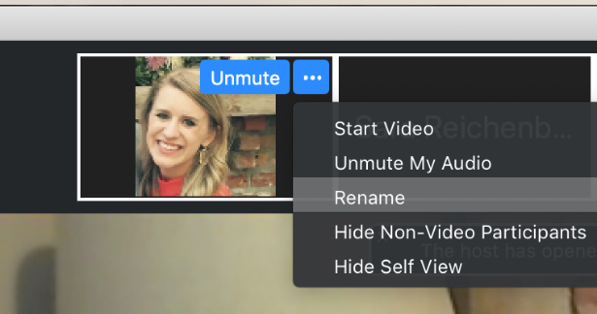
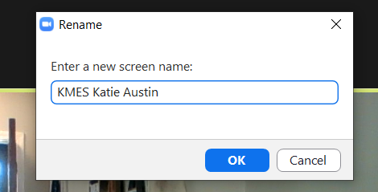
Renaming:
School Initials + First and Last Name
To help us put you in breakout rooms …
1. Click the three dots at the top
right corner of your video square.
2. Rename yourself with your
school initials then first and last name.

Slide 4
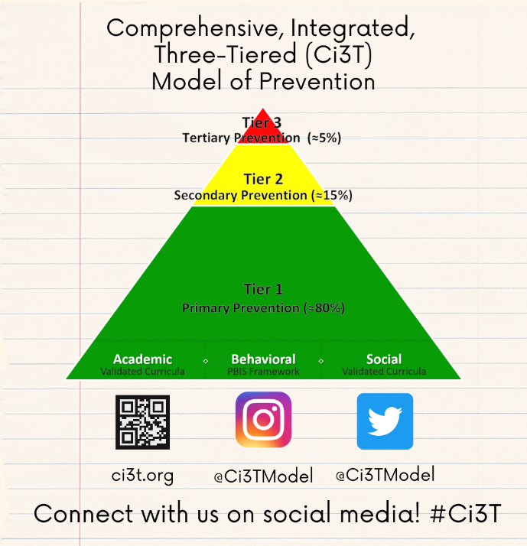
Let’s Connect on Social Media!
Tag us in your Ci3T highlights- we’d love to see Ci3T in action!
Follow us on Twitter or Instagram for updates and links to resources!
  @Ci3TModel

Slide 5
Ci3T Professional Learning Calendar
 | 0 | 1 | 2 | 3 | 4 | 5 | 6 | 7 | 8 | 9 | 10 | 11
 | July | Aug | Sep | Oct | Nov | Dec | Jan | Feb | Mar | Apr | May | Jun
Ci3T Training |  |  |  |  | Ci3T Professional Learning Series Session 1 | Ci3T Professional Learning Series Session 2 | Ci3T Professional Learning Series Session 3 | Ci3T Professional Learning Series Session 4 |  | Ci3T Professional Learning Series Session 5 | Ci3T Professional Learning Series Session 6
Ci3T Implementation Support | Ci3T Implementation Series Prep Session |  | Ci3T Implementation Series Session 1 |  | Ci3T Implementation Series Session 2 |  | Ci3T Implementation Series Session 3 |  | Ci3T Implementation Series Session 4 | Ci3T Implementation Series Session 5
Ci3T EMPOWER |  |  | Ci3T EMPOWER Session 1 | Ci3T EMPOWER Session 2 | Ci3T EMPOWER Session 3 |  | Ci3T EMPOWER Session 4 |  | Ci3T EMPOWER Session 5 | Ci3T EMPOWER Session 6
Ci3T Trainers & Coaches Calls |  | Trainers & Coaches Call Session 1 | Trainers & Coaches Call Session 2 | Trainers & Coaches Call Session 3 | Trainers & Coaches Call Session 4 | Trainers & Coaches Call Session 5 | Trainers & Coaches Call Session 6 | Trainers & Coaches Call Session 7 | Trainers & Coaches Call Session 8 | Trainers & Coaches Call Session 9 | Trainers & Coaches Call Session 10

Slide 6
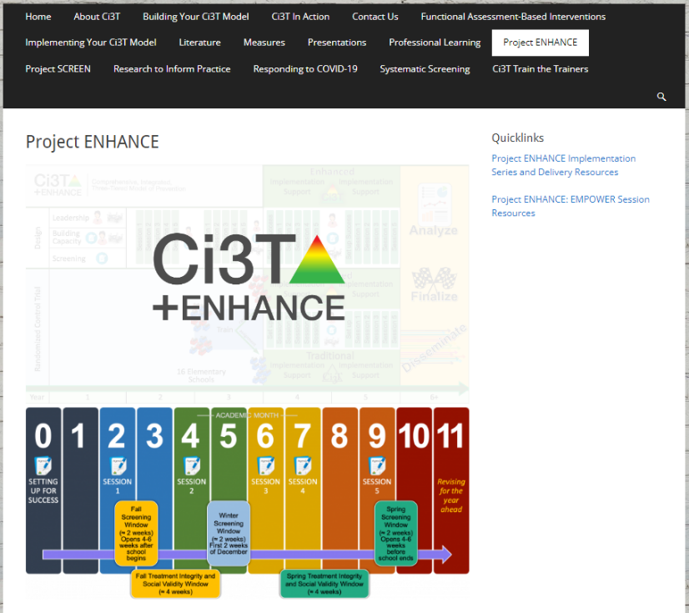
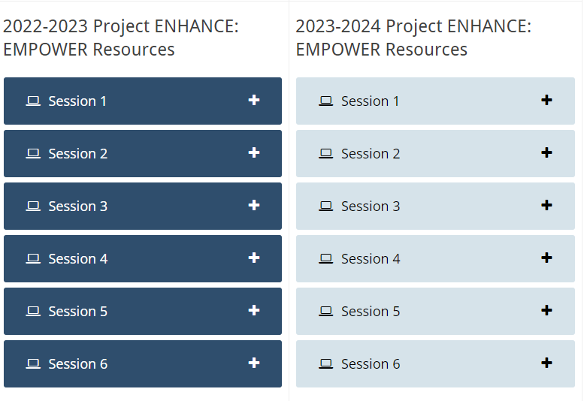
Accessing Professional Learning Materials
Navigate to ci3t.org/enhance
Type password: enhanceci3t!
Access session resources via the Project ENHANCE: EMPOWER Session Resources quicklink or by scrolling to the bottom of the page

Slide 7
Agenda
Welcome
Overview of Ci3T
Rolling out your Ci3T Plan…Sharing Successes!
Implementing Tier 1…
  Academics
  Behavior: Positive Behavior Interventions and Supports (PBIS)
  Social and Emotional Well-being: Your Validated Resource
Procedures for…
  Teaching
  Reinforcing
  Monitoring
Wrapping Up and Moving Forward

Slide 8
Welcome
Please pull up your Ci3T Implementation Manual

Slide 9

Thank you for your commitment
Shift to a systems level perspective
Internalizing
Externalizing
ED <1%
EBD 12-20%
Source: Forness, S.R., Freeman, S.F., Paparella, T., Kauffman, J.M., & Walker, H.M. (2012). Special education implications of point and cumulative prevalence for children with emotional or behavioral disorders. Journal of Emotional and Behavioral Disorders, 20, 4-18.

Slide 10




The Journey of Ci3T: Respectful Partnerships
1997

Slide 12
Overview of Ci3T

Slide 14
Primary (Tier 1) Prevention
All students are eligible for participation
(Lane, Robertson et al., 2006)
About 80% of students respond to this level
(Gresham, Sugai, Horner, Quinn, & McInerney, 1998; Sugai & Horner, 2006)
Examples of primary (Tier 1) prevention
  Validated literacy curricula
  Violence prevention
  Conflict resolution programs
  Anti-bullying programs
  Schoolwide social skills instruction
  Character education programs
Notes:
Sources: Gresham, F. M., Sugai, G., Horner, R. H., Quinn, M. M., & McInerney, M. (1998). Classroom and schoolwide practices that support students’ social competence: A synthesis of research. Washington, DC: Office of Special Education Programs.
Lane, K. L., Robertson, E. J., & Graham-Bailey, M. A. L. (2006). An examination of school-wide interventions with primary level efforts conducted in secondary schools: Methodological considerations. In T. E. Scruggs & M. A. Mastropieri (Eds.) Applications of research methodology: Advances in learning and behavioral disabilities (Vol. 19), pp. 157-199. Oxford, UK: Elsevier.
Sugai, G., & Horner, R.R. (2006). A promising approach for expanding and sustaining school-wide positive behavior support. School psychology review, 35, 245.

Slide 15
Secondary (Tier 2) Prevention
Students who need more than the primary prevention plan, 10-15% of students
Focused intervention to address academic, behavior, and/or social concerns
  Acquisition (can’t do)
  Fluency (trouble doing)
  Performance (won’t do)
Examples of secondary (Tier 2) prevention
  Small group instruction in anger management
  Reading comprehension strategies
Notes:
Source: Lane, K.L., Oakes, W.P., Ennis, R.P., & Hirsch, S.E. (2014). Identifying students for secondary and tertiary prevention efforts: How do we determine which students have tier 2 and tier 3 needs? Preventing School Failure, 58, 171-182.

Slide 16
Tertiary (Tier 3) Prevention
Students who need more than primary or secondary prevention, 5-7% of students
Intensive individualized interventions
Examples of tertiary (Tier 3) prevention
  Functional assessment-based interventions
  (Umbreit, Ferro, Liaupsin, & Lane, 2007)
  Multisystemic therapy program
  (Schoenwald, Brown, & Henggeler, 2000)
Notes:
Sources: Lane, K.L., Oakes, W.P., Ennis, R.P., & Hirsch, S.E. (2014). Identifying students for secondary and tertiary prevention efforts: How do we determine which students have Tier 2 and Tier 3 needs? Preventing School Failure, 58, 171-182.
Schoenwald, S. K., Brown, T. L., & Henggeler, S. W. (2000). Inside multisystemic therapy therapist, supervisory, and program practices. Journal of Emotional and Behavioral Disorders, 8, 113-127.
Umbreit, J., Ferro, J.B., Liaupsin, C.J., & Lane, K.L. (2007). Functional behavioral assessment and function-based intervention: An effective, practical approach. Upper Saddle River, NJ: Prentice-Hall.

Slide 17

Core Features

Slide 18
Core features of the Ci3T model of prevention
Academic
Behavior
Social

Slide 19

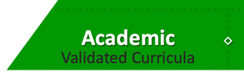
Academic Component
Coordinated instruction within and across grade levels
Instruction linked to College and Career-Ready Standards, early learning standards, state, or district standards
Benchmarking student progress to inform instruction
Progress monitoring for students identified for secondary (Tier 2) and tertiary (Tier 3) supports

Slide 20
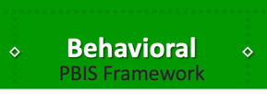
Behavioral Component
A Framework,
Not a Curriculum
Positive Behavioral Interventions and Supports (PBIS)
  Establish, clarify, and define expectations
  Teach all students the expectations, planned and implemented by all adults in the school
  Give opportunities to practice
  Reinforce students consistently, facilitate success
  Consider rules, routines, and physical arrangements
  Monitor the plan using school-wide data to identify students who need more support
  Monitor student progress

Slide 21
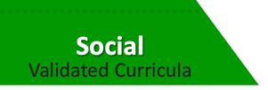
Social Component:
Identifying a Validated Curriculum
Violence Prevention
  Second Step Violence Prevention (www.cfchildren.org)
Character Education
  Positive Action (www.positiveaction.net)
  Caring School Community (www.characterplus.org)
Social Skills
  Social Skills Improvement System: Classwide Intervention Program (Elliott & Gresham, 2007)

Slide 22



Ci3T Implementation Manual

Slide 23
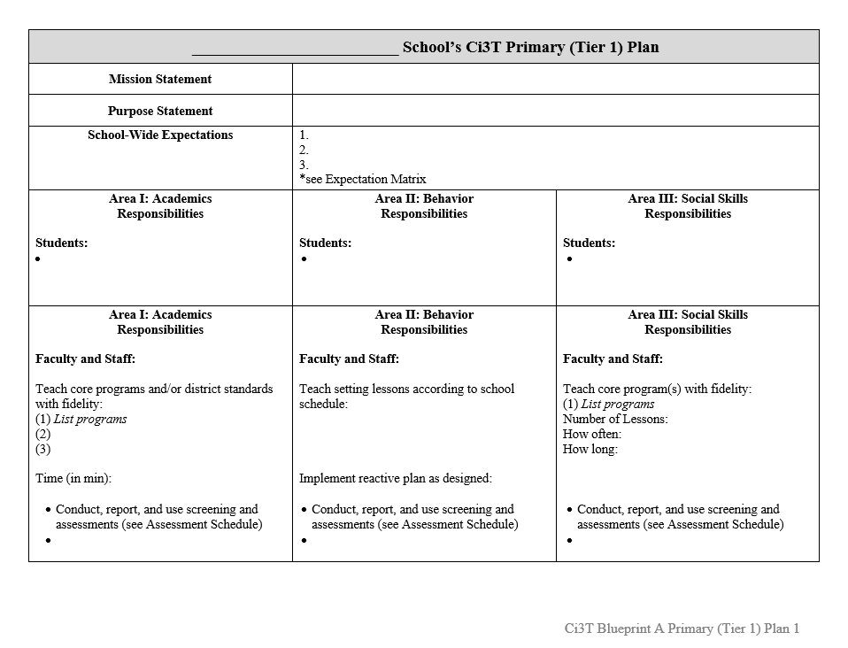
Ci3T Implementation Manual Primary (Tier 1) Plan
What are ALL students accessing?

Slide 24
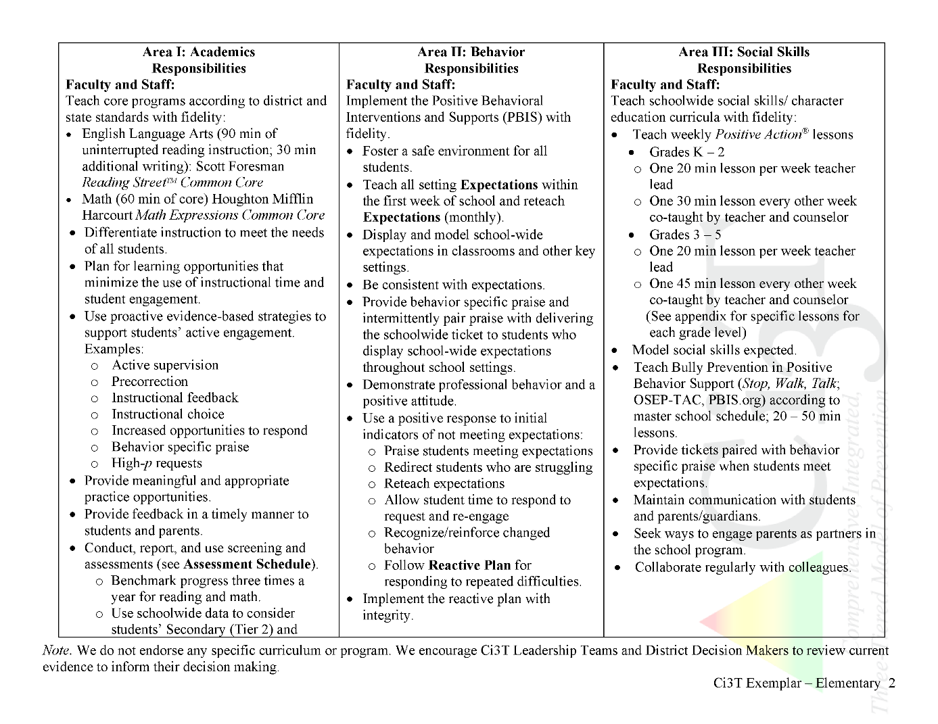
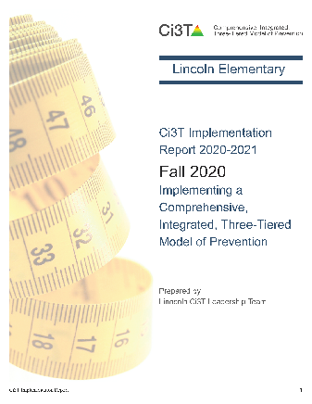


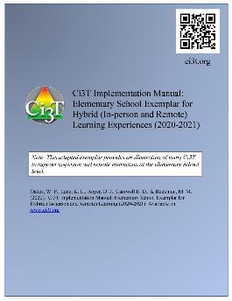
Ci3T Primary Plan: Procedures for Teaching
Ci3T Primary Plan: Procedures for Reinforcing
Ci3T Primary Plan: Procedures for Monitoring
Notes:
Continued to keep implementation manuals, which are foundational to Ci3T, updated and current

Slide 25

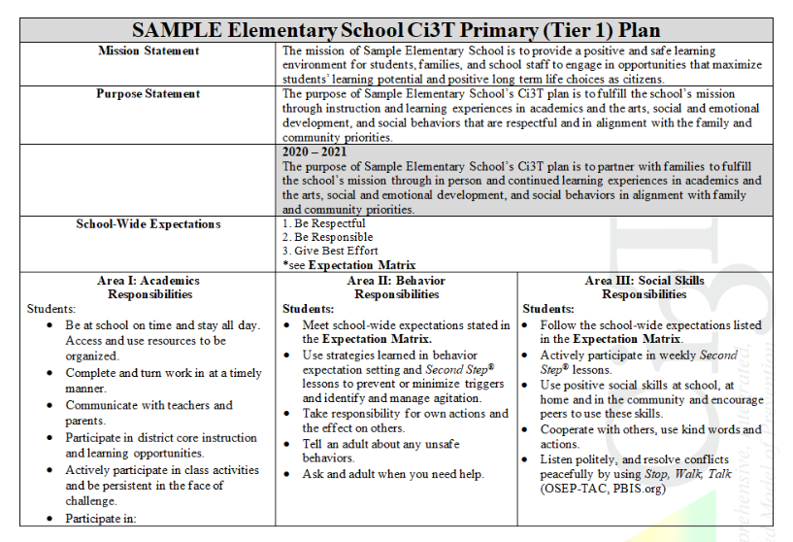
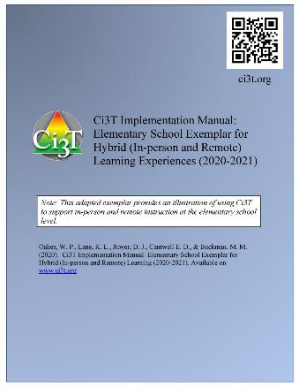
https://www.ci3t.org/covid

Slide 26
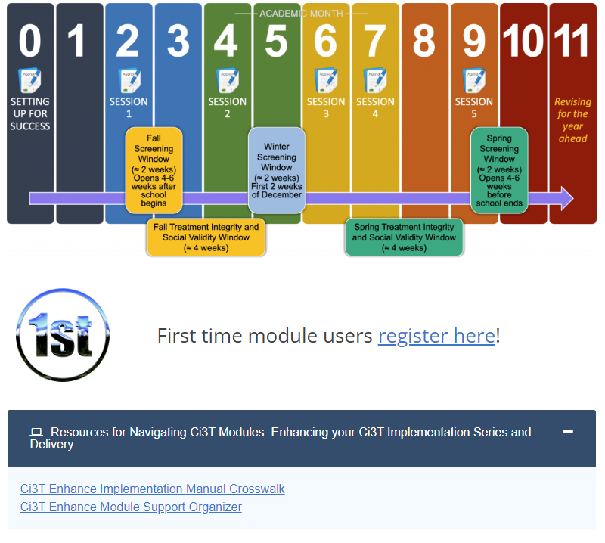
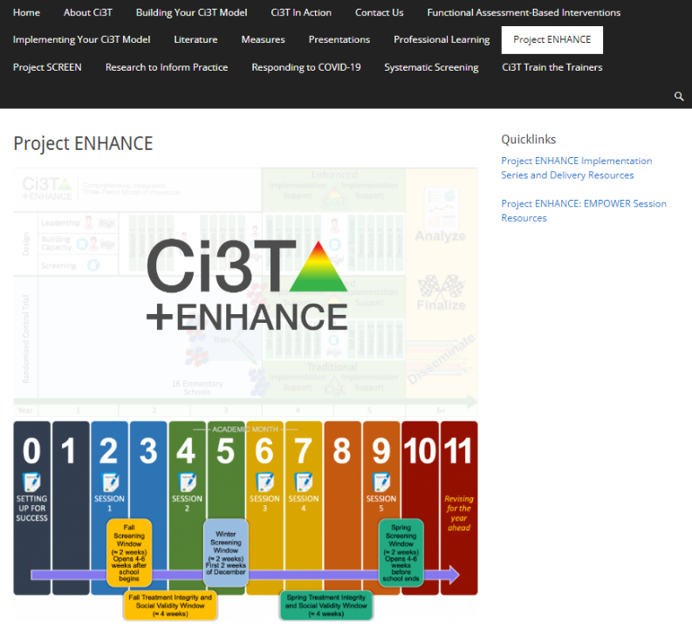
Enhanced Ci3T Professional Learning Modules
Navigate to ci3t.org/enhance
Type password: enhanceci3t!

Slide 27
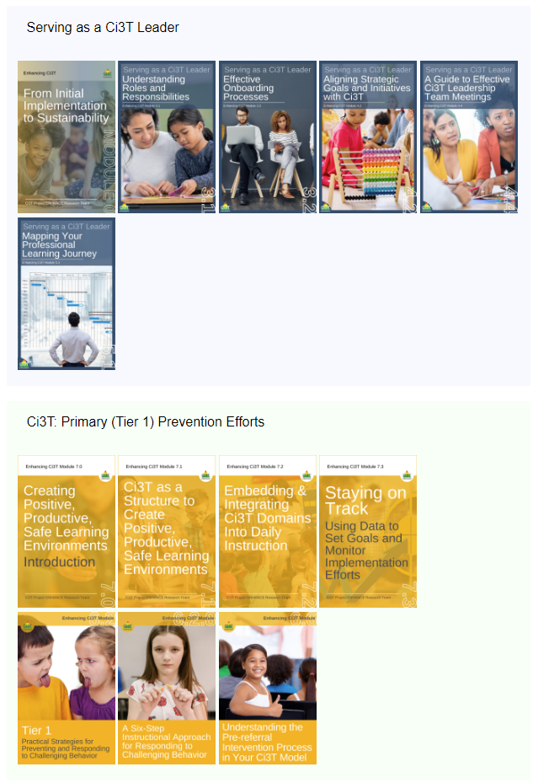
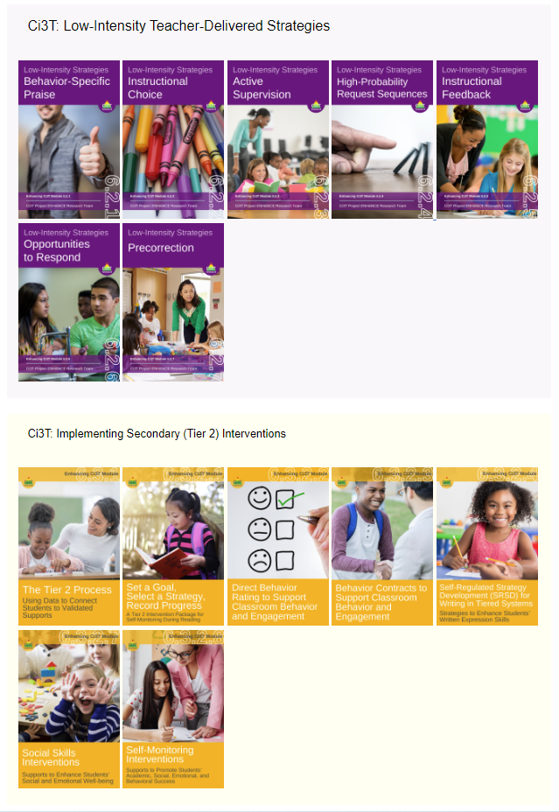
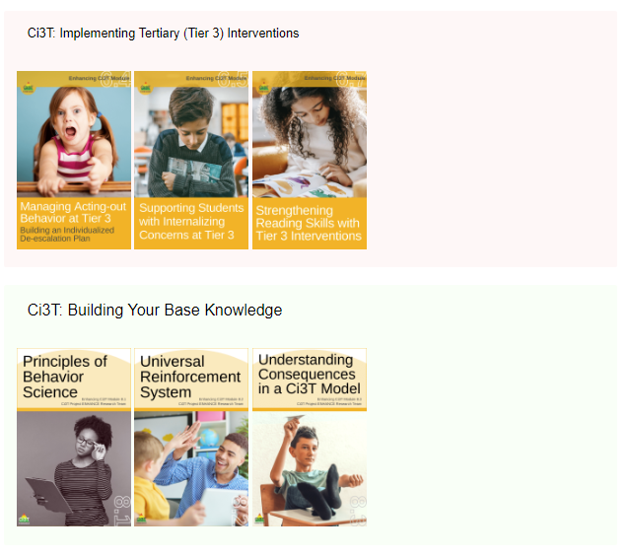
Enhanced Ci3T Professional Learning Modules

Slide 28
Rolling out your Ci3T Plan
…Sharing Successes!

Slide 29
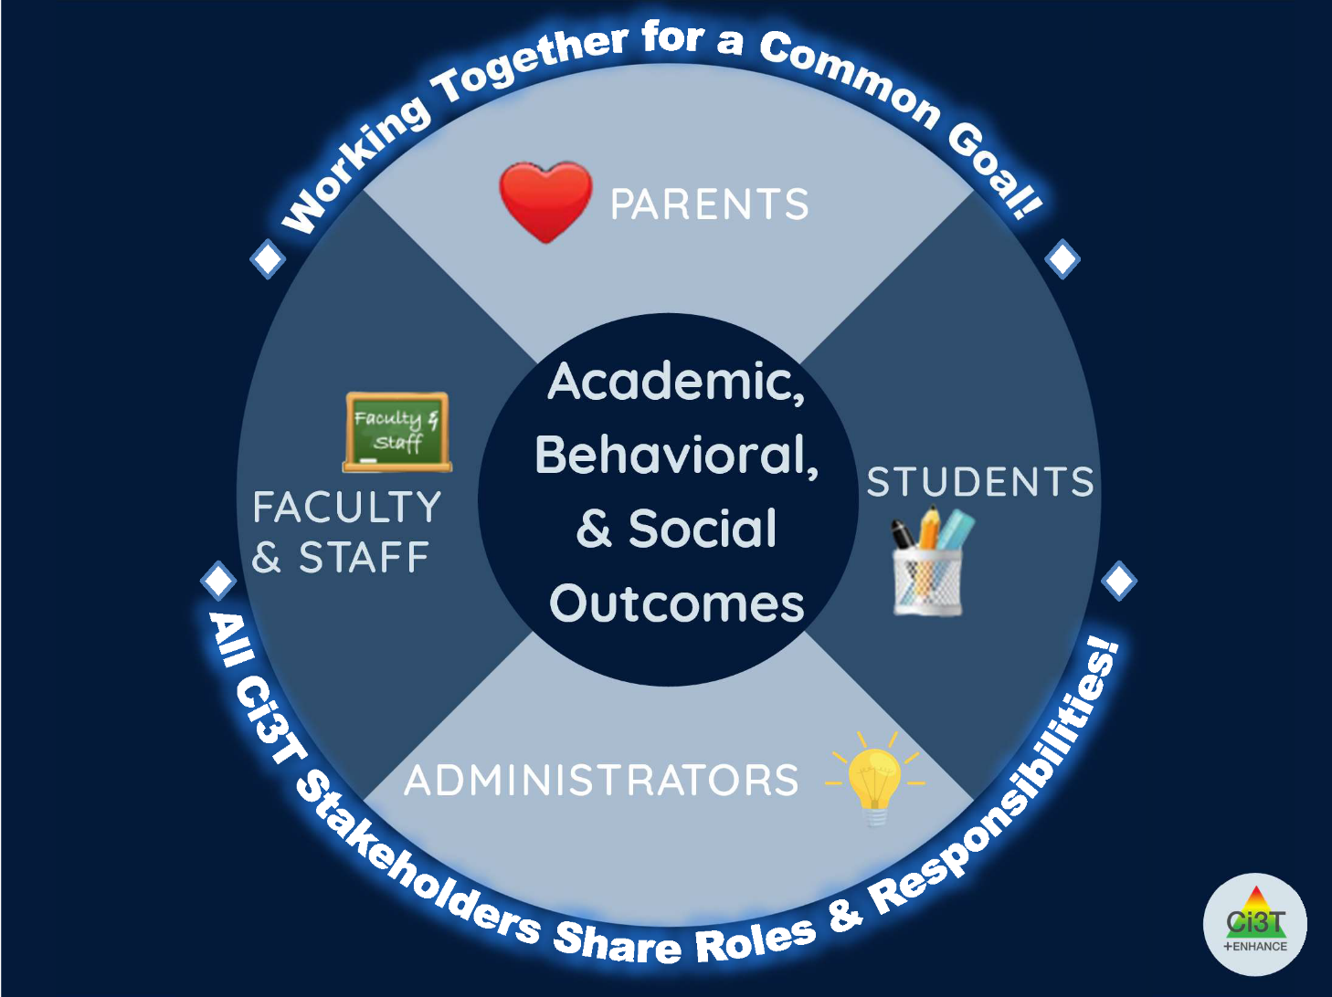

Slide 30
Rolling out the plan to Ci3T Stakeholders
Faculty and Staff
Students
Families and Community
Notes:
More than preventing problem behavior from occurring.
Lewis, T. J., Powers, L. J., Kely, M. J., & Newcomer, L. L. (2002). Reducing problem behaviors on the playground: An investigation of the application of schoolwide positive behavior supports. Psychology in the Schools, 39(2), 181-190;
Turnbull, A., Edmonson, H., Griggs, P., Wickham, D., Sailor, W., Freeman, R., ... & Riffel, L. (2002). A blueprint for schoolwide positive behavior support: Implementation of three components. Exceptional Children, 68(3), 377-402.

Slide 31

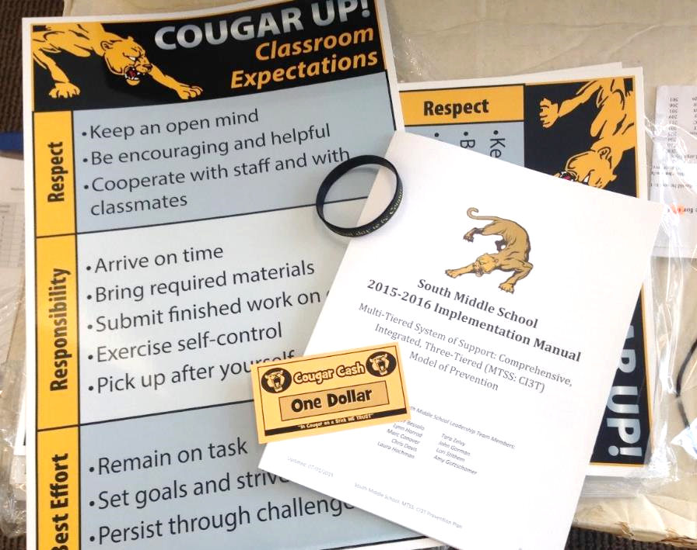
Ci3T Faculty and Staff Orientation

Slide 32


Slide 33
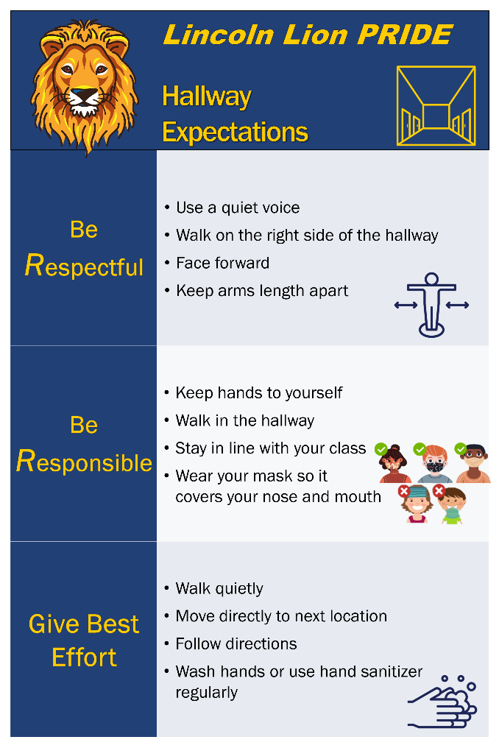
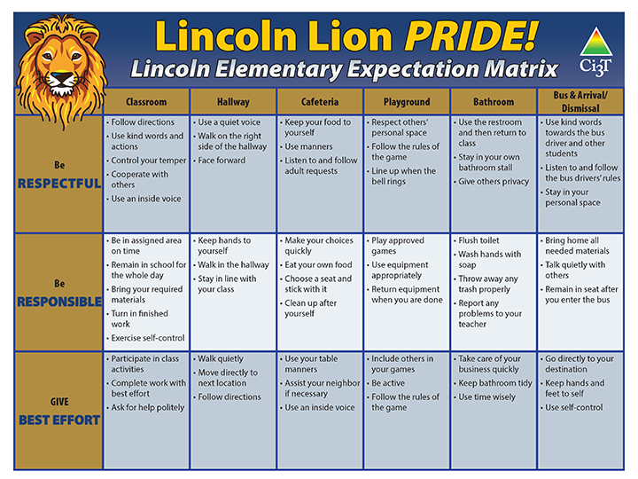
Post up!
Ci3T Signage

Slide 34



Start the Year Off with Excitement!
Kick-off Assemblies

Slide 35
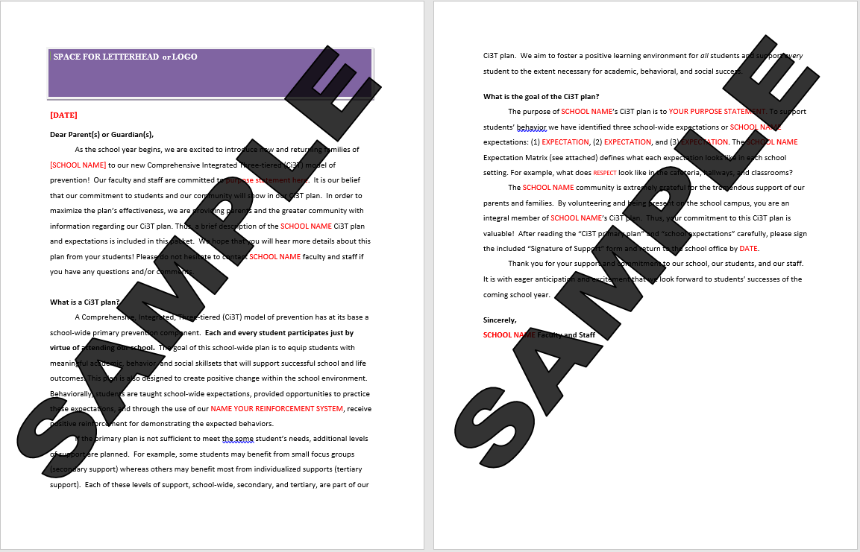
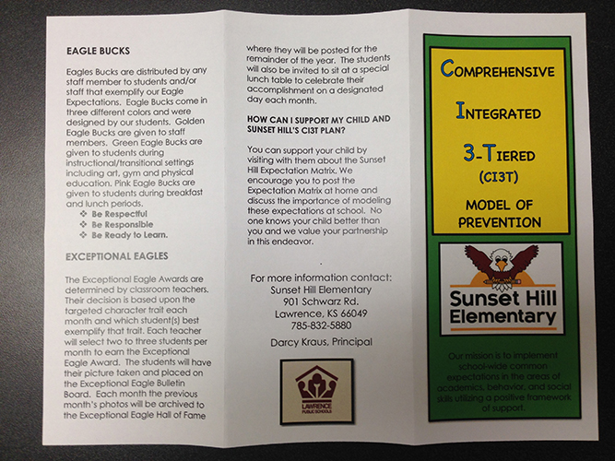
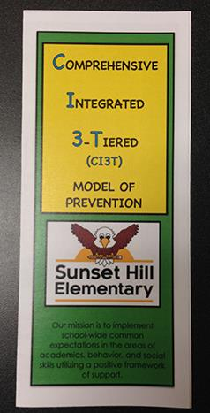
Ci3T Sharing with Parents and Families

Slide 36
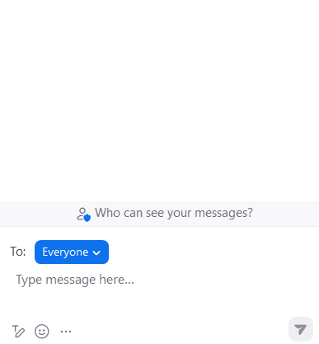
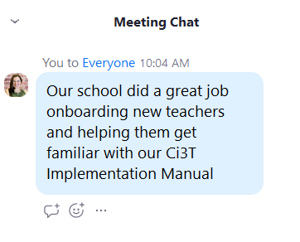


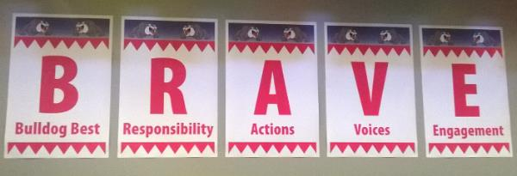
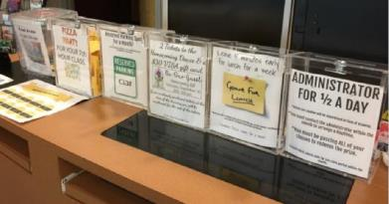
Rolling out Your Plan … Sharing Successes!
Do you know where your Ci3T Implementation Manual is located?
What have you seen done well at your building?
What are you looking forward to in the coming year?

Slide 37
Implementing Tier 1…
Academics
Behavior: Positive Behavior Interventions and Supports (PBIS)
Social and Emotional Well-being: Your Validated Curricula

Slide 38
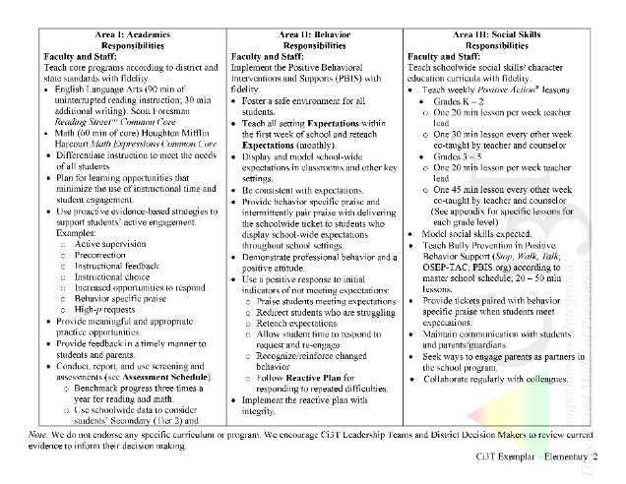
Rolling out at Tier 1: Academic Domain
Teaching
Reinforcing
Monitoring

Slide 39

Academics
Area II: Academics Responsibilities Faculty and Staff: Teach core programs according to district and state standards with integrity Use teacher-delivered, low-intensity strategies to support students’ active engagement | Area II: Behavior Responsibilities Faculty and Staff: Implement Positive Behavioral Interventions and Supports (PBIS) with integrity. Teach all setting Expectations within the first week of school and reteach Expectations (monthly). Display and model school-wide expectations in classrooms and other key settings. Implement the reactive plan with integrity. | Area II: Social Responsibilities Faculty and Staff: Teach schoolwide social skills/ character education curricula with integrity: Teach daily Second Step ® lessons (link to grade level instructional schedules) Seek ways to engage parents as partners in the school program

Slide 40

Academics
Area II: Academics Responsibilities Faculty and Staff: Teach core programs according to district and state standards with integrity Use teacher-delivered, low-intensity strategies to support students’ active engagement | Area II: Behavior Responsibilities Faculty and Staff: Implement Positive Behavioral Interventions and Supports (PBIS) with integrity. Teach all setting Expectations within the first week of school and reteach Expectations (monthly). Display and model school-wide expectations in classrooms and other key settings. Implement the reactive plan with integrity. | Area II: Social Responsibilities Faculty and Staff: Teach schoolwide social skills/ character education curricula with integrity: Teach daily Second Step ® lessons (link to grade level instructional schedules) Seek ways to engage parents as partners in the school program

Slide 41
What do I need to know?
Ci3T Exemplar - Elementary

Slide 42
Rolling out at Tier 1: Academics
Reviewing Roles & Responsibilities
  What do I need to know?
Procedures for Teaching
  How am I doing with using low-intensity supports?
Procedures for Reinforcing
  How have I been reinforcing students for meeting expectations?
Procedures for Monitoring
  How am I doing with implementation?
Questions & Considerations?
Successes!

Slide 43
Rolling out at Tier 1: Behavioral Domain
Teaching
Reinforcing
Monitoring

Slide 44
Behavioral
Area II: Academics Responsibilities Faculty and Staff: Teach core programs according to district and state standards with integrity: Use teacher-delivered, low-intensity strategies to support students’ active engagement | Area II: Behavior Responsibilities Faculty and Staff: Implement Positive Behavioral Interventions and Supports (PBIS) with integrity. Teach all setting Expectations within the first week of school and reteach Expectations (monthly). Display and model school-wide expectations in classrooms and other key settings. Implement the reactive plan with integrity. | Area II: Social Responsibilities Faculty and Staff: Teach schoolwide social skills/ character education curricula with integrity: Teach daily Second Step ® lessons (link to grade level instructional schedules) Seek ways to engage parents as partners in the school program

Slide 45
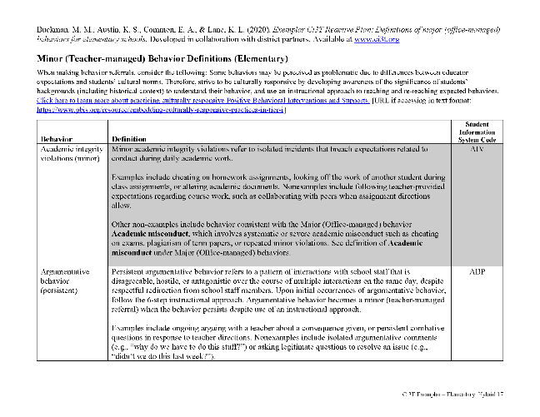
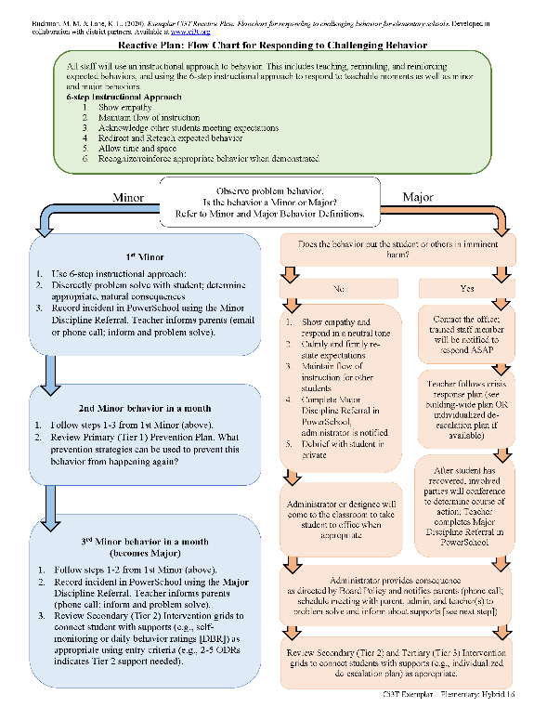
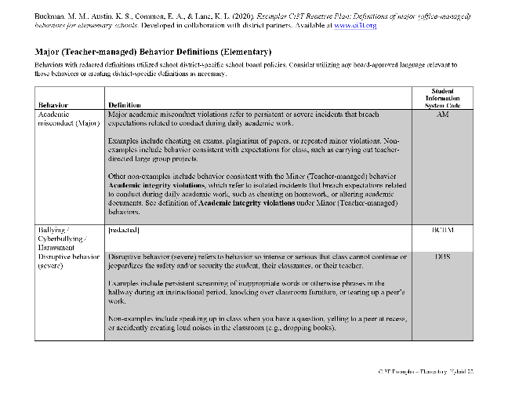
Behavioral
Area II: Academics Responsibilities Faculty and Staff: Teach core programs according to district and state standards with integrity: Use teacher-delivered, low-intensity strategies to support students’ active engagement | Area II: Behavior Responsibilities Faculty and Staff: Implement Positive Behavioral Interventions and Supports (PBIS) with integrity. Teach all setting Expectations within the first week of school and reteach Expectations (monthly). Display and model school-wide expectations in classrooms and other key settings. Implement the reactive plan with integrity. | Area II: Social Responsibilities Faculty and Staff: Teach schoolwide social skills/ character education curricula with integrity: Teach daily Second Step ® lessons (link to grade level instructional schedules) Seek ways to engage parents as partners in the school program

Slide 46
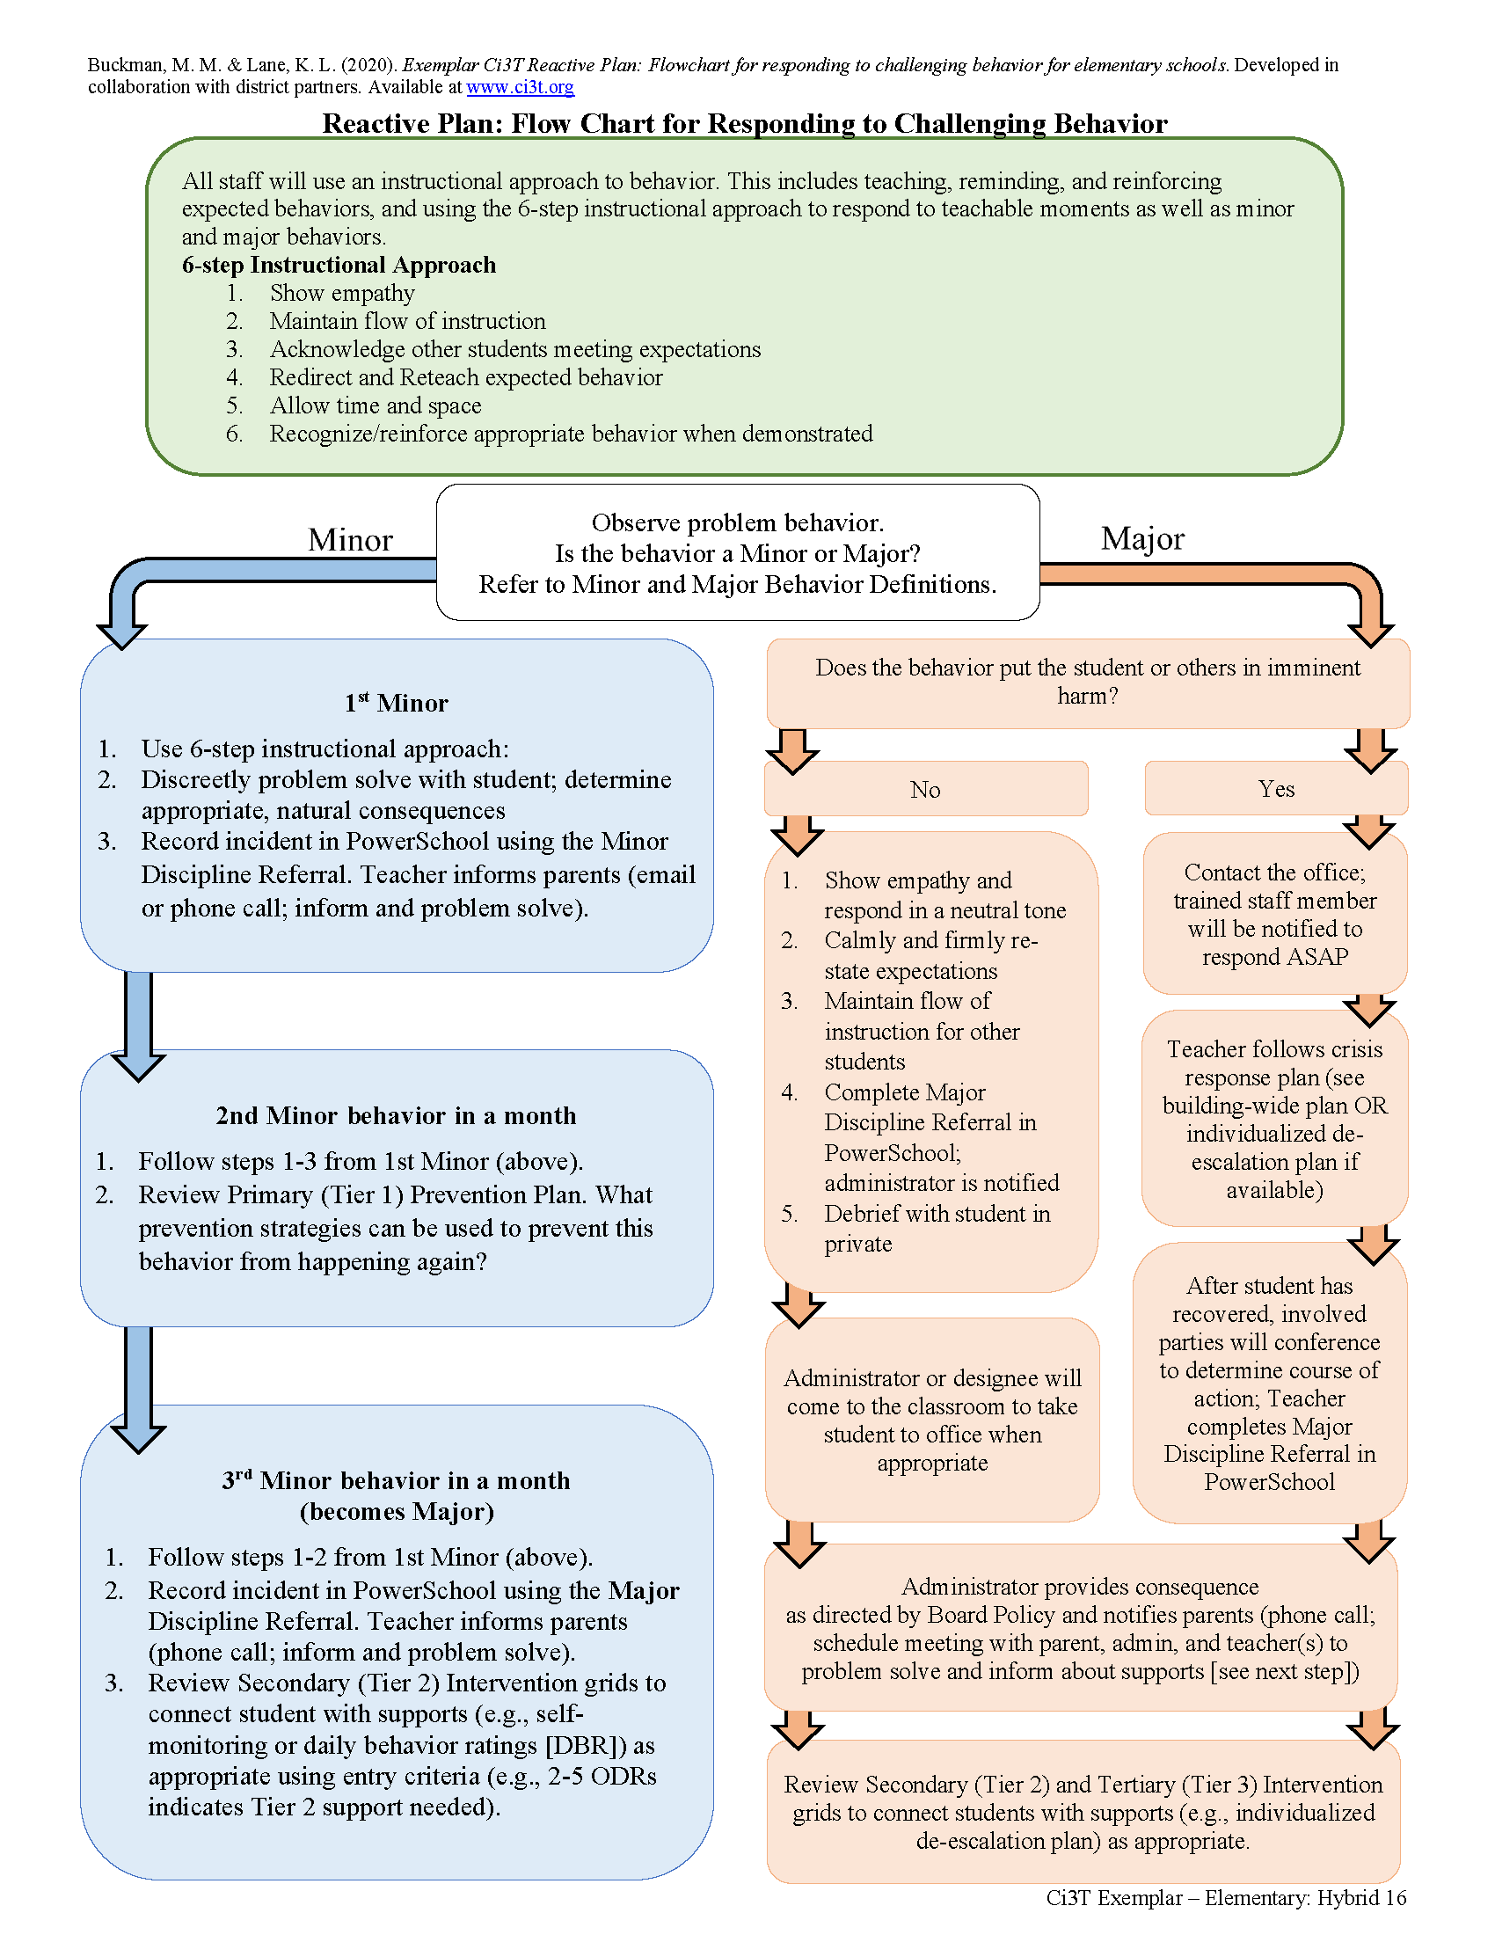

Slide 48

ENHANCED Resource!
6-Step Instructional Approach for Responding to Challenging Behavior
Step 1
Acknowledge other students meeting expectations
Step 2
Redirect and reteach expected behavior
Step 6
Allow time and space
Step 5
Maintain the flow of instruction
Show empathy
Step 3
Step 4
Recognize and reinforce

Slide 49
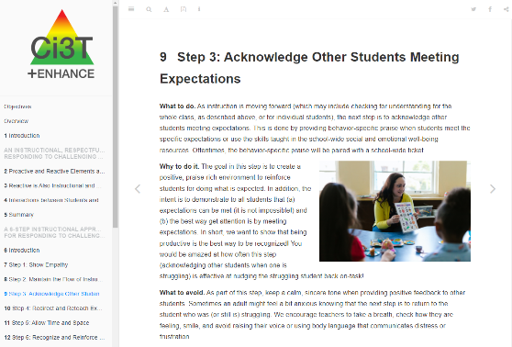
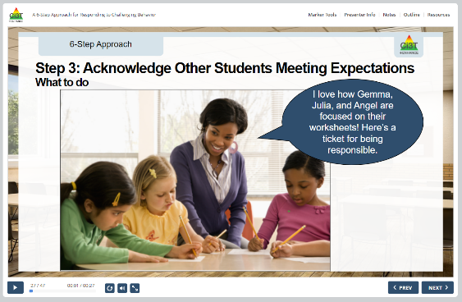
ENHANCED Resource!
6-Step Instructional Approach for Responding to Challenging Behavior
eBook
Interactive Resource

Slide 50

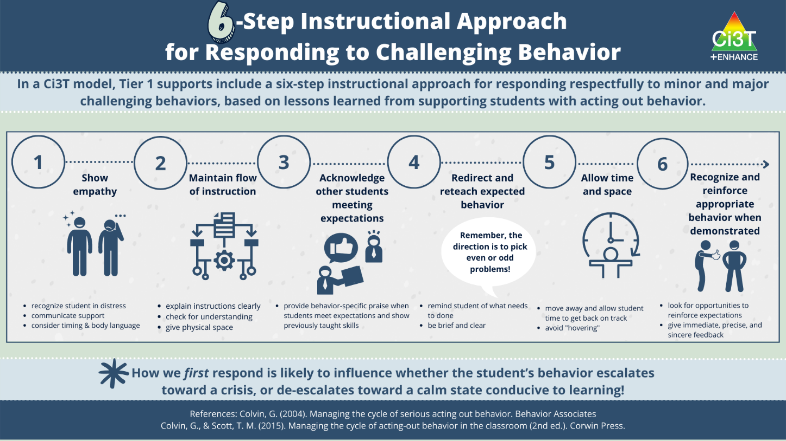
ENHANCED Resource!

Slide 51
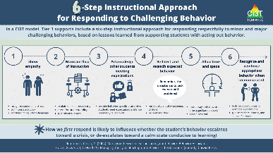
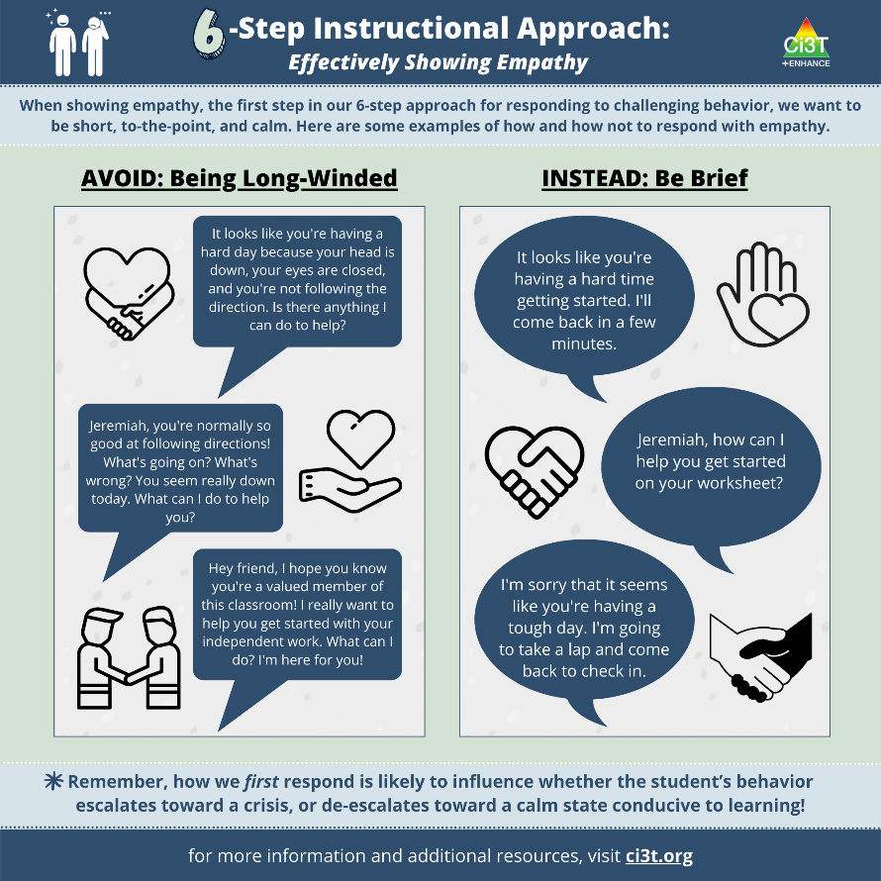
ENHANCED Resource!

Slide 52
What do I need to know?
Ci3T Exemplar - Elementary

Slide 53
Rolling out at Tier 1: Behavior
Reviewing Roles & Responsibilities
  What do I need to know?
Procedures for Teaching
  How am I doing with teaching expectations for specific settings?
Procedures for Reinforcing
  How have I been reinforcing students for meeting expectations?
Procedures for Monitoring
  How am I doing with implementation?
Questions & Considerations?
Successes!

Slide 54
Rolling out at Tier 1: Social Domain
Teaching
Reinforcing
Monitoring

Slide 55
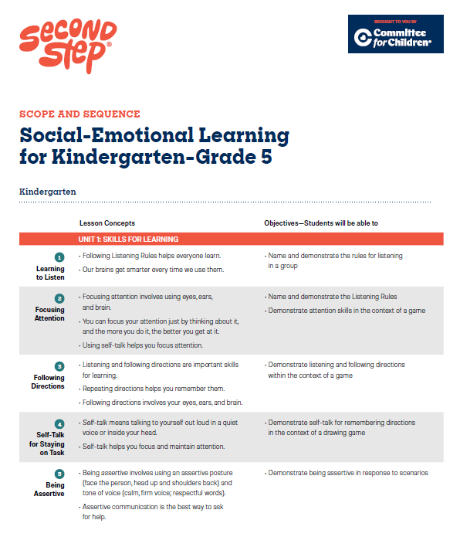
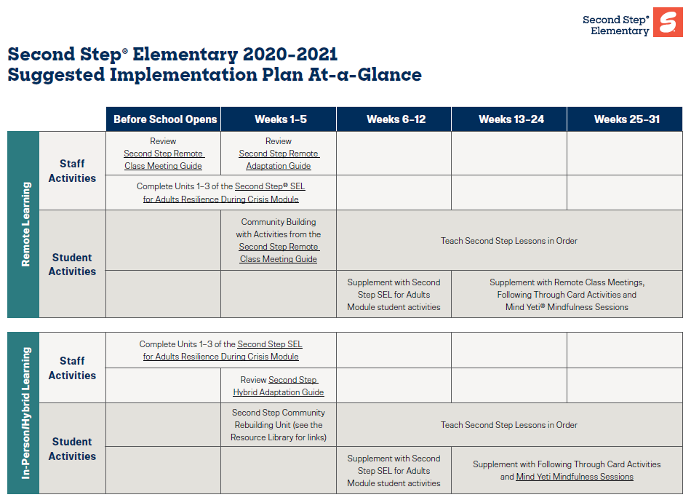
Social-Emotional Well-being
Area II: Academics Responsibilities Faculty and Staff: Teach core programs according to district and state standards with integrity: Use teacher-delivered, low-intensity strategies to support students’ active engagement | Area II: Behavior Responsibilities Faculty and Staff: Implement Positive Behavioral Interventions and Supports (PBIS) with integrity. Teach all setting Expectations within the first week of school and reteach Expectations (monthly). Display and model school-wide expectations in classrooms and other key settings. Implement the reactive plan with integrity. | Area II: Social Responsibilities Faculty and Staff: Teach schoolwide social skills/ character education curricula with integrity: Teach daily Second Step ® lessons (link to grade level instructional schedules) Seek ways to engage parents as partners in the school program

Slide 56
What do I need to know?
Ci3T Exemplar - Elementary

Slide 57
Rolling out at Tier 1: Social and Emotional Well-being
Reviewing Roles & Responsibilities
  What do I need to know?
Procedures for Teaching
  How am I doing with teaching social and emotional well-being lessons at Tier 1? Am I weaving them into daily instruction?
Procedures for Reinforcing
  How have I been acknowledging students who are using these skills throughout the day?
Procedures for Monitoring
  How am I doing with implementation?
Questions & Considerations?
Successes!

Slide 58
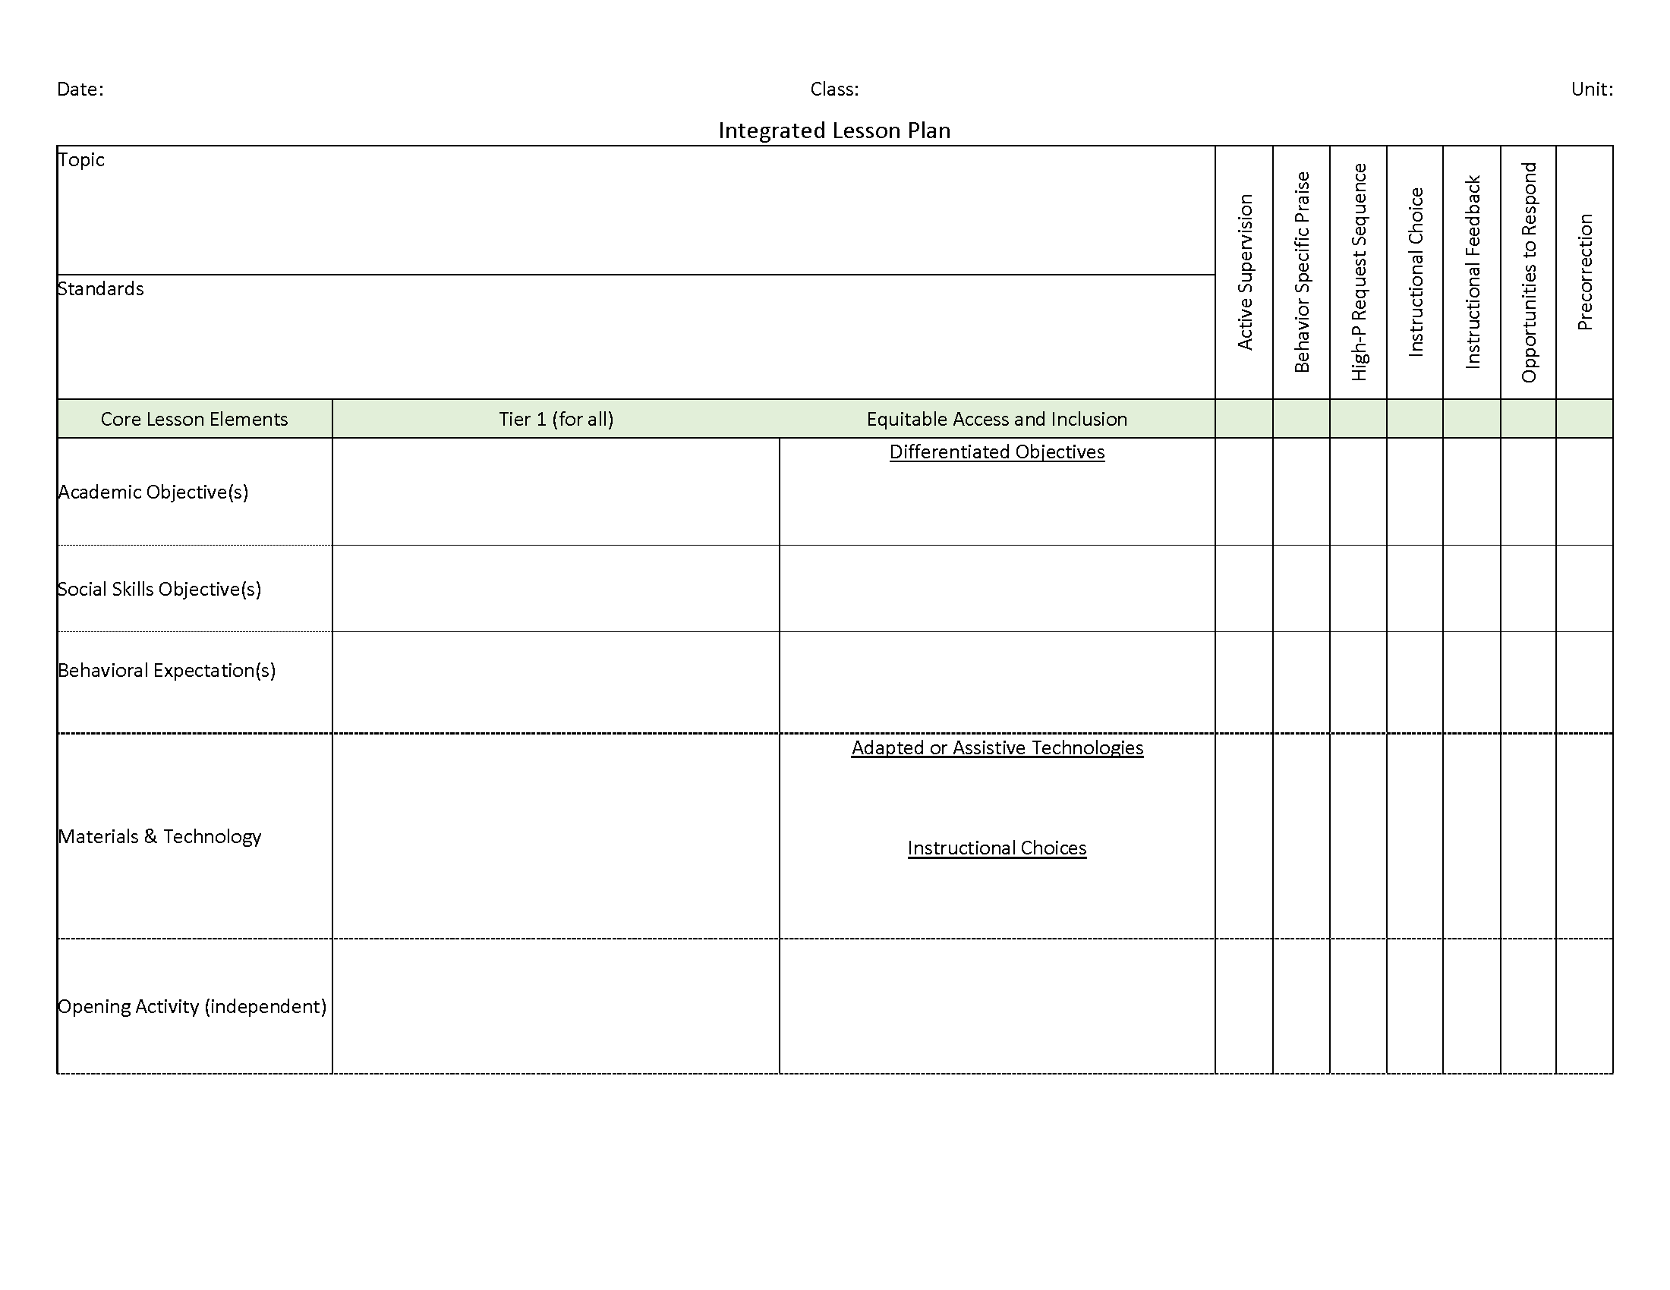
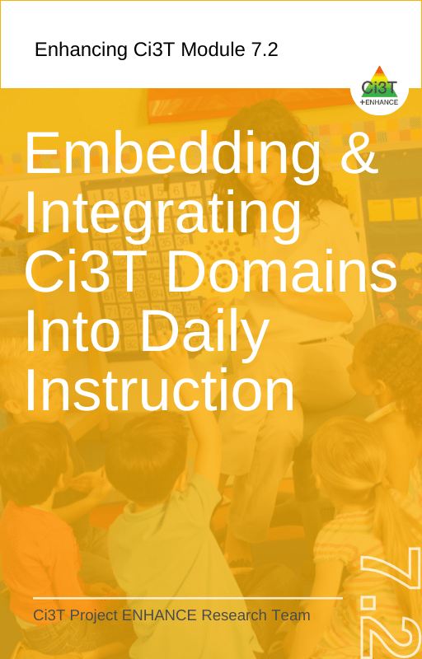


Social-Emotional Well-being
Area II: Academics Responsibilities Faculty and Staff: Teach core programs according to district and state standards with integrity: Use teacher-delivered, low-intensity strategies to support students’ active engagement | Area II: Behavior Responsibilities Faculty and Staff: Implement Positive Behavioral Interventions and Supports (PBIS) with integrity. Teach all setting Expectations within the first week of school and reteach Expectations (monthly). Display and model school-wide expectations in classrooms and other key settings. Implement the reactive plan with integrity. | Area II: Social Responsibilities Faculty and Staff: Teach schoolwide social skills/ character education curricula with integrity: Teach daily Second Step ® lessons (link to grade level instructional schedules) Seek ways to engage parents as partners in the school program

Slide 59












Talk Time
Reviewing Roles & Responsibilities: Do I know what my roles and responsibilities are in teaching academic skills? Do I know what my roles and responsibilities are in teaching expectations? Do I know what my roles and responsibilities are in teaching social and emotional well being skills to my students? Procedures for Teaching How often am I implementing low-intensity strategies? Do I receive support or offer support to others? How comfortable do I feel incorporating social and emotional well-being lesson content into daily instruction? Procedures for Reinforcing What are my new lessons learned about reinforcement? How have I been reinforcing expectations when students meet them?
Notes:
10-min timer

Slide 60
Procedures for…
Teaching
Reinforcing
Monitoring

Slide 61
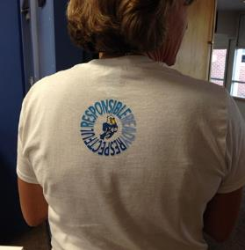
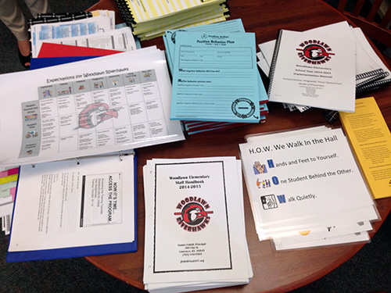
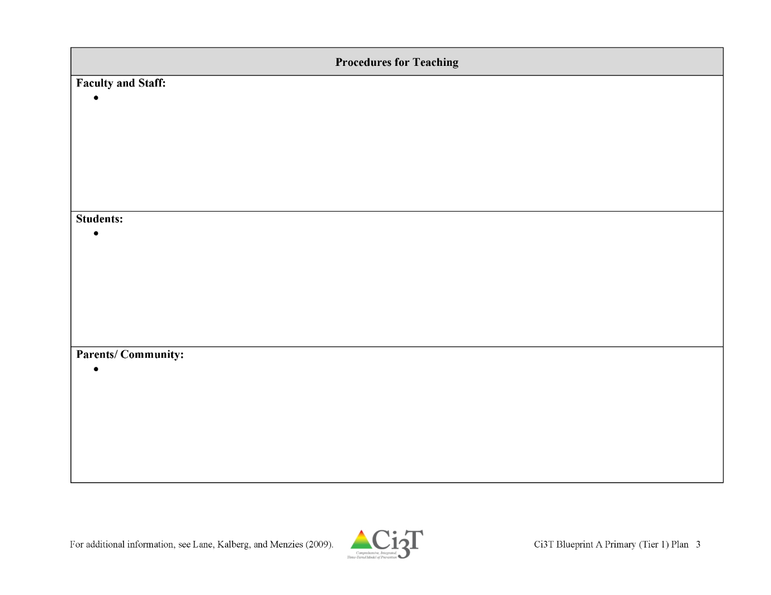
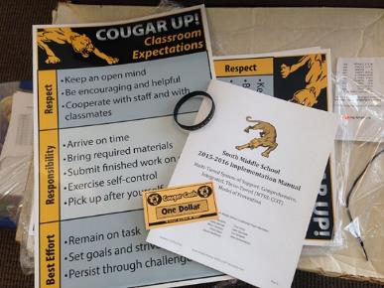


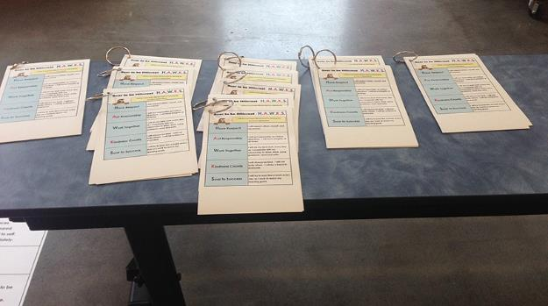
Locate in your Ci3T Implementation Manual

Slide 62
Procedures for Teaching
Faculty and Staff
Procedures for Teaching
Faculty and Staff: Ci3T Leadership Teams and District Leaders will teach procedures to faculty and staff by: Provide faculty and staff Ci3T Implementation Manual and other materials such as posters, lesson plans, tickets, etc. to teach, implement and support our Ci3T plan. Provide training of plan and expectation to staff at the beginning of each school year, with attention to academic, behavior, and social domains. Post resources for implementing plan on SharePoint > Important Documents > Ci3T Plan. Post videos and professional learning on the reactive plan. Regular ongoing teacher professional learning during staff meetings and collaboration (e.g., professional learning on Tier 2 and 3 strategies as well as other requested topics). Professional learning opportunities at the district level to support implementation and sustainability of Ci3T, with attention to academic, behavior, and social domains. Expectations Matrix taught and posted. Ongoing re-teaching of expectations and procedures – dedicated staff meeting time for discussions. Ci3T session for new staff orientation. Provide expectation matrix in substitute folder. Meet twice per year with bus drivers, after school care providers based as school site and open to community providers, cafeteria staff, building maintenance staff. Weekly tips for teachers and challenges for PBIS. Offer professional learning to support high integrity implementation of Tier 1, 2, and 3 components Offer district- and school-led professional learning of coaching support for curriculum, low-intensity strategies, assessment tools, and data management systems Establish and implement a communication schedule for sharing summaries of: treatment integrity, social validity, and screening data to inform instruction

Slide 63
Procedures for Teaching
Students
Procedures for Teaching
Students: Ci3T Leadership Teams will collaborate with faculty and staff to teach procedures to students by: Beginning of the year lesson: Setting Stations with examples and non-examples, role play and modeling of expectations with adults and peers. Reteach lessons at key time points (e.g., after breaks from school). Teachers will explicitly teach, model and practice the expectations and procedures Schedule: 1st 2 weeks of school, 3rd – 6th week of school, 1st 2 weeks of January, 1st week of March, anytime as needed or indicated by school data (e.g., increase in office disciplinary referrals, decreases in attendance) Teachers will use the lesson plans provided in the Ci3T Implementation Materials or provide lesson plan to administrator. Teachers will use and display the posters provided in all instructional and non-instructional areas. Teachers will use tickets to intermittently reinforce those students demonstrating the expectations (higher rates of praise used early in the year). PBIS video played every Monday morning in each classroom demonstrating a setting, behavior, or social skill. Expectations reviewed over announcements. Weekly social skills focus (including Stop, Walk, Talk) announced in morning announcement Participate in class meetings and Second Step® lessons.

Slide 64
Procedures for Teaching
Parents, Families, and Community Members
Procedures for Teaching
Parents/ Community: Ci3T Leadership Teams and District Leaders will teach procedures to parents and community members by: Team present plan at September Site Council, September/October PTO meeting, and other meetings as invited. Post Ci3T Implementation Manual on school website and send Ci3T Brochure home in September, with new student upon registration, and again before spring break. Post video on website that explains our Ci3T Plan, with attention to academic, behavior, and social domains. Hold monthly “coffee talks” with parents and community members to increase understanding and support and develop partnerships.

Slide 65


Procedures for Teaching

Slide 66



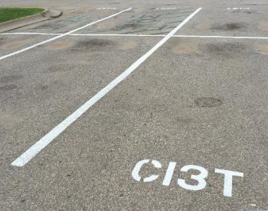



Locate in your Ci3T Implementation Manual
Procedures for Reinforcing
Faculty and Staff:
Students: ROAR zone Parking spaces
Parents/ Community:
Donation Coupon:
1 box of Macaroni and Cheese to Community Food Drive

Slide 67
Procedures for Reinforcing
Faculty and Staff, Students, & Parents, Families, Community Members
Procedures for Reinforcing
Faculty and Staff: Ci3T Leadership Teams and District Leaders will provide reinforcement to faculty and staff by: Raffle of Ci3T parking spot (awarded to the teacher who provided the ticker to the student raffle winner) Breakfast/Lunch provided to celebrate increase in fidelity data or progress toward goals in student outcome data (see Assessment Schedule). Drawing for tangible and non-tangible items (from community partners) – criteria for drawing based on Ci3T goals (e.g., completing screening on time for all students, meeting goals for reporting of fidelity data, progress toward goal of parent engagement) School-wide drawings for students – also reward teacher who gave the PBIS ticket to selected student.
Students: Ci3T Leadership Teams will collaborate with faculty and staff to provide reinforcement to students by: Students participate in providing feedback for reinforcements Intermittent reinforcement of expectations with behavior specific praise and PBIS tickets PBIS tickets exchanged for donated tangible and non-tangible choices (privileges, time with teachers, art lessons, special PE time, postcards or phone calls home), allowing students to access or avoid attention, tangibles/activities, and sensory experiences What can be earned? Individually earned tickets Work together with class to earn golden tickets What tickets can be used for? Each teacher will have a classroom menu (student choice of items on menu) Classroom drawings for parties (teacher choice) School-wide drawings (1 daily winner, 3 weekly winners) Tangible and nontangible reinforcement choices
Parents/ Community: Ci3T Leadership Teams and District Leaders will provide reinforcement to parents and community members by: Positive phone calls and postcards home Student name in the newsletter Parent-Teacher-Student Organization (PTSO) shared events and support Ci3T supporter bumper stickers for parents and window stickers for businesses Student written thank you notes for community supporters

Slide 68



ENHANCED Resource!
Universal Reinforcement System
eBook
Interactive Resource

Slide 69




Where does reinforcement fit in Ci3T?

Slide 70





What is reinforcement?

Slide 71


What is reinforcement?
Reinforcement re·in·force·ment | /rē-ən-ˈfȯrs-mənt/ noun the action of strengthening or encouraging something; the state of being reinforced (Merriam Webster)

Slide 72




What reinforces behavior?
Reinforcer
Something added that increases the future probability of the behavior occurring

Slide 75



Which are examples of reinforcement?
Notes:
Answer: all of them! The principal’s office could be a reinforcer is the behavior is motivated by escape / avoidance of work or if the principal is a preferred adult and going to the principal’s office means accessing attention.

Slide 76




How can we use consequences to change behavior?

Slide 77




What is a Universal Reinforcement System?

Slide 78


What does the research say?
28 studies from 1980-2014
Studies looked at academic and behavioral domains
Strong, positive impact on student behavior (effect size = 0.82)
Equally effective in achieving positive academic and behavioral outcomes
Universal Reinforcement System
=
a type of token economy
Effect Size for Token Economy Use in Contemporary Classroom Settings: A Meta-Analysis of Single-Case Research
Soares, Harrison, Vannest, & McClelland (2016)

Slide 79
What does the research say?
Universal Reinforcement Systems are also a component of Positive Behavioral Interventions and Supports (PBIS; pbis.org).
PBIS has a strong evidence-base indicating it is an effective framework for supporting positive outcomes for students (e.g., reductions in suspensions, expulsions) and school functioning (e.g., organizational health, safety).
Examining the Evidence Base for School-wide Positive Behavior Support
(Horner, Sugai, & Anderson, 2010)
Updating and Expanding Systematic Reviews and Meta-analyses on the Effects of School-wide Positive Behavior Interventions and Supports
(Lee & Gage, 2020)
Is School-wide Positive Behavior Support an Evidence-based Practice?
(Horner, Sugai, and Lewis, 2020)

Slide 80


What are the benefits of having a universal system?
Consistency
Flexibility

Slide 81

Consistency #1: Everyone Gives the Same Thing

Slide 82

Consistency #2: Everyone Uses Similar Procedures
+
behavior-specific praise

Slide 83

Flexibility #1: Variety is the Spice of Life

Slide 84
 | Positive Reinforcement (Access Something) | Negative Reinforcement (Avoid Something)
Attention | Time to work with a chosen peer Eat lunch with teacher in classroom | Get out of being called on card Eat lunch alone
Tangibles / Activities | Item from school store Extended recess period | Homework pass Skip evens or odd problems on an assignment Front of the lunch line pass to avoid the line
Sensory | Playing with a pop fidget toy Using headphones to listen to (clean!) music | Time in the quiet reading corner Using noise cancelling headphones in the cafeteria

Slide 85
Let’s Chat!
What is the most unique reinforcer you have offered?
OR
What is the most popular reinforcer on your menu?

Slide 86

Flexibility #2: Individual Student Considerations
Looking to individualize your school’s universal reinforcement system?
Make individual adjustments to:
  rate of reinforcement
  (e.g., how often you provide reinforcers)
  options for using reinforcers
  (e.g., what can students use reinforcers to get/avoid?)
  frequency with which students can select options (e.g., how often can the student ‘shop’?)

Slide 87



“Why does Marina
have so many tickets?”

Slide 88

Summary
Consistency
Flexibility
Rate of reinforcement
Everyone gives the same thing
Frequency with which students can use reinforcers
Adults provide reinforcement the same way
Options for using reinforcers

Slide 89


The Bundle
Avoid…
Instead try…
“You got the correct answer, you get two tickets!”
“Great participation – I can tell you’ve been paying attention. Awesome job!” [teacher gives a single ticket]

Slide 90




The Bribe
Avoid…
Instead try…
“If you follow directions, I’ll give you a ticket.”
“Remember, the expectation is to…”

Slide 91




The Ultimatum
Avoid…
Instead try…
“You can’t earn tickets behaving that way”
Show empathy, remind of expectations, acknowledge a different student who is following expectations

Slide 92












Talk Time | Talk Time
Teaching | Reinforcing
What are your plans for teaching expectations to your students? What are your plans for teaching lessons to support social and emotional well-being? What are your plans for utilizing integrated lesson planning? What support do you need from your Ci3T Leadership Team? Signage? Lesson plans? | What are your plans for reinforcing students? Consider the types of reinforcement (social/attention, tangible/activity, sensory)…which ones do you need to do some brainstorming on to provide? How would you support a colleague who requested assistance with procedures for reinforcing?
Consider sharing ideas with colleagues in your buildings!
Notes:
10-min timer

Slide 93



Essential Components of
Primary Prevention Efforts
Social Validity
Systematic Screening
Academic
Behavior
Treatment Integrity

Slide 94
Procedures for Monitoring
Procedures for Monitoring
Student Measures | Academic: AIMSweb academic screeners (reading and math) District assessment State assessments Unit assessments Progress reports | Behavior: Student Risk Screening Scale Internalizing and Externalizing (SRSS-IE) *note instructional method selected (e.g., in-person, remote, or hybrid) Attendance (absence) Tardies Office discipline referrals (ODR) Nurse visits | Social Skills: Student Risk Screening Scale Internalizing and Externalizing (SSRS-IE) *note instructional method selected (e.g., in-person, remote, or hybrid) Office discipline referrals (ODR) Counselor referrals Bullying referrals
Program Measures (School-level) | Social Validity: Primary Intervention Rating Scale (PIRS) | Treatment Integrity: Tiered Fidelity Inventory (TFI) Ci3T Treatment Integrity: Teacher Self-Report (Ci3T TI: TSR) Ci3T Treatment Integrity: Direct Observations (Ci3T TI: DO) Second Step® treatment integrity data | Program Goals: Year 1 Implementation: 1. Maintain 80% fidelity across treatment integrity measures. 2. At least 80% of students in grades K-5 will meet growth targets in reading and math according to AIMSweb. 3. At least 80% of students in grades K-5 at low risk on the SRSS-IE.

Slide 95
Social Validity
How do stakeholders view the plan?
Social validity refers to the level of:
Social significance of intervention goals
Social acceptability of intervention procedures
Social importance of intervention outcomes
(Wolf, 1978)
Assessed using the Primary Intervention Rating Scale (PIRS)
Social Validity: PIRS Results
Year | Fall |  | Spring
 | n | % (SD) | n | % (SD)
2020-2021 | 32 | 85.39 (8.89) | TBD | TBD

Slide 96


Treatment Integrity

Slide 97
Wrapping Up and Moving Forward

Slide 98

Project EMPOWER - Enhanced
Ci3T EMPOWER Sessions Location: Remote via Zoom Attended by: School Ci3T Leadership Teams, Ci3T District Trainers and Coaches, Faculty and Staff, Families (adults only). Community Members |  | Times (Pacific) | Times (Central) | Times (Eastern)
1. Setting up for Success | Sep. 21, 2023 (Th) | 3:00 – 5:00 p.m. | 5:00 – 7:00 p.m. | 6:00 – 8:00 p.m.
2. Screening | Oct. 18, 2023 (Wed) | 3:00 – 5:00 p.m. | 5:00 – 7:00 p.m. | 6:00 – 8:00 p.m.
3. Low Intensity Supports (3) | Nov. 28, 2023 (Tu) | 3:00 – 5:00 p.m. | 5:00 – 7:00 p.m. | 6:00 – 8:00 p.m.
4. Tier 2 | Jan. 11, 2024 (Th) | 3:00 – 5:00 p.m. | 5:00 – 7:00 p.m. | 6:00 – 8:00 p.m.
5. Tier 3 | Mar. 26, 2024 (Tu) | 3:00 – 5:00 p.m. | 5:00 – 7:00 p.m. | 6:00 – 8:00 p.m.
6. Moving Forward | Apr. 25, 2024 (Th) | 3:00 – 5:00 p.m. | 5:00 – 7:00 p.m. | 6:00 – 8:00 p.m.

Slide 99
Ci3T
Comprehensive Professional Learning Plan
Ci3T: Primary Prevention
Session 1:
Overview of Ci3T Prevention Models
Setting a Purpose
Establish team meetings and roles
Session 2:
Mission and Purpose
Establish Roles and Responsibilities
Procedures for Teaching
Procedures for Reinforcing
Reactive Plan
Session 3:
Procedures for Monitoring
Session 4:
Revise Primary Plan using Stakeholder feedback
Prepare presentation
Ci3T: Secondary Prevention
Session 5:
Overview of Teacher focused Strategies
Overview of Student Focused Strategies
Using data to determine which students may need Secondary (Tier 2) supports
Draft the Secondary Intervention Grid based on existing supports
Ci3T: Tertiary Prevention
Session 6:
Final revisions of Ci3T Plan based on stakeholder feedback
Draft Tertiary (Tier 3) Prevention Intervention Grids
Design Implementation Manual and Plan for roll out to faculty, students, and parents
Ci3T Leadership Team Training Sequence
Implementation Stages of Tier 2 and 3 within Ci3T
Additional Professional Development on Specific Topics
Core Content Curriculum
Check In - Check Out
Functional Assessment-based Interventions
Reading, Math, Writing Benchmarking and Progress Monitoring Tools
Interventions, Strategies, & Practices
Additional Tier 3 Supports
Instructional Techniques to Improve Students’ Motivation; Classroom Management Practices;
Low-Intensity Behavior Supports

Slide 100



Examining your screening data…
…Inform Instruction at Tier 1
…Empower Teachers with Low-intensity Supports
…Connect Students to Tier 2 and Tier 3 Interventions

Slide 101



Ci3T Trainer and Coaches Calls

Slide 102
Ci3T Professional Learning Calendar
 | 0 | 1 | 2 | 3 | 4 | 5 | 6 | 7 | 8 | 9 | 10 | 11
 | July | Aug | Sep | Oct | Nov | Dec | Jan | Feb | Mar | Apr | May | Jun
Ci3T Training |  |  |  |  | Ci3T Professional Learning Series Session 1 | Ci3T Professional Learning Series Session 2 | Ci3T Professional Learning Series Session 3 | Ci3T Professional Learning Series Session 4 |  | Ci3T Professional Learning Series Session 5 | Ci3T Professional Learning Series Session 6
Ci3T Implementation Support | Ci3T Implementation Series Prep Session |  | Ci3T Implementation Series Session 1 |  | Ci3T Implementation Series Session 2 |  | Ci3T Implementation Series Session 3 |  | Ci3T Implementation Series Session 4 | Ci3T Implementation Series Session 5
Ci3T EMPOWER |  |  | Ci3T EMPOWER Session 1 | Ci3T EMPOWER Session 2 | Ci3T EMPOWER Session 3 |  | Ci3T EMPOWER Session 4 |  | Ci3T EMPOWER Session 5 | Ci3T EMPOWER Session 6
Ci3T Trainers & Coaches Calls |  | Trainers & Coaches Call Session 1 | Trainers & Coaches Call Session 2 | Trainers & Coaches Call Session 3 | Trainers & Coaches Call Session 4 | Trainers & Coaches Call Session 5 | Trainers & Coaches Call Session 6 | Trainers & Coaches Call Session 7 | Trainers & Coaches Call Session 8 | Trainers & Coaches Call Session 9 | Trainers & Coaches Call Session 10

Slide 103


Sustaining and Disseminating Professional Learning
Designate two staff to attend trainings to become on-site coaches
10 min @ next Faculty and Staff meeting
Setting Up for Success with Ci3T
Systematic Screening
Low-Intensity Supports
Tier 2
Planning Ahead
Tier 3

Slide 104
Wrapping Up & Previewing Next Session
Today
Next time
Overview of Ci3T
Rolling out your Ci3T Plan … Sharing Success!
Implementing Tier 1
  Academics
  Behavior: Positive Behavior Interventions and Support (PBIS)
  Social and Emotional Well-being: Your Validated Curricula and Resources
Procedures for …
  Teaching
  Reinforcing
  Monitoring
Overview of Systematic Screening in Ci3T Models
Using Systematic Screening to
  Inform Instruction at Tier 1
  Empower Teachers with Low-Intensity Supports
  Connect Students to Tier 2 and Tier 3 Interventions
Exploring Resources to Support Systematic Screening Efforts

Slide 105



Comprehensive, Integrated, Three-Tiered Model of Prevention
(Lane, Kalberg, & Menzies, 2009)
Thank you!
Notes:
Tag us in your Ci3T highlights- we’d love to see Ci3T in action! Follow us on Twitter or Instagram for updates and links to resources! @Ci3TModel
You will receive a brief session evaluation – we value your feedback and would greatly appreciate you taking a few minutes to share your thoughts on what you liked about the session and how we can improve

