Slide 1
Implementing Comprehensive, Integrated, Three-tiered (Ci3T) Models: Using Data to Inform Instruction
E-Ci3T Implementation Series and Delivery – Session 2
Presenters and Contributors | Contributors
Allison M. Bernard | Wendy Peia Oakes
Mark M. Buckman | Elise Sarasin
Kathleen Lynne Lane | Rebecca L. Sherod

Slide 3
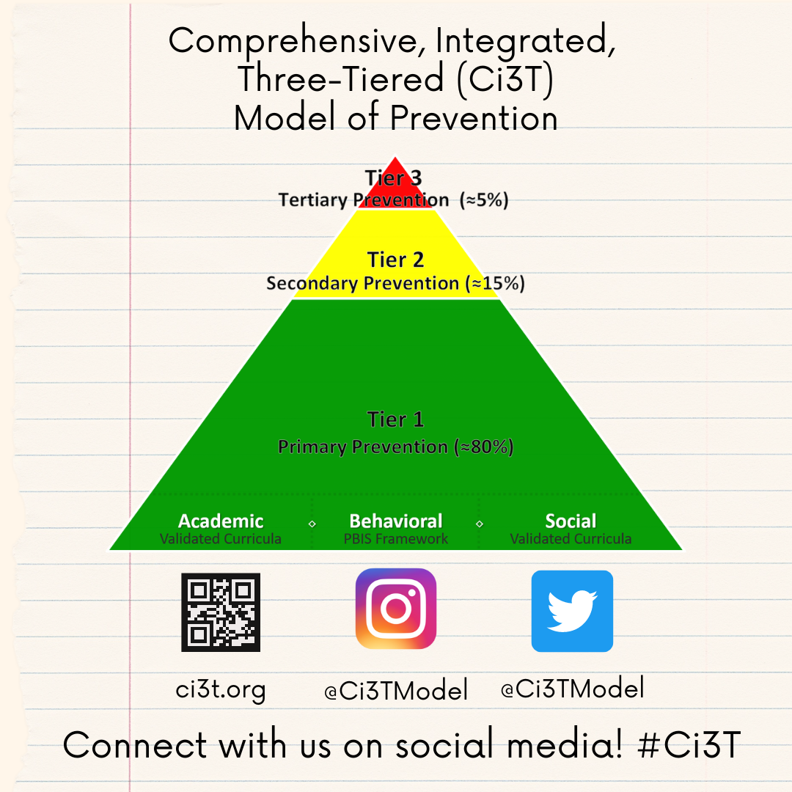
Let’s Connect on Social Media!
Tag us in your Ci3T highlights- we’d love to see Ci3T in action!
Follow us on Twitter or Instagram for updates and links to resources!
  @Ci3TModel

Slide 4
Ci3T Professional Learning Calendar
 | 0 | 1 | 2 | 3 | 4 | 5 | 6 | 7 | 8 | 9 | 10 | 11
 | July | Aug | Sep | Oct | Nov | Dec | Jan | Feb | Mar | Apr | May | Jun
Ci3T Training |  |  |  |  | Ci3T Professional Learning Series Session 1 | Ci3T Professional Learning Series Session 2 | Ci3T Professional Learning Series Session 3 | Ci3T Professional Learning Series Session 4 |  | Ci3T Professional Learning Series Session 5 | Ci3T Professional Learning Series Session 6
Ci3T Implementation Support | Ci3T Implementation Series Prep Session |  | Ci3T Implementation Series Session 1 |  | Ci3T Implementation Series Session 2 |  | Ci3T Implementation Series Session 3 |  | Ci3T Implementation Series Session 4 | Ci3T Implementation Series Session 5
Ci3T EMPOWER |  |  | Ci3T EMPOWER Session 1 | Ci3T EMPOWER Session 2 | Ci3T EMPOWER Session 3 |  | Ci3T EMPOWER Session 4 |  | Ci3T EMPOWER Session 5 | Ci3T EMPOWER Session 6
Ci3T Trainers & Coaches Calls |  | Trainers & Coaches Call Session 1 | Trainers & Coaches Call Session 2 | Trainers & Coaches Call Session 3 | Trainers & Coaches Call Session 4 | Trainers & Coaches Call Session 5 | Trainers & Coaches Call Session 6 | Trainers & Coaches Call Session 7 | Trainers & Coaches Call Session 8 | Trainers & Coaches Call Session 9 | Trainers & Coaches Call Session 10

Slide 5
Agenda
Welcome
Preparing to Collect and Use Social Validity & Treatment Integrity Data
Using Fall Screening Data to Inform Instruction:
  Primary (Tier 1) Prevention Efforts
  Teacher-Delivered, Low-Intensity Strategies
  Secondary (Tier 2) and Tertiary (Tier 3) Interventions
Facilitating Clear Communication and Collaborations with Stakeholders
  Communication and Collaboration: Plans & Timelines
  Data-informed Professional Learning
Wrapping Up and Moving Forward

Slide 6
Review and Preview
Last Time
Today…
Scheduling for Success
Implementing Your Primary
(Tier 1) Prevention Efforts
Preparing to Collect Treatment Integrity Data
  Ci3T Treatment Integrity Team Leader Training
Preparing to Collect and Use Social Validity & Treatment Integrity Data
Using Fall Screening Data to Inform Instruction
Facilitating Clear Communication and Collaborations with Stakeholders

Slide 7
Welcome
Please pull up your Ci3T Implementation Manual

Slide 8
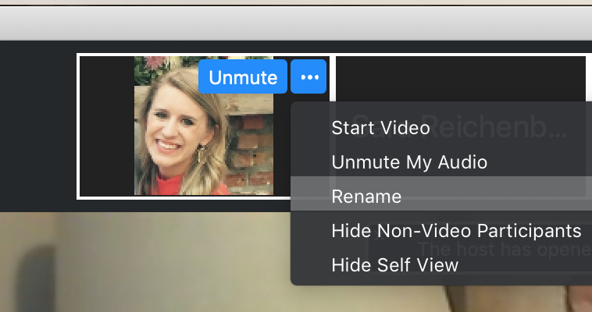
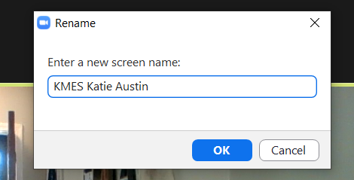
Renaming: School Initials + First and Last Name
To help us put you in breakout rooms with your colleagues today…
1. Click the three dots at the top
right corner of your video square.
2. Rename yourself with your
school initials then first and last name.

Slide 9
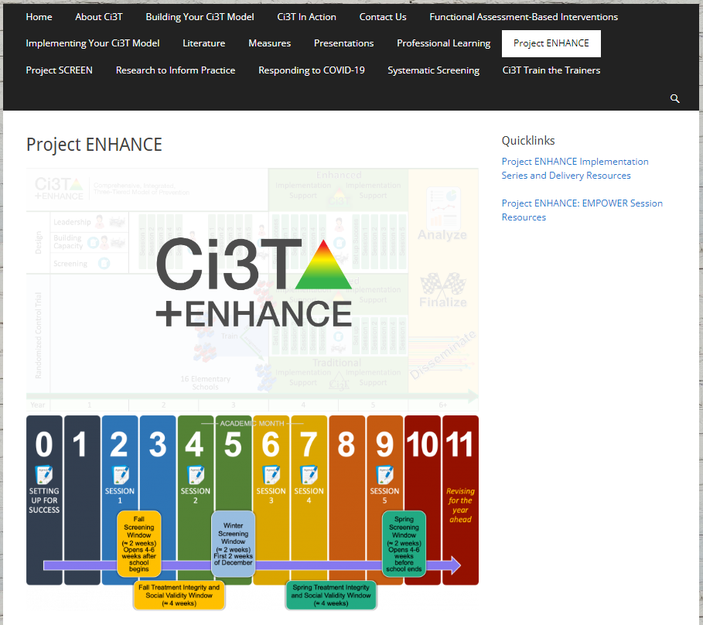
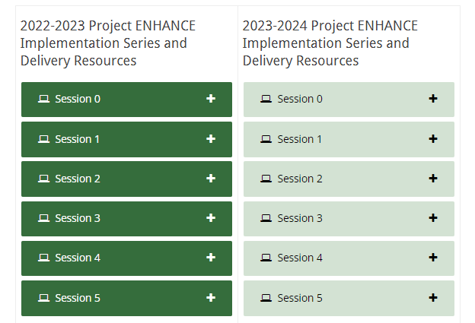
Accessing Professional Learning Materials
Navigate to ci3t.org/enhance
Type password: enhanceci3t!
Access session resources via the Project ENHANCE Implementation Series and Delivery Resources quicklink or by scrolling to the bottom of the page

Slide 10

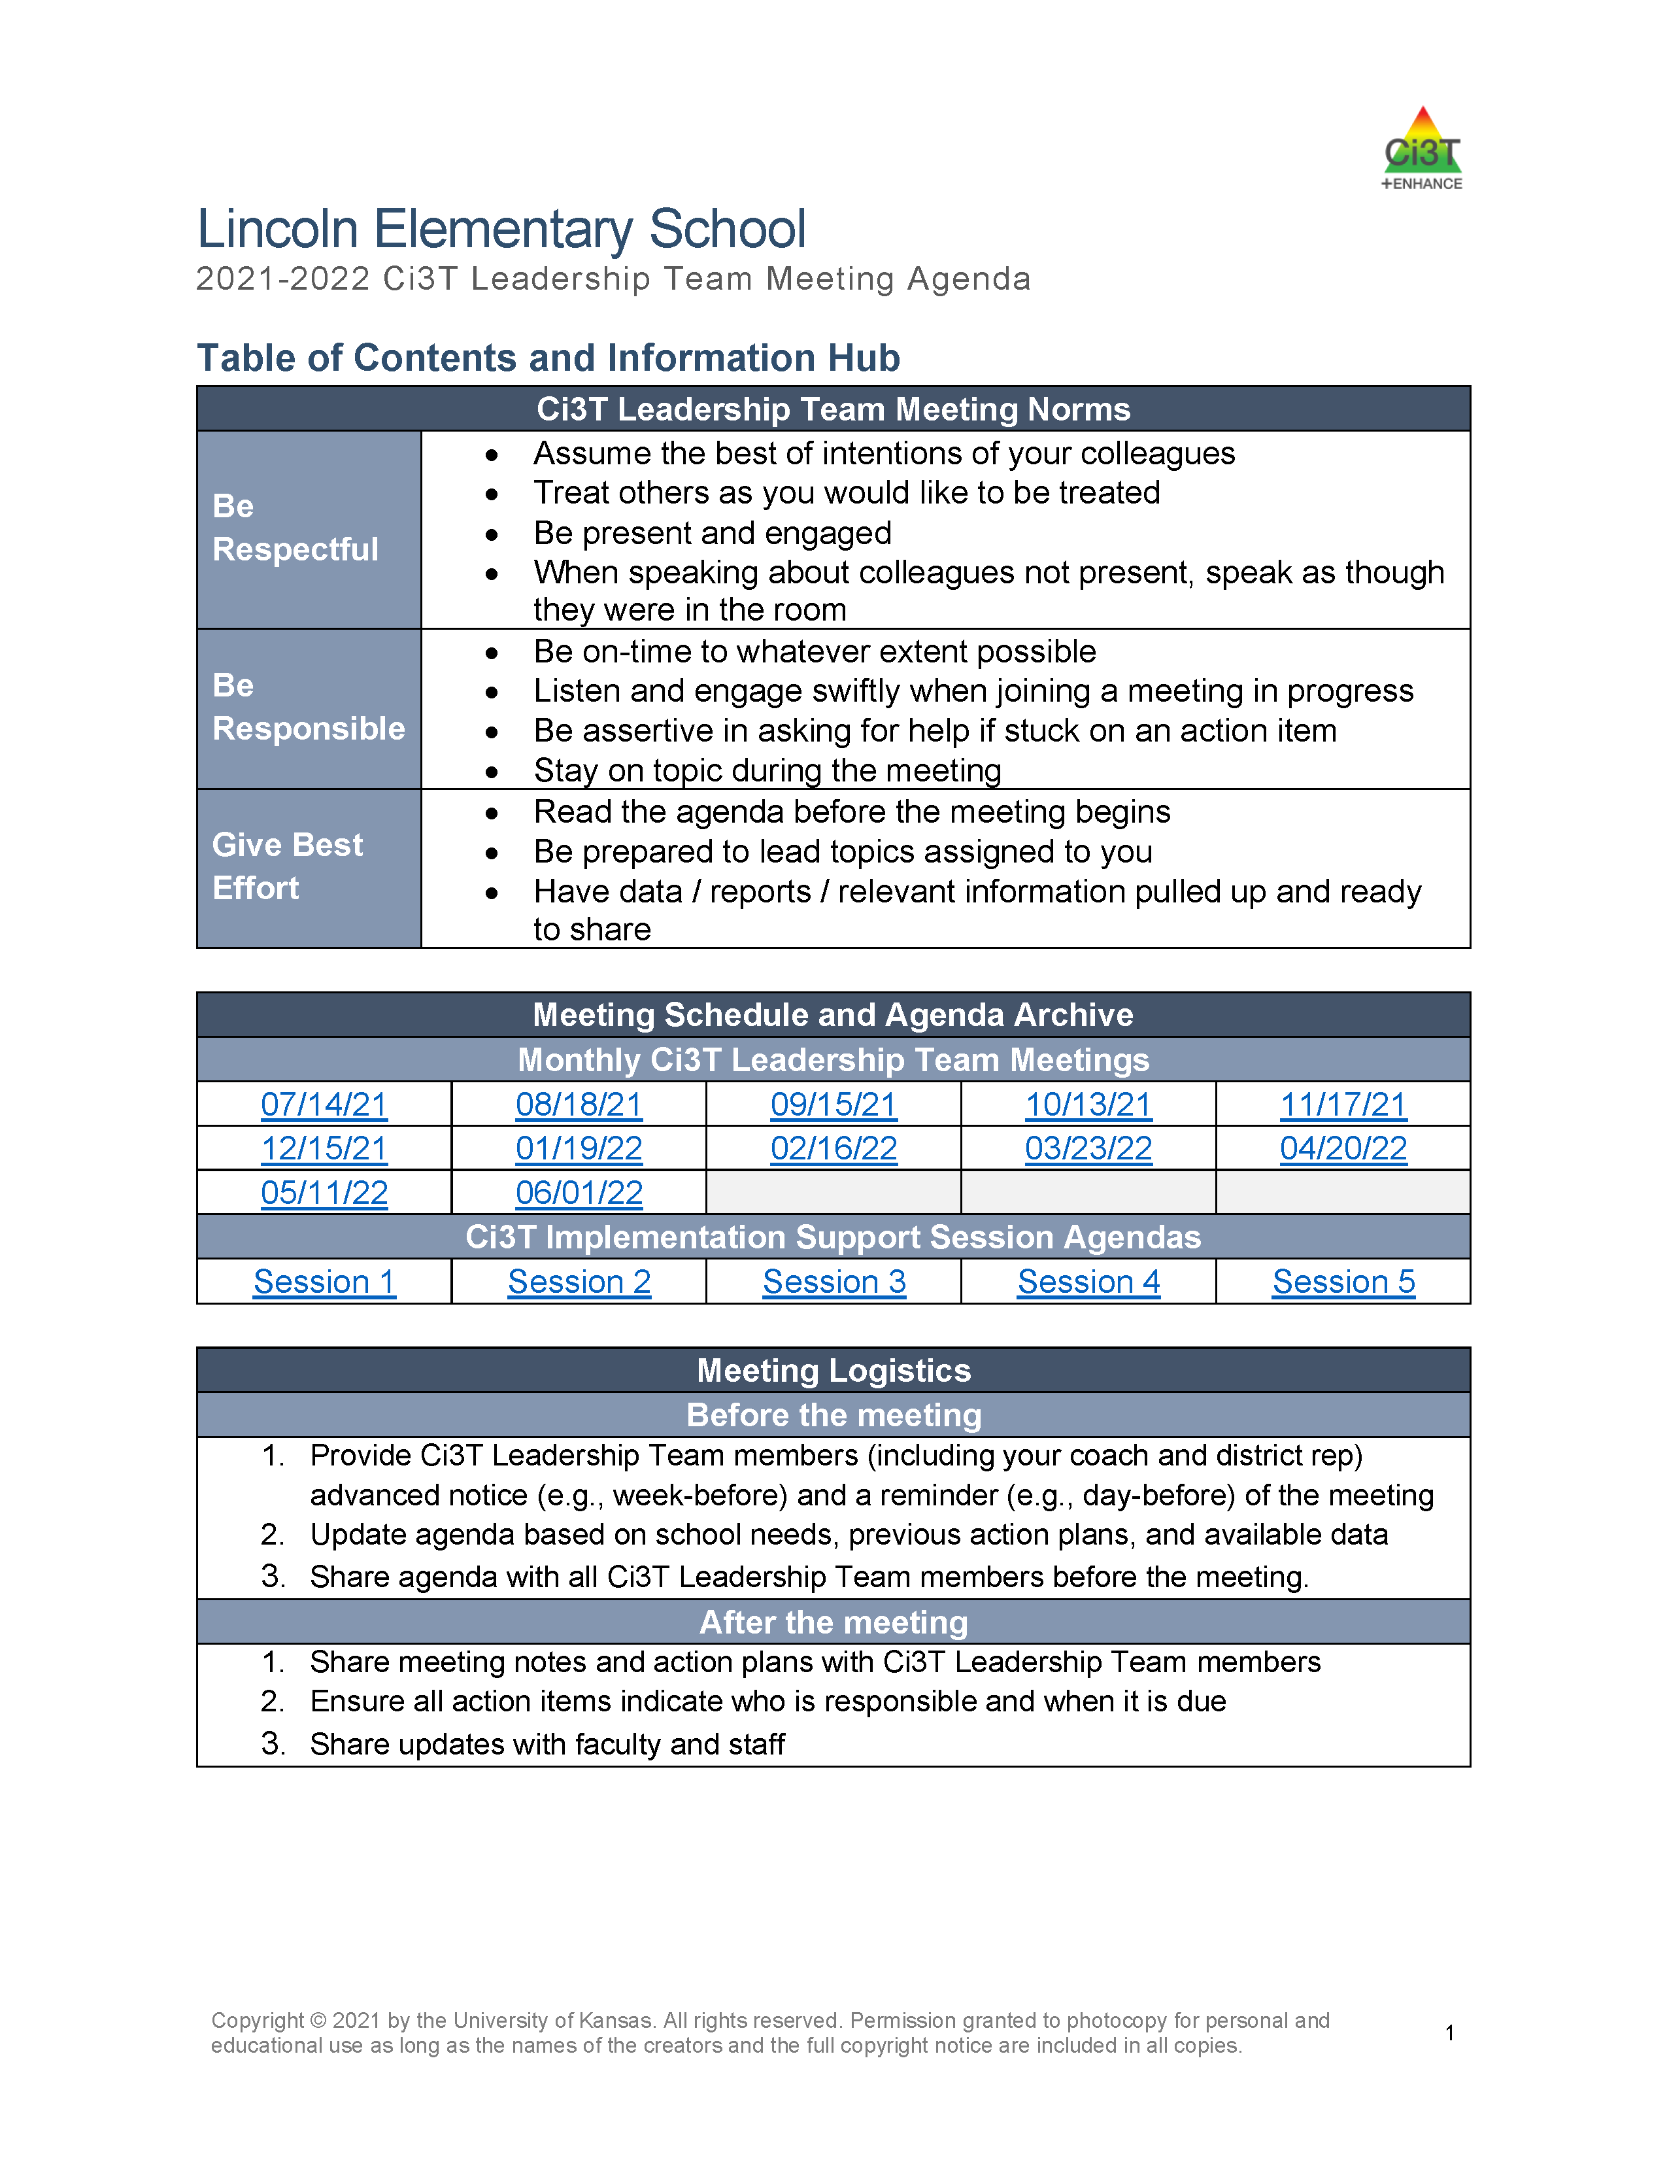
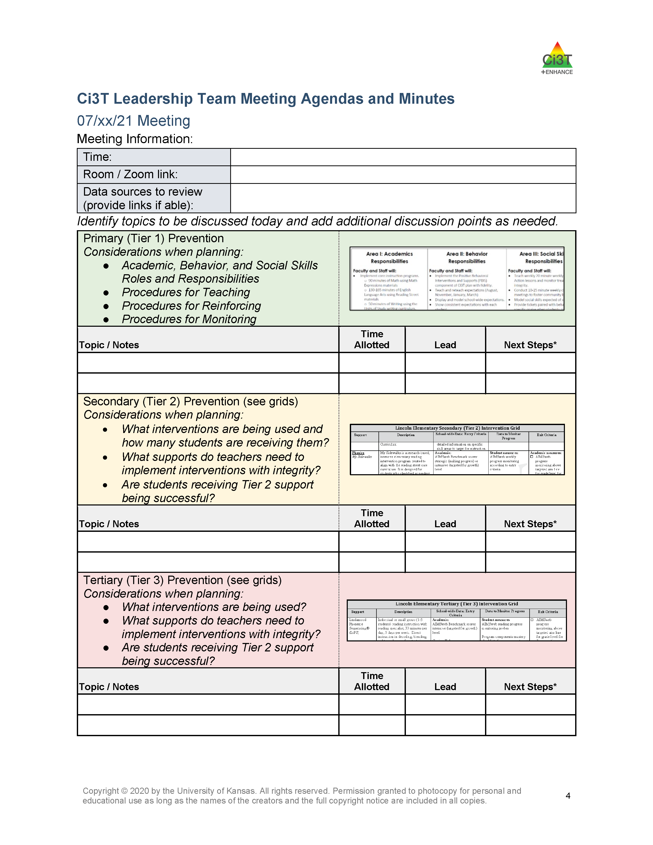
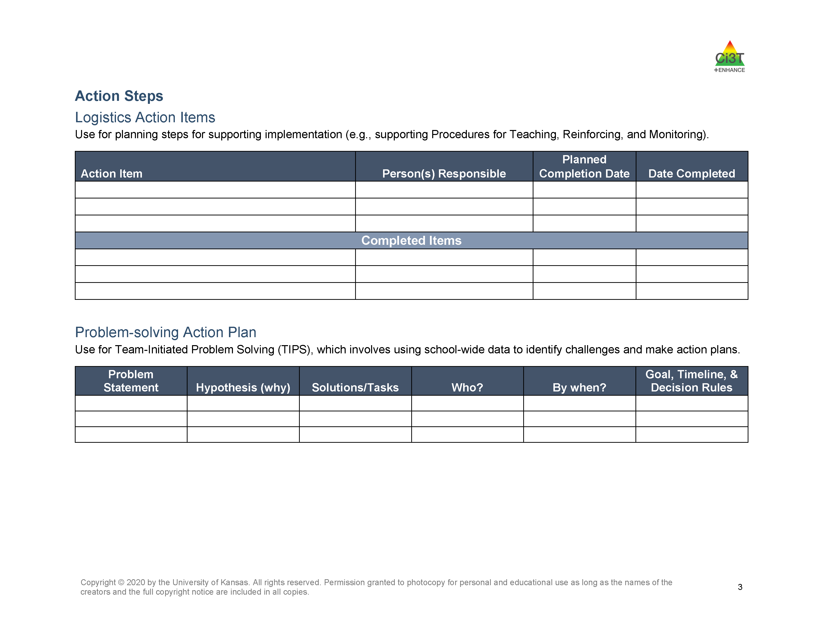
Agenda

Slide 11

Goals for this Implementation Year
Establish effective Ci3T leadership structures
Gain a deeper understanding of Ci3T models of prevention
Implement your school’s plan with high fidelity
Collect and use social validity and treatment integrity data to monitor Ci3T plan implementation
Collect student academic and behavioral outcome data to inform Ci3T implementation efforts
Share data with all stakeholders regularly (e.g., monthly, quarterly)
Identify areas of additional professional learning for faculty and staff and support faculty and staff access to professional learning
Address any barriers to implementing your Ci3T model

Slide 12
Preparing to Collect and Use Social Validity and Treatment Integrity Data

Slide 13
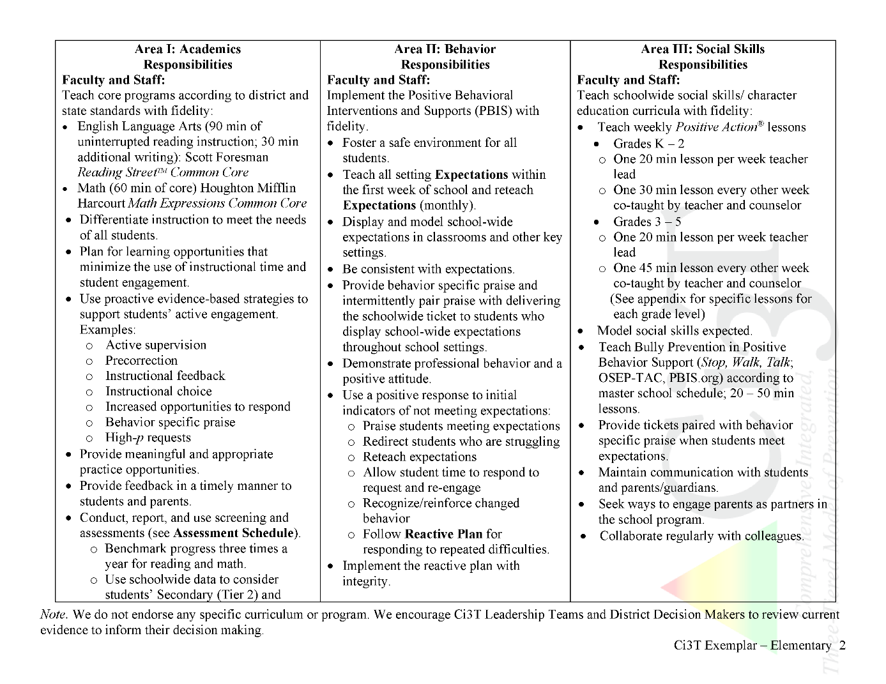
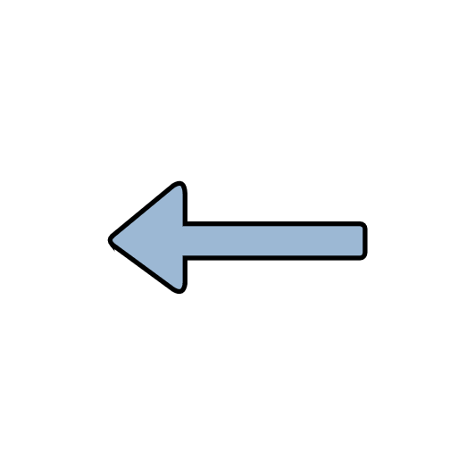
Ci3T Primary Plan: Procedures for Teaching
Ci3T Primary Plan: Procedures for Reinforcing
Ci3T Primary Plan: Procedures for Monitoring

Slide 14
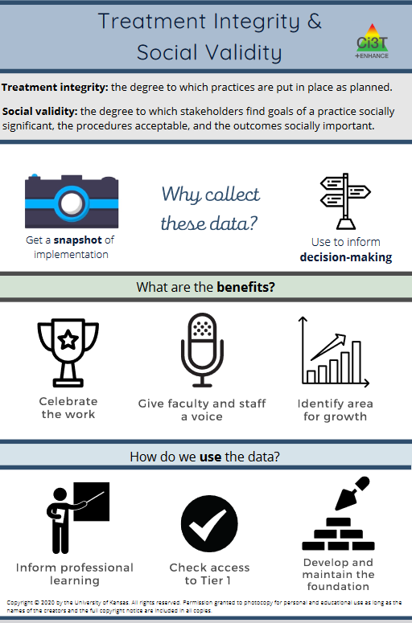
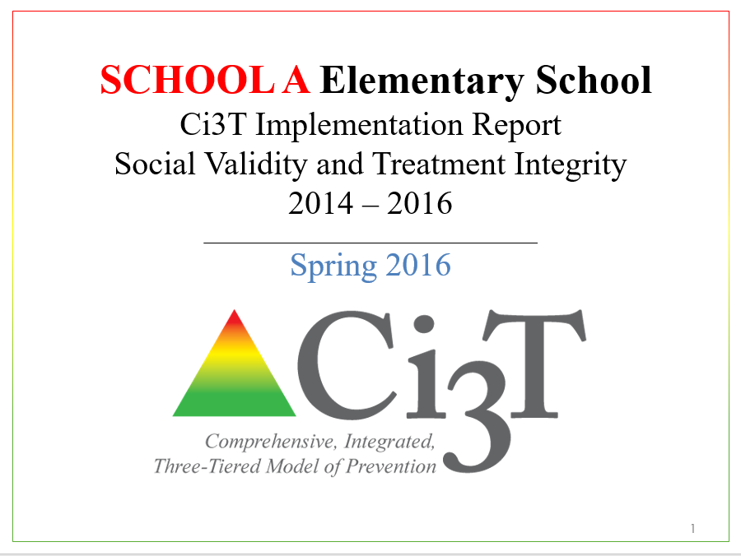
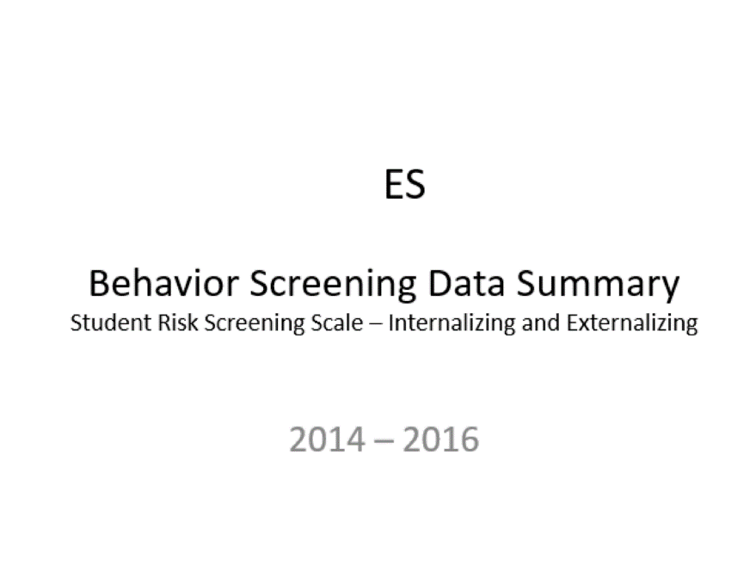
Essential Components of
Primary Prevention Efforts
Social Validity
Systematic Screening
Academic
Behavior
Treatment Integrity
ci3t.org/measures
Notes:
Infographic - https://www.ci3t.org/measures

Slide 15
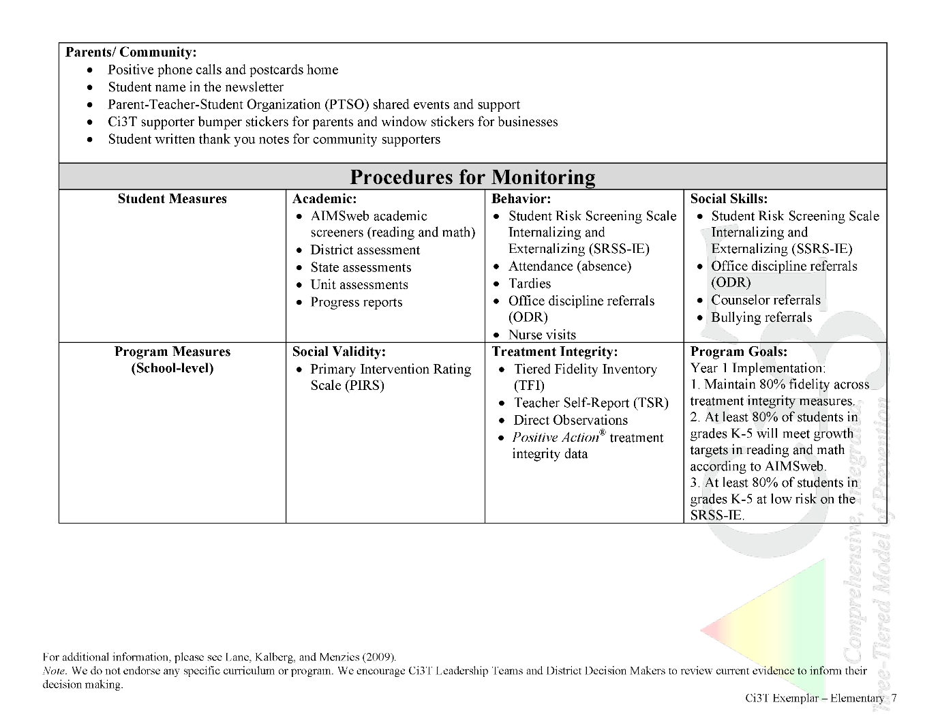


In future years, consider alternative program goals.
80% of students meeting reading and math targets on assessments
Locate in your Ci3T Implementation Manual

Slide 16
Sample Elementary Assessment Schedule
Measure | Aug | Sep | Oct | Nov | Dec | Jan | Feb | Mar | Apr | May
School Demographics
Student Demographic Information | X | X | X | X | X | X | X | X | X | X
Screening Measures
Behavior Screeners: SRSS-IE |  | X |  |  | X |  |  |  | X
Academic Screeners: AIMSWeb | X | X |  |  |  | X |  |  |  | X
Student Outcome Measures - Academic
State & District assessment |  |  |  |  |  |  |  | X | X
Progress reports |  |  |  | X |  |  | X |  |  | X
Student Outcome Measures - Behavior
Absences |  | X | X | X | X | X | X | X | X
Office discipline referrals (ODR) |  | X |  |  | X |  |  |  | X
Counselor referrals | X | X | X | X | X | X | X | X | X | X
Nurse visits | X | X | X | X | X | X | X | X | X | X
Program Measures
Primary Intervention Rating Scale |  |  | X |  |  |  |  | X
School-wide Evaluation Tool |  |  | X |  |  |  |  | X
Ci3T TI: Teacher Self-Report |  |  | X |  |  |  |  | X
Ci3T TI: Direct Observation |  |  | X |  |  |  |  | X
Second Step® Treatment Integrity |  |  | X |  |  |  |  | X
Adapted from Lane, K. L., Oakes, W. P., Cantwell, E. D., & Royer, D. J. (2018). Building and installing comprehensive, integrated, three-tiered (Ci3T) models of prevention: A practical guide to supporting school success V1.2. KOI Education. (Interactive eBook)

Slide 17
Social Validity
How do stakeholders view the plan?
Social validity refers to the level of:
Social significance of intervention goals
Social acceptability of intervention procedures
Social importance of intervention outcomes
(Wolf, 1978)
Assessed using the Primary Intervention Rating Scale (PIRS)
Social Validity: PIRS Results
Year | Fall |  | Spring
 | n | % (SD) | n | % (SD)
2020-2021 | 32 | 85.39 (8.89) | TBD | TBD

Slide 18
Treatment Integrity
Are we implementing our plan as intended?
Treatment integrity can refer to:
Adherence
Dosage
Quality
Assessed using:
Ci3T Treatment Integrity: Teacher Self-Report
Ci3T Treatment Integrity: Direct Observation
Tiered Fidelity Inventory (TFI)
Ci3T Procedures | Teacher Self-Report* | Direct Observation*
 | Fall 2021 n = 45 % (SD) | Educator n = 6 % (SD) | Observer n = 7 % (SD)
Teaching | 80.43% (10.86) | 70.72% (13.81) | 75.02% (17.05)
Reinforcing | 80.83% (12.89) | 62.06% (15.33) | 34.99% (16.02)
Monitoring | 75.49% (18.06) | - | -
Total | 79.10% (11.87) | 67.66% (14.03) | 62.28% (14.58)

Slide 19
Treatment Integrity
Tiered Fidelity Inventory (TFI)
  Survey for all faculty and staff
  Measures treatment integrity and social validity of Tier 1 Ci3T implementation
  Measures treatment integrity of SW-PBIS
  Tier 1 Walkthrough
  Tier 1, 2, and 3 protocols completed by Ci3T Leadership Team
  Observe 25% of instructional staff
  Measures treatment integrity of Tier 1 Ci3T implementation
  Educator and observer perspectives
Ci3T TI: TSR & PIRS
Ci3T TI: Direct Observation

Slide 20
Logistics Planning
Method | Measure Name | Completed by…
Method | Measure Name | All Staff | Randomly Selected Classrooms | Ci3T Leadership Team
Survey | Ci3T Treatment Integrity: Teacher Self-Report and Primary Intervention Rating Scale | X
Observations | Ci3T Treatment Integrity: Direct Observation |  | X
Rubric | Tiered Fidelity Inventory (TFI) |  |  | X
Schedule time for your faculty and staff to complete this survey during your district’s treatment integrity and social validity window.

Slide 21
Logistics Planning
Method | Measure Name | Completed by…
Method | Measure Name | All Staff | Randomly Selected Classrooms | Ci3T Leadership Team
Survey | Ci3T Treatment Integrity: Teacher Self-Report and Primary Intervention Rating Scale | X
Observations | Ci3T Treatment Integrity: Direct Observation |  | X
Rubric | Tiered Fidelity Inventory (TFI) |  |  | X
Coordinate with your District Ci3T Leadership Team to determine who will conduct observations in your school.

Slide 22
Logistics Planning
Method | Measure Name | Completed by…
Method | Measure Name | All Staff | Randomly Selected Classrooms | Ci3T Leadership Team
Survey | Ci3T Treatment Integrity: Teacher Self-Report and Primary Intervention Rating Scale | X
Observations | Ci3T Treatment Integrity: Direct Observation |  | X
Rubric | Tiered Fidelity Inventory (TFI) |  |  | X
Complete Tier 1, 2, and 3 TFI Protocols during your upcoming Ci3T Leadership Team meetings.

Slide 23
What is the TFI?
“The TFI gives teams a single, efficient, valid, reliable survey to guide implementation and sustained use of SWPBIS. Using the TFI, teams measure the extent to which school personnel apply the core features of SWPBIS at all three tiers – either individually or collectively.”(PBISApps)
For Ci3T Purposes, the TFI serves as:
An initial assessment
A guide for implementation of Tier I, Tier II, and/or Tier III practices
An index of sustained implementation

Slide 24
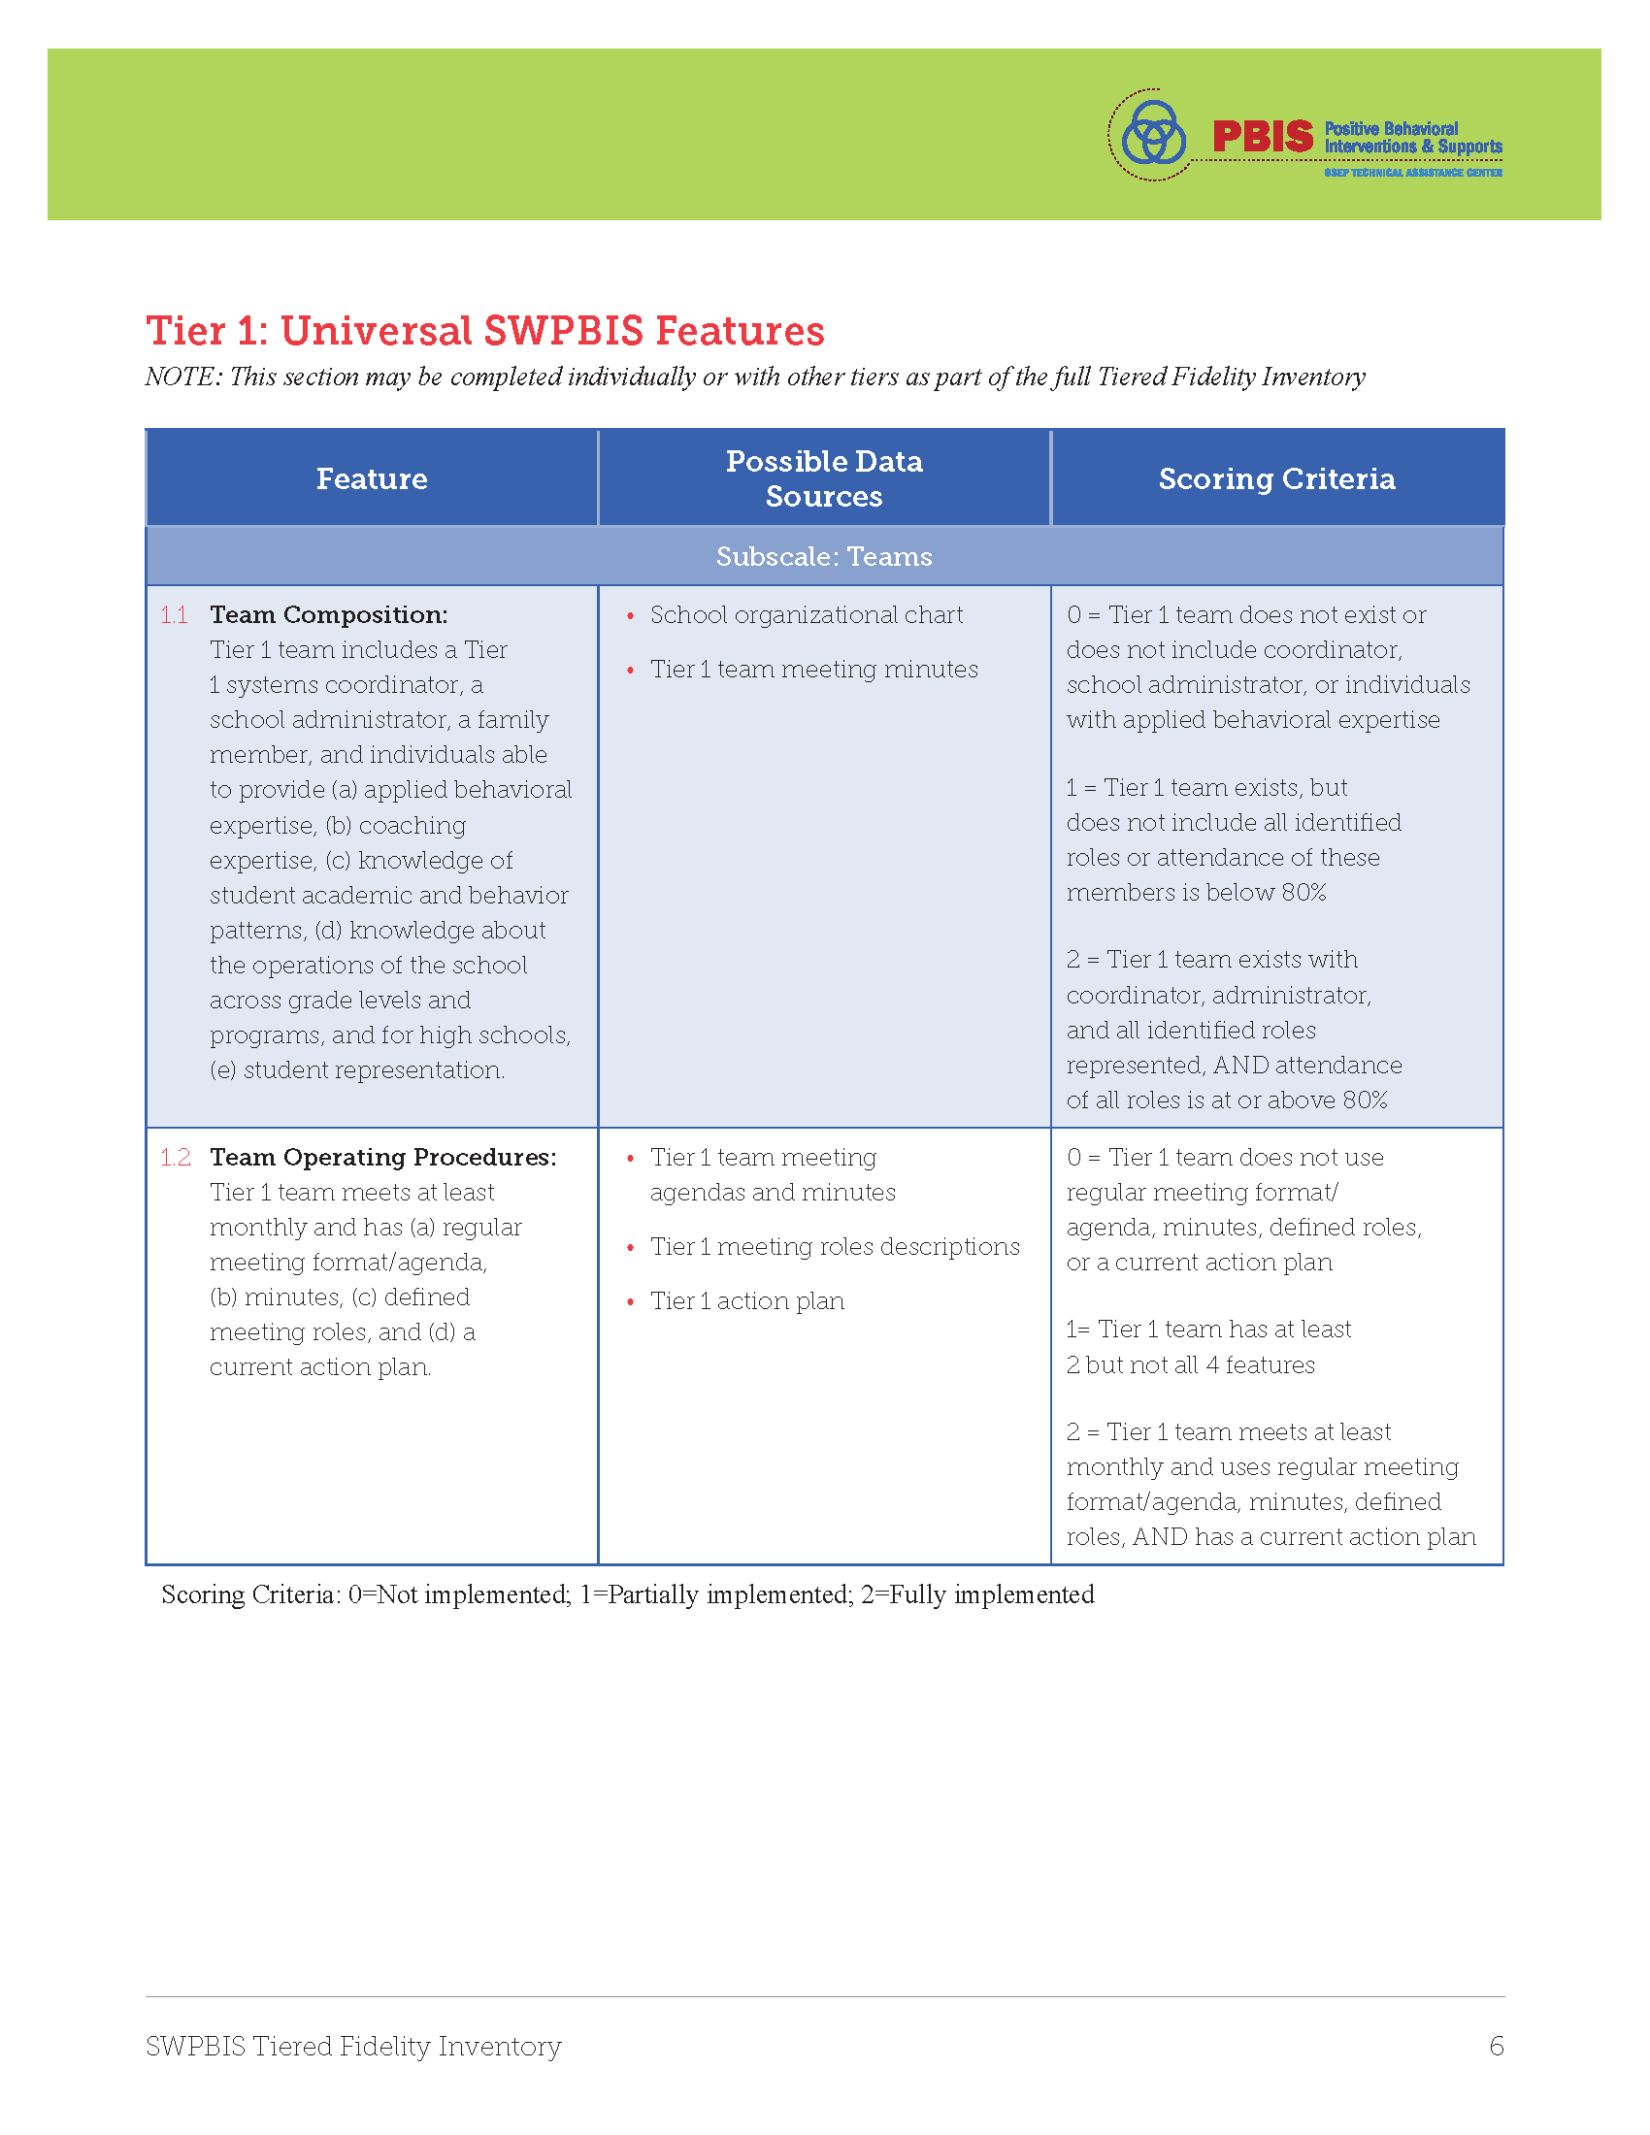
Conducting the TFI:
Before the Meeting
Walkthrough
-Handout available in TFI Protocol, pp. 27-28
-Completed by an external party or Ci3T Leadership Team member
-Interviews students and staff (chosen at random) using a scripted guide
-Provides information regarding school-wide expectations and acknowledgements
Pre-Meeting Prep
Ci3T Leadership Team members…
-Review the completed walkthrough information
-Review the TFI for the tier to-be-completed
-Prepare scores independently to prepare for voting as a group in the meeting

Slide 25
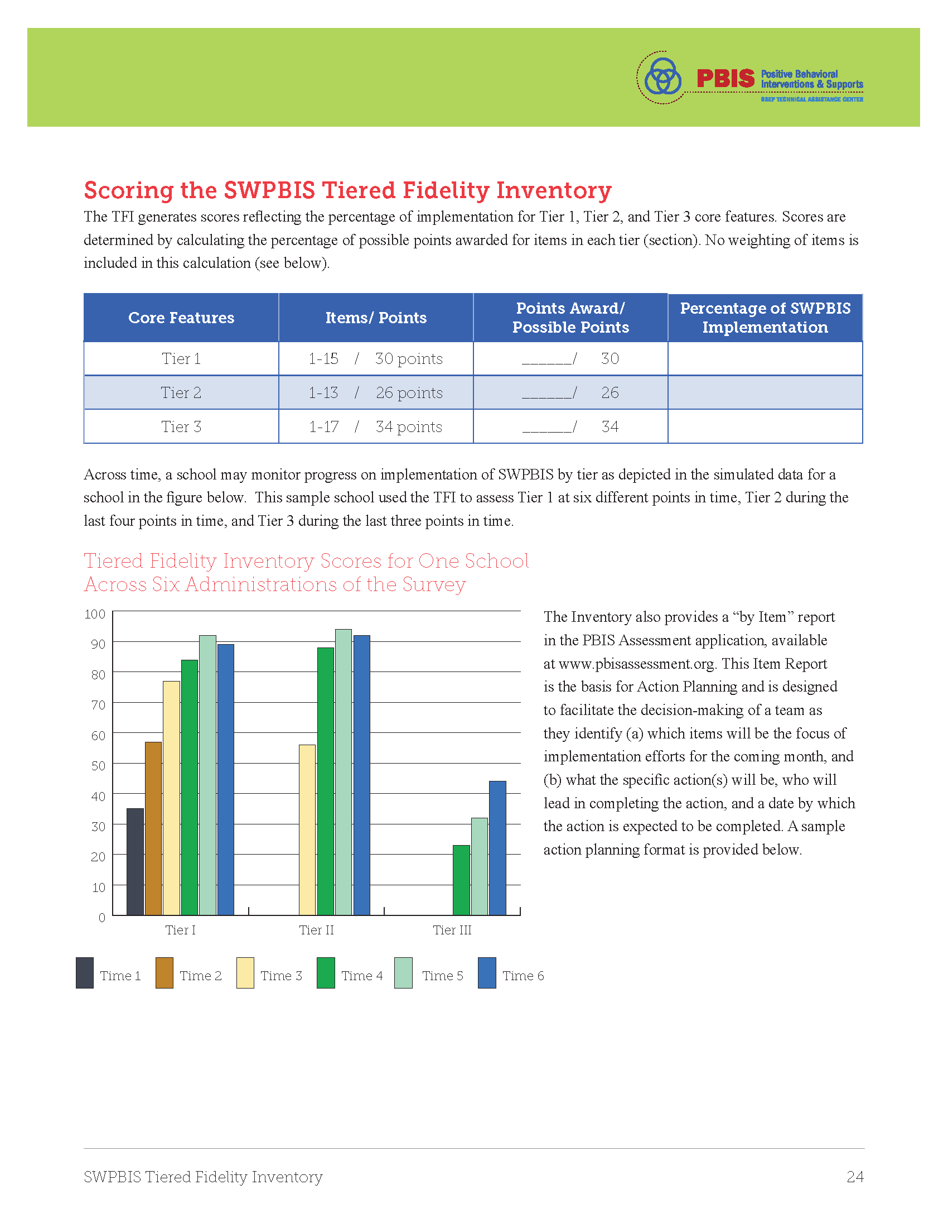
Download Tiered Fidelity Inventory (TFI) materials here
https://www.pbis.org/resource/tfi

Slide 26
Treatment Integrity and Social Validity Window:
Template – update with your district dates
*Measures include: Ci3T Treatment Integrity: Teacher Self-Report (Ci3T TI: TSR); Ci3T Treatment Integrity: Direct Observation (Ci3T TI: DO); Tiered Fidelity Inventory (TFI); Primary Intervention Rating Scale (PIRS)
Screening
Measures | SRSS-IE |  |  |  | Academic
Timepoint | Preview | Open |  | Close | Open | Close
Fall | 09/13/23 | 09/20/23 |  | 10/04/23 | 08/28/23 | 09/29/23
Winter | 11/21/23 | 11/29/23 |  | 12/13/23 | 12/01/23 | 12/22/23
Spring | 03/29/24 | 04/10/24 |  | 04/24/24 | 04/08/24 | 05/03/24
Treatment Integrity & Social Validity
Timepoint | Open | Close | Close |  | Report
Fall | 10/18/23 |  | 12/08/23 |  | 12/15/23
Spring | 02/15/24 |  | 03/29/24 |  | 04/05/24

Slide 27
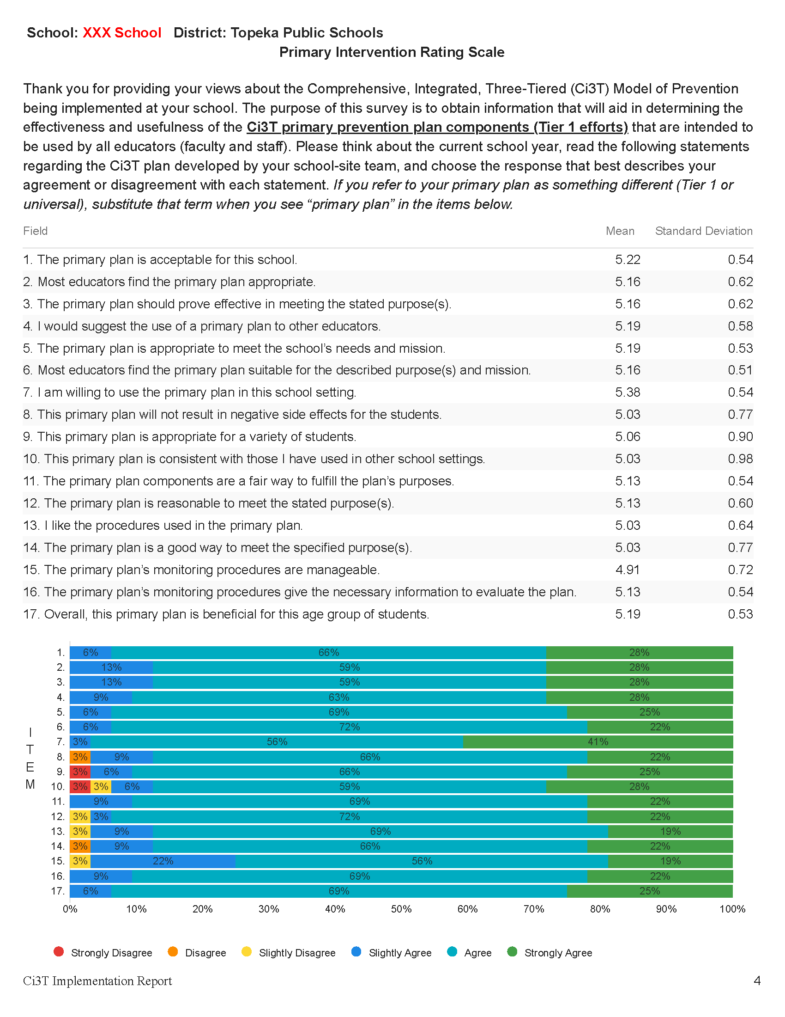
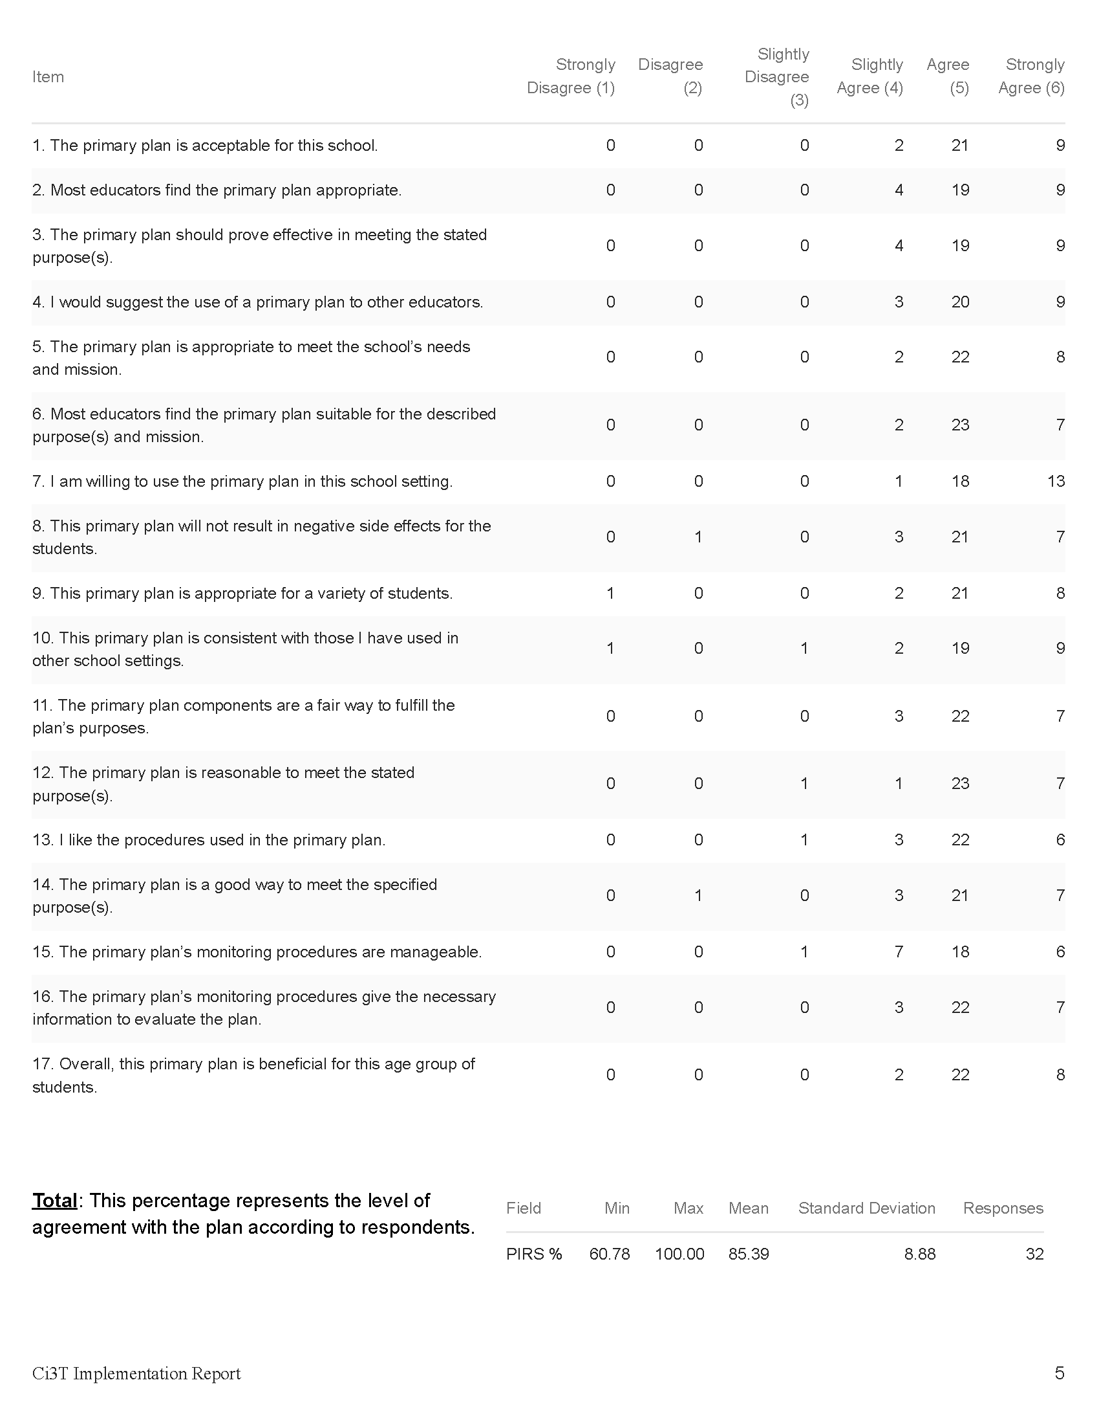
Preparing to Use Treatment Integrity and Social Validity Data

Slide 29
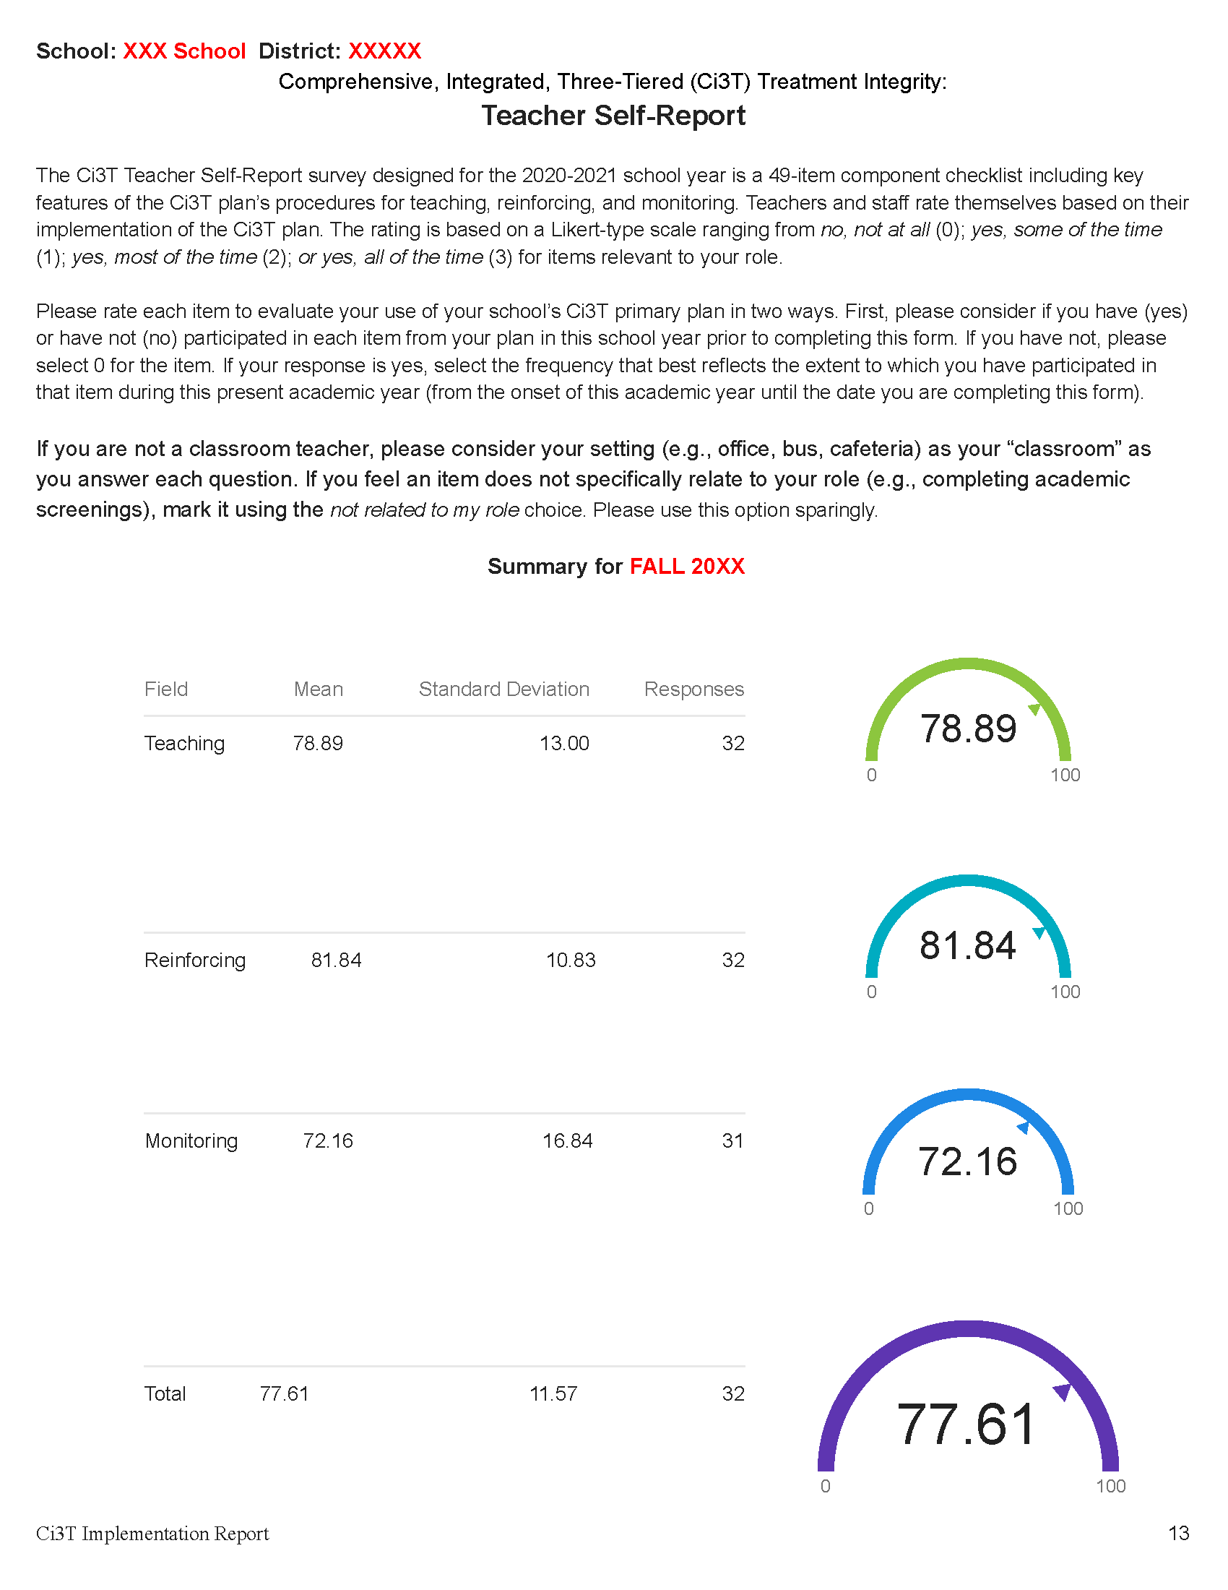
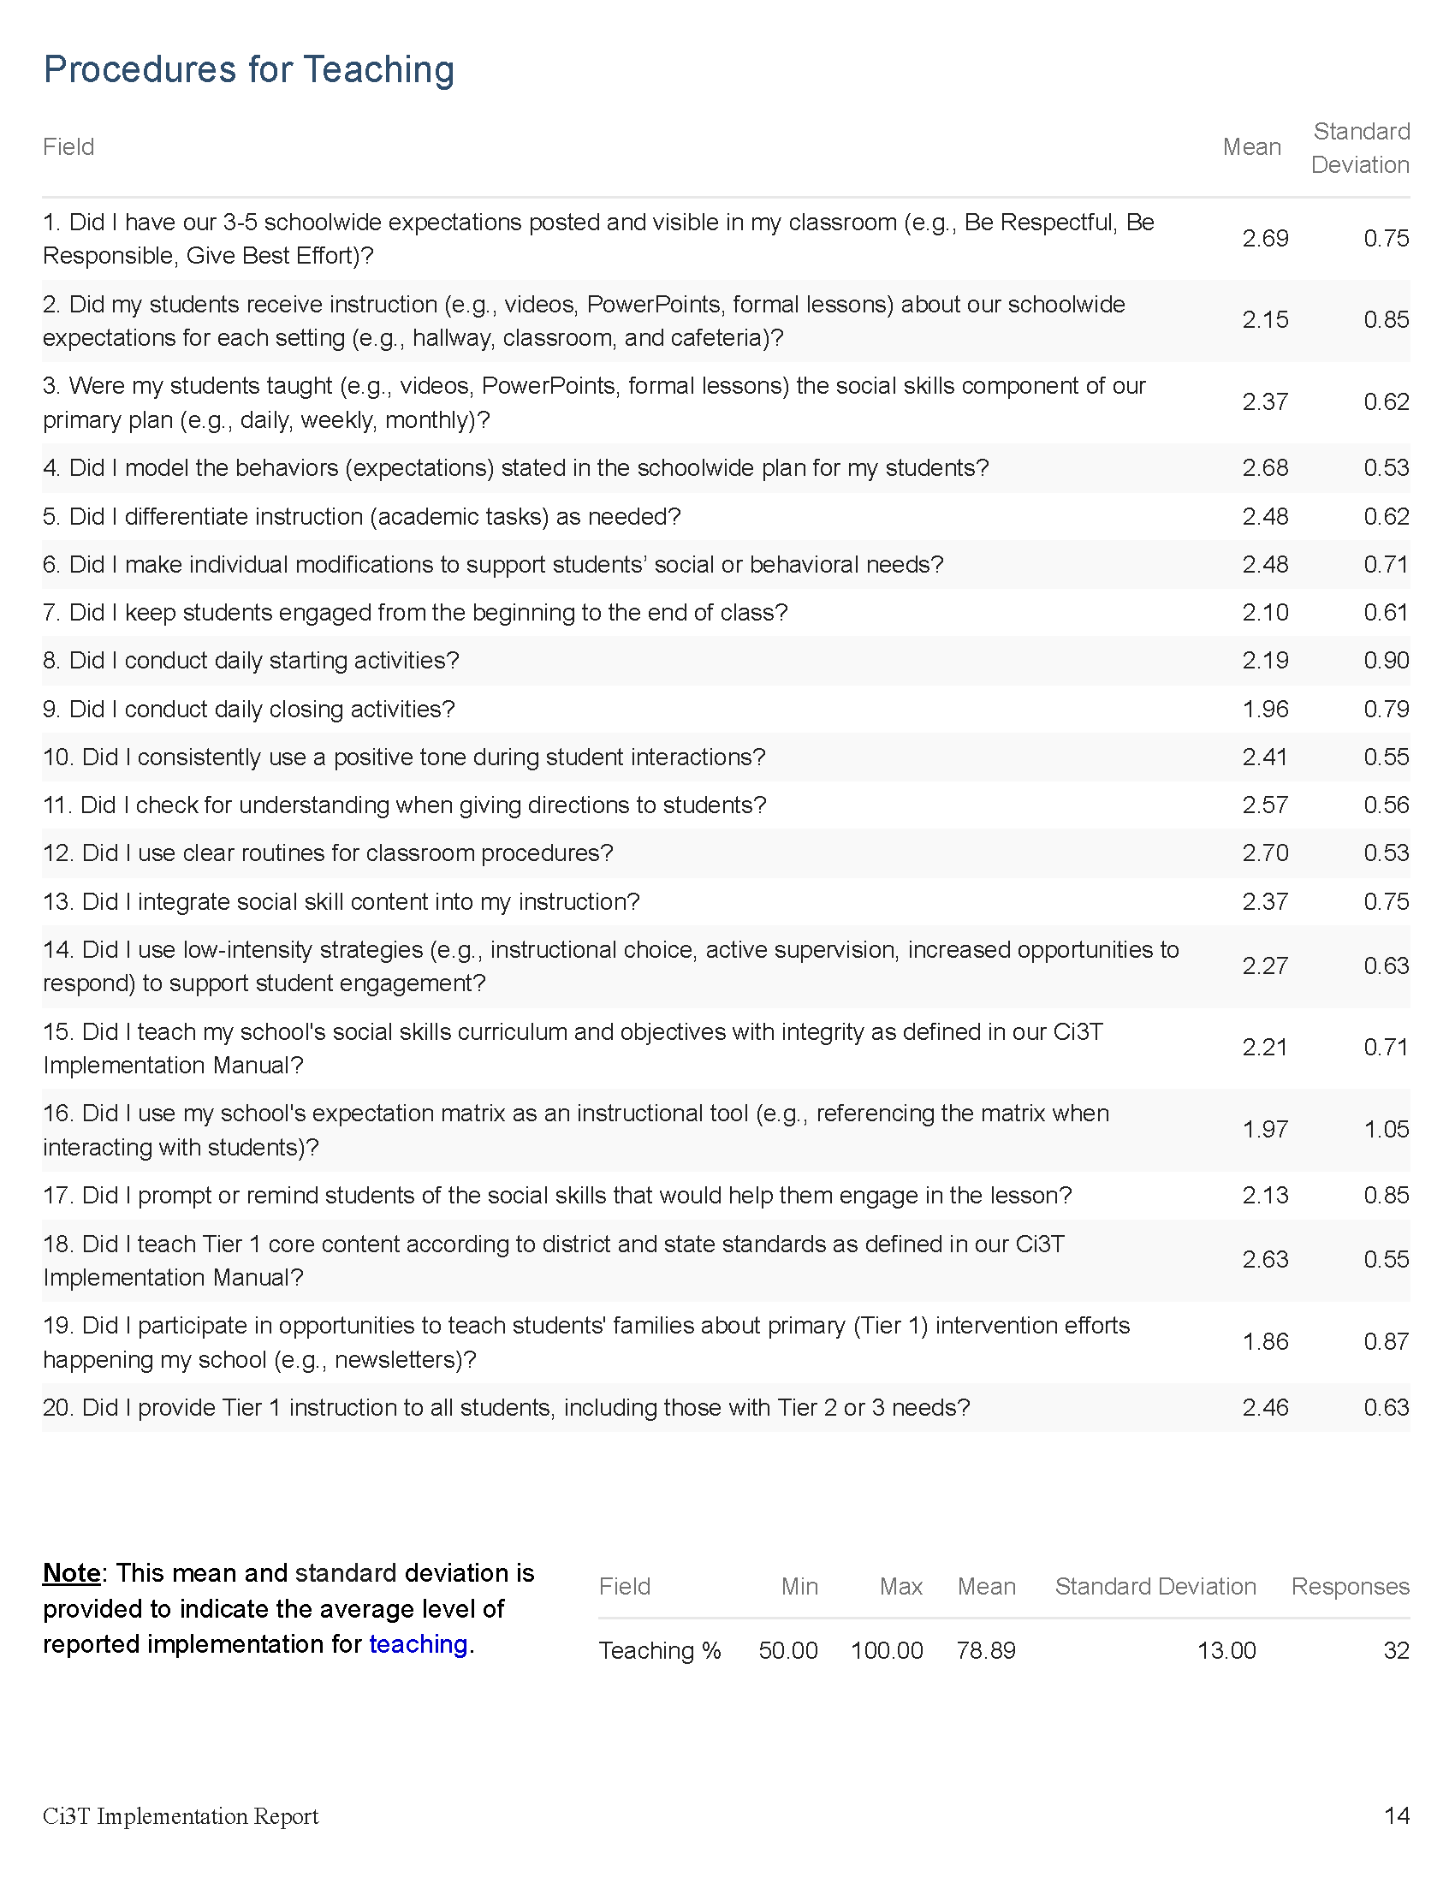
Preparing to Use Treatment Integrity and Social Validity Data

Slide 31
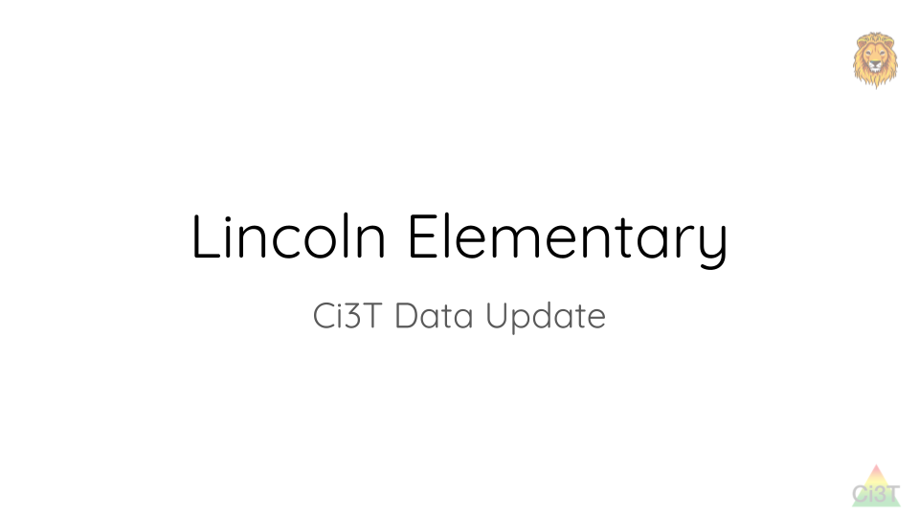
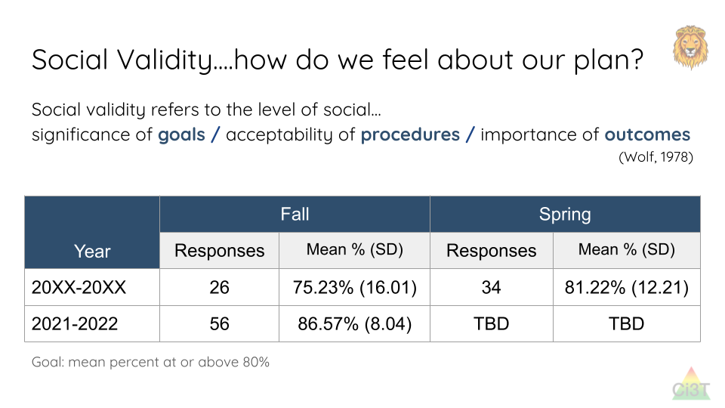
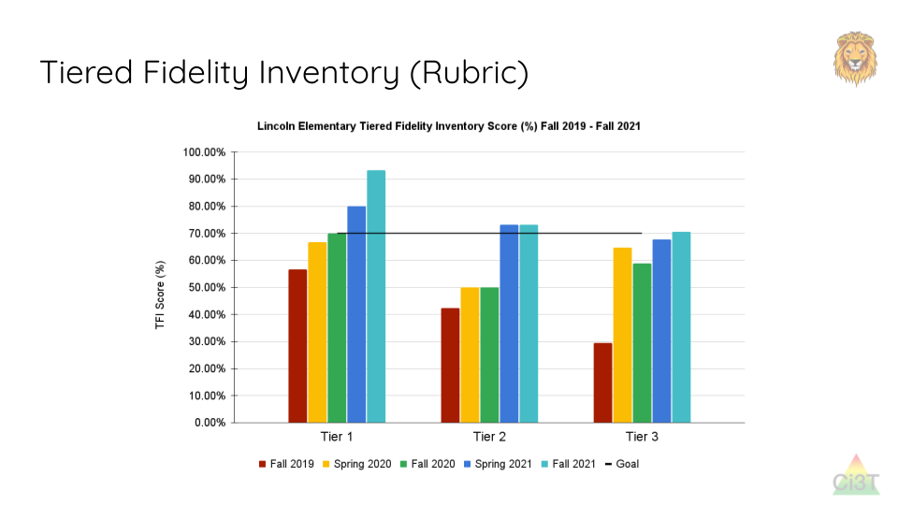
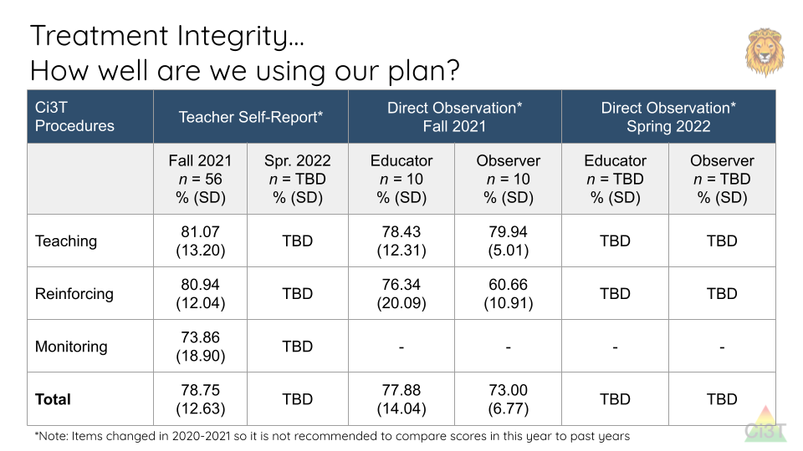
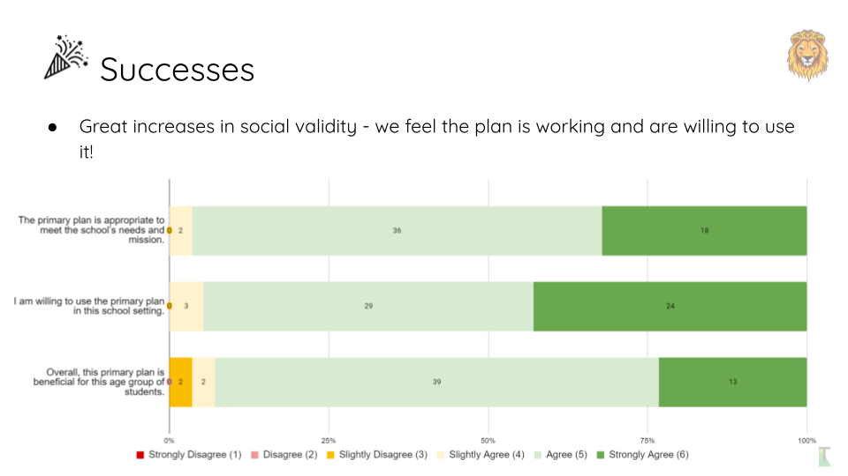
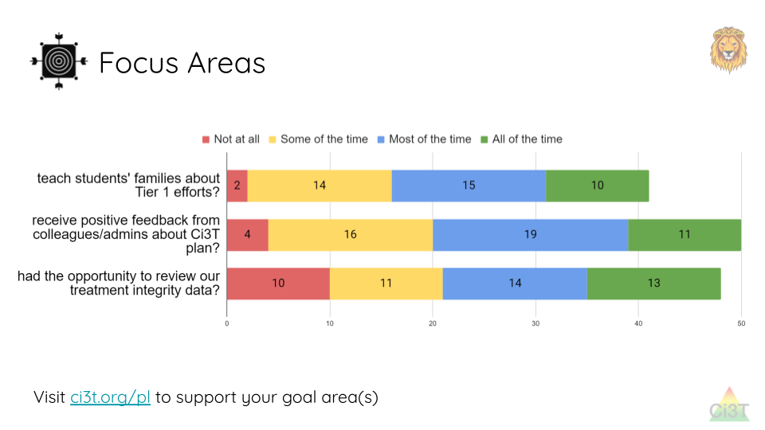
Sharing and Using Your Data

Slide 32












Let’s discuss!
Confirm data collection logistics When will our faculty and staff complete the Ci3T Treatment Integrity: Teacher Self-Report & Primary Intervention Rating Scale Survey? When will our Ci3T Leadership Team complete the Tiered Fidelity Inventory (TFI) protocols? Add action items on agenda for upcoming Ci3T Leadership Team meetings (e.g., Nov./Dec.) | Begin brainstorming re: how to share data How will we share treatment integrity and social validity data with stakeholders (e.g., faculty & staff, families)? How can we use treatment integrity and social validity data to inform professional learning opportunities? What assistance do we need in summarizing and sharing data?
Write any action items in your Ci3T Leadership Team Meeting Agenda
Notes:
10 min timer

Slide 33
Using Fall Screening Data to Inform Instruction
Primary (Tier 1) Prevention Efforts
Teacher-Delivered, Low-Intensity Strategies
Secondary (Tier 2) and Tertiary (Tier 3) Interventions

Slide 34
Comprehensive, Integrated, Three-Tiered Model of Prevention
(Lane, Kalberg, & Menzies, 2009)
Tier 3
Tertiary Prevention (≈5%)
Tier 2
Secondary Prevention (≈15%)
Tier 1
Primary Prevention (≈80%)
Academic ◇ Behavioral ◇ Social
Validated Curricula PBIS Framework Validated Curricula

Slide 35

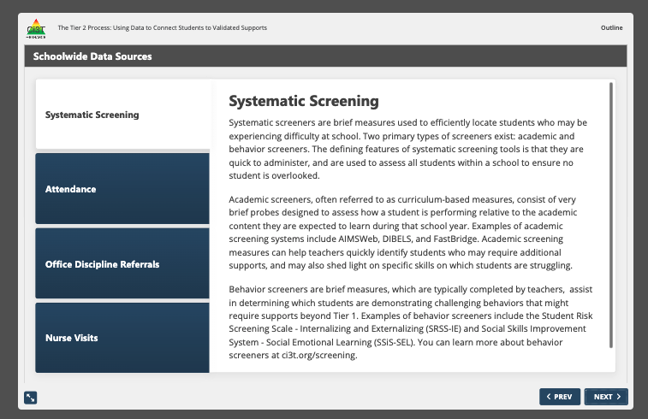

Slide 36
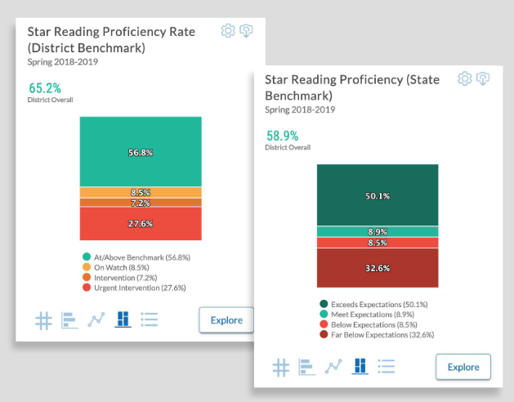
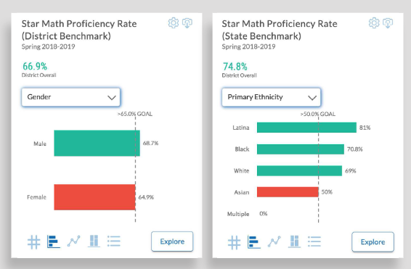

Academic Screening
Notes:
Might consider beginning by looking at data broadly
compared against district or state benchmarks
Subgroup analyses

Slide 37
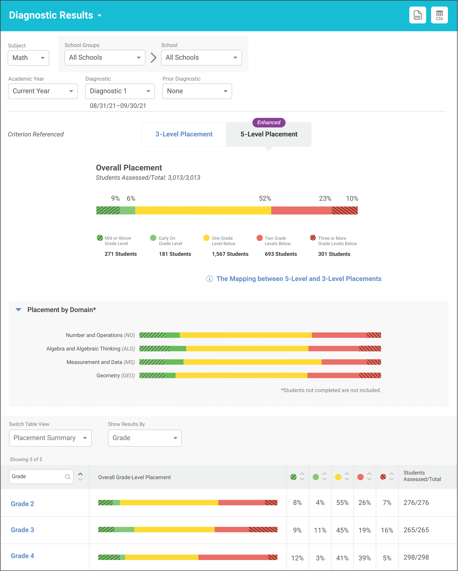
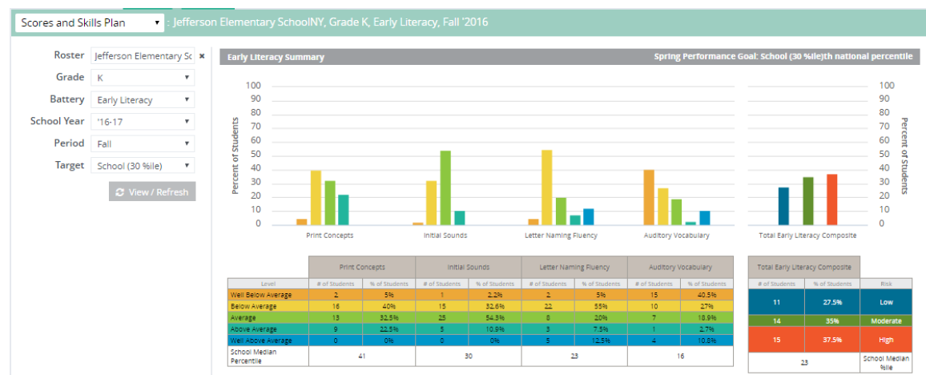
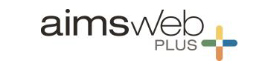

Academic Screening
Notes:
Then, might zoom in at the grade-level looking at distribution across risk category, mastery, or growth

Slide 40
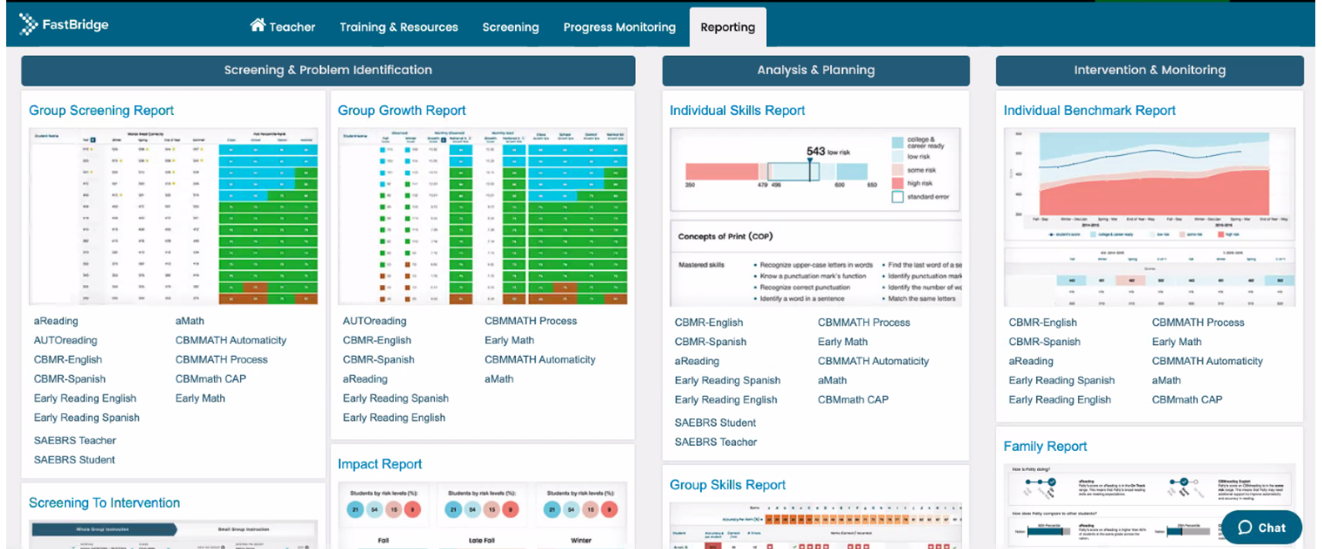
Academic Screening

Slide 41
Academic Screening

Slide 42
Academic Screening

Slide 43
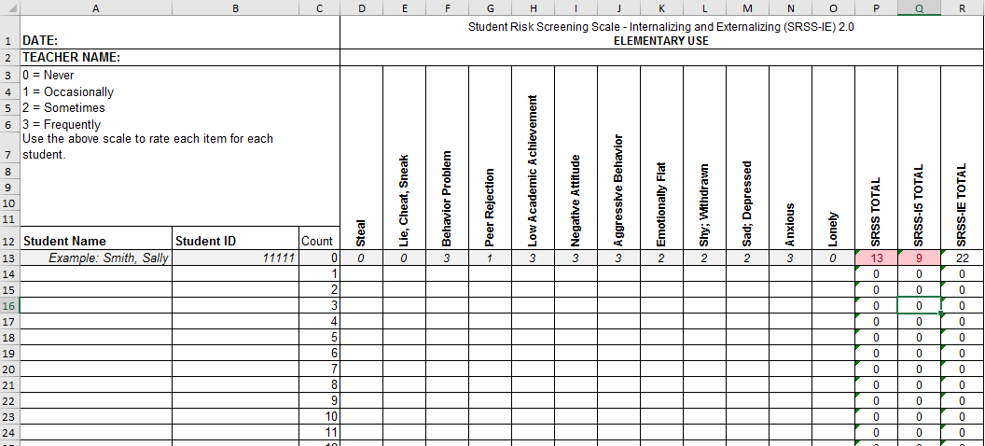
Student Risk Screening Scale for
Internalizing and Externalizing
(SRSS-IE; Drummond, 1994; Lane & Menzies, 2009)

Slide 44
SRSS-IE: Cut Scores
Elementary School |  | Middle and High School
SRSS-E7 | SRSS-I5 | SRSS-E7 | SRSS-I6
Items 1-7 | Items 8-12 | Items 1-7 | Items 4, 8-12
0-3 = low risk 4-8 = moderate risk 9-21 = high risk | 0-1 = low risk 2-3 = moderate risk 4-15 = high risk | 0-3 = low risk 4-8 = moderate risk 9-21 = high risk | 0-3 = low risk 4-5 = moderate risk 6-18 = high risk
Elementary School Level:
Lane, K. L., Oakes, W. P., Swogger, E. D., Schatschneider, C., Menzies, H., M., & Sanchez, J. (2015). Student risk screening scale for internalizing and externalizing behaviors: Preliminary cut scores to support data-informed decision making. Behavioral Disorders, 40, 159-170.
Middle and High School Levels:
Lane, K. L., Oakes, W. P., Cantwell, E. D., Schatschneider, C., Menzies, H., Crittenden, M., & Messenger, M. (2016). Student Risk Screening Scale for Internalizing and Externalizing Behaviors: Preliminary cut scores to support data-informed decision making in middle and high schools. Behavioral Disorders, 42(1), 271-284

Slide 45
Fall 2022
SRSS-Externalizing Results – Elementary School
n = 44
n = 43
n = 47
n = 27
n = 36
n = 29
n = 6
n = 17
n = 22
n = 30
n = 69
n = 61
n = 85
n = 94
n = 86
n = 83
n = 118
n = 100
n = 283
n = 276
n = 335
n = 329
n = 306
n = 293
n = 333
n = 346
n = 352
Notes:
***note to presenter***
If you would like to feature middle or high school data – hide the elementary slides (45-47) and unhide the middle or high school slides
If you would like to update this slide with data from your school or district- Fill in <year> based on current academic year. This is located in column A of the data sheet. Edit by right clicking and selecting “Edit data”.

Slide 46
Fall 2022
SRSS-Internalizing Results – Elementary School
n = 59
n = 62
n = 39
n = 39
n = 31
n = 18
n = 13
n = 32
n = 23
n = 82
n = 65
n = 67
n = 46
n = 47
n = 35
n = 69
n = 73
n = 62
n = 304
n = 292
n = 361
n = 338
n = 351
n = 340
n = 321
n = 338
n = 343
Cut scores vary by school level:
Elementary (I5): Low (0-1), Moderate (2-3), High (4-15)
Middle and High (I6): Low (0-3), Moderate (4-5), High (6-18)
Notes:
Fill in <year> based on current academic year. This is located in column A of the data sheet. Edit by right clicking and selecting “Edit data”.
IMPORTANT NOTE: The INTERNALIZING subscale and CUT SCORES are specific to school level.
Elementary: SRSS-I5, Items 8-12, 0-1 = low risk, 2-3 = moderate risk, 4-15 = high risk
Middle and High: SRSS-I6, Items 4, 8-12, 0-3 = low risk, 4-5 = moderate risk, 6-18 = high risk

Slide 47
Fall 2022
SRSS-Internalizing Results – Elementary School
Grade Level | N Screened | Low n (%) | Moderate n (%) | High n (%)
K | 64 | 52 (81.25%) | 7 (10.94%) | 5 (7.81%)
1 | 81 | 69 (85.19%) | 9 (11.11%) | 3 (3.70%)
2 | 56 | 44 (78.57%) | 11 (19.64%) | 1 (1.79%)

Slide 48
Fall 2022
SRSS-Externalizing Results – Middle School
n = 19
n = 23
n = 24
n = 9
n = 11
n = 3
n = 18
n = 16
n = 31
n = 27
n = 75
n = 57
n = 53
n = 75
n = 67
n = 53
n = 541
n = 475
n = 517
n = 400
n = 515
n = 552
n = 518
n = 460
Notes:
Fill in <year> based on current academic year. This is located in column A of the data sheet. Edit by right clicking and selecting “Edit data”.

Slide 49
Fall 2022
SRSS-Internalizing Results – Middle School
n = 87
n = 43
n = 37
n = 13
n = 21
n = 19
n = 53
n = 37
n = 13
n = 42
n = 26
n = 39
n = 30
n = 27
n = 40
n = 88
n = 460
n = 486
n = 518
n = 414
n = 550
n = 536
n = 510
n = 450
Cut scores vary by school level:
Elementary (I5): Low (0-1), Moderate (2-3), High (4-15)
Middle and High (I6): Low (0-3), Moderate (4-5), High (6-18)
Notes:
Fill in <year> based on current academic year. This is located in column A of the data sheet. Edit by right clicking and selecting “Edit data”.
IMPORTANT NOTE: The INTERNALIZING subscale and CUT SCORES are specific to school level.
Elementary: SRSS-I5, Items 8-12, 0-1 = low risk, 2-3 = moderate risk, 4-15 = high risk
Middle and High: SRSS-I6, Items 4, 8-12, 0-3 = low risk, 4-5 = moderate risk, 6-18 = high risk

Slide 50
Fall 2022
SRSS-Internalizing Results – Middle School
Grade Level | N Screened | Low n (%) | Moderate n (%) | High n (%)
6 | 176 | 151 (85.80%) | 15 (8.52%) | 10 (5.68%)
7 | 176 | 141 (80.11%) | 17 (9.66%) | 18 (10.23%)
8 | 177 | 158 (89.21%) | 10 (5.65%) | 9 (5.08%)

Slide 51
Fall 2022
SRSS-Externalizing Results – High School
n = 29
n = 39
n = 23
n = 25
n = 30
n = 13
n = 26
n = 38
n = 96
n = 95
n = 90
n = 82
n = 69
n = 55
n = 95
n = 129
n = 1072
n = 1404
n = 1339
n = 1222
n = 692
n = 1119
n = 1270
n = 1242
Notes:
Fill in <year> based on current academic year. This is located in column A of the data sheet. Edit by right clicking and selecting “Edit data”.

Slide 52
Fall 2022
SRSS-Internalizing Results – High School
n = 112
n = 87
n = 76
n = 62
n = 63
n = 70
n = 78
n = 91
n = 124
n = 64
n = 56
n = 42
n = 38
n = 41
n = 66
n = 106
n = 961
n = 1387
n = 1320
n = 1225
n = 690
n = 1076
n = 1247
n = 1212
Cut scores vary by school level:
Elementary (I5): Low (0-1), Moderate (2-3), High (4-15)
Middle and High (I6): Low (0-3), Moderate (4-5), High (6-18)
Notes:
Fill in <year> based on current academic year. This is located in column A of the data sheet. Edit by right clicking and selecting “Edit data”.
IMPORTANT NOTE: The INTERNALIZING subscale and CUT SCORES are specific to school level.
Elementary: SRSS-I5, Items 8-12, 0-1 = low risk, 2-3 = moderate risk, 4-15 = high risk
Middle and High: SRSS-I6, Items 4, 8-12, 0-3 = low risk, 4-5 = moderate risk, 6-18 = high risk

Slide 53
Fall 2022
SRSS-Internalizing Results – High School
Grade Level | N Screened | Low n (%) | Moderate n (%) | High n (%)
9 | 367 | 308 (83.92%) | 30 (8.17%) | 29 (7.90%)
10 | 375 | 308 (82.13%) | 35 (9.33%) | 32 (8.53%)
11 | 367 | 321 (87.47%) | 24 (6.54%) | 22 (5.99%)
12 | 300 | 275 (91.67%) | 17 (5.67%) | 8 (2.67%)

Slide 54
Screening Data: High School Yrs1-3
Fall- SRSSIE-I |  | Low |  | Moderate |  | High |  | Fall- SRSSIE-E |  | Low |  | Moderate |  | High
2016 |  | 80.28% |  | 10.36% |  | 9.36% |  | 2016 |  | 89.56% |  | 8.02% |  | 2.42%
2017 |  | 90.18% |  | 4.16% |  | 5.66% |  | 2017 |  | 91.29% |  | 6.18% |  | 2.54%
2018 |  | 90.91% |  | 3.86% |  | 5.23% |  | 2018 |  | 92.22% |  | 6.20% |  | 1.58%
WTR-SRSSIE-I |  | Low |  | Moderate |  | High |  | WTR-SRSSIE-E |  | Low |  | Moderate |  | High
2016 |  | 87.25% |  | 9.49% |  | 3.26% |  | 2016 |  | 87.25% |  | 9.49% |  | 3.26%
2017 |  | 86.14% |  | 9.02% |  | 4.85% |  | 2017 |  | 86.14% |  | 9.02% |  | 4.85%
2018 |  | 88.79% |  | 8.52% |  | 2.69% |  | 2018 |  | 88.79% |  | 8.52% |  | 2.69%

Slide 55





Slide 56
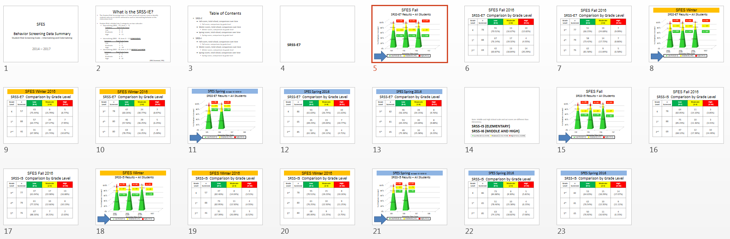
Sample Middle School: Fall
SRSS-E7 Results – All Students
N = 26
N = 12
N = 89
N = 66
N = 554
N = 550

Slide 57
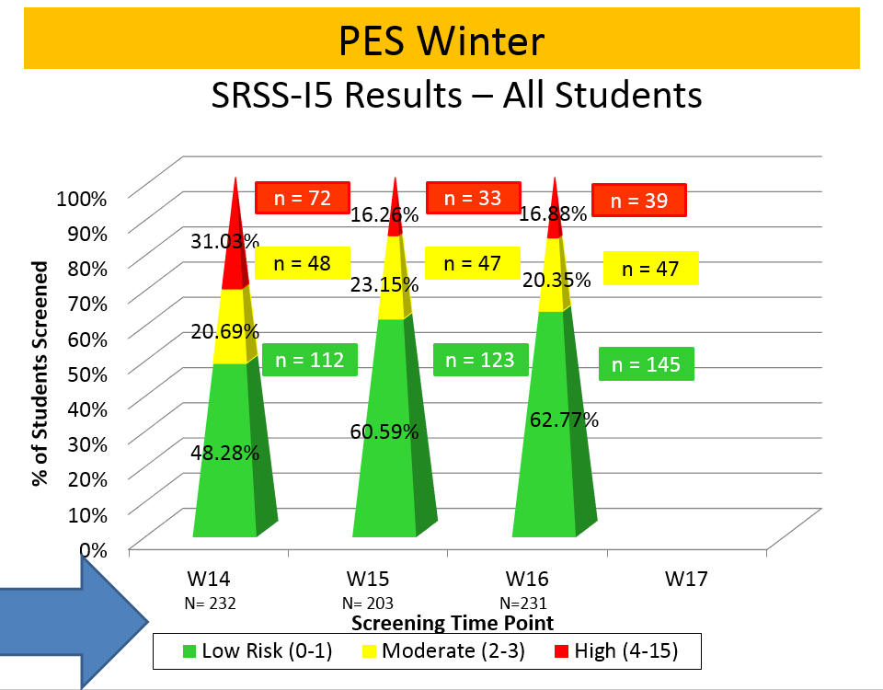
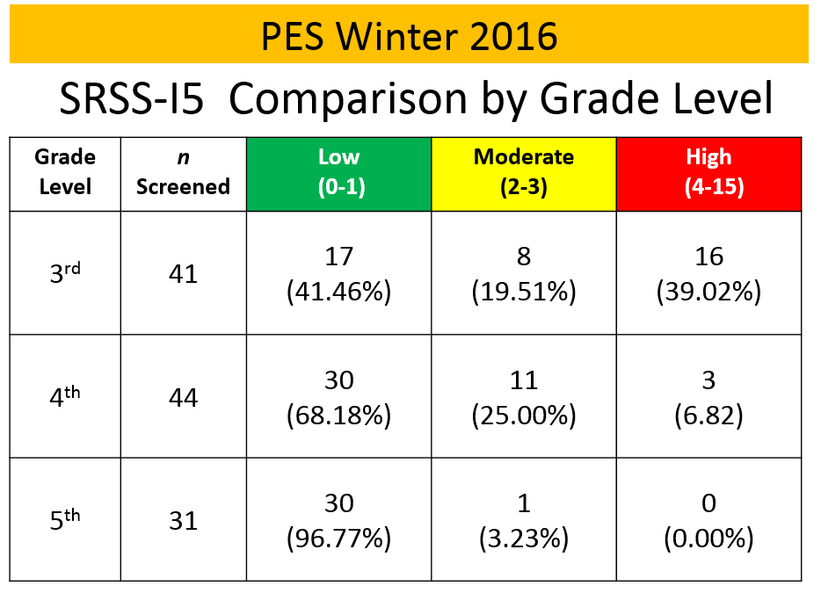
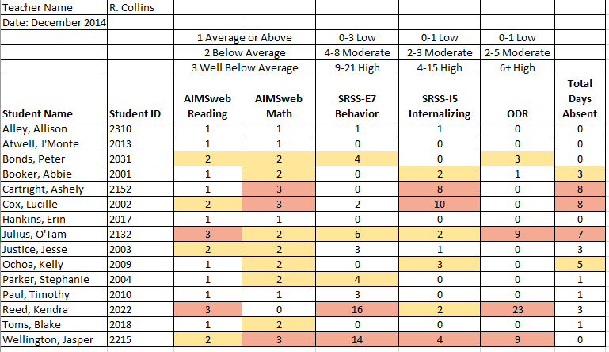
Data sharing…
Schoolwide data
  …decisions related to primary prevention efforts
Grade / Department / Class
  …implications for teachers’ practice
Individual student
  …decisions about student-based interventions

Slide 58
Using Fall Screening Data to Inform Instruction
Primary (Tier 1) Prevention Efforts
Teacher-Delivered, Low-Intensity Strategies
Secondary (Tier 2) and Tertiary (Tier 3) Interventions

Slide 59
Social Skills Improvement System – Performance Screening Guide Spring 2012 – Total School
N = 54
N = 22
N = 35
N = 31
N = 223
N = 233
N = 180
N = 187
N = 212
N = 235
N = 275
N = 271
n = 489 n = 490 n = 490 n = 489
Lane, K. L., Oakes, W. P., & Magill, L. (2013). Primary prevention efforts: How do we implemented and monitor the Tier 1 component of our Comprehensive, Integrated, Three-Tiered (Ci3T) Model?, Preventing School Failure, 58(1), 143-158.

Slide 60
Fall 2022
SRSS-Externalizing Results – Elementary School
n = 44
n = 43
n = 47
n = 27
n = 36
n = 29
n = 6
n = 17
n = 22
n = 118
n = 100
n = 85
n = 94
n = 86
n = 83
n = 30
n = 69
n = 61
n = 276
n = 335
n = 329
n = 306
n = 293
n = 333
n = 283
n = 346
n = 352
Notes:
Fill in <year> based on current academic year. This is located in column A of the data sheet. Edit by right clicking and selecting “Edit data”.

Slide 61
Student Risk Screening Scale Fall 2004 – 2012 Middle School
Source: Lane, K. L., Oakes, W. P., & Magill, L. M., (2014). Primary prevention efforts: How do we implement and monitor the Tier 1 component of our comprehensive, integrated, three-tiered model of prevention. Preventing School Failure, 58, 143-158. doi:10.1080/1045988X.2014.893978 [Figure 4. Middle school behavior screening data over time at the fall time point. Adapted from Figure 4.6 p. 127 Lane, K. L., Menzies, H. M, Oakes, W. P., & Kalberg, J. R. (2012). Systematic screenings of behavior to support instruction: From preschool to high school. Guilford Press.]

Slide 62
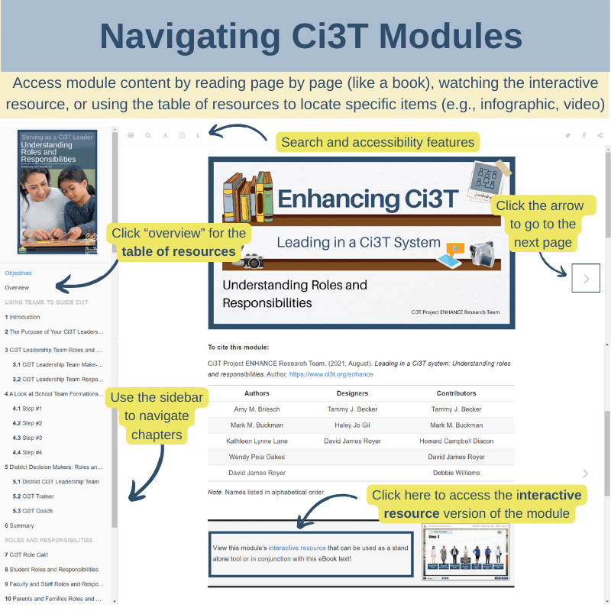
Using Fall Screening Data to Inform Instruction
Primary (Tier 1) Prevention Efforts
Teacher-Delivered, Low-Intensity Strategies
Secondary (Tier 2) and Tertiary (Tier 3) Interventions

Slide 63
Notes:
In this section we are going to highlight content from modules and wanted to start by grounding in this infographic, a new resource to help people get oriented to modules and how to use them. We heard your feedback that sometimes staff who are new to using modules find it tricky to navigate so wanted to highlight these key features!
If you’re accessing the module as an eBook and reading page x page, use arrow to navigate to the next page or sidebar to navigate chapters and pick up where you left off
If you want to watch the interactive resource, click here
If you’ve already reviewed the module and you’re coming back to locate a specific item (or “lucky charm” at Kathleen likes to call them) like an infographic, video, or activity, click where it says “overview” here on the sidebar to be taken to the table of resource. From there you can click “page” to be taken to that part of the eBook or “link” to download the material directly.

Slide 64
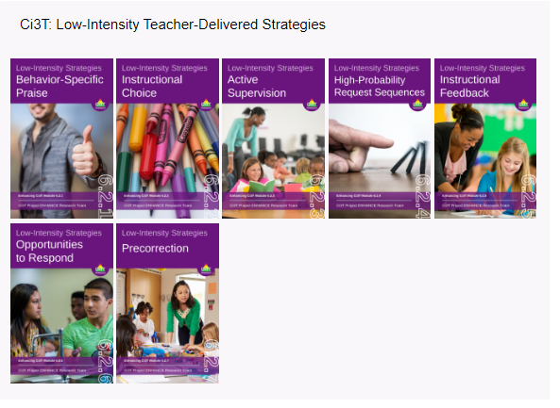
Notes:
Continued to keep implementation manuals, which are foundational to Ci3T, updated and current

Slide 65
Examining Academic and Behavioral Data
Lane, K. L., Menzies, H. M., Ennis, R. P., & Oakes, W. P. (2015). Supporting Behavior for School Success: A Step-by-Step Guide to Key Strategies. Guilford Press.
Notes:
Lane, K. L., Oakes, W. P., Ennis, R. P., & Hirsch, S. E. (2014). Identifying students for secondary and tertiary prevention efforts: How do we determine which students have Tier 2 and Tier 3 needs? Preventing School Failure, 58, 171-182, DOI: 10.1080/1045988X.2014.895573

Slide 66
Low-Intensity Strategy | Franklin High School On-Site Expert
Behavior-Specific Praise: Identifying the specific expectation the student met. “Niama, I noticed you outlined your paper and used the graphic organizer to draft your essay. Well done!” “Justice, thank you for pushing in your chair to keep the walkway safe.” | Eric Common, Behavior Specialist Mark Buckman, Special Education Grant Allen, Parent Volunteer Paloma Pérez-Clark, School Psychologist
Opportunities to Respond: Providing 4-6 opportunities per minute for students to respond individually, choral, verbal, written, gesture, or symbol. “Show me thumbs or thumbs down if...” “Show me on your white board what…” “Turn to your elbow partner and say…” “All together now, what is…” | David Royer, Administration Emily Cantwell, 12th Grade Scarlett Lane, 11rd Grade Mallory Messenger, Counselor
Instructional Choice: Providing within-task or between task choices to increase academic engaged time and motivation. “Ronaldo, our of our 3 learning objectives today, which would you like to work on first?” “Suzy, do you want to work on the laptop, or handwrite your answers for this assignment?” | Abbie Jenkins, 10th Grade Scarlett Lane, 11th Grade José Sousa, PE Liane Johl, 9th Grade

Slide 67

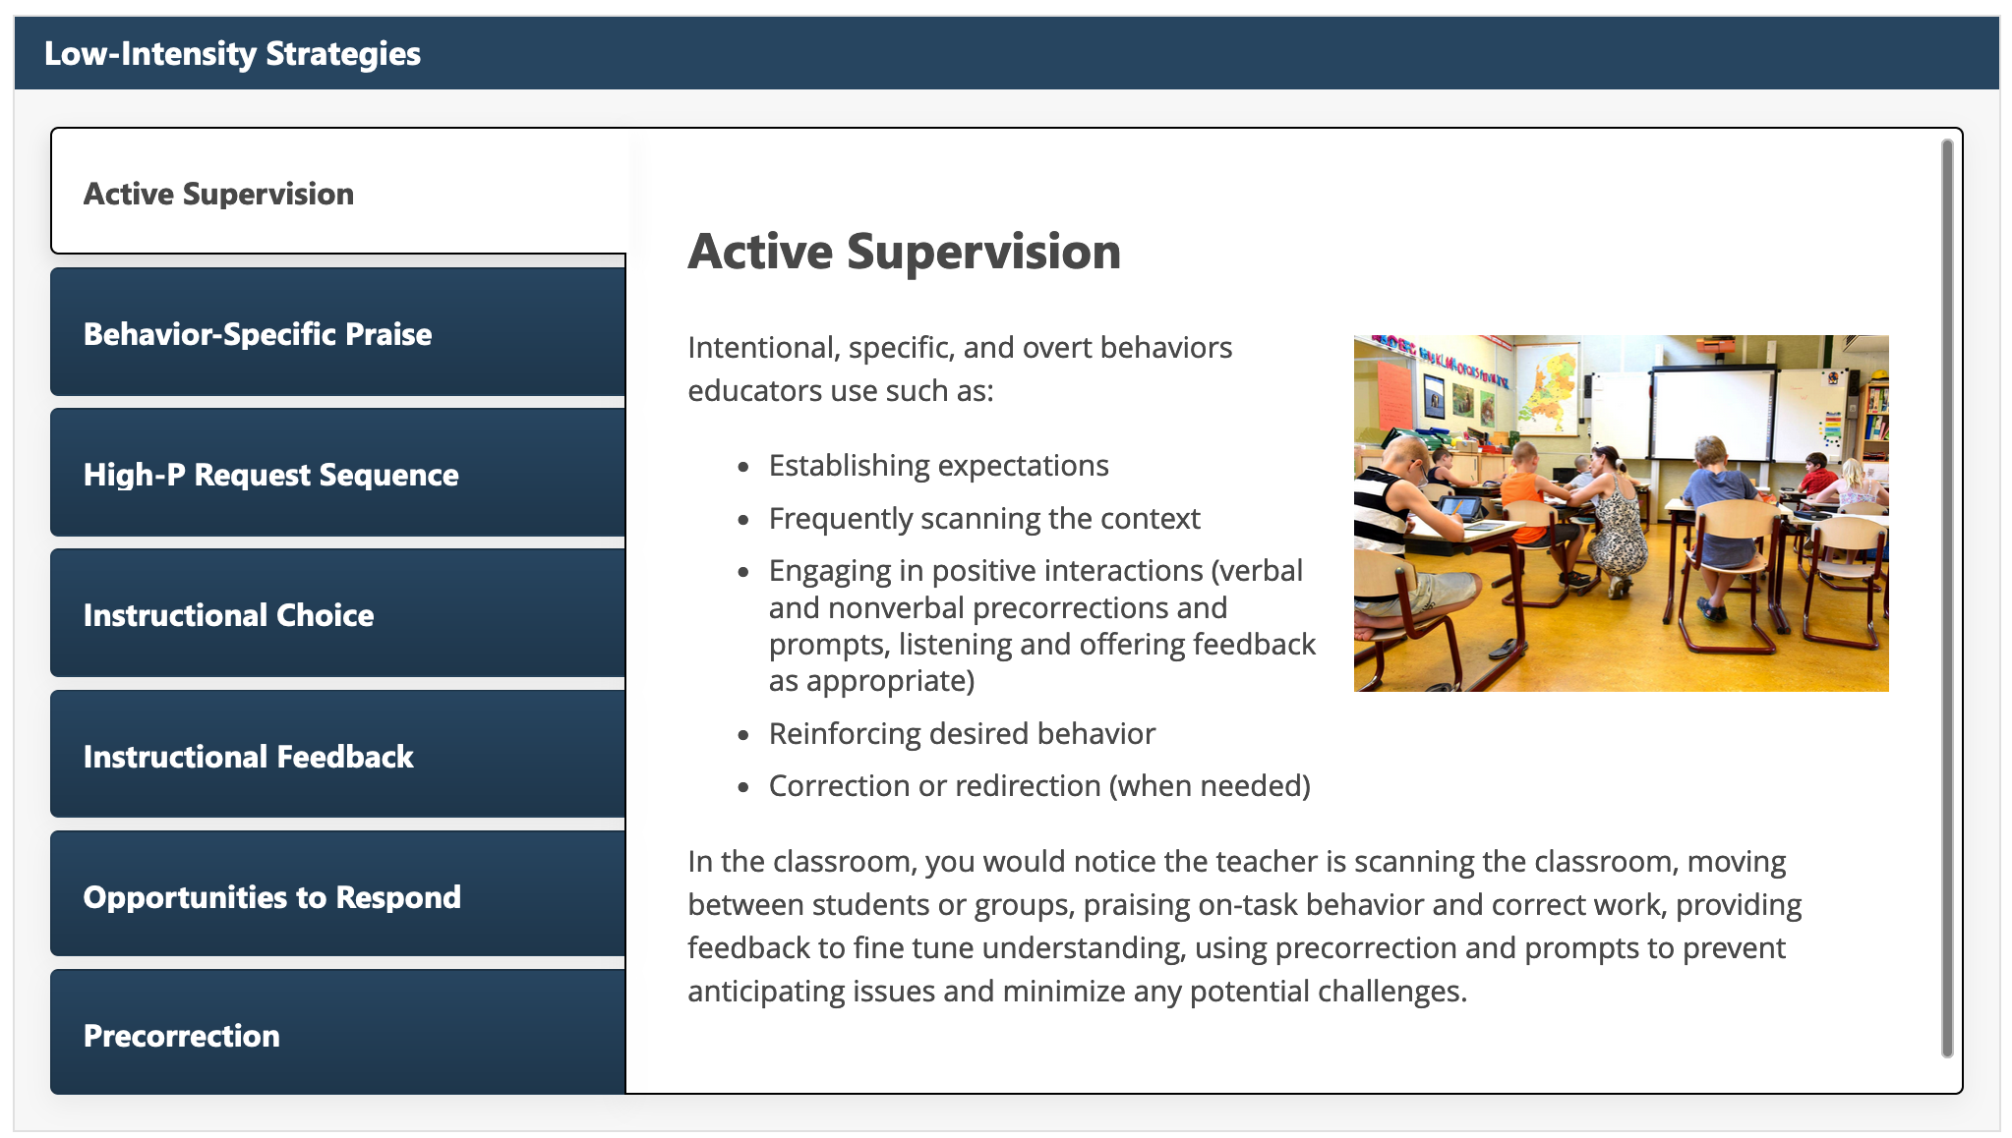
Low-Intensity Strategies to Prevent Challenging Behavior

Slide 68

Embedding Low-Intensity Strategies in Daily Instruction
Notes:
2:44 video – elementary, numerous examples of embedding pre-correction, active supervision, BSP into routines (e.g., moving from desk to carpet, using response cards during a vocabulary lesson)

Slide 69
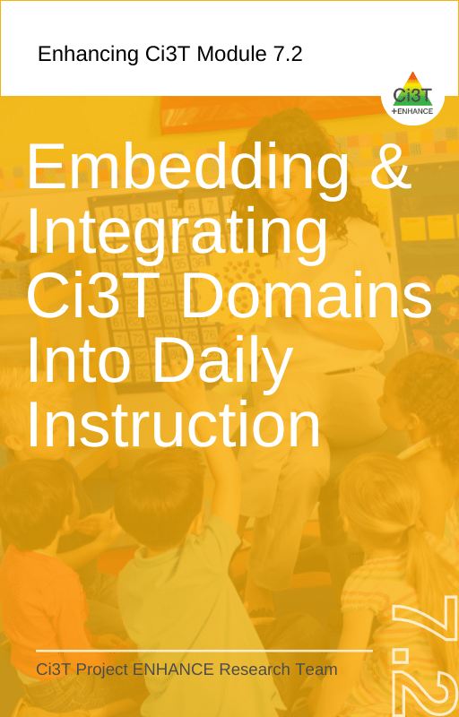
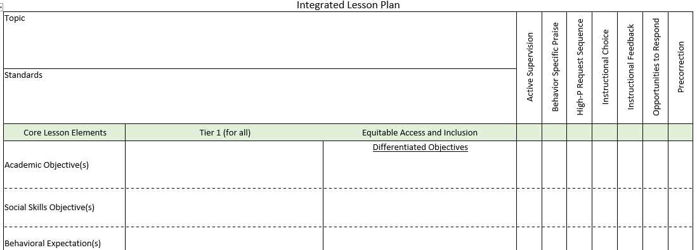
Integrated Lesson Planning

Slide 70
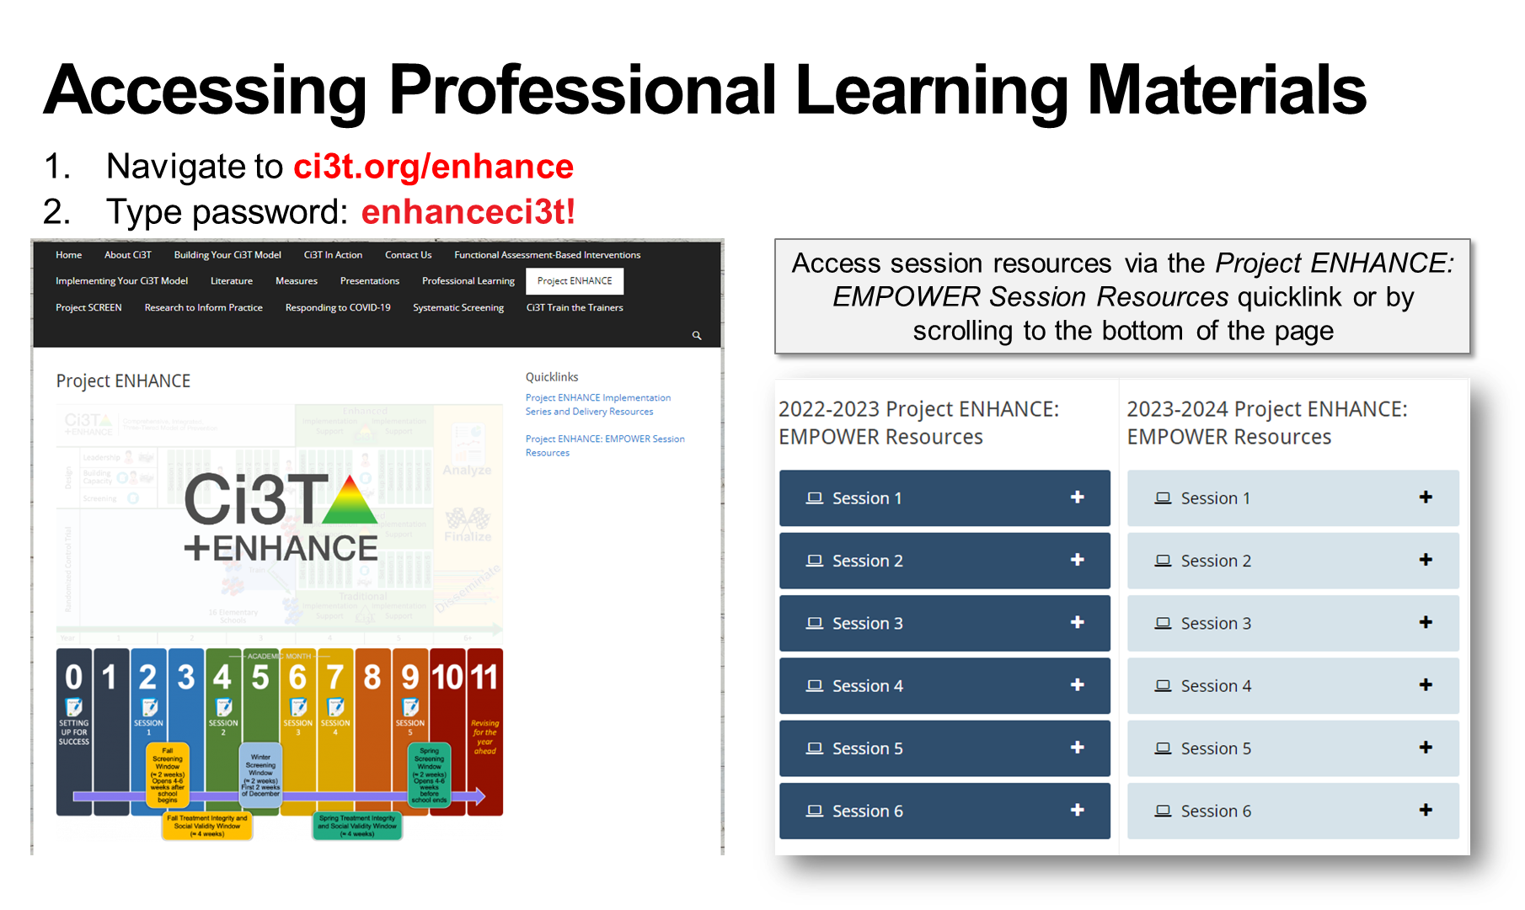


Slide 71
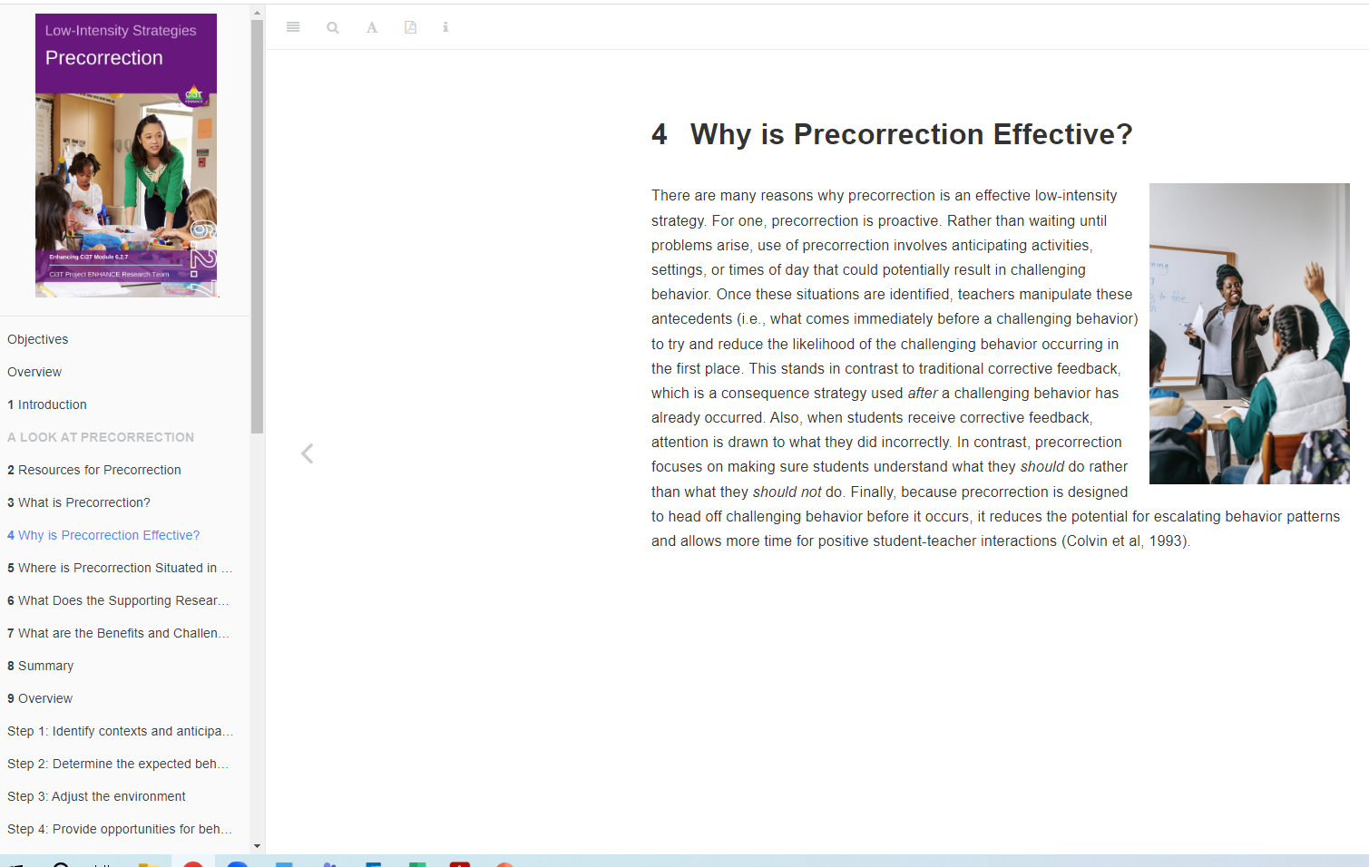
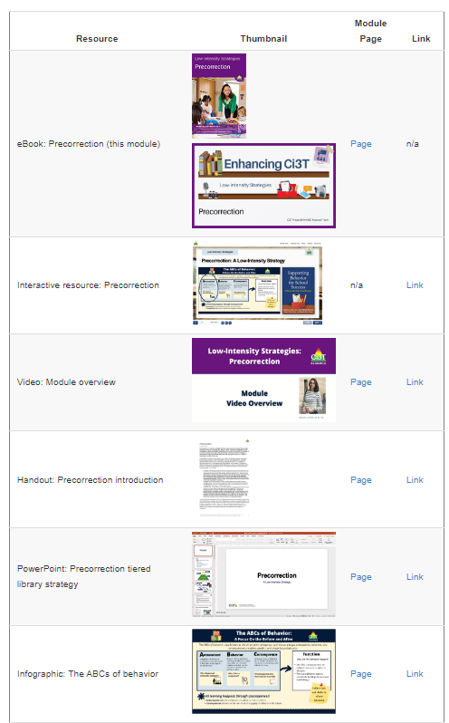
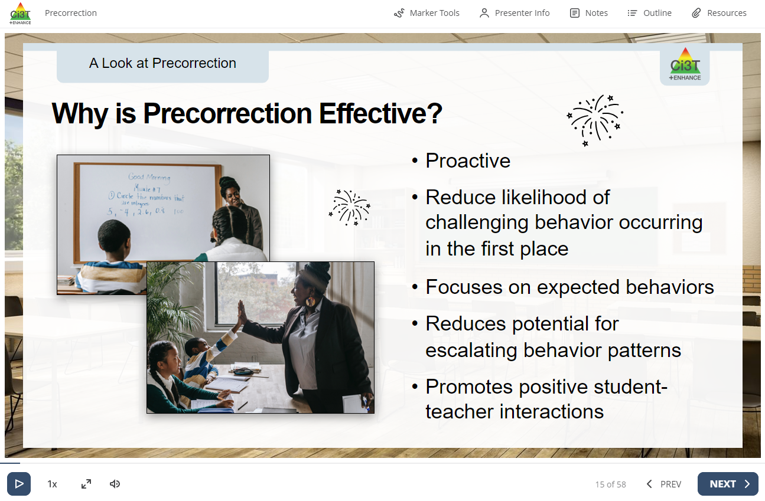
eBook
Interactive resource
table of resources
Notes:
As we dive into this module, remember there are (3) ways to access content:
Read like a book
Watch the interactive resources
Use the table of resources to quickly find

Slide 72
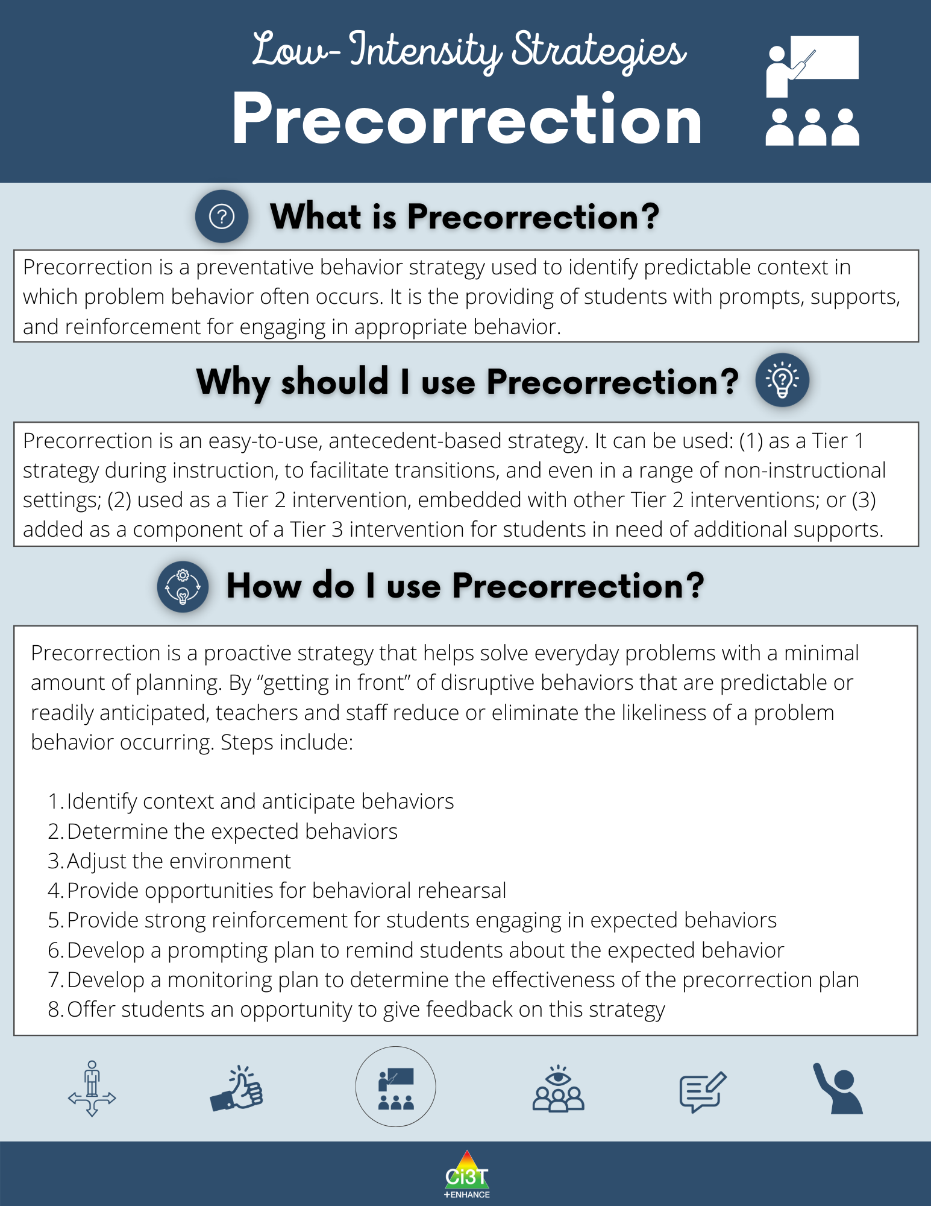
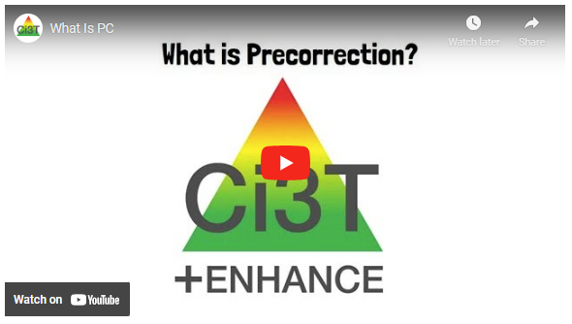
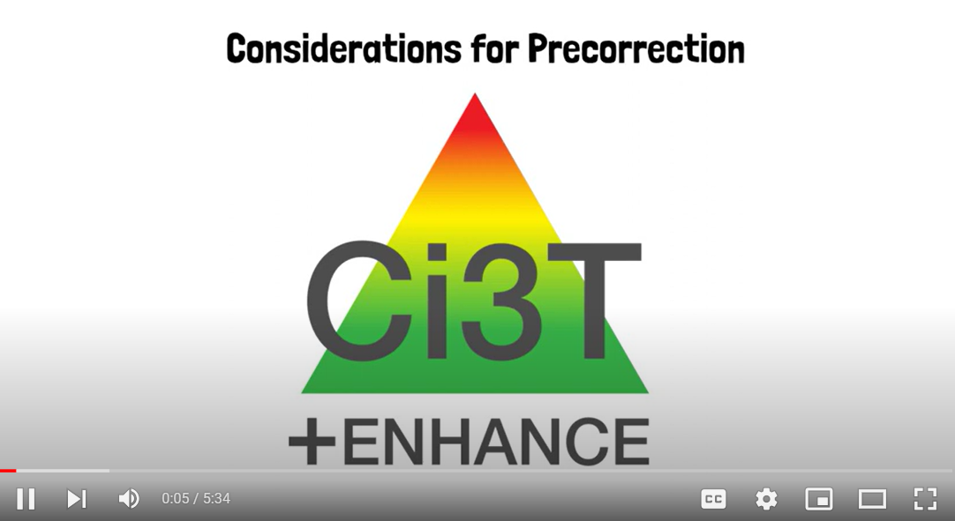

Slide 73



Slide 74



Slide 75




Slide 76


Deep dive into this at EMPOWER Session 3!
Designate two staff to attend trainings to become on-site coaches
10 min @ next Faculty and Staff meeting
Ci3T Setting Up for Success
Systematic Screening
Low-Intensity Strategies
Tier 2
Planning Ahead
Tier 3

Slide 77

Consider Teacher-Delivered Strategies Across Tiers
Opportunites to Respond
Behavior-Specific Praise
Active Supervision
Instructional Feedback
High-Probability Requests
Precorrection
Instructional Choice

Slide 78
Using Fall Screening Data to Inform Instruction
Primary (Tier 1) Prevention Efforts
Teacher-Delivered, Low-Intensity Strategies
Secondary (Tier 2) and Tertiary (Tier 3) Interventions

Slide 79

Comprehensive, Integrated, Three-Tiered Model of Prevention
(Lane, Kalberg, & Menzies, 2009)
Tier 3
Tertiary Prevention (≈5%)
Tier 2
Secondary Prevention (≈15%)
Secondary (Tier 2) Intervention Grids
Tier 1
Primary Prevention (≈80%)
Academic ◇ Behavioral ◇ Social
Validated Curricula PBIS Framework Validated Curricula

Slide 80


Slide 81



Slide 82


Slide 83


Slide 84


Slide 85



Slide 86


Slide 87


Slide 88


Slide 89

An illustration

Slide 90

Small group Reading Instruction with Self-Monitoring
Lane, K. L., Oakes, W. P., & Magill, L. (2013). Primary prevention efforts: How do we implemented and monitor the Tier 1 component of our Comprehensive, Integrated, Three-Tiered (Ci3T) Model?, Preventing School Failure, 58(1), 143-158.
Notes:
Citation: Lane, K.L., & Oakes, W. P. (2012). Identifying Students for Secondary and Tertiary Prevention Efforts: How do we determine which students have Tier 2 and Tier 3 needs? In preparation.

Slide 91

First Grade Students’ Self Monitoring Form
Altmann, S. A. (2010). Project support and include: the additive benefits of self-monitoring on students’ reading acquisition. Unpublished master’s thesis, Vanderbilt University.

Slide 92

Treatment Integrity
Social Validity
Monitor student progress
Altmann, S. A. (2010). Project support and include: the additive benefits of self-monitoring on students’ reading acquisition. Unpublished master’s thesis, Vanderbilt University.

Slide 93





Professional Learning Modules

Slide 94


Building a Ci3T Tier Library
Teacher Delivered Strategies
Tier 1
Tier 2
Tier 3

Slide 95

Comprehensive, Integrated, Three-Tiered Model of Prevention
(Lane, Kalberg, & Menzies, 2009)
Tier 3
Tertiary Prevention (≈5%)
Tier 2
Secondary Prevention (≈15%)
Tertiary (Tier 3) Intervention Grids
Tier 1
Primary Prevention (≈80%)
Academic ◇ Behavioral ◇ Social
Validated Curricula PBIS Framework Validated Curricula

Slide 96

Tertiary (Tier 3) Intervention Grid

Slide 97








Professional Learning Modules

Slide 98

Tertiary (Tier 3) Intervention Grid

Slide 99

Changes in Harry’s Behavior
Cox, M., Griffin, M. M., Hall, R., Oakes, W. P., & Lane, K. L. (2012). Using a functional assessment-based intervention to increase academic engaged time in an inclusive middle school setting. Beyond Behavior, 2, 44 – 54.

Slide 100





Slide 101


Slide 102
Deep dive into this at EMPOWER Sessions 4 and 5!
Designate two staff to attend trainings to become on-site coaches
10 min @ next Faculty and Staff meeting
Ci3T Setting Up for Success
Systematic Screening
Low-Intensity Strategies
Tier 2
Planning Ahead
Tier 3

Slide 103






Let’s discuss!
Tier 1 & Empowering Teachers Review fall screening data (e.g., Behavior, Academic) How could implementing teacher-delivered low-intensity strategies help us respond to our fall screening data? What professional learning is necessary to respond to these data? What are our plans to share our data – and corresponding plans – with faculty & staff and stakeholders (e.g., families/community)? | Tier 2 & Tier 3 Use fall screening data (e.g., Behavior, Academic) to identify where Tier 2 and Tier 3 supports are needed Consider which teacher-delivered low-intensity strategies would be most helpful in responding to our Tier 2 and Tier 3 support needs? What professional learning is necessary to respond to these data? What are our plans to share our data – and corresponding plans – with faculty & staff and stakeholders (e.g., families/community)?
Write any action items in your Ci3T Leadership Team Meeting Agenda
Notes:
15 min timer

Slide 104
Facilitating Clear Communication and Collaborations with Stakeholders
Communicating and Collaborating with your:
District
Ci3T Leadership Team
Faculty and Staff
Students, Parents, and Community
Policy Makers
Communication and Collaboration: Plans & Timelines
Data-Informed Professional Learning

Slide 105



Slide 106



Notes:
This module features guidance and resources to ensure all members of the Ci3T Implementation Community are clear on their roles and responsibilities

Slide 107
Agenda

Slide 108

Communicating and Collaborating with your:
District
Ci3T Leadership Team
Faculty and Staff
Students, Parents, and Community
Policy Makers

Slide 109
Agenda

Slide 111

Building Capacity and Sustainability
of Tiered Prevention Models
For Academic Achievement, Behavior, and Social Competencies

Slide 112


District Communication with Stakeholders

Slide 113
Reflect & Plan: Communication with Stakeholders
How will you use multiple sources of data to inform professional learning for developing school capacity for low intensity strategies and tiered supports?
How will you use your Ci3T Team meeting time effectively and plan to communicate with all stakeholders?
How will you share program level data (treatment integrity and social validity) as well as student progress?
Notes:
10-min timer

Slide 114
Wrapping Up and Moving Forward

Slide 115
Ci3T
Comprehensive Professional Learning Plan
Ci3T: Primary Prevention
Session 1:
Overview of Ci3T Prevention Models
Setting a Purpose
Establish team meetings and roles
Session 2:
Mission and Purpose
Establish Roles and Responsibilities
Procedures for Teaching
Procedures for Reinforcing
Reactive Plan
Session 3:
Procedures for Monitoring
Session 4:
Revise Primary Plan using Stakeholder feedback
Prepare presentation
Ci3T: Secondary Prevention
Session 5:
Overview of Teacher focused Strategies
Overview of Student Focused Strategies
Using data to determine which students may need Secondary (Tier 2) supports
Draft the Secondary Intervention Grid based on existing supports
Ci3T: Tertiary Prevention
Session 6:
Final revisions of Ci3T Plan based on stakeholder feedback
Draft Tertiary (Tier 3) Prevention Intervention Grids
Design Implementation Manual and Plan for roll out to faculty, students, and parents
Ci3T Leadership Team Training Sequence
Implementation Stages of Tier 2 and 3 within Ci3T
Additional Professional Development on Specific Topics
Core Content Curriculum
Check In - Check Out
Functional Assessment-based Interventions
Reading, Math, Writing Benchmarking and Progress Monitoring Tools
Interventions, Strategies, & Practices
Additional Tier 3 Supports
Instructional Techniques to Improve Students’ Motivation; Classroom Management Practices;
Low-Intensity Behavior Supports

Slide 116
Ci3T Professional Learning Calendar
 | 0 | 1 | 2 | 3 | 4 | 5 | 6 | 7 | 8 | 9 | 10 | 11
 | July | Aug | Sep | Oct | Nov | Dec | Jan | Feb | Mar | Apr | May | Jun
Ci3T Training |  |  |  |  | Ci3T Professional Learning Series Session 1 | Ci3T Professional Learning Series Session 2 | Ci3T Professional Learning Series Session 3 | Ci3T Professional Learning Series Session 4 |  | Ci3T Professional Learning Series Session 5 | Ci3T Professional Learning Series Session 6
Ci3T Implementation Support | Ci3T Implementation Series Prep Session |  | Ci3T Implementation Series Session 1 |  | Ci3T Implementation Series Session 2 |  | Ci3T Implementation Series Session 3 |  | Ci3T Implementation Series Session 4 | Ci3T Implementation Series Session 5
Ci3T EMPOWER |  |  | Ci3T EMPOWER Session 1 | Ci3T EMPOWER Session 2 | Ci3T EMPOWER Session 3 |  | Ci3T EMPOWER Session 4 |  | Ci3T EMPOWER Session 5 | Ci3T EMPOWER Session 6
Ci3T Trainers & Coaches Calls |  | Trainers & Coaches Call Session 1 | Trainers & Coaches Call Session 2 | Trainers & Coaches Call Session 3 | Trainers & Coaches Call Session 4 | Trainers & Coaches Call Session 5 | Trainers & Coaches Call Session 6 | Trainers & Coaches Call Session 7 | Trainers & Coaches Call Session 8 | Trainers & Coaches Call Session 9 | Trainers & Coaches Call Session 10

Slide 117

Project EMPOWER - Enhanced
Ci3T EMPOWER Sessions Location: Remote via Zoom Attended by: School Ci3T Leadership Teams, Ci3T District Trainers and Coaches, Faculty and Staff, Families (adults only). Community Members |  | Times (Pacific) | Times (Central) | Times (Eastern)
1. Getting Started | Sep. 21, 2023 (Th) | 3:00 – 5:00 p.m. | 5:00 – 7:00 p.m. | 6:00 – 8:00 p.m.
2. Screening | Oct. 18, 2023 (Wed) | 3:00 – 5:00 p.m. | 5:00 – 7:00 p.m. | 6:00 – 8:00 p.m.
3. Low Intensity Strategies | Nov. 28, 2023 (Tu) | 3:00 – 5:00 p.m. | 5:00 – 7:00 p.m. | 6:00 – 8:00 p.m.
4. Tier 2 | Jan. 11, 2024 (Th) | 3:00 – 5:00 p.m. | 5:00 – 7:00 p.m. | 6:00 – 8:00 p.m.
5. Tier 3 | Mar. 26, 2024 (Tu) | 3:00 – 5:00 p.m. | 5:00 – 7:00 p.m. | 6:00 – 8:00 p.m.
6. Moving Forward | Apr. 25, 2024 (Th) | 3:00 – 5:00 p.m. | 5:00 – 7:00 p.m. | 6:00 – 8:00 p.m.

Slide 118
Wrap Up and Preview
Today
Next time
Preparing to Collect and Use Social Validity & Treatment Integrity Data
Using Fall Screening Data to Inform Instruction
Facilitating Clear Communication and Collaborations with Stakeholders
Procedures for Monitoring
  Review your School’s Social Validity & Treatment Integrity Data
  Review your School’s Winter Screening Data
Data-informed Decision-making
  Professional Learning Targets and Resources
  Communication Plans

Slide 119

Homework
Schedule time for your faculty and staff to complete:
  Ci3T Treatment Integrity: Teacher Self-Report & Primary Intervention Rating Scale Survey
  Efficacy and Burnout Survey (≈ 2 weeks following open of treatment integrity and social validity window)*
  Ci3T Usability Rating Profile (≈ 4 weeks following open of treatment integrity and social validity window)*
*Please share your selected date with your Stacie Williams (stacie.w@ku.edu) and your Ci3T Coach
At your next Ci3T Leadership Team meeting:
  Complete the Tiered Fidelity Inventory
At your next faculty meeting:
  Share systematic screening data, takeaways, and professional learning with faculty and staff (e.g., emphasis on use of teacher-delivered, low-intensity strategies, Tier 2 and Tier 3 strategies)

Slide 120



Comprehensive, Integrated, Three-Tiered Model of Prevention
(Lane, Kalberg, & Menzies, 2009)
Thank you!
Notes:
Tag us in your Ci3T highlights- we’d love to see Ci3T in action! Follow us on Twitter or Instagram for updates and links to resources! @Ci3TModel
You will receive a brief session evaluation – we value your feedback and would greatly appreciate you taking a few minutes to share your thoughts on what you liked about the session and how we can improve

