Slide 1
Implementing Comprehensive, Integrated, Three-tiered (Ci3T) Models: Using Data to Inform Professional Learning
E-Ci3T Implementation Series and Delivery – Session 3
Presenters and Contributors | Contributors
Allison M. Bernard | Wendy Peia Oakes
Mark M. Buckman | Elise Sarasin
Kathleen Lynne Lane | Rebecca L. Sherod

Slide 3
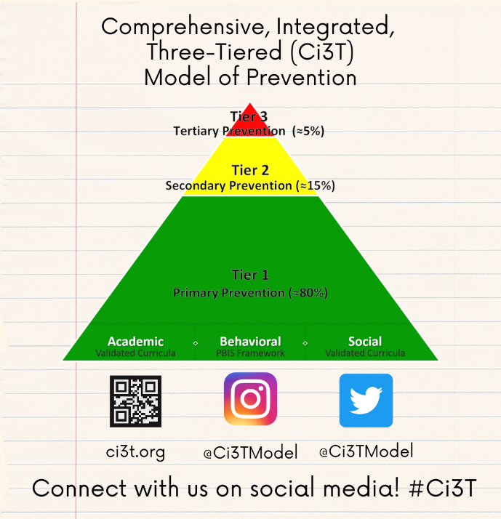
Let’s Connect on Social Media!
Tag us in your Ci3T highlights- we’d love to see Ci3T in action!
Follow us on Twitter or Instagram for updates and links to resources!
  @Ci3TModel

Slide 4
Ci3T Professional Learning Calendar
 | 0 | 1 | 2 | 3 | 4 | 5 | 6 | 7 | 8 | 9 | 10 | 11
 | July | Aug | Sep | Oct | Nov | Dec | Jan | Feb | Mar | Apr | May | Jun
Ci3T Training |  |  |  |  | Ci3T Professional Learning Series Session 1 | Ci3T Professional Learning Series Session 2 | Ci3T Professional Learning Series Session 3 | Ci3T Professional Learning Series Session 4 |  | Ci3T Professional Learning Series Session 5 | Ci3T Professional Learning Series Session 6
Ci3T Implementation Support | Ci3T Implementation Series Prep Session |  | Ci3T Implementation Series Session 1 |  | Ci3T Implementation Series Session 2 |  | Ci3T Implementation Series Session 3 |  | Ci3T Implementation Series Session 4 | Ci3T Implementation Series Session 5
Ci3T EMPOWER |  |  | Ci3T EMPOWER Session 1 | Ci3T EMPOWER Session 2 | Ci3T EMPOWER Session 3 |  | Ci3T EMPOWER Session 4 |  | Ci3T EMPOWER Session 5 | Ci3T EMPOWER Session 6
Ci3T Trainers & Coaches Calls |  | Trainers & Coaches Call Session 1 | Trainers & Coaches Call Session 2 | Trainers & Coaches Call Session 3 | Trainers & Coaches Call Session 4 | Trainers & Coaches Call Session 5 | Trainers & Coaches Call Session 6 | Trainers & Coaches Call Session 7 | Trainers & Coaches Call Session 8 | Trainers & Coaches Call Session 9 | Trainers & Coaches Call Session 10

Slide 5
Agenda
Welcome
Procedures for Monitoring
  Review your School’s Social Validity & Treatment Integrity Data
  Review your School’s Winter Screening Data
Data-informed Decision-making
  Professional Learning Targets and Resources
  Communication Plans
Wrapping Up and Moving Forward

Slide 6
Review and Preview
Last Time
Today…
Preparing to Collect and Use Social Validity & Treatment Integrity Data
Using Fall Screening Data to Inform Instruction:
Facilitating Clear Communication and Collaborations with Stakeholders
Procedures for Monitoring
  Review your School’s Social Validity & Treatment Integrity Data
  Review your School’s Winter Screening Data
Data-informed Decision-making
  Professional Learning Targets and Resources
  Communication Plans

Slide 7
Welcome
Please pull up your Ci3T Implementation Manual

Slide 8
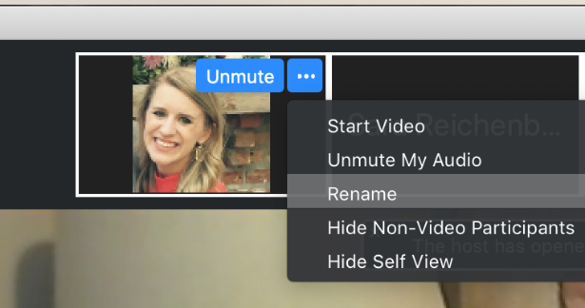
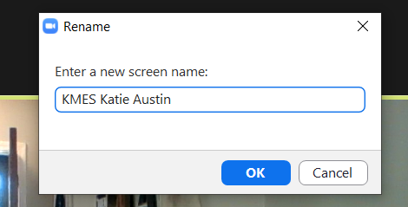
Renaming: School Initials + First and Last Name
To help us put you in breakout rooms with your colleagues today…
1. Click the three dots at the top
right corner of your video square.
2. Rename yourself with your
school initials then first and last name.

Slide 9
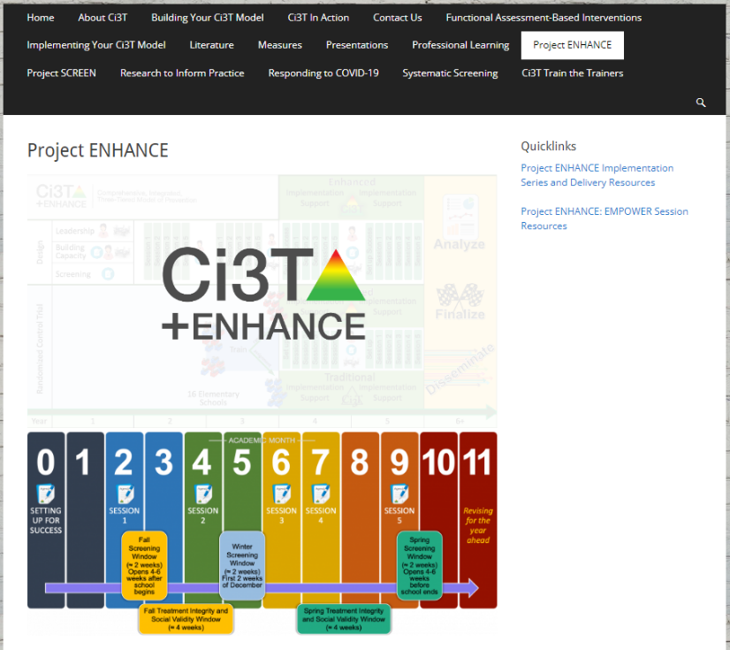
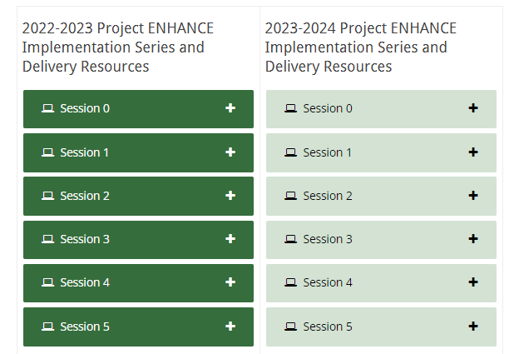
Accessing Professional Learning Materials
Navigate to ci3t.org/enhance
Type password: enhanceci3t!
Access session resources via the Project ENHANCE Implementation Series and Delivery Resources quicklink or by scrolling to the bottom of the page

Slide 10

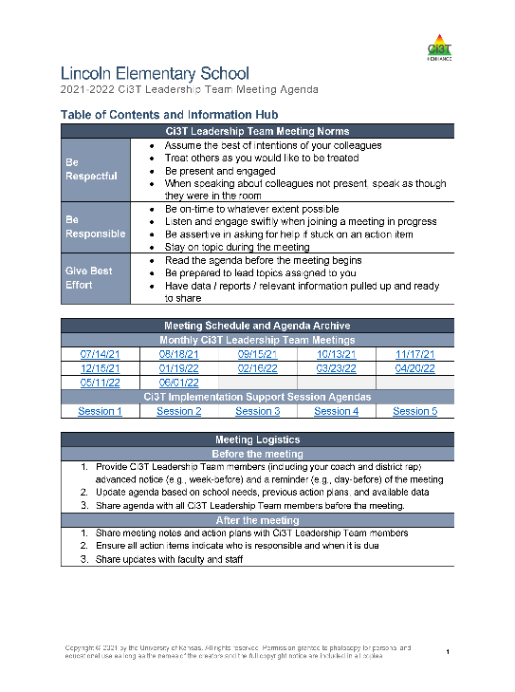
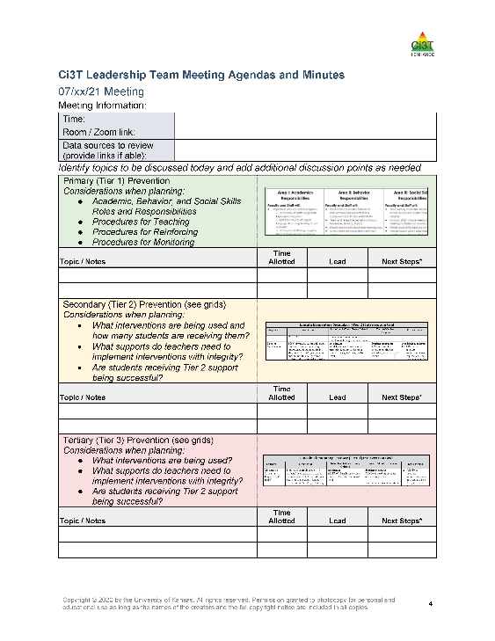
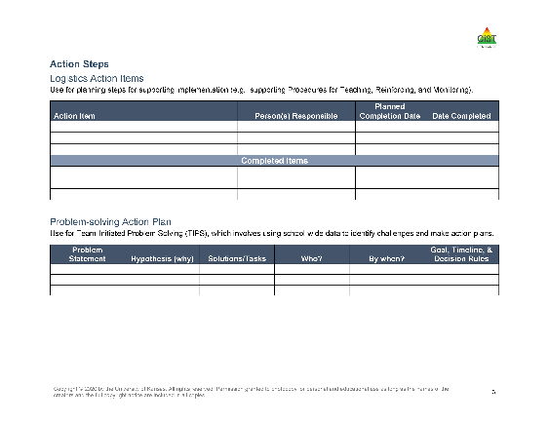
Agenda

Slide 11

Goals for this Implementation Year
Establish effective Ci3T leadership structures
Gain a deeper understanding of Ci3T models of prevention
Implement your school’s plan with high fidelity
Collect and use social validity and treatment integrity data to monitor Ci3T plan implementation
Collect student academic and behavioral outcome data to inform Ci3T implementation efforts
Share data with all stakeholders regularly (e.g., monthly, quarterly)
Identify areas of additional professional learning for faculty and staff and support faculty and staff access to professional learning
Address any barriers to implementing your Ci3T model

Slide 12
Procedures for Monitoring
Review your School’s Social Validity & Treatment Integrity Data
Review your School’s Winter Screening Data

Slide 13
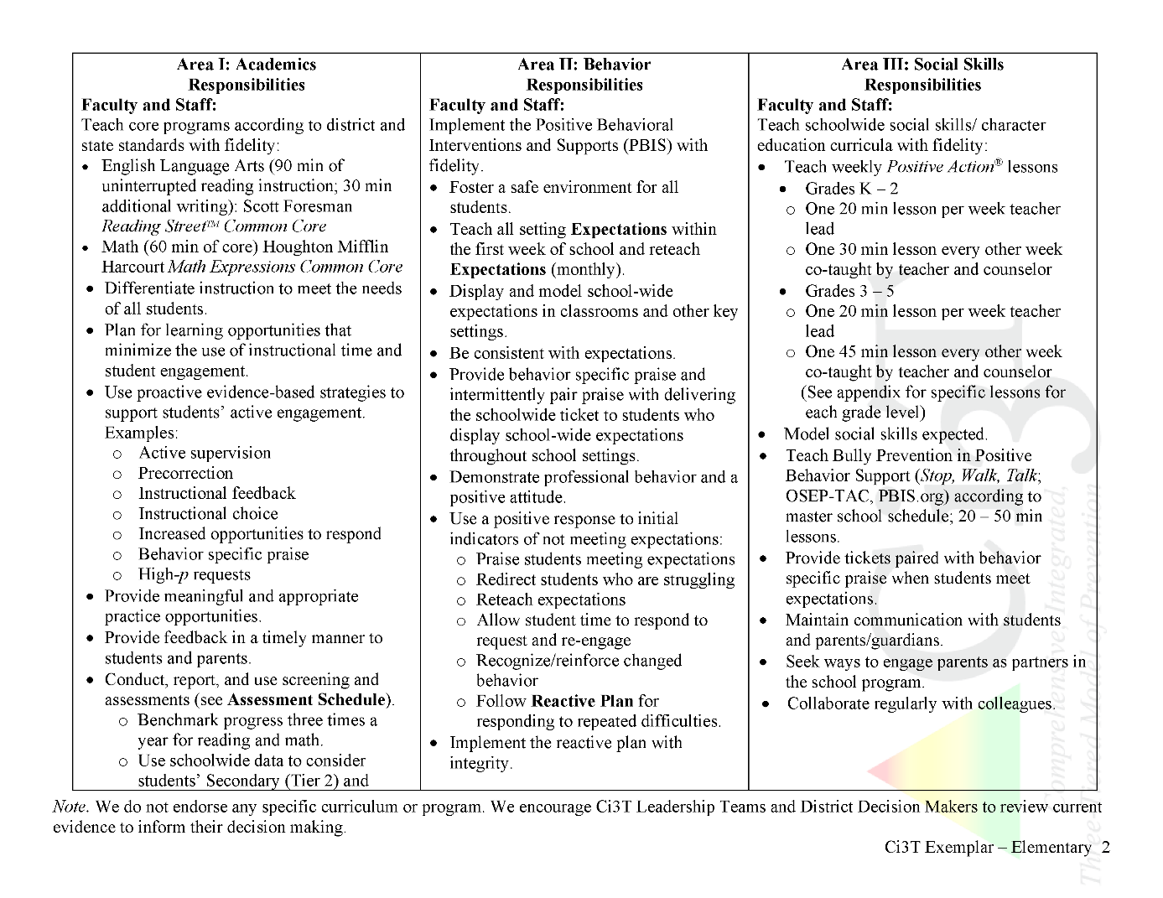
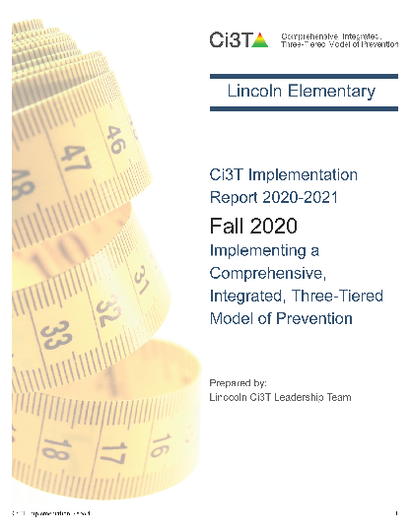
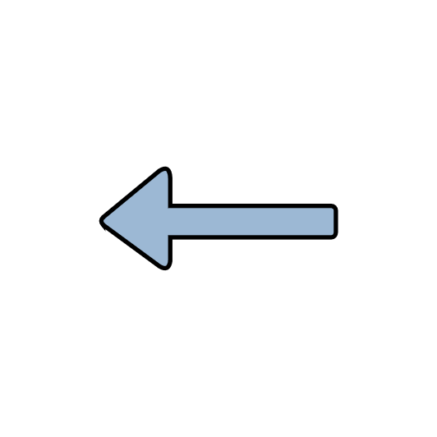
Ci3T Primary Plan: Procedures for Teaching
Ci3T Primary Plan: Procedures for Reinforcing
Ci3T Primary Plan: Procedures for Monitoring

Slide 14
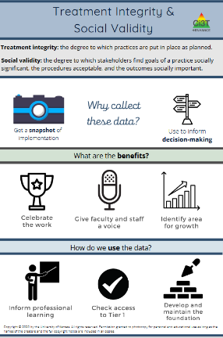
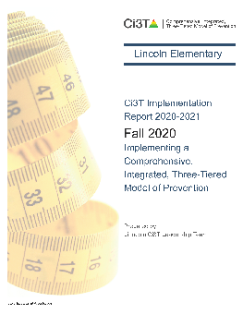


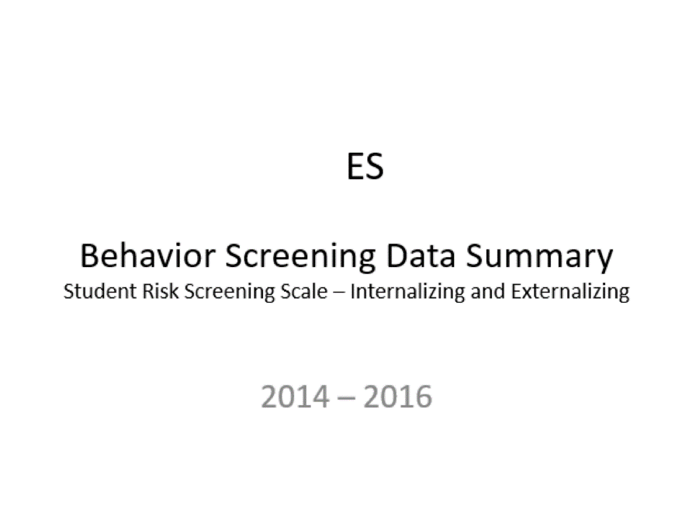
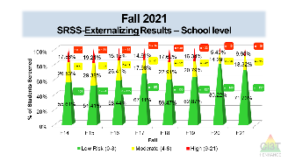
Essential Components of
Primary Prevention Efforts
Social Validity
Systematic Screening
Academic
Behavior
Treatment Integrity
ci3t.org/measures
Notes:
Infographic - https://www.ci3t.org/measures

Slide 15
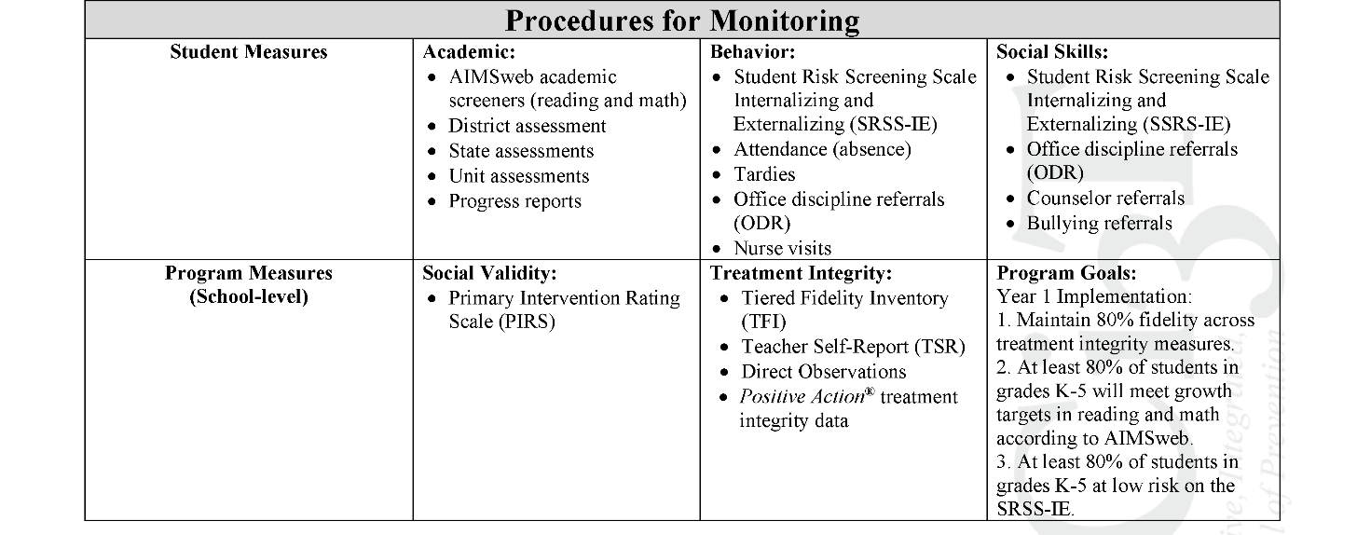
Ci3T Primary Plan
Procedures for Monitoring: Elementary
Program Measures and Goals

Slide 16
Sample Elementary Assessment Schedule
Measure | Aug | Sep | Oct | Nov | Dec | Jan | Feb | Mar | Apr | May
School Demographics
Student Demographic Information | X | X | X | X | X | X | X | X | X | X
Screening Measures
Behavior Screeners: SRSS-IE |  | X |  |  | X |  |  |  | X
Academic Screeners: AIMSWeb | X | X |  |  |  | X |  |  |  | X
Student Outcome Measures - Academic
State & District assessment |  |  |  |  |  |  |  | X | X
Progress reports |  |  |  | X |  |  | X |  |  | X
Student Outcome Measures - Behavior
Absences |  | X | X | X | X | X | X | X | X
Office discipline referrals (ODR) |  | X |  |  | X |  |  |  | X
Counselor referrals | X | X | X | X | X | X | X | X | X | X
Nurse visits | X | X | X | X | X | X | X | X | X | X
Program Measures
Primary Intervention Rating Scale |  |  | X |  |  |  |  | X
School-wide Evaluation Tool |  |  | X |  |  |  |  | X
Ci3T TI: Teacher Self-Report |  |  | X |  |  |  |  | X
Ci3T TI: Direct Observation |  |  | X |  |  |  |  | X
Second Step® Treatment Integrity |  |  | X |  |  |  |  | X
Adapted from Lane, K. L., Oakes, W. P., Cantwell, E. D., & Royer, D. J. (2018). Building and installing comprehensive, integrated, three-tiered (Ci3T) models of prevention: A practical guide to supporting school success V1.2. KOI Education. (Interactive eBook)

Slide 17
Procedures for Monitoring
Review your School’s Social Validity & Treatment Integrity Data
Review your School’s Winter Screening Data

Slide 18
Social Validity
How do stakeholders view the plan?
Social validity refers to the level of:
Social significance of intervention goals
Social acceptability of intervention procedures
Social importance of intervention outcomes
(Wolf, 1978)
Assessed using the Primary Intervention Rating Scale (PIRS)
Social Validity: PIRS Results
Year | Fall |  | Spring
 | n | % (SD) | n | % (SD)
2020-2021 | 32 | 85.39 (8.89) | TBD | TBD

Slide 19
Treatment Integrity
Are we implementing our plan as intended?
Treatment integrity can refer to:
Adherence
Dosage
Quality
Assessed using:
Ci3T Treatment Integrity: Teacher Self-Report
Ci3T Treatment Integrity: Direct Observation
Tiered Fidelity Inventory (TFI)
Ci3T Procedures | Teacher Self-Report* | Direct Observation*
 | Fall 2021 n = 45 % (SD) | Educator n = 6 % (SD) | Observer n = 7 % (SD)
Teaching | 80.43% (10.86) | 70.72% (13.81) | 75.02% (17.05)
Reinforcing | 80.83% (12.89) | 62.06% (15.33) | 34.99% (16.02)
Monitoring | 75.49% (18.06) | - | -
Total | 79.10% (11.87) | 67.66% (14.03) | 62.28% (14.58)

Slide 20
Logistics Planning
Method | Measure Name | Completed by…
Method | Measure Name | All Staff | Randomly Selected Classrooms | Ci3T Leadership Team
Survey | Ci3T Treatment Integrity: Teacher Self-Report and Primary Intervention Rating Scale | X
Observations | Ci3T Treatment Integrity: Direct Observation |  | X
Rubric | Tiered Fidelity Inventory (TFI) |  |  | X

Slide 21
Using Treatment Integrity and
Social Validity Data
Individualized Feedback and Coaching
Data-informed
Linked to school-wide plan
Professional Learning for all Staff
On-demand resources
Free-access PL events
Revising the Ci3T Plan
Annual revisions based on stakeholder feedback and values

Slide 22
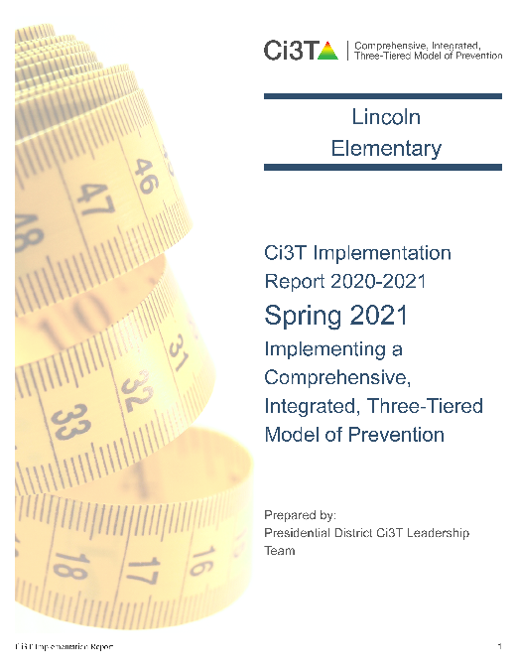
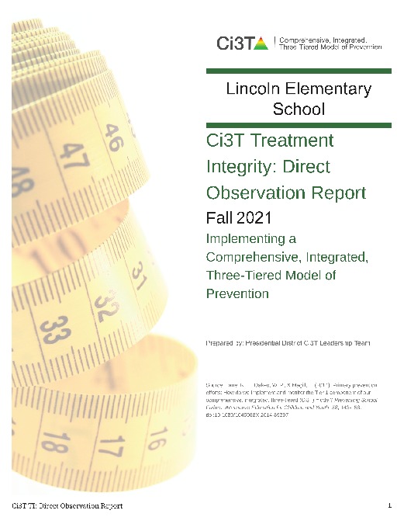

Treatment Integrity and Social Validity Data Sources
Primary Intervention Rating Scale (Social Validity)
Ci3T Treatment Integrity: Teacher Self Report
Ci3T Treatment Integrity: Direct Observation
Tiered Fidelity Inventory

Slide 23
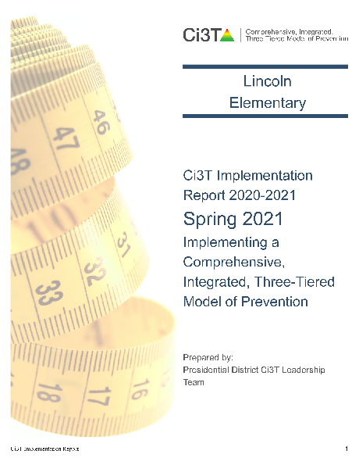
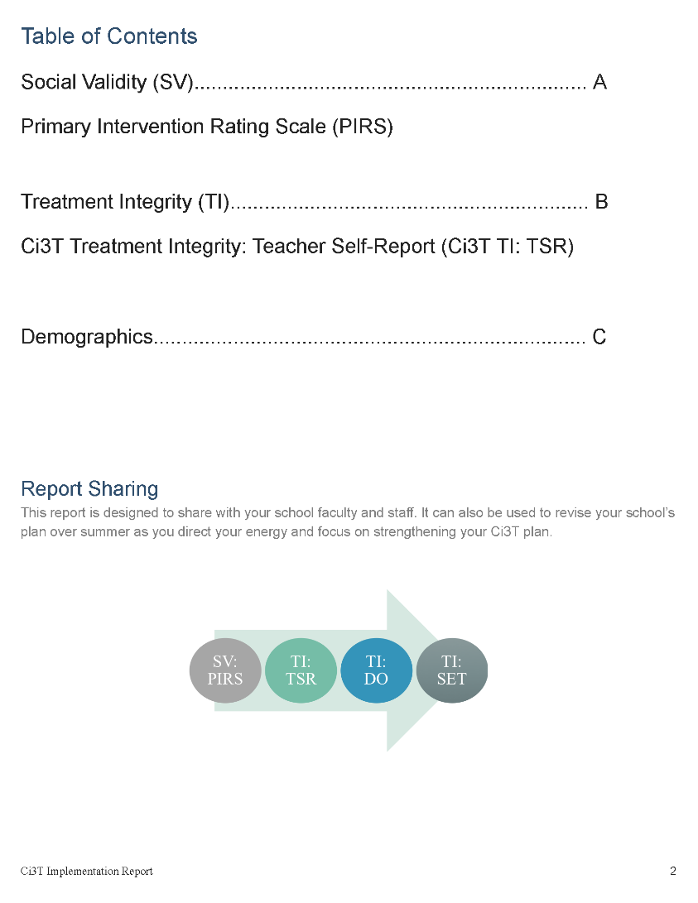

Slide 24
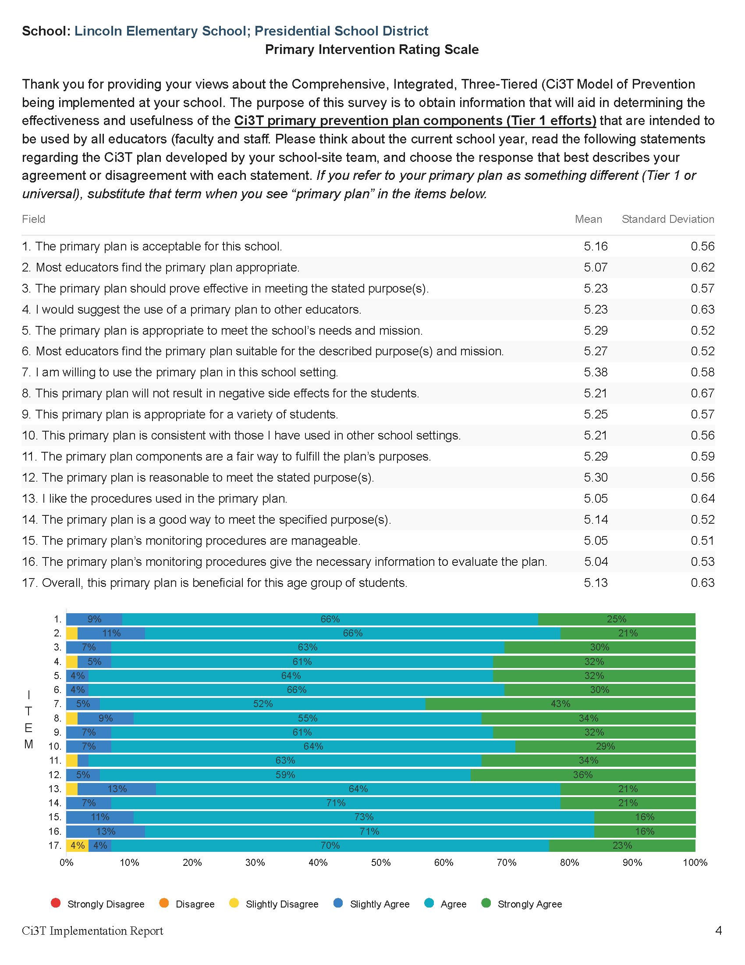

Slide 25
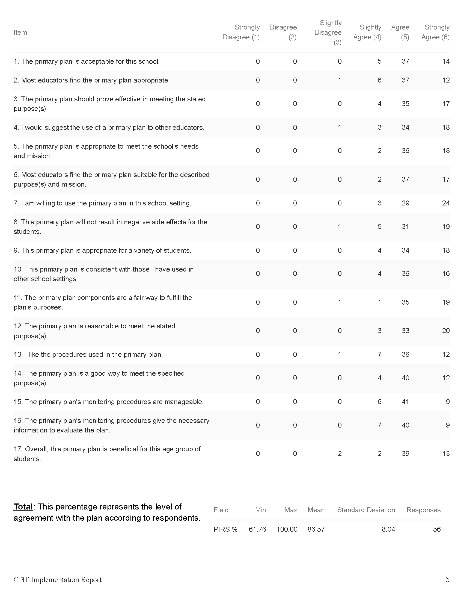

Slide 27
Open-Ended Questions:
A) What do you feel is most beneficial about this primary prevention plan’s components (Tier 1 efforts)? B) What is the least beneficial part?
Do you think that your and your students’ participation in this Ci3T plan will cause your students’ behavior, social, and/or learning problems to improve? Why or why not? Or if so, how?
What would you change about this plan (components, design, implementation etc.) to make it more student-friendly and educator-friendly?
What other information would you like to contribute about this plan?
Read through comments
Highlight success (literally!)
Look for themes for celebrations and focus areas

Slide 28
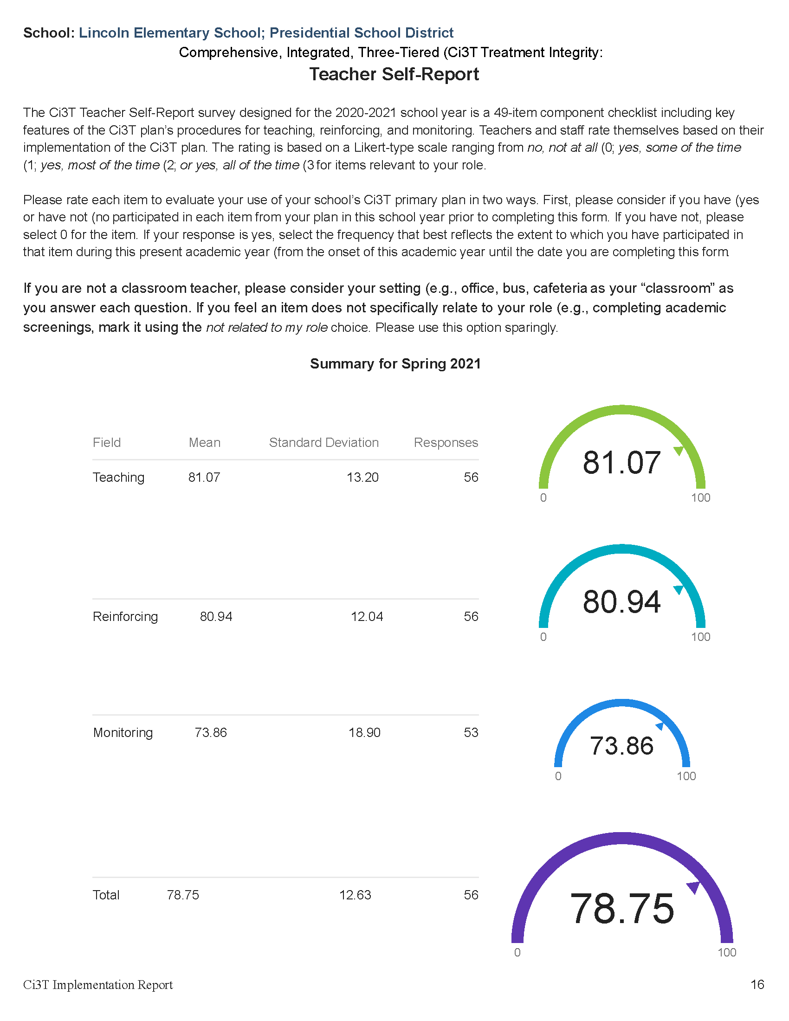

Slide 29
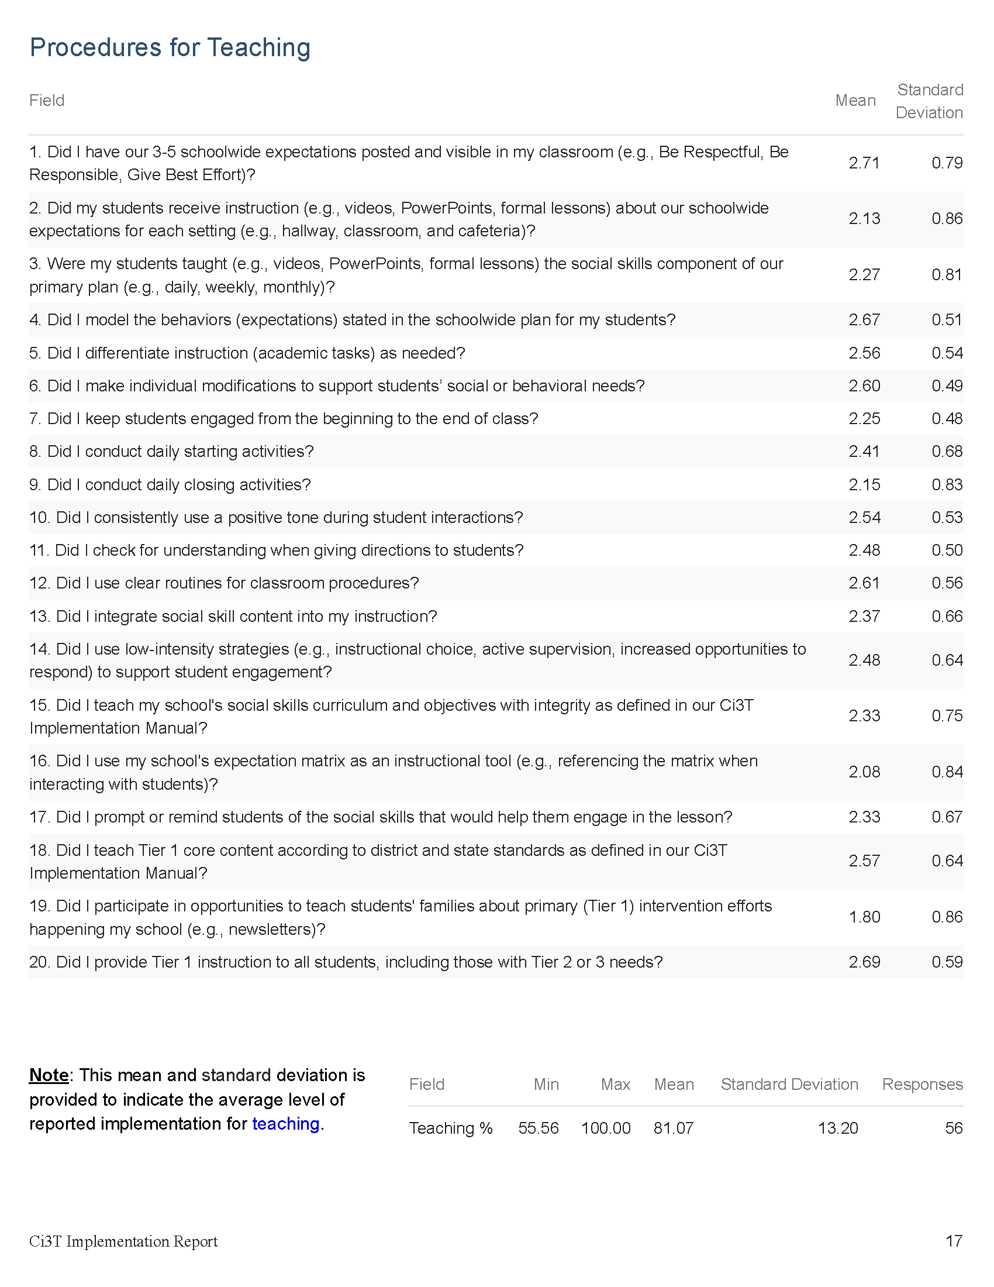

Slide 30
Notes:
#11 = bright spot. Might be helpful to consider- what led to this success? Could we replicate those strategies in other areas?
#16 = potential area of emphasis

Slide 31
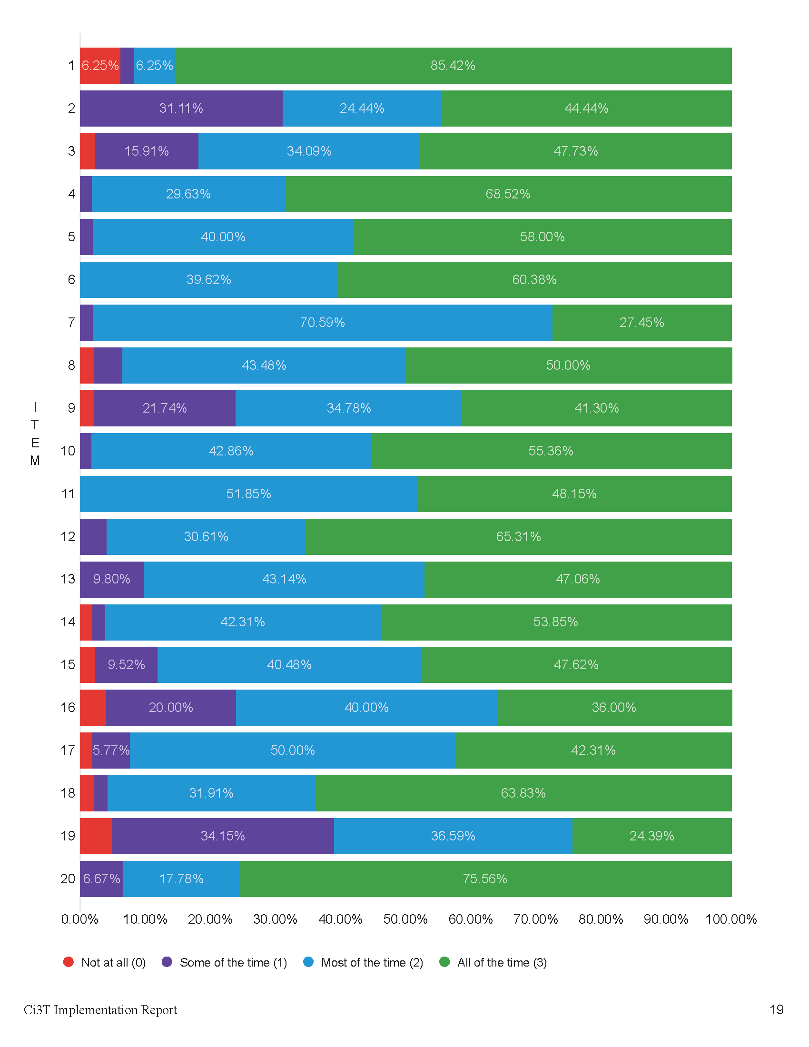

Slide 32

Notes:
Graphs provide a visual way to look at the data. For example:
#11 = Did I check for understanding when giving directions to students?
This visual representation helps us see that everyone responded “most of the time” or “all of the time” to this question. This is worth celebrating!
#16 – Did I use my school’s expectation matrix as an instructional tool (e.g., referencing the matrix when interacting with students)?
This visual representation of the data underscores that this might be an area to focus on – 20% responding some of the time and ~4% not at all

Slide 33
Treatment Integrity and Social Validity Data Sources
Primary Intervention Rating Scale (Social Validity)
Ci3T Treatment Integrity: Teacher Self Report
Ci3T Treatment Integrity: Direct Observation
Tiered Fidelity Inventory

Slide 34
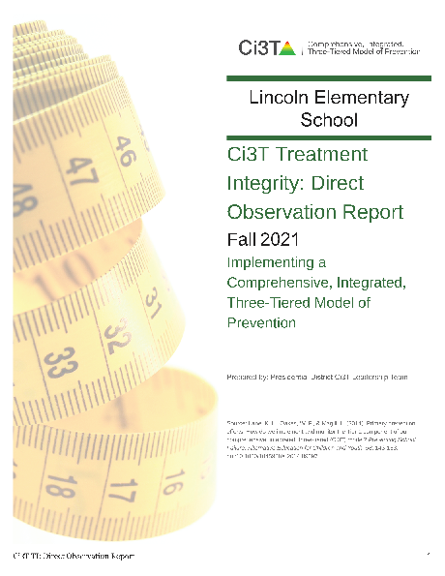
Ci3T Treatment Integrity
Direct Observation (Ci3T TI: DO)
Subset of Ci3T TI: TSR
Stratified, random selection of educators
  Personnel who directly instruct students
Observers trained to criterion
30-min observations
  Educator perspective
  Observer perspective

Slide 35
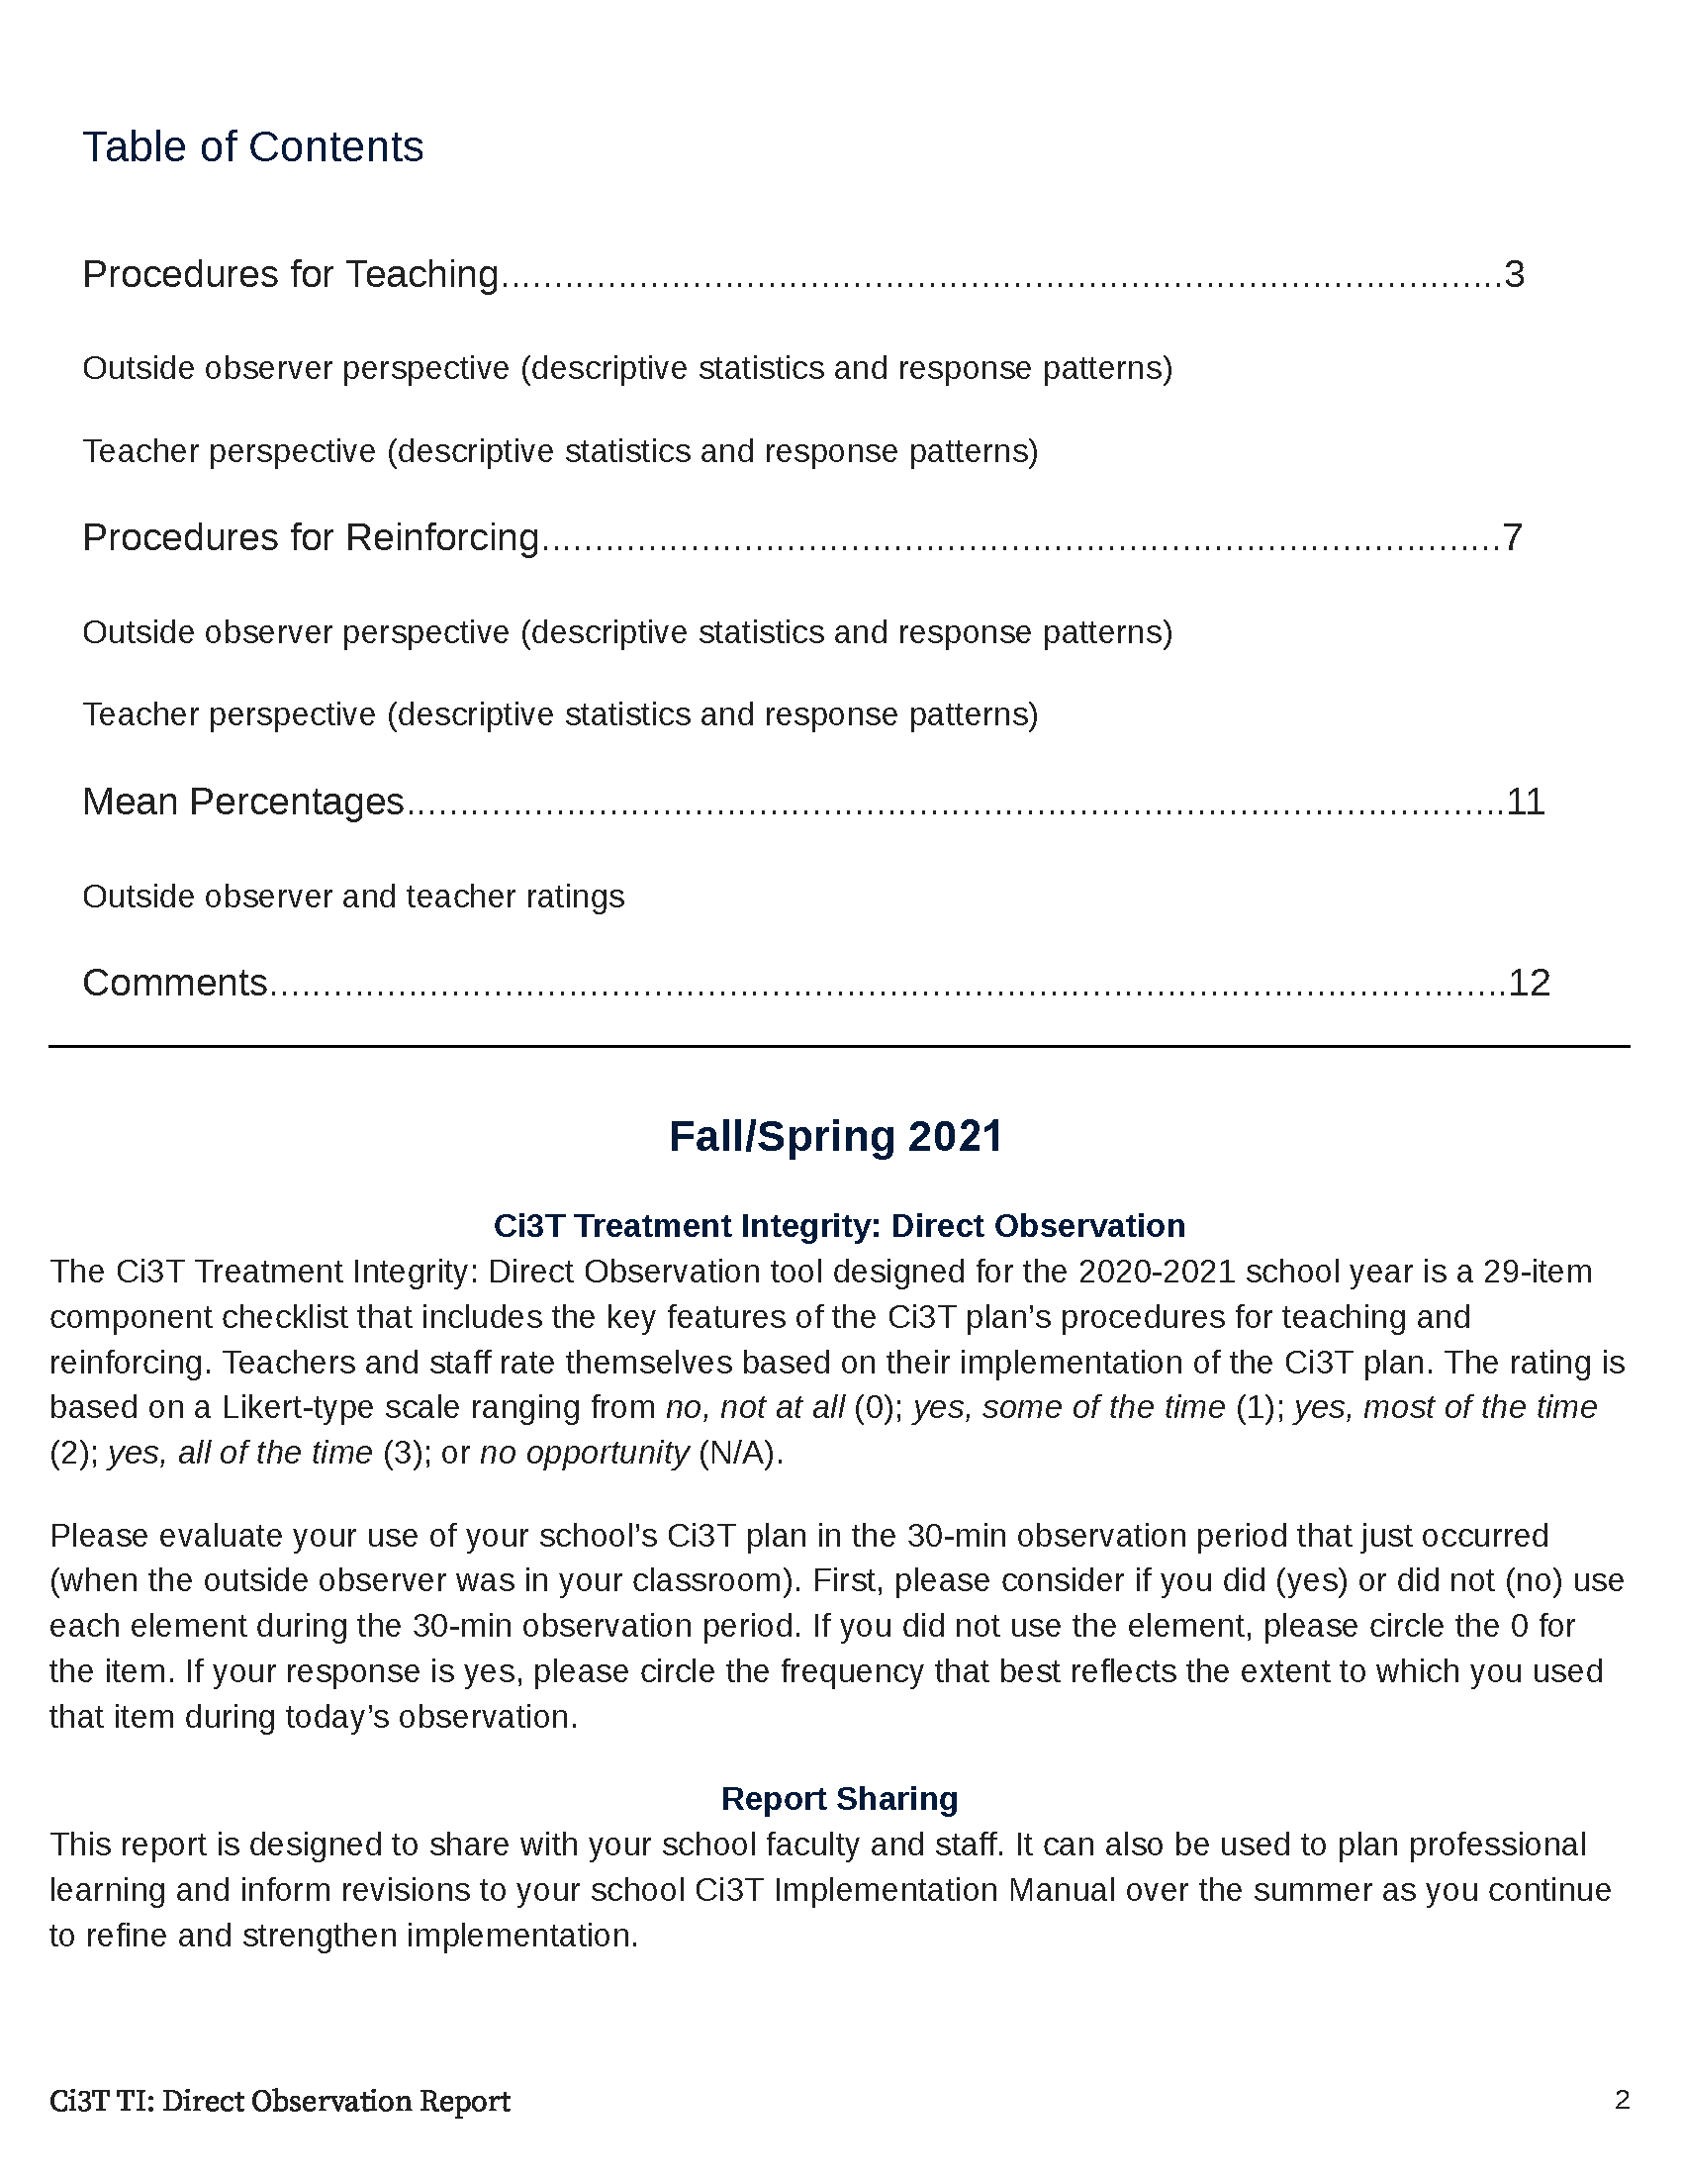

Slide 36
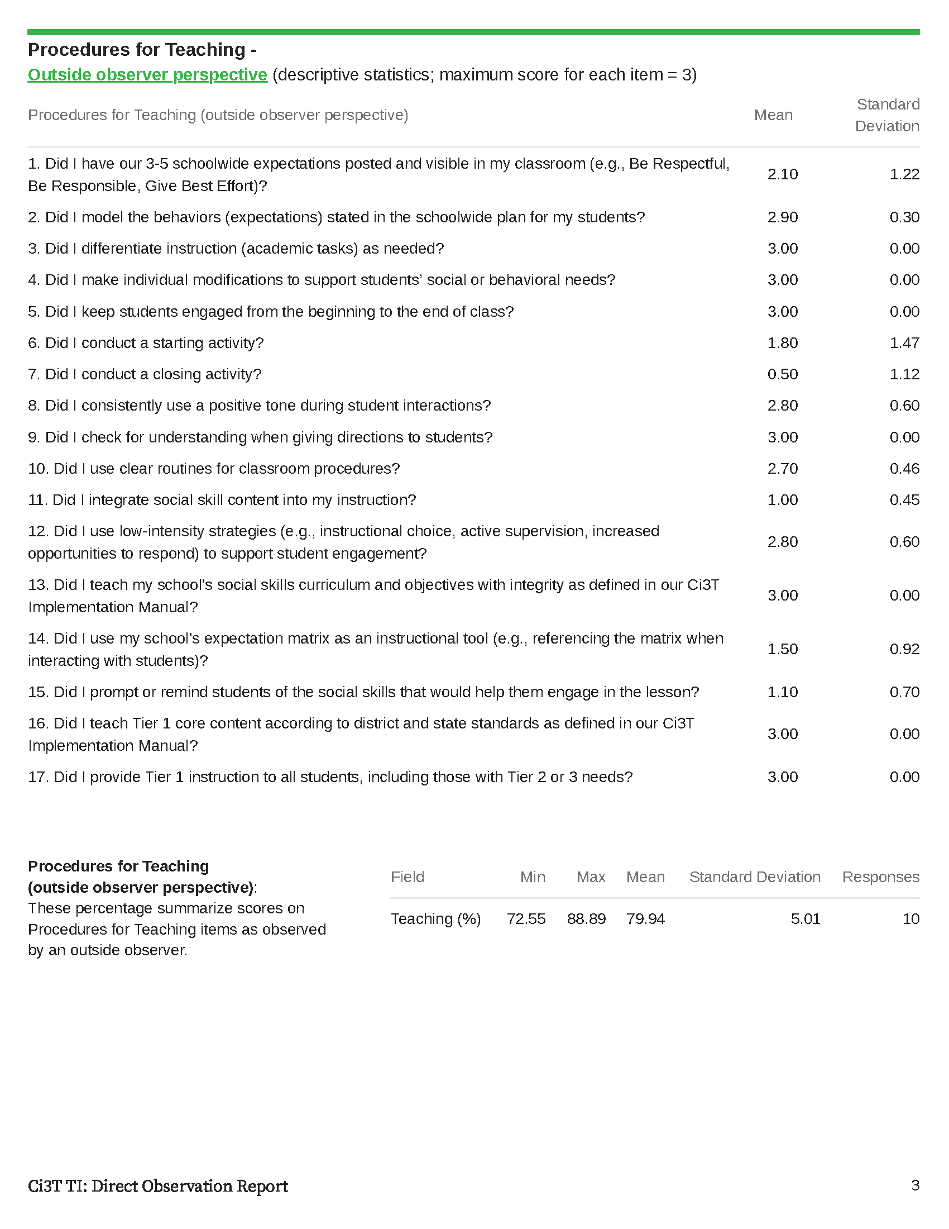

Slide 37
Notes:
Convergent validity. What the outside observer noticed during direct observation matches what your staff indicated In teacher self-report.

Slide 39
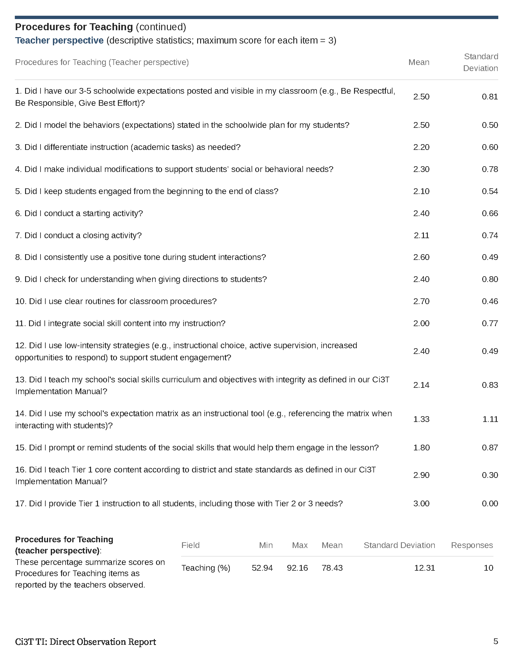

Slide 40
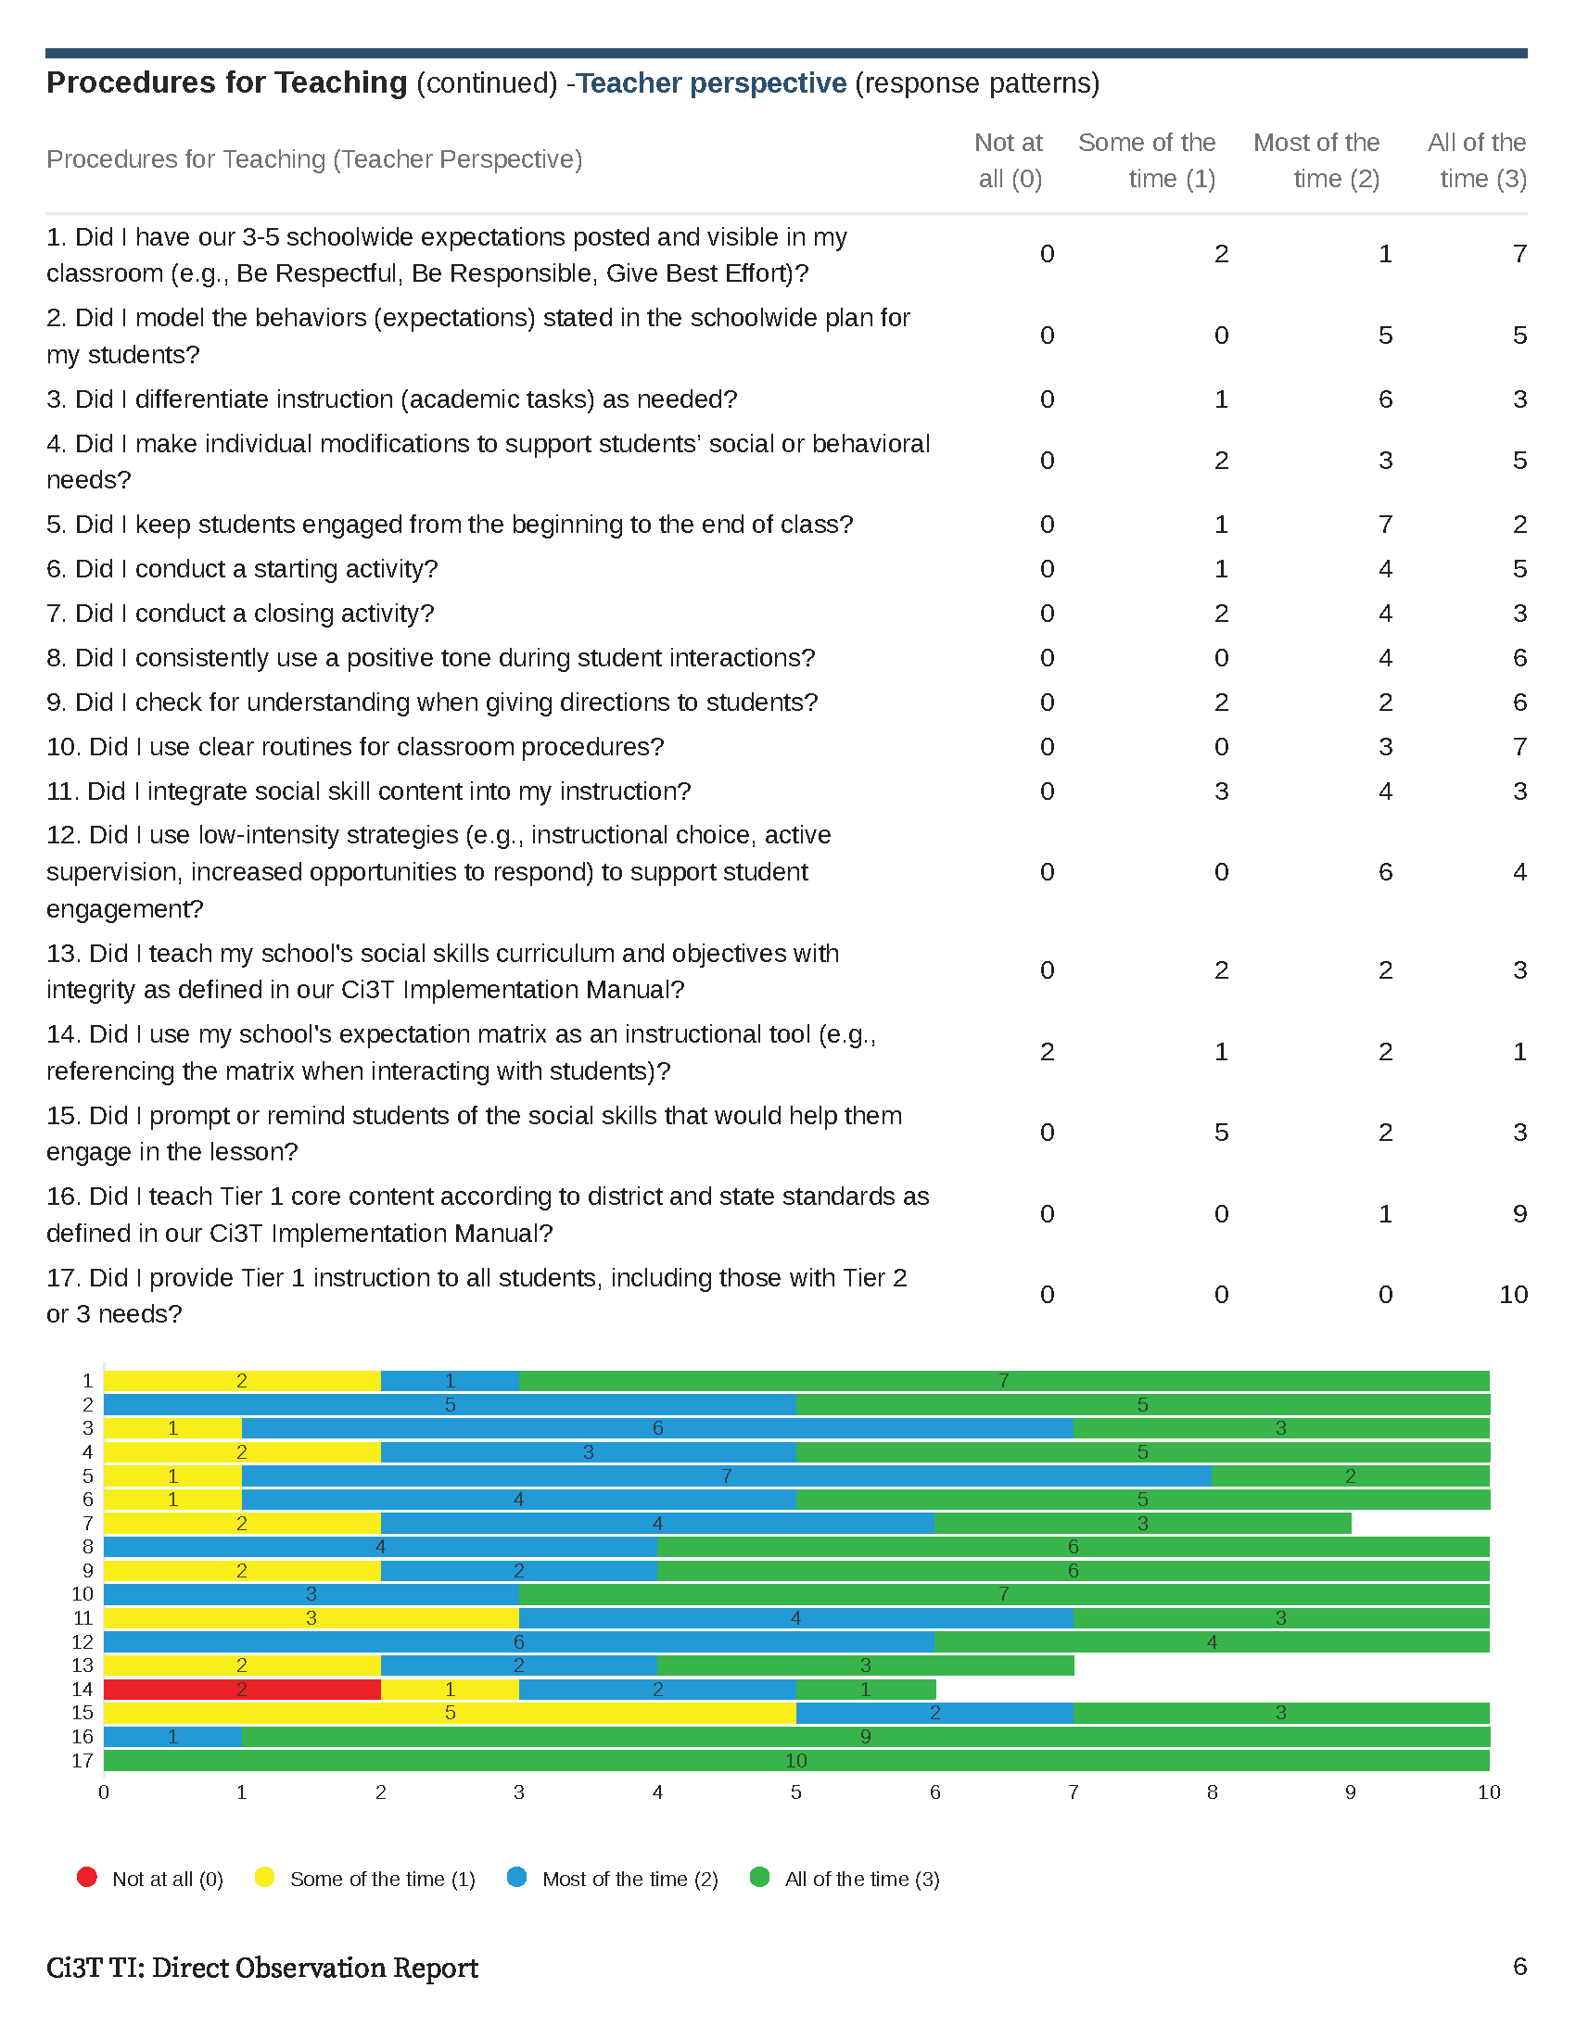

Slide 41
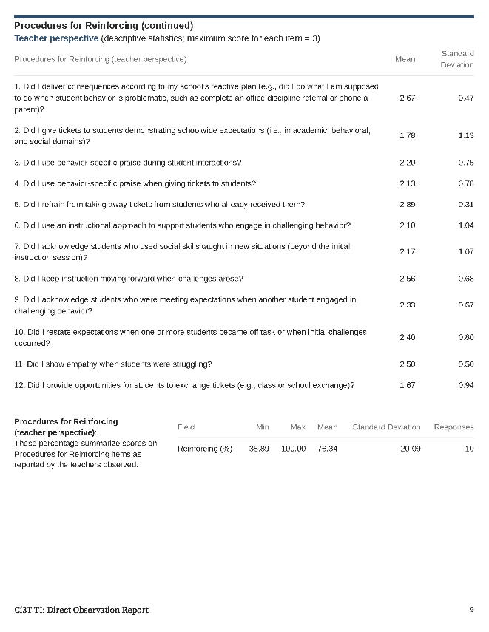
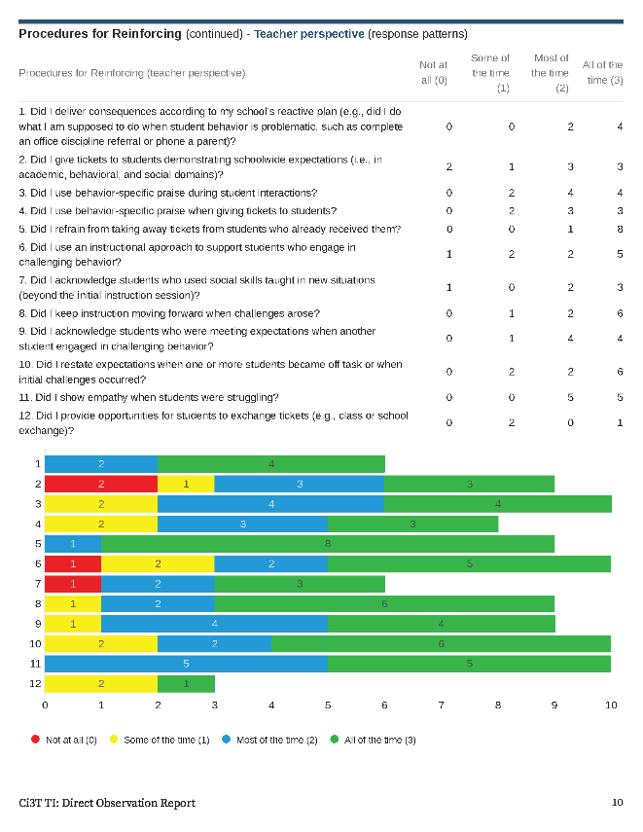

Slide 42
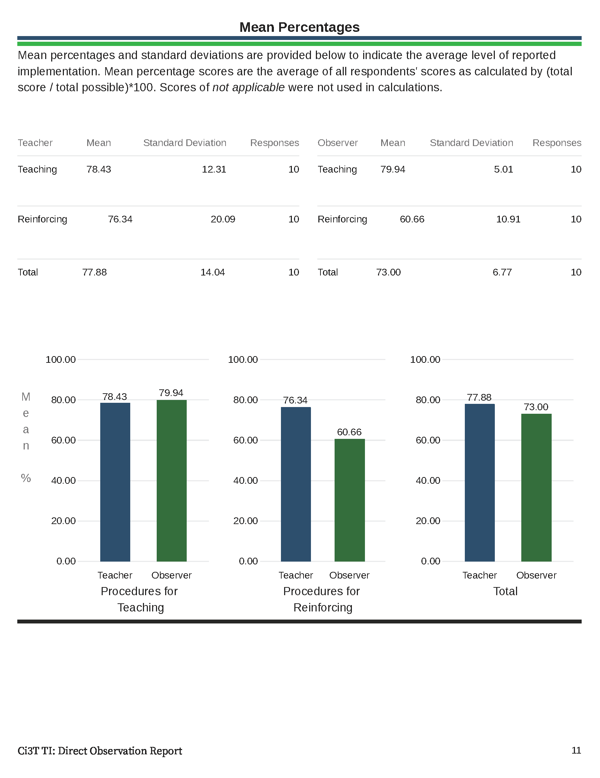

Slide 43
Treatment Integrity and Social Validity Data Sources
Primary Intervention Rating Scale (Social Validity)
Ci3T Treatment Integrity: Teacher Self Report
Ci3T Treatment Integrity: Direct Observation
Tiered Fidelity Inventory

Slide 44

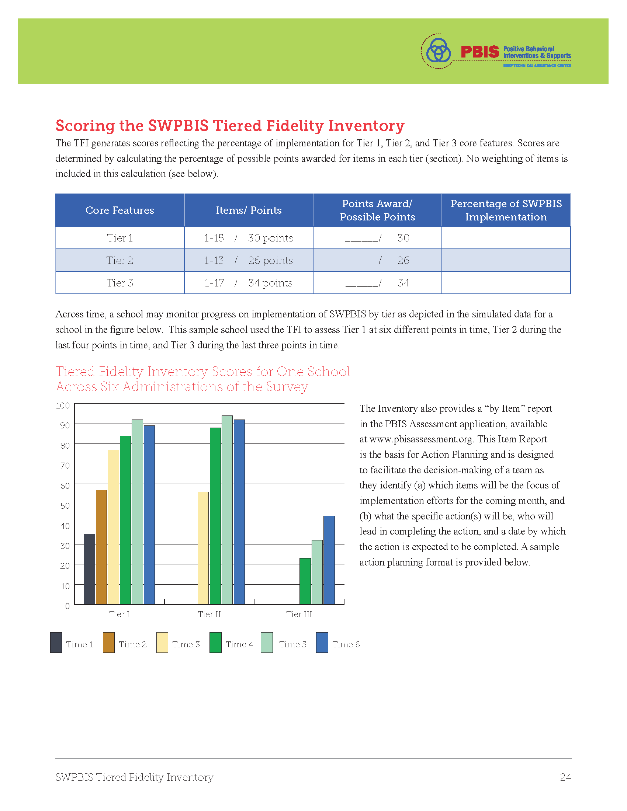
p.24

Slide 45
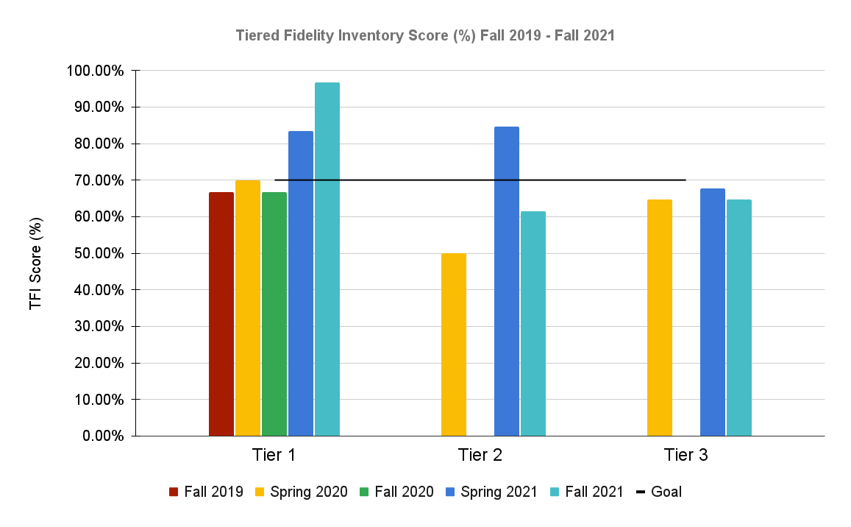

Slide 46
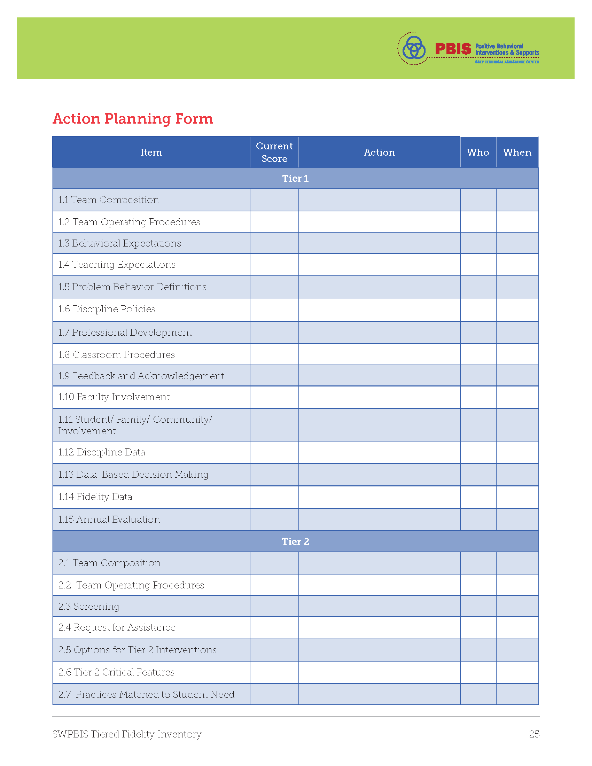
p.25

Slide 47
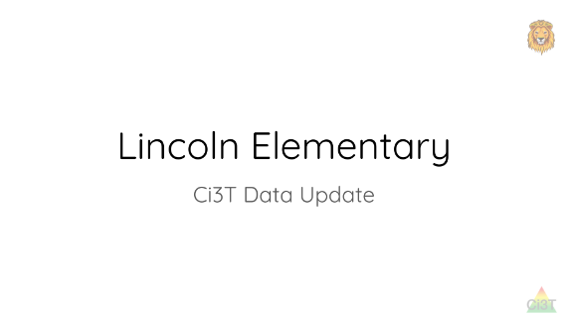
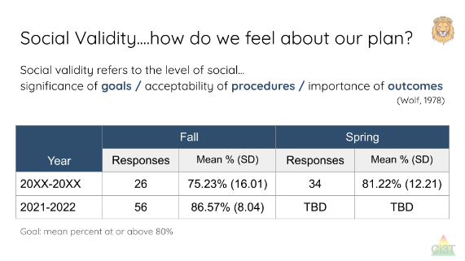
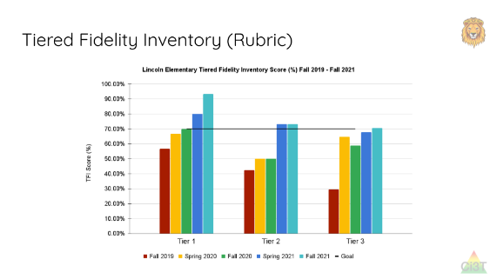
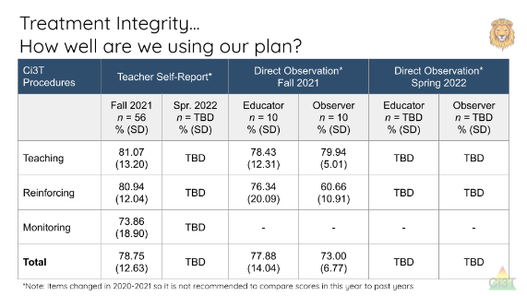
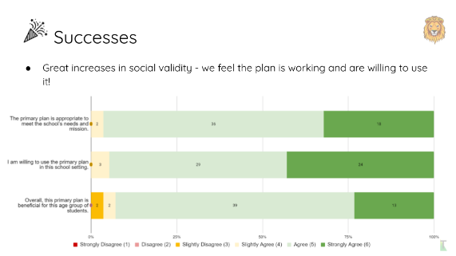
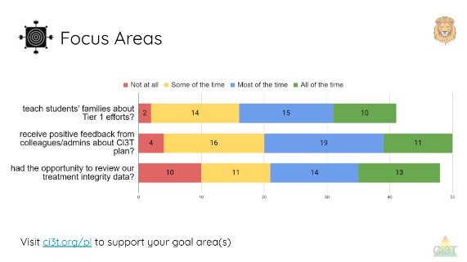
Sharing and Using Your Data

Slide 48

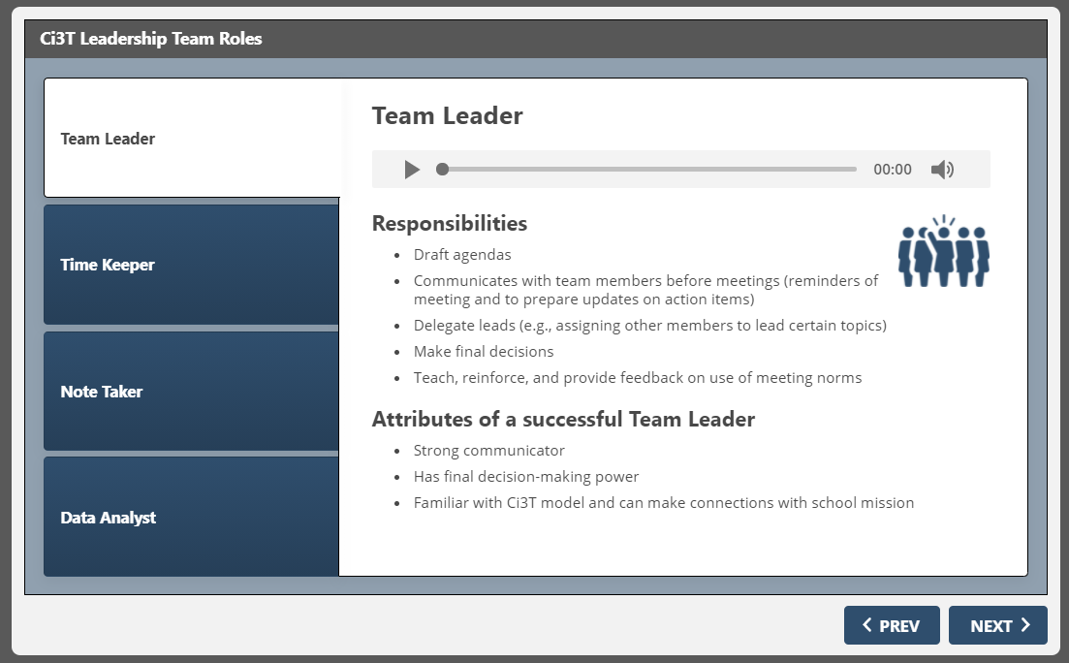
Team Roles

Slide 49

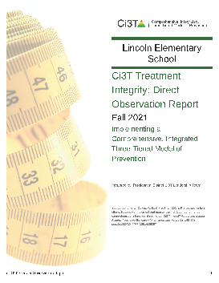


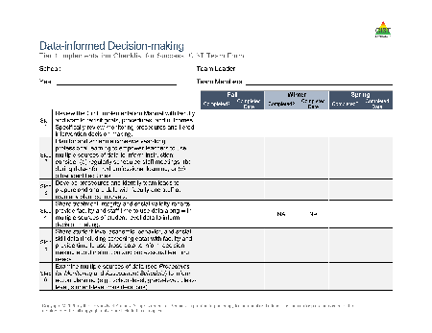

















Let’s Talk!
Locate your school’s Ci3T Implementation Report and
Ci3T Treatment Integrity: Direct Observation Report.
Then:
Highlight successes.
Discuss concerns and plans for addressing these focus areas.
Make plans to share data and plans back with stakeholders.
Write action items in your Ci3T Leadership Team Meeting Agenda
Use HO Ci3T PL Map to help guide your thinking
Notes:
15-min timer

Slide 50
Procedures for Monitoring
Review your School’s Social Validity & Treatment Integrity Data
Review your School’s Winter Screening Data

Slide 51
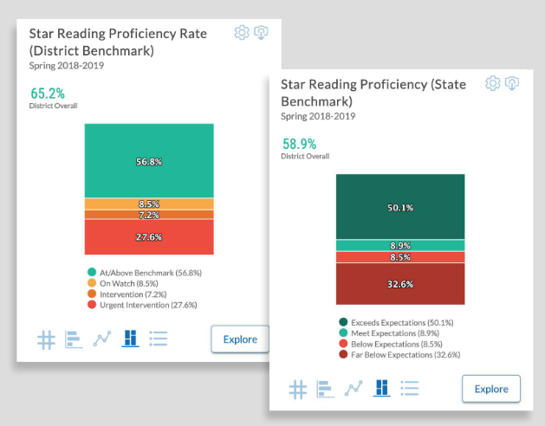
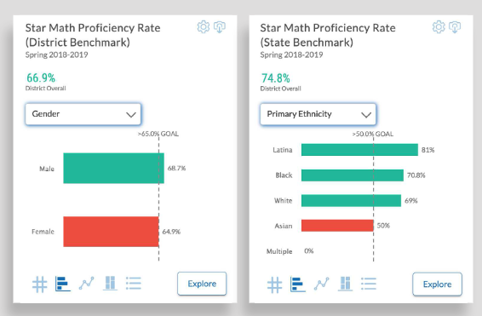

Academic Screening
Notes:
Might consider beginning by looking at data broadly
compared against district or state benchmarks
Subgroup analyses

Slide 52
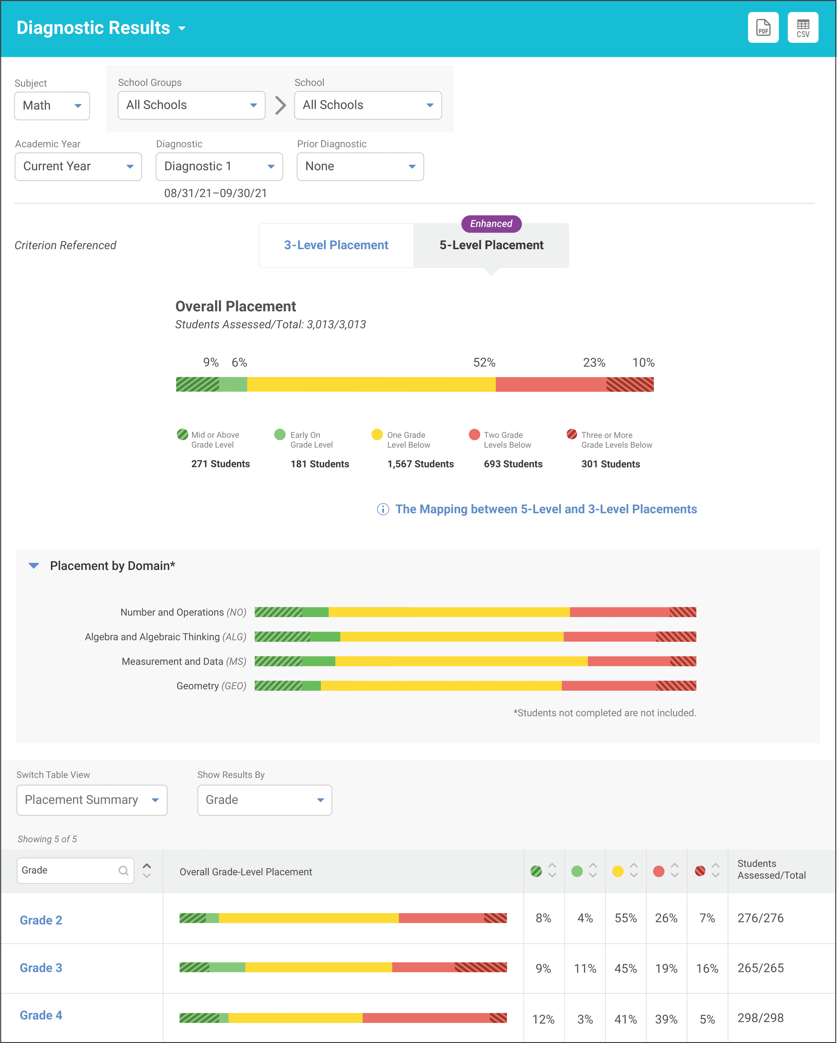
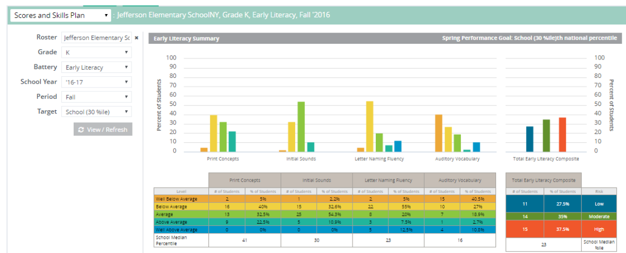


Academic Screening
Notes:
Then, might zoom in at the grade-level looking at distribution across risk category, mastery, or growth

Slide 55
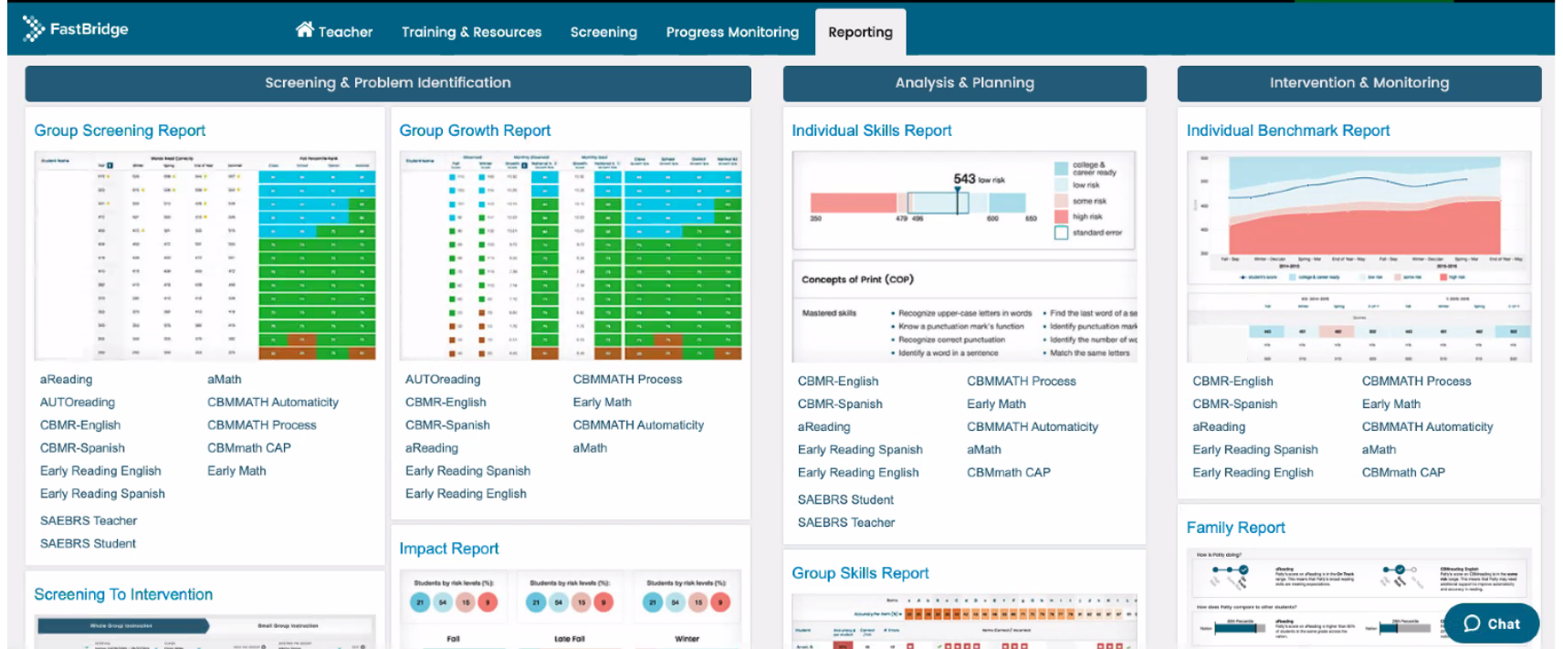
Academic Screening

Slide 56
Academic Screening

Slide 57
Academic Screening

Slide 58

Student Risk Screening Scale for
Internalizing and Externalizing
(SRSS-IE; Drummond, 1994; Lane & Menzies, 2009)

Slide 59
SRSS-IE: Cut Scores
Elementary School |  | Middle and High School
SRSS-E7 | SRSS-I5 | SRSS-E7 | SRSS-I6
Items 1-7 | Items 8-12 | Items 1-7 | Items 4, 8-12
0-3 = low risk 4-8 = moderate risk 9-21 = high risk | 0-1 = low risk 2-3 = moderate risk 4-15 = high risk | 0-3 = low risk 4-8 = moderate risk 9-21 = high risk | 0-3 = low risk 4-5 = moderate risk 6-18 = high risk
Elementary School Level:
Lane, K. L., Oakes, W. P., Swogger, E. D., Schatschneider, C., Menzies, H., M., & Sanchez, J. (2015). Student risk screening scale for internalizing and externalizing behaviors: Preliminary cut scores to support data-informed decision making. Behavioral Disorders, 40, 159-170.
Middle and High School Levels:
Lane, K. L., Oakes, W. P., Cantwell, E. D., Schatschneider, C., Menzies, H., Crittenden, M., & Messenger, M. (2016). Student Risk Screening Scale for Internalizing and Externalizing Behaviors: Preliminary cut scores to support data-informed decision making in middle and high schools. Behavioral Disorders, 42(1), 271-284

Slide 60
Winter 2022
SRSS-Externalizing Results – Elementary School Level
n = 66
n = 44
n = 33
n = 35
n = 38
n = 37
n = 2
n = 17
n = 32
n = 32
n = 69
n = 74
n = 128
n = 109
n = 97
n = 92
n = 101
n = 125
n = 305
n = 297
n = 287
n = 332
n = 309
n = 263
n = 294
n = 346
n = 355
Notes:
***note to presenter*** If you would like to feature middle or high school data – hide the elementary slides (60-63) and unhide the middle or high school slides
If you would like to update this slide with data from your school or district- Fill in <year> based on current academic year. This is located in column A of the data sheet. Edit by right clicking and selecting “Edit data”.

Slide 61
Winter 2022
SRSS-Externalizing Results – Elementary Grade level
Grade Level | N Screened | Low n (%) | Moderate n (%) | High n (%)
K | 66 | 47 (71.21%) | 12 (18.18%) | 7 (10.61%)
1 | 82 | 67 (81.71%) | 11 (13.41%) | 4 (4.88%)
2 | 77 | 64 (83.12%) | 9 (11.69%) | 4 (5.19%)

Slide 62
Winter 2022
SRSS-Internalizing Results – Elementary School Level
n = 75
n = 46
n = 29
n = 41
n = 35
n = 25
n = 16
n = 40
n = 38
n = 27
n = 65
n = 69
n = 59
n = 48
n = 69
n = 72
n = 87
n = 86
n = 334
n = 337
n = 335
n = 354
n = 354
n = 328
n = 285
n = 346
n = 351
Notes:
If you would like to update this slide with data from your school or district- Fill in <year> based on current academic year. This is located in column A of the data sheet. Edit by right clicking and selecting “Edit data”.

Slide 63
Winter 2022
SRSS-Internalizing Results – Elementary Grade Level
Grade Level | N Screened | Low n (%) | Moderate n (%) | High n (%)
3 | 63 | 49 (77.78%) | 8 (12.70%) | 6 (9.52%)
4 | 83 | 63 (75.90%) | 11 (13.25%) | 9 (10.84%)
5 | 90 | 69 (76.67%) | 15 (16.67%) | 6 (6.67%)

Slide 64
Winter 2022
SRSS-Externalizing Results – Middle School Level
n = 21
n = 27
n = 27
n = 13
n = 6
n = 17
n = 26
n = 47
n = 96
n = 68
n = 71
n = 53
n = 42
n = 54
n = 491
n = 448
n = 383
n = 346
n = 445
n = 518
n = 527
Notes:
If you would like to update this slide with data from your school or district- Fill in <year> based on current academic year. This is located in column A of the data sheet. Edit by right clicking and selecting “Edit data”.

Slide 65
Winter 2022
SRSS-Externalizing Results – Middle School Grade level
Grade Level | N Screened | Low n (%) | Moderate n (%) | High n (%)
6 | 96 | 68 (70.83%) | 17 (17.71%) | 11 (11.46%)
7 | 126 | 79 (62.70%) | 32 (25.40%) | 15 (11.90%)
8 | 79 | 48 (60.76%) | 19 (24.05%) | 12 (15.19%)

Slide 66
Winter 2022
SRSS-Internalizing Results – Middle School Level
n = 79
n = 52
n = 54
n = 60
n = 23
n = 44
n = 42
n = 41
n = 37
n = 40
n = 32
n = 45
n = 30
n = 31
n = 55
n = 70
n = 306
n = 312
n = 356
n = 342
n = 349
n = 351
n = 432
n = 229
Notes:
If you would like to update this slide with data from your school or district- Fill in <year> based on current academic year. This is located in column A of the data sheet. Edit by right clicking and selecting “Edit data”.

Slide 67
Winter 2022
SRSS-Internalizing Results – Middle School Grade Level
Grade Level | N Screened | Low n (%) | Moderate n (%) | High n (%)
6 | 96 | 76 (79.17%) | 8 (8.33%) | 12 (12.50%)
7 | 126 | 93 (73.81%) | 14 (11.11%) | 19 (15.08%)
8 | 79 | 60 (75.95%) | 9 (11.39%) | 10 (12.66%)

Slide 68
Winter 2022
SRSS-Externalizing Results – High School Level
n = 47
n = 72
n = 36
n = 36
n = 40
n = 8
n = 17
n = 38
n = 119
n = 113
n = 47
n = 137
n = 134
n = 114
n = 90
n = 65
n = 1259
n = 1280
n = 1188
n = 994
n = 447
n = 717
n = 750
n = 920
Notes:
If you would like to update this slide with data from your school or district- Fill in <year> based on current academic year. This is located in column A of the data sheet. Edit by right clicking and selecting “Edit data”.

Slide 69
Winter 2022
SRSS-Externalizing Results – High School Grade level
Grade Level | N Screened | Low n (%) | Moderate n (%) | High n (%)
9 | 271 | 207 (76.38%) | 44 (16.24%) | 20 (7.38%)
10 | 303 | 259 (85.48%) | 34 (11.22%) | 10 (3.30%)
11 | 256 | 229 (89.45%) | 20 (7.81%) | 7 (2.73%)
12 | 241 | 225 (93.36%) | 15 (6.22%) | 1 (0.41%)

Slide 70
Winter 2022
SRSS-Internalizing Results – High School Level
n = 165
n = 106
n = 83
n = 99
n = 55
n = 65
n = 52
n = 87
n = 73
n = 65
n = 50
n = 34
n = 59
n =48
n = 56
n = 167
n = 1111
n = 1307
n = 1109
n = 1000
n = 445
n = 691
n = 710
n = 923
Notes:
If you would like to update this slide with data from your school or district- Fill in <year> based on current academic year. This is located in column A of the data sheet. Edit by right clicking and selecting “Edit data”.

Slide 71
Winter 2022
SRSS-Internalizing Results – High School Grade Level
Grade Level | N Screened | Low n (%) | Moderate n (%) | High n (%)
9 | 271 | 222 (81.92%) | 19 (7.01%) | 30 (11.07%)
10 | 303 | 265 (87.46%) | 20 (6.60%) | 18 (5.94%)
11 | 256 | 216 (84.38%) | 9 (3.52%) | 31 (12.11%)
12 | 241 | 225 (93.36%) | 8 (3.32%) | 8 (3.32%)

Slide 72
Consider this class….
Teacher Name | R. Collins
Date: December 2022
 |  | 1 Average or Above |  | 0-3 Low | 0-1 Low | 0-1 Low
 |  | 2 Below Average |  | 4-8 Moderate | 2-3 Moderate | 2-5 Moderate
 |  | 3 Well Below Average |  | 9-21 High | 4-15 High | 6+ High
Student Name | Student ID | AIMSweb Reading | AIMSweb Math | SRSS-E7 Behavior | SRSS-I5 Internalizing | ODR | Total Days Absent
Alley, Allison | 2310 | 1 | 1 | 1 | 1 | 0 | 0
Atwell, J'Monte | 2013 | 1 | 1 | 0 | 0 | 0 | 0
Bonds, Peter | 2031 | 2 | 2 | 4 | 0 | 3 | 0
Booker, Abbie | 2001 | 1 | 2 | 0 | 2 | 1 | 3
Cartright, Ashely | 2152 | 1 | 3 | 0 | 8 | 0 | 8
Cox, Lucille | 2002 | 2 | 3 | 2 | 10 | 0 | 8
Hankins, Erin | 2017 | 1 | 1 | 0 | 0 | 0 | 0
Julius, O'Tam | 2132 | 3 | 2 | 6 | 2 | 9 | 7
Justice, Jesse | 2003 | 2 | 2 | 3 | 1 | 0 | 3
Ochoa, Kelly | 2009 | 1 | 2 | 0 | 3 | 0 | 5
Parker, Stephanie | 2004 | 1 | 2 | 4 | 0 | 0 | 1
Paul, Timothy | 2010 | 1 | 1 | 3 | 0 | 0 | 1
Reed, Kendra | 2022 | 3 | 0 | 16 | 2 | 23 | 3
Toms, Blake | 2018 | 1 | 2 | 0 | 0 | 0 | 1
Wellington, Jasper | 2215 | 2 | 3 | 14 | 4 | 9 | 0

Slide 73


Handout available for download (Session 3 Resources)

Slide 74







Sharing Screening Data with Faculty and Staff

Slide 75





Slide 76

Data-Informed Decision-Making
Professional Learning Targets and Resources
Communication Plans

Slide 77
Notes:
Throughout the remainder of the presentation, we will highlight content from modules and therefore want to start by grounding in this infographic, a resource to help people get oriented to modules and how to use them. We heard your feedback that sometimes staff who are new to using modules find it tricky to navigate so wanted to highlight these key features!
If you’re accessing the module as an eBook and reading page x page, use arrow to navigate to the next page or sidebar to navigate chapters and pick up where you left off
If you want to watch the interactive resource, click here
If you’ve already reviewed the module and you’re coming back to locate a specific item (or “lucky charm” at Kathleen likes to call them) like an infographic, video, or activity, click where it says “overview” here on the sidebar to be taken to the table of resource. From there you can click “page” to be taken to that part of the eBook or “link” to download the material directly.

Slide 79
Winter 2022
SRSS-Externalizing Results – Elementary School Level
n = 66
n = 44
n = 33
n = 35
n = 38
n = 37
n = 2
n = 17
n = 32
n = 32
n = 69
n = 74
n = 128
n = 109
n = 97
n = 92
n = 101
n = 125
n = 305
n = 297
n = 287
n = 332
n = 309
n = 263
n = 294
n = 346
n = 355
Notes:
If you would like to update this slide with data from your school or district- Fill in <year> based on current academic year. This is located in column A of the data sheet. Edit by right clicking and selecting “Edit data”.

Slide 80
Using Treatment Integrity and
Social Validity Data
Individualized Feedback and Coaching
Data-informed
Linked to school-wide plan
Professional Learning for all Staff
On-demand resources
Free-access PL events
Revising the Ci3T Plan
Annual revisions based on stakeholder feedback and values

Slide 81

Guidelines for Reviewing Teacher-Level Data
Non-evaluative
Solutions-based planning
  Identify areas of strength
  Identify focus areas
  Let the data drive the conversation
  Connect to available resources for professional learning

Slide 82


Module Connection
Notes:
In the next series of slides we will talk through examples of data-informed decision making.
We also want to highlight this module which contains multiple videos and resources for using data dashboards and intervention trackers. Specifically, there is a 15-minute video of a principal and coach using the data dashboard to examine data from multiple perspectives (e.g., Tier 2 academic needs, attendance, internalizing and externalizing behavior). We’re going to watch a quick snippet of that next

Slide 83


Notes:
2-minute video

Slide 84


Consider this class…

Slide 85

Consider this class…

Slide 86
Consider this class…

Slide 87
Consider this class…

Slide 88
Consider this class…

Slide 89


Slide 90







Solutions-based Planning
What if we need to focus on Tier 1?

Slide 91



Asynchronous Learning
eBook
Interactive Resource

Slide 92



Synchronous Professional Learning
Notes:
Use the downloadable PowerPoint presentation OR present (push play) on portions of the interactive resource during PLCs or as whole-staff during faculty meeting. Consider sharing infographics during professional learning (e.g., as a handout) or as follow up (e.g., sending in a follow up email)

Slide 93



Email or Newsletter

Slide 94



Share with Families

Slide 95

Solutions-based Planning
What if we need to focus on Tier 1?

Slide 96



Embedding Low-Intensity Strategies
Notes:
For an overview of low-intensity strategies, see the Tier 1 Module – Practical Strategies for Preventing and Responding to Challenging Behavior. It’s the one with the girl in a purple shirt! Then each low-intensity strategy has its own module with the purple cover.
To focus on embedded low-intensity strategies, we recommend spending some time exploring the Embedding and Integrating Ci3T Domains into Daily instruction

Slide 97


Slide 98



Notes:
Navigate to module: https://kusurvey.ca1.qualtrics.com/jfe/form/SV_0HWM8d2BdorMHDo
Model how to access video (table of contents)
Select a video to play (all 3 videos are less than 2 minutes)

Slide 99

Activity: Integrating academic, behavior, and social domains Time: 15-30 min Take an Integrated Approach Identify an academic learning target or objective and draft ideas for a lesson plan. Determine the ways students will engage in learning. Select a social skill recently taught or one you would like students to practice. Review your expectation matrix and determine behaviors that might need precorrection for successful engagement. Please note that the order can vary depending on the opportunities for practice desired.

Slide 100
Solutions-based Planning
What if we need to focus on Tier 1?

Slide 101



Slide 102




Slide 103


Slide 104


Slide 105



Solutions-based Planning
What if we need to focus on Tiers 2 and 3?
Notes:
Large bank of modules highlighting Tier 2 and Tier 3 supports. Be sure to review the Tier 2 and Tier 3 Intervention Grids in your Implementation Manual

Slide 106

Tier 3 Supports
Notes:
For students with exceptionally challenging behaviors, Tier 3 supports such as an individualized de-escalation plan may be needed.

Slide 107

Whether the problem behavior is managed safely or not
or is defused
in a large measure depends on
YOUR INITIAL RESPONSE
-Dr. Geoff Colvin

Slide 108




Slide 109


Deep dive into this at EMPOWER Sessions 4 and 5!
Designate two staff to attend trainings to become on-site coaches
10 min @ next Faculty and Staff meeting
Ci3T Setting Up for Success
Systematic Screening
Low-Intensity Supports
Tier 2
Planning Ahead
Tier 3

Slide 110




















Let’s discuss!
Reviewing data Review winter screening data, if available (e.g., academic, behavior) Consider implications across all tiers Use data informed decision-making skills to prioritize areas to be addressed Consider what teacher-delivered, low intensity supports could address our prioritized areas? | Making a data-informed plan What is our plan to implement data-informed professional learning with our faculty & staff? What upcoming, available building-wide professional development times could we leverage? Do we have capacity to provide individual implementation supports to classrooms in which data suggest support is needed (e.g., coaching, mentoring)? | Sharing data How will we communicate our plans with stakeholders (e.g., faculty & staff, families and communities)?
Write any action items in your Ci3T Leadership Team Meeting Agenda
Use HO Ci3T PL Map to help guide your thinking
Notes:
15 Minutes

Slide 111
Wrapping Up and Moving Forward

Slide 112
Ci3T
Comprehensive Professional Learning Plan
Ci3T: Primary Prevention
Session 1:
Overview of Ci3T Prevention Models
Setting a Purpose
Establish team meetings and roles
Session 2:
Mission and Purpose
Establish Roles and Responsibilities
Procedures for Teaching
Procedures for Reinforcing
Reactive Plan
Session 3:
Procedures for Monitoring
Session 4:
Revise Primary Plan using Stakeholder feedback
Prepare presentation
Ci3T: Secondary Prevention
Session 5:
Overview of Teacher focused Strategies
Overview of Student Focused Strategies
Using data to determine which students may need Secondary (Tier 2) supports
Draft the Secondary Intervention Grid based on existing supports
Ci3T: Tertiary Prevention
Session 6:
Final revisions of Ci3T Plan based on stakeholder feedback
Draft Tertiary (Tier 3) Prevention Intervention Grids
Design Implementation Manual and Plan for roll out to faculty, students, and parents
Ci3T Leadership Team Training Sequence
Implementation Stages of Tier 2 and 3 within Ci3T
Additional Professional Development on Specific Topics
Core Content Curriculum
Check In - Check Out
Functional Assessment-based Interventions
Reading, Math, Writing Benchmarking and Progress Monitoring Tools
Interventions, Strategies, & Practices
Additional Tier 3 Supports
Instructional Techniques to Improve Students’ Motivation; Classroom Management Practices;
Low-Intensity Behavior Supports

Slide 113
Ci3T Professional Learning Calendar
 | 0 | 1 | 2 | 3 | 4 | 5 | 6 | 7 | 8 | 9 | 10 | 11
 | July | Aug | Sep | Oct | Nov | Dec | Jan | Feb | Mar | Apr | May | Jun
Ci3T Training |  |  |  |  | Ci3T Professional Learning Series Session 1 | Ci3T Professional Learning Series Session 2 | Ci3T Professional Learning Series Session 3 | Ci3T Professional Learning Series Session 4 |  | Ci3T Professional Learning Series Session 5 | Ci3T Professional Learning Series Session 6
Ci3T Implementation Support | Ci3T Implementation Series Prep Session |  | Ci3T Implementation Series Session 1 |  | Ci3T Implementation Series Session 2 |  | Ci3T Implementation Series Session 3 |  | Ci3T Implementation Series Session 4 | Ci3T Implementation Series Session 5
Ci3T EMPOWER |  |  | Ci3T EMPOWER Session 1 | Ci3T EMPOWER Session 2 | Ci3T EMPOWER Session 3 |  | Ci3T EMPOWER Session 4 |  | Ci3T EMPOWER Session 5 | Ci3T EMPOWER Session 6
Ci3T Trainers & Coaches Calls |  | Trainers & Coaches Call Session 1 | Trainers & Coaches Call Session 2 | Trainers & Coaches Call Session 3 | Trainers & Coaches Call Session 4 | Trainers & Coaches Call Session 5 | Trainers & Coaches Call Session 6 | Trainers & Coaches Call Session 7 | Trainers & Coaches Call Session 8 | Trainers & Coaches Call Session 9 | Trainers & Coaches Call Session 10

Slide 114

Project EMPOWER - Enhanced
Ci3T EMPOWER Sessions Location: Remote via Zoom Attended by: School Ci3T Leadership Teams, Ci3T District Trainers and Coaches, Faculty and Staff, Families (adults only). Community Members |  | Times (Pacific) | Times (Central) | Times (Eastern)
1. Getting Started | Sep. 21, 2023 (Th) | 3:00 – 5:00 p.m. | 5:00 – 7:00 p.m. | 6:00 – 8:00 p.m.
2. Screening | Oct. 18, 2023 (Wed) | 3:00 – 5:00 p.m. | 5:00 – 7:00 p.m. | 6:00 – 8:00 p.m.
3. Low Intensity Supports (2) | Nov. 28, 2023 (Tu) | 3:00 – 5:00 p.m. | 5:00 – 7:00 p.m. | 6:00 – 8:00 p.m.
4. Tier 2 | Jan. 11, 2024 (Th) | 3:00 – 5:00 p.m. | 5:00 – 7:00 p.m. | 6:00 – 8:00 p.m.
5. Tier 3 | Mar. 26, 2024 (Tu) | 3:00 – 5:00 p.m. | 5:00 – 7:00 p.m. | 6:00 – 8:00 p.m.
6. Moving Forward | Apr. 25, 2024 (Th) | 3:00 – 5:00 p.m. | 5:00 – 7:00 p.m. | 6:00 – 8:00 p.m.

Slide 115
Wrap Up and Preview
Today
Next time
Procedures for Monitoring
  Review your School’s Social Validity & Treatment Integrity Data
  Review your School’s Winter Screening Data
Data-informed Decision-making
  Professional Learning Targets and Resources
  Communication Plans
Data-Informed Decision-Making
  Sharing Data with Stakeholders
  Using Data to Inform Professional Learning and Instruction
Integrated Lesson Planning at Tier 1
Planning and Implementing Tier 2 Interventions
Planning and Implementing Tier 3 Interventions

Slide 116
Please Take a Minute to Get Organized
Please stay until all materials are organized.
Team Materials:
  Make sure your notes are in your Ci3T Leadership Team agenda and that document is saved in your Ci3T Leadership Team Drive.
  Clearly identify the person(s) on your team
  in charge of each action item listed on the agenda.
Thank you!

Slide 117

Homework
At your next Ci3T Leadership Team meeting:
  Complete remaining Tiered Fidelity Inventory (TFI) protocols if needed
  Review winter screening data once available
  Plan professional learning opportunities for faculty and staff for spring
  Make plans for information sharing to all stakeholders
  Make preliminary plans for faculty and staff to complete
    Treatment integrity and social validity surveys during the spring timepoint
    Teacher well-being and input measures during the spring timepoint
At your next faculty meeting:
  Share treatment integrity and social validity data (successes, focus areas)
  Review Ci3T implementation procedures
  Share professional learning resources and opportunities (see ci3t.org/enhance)

Slide 118



Comprehensive, Integrated, Three-Tiered Model of Prevention
(Lane, Kalberg, & Menzies, 2009)
Thank you!
Notes:
Tag us in your Ci3T highlights- we’d love to see Ci3T in action! Follow us on Twitter or Instagram for updates and links to resources! @Ci3TModel
You will receive a brief session evaluation – we value your feedback and would greatly appreciate you taking a few minutes to share your thoughts on what you liked about the session and how we can improve

