Slide 1
Systematic Screening: What Do I Need to Know?
EMPOWER+ - Enhanced Session 2
Presenters and Contributors | Contributors
Allison M. Bernard | Elise Sarasin
Mark M. Buckman | Rebecca L. Sherod
Kathleen Lynne Lane | Stacie Williams
Wendy Peia Oakes

Slide 3
Let’s Connect on Social Media!
Tag us in your Ci3T highlights- we’d love to see Ci3T in action!
Follow us on Twitter or Instagram for updates and links to resources!
@Ci3TModel

Slide 4
 | 0 | 1 | 2 | 3 | 4 | 5 | 6 | 7 | 8 | 9 | 10 | 11
 | July | Aug | Sep | Oct | Nov | Dec | Jan | Feb | Mar | Apr | May | Jun
Ci3T Training |  |  |  |  | Ci3T Professional Learning Series Session 1 | Ci3T Professional Learning Series Session 2 | Ci3T Professional Learning Series Session 3 | Ci3T Professional Learning Series Session 4 |  | Ci3T Professional Learning Series Session 5 | Ci3T Professional Learning Series Session 6
Ci3T Implementation Support | Ci3T Implementation Series Prep Session |  | Ci3T Implementation Series Session 1 |  | Ci3T Implementation Series Session 2 |  | Ci3T Implementation Series Session 3 |  | Ci3T Implementation Series Session 4 | Ci3T Implementation Series Session 5
Ci3T EMPOWER |  |  | Ci3T EMPOWER Session 1 | Ci3T EMPOWER Session 2 | Ci3T EMPOWER Session 3 |  | Ci3T EMPOWER Session 4 |  | Ci3T EMPOWER Session 5 | Ci3T EMPOWER Session 6
Ci3T Trainers & Coaches Calls |  | Trainers & Coaches Call Session 1 | Trainers & Coaches Call Session 2 | Trainers & Coaches Call Session 3 | Trainers & Coaches Call Session 4 | Trainers & Coaches Call Session 5 | Trainers & Coaches Call Session 6 | Trainers & Coaches Call Session 7 | Trainers & Coaches Call Session 8 | Trainers & Coaches Call Session 9 | Trainers & Coaches Call Session 10

Slide 6
Agenda
Welcome
Overview of Systematic Screening in Ci3T Models
Using Systematic Screening to
Inform Instruction at Tier 1
Empower Teachers with Low-Intensity Strategies
Connect Students to Tier 2 and Tier 3 Interventions
Exploring Resources to Support Systematic Screening Efforts
Wrapping Up and Moving Forward

Slide 7
Welcome

Slide 8
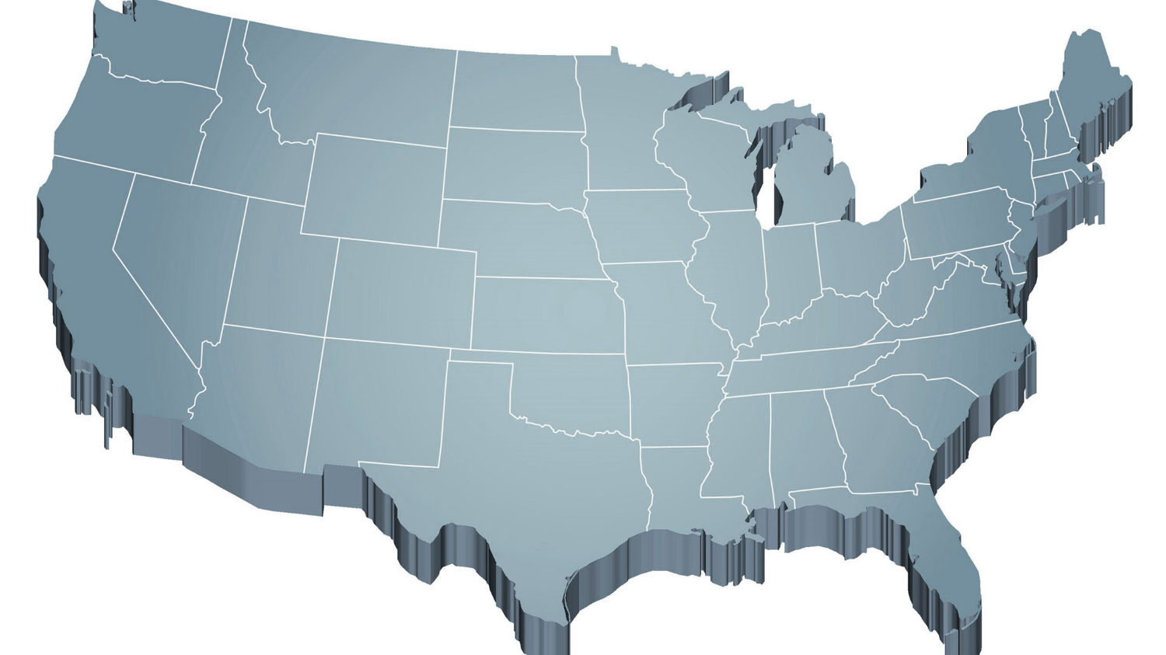
The Journey of Ci3T: Respectful Partnerships
1997
Notes:
CA & AZ start→ Tennessee → North Carolina→ Kansas
Trainings (MO, KANSAS, VERMONT, AZ)
MO, KS, UAB
HI

Slide 10
Overview of Systemic Screening in Ci3T Models

Slide 12
Primary (Tier 1) Prevention
All students are eligible for participation (Lane, Robertson et al., 2006)
About 80% of students respond to this level (Gresham, Sugai, Horner, Quinn, & McInerney, 1998; Sugai & Horner, 2006)
Examples of primary (Tier 1) prevention
Validated literacy curricula
Violence prevention
Conflict resolution programs
Anti-bullying programs
Schoolwide social skills instruction
Character education programs
Notes:
Sources: Gresham, F. M., Sugai, G., Horner, R. H., Quinn, M. M., & McInerney, M. (1998). Classroom and schoolwide practices that support students’ social competence: A synthesis of research. Washington, DC: Office of Special Education Programs.
Lane, K. L., Robertson, E. J., & Graham-Bailey, M. A. L. (2006). An examination of school-wide interventions with primary level efforts conducted in secondary schools: Methodological considerations. In T. E. Scruggs & M. A. Mastropieri (Eds.) Applications of research methodology: Advances in learning and behavioral disabilities (Vol. 19), pp. 157-199. Oxford, UK: Elsevier.
Sugai, G., & Horner, R.R. (2006). A promising approach for expanding and sustaining school-wide positive behavior support. School psychology review, 35, 245.

Slide 13
Secondary (Tier 2) Prevention
Students who need more than the primary prevention plan, 10-15% of students
Focused intervention to address academic, behavior, and/or social concerns
Acquisition (can’t do)
Fluency (trouble doing)
Performance (won’t do)
Examples of secondary (Tier 2) prevention
Small group instruction in anger management
Reading comprehension strategies
Notes:
Source: Lane, K.L., Oakes, W.P., Ennis, R.P., & Hirsch, S.E. (2014). Identifying students for secondary and tertiary prevention efforts: How do we determine which students have tier 2 and tier 3 needs? Preventing School Failure, 58, 171-182.

Slide 14
Tertiary (Tier 3) Prevention
Students who need more than primary or secondary prevention, 5-7% of students
Intensive individualized interventions
Examples of tertiary (Tier 3) prevention
Functional assessment-based interventions (Umbreit, Ferro, Liaupsin, & Lane, 2007)
Multisystemic therapy program (Schoenwald, Brown, & Henggeler, 2000)
Notes:
Sources: Lane, K.L., Oakes, W.P., Ennis, R.P., & Hirsch, S.E. (2014). Identifying students for secondary and tertiary prevention efforts: How do we determine which students have Tier 2 and Tier 3 needs? Preventing School Failure, 58, 171-182.
Schoenwald, S. K., Brown, T. L., & Henggeler, S. W. (2000). Inside multisystemic therapy therapist, supervisory, and program practices. Journal of Emotional and Behavioral Disorders, 8, 113-127.
Umbreit, J., Ferro, J.B., Liaupsin, C.J., & Lane, K.L. (2007). Functional behavioral assessment and function-based intervention: An effective, practical approach. Upper Saddle River, NJ: Prentice-Hall.

Slide 15
Comprehensive, Integrated, Three-Tiered Model of Prevention
(Lane, Kalberg, & Menzies, 2009)
Tier 3
Tertiary Prevention (≈5%)
Tier 2
Secondary Prevention (≈15%)
District & State Standards
High Quality Instruction
Tier 1
Primary Prevention (≈80%)
Academic ◇ Behavioral ◇ Social
Validated Curricula PBIS Framework Validated Curricula

Slide 16
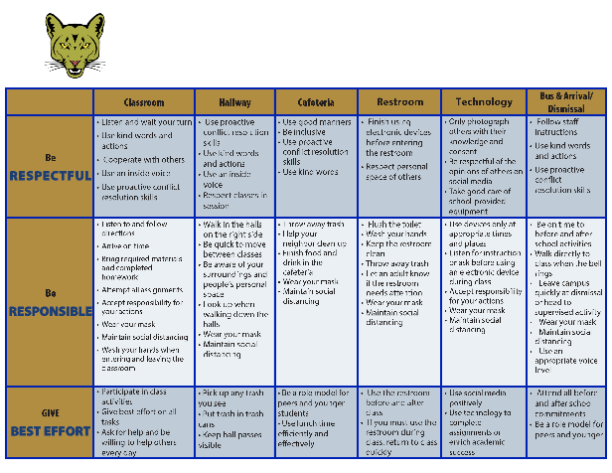
Comprehensive, Integrated, Three-Tiered Model of Prevention
(Lane, Kalberg, & Menzies, 2009)
Tier 3
Tertiary Prevention (≈5%)
Tier 2
Secondary Prevention (≈15%)
Establish, Clarify, Define Expectations
Positive Behavior Interventions and Supports (PBIS)
Tier 1
Primary Prevention (≈80%)
Academic ◇ Behavioral ◇ Social
Validated Curricula PBIS Framework Validated Curricula

Slide 17
Comprehensive, Integrated, Three-Tiered Model of Prevention
(Lane, Kalberg, & Menzies, 2009)
Tier 3
Tertiary Prevention (≈5%)
Tier 2
Secondary Prevention (≈15%)
Positive Action
Tier 1
Primary Prevention (≈80%)
Academic ◇ Behavioral ◇ Social
Validated Curricula PBIS Framework Validated Curricula

Slide 18
Comprehensive, Integrated, Three-Tiered Model of Prevention
(Lane, Kalberg, & Menzies, 2009)
Tier 3
Tertiary Prevention (≈5%)
Tier 2
Secondary Prevention (≈15%)
Tier 1
Primary Prevention (≈80%)
Academic ◇ Behavioral ◇ Social
Validated Curricula PBIS Framework Validated Curricula

Slide 19
Ci3T Implementation Manual

Slide 20
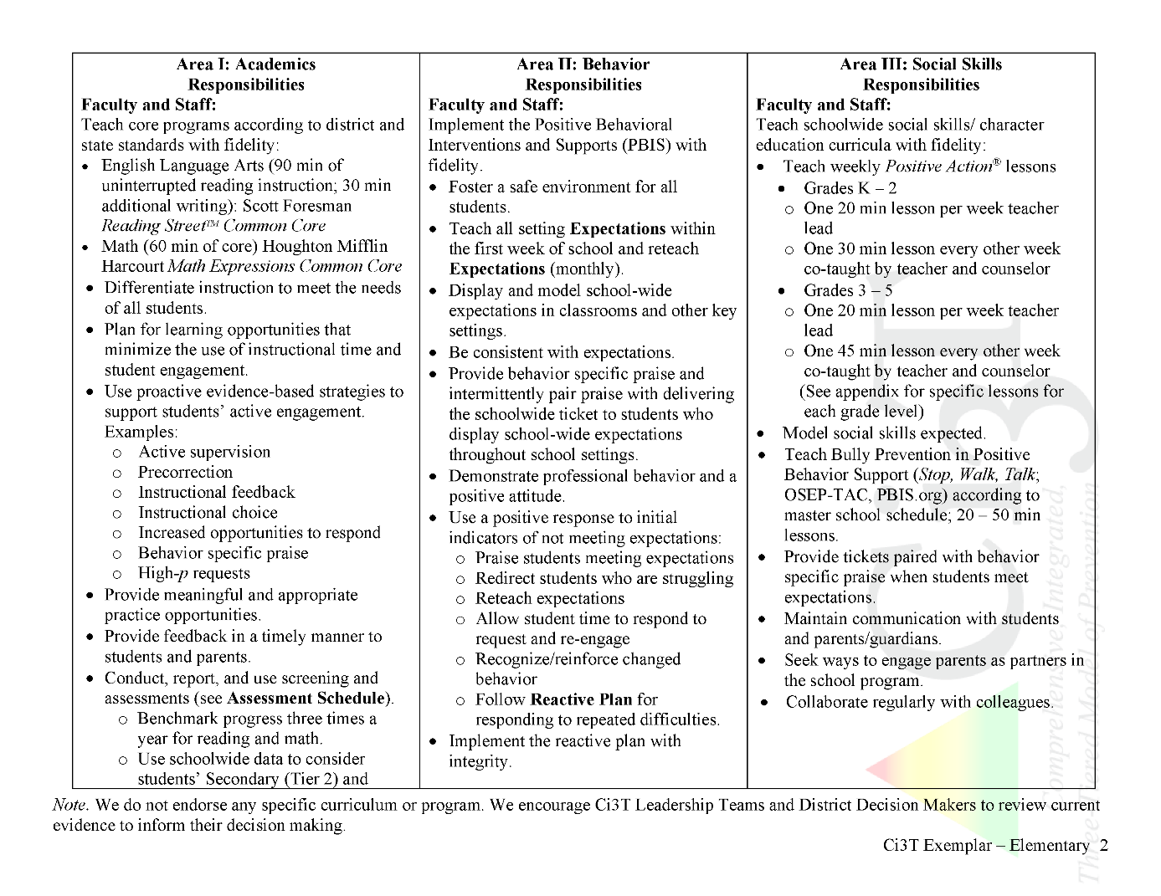
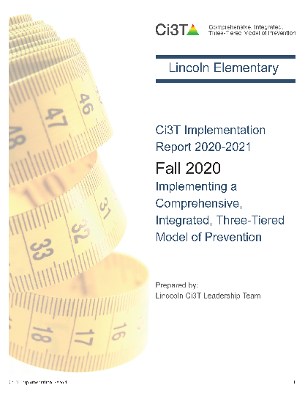
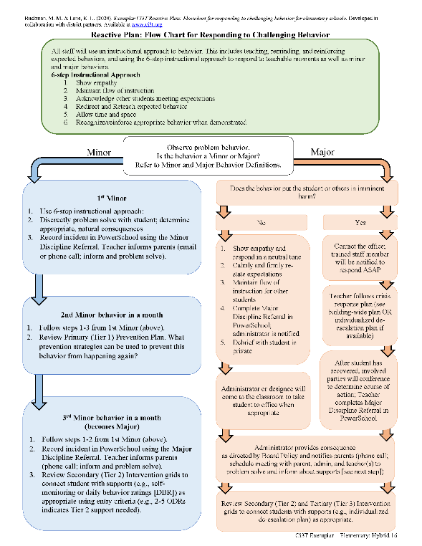
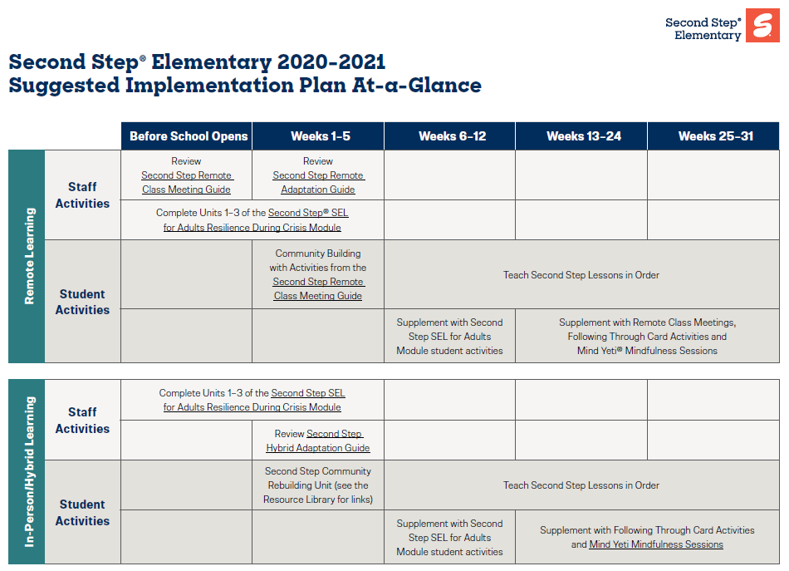
Ci3T Primary Plan: Procedures for Teaching
Opportunities to Respond
Behavior-Specific Praise
Ci3T Primary Plan: Procedures for Reinforcing
Active Supervision
Instructional Feedback
High-p Requests
Ci3T Primary Plan: Procedures for Monitoring
Precorrection
Instructional Choice
Notes:
Continued to keep implementation manuals, which are foundational to Ci3T, updated and current

Slide 21
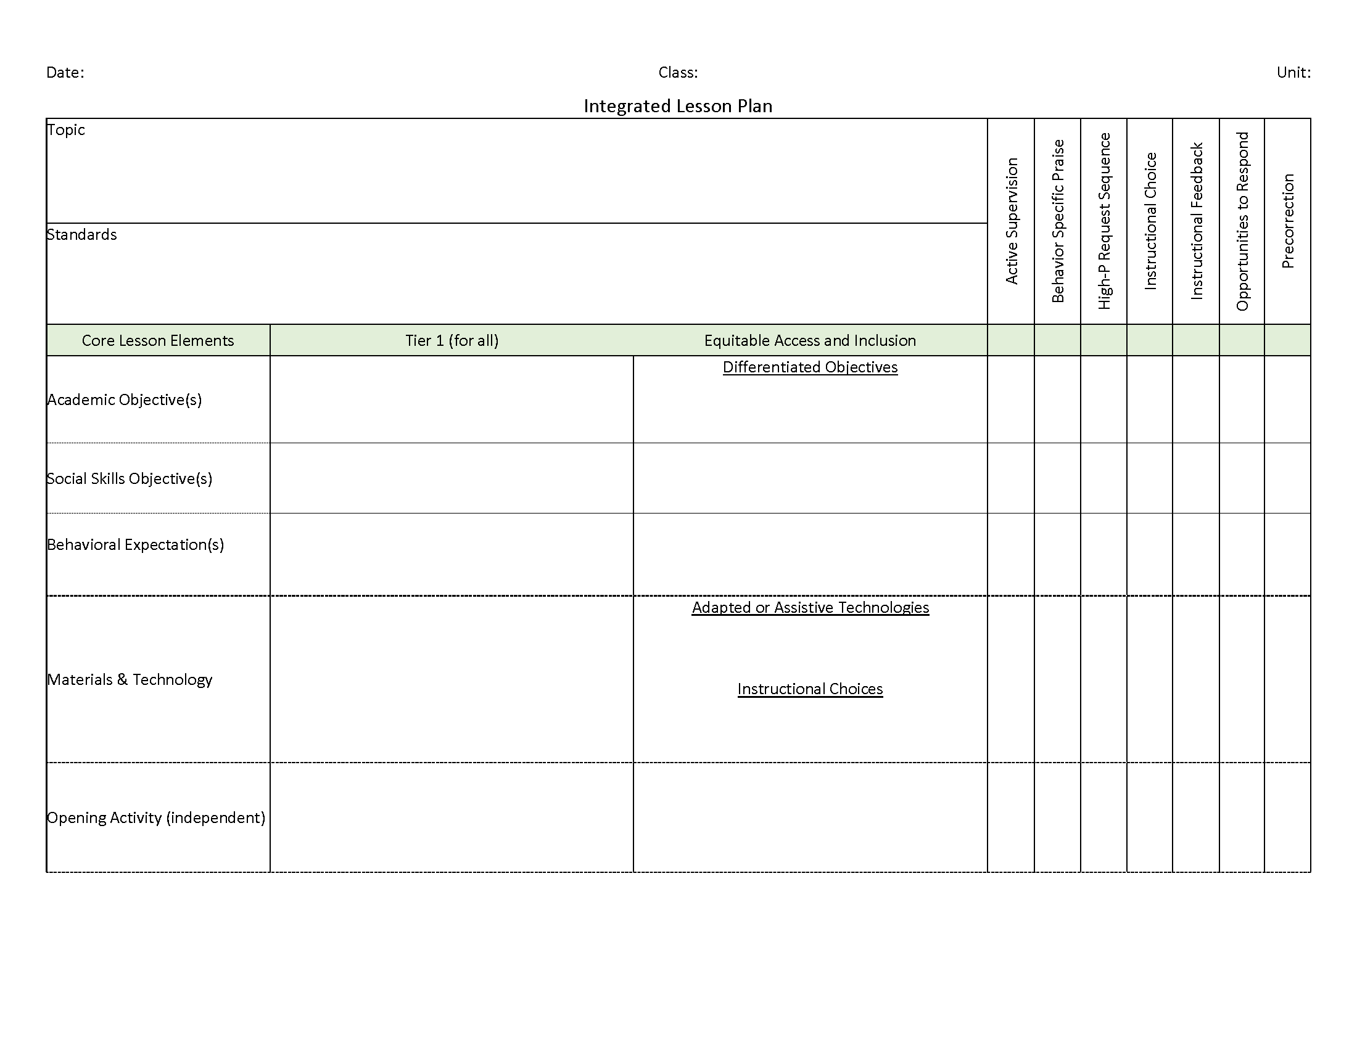
Ci3T: Integrated Lesson Planning

Slide 22
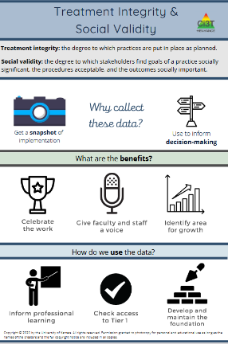
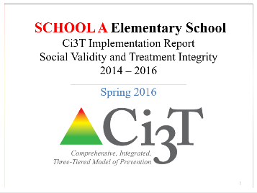
Essential Components of Primary Prevention Efforts
Social Validity
Systematic Screening
Academic
Behavior
Treatment Integrity
ci3t.org/measures
Notes:
Infographic - https://www.ci3t.org/measures

Slide 25
Comprehensive, Integrated, Three-Tiered Model of Prevention
(Lane, Kalberg, & Menzies, 2009)
Tier 3
Tertiary Prevention (≈5%)
Tier 2
Secondary Prevention (≈15%)
Tier 1
Primary Prevention (≈80%)
Academic ◇ Behavioral ◇ Social
Validated Curricula PBIS Framework Validated Curricula

Slide 26
Using Systematic Screening to
Inform Instruction at Tier 1
Empower Teachers with Low-intensity Strategies
Connect Students to Tier 2 and Tier 3 Interventions

Slide 27
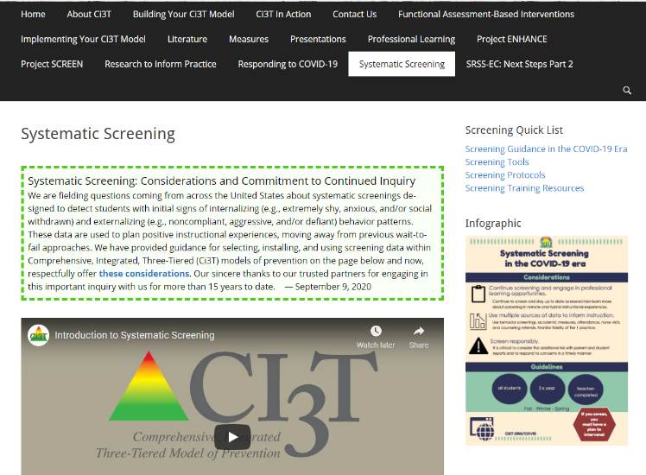
https://www.ci3t.org/screening

Slide 28
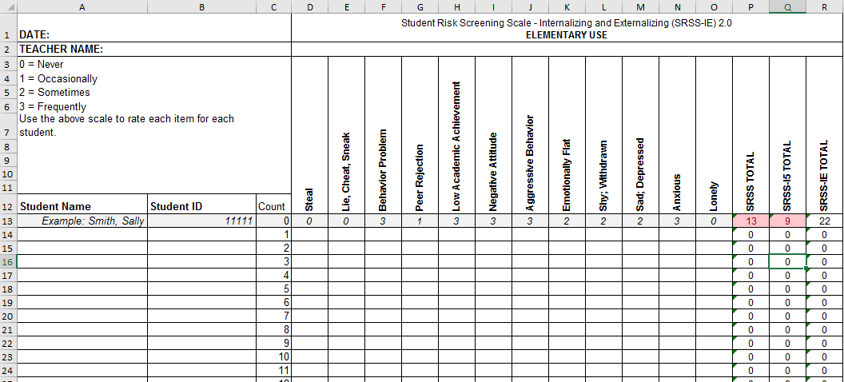
Student Risk Screening Scale for Internalizing and Externalizing
Available on ci3t.org
(SRSS-IE; Drummond, 1994; Lane & Menzies, 2009)

Slide 29
Student Risk Screening Scale for Internalizing and Externalizing (SRSS-IE; Drummond, 1994; Lane & Menzies, 2009)

Slide 30
SRSS-IE: Cut Scores
Elementary School |  | Middle and High School
SRSS-E7 | SRSS-I5 | SRSS-E7 | SRSS-I6
Items 1-7 | Items 8-12 | Items 1-7 | Items 4, 8-12
0-3 = low risk 4-8 = moderate risk 9-21 = high risk | 0-1 = low risk 2-3 = moderate risk 4-15 = high risk | 0-3 = low risk 4-8 = moderate risk 9-21 = high risk | 0-3 = low risk 4-5 = moderate risk 6-18 = high risk
Elementary School Level:
Lane, K. L., Oakes, W. P., Swogger, E. D., Schatschneider, C., Menzies, H., M., & Sanchez, J. (2015). Student risk screening scale for internalizing and externalizing behaviors: Preliminary cut scores to support data-informed decision making. Behavioral Disorders, 40, 159-170.
Middle and High School Levels:
Lane, K. L., Oakes, W. P., Cantwell, E. D., Schatschneider, C., Menzies, H., Crittenden, M., & Messenger, M. (2016). Student Risk Screening Scale for Internalizing and Externalizing Behaviors: Preliminary cut scores to support data-informed decision making in middle and high schools. Behavioral Disorders, 42(1), 271-284

Slide 31
Fall 2022 SRSS-Externalizing Results – Elementary School
n = 44
n = 43
n = 47
n = 27
n = 36
n = 29
n = 6
n = 17
n = 22
n = 30
n = 69
n = 61
n = 85
n = 94
n = 86
n = 83
n = 118
n = 100
n = 283
n = 276
n = 335
n = 329
n = 306
n = 293
n = 333
n = 346
n = 352
Notes:
***note to presenter***
If you would like to feature middle or high school data – hide the elementary slides (32-24) and unhide the middle or high school slides
If you would like to update this slide with data from your school or district- Fill in <year> based on current academic year. This is located in column A of the data sheet. Edit by right clicking and selecting “Edit data”.

Slide 32
Fall 2022 SRSS-Internalizing Results – Elementary School
n = 59
n = 62
n = 39
n = 39
n = 31
n = 18
n = 13
n = 32
n = 23
n = 82
n = 65
n = 67
n = 46
n = 47
n = 35
n = 69
n = 73
n = 62
n = 304
n = 292
n = 361
n = 338
n = 351
n = 340
n = 321
n = 338
n = 343
Cut scores vary by school level:
Elementary (I5): Low (0-1), Moderate (2-3), High (4-15)
Middle and High (I6): Low (0-3), Moderate (4-5), High (6-18)
Notes:
Fill in <year> based on current academic year. This is located in column A of the data sheet. Edit by right clicking and selecting “Edit data”.
IMPORTANT NOTE: The INTERNALIZING subscale and CUT SCORES are specific to school level.
Elementary: SRSS-I5, Items 8-12, 0-1 = low risk, 2-3 = moderate risk, 4-15 = high risk
Middle and High: SRSS-I6, Items 4, 8-12, 0-3 = low risk, 4-5 = moderate risk, 6-18 = high risk

Slide 33
Fall 2022 SRSS-Internalizing Results – Elementary School
Grade Level | N Screened | Low n (%) | Moderate n (%) | High n (%)
K | 64 | 52 (81.25%) | 7 (10.94%) | 5 (7.81%)
1 | 81 | 69 (85.19%) | 9 (11.11%) | 3 (3.70%)
2 | 56 | 44 (78.57%) | 11 (19.64%) | 1 (1.79%)

Slide 34
Fall 2022 SRSS-Externalizing Results – Middle School
n = 19
n = 23
n = 24
n = 9
n = 11
n = 3
n = 18
n = 16
n = 31
n = 27
n = 75
n = 57
n = 53
n = 75
n = 67
n = 53
n = 541
n = 475
n = 517
n = 400
n = 515
n = 552
n = 518
n = 460
Notes:
Fill in <year> based on current academic year. This is located in column A of the data sheet. Edit by right clicking and selecting “Edit data”.

Slide 35
Fall 2022 SRSS-Internalizing Results – Middle School
n = 87
n = 43
n = 37
n = 13
n = 21
n = 19
n = 53
n = 37
n = 13
n = 42
n = 26
n = 39
n = 30
n = 27
n = 40
n = 88
n = 460
n = 486
n = 518
n = 414
n = 550
n = 536
n = 510
n = 450
Cut scores vary by school level:
Elementary (I5): Low (0-1), Moderate (2-3), High (4-15)
Middle and High (I6): Low (0-3), Moderate (4-5), High (6-18)
Notes:
Fill in <year> based on current academic year. This is located in column A of the data sheet. Edit by right clicking and selecting “Edit data”.
IMPORTANT NOTE: The INTERNALIZING subscale and CUT SCORES are specific to school level.
Elementary: SRSS-I5, Items 8-12, 0-1 = low risk, 2-3 = moderate risk, 4-15 = high risk
Middle and High: SRSS-I6, Items 4, 8-12, 0-3 = low risk, 4-5 = moderate risk, 6-18 = high risk

Slide 36
Fall 2022 SRSS-Internalizing Results – Middle School
Grade Level | N Screened | Low n (%) | Moderate n (%) | High n (%)
6 | 176 | 151 (85.80%) | 15 (8.52%) | 10 (5.68%)
7 | 176 | 141 (80.11%) | 17 (9.66%) | 18 (10.23%)
8 | 177 | 158 (89.21%) | 10 (5.65%) | 9 (5.08%)

Slide 37
Fall 2022 SRSS-Externalizing Results – High School
n = 29
n = 39
n = 23
n = 25
n = 30
n = 13
n = 26
n = 38
n = 96
n = 95
n = 90
n = 82
n = 69
n = 55
n = 95
n = 129
n = 1072
n = 1404
n = 1339
n = 1222
n = 692
n = 1119
n = 1270
n = 1242
Notes:
Fill in <year> based on current academic year. This is located in column A of the data sheet. Edit by right clicking and selecting “Edit data”.

Slide 38
Fall 2022 SRSS-Internalizing Results – High School
n = 112
n = 87
n = 76
n = 62
n = 63
n = 70
n = 78
n = 91
n = 124
n = 64
n = 56
n = 42
n = 38
n = 41
n = 66
n = 106
n = 961
n = 1387
n = 1320
n = 1225
n = 690
n = 1076
n = 1247
n = 1212
Cut scores vary by school level:
Elementary (I5): Low (0-1), Moderate (2-3), High (4-15)
Middle and High (I6): Low (0-3), Moderate (4-5), High (6-18)
Notes:
Fill in <year> based on current academic year. This is located in column A of the data sheet. Edit by right clicking and selecting “Edit data”.
IMPORTANT NOTE: The INTERNALIZING subscale and CUT SCORES are specific to school level.
Elementary: SRSS-I5, Items 8-12, 0-1 = low risk, 2-3 = moderate risk, 4-15 = high risk
Middle and High: SRSS-I6, Items 4, 8-12, 0-3 = low risk, 4-5 = moderate risk, 6-18 = high risk

Slide 39
Fall 2022 SRSS-Internalizing Results – High School
Grade Level | N Screened | Low n (%) | Moderate n (%) | High n (%)
9 | 367 | 308 (83.92%) | 30 (8.17%) | 29 (7.90%)
10 | 375 | 308 (82.13%) | 35 (9.33%) | 32 (8.53%)
11 | 367 | 321 (87.47%) | 24 (6.54%) | 22 (5.99%)
12 | 300 | 275 (91.67%) | 17 (5.67%) | 8 (2.67%)

Slide 40
Results:
SRSS-IE: Externalizing Subscale Elementary
Fall Externalizing
Winter
Spring
ORF
MAP Reading
Nurse Visit
Suspensions
Variable | Risk |  |  | Significance Testing
 | Low M (SD) n | Moderate M (SD) n | High M (SD) n
Oral Reading Fluency | 163.23 (39.66) 468 | 138.62 (42.70) 107 | 115.82 (46.21) 46 | L > M > H
MAP Reading | 66.54 (26.48) 2,047 | 42.91 (30.37) 443 | 33.32 (29.82) 199 | L > M > H
Nurse Visits | 6.14 (6.81) 3,256 | 9.18 (9.59) 820 | 11.83 (9.89) 389 | L < M < H
In-School Suspensions | 0.0052 (0.08) 3,256 | 0.0427 (0.30) 820 | 0.1080 (0.46) 389 | L < M < H

Slide 41
Results:
SRSS-IE: internalizing Subscale Elementary
Variable | Risk |  |  | Significance Testing
 | Low M (SD) n | Moderate M (SD) n | High M (SD) n
Oral Reading Fluency | 159.04 (41.45) 459 | 150.59 (45.76) 88 | 139.18 (46.53) 74 | L > H L = M; M = H
MAP Reading | 63.38 (28.32) 2,070 | 53.93 (32.15) 356 | 43.57 (30.47) 263 | L > M > H
Nurse Visits | 6.84 (7.37) 3,387 | 7.59 (8.05) 628 | 9.33 (10.81) 450 | L < M < H
In-School Suspensions | 0.0142 (0.15) 3,387 | 0.0510 (0.36) 628 | 0.0311 (0.20) 450 | L < M, H M = H
Fall Internalizing
Winter Internalizing
Spring
ORF*
MAP Reading
Nurse Visit
Suspensions*

Slide 42
Student Risk Screening Scale Fall 2004 – 2012 Middle School
Source: Lane, K. L., Oakes, W. P., & Magill, L. M., (2014). Primary prevention efforts: How do we implement and monitor the Tier 1 component of our comprehensive, integrated, three-tiered model of prevention. Preventing School Failure, 58, 143-158. 10.1080/1045988X.2014.893978 [Figure 4. Middle school behavior screening data over time at the fall time point. Adapted from Figure 4.6 p. 127 Lane, K. L., Menzies, H. M, Oakes, W. P., & Kalberg, J. R. (2012). Systematic screenings of behavior to support instruction: From preschool to high school. Guilford Press.]

Slide 43
Middle School Study 1: Behavioral & Academic Characteristics of SRSS Risk Groups
Variable |  | Risk
 | Low (n = 422) M (SD) | Moderate (n = 51) M (SD) | High (n = 12) M (SD) | Significance Testing
ODR | 1.50 (2.85) | 5.02 (5.32) | 8.42 (7.01) | L<M<H
In-School Suspensions | 0.08 (0.38) | 0.35 (1.04) | 1.71 (2.26) | L<M<H
GPA | 3.35 (0.52) | 2.63 (0.65) | 2.32 (0.59) | L>M, H M=H
Course Failures | 0.68 (1.50) | 2.78 (3.46) | 4.17 (3.49) | L<M, H M=H
(Lane, Parks, Kalberg, & Carter, 2007)

Slide 44
Screening Data: High School Yrs1-3
Fall- SRSSIE-I |  | Low |  | Moderate |  | High |  | Fall- SRSSIE-E |  | Low |  | Moderate |  | High
2016 |  | 80.28% |  | 10.36% |  | 9.36% |  | 2016 |  | 89.56% |  | 8.02% |  | 2.42%
2017 |  | 90.18% |  | 4.16% |  | 5.66% |  | 2017 |  | 91.29% |  | 6.18% |  | 2.54%
2018 |  | 90.91% |  | 3.86% |  | 5.23% |  | 2018 |  | 92.22% |  | 6.20% |  | 1.58%
WTR-SRSSIE-I |  | Low |  | Moderate |  | High |  | WTR-SRSSIE-E |  | Low |  | Moderate |  | High
2016 |  | 87.25% |  | 9.49% |  | 3.26% |  | 2016 |  | 87.25% |  | 9.49% |  | 3.26%
2017 |  | 86.14% |  | 9.02% |  | 4.85% |  | 2017 |  | 86.14% |  | 9.02% |  | 4.85%
2018 |  | 88.79% |  | 8.52% |  | 2.69% |  | 2018 |  | 88.79% |  | 8.52% |  | 2.69%
Shared with permission from district partner

Slide 46
Sample Middle School: Fall
SRSS-E7 Results – All Students
N = 26
N = 12
N = 89
N = 66
N = 554
N = 550

Slide 47
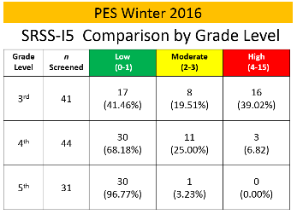
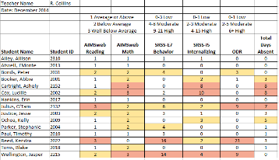
Data sharing…
Schoolwide data
…decisions related to primary prevention efforts
Grade / Department / Class
…implications for teachers’ practice
Individual student
…decisions about student-based interventions

Slide 48
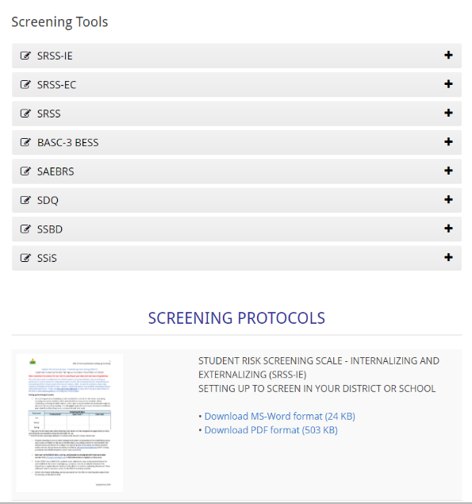
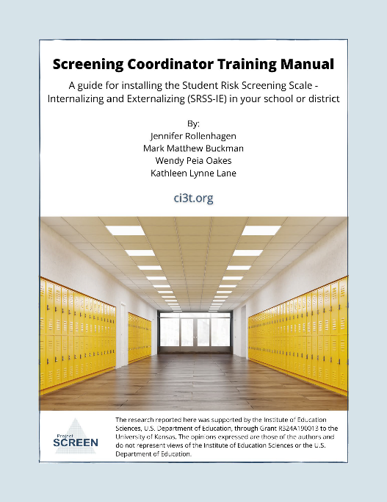

Slide 49
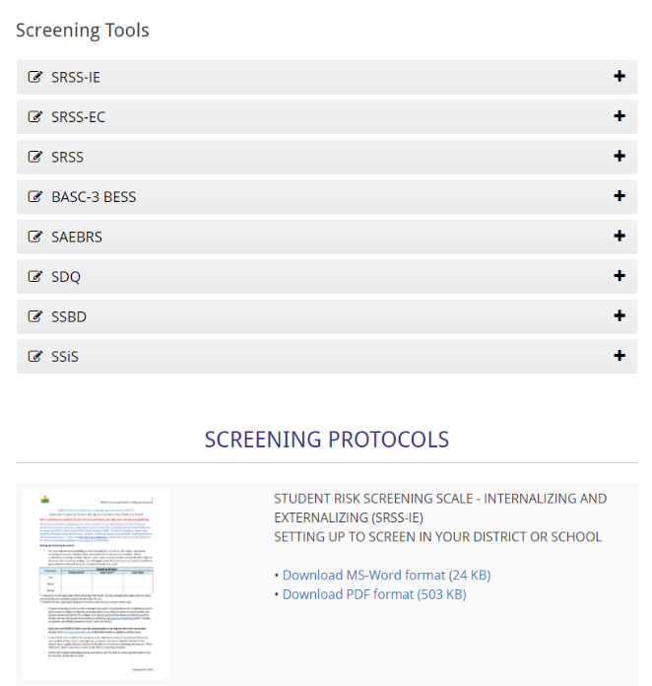
Talk Time
What are some of the potential benefits of systematic screening?
What are some of the potential challenges of systematic screening?
What questions do you have about systematic screening?
Notes:
15-min timer

Slide 50
Using Systematic Screening to
Inform Instruction at Tier 1
Empower Teachers with Low-intensity Strategies
Connect Students to Tier 2 and Tier 3 Interventions

Slide 51
Social Skills Improvement System – Performance Screening Guide Spring 2012 – Total School
N = 54
N = 22
N = 35
N = 31
N = 223
N = 233
N = 180
N = 187
N = 212
N = 235
N = 275
N = 271
n = 489 n = 490 n = 490 n = 489
Lane, K. L., Oakes, W. P., & Magill, L. (2013). Primary prevention efforts: How do we implemented and monitor the Tier 1 component of our Comprehensive, Integrated, Three-Tiered (Ci3T) Model?, Preventing School Failure, 58(1), 143-158.

Slide 52
Fall 2022 SRSS-Externalizing Results – Elementary School
n = 44
n = 43
n = 47
n = 27
n = 36
n = 29
n = 6
n = 17
n = 22
n = 30
n = 69
n = 61
n = 85
n = 94
n = 86
n = 83
n = 118
n = 100
n = 283
n = 276
n = 335
n = 329
n = 306
n = 293
n = 333
n = 346
n = 352

Slide 53
Student Risk Screening Scale Fall 2004 – 2012 Middle School
Source: Lane, K. L., Oakes, W. P., & Magill, L. M., (2014). Primary prevention efforts: How do we implement and monitor the Tier 1 component of our comprehensive, integrated, three-tiered model of prevention. Preventing School Failure, 58, 143-158. doi:10.1080/1045988X.2014.893978 [Figure 4. Middle school behavior screening data over time at the fall time point. Adapted from Figure 4.6 p. 127 Lane, K. L., Menzies, H. M, Oakes, W. P., & Kalberg, J. R. (2012). Systematic screenings of behavior to support instruction: From preschool to high school. Guilford Press.]

Slide 54
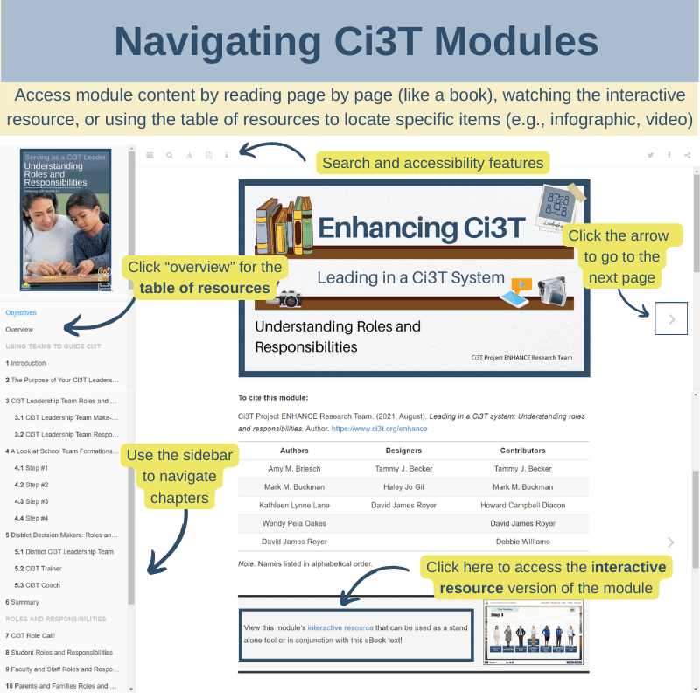
Using Systematic Screening to
Inform Instruction at Tier 1
Empower Teachers with Low-intensity Strategies
Connect Students to Tier 2 and Tier 3 Interventions

Slide 55
Notes:
In this section we are going to highlight content from modules and wanted to start by grounding in this infographic, a new resource to help people get oriented to modules and how to use them. We heard your feedback that sometimes staff who are new to using modules find it tricky to navigate so wanted to highlight these key features!
If you’re accessing the module as an eBook and reading page x page, use arrow to navigate to the next page or sidebar to navigate chapters and pick up where you left off
If you want to watch the interactive resource, click here
If you’ve already reviewed the module and you’re coming back to locate a specific item (or “lucky charm” at Kathleen likes to call them) like an infographic, video, or activity, click where it says “overview” here on the sidebar to be taken to the table of resource. From there you can click “page” to be taken to that part of the eBook or “link” to download the material directly.

Slide 56
Notes:
Continued to keep implementation manuals, which are foundational to Ci3T, updated and current

Slide 57
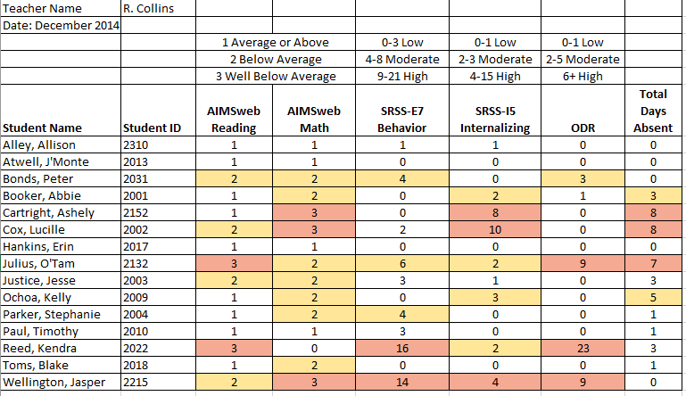
Examining Academic and Behavioral Data
Lane, K. L., Menzies, H. M., Ennis, R. P., & Oakes, W. P. (2015). Supporting Behavior for School Success: A Step-by-Step Guide to Key Strategies. Guilford Press.
Notes:
Lane, K. L., Oakes, W. P., Ennis, R. P., & Hirsch, S. E. (2014). Identifying students for secondary and tertiary prevention efforts: How do we determine which students have Tier 2 and Tier 3 needs? Preventing School Failure, 58, 171-182, DOI: 10.1080/1045988X.2014.895573

Slide 58
Low-Intensity Strategy | Franklin High School On-Site Expert
Behavior-Specific Praise: Identifying the specific expectation the student met. “Niama, I noticed you outlined your paper and used the graphic organizer to draft your essay. Well done!” “Justice, thank you for pushing in your chair to keep the walkway safe.” | Eric Common, Behavior Specialist Mark Buckman, Special Education Grant Allen, Parent Volunteer Paloma Pérez-Clark, School Psychologist
Opportunities to Respond: Providing 4-6 opportunities per minute for students to respond individually, choral, verbal, written, gesture, or symbol. “Show me thumbs or thumbs down if...” “Show me on your white board what…” “Turn to your elbow partner and say…” “All together now, what is…” | David Royer, Administration Emily Cantwell, 12th Grade Scarlett Lane, 11rd Grade Mallory Messenger, Counselor
Instructional Choice: Providing within-task or between task choices to increase academic engaged time and motivation. “Ronaldo, our of our 3 learning objectives today, which would you like to work on first?” “Suzy, do you want to work on the laptop, or handwrite your answers for this assignment?” | Abbie Jenkins, 10th Grade Scarlett Lane, 11th Grade José Sousa, PE Liane Johl, 9th Grade

Slide 59
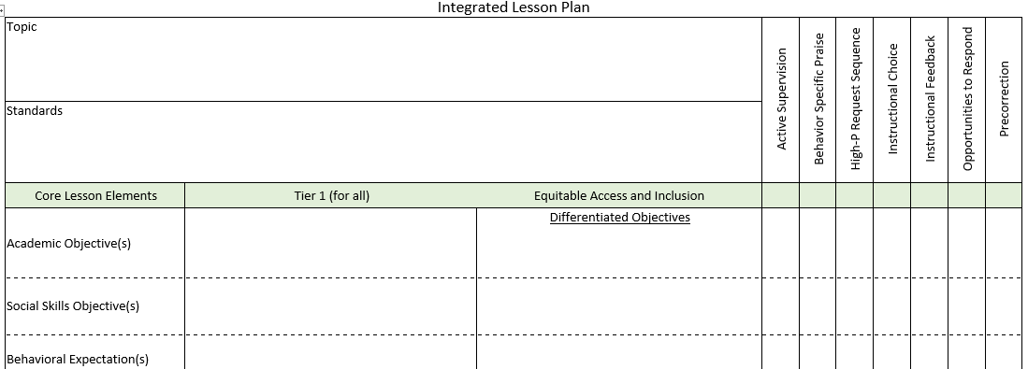
Integrated Lesson Planning

Slide 60
Example Integrated Lesson Plan
Notes:
Video = 1:39, example with fractions

Slide 61
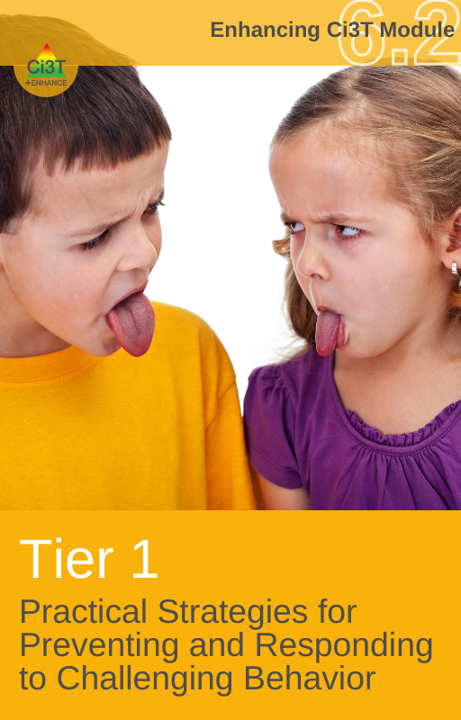
Low-Intensity Supports to Prevent Challenging Behavior

Slide 62
Embedding Low-Intensity Supports in Daily Instruction
Notes:
2:44 video – elementary, numerous examples of embedding pre-correction, active supervision, BSP into routines (e.g., moving from desk to carpet, using response cards during a vocabulary lesson)

Slide 64
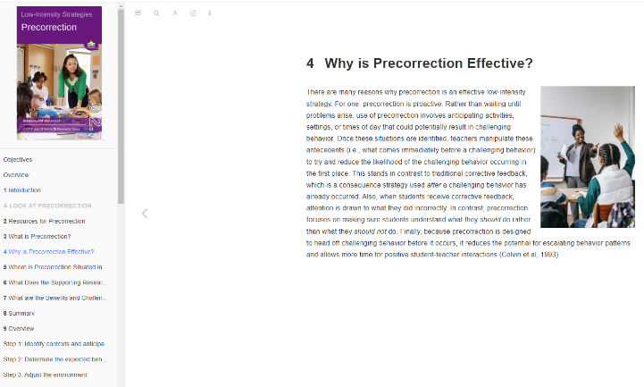
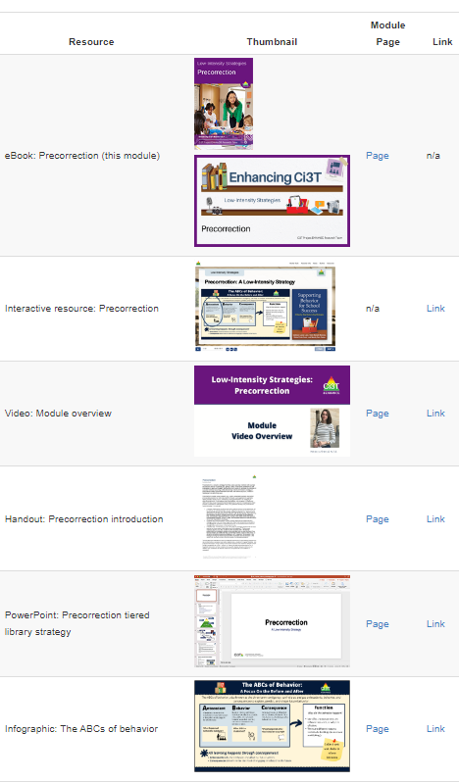
eBook
Interactive resource
table of resources
Notes:
As we dive into this module, remember there are (3) ways to access content:
Read like a book
Watch the interactive resources
Use the table of resources to quickly find

Slide 66
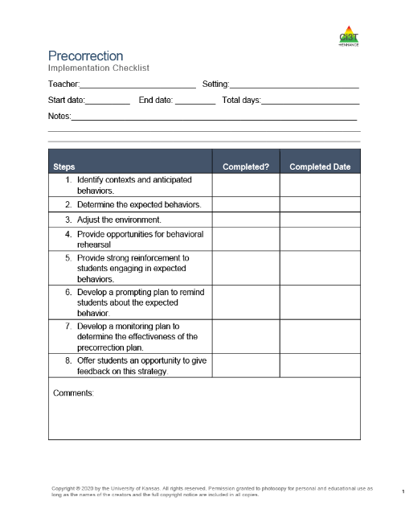

Slide 67
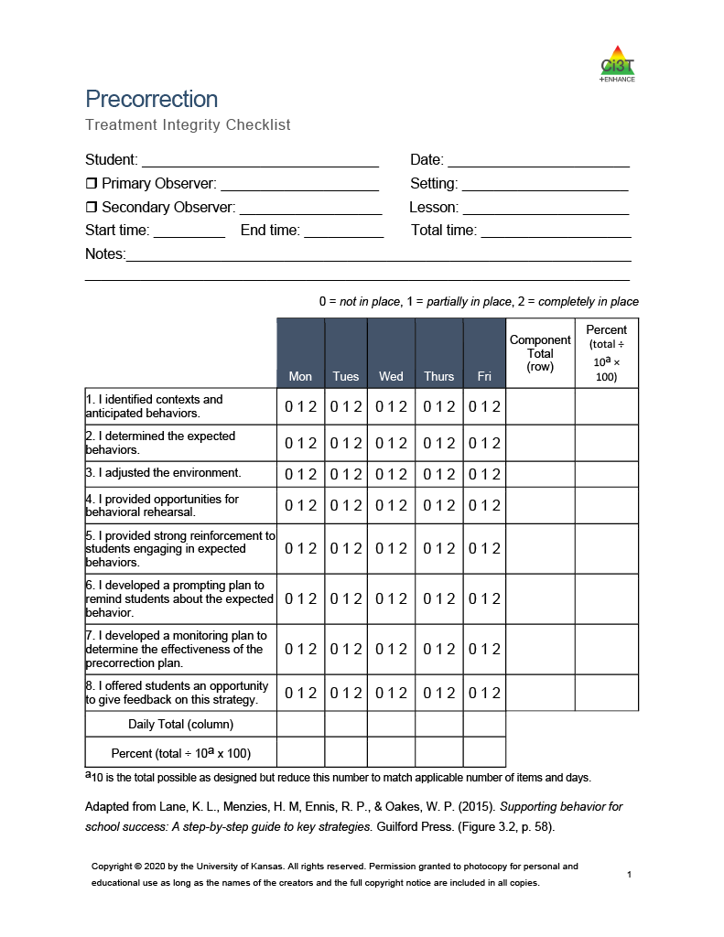
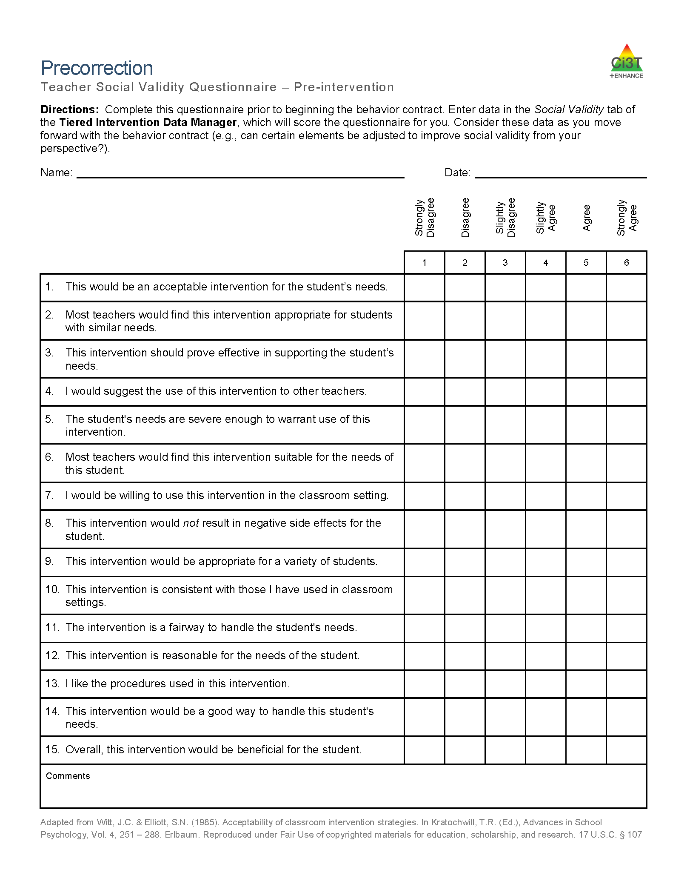

Slide 68
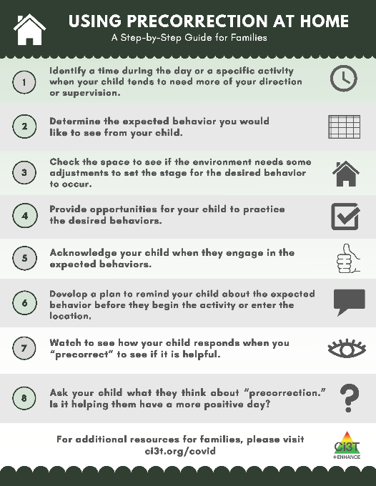
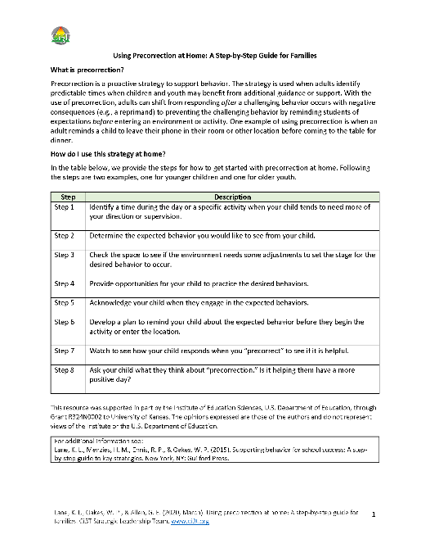
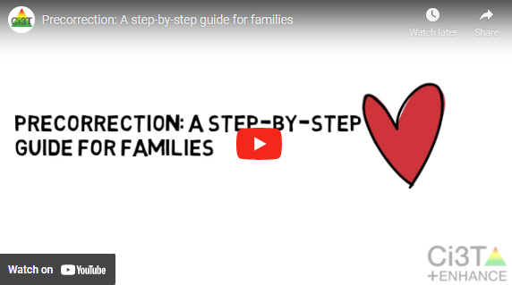

Slide 69
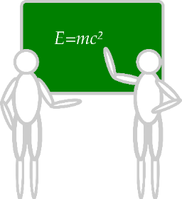
Deep dive into this at EMPOWER Session 3!
Designate two staff to attend trainings to become on-site coaches
10 min @ next Faculty and Staff meeting
Ci3T Setting Up for Success
Systematic Screening
Low-Intensity Supports
Tier 2
Planning Ahead
Tier 3

Slide 70
Talk Time
Select a low-intensity strategy to explore.
Consider
How might you incorporate this strategy into your classroom?
How could you share this information with your faculty & staff?
Notes:
15-min timer

Slide 71
Using Systematic Screening to
Inform Instruction at Tier 1
Empower Teachers with Low-intensity Strategies
Connect Students to Tier 2 and Tier 3 Interventions

Slide 72
Comprehensive, Integrated, Three-Tiered Model of Prevention
(Lane, Kalberg, & Menzies, 2009)
Tier 3
Tertiary Prevention (≈5%)
Tier 2
Secondary Prevention (≈15%)
Secondary (Tier 2) Intervention Grids
Tier 1
Primary Prevention (≈80%)
Academic ◇ Behavioral ◇ Social
Validated Curricula PBIS Framework Validated Curricula

Slide 74
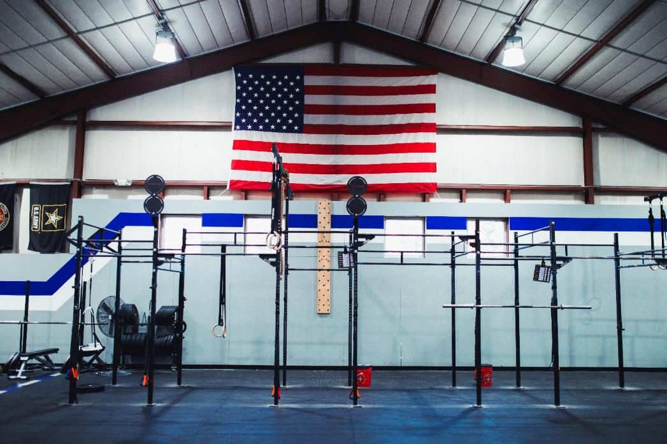

Slide 75
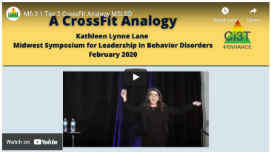
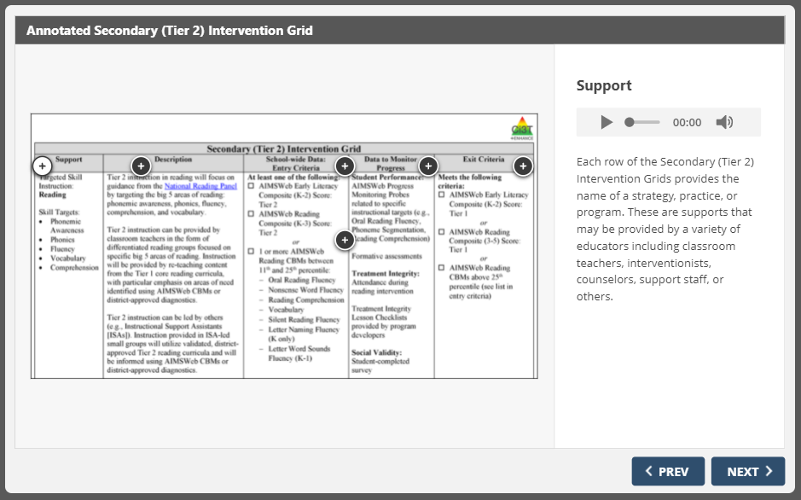

Slide 76
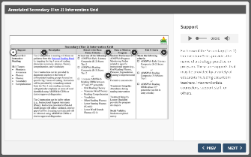
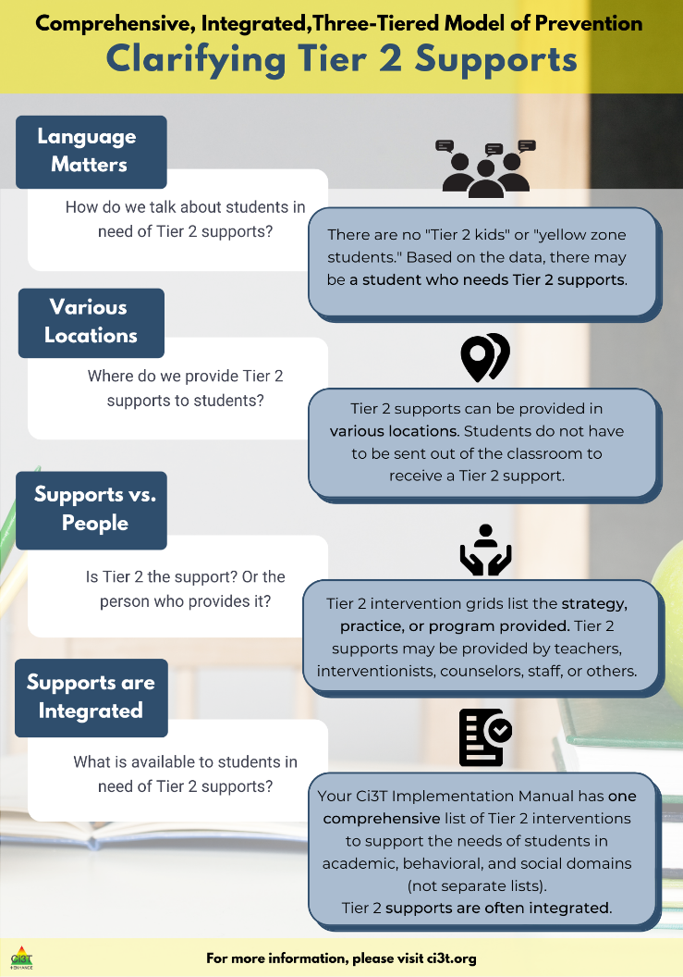

Slide 77
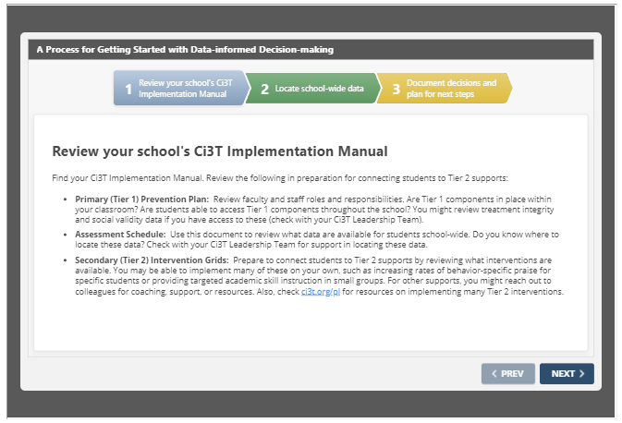

Slide 78
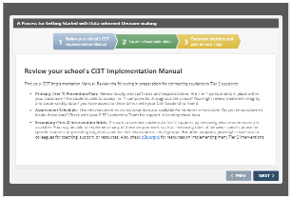
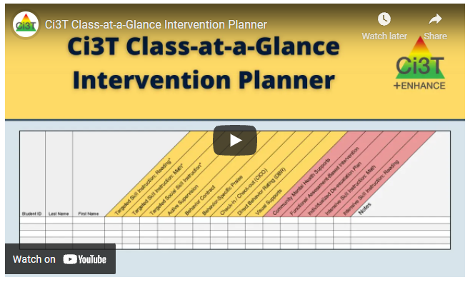

Slide 79
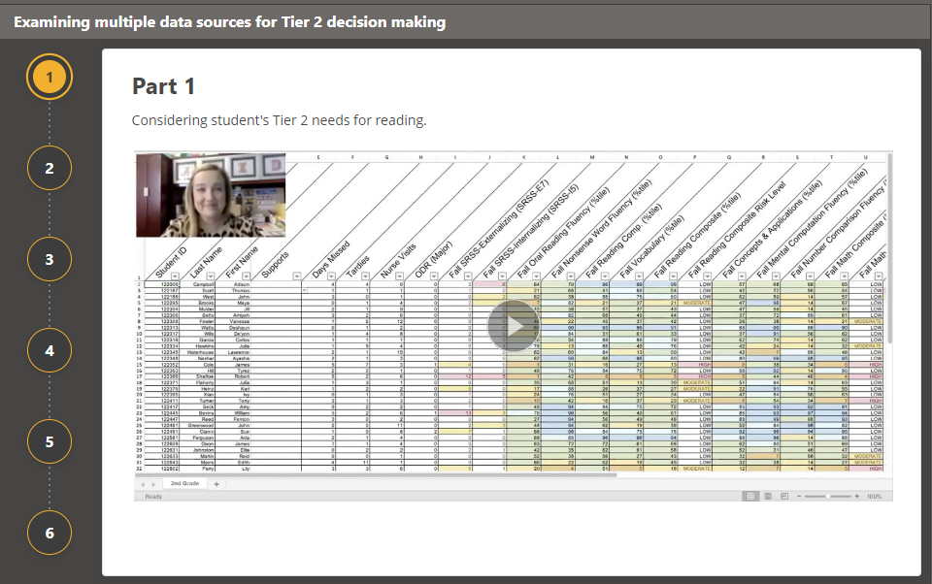

Slide 82
An illustration

Slide 83
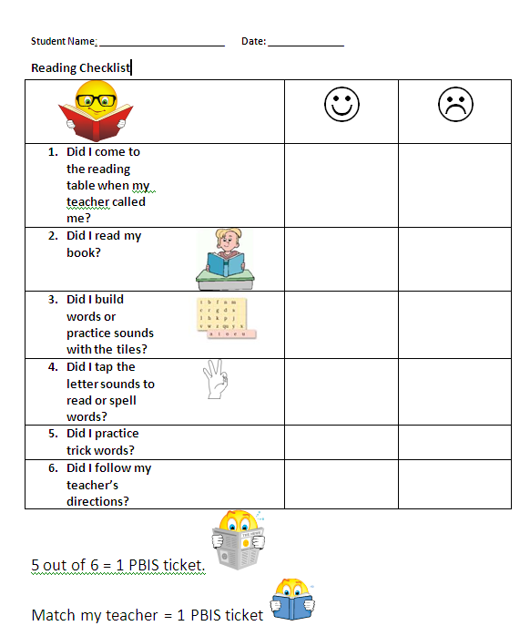
First Grade Students’ Self Monitoring Form
Altmann, S. A. (2010). Project support and include: the additive benefits of self-monitoring on students’ reading acquisition. Unpublished master’s thesis, Vanderbilt University.

Slide 84
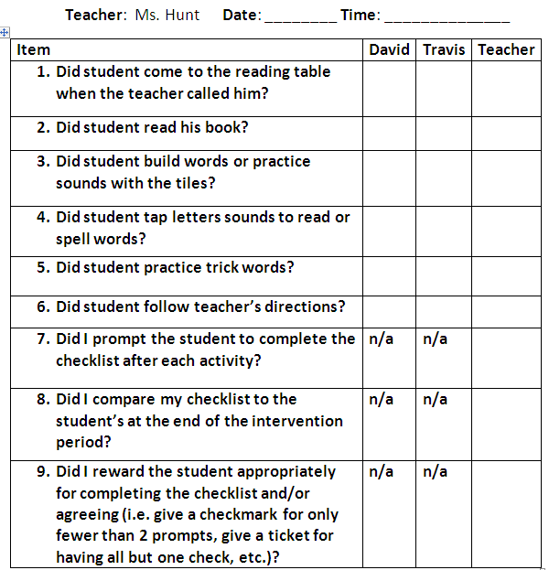
Treatment Integrity Social Validity Monitor student progress
Altmann, S. A. (2010). Project support and include: the additive benefits of self-monitoring on students’ reading acquisition. Unpublished master’s thesis, Vanderbilt University.

Slide 85
Support | Description | Schoolwide Data: Entry Criteria | Data to Monitor Progress: | Exit Criteria
Mentoring Program (Sophomores/ Juniors/ Seniors) | Focus is on academic achievement, character development, problem-solving skills, improving self-esteem, relationships with adults and peers, and school attendance. Volunteer teachers serve as mentors; meeting weekly (30 – 60 min) with students during the school day. | (1) 10th/11th/ 12th graders (2) Behavior: SRSS: High (9-21) or Moderate (4-8) by either 2nd or 7th period teacher ODR ≥ 2 Absences ≥ 5 days in one grading period (3) Academic: GPA ≤ 2.75 | Student Measures: (1) Increase of GPA at mid-term and semester report cards. (2) Decrease of ODR monitored weekly. (3) Reduced absences (fewer than one per quarter) Treatment Integrity: Mentors complete weekly mentoring checklists to report meeting time and activities. Social Validity: Pre and post surveys for students and mentors. | Yearlong support Students who no longer meet criteria next fall Seniors: graduation
Lane, K. L., Oakes, W. P., Menzies, H. M., Oyer, J., & Jenkins, A. (2013). Working within the context of three-tiered models of prevention: Using school wide data to identify high school students for targeted supports. Journal of Applied School Psychology, 29, 203-229

Slide 86
Support | Description | Schoolwide Data: Entry Criteria | Data to Monitor Progress: | Exit Criteria
Targeted Algebra II Study Hall | Direct, targeted instruction of Algebra II learning targets by math teachers. Time will be used to re-teach concepts, provide one-on-one or small group instruction and offer greater supports for students struggling to pass the graduation requirement course. 50 min per day until exit criteria is met. | (1) 12th graders (2) Algebra II grade drops below a 75 at any point in the semester (3) Have study hall time available and permission of 5th period teacher (4) Self-selecting to engage in study hall | Student Measures: Algebra II classroom grades Daily class average if grade is ≤ 75 Treatment Integrity: Daily monitoring of the lessons covered and student attendance Social Validity: Pre and Post Student Surveys | Algebra II Grade increases to satisfactory level (above 75%).
Lane, K. L., Oakes, W. P., Menzies, H. M., Oyer, J., & Jenkins, A. (2013). Working within the context of three-tiered models of prevention: Using school wide data to identify high school students for targeted supports. Journal of Applied School Psychology, 29, 203-229.

Slide 87
Tiered Fidelity Inventory (TFI)
Survey for all faculty and staff
Measures treatment integrity and social validity of Tier 1 Ci3T implementation
Tier 1, 2, and 3 protocols completed by Ci3T Leadership Team
Measures treatment integrity of SW-PBIS
Tier 1 Walkthrough
Observe 25% of instructional staff
Measures treatment integrity of Tier 1 Ci3T implementation
Educator and observer perspectives
Ci3T Treatment Integrity: Teacher Self-Report
&
Primary Intervention Rating Scale Survey
Ci3T TI: Direct Observation

Slide 88
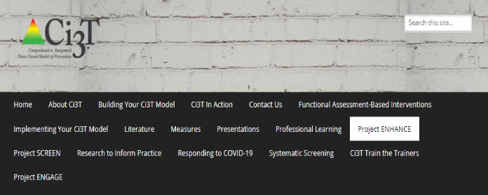
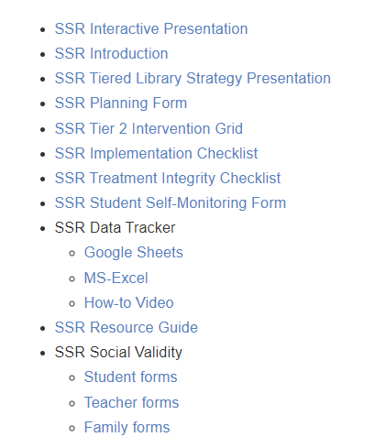
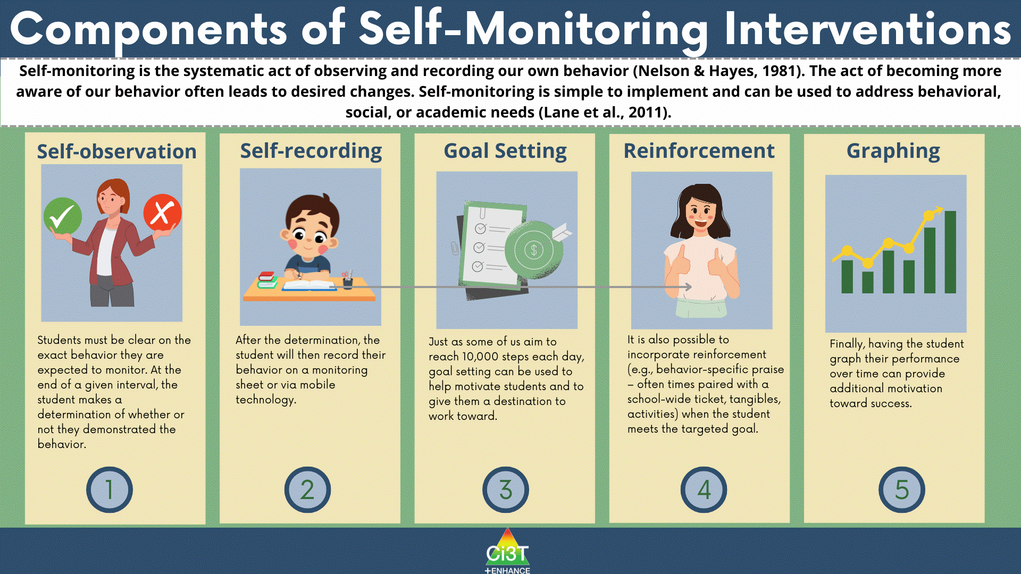
Professional Learning Modules

Slide 89
Comprehensive, Integrated, Three-Tiered Model of Prevention
(Lane, Kalberg, & Menzies, 2009)
Tier 3
Tertiary Prevention (≈5%)
Tier 2
Secondary Prevention (≈15%)
Tertiary (Tier 3) Intervention Grids
Tier 1
Primary Prevention (≈80%)
Academic ◇ Behavioral ◇ Social
Validated Curricula PBIS Framework Validated Curricula

Slide 90
Tertiary (Tier 3) Intervention Grid

Slide 91
Tertiary (Tier 3) Intervention Grid

Slide 92
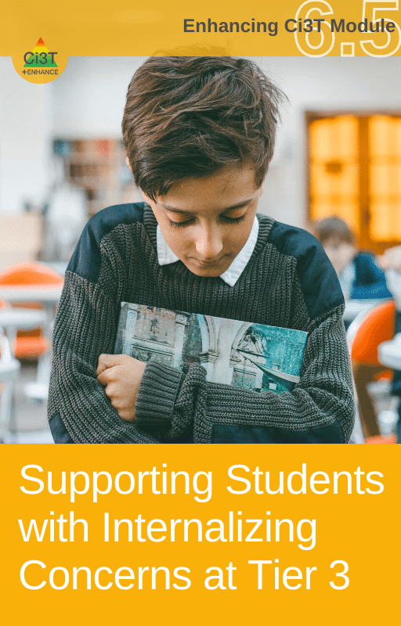
Professional Learning Modules

Slide 93
Changes in Harry’s Behavior
Cox, M., Griffin, M. M., Hall, R., Oakes, W. P., & Lane, K. L. (2012). Using a functional assessment-based intervention to increase academic engaged time in an inclusive middle school setting. Beyond Behavior, 2, 44 – 54.

Slide 94
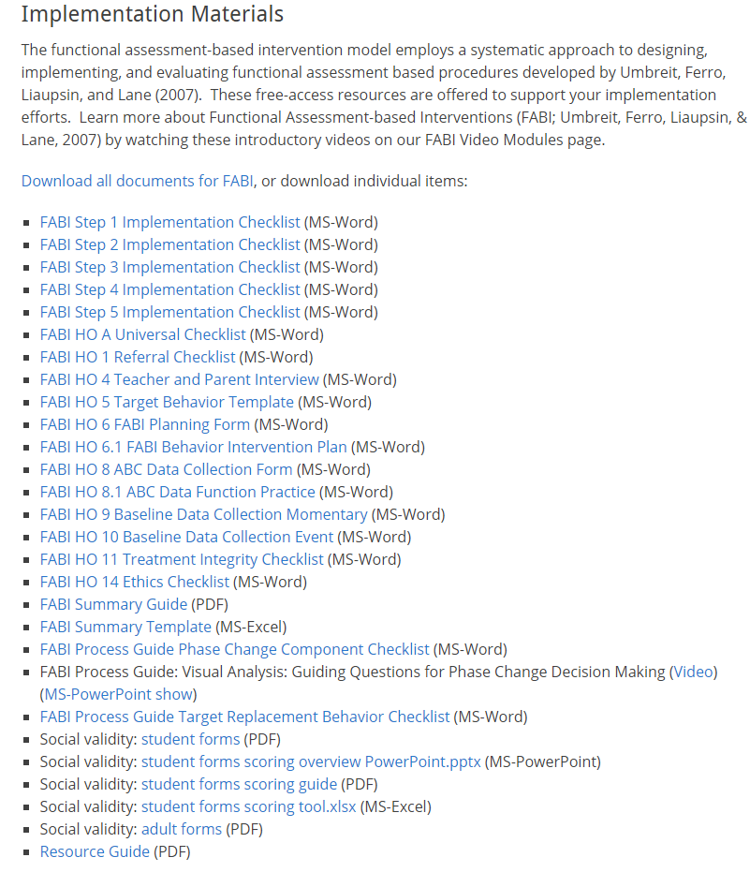

Slide 95
Sustaining and Disseminating Professional Learning
Designate two staff to attend trainings to become on-site coaches
10 min @ next Faculty and Staff meeting
Ci3T Setting Up for Success
Systematic Screening
Low-Intensity Supports
Tier 2
Planning Ahead
Tier 3

Slide 96
Talk Time
Find the Tier 2 and Tier 3 grids in your Ci3T Implementation Manual
Review a corresponding module
Notes:
15-min timer

Slide 97
Exploring Resources to Support Systematic Screening Efforts

Slide 98
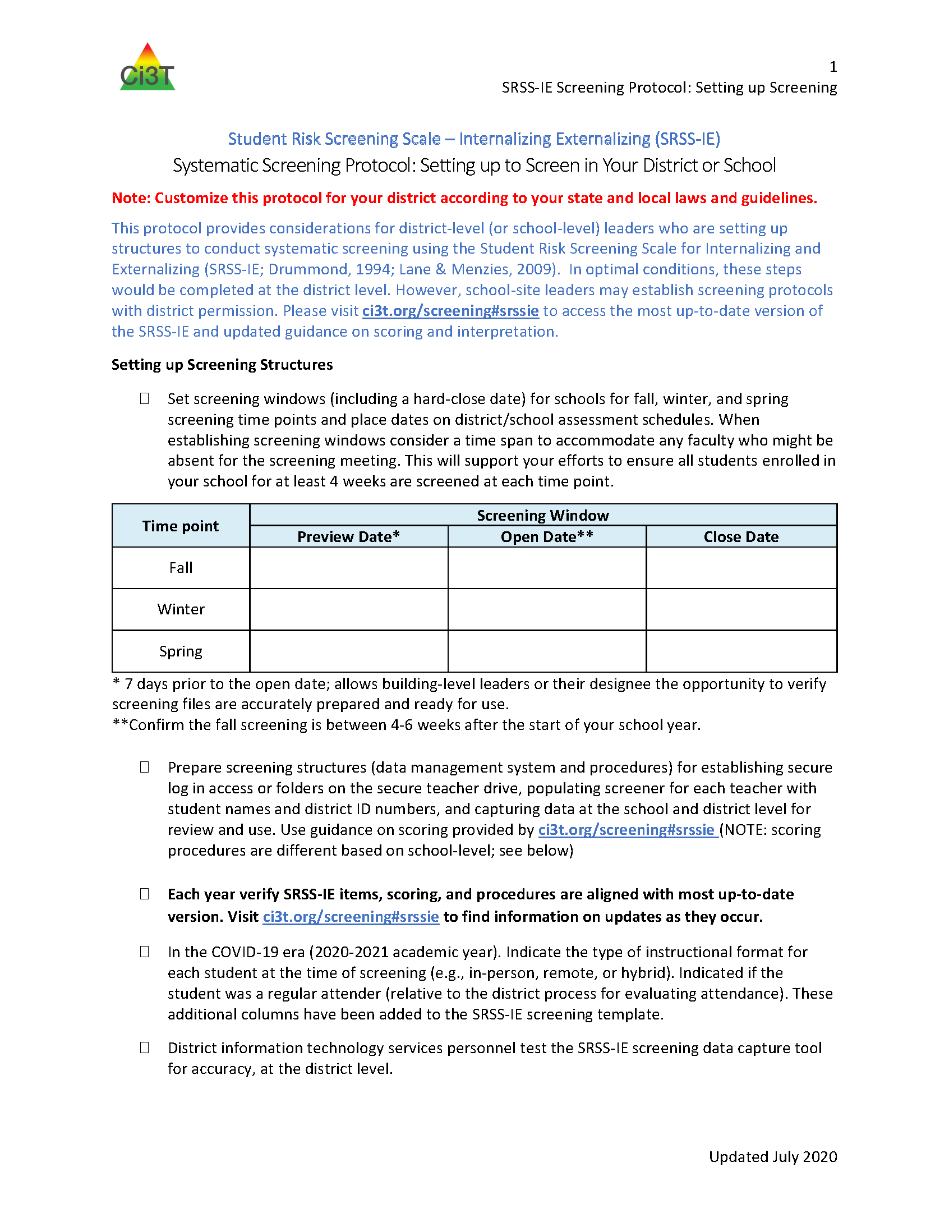
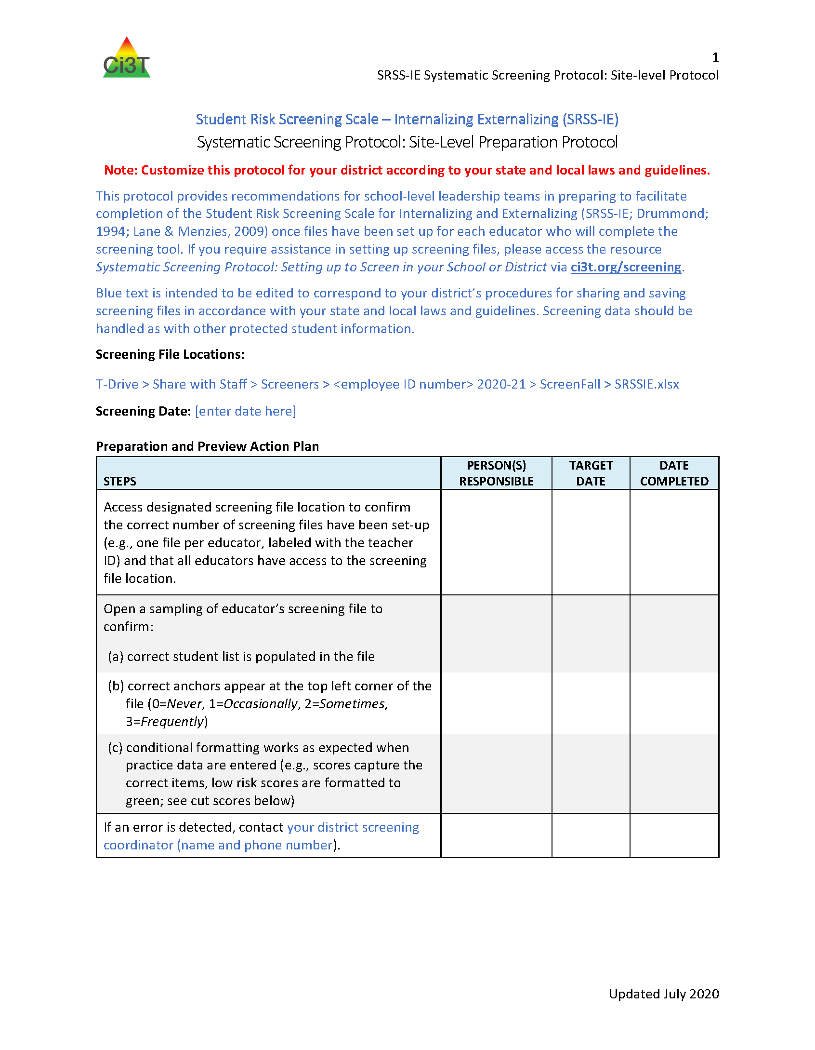
Protocols

Slide 99
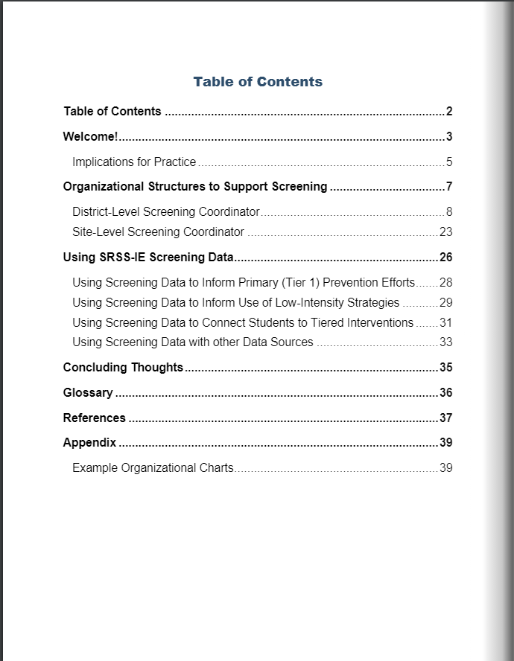
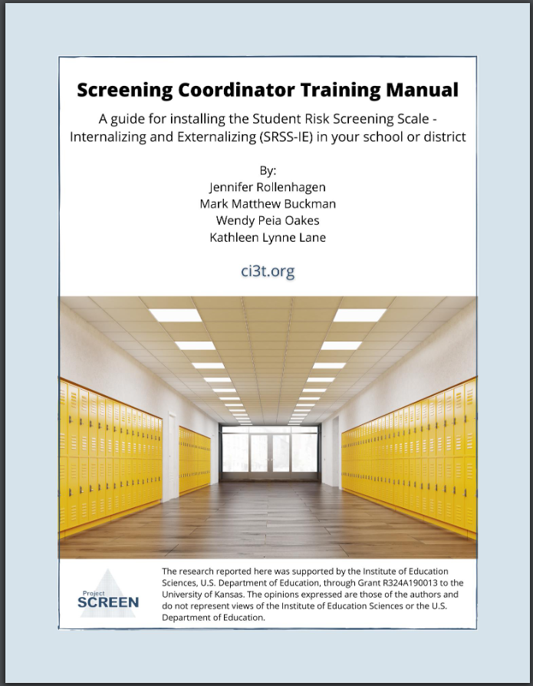
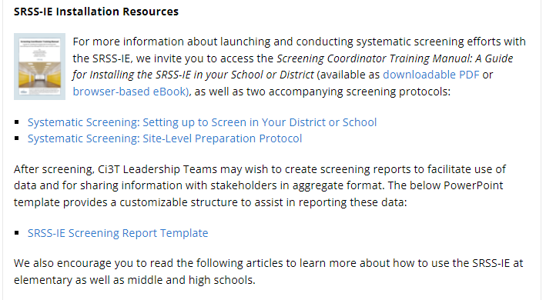
Manual

Slide 101
Resources for screening available on PBIS.org…
Notes:
Selecting, https://www.pbis.org/resource/selecting-a-universal-behavior-screening-tool-questions-to-consider
Installing https://www.pbis.org/resource/installing-a-universal-behavior-screening-tool-questions-to-consider
Interpreting https://www.pbis.org/resource/interpreting-universal-behavior-screening-data-questions-to-consider

Slide 102
Tips for Communicating with Your Community about Systematic Screening

Slide 103
Guidance and Lessons Learned

Slide 104
Wrapping Up and Moving Forward

Slide 105
Project EMPOWER - Enhanced
Ci3T EMPOWER Sessions Location: Remote via Zoom Attended by: School Ci3T Leadership Teams, Ci3T District Trainers and Coaches, Faculty and Staff, Families (adults only). Community Members |  | Times (Pacific) | Times (Central) | Times (Eastern)
1. Setting up for Success | Sep. 21, 2023 (Th) | 3:00 – 5:00 p.m. | 5:00 – 7:00 p.m. | 6:00 – 8:00 p.m.
2. Screening | Oct. 18, 2023 (Wed) | 3:00 – 5:00 p.m. | 5:00 – 7:00 p.m. | 6:00 – 8:00 p.m.
3. Low Intensity Supports (3) | Nov. 28, 2023 (Tu) | 3:00 – 5:00 p.m. | 5:00 – 7:00 p.m. | 6:00 – 8:00 p.m.
4. Tier 2 | Jan. 11, 2024 (Th) | 3:00 – 5:00 p.m. | 5:00 – 7:00 p.m. | 6:00 – 8:00 p.m.
5. Tier 3 | Mar. 26, 2024 (Tu) | 3:00 – 5:00 p.m. | 5:00 – 7:00 p.m. | 6:00 – 8:00 p.m.
6. Moving Forward | Apr. 25, 2024 (Th) | 3:00 – 5:00 p.m. | 5:00 – 7:00 p.m. | 6:00 – 8:00 p.m.

Slide 106
Ci3T
Comprehensive Professional Learning Plan
Ci3T: Primary Prevention
Session 1:
Overview of Ci3T Prevention Models
Setting a Purpose
Establish team meetings and roles
Session 2:
Mission and Purpose
Establish Roles and Responsibilities
Procedures for Teaching
Procedures for Reinforcing
Reactive Plan
Session 3:
Procedures for Monitoring
Session 4:
Revise Primary Plan using Stakeholder feedback
Prepare presentation
Ci3T: Secondary Prevention
Session 5:
Overview of Teacher focused Strategies
Overview of Student Focused Strategies
Using data to determine which students may need Secondary (Tier 2) supports
Draft the Secondary Intervention Grid based on existing supports
Ci3T: Tertiary Prevention
Session 6:
Final revisions of Ci3T Plan based on stakeholder feedback
Draft Tertiary (Tier 3) Prevention Intervention Grids
Design Implementation Manual and Plan for roll out to faculty, students, and parents
Ci3T Leadership Team Training Sequence
Implementation Stages of Tier 2 and 3 within Ci3T
Additional Professional Development on Specific Topics
Core Content Curriculum
Check In - Check Out
Functional Assessment-based Interventions
Reading, Math, Writing Benchmarking and Progress Monitoring Tools
Interventions, Strategies, & Practices
Additional Tier 3 Supports
Instructional Techniques to Improve Students’ Motivation; Classroom Management Practices;
Low-Intensity Behavior Supports

Slide 107
Building a Ci3T Tier Library
Teacher Delivered Strategies
Tier 1
Tier 2
Tier 3

Slide 109
Ci3T Trainer and Coaches Calls

Slide 110
Ci3T Professional Learning Calendar
 | 0 | 1 | 2 | 3 | 4 | 5 | 6 | 7 | 8 | 9 | 10 | 11
 | July | Aug | Sep | Oct | Nov | Dec | Jan | Feb | Mar | Apr | May | Jun
Ci3T Training |  |  |  |  | Ci3T Professional Learning Series Session 1 | Ci3T Professional Learning Series Session 2 | Ci3T Professional Learning Series Session 3 | Ci3T Professional Learning Series Session 4 |  | Ci3T Professional Learning Series Session 5 | Ci3T Professional Learning Series Session 6
Ci3T Implementation Support | Ci3T Implementation Series Prep Session |  | Ci3T Implementation Series Session 1 |  | Ci3T Implementation Series Session 2 |  | Ci3T Implementation Series Session 3 |  | Ci3T Implementation Series Session 4 | Ci3T Implementation Series Session 5
Ci3T EMPOWER |  |  | Ci3T EMPOWER Session 1 | Ci3T EMPOWER Session 2 | Ci3T EMPOWER Session 3 |  | Ci3T EMPOWER Session 4 |  | Ci3T EMPOWER Session 5 | Ci3T EMPOWER Session 6
Ci3T Trainers & Coaches Calls |  | Trainers & Coaches Call Session 1 | Trainers & Coaches Call Session 2 | Trainers & Coaches Call Session 3 | Trainers & Coaches Call Session 4 | Trainers & Coaches Call Session 5 | Trainers & Coaches Call Session 6 | Trainers & Coaches Call Session 7 | Trainers & Coaches Call Session 8 | Trainers & Coaches Call Session 9 | Trainers & Coaches Call Session 10

Slide 111
Sustaining and Disseminating Professional Learning
Designate two staff to attend trainings to become on-site coaches
10 min @ next Faculty and Staff meeting
Ci3T Setting Up for Success
Systematic Screening
Low-Intensity Supports
Tier 2
Planning Ahead
Tier 3

Slide 112
Accessing Project EHANCE: EMPOWER Professional Learning

Slide 113
Wrapping Up & Previewing Next Session
Today
Next time
Overview of Systematic Screening in Ci3T Models
Using Systematic Screening to
Inform Instruction at Tier 1
Empower Teachers with Low-Intensity Strategies
Connect Students to Tier 2 and Tier 3 Interventions
Exploring Resources to Support Systematic Screening Efforts
Overview of Teacher-Delivered, Low-Intensity Strategies in Ci3T Models
Strategy 1: Precorrection
Strategy 2: Active Supervision
Strategy 3: Opportunities to Respond
Exploring Other Teacher-Delivered, Low-Intensity Strategies in Ci3T Models

Slide 114
Comprehensive, Integrated, Three-Tiered Model of Prevention
(Lane, Kalberg, & Menzies, 2009)
Thank you!
Notes:
Tag us in your Ci3T highlights- we’d love to see Ci3T in action! Follow us on Twitter or Instagram for updates and links to resources! @Ci3TModel
You will receive a brief session evaluation – we value your feedback and would greatly appreciate you taking a few minutes to share your thoughts on what you liked about the session and how we can improve

