Slide 1
Implementing Comprehensive, Integrated, Three-tiered (Ci3T) Models:
Supporting Student Success Across the Tiers
E-Ci3T Implementation Series and Delivery – Session 4
Presenters and Contributors | Contributors
Allison M. Bernard | Wendy Peia Oakes
Mark M. Buckman | Elise Sarasin
Kathleen Lynne Lane | Rebecca L. Sherod

Slide 3
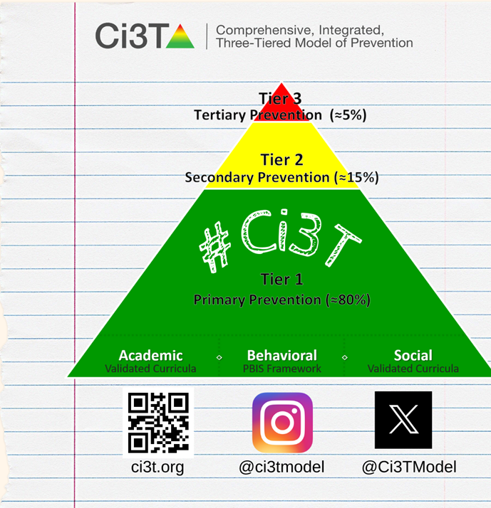
Let’s Connect on Social Media!
Tag us in your Ci3T highlights- we’d love to see Ci3T in action!
Follow us on Twitter or Instagram for updates and links to resources!
  @Ci3TModel

Slide 4
Ci3T Professional Learning Calendar
 | 0 | 1 | 2 | 3 | 4 | 5 | 6 | 7 | 8 | 9 | 10 | 11
 | July | Aug | Sep | Oct | Nov | Dec | Jan | Feb | Mar | Apr | May | Jun
Ci3T Training |  |  |  |  | Ci3T Professional Learning Series Session 1 | Ci3T Professional Learning Series Session 2 | Ci3T Professional Learning Series Session 3 | Ci3T Professional Learning Series Session 4 |  | Ci3T Professional Learning Series Session 5 | Ci3T Professional Learning Series Session 6
Ci3T Implementation Support | Ci3T Implementation Series Prep Session |  | Ci3T Implementation Series Session 1 |  | Ci3T Implementation Series Session 2 |  | Ci3T Implementation Series Session 3 |  | Ci3T Implementation Series Session 4 | Ci3T Implementation Series Session 5
Ci3T EMPOWER |  |  | Ci3T EMPOWER Session 1 | Ci3T EMPOWER Session 2 | Ci3T EMPOWER Session 3 |  | Ci3T EMPOWER Session 4 |  | Ci3T EMPOWER Session 5 | Ci3T EMPOWER Session 6
Ci3T Trainers & Coaches Calls |  | Trainers & Coaches Call Session 1 | Trainers & Coaches Call Session 2 | Trainers & Coaches Call Session 3 | Trainers & Coaches Call Session 4 | Trainers & Coaches Call Session 5 | Trainers & Coaches Call Session 6 | Trainers & Coaches Call Session 7 | Trainers & Coaches Call Session 8 | Trainers & Coaches Call Session 9 | Trainers & Coaches Call Session 10

Slide 5
Agenda
Welcome
Data-Informed Decision-Making
  Sharing Data with Stakeholders
  Using Data to Inform Professional Learning and Instruction
Integrated Lesson Planning at Tier 1
Planning and Implementing Tier 2 Interventions
Planning and Implementing Tier 3 Interventions
Wrapping Up and Moving Forward

Slide 6
Review and Preview
Last Time
Today
Procedures for Monitoring
  Review your School’s Social Validity & Treatment Integrity Data
  Review your School’s Winter Screening Data
Data-informed Decision-making
  Professional Learning Targets and Resources
  Communication Plans
Data-Informed Decision-Making
Integrated Lesson Planning at Tier 1
Planning and Implementing Tier 2 Interventions
Planning and Implementing Tier 3 Interventions

Slide 7
Welcome
Please pull up your Ci3T Implementation Manual

Slide 8
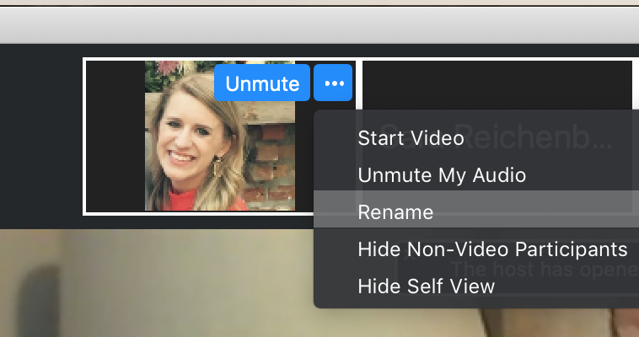
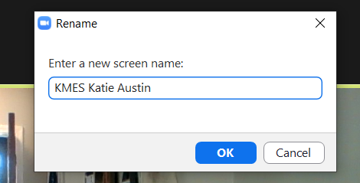
Renaming: School Initials + First and Last Name
To help us put you in breakout rooms with your colleagues today…
1. Click the three dots at the top
right corner of your video square.
2. Rename yourself with your
school initials then first and last name.

Slide 9
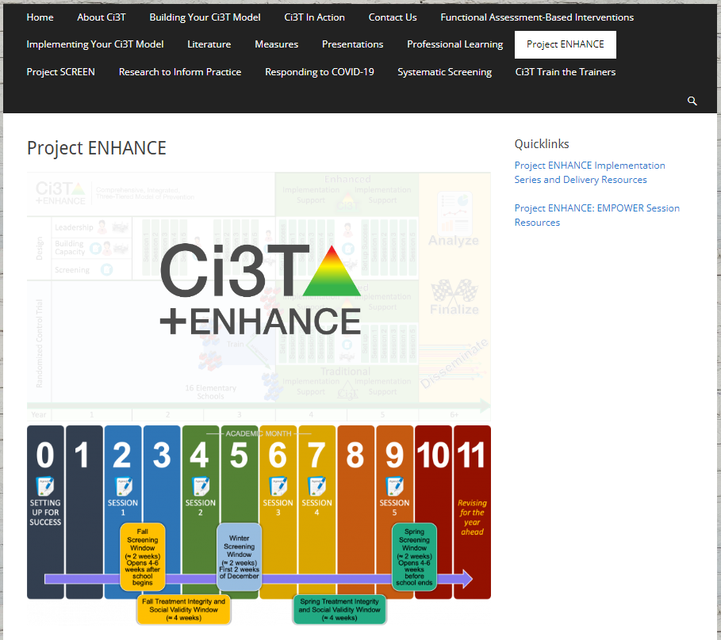
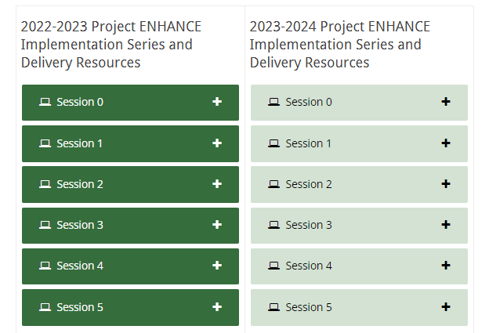
Accessing Professional Learning Materials
Navigate to ci3t.org/enhance
Type password: enhanceci3t!
Access session resources via the Project ENHANCE Implementation Series and Delivery Resources quicklink or by scrolling to the bottom of the page

Slide 10

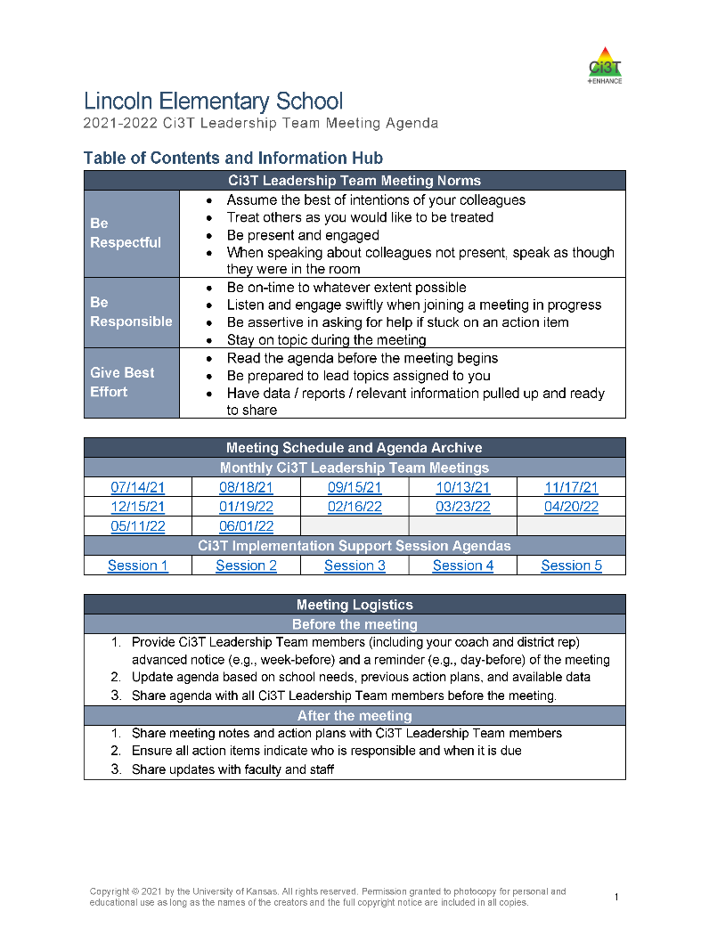
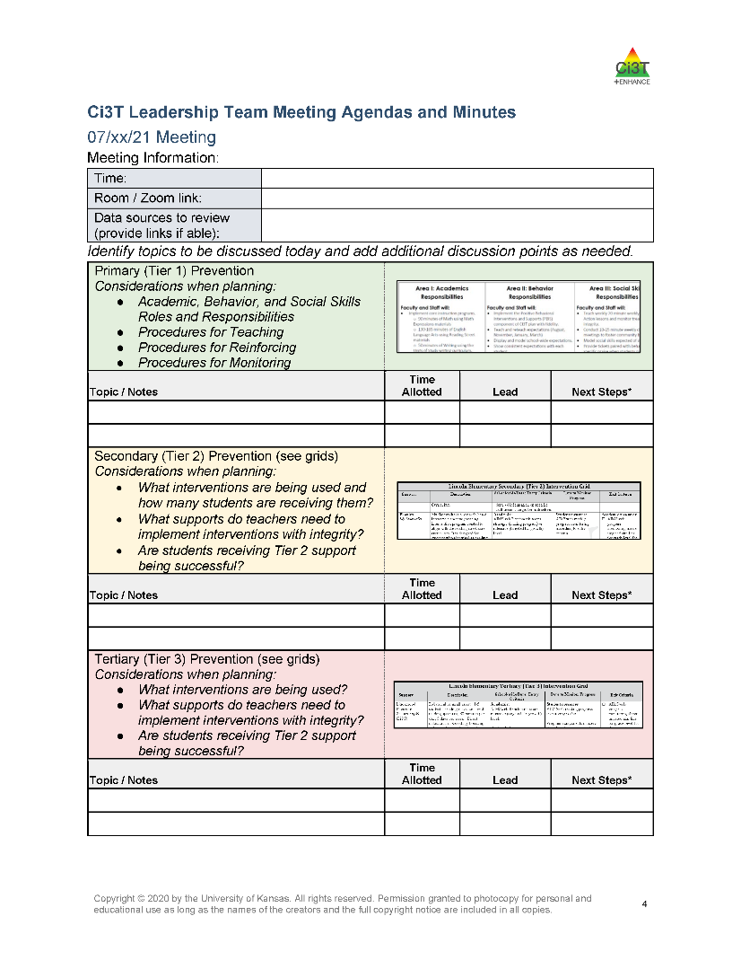
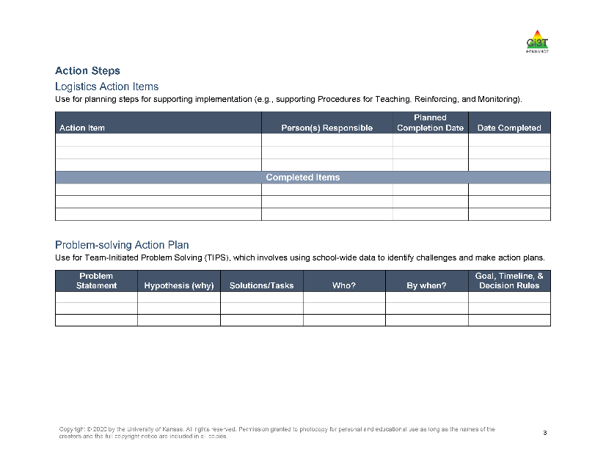
Agenda

Slide 11

Goals for this Implementation Year
Establish effective Ci3T leadership structures
Gain a deeper understanding of Ci3T models of prevention
Implement your school’s plan with high fidelity
Collect and use social validity and treatment integrity data to monitor Ci3T plan implementation
Collect student academic and behavioral outcome data to inform Ci3T implementation efforts
Share data with all stakeholders regularly (e.g., monthly, quarterly)
Identify areas of additional professional learning for faculty and staff and support faculty and staff access to professional learning
Address any barriers to implementing your Ci3T model

Slide 12
Data-Informed Decision-Making
Sharing Data with Stakeholders
Using Data to Inform Professional Learning and Instruction

Slide 13
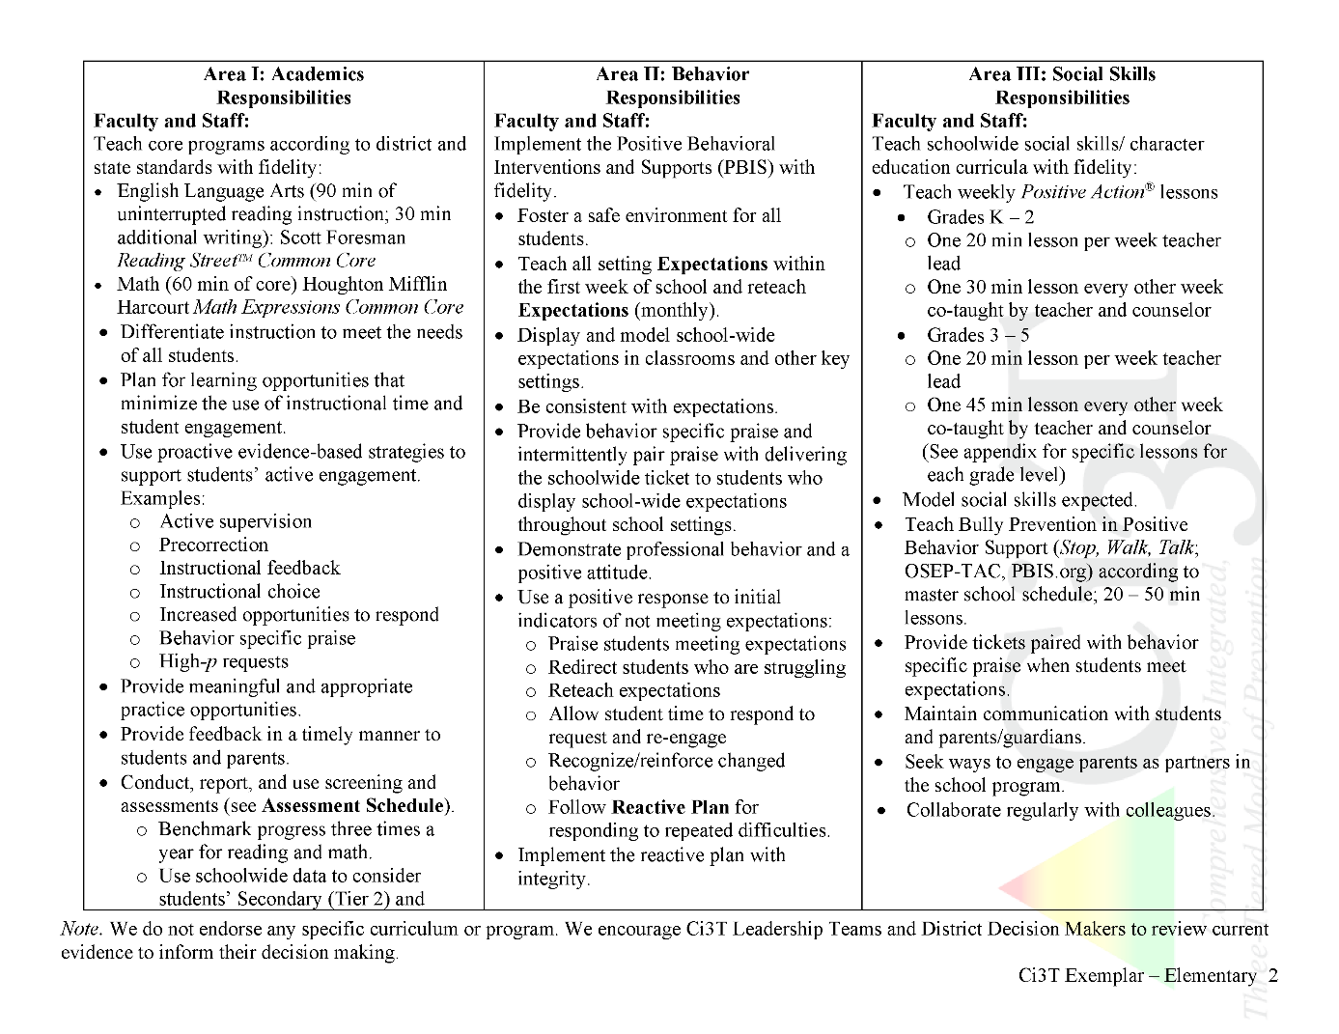
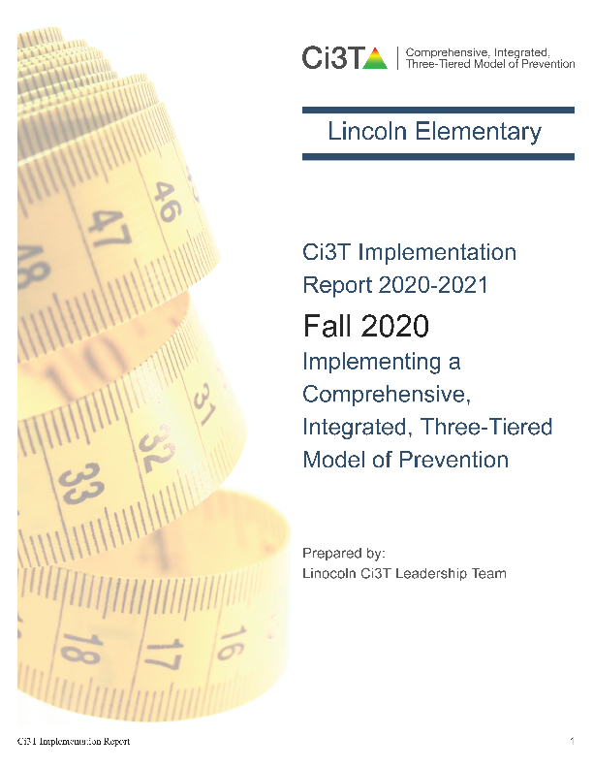

Slide 14

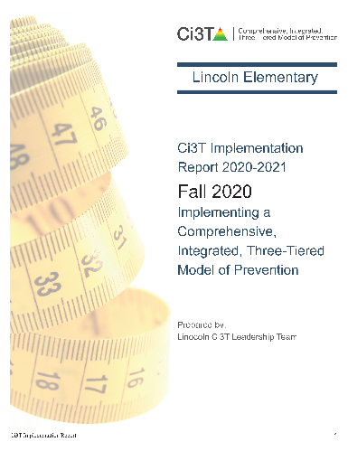


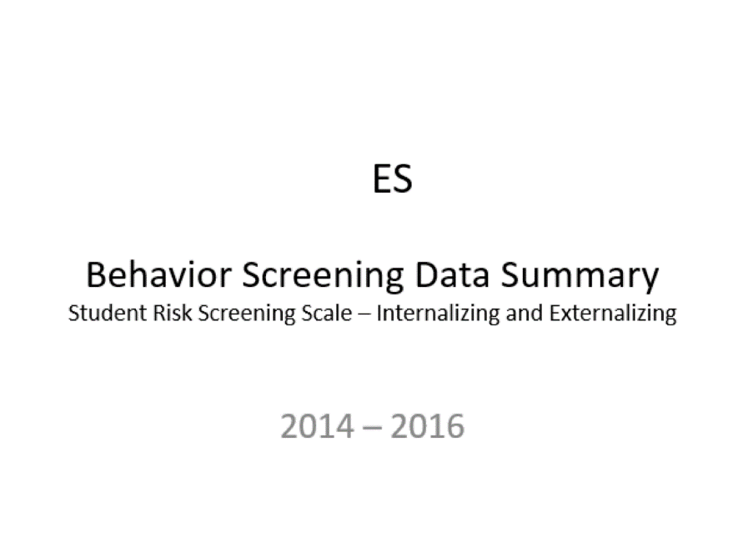
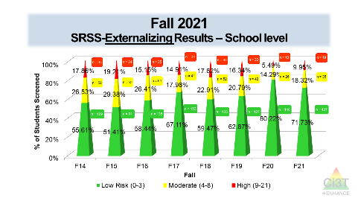
Essential Components of
Primary Prevention Efforts
Social Validity
Systematic Screening
Academic
Behavior
Treatment Integrity
ci3t.org/measures
Notes:
Infographic - https://www.ci3t.org/measures

Slide 15
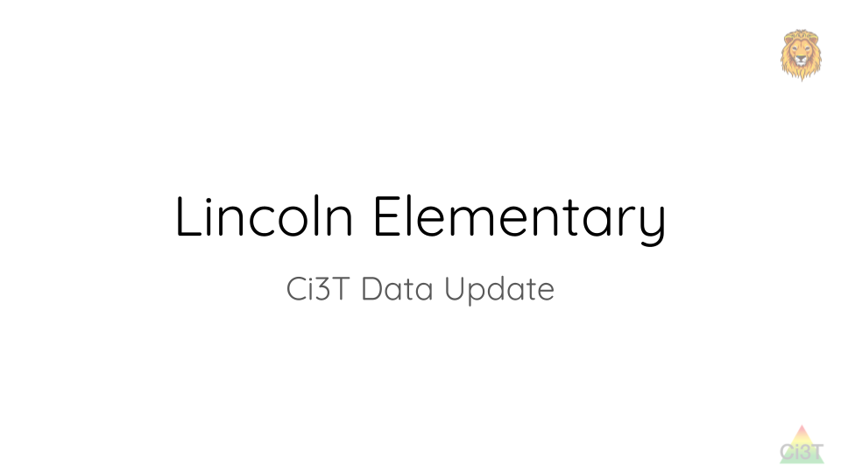
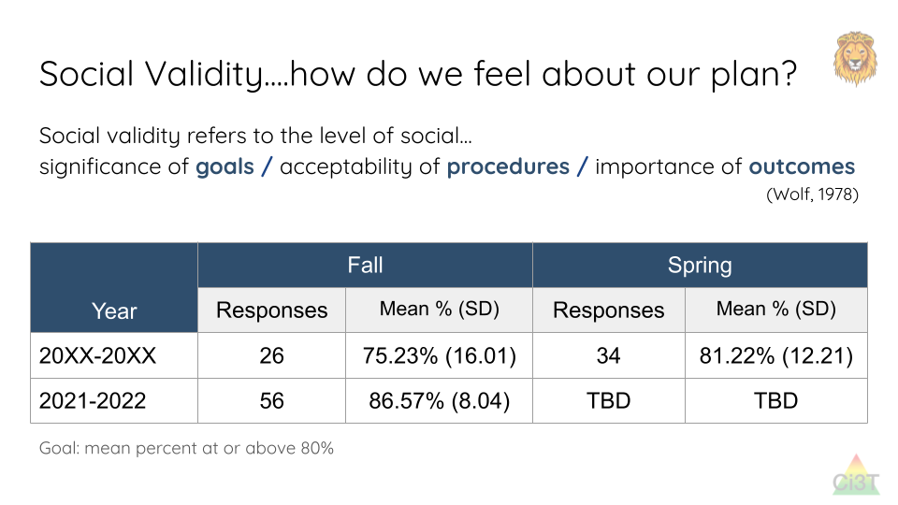
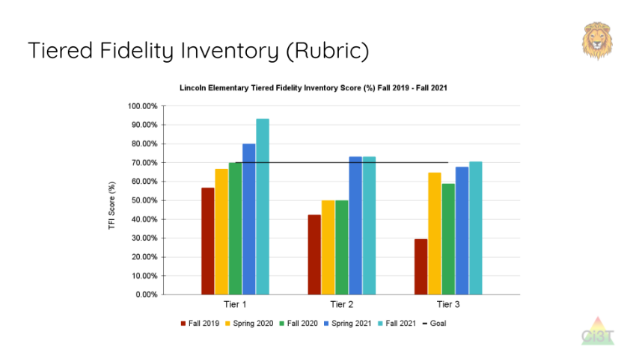
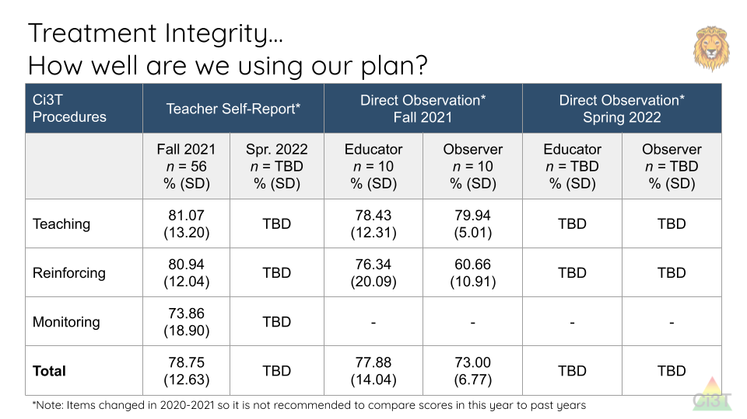
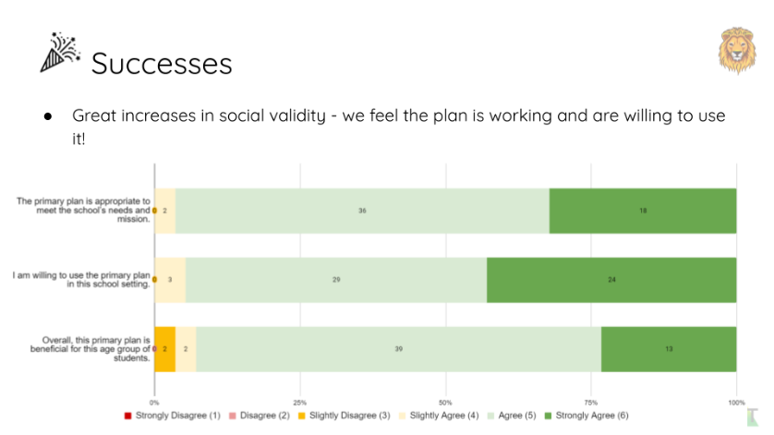
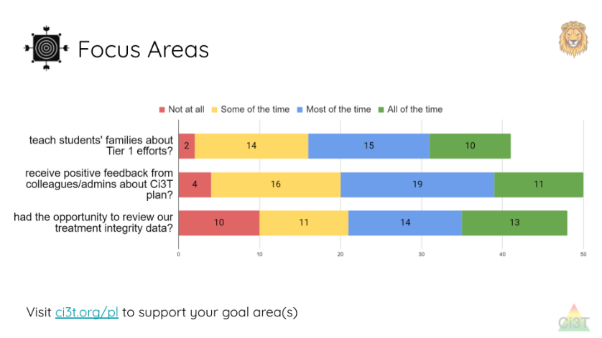
Sharing and Using Your Data

Slide 16
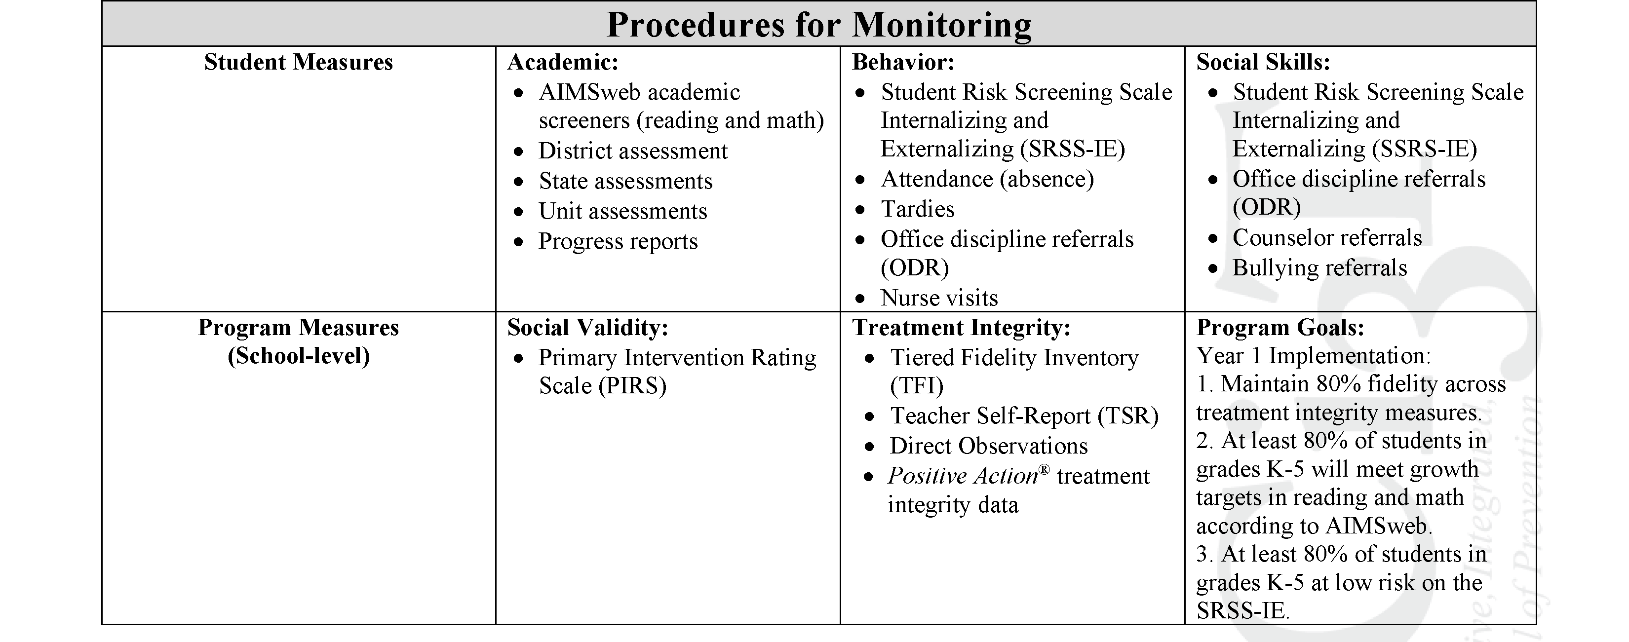
Ci3T Primary Plan
Procedures for Monitoring: Elementary
Program Measures and Goals

Slide 17
Sample Elementary Assessment Schedule
Measure | Aug | Sep | Oct | Nov | Dec | Jan | Feb | Mar | Apr | May
School Demographics
Student Demographic Information | X | X | X | X | X | X | X | X | X | X
Screening Measures
Behavior Screeners: SRSS-IE |  | X |  |  | X |  |  |  | X
Academic Screeners: AIMSWeb | X | X |  |  |  | X |  |  |  | X
Student Outcome Measures - Academic
State & District assessment |  |  |  |  |  |  |  | X | X
Progress reports |  |  |  | X |  |  | X |  |  | X
Student Outcome Measures - Behavior
Absences |  | X | X | X | X | X | X | X | X
Office discipline referrals (ODR) |  | X |  |  | X |  |  |  | X
Counselor referrals | X | X | X | X | X | X | X | X | X | X
Nurse visits | X | X | X | X | X | X | X | X | X | X
Program Measures
Primary Intervention Rating Scale |  |  | X |  |  |  |  | X
School-wide Evaluation Tool |  |  | X |  |  |  |  | X
Ci3T TI: Teacher Self-Report |  |  | X |  |  |  |  | X
Ci3T TI: Direct Observation |  |  | X |  |  |  |  | X
Second Step® Treatment Integrity |  |  | X |  |  |  |  | X
Adapted from Lane, K. L., Oakes, W. P., Cantwell, E. D., & Royer, D. J. (2018). Building and installing comprehensive, integrated, three-tiered (Ci3T) models of prevention: A practical guide to supporting school success V1.2. KOI Education. (Interactive eBook)

Slide 18

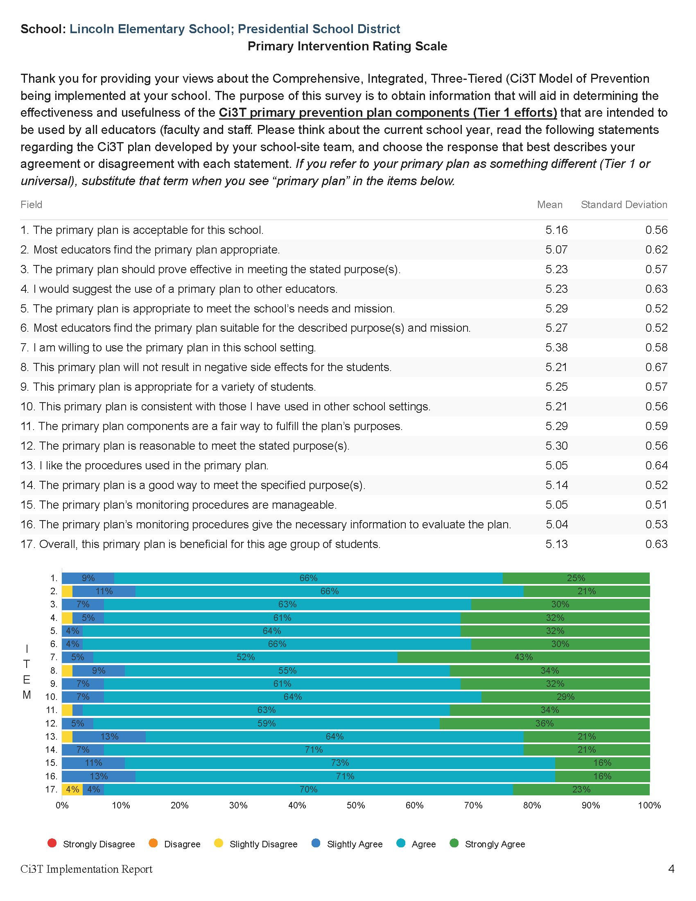

Slide 19


Slide 20

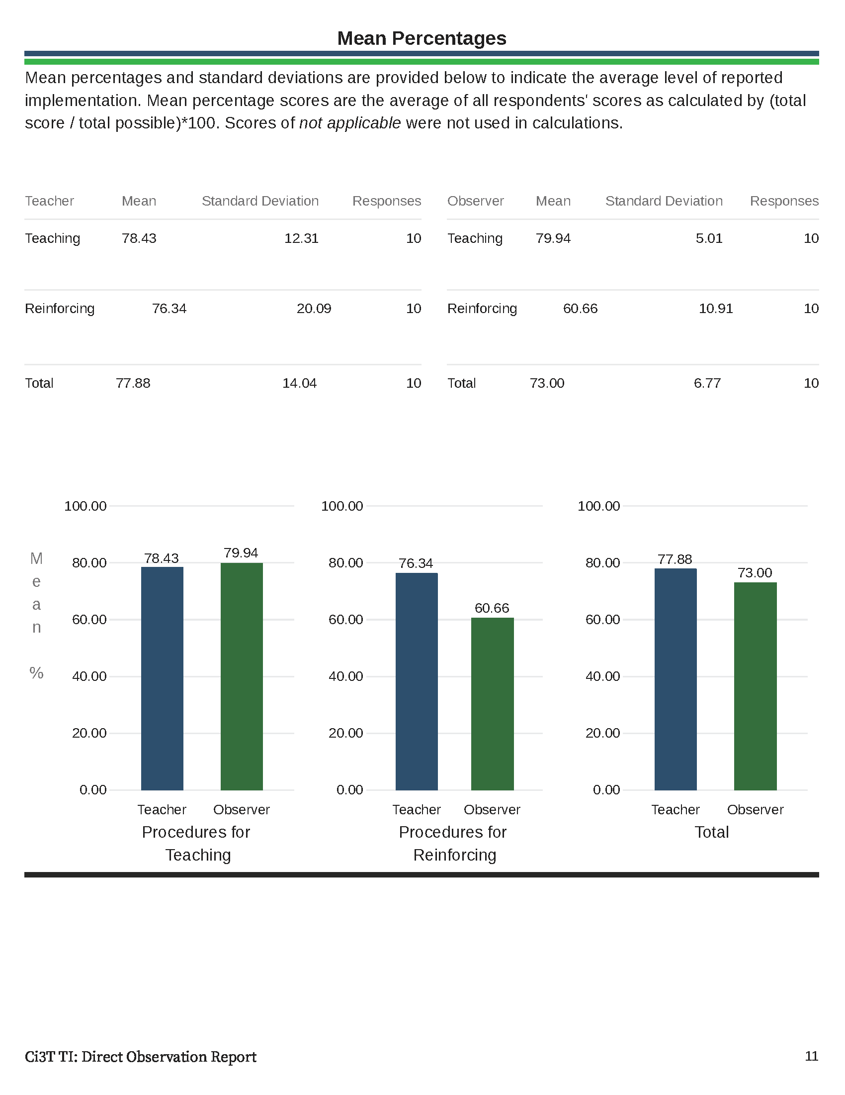

Slide 21
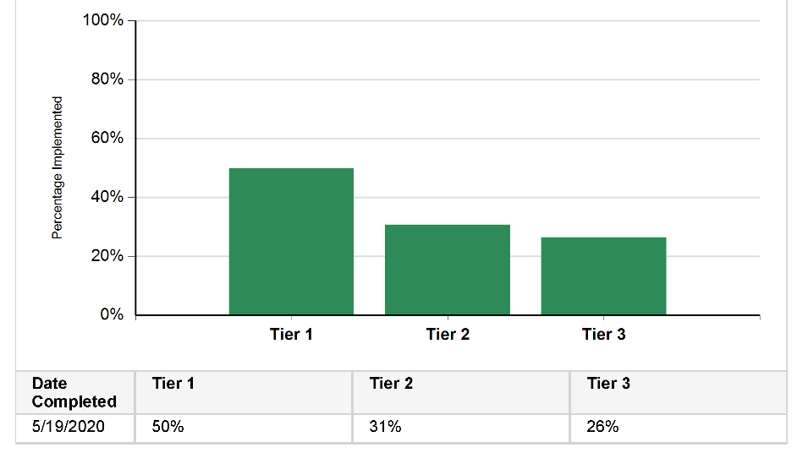
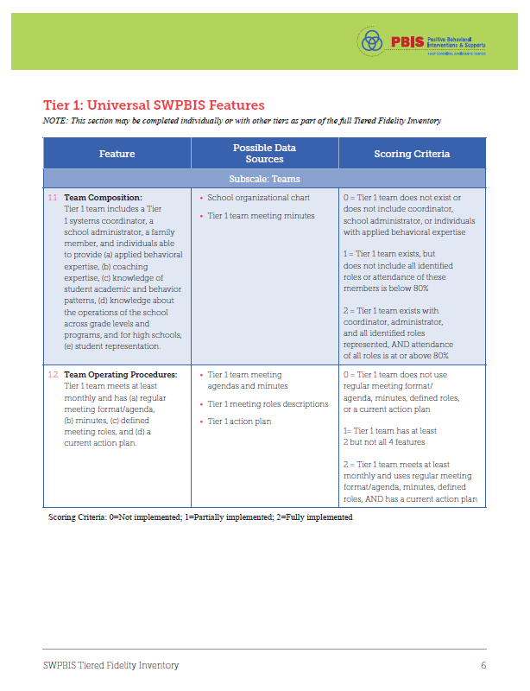
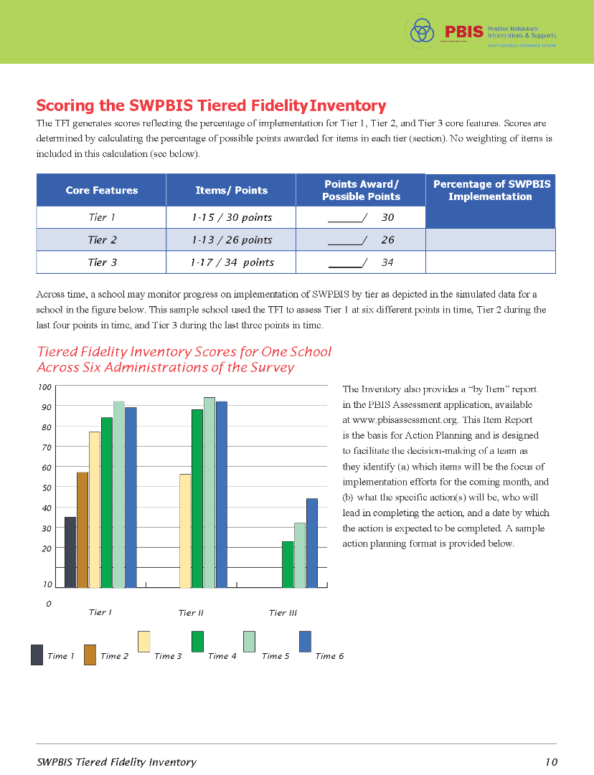

Tiered Fidelity Inventory (TFI)

Slide 22
Winter 2022
SRSS-Externalizing Results – Elementary School Level
n = 66
n = 44
n = 33
n = 35
n = 38
n = 37
n = 2
n = 17
n = 32
n = 32
n = 69
n = 74
n = 128
n = 109
n = 97
n = 92
n = 101
n = 125
n = 305
n = 297
n = 287
n = 332
n = 309
n = 263
n = 294
n = 346
n = 355
Notes:
***note to presenter*** If you would like to feature middle or high school data – hide the elementary slides (22-23) and unhide the middle or high school slides
If you would like to update this slide with data from your school or district- Fill in <year> based on current academic year. This is located in column A of the data sheet. Edit by right clicking and selecting “Edit data”.

Slide 23
Winter 2022
SRSS-Internalizing Results – Elementary School Level
n = 75
n = 46
n = 29
n = 41
n = 35
n = 25
n = 16
n = 40
n = 38
n = 27
n = 65
n = 69
n = 59
n = 48
n = 69
n = 72
n = 87
n = 86
n = 334
n = 337
n = 335
n = 354
n = 354
n = 328
n = 285
n = 346
n = 351
Notes:
If you would like to update this slide with data from your school or district- Fill in <year> based on current academic year. This is located in column A of the data sheet. Edit by right clicking and selecting “Edit data”.

Slide 24
Winter 2022
SRSS-Externalizing Results – Middle School Level
n = 21
n = 27
n = 27
n = 13
n = 6
n = 17
n = 26
n = 47
n = 96
n = 68
n = 71
n = 53
n = 42
n = 54
n = 491
n = 448
n = 383
n = 346
n = 445
n = 518
n = 527
Notes:
If you would like to update this slide with data from your school or district- Fill in <year> based on current academic year. This is located in column A of the data sheet. Edit by right clicking and selecting “Edit data”.

Slide 25
Winter 2022
SRSS-Internalizing Results – Middle School Level
n = 79
n = 52
n = 54
n = 60
n = 23
n = 44
n = 42
n = 41
n = 37
n = 40
n = 32
n = 45
n = 30
n = 31
n = 55
n = 70
n = 306
n = 312
n = 356
n = 342
n = 349
n = 351
n = 432
n = 229
Notes:
If you would like to update this slide with data from your school or district- Fill in <year> based on current academic year. This is located in column A of the data sheet. Edit by right clicking and selecting “Edit data”.

Slide 26
Winter 2022
SRSS-Externalizing Results – High School Level
n = 47
n = 72
n = 36
n = 36
n = 40
n = 8
n = 17
n = 38
n = 119
n = 113
n = 47
n = 137
n = 134
n = 114
n = 90
n = 65
n = 1259
n = 1280
n = 1188
n = 994
n = 447
n = 717
n = 750
n = 920
Notes:
If you would like to update this slide with data from your school or district- Fill in <year> based on current academic year. This is located in column A of the data sheet. Edit by right clicking and selecting “Edit data”.

Slide 27
Winter 2022
SRSS-Internalizing Results – High School Level
n = 165
n = 106
n = 83
n = 99
n = 55
n = 65
n = 52
n = 87
n = 73
n = 65
n = 50
n = 34
n = 59
n =48
n = 56
n = 167
n = 1111
n = 1307
n = 1109
n = 1000
n = 445
n = 691
n = 710
n = 923
Notes:
If you would like to update this slide with data from your school or district- Fill in <year> based on current academic year. This is located in column A of the data sheet. Edit by right clicking and selecting “Edit data”.

Slide 28
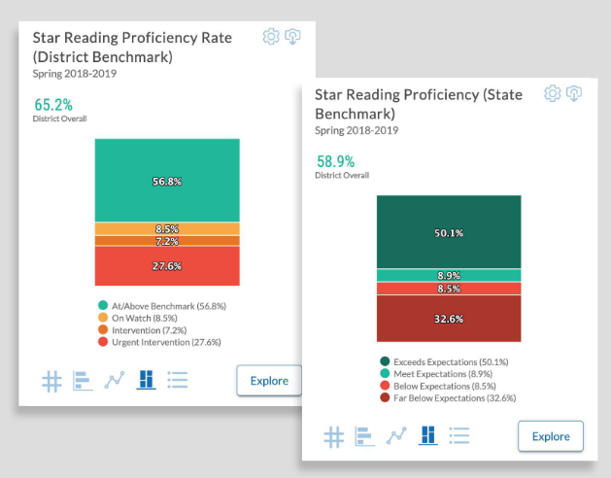
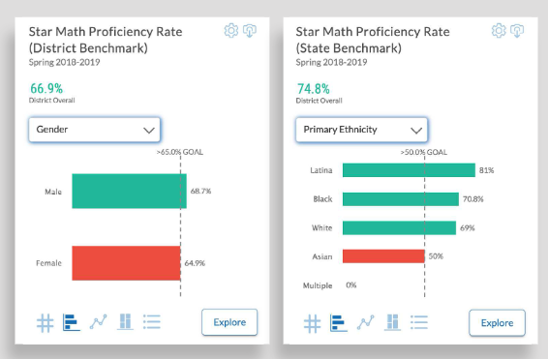

Academic Screening
Notes:
Might consider beginning by looking at data broadly
compared against district or state benchmarks
Subgroup analyses

Slide 29
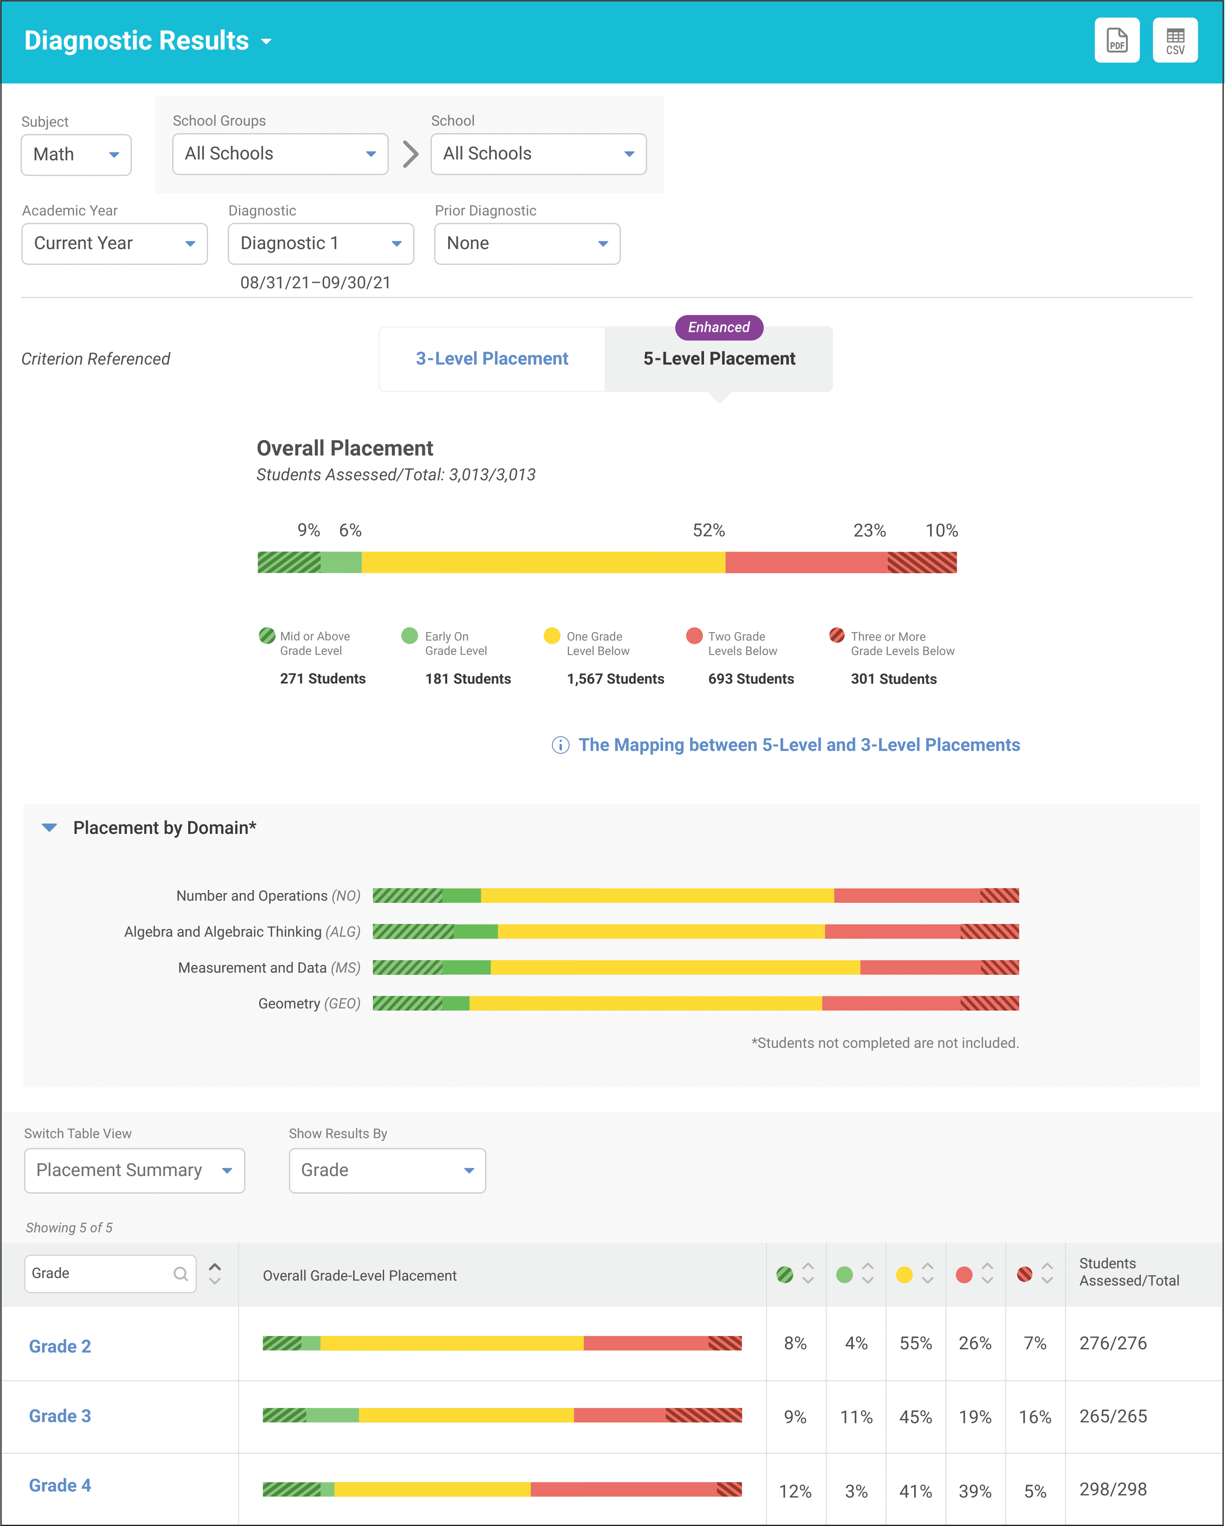
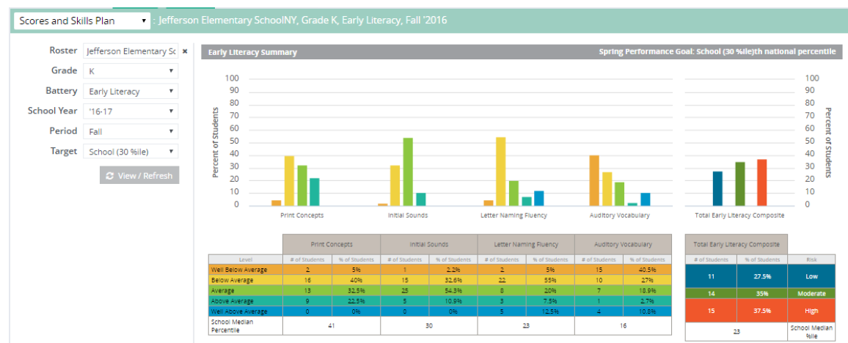


Academic Screening
Notes:
Then, might zoom in at the grade-level looking at distribution across risk category, mastery, or growth

Slide 32
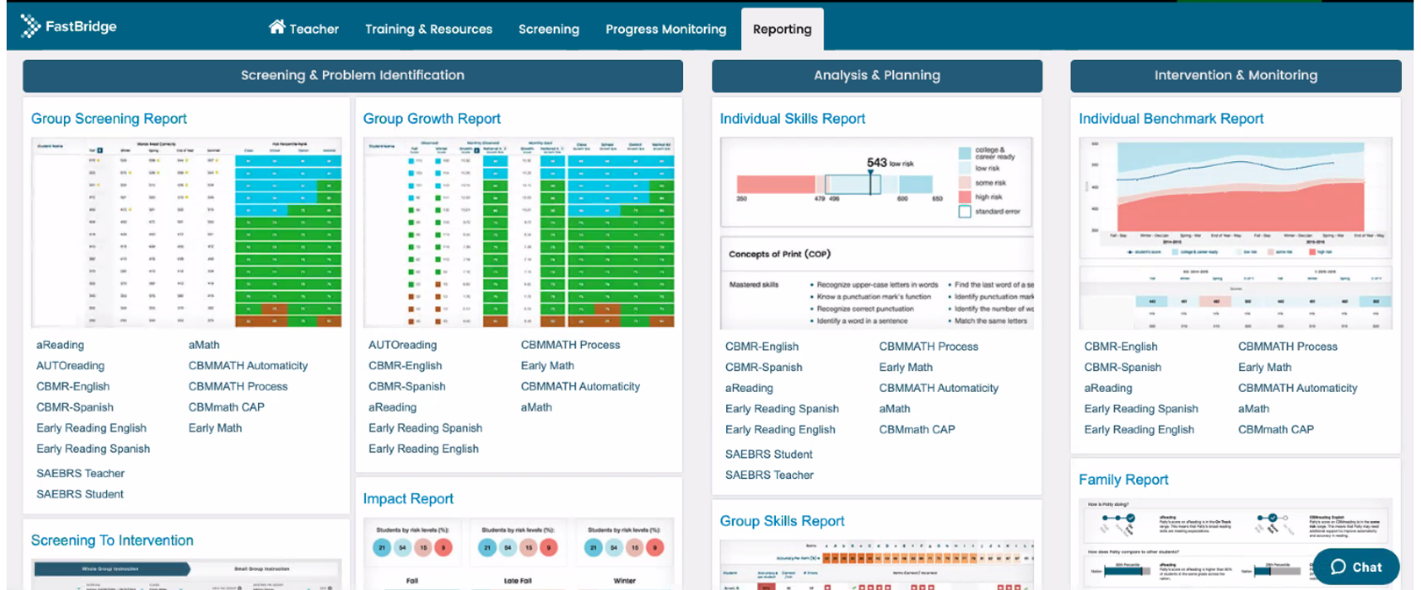
Academic Screening

Slide 33
Academic Screening

Slide 34
Academic Screening

Slide 35
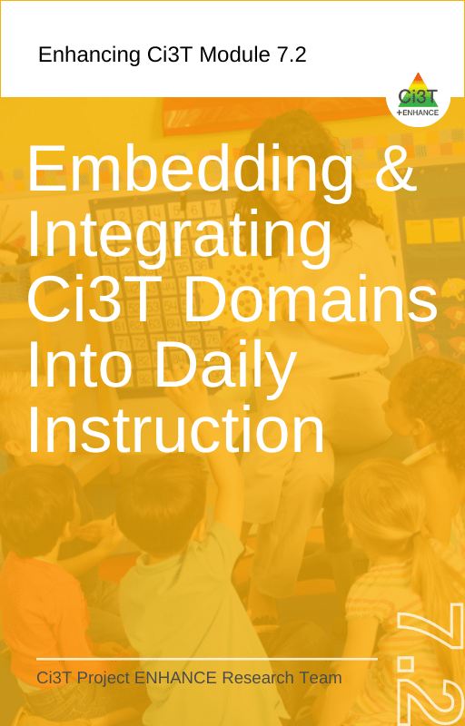

Integrating Data Sources
Academic screening
Behavioral screening
Other school-wide data
Attendance
Office discipline referrals
Nurse visits
Common formative assessments
Remember treatment integrity and social validity data – is Tier 1 in place?

Slide 36

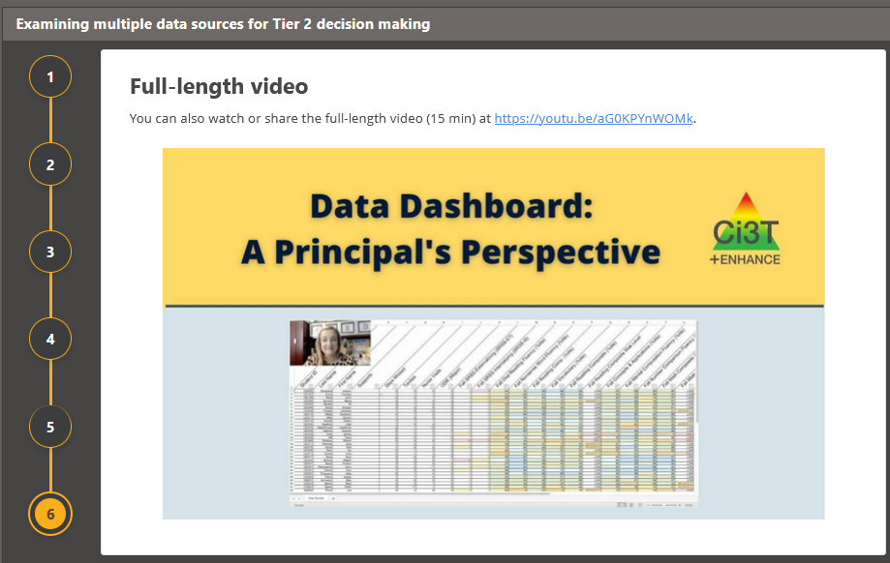
Module Connection
Notes:
In the next series of slides we will talk through examples of data-informed decision making.
We also want to highlight this module which contains a 15-minute video of a principal and coach using the data dashboard to examine data from multiple perspectives (e.g., Tier 2 academic needs, attendance, internalizing and externalizing behavior).
Link to module: https://kusurvey.ca1.qualtrics.com/jfe/form/SV_5gPWu51IYfqlpUa

Slide 37

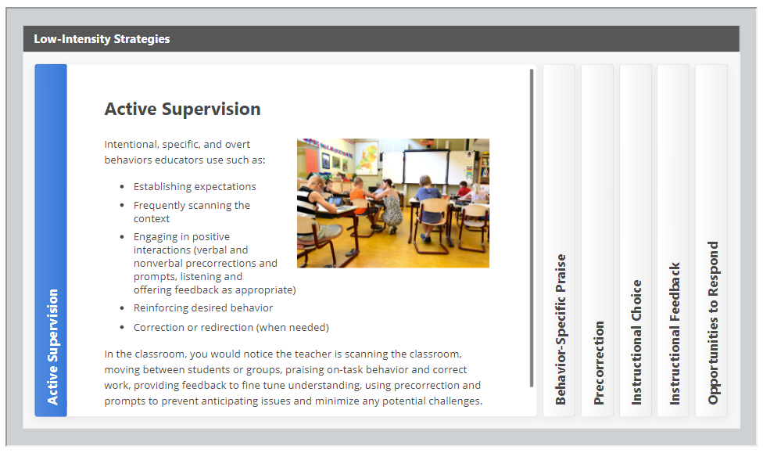

Solutions-based planning
Identify areas of strength
Identify focus areas
Let the data drive the conversation
Connect to available resources for professional learning

Slide 38
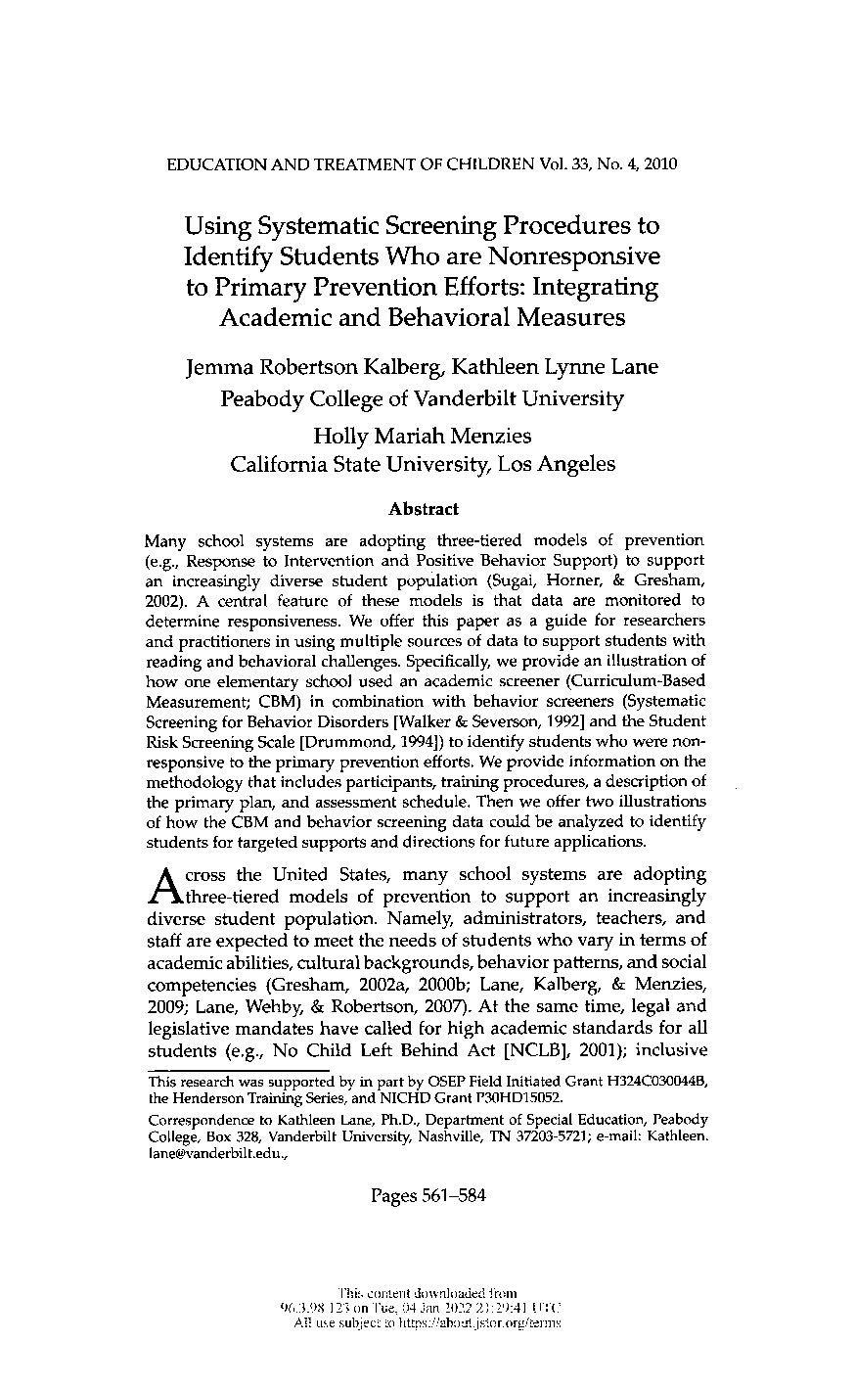
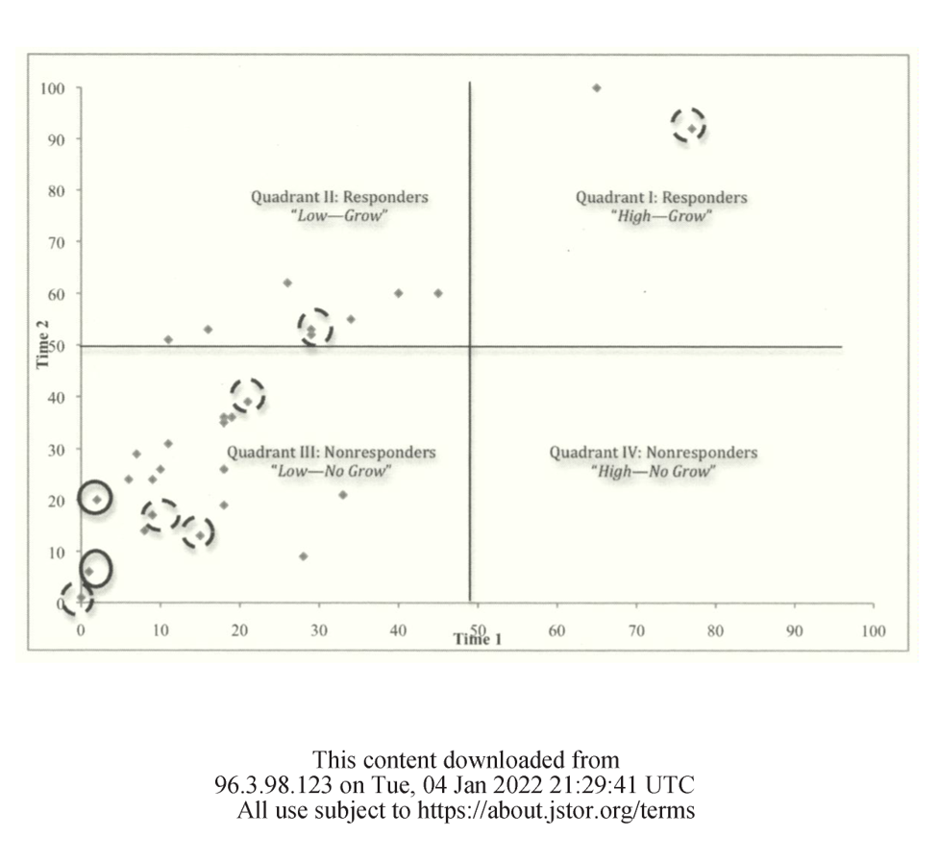

Slide 39
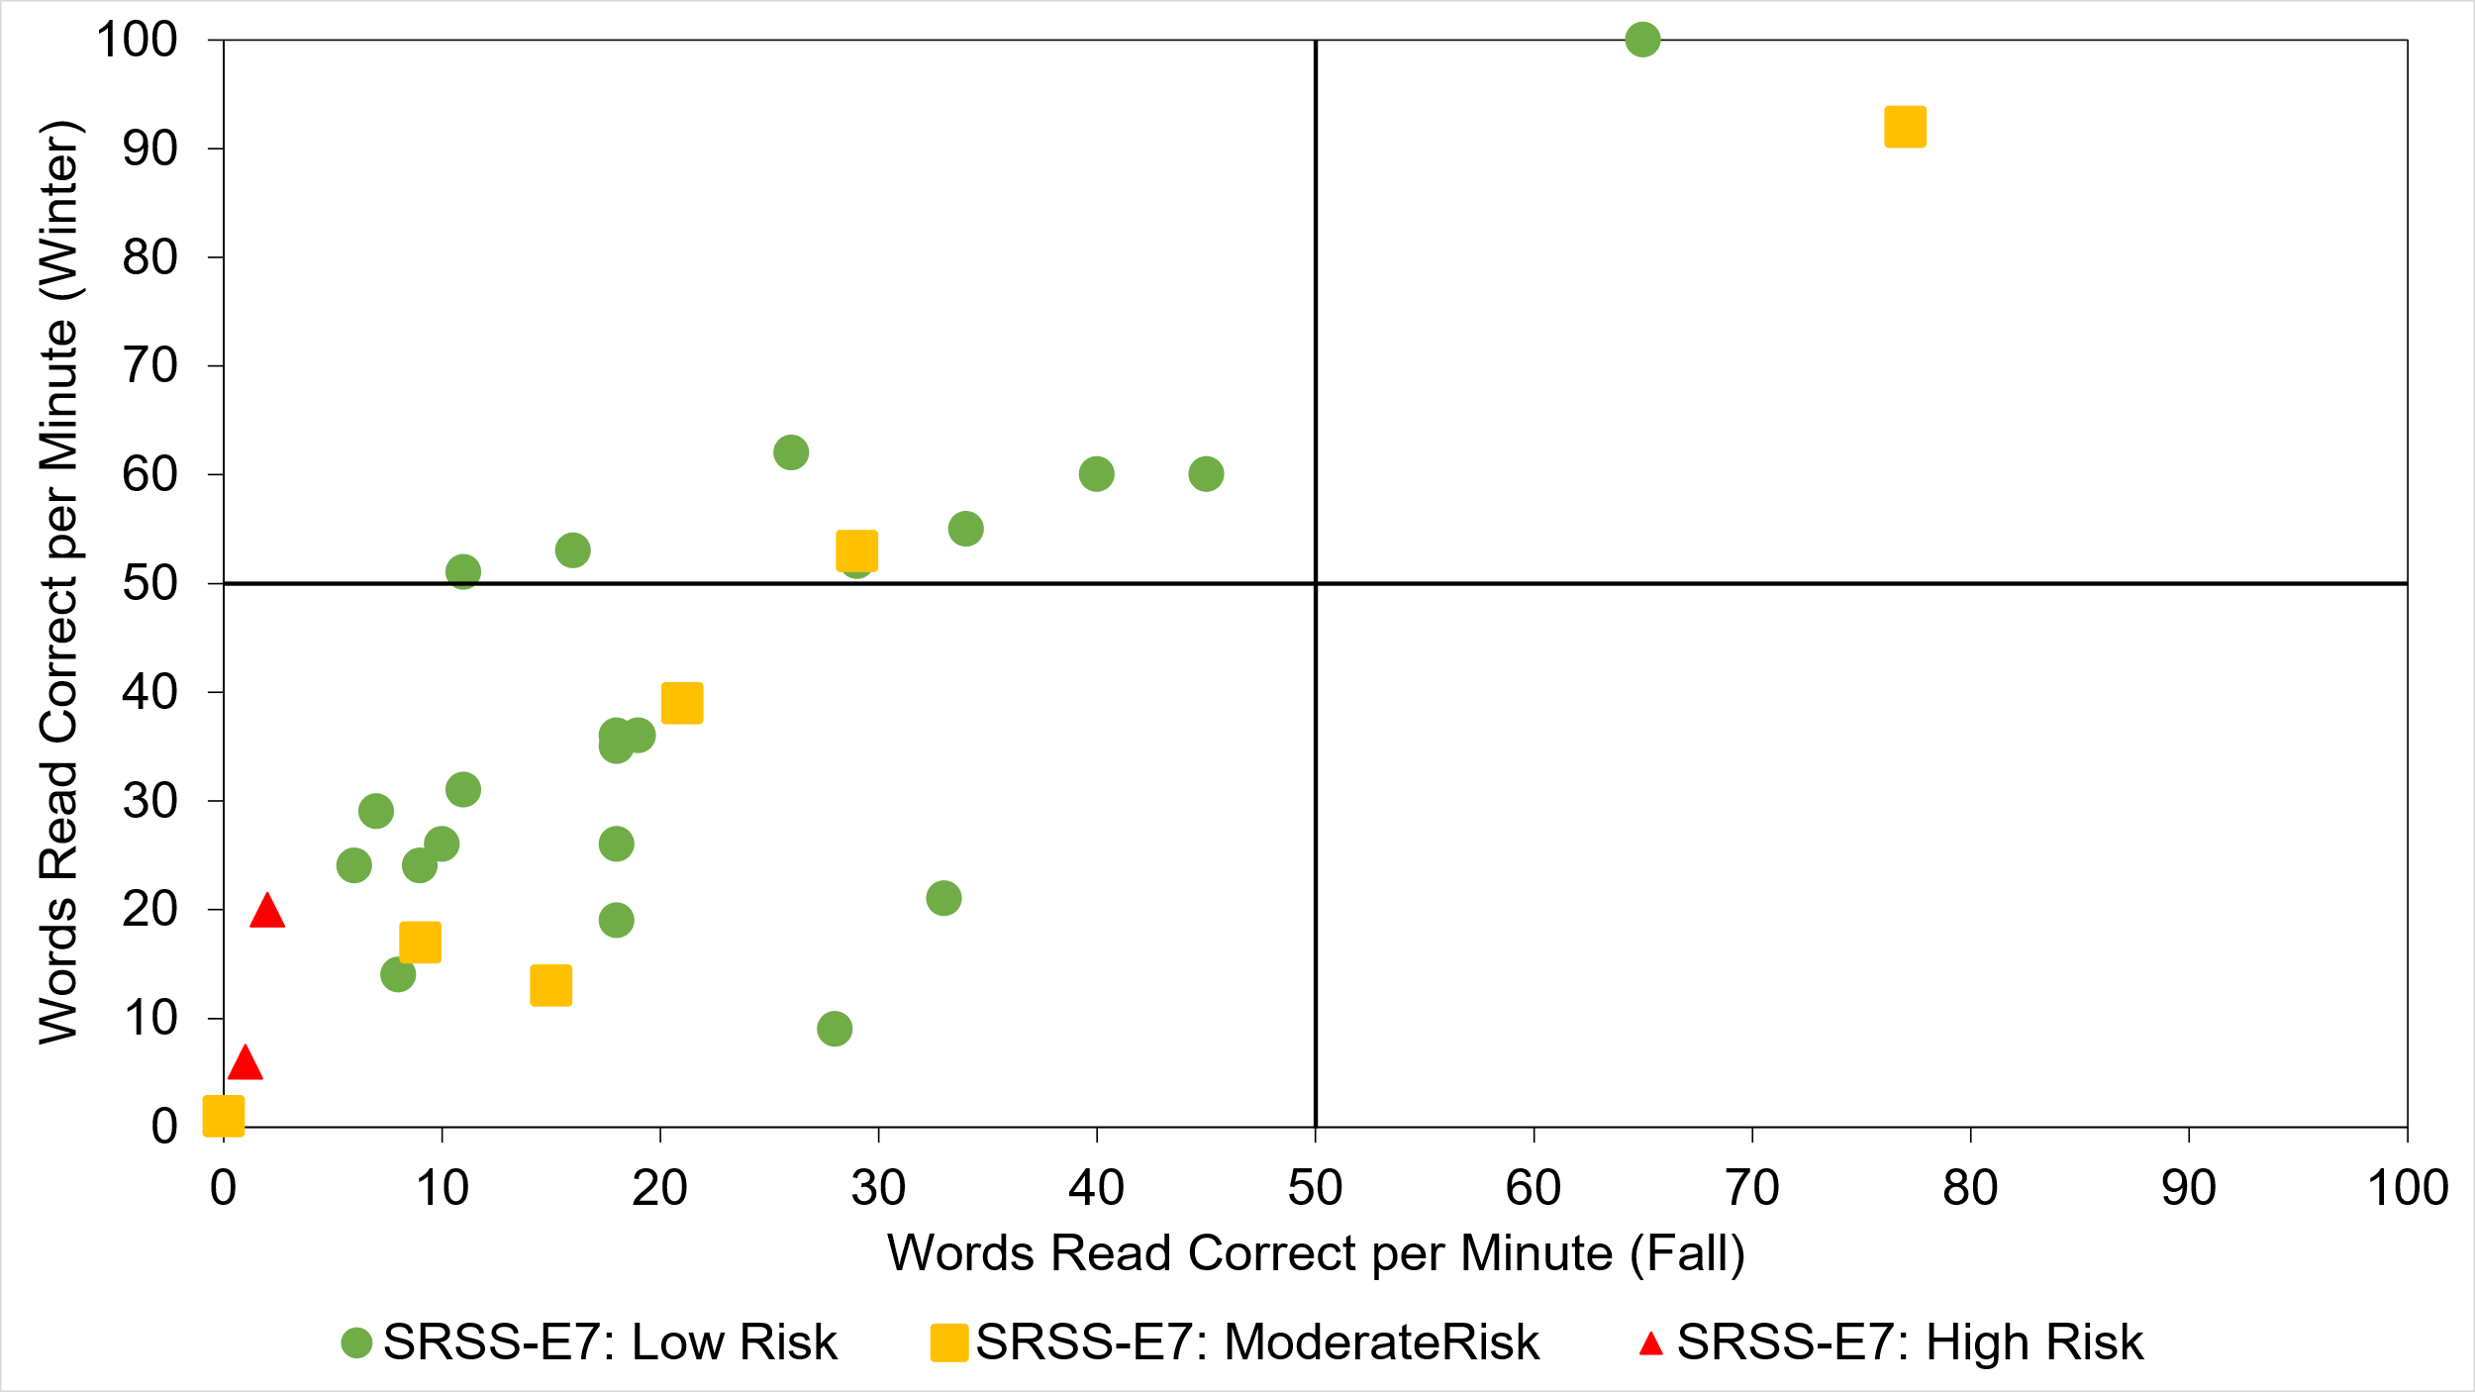
Quadrant 2: Responsive
“Low—Grow”
Quadrant 1: Responsive
“High—Grow”
Quadrant 3: Not responding
“Low—No Grow”
Quadrant 4: Not responding
“High—No Grow”

Slide 40
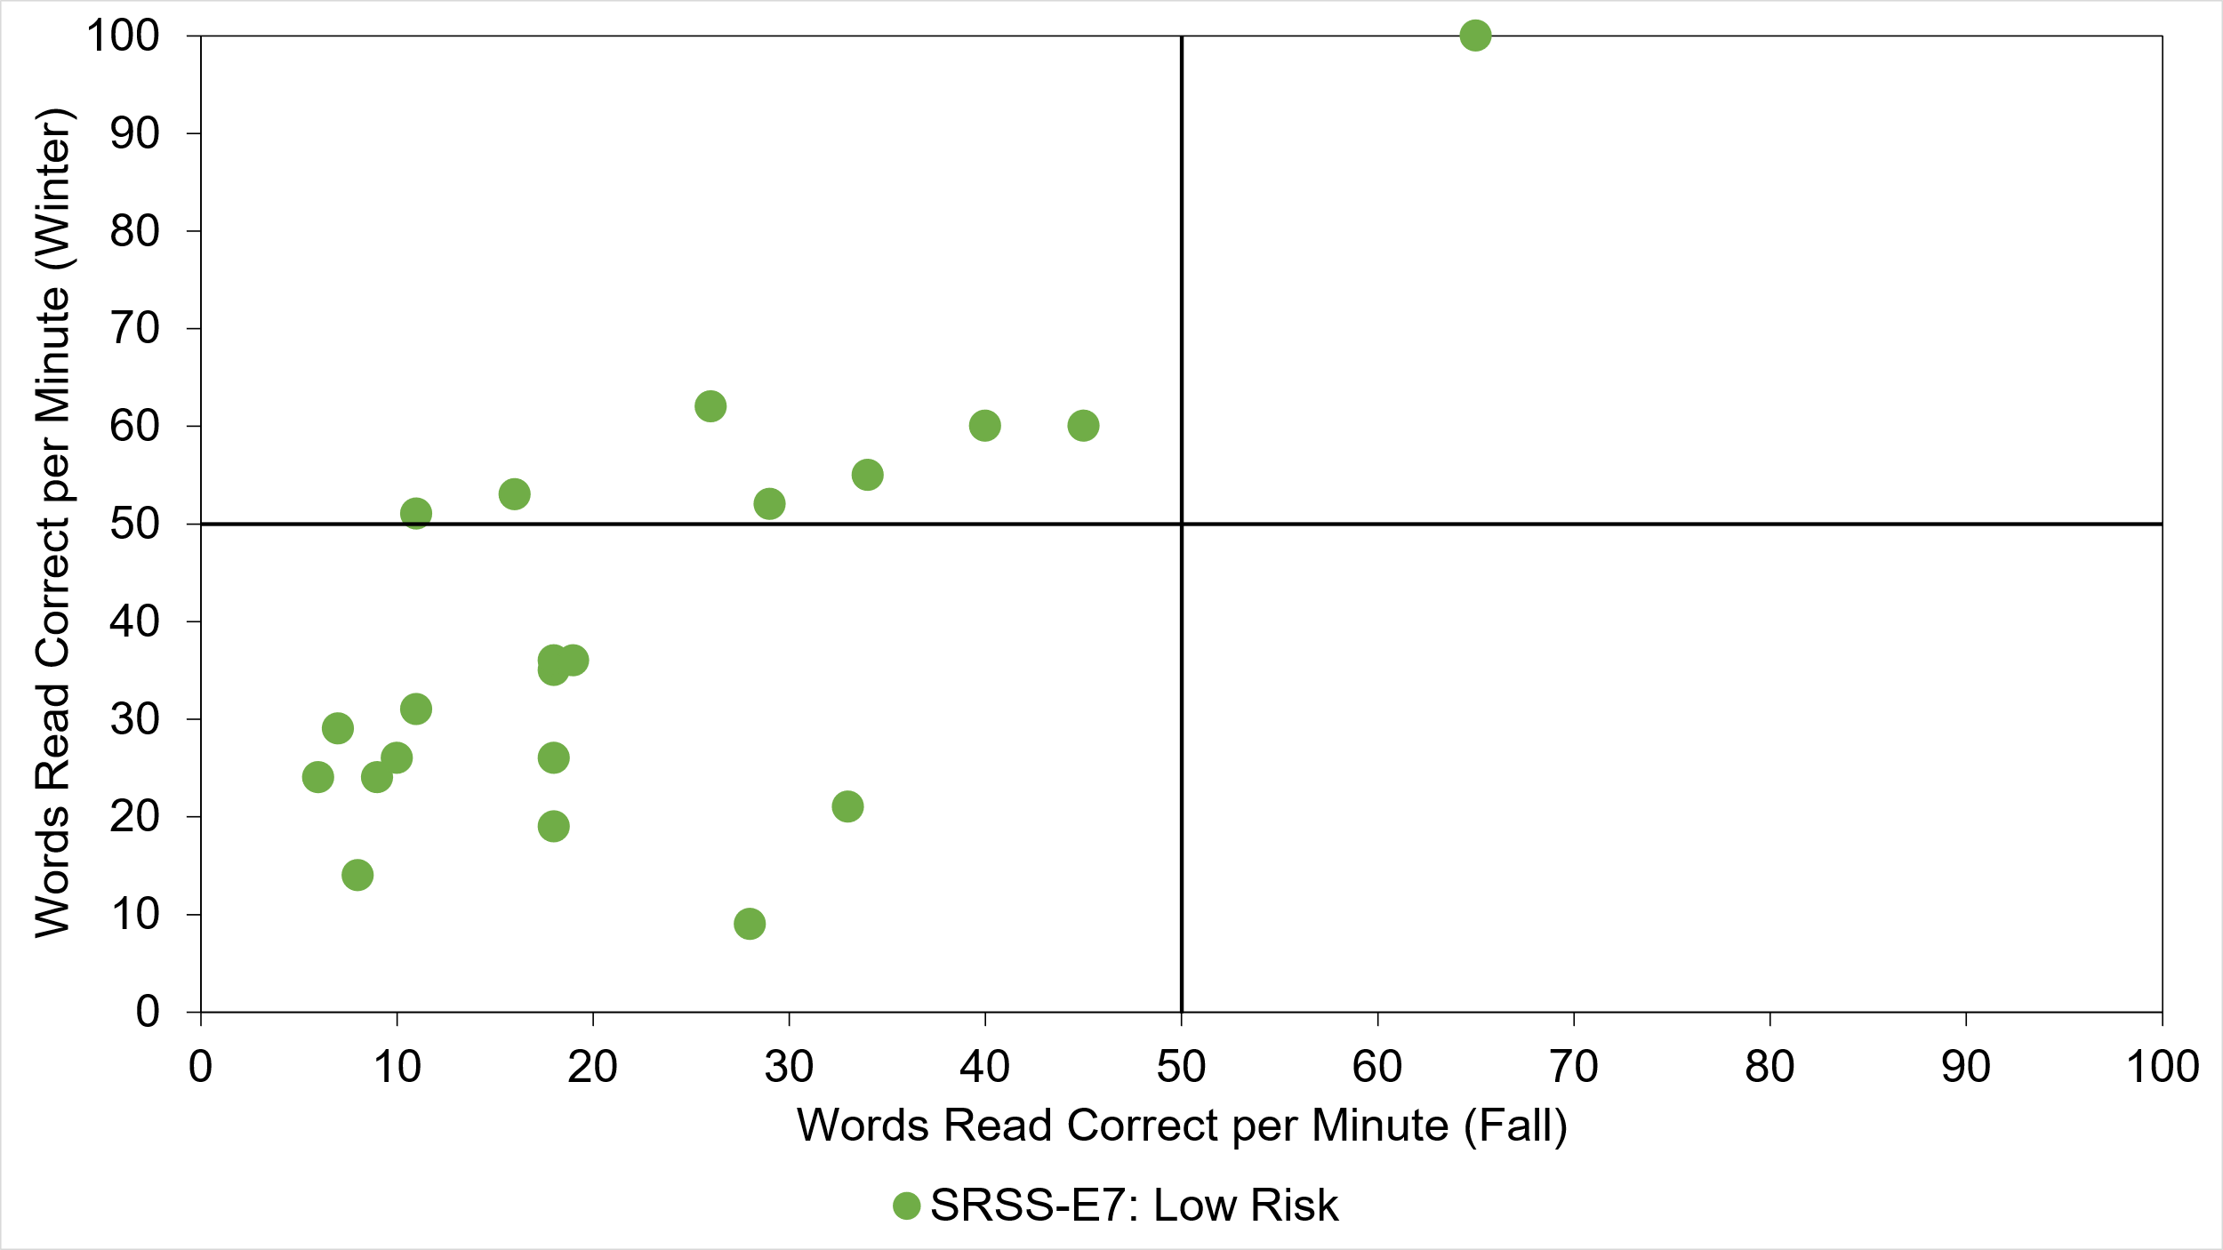
Quadrant 2: Responsive
“Low—Grow”
Quadrant 1: Responsive
“High—Grow”
Quadrant 3: Not responding
“Low—No Grow”
Quadrant 4: Not responding
“High—No Grow”

Slide 41
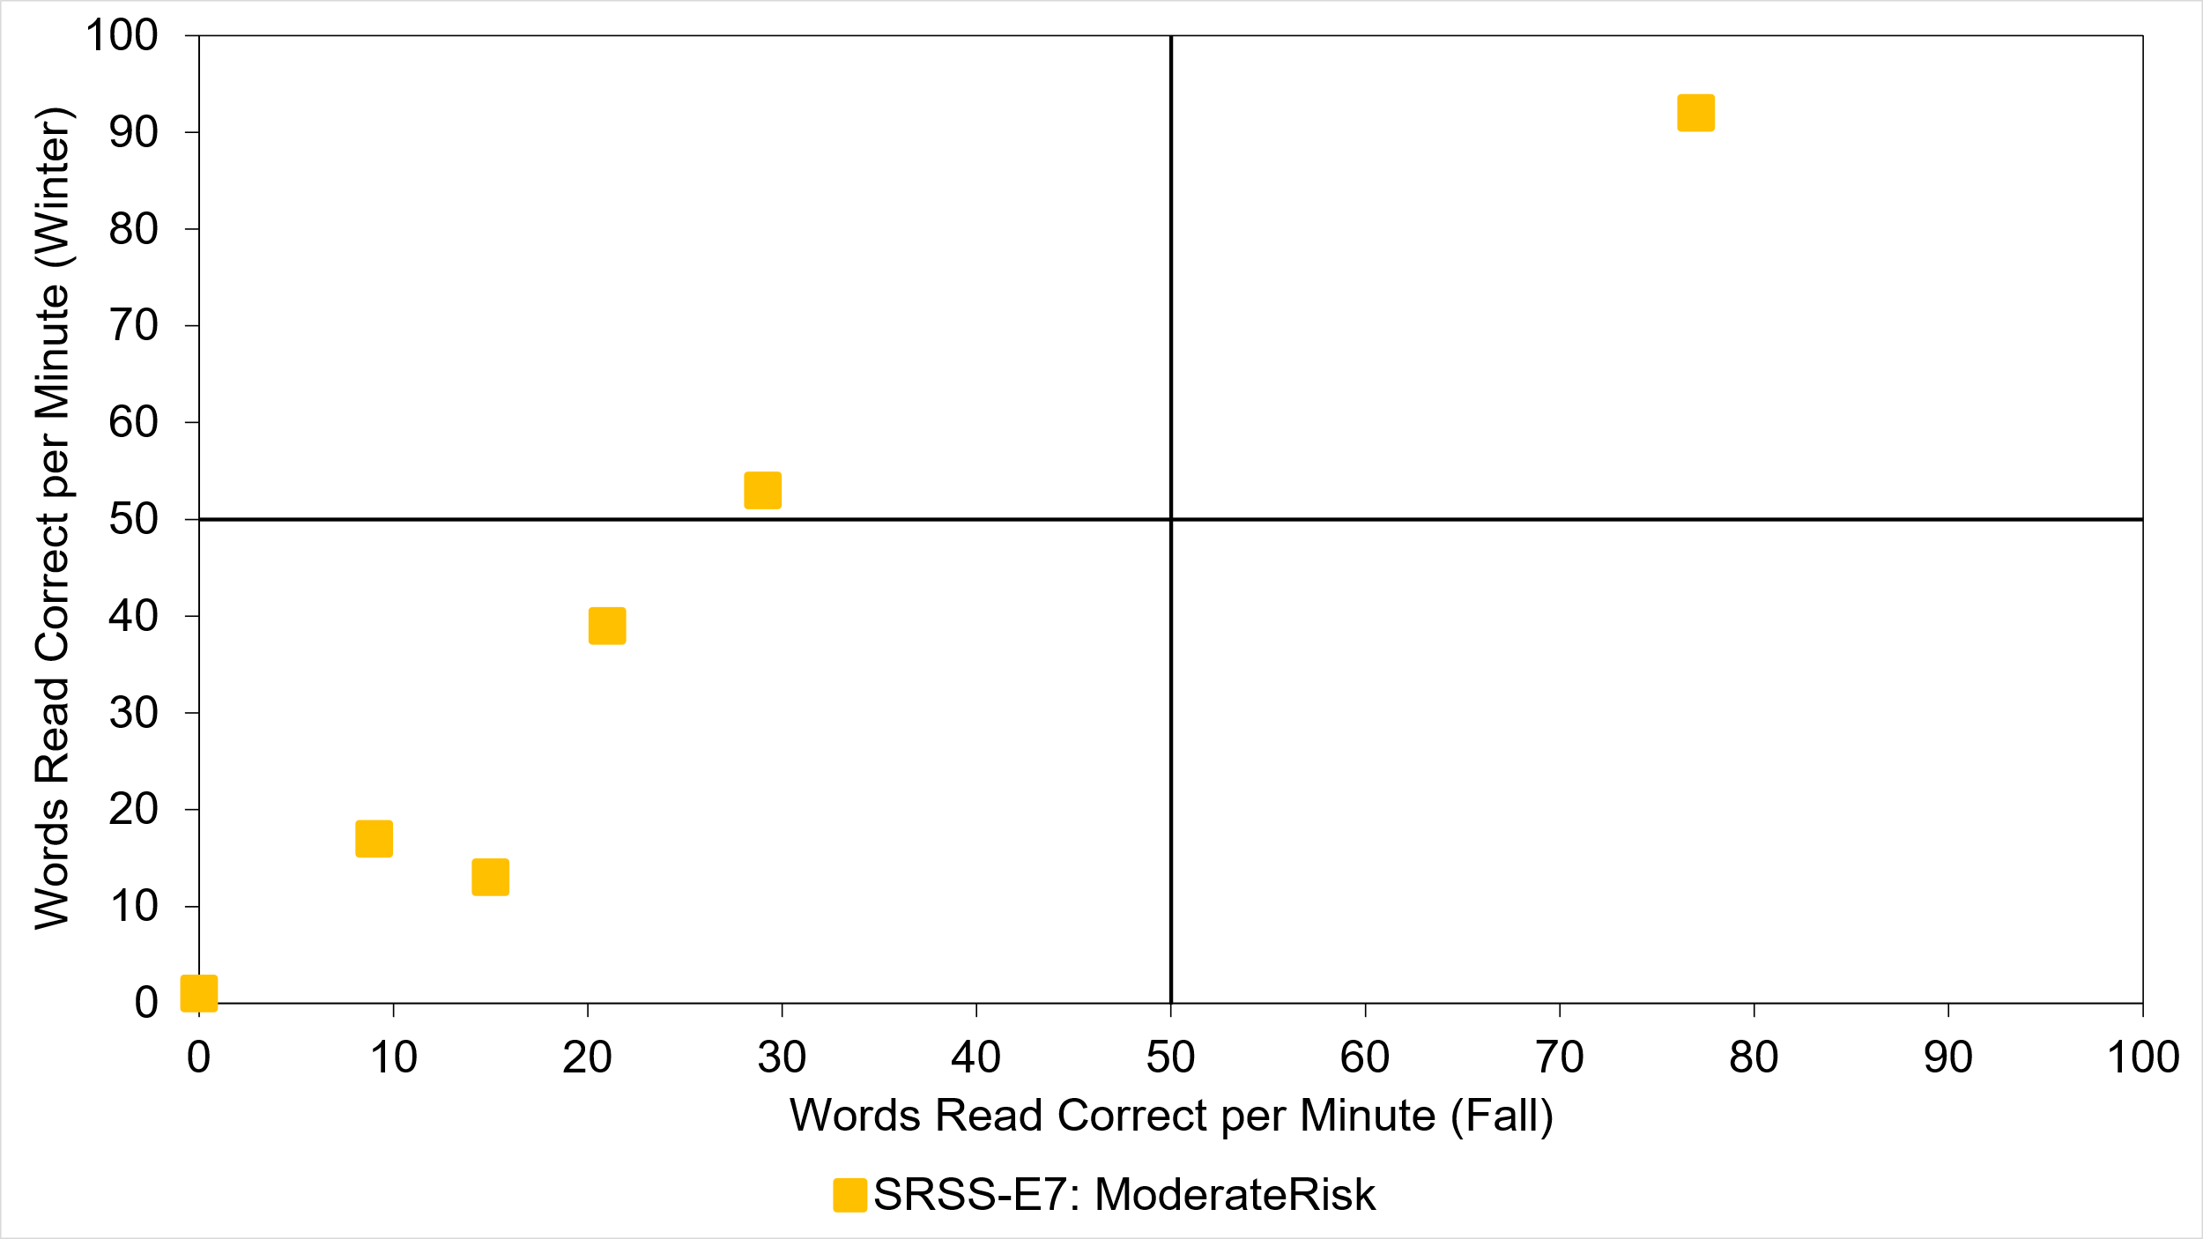


Quadrant 2: Responsive
“Low—Grow”
Quadrant 1: Responsive
“High—Grow”
Quadrant 3: Not responding
“Low—No Grow”
Quadrant 4: Not responding
“High—No Grow”

Slide 42
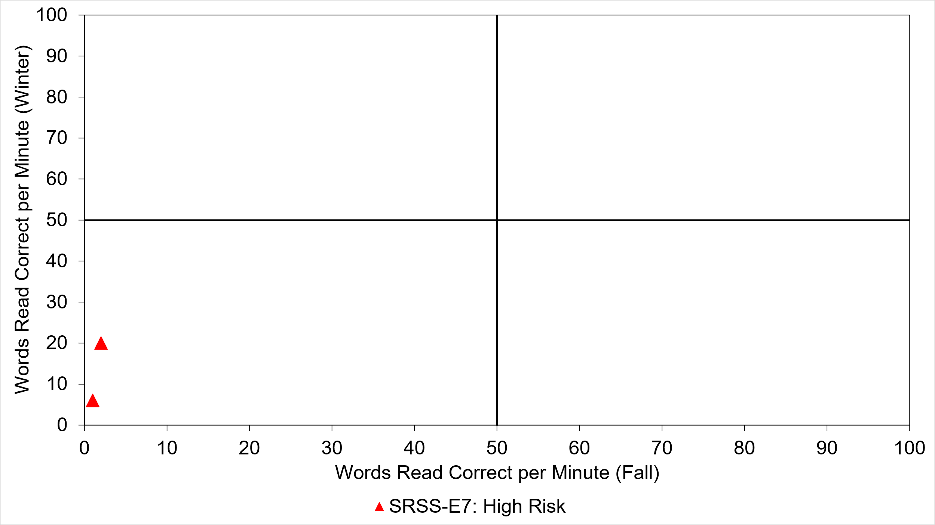


Quadrant 2: Responsive
“Low—Grow”
Quadrant 1: Responsive
“High—Grow”
Quadrant 3: Not responding
“Low—No Grow”
Quadrant 4: Not responding
“High—No Grow”

Slide 43
Quadrant 2: Responsive
“Low—Grow”
Quadrant 1: Responsive
“High—Grow”
Quadrant 3: Not responding
“Low—No Grow”
Quadrant 4: Not responding
“High—No Grow”

Slide 44
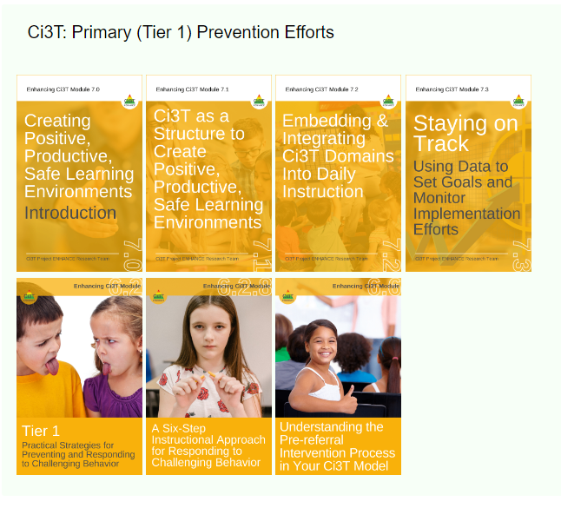




Solutions-based Planning
What if we need to focus on Tier 1?

Slide 45
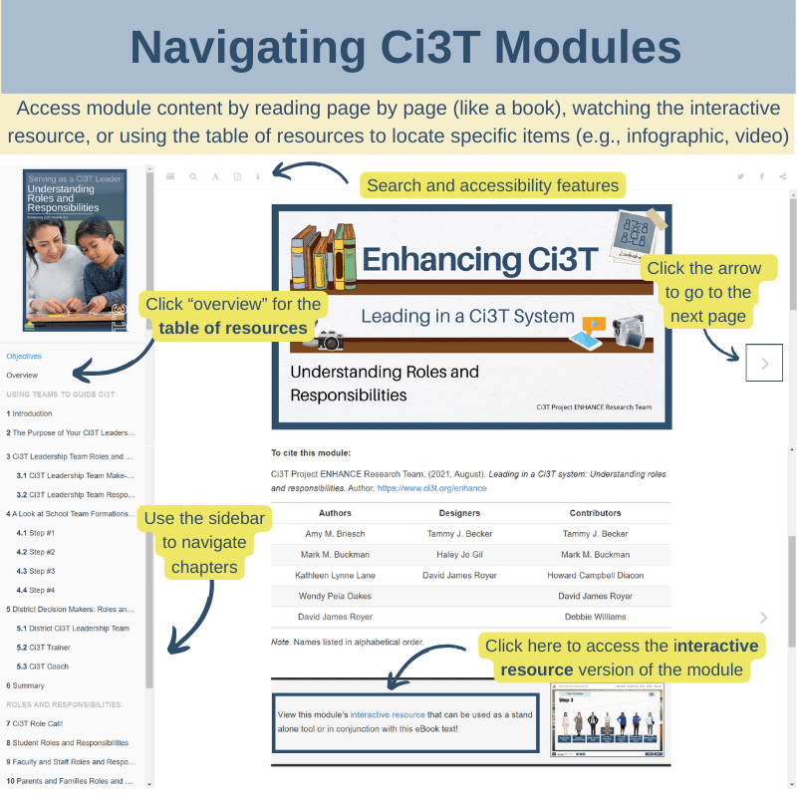
Integrated Lesson Planning at Tier 1

Slide 46
Notes:
Throughout the remainder of the presentation, we will highlight content from modules and therefore want to start by grounding in this infographic, a resource to help people get oriented to modules and how to use them. We heard your feedback that sometimes staff who are new to using modules find it tricky to navigate so wanted to highlight these key features!
If you’re accessing the module as an eBook and reading page x page, use arrow to navigate to the next page or sidebar to navigate chapters and pick up where you left off
If you want to watch the interactive resource, click here
If you’ve already reviewed the module and you’re coming back to locate a specific item (or “lucky charm” at Kathleen likes to call them) like an infographic, video, or activity, click where it says “overview” here on the sidebar to be taken to the table of resource. From there you can click “page” to be taken to that part of the eBook or “link” to download the material directly.

Slide 47

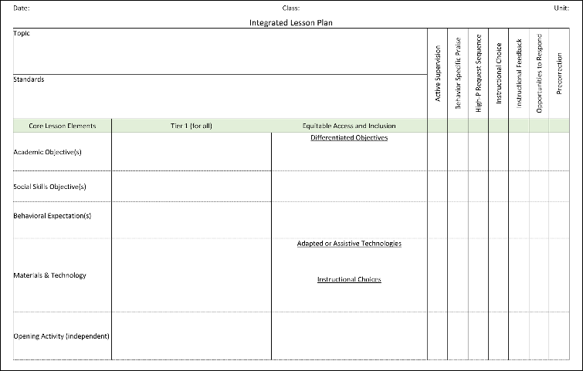
Embedding Low-Intensity Strategies

Slide 48
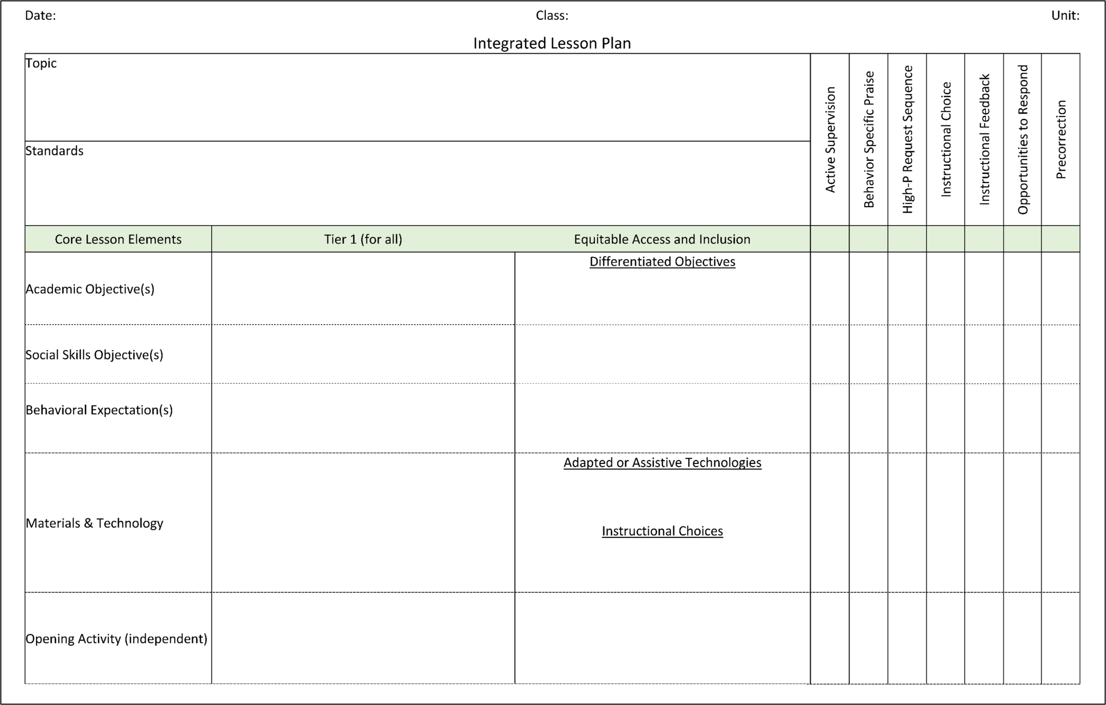
Notes:
Identify the academic learning objectives and standards for the lesson.
Plan lesson activities.
Consider what social skill(s) have been taught and/or are needed for successful participation by all.
Select the specific behavioral expectations that will be important for prosocial lesson engagement.
For example,
Does the lesson require team work? Discussions from multiple perspectives? Sharing materials? Use of digital media? Use of classroom materials?
Social skills needed to engage in those activities… respect ideas different than you own, seek to understand the perspective of others, take turns, offer your own ideas, listen to others, use of reliable resources online,
Behaviors: treat materials with care, look at the speaker, one speaker at a time, keep unrelated materials put away, ask for a turn, ask questions to understand others, include only your original work or properly cited work in your assignment.

Slide 49
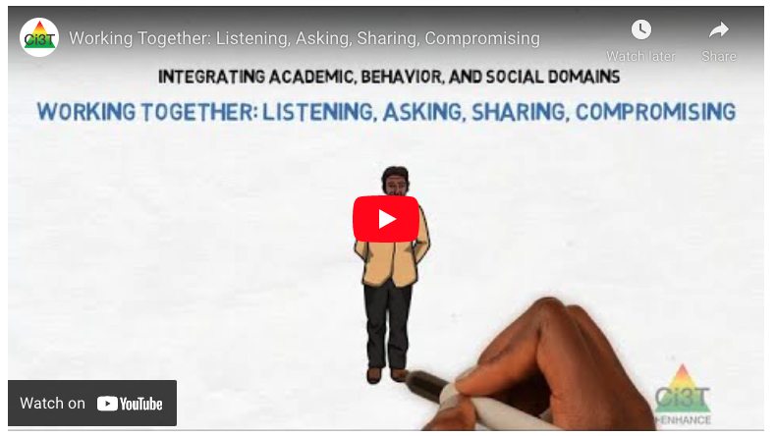
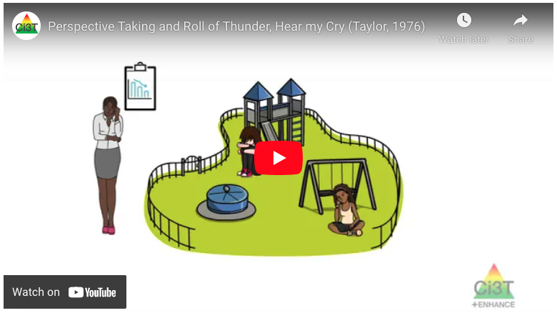
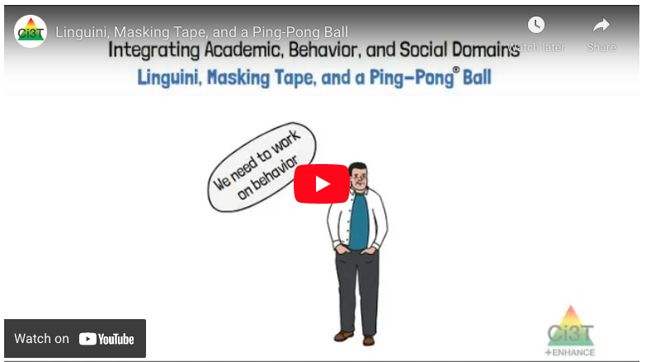
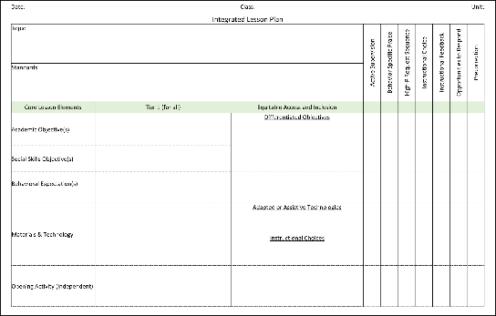
Notes:
If time – navigate to module: https://kusurvey.ca1.qualtrics.com/jfe/form/SV_0HWM8d2BdorMHDo
Model how to access video (table of contents)
Select a video to play (all 3 videos are less than 2 minutes)

Slide 50
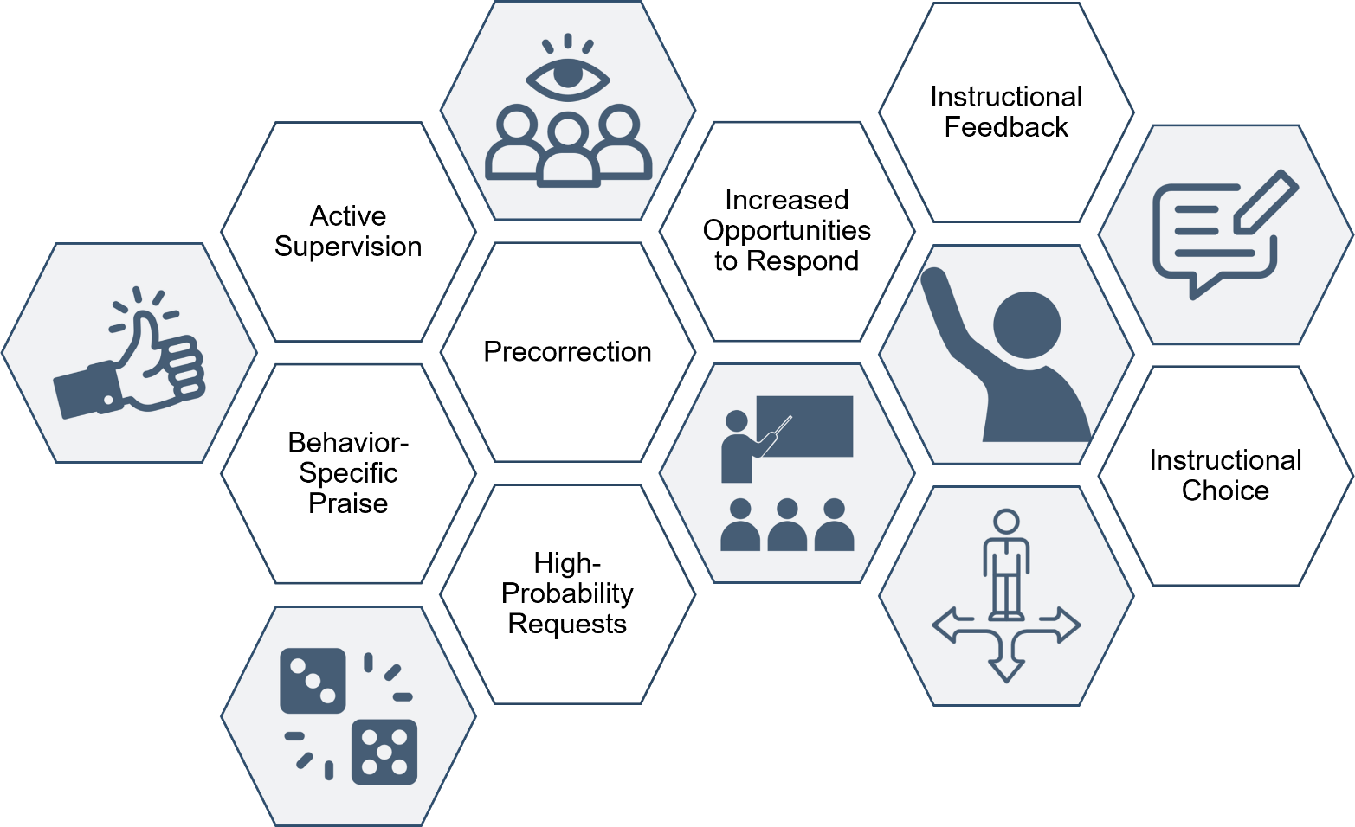
Academic
Behavioral
Social and emotional

Slide 51

Activity: Integrating academic, behavior, and social domains Time: 15-30 min Take an Integrated Approach Identify an academic learning target or objective and draft ideas for a lesson plan. Determine the ways students will engage in learning. Select a social skill recently taught or one you would like students to practice. Review your expectation matrix and determine behaviors that might need precorrection for successful engagement. Please note that the order can vary depending on the opportunities for practice desired.

Slide 53

















Let’s Talk!
In what ways does your school take an integrated approach to supporting students’ academic, behavioral, and social needs?
Where and how might you make integrations stronger within your own classroom or school?
How do your data support areas to target, and how can you share those data with stakeholders (e.g., faculty and staff, district administrators, families)?
Notes:
15-min timer

Slide 54
Planning and Implementing Tier 2 Interventions

Slide 55

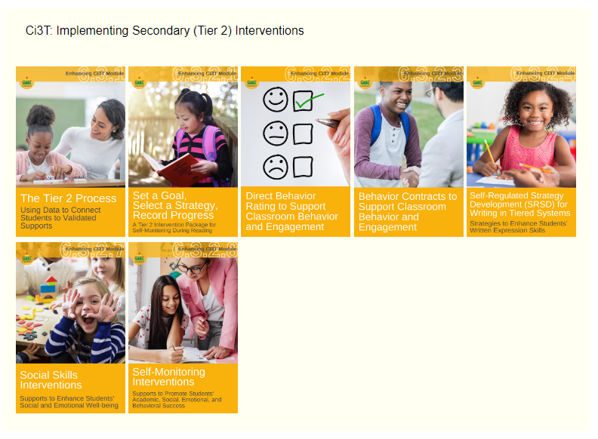

Slide 56
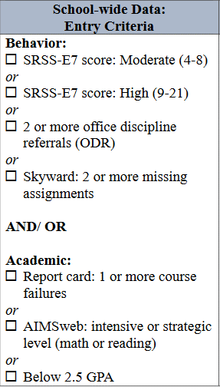

Data in action

Slide 57

Data in action

Slide 58


Data in action
Other Tier 2 options…
Behavior Contract
Direct Behavior Rating
Behavior Specific Praise
Instructional Choice

Slide 59
Planning Tier 2 Supports
Considering Treatment Integrity data to inform next steps:
TFI Item 2.3
Screening: Tier 2 team uses decision rules and multiple sources of data (e.g., ODRs, academic progress, screening tools, attendance, teacher/ family/student nominations) to identify students who require Tier 2 supports. | Multiple data sources used (e.g., ODRs, time out of instruction, attendance, academic performance) Team decision rubric Team meeting minutes School policy | 0 = No specific rules for identifying students who qualify for Tier 2 supports 1 = Data decision rules established but not consistently followed or used with only one data source 2 = Written policy exists that (a) uses multiple data sources for identifying students, and (b) ensures that families are notified promptly when students enter Tier 2 supports

Slide 60


Planning Tier 2 Supports
TFI Item 2.6
Options for Tier 2 Interventions: Tier 2 team has multiple ongoing behavior support interventions with documented evidence of effectiveness matched to student need. | School Tier 2 handbook Targeted Interventions Reference Guide | 0 = No Tier 2 interventions with documented evidence of effectiveness are in use 1 = Only 1 Tier 2 intervention with documented evidence of effectiveness is in use 2 = Multiple Tier 2 interventions with documented evidence of effectiveness matched to student need

Slide 61



Slide 62




Behavior Contracts
to Support Classroom
Behavior and Engagement

Slide 63


Agenda
Comprehensive, integrated, three-tiered (Ci3T) model of prevention
A look at Behavior Contracts
  What are Behavior Contracts?
  Why are Behavior Contracts effective?
  What does the supporting research for Behavior Contracts say?
  What are the benefits and challenges?
  How do I implement Behavior Contracts in my classroom?
    Implementation checklist
  How well is it working?
    Examining the effects

Slide 64

What are Behavior Contracts?
A behavior contract (or contingency contract) is a mutually agree-upon document between at least two individuals in which one or both individuals agree to demonstrate certain behavior(s).
Three Core Components:
  Behavior
  Reward
  Recording Sheet

Slide 65




Examples of Behavior Contracts
Also available in Spanish!

Slide 66

Behavior Contract Components
1: Behavior
Who?
What?
When?
How well?
Notes:
When specifying the behavior or task, it is important to include four pieces of information: who, what, when, and how well (Cooper et al., 2020).
Who refers to the parties—which could be a single or several persons—entering into the contract. Behavior contracts can be between one or more parties. Multi-party contracts are the most common type of behavior contract and involve two or more individuals, each of whom is focused on changing a given behavior. In school settings, one of the participating parties will always be the student, as they are the one who will perform the behavior(s) and receive the reinforcer (also referred to as a reward). However, it is also possible to involve teachers, paraprofessionals, and/or parents. One-party contracts (also known as unilateral contracts or self-contracts) emphasize the behavior change of one individual. In one-party contracts, the individual (e.g., the student) desires to change their own behavior. To assist in the behavior change process, this individual arranges reinforcement (or punishment) contingencies with a contingency manager.
What refers to the behavior(s) to be performed. From a behavioral perspective, everything is behavior: the amount of time engaged in a task, the number of times a person participates in a conversation, the number of words read correctly per minute (oral reading fluency), or the number of days in attendance to list a few examples. In each instance the behavior is operationally defined to ensure people are 100% clear as to what the “behavior” is to be performed.
When identifies the time—such as day and time or every school day—by which the behavior must be completed. For example, turning in homework on time may be defined as: the assignment turned in to homework basket or uploaded by 8:00 A.M. or before the late bell rings.
How well specifies the levels of performance or standards to meet criterion. For example, work completion may be defined as attempting each problem or task whereas work accuracy may be defined as 80% of the problems being correct.

Slide 67


Slide 69

Behavior Contract Components
2: Reward
Who?
What?
When?
How well?
Notes:
Similarly, equally specific detail is necessary to describe the reward component of the behavior contract.
Who is the person(s) who will judge the behavior and control delivery of the reward. This might be the classroom teacher, a paraprofessional, student teacher, or a family member.
What is the reward itself. For example, in a school implementing Ci3T, this might be a ticket (e.g., BEST Buck) paired with behavior-specific praise.
When identifies the time the reward can be received by the person who met the specified expectations. For example, this might be at the end of the school day, or more immediately at the end of a specific time period (e.g., lunch).
How much specifies the amount of reward (e.g., dosage) that can be earned by performing the behavior and meeting criteria. For example, this might be one ticket (e.g., BEST Buck) paired with behavior-specific praise for each homework assignment turned in on time, with all problems attempted.

Slide 70


Behavior Contract Components
3: Recording Sheet
Notes:
The recording sheet is designed to serve as (a) a prompt for all parties to review the contract regularly and (b) a method for recording behavior performance. It is important this be understandable to all parties involved given contracts often include multiple people (e.g., students, teachers, family members). You might also consider creating a method to enter data into a spreadsheet, which will graph student progress. We offer an example behavior contracts data tracker as part of this module.

Slide 71
What are the benefits and challenges?
Benefits
Challenges
Research-based
Cost effective
Require little time to implement
Measurable target behavior
Behavior must be within students’ repertoire
Developmentally appropriate
Universal agreement to implement

Slide 72




How do I implement Behavior Contracts in my classroom?
Notes:
In the module, there are a variety of tools you can access to learn more about the steps for implementing behavior contracts including a video, the interactive resource, an implementation checklist, and a planning sheet. In the next series of slides, we’re going to walk through the planning guide to highlight each step of this process.

Slide 73


Slide 74


Slide 75


Slide 77


Slide 79


Slide 80


Slide 82

How well is it working?
Examining the effects
Treatment Integrity
Is it happening?
Social Validity
What do stakeholders think about the goals, procedures, and outcomes?
Experimental Design
How well did this support work for this student?

Slide 83

Ensuring Behavior Contracts are in place: Treatment integrity
Have structures in place to monitor whether the behavior contract carried out as intended.

Slide 84


What does the student think about it?
Pre-
Post-

Slide 85


What do the adults think about it?
Completed by the teacher(s), paraeducator(s), and parent(s) involved in the intervention at two time points:
pre- and post-
intervention

Slide 86
Data to Progress Monitor
Student Outcomes

Slide 87


Deep dive into this at EMPOWER Sessions 4!
Notes:
EMPOWER Session 4 focused on connecting students with Tier 2 interventions and with a deep dive into behavior contracts and Self-Regulated Strategy Development (SRSD) for writing. If you’d like to share this session with your staff, the recording along with all session materials can be found in light blue accordion!

Slide 88
Planning and Implementing Tier 3 Interventions

Slide 89


Tertiary (Tier 3) Intervention Grids

Slide 90





Tier 3 Functional Assessment-based Intervention (FABI)

Slide 91






Tier 3 Supports

Slide 92


Deep dive into this at EMPOWER Sessions 5!
Designate two staff to attend trainings to become on-site coaches
10 min @ next Faculty and Staff meeting
Ci3T Setting Up for Success
Systematic Screening
Low-Intensity Supports
Tier 2
Planning Ahead
Tier 3
Notes:
EMPOWER Session 5 – deep dive into Tier 3 behavior supports for internalizing and externalizing behavior challenges

Slide 93






Jigsaw: Tier 2 and Tier 3 Supports
Direct Behavior Rating
SRSD for Writing
Self-Monitoring
Acting Out
FABI
Internalizing

Slide 94
Let’s Talk!
Read over the list of Tier 2 and Tier 3 supports listed in your school’s Ci3T Implementation Manual.
Jigsaw: For this breakout session, divide up your team members to attend these sessions:
  Tier 2 Direct Behavior Rating
  Tier 2 SRSD for Writing
  Tier 2 Self-Monitoring
  Tier 3 Managing Acting Out Behavior at Tier 3
  Tier 3 Supporting Students with Internalizing Behaviors at Tier 3
  Tier 3 Functional Assessment-Based Intervention (FABI)
Post in the chat the one you would like to attend so your Ci3T Leadership Team members can divide up to learn more!
Notes:
15-min timer

Slide 95

Jigsaw Room 1 – Direct Behavior Rating

Slide 96

Jigsaw Room 2 – SRSD for Writing

Slide 97
Jigsaw Room 3 – Self-Monitoring

Slide 98
Jigsaw Room 4 – Managing Acting-out Behavior at Tier 3

Slide 99
Jigsaw Room 5 – Supporting Students with Internalizing Concerns at Tier 3

Slide 100
Jigsaw Room 6 –
Functional Assessment - Based Intervention (FABI)

Slide 101



Planning Tier 2 and Tier 3 Supports:
Structures for Success
Example of Tier 2 Intervention Drive in shared digital space

Slide 102

Planning Tier 2 and Tier 3 Supports :
Structures for Success

Slide 103

Find students who need support
Identify classrooms in which Tier 1 is implemented with integrity
Use screening data to find students with moderate risk
Consider students demonstrating risk across academic
and
behavioral domains…

Slide 104

Planning Tier 2 and Tier 3 Supports
Monitor who is receiving Tier 2 and Tier 3 supports
Store data in a secure location accessible to relevant parties

Slide 105
Planning Tier 2 and Tier 3 Supports
Considering Treatment Integrity data to inform next steps:
TFI Item 2.3
Level of Use: Team follows written process to track proportion of students participating in Tier 2 supports, and access is proportionate. | Tier 2 enrollment data Tier 2 team meeting minutes Progress monitoring tool | 0 = Team does not track number of students responding to Tier 2 interventions 1 = Team defines criteria for responding to each Tier 2 intervention and tracks students, but fewer than 5% of students are enrolled 2 = Team defines criteria and tracks proportion, with at least 5% of students receiving Tier 2 supports

Slide 106

Planning Tier 2 and Tier 3 Supports :
Structures for Success

Slide 107

Planning Tier 2 and Tier 3 Supports :
Structures for Success

Slide 108


Planning Tier 2 and Tier 3 Supports

Slide 109

Planning Tier 2 and Tier 3 Supports
Notes:
If you’re looking for tips and tricks to set up and use the Tiered Intervention Data manager, we invite to review this 5-minute video found in the Tier 3 Reading Intervention module
Video Link: https://youtu.be/TsCBbZDWpM8

Slide 110
Let’s Talk!
Share out with your team:
  Tier 2 Direct Behavior Rating
  Tier 2 SRSD for Writing
  Tier 2 Self-Monitoring
  Tier 3 Managing Acting Out Behavior at Tier 3
  Tier 3 Supporting Students with Internalizing Behaviors at Tier 3
  Tier 3 Functional Assessment-Based Intervention (FABI)
What structures are in place to support teachers using data to connect students to Tier 2 and 3 supports?
Action Planning: What would you like to share out with your faculty and staff about Tier 2 and Tier 3 supports?
Notes:
15-min timer

Slide 111
Wrapping Up and Moving Forward

Slide 112
Ci3T
Comprehensive Professional Learning Plan
Ci3T: Primary Prevention
Session 1:
Overview of Ci3T Prevention Models
Setting a Purpose
Establish team meetings and roles
Session 2:
Mission and Purpose
Establish Roles and Responsibilities
Procedures for Teaching
Procedures for Reinforcing
Reactive Plan
Session 3:
Procedures for Monitoring
Session 4:
Revise Primary Plan using Stakeholder feedback
Prepare presentation
Ci3T: Secondary Prevention
Session 5:
Overview of Teacher focused Strategies
Overview of Student Focused Strategies
Using data to determine which students may need Secondary (Tier 2) supports
Draft the Secondary Intervention Grid based on existing supports
Ci3T: Tertiary Prevention
Session 6:
Final revisions of Ci3T Plan based on stakeholder feedback
Draft Tertiary (Tier 3) Prevention Intervention Grids
Design Implementation Manual and Plan for roll out to faculty, students, and parents
Ci3T Leadership Team Training Sequence
Implementation Stages of Tier 2 and 3 within Ci3T
Additional Professional Development on Specific Topics
Core Content Curriculum
Check In - Check Out
Functional Assessment-based Interventions
Reading, Math, Writing Benchmarking and Progress Monitoring Tools
Interventions, Strategies, & Practices
Additional Tier 3 Supports
Instructional Techniques to Improve Students’ Motivation; Classroom Management Practices;
Low-Intensity Behavior Supports

Slide 113
Ci3T Professional Learning Calendar
 | 0 | 1 | 2 | 3 | 4 | 5 | 6 | 7 | 8 | 9 | 10 | 11
 | July | Aug | Sep | Oct | Nov | Dec | Jan | Feb | Mar | Apr | May | Jun
Ci3T Training |  |  |  |  | Ci3T Professional Learning Series Session 1 | Ci3T Professional Learning Series Session 2 | Ci3T Professional Learning Series Session 3 | Ci3T Professional Learning Series Session 4 |  | Ci3T Professional Learning Series Session 5 | Ci3T Professional Learning Series Session 6
Ci3T Implementation Support | Ci3T Implementation Series Prep Session |  | Ci3T Implementation Series Session 1 |  | Ci3T Implementation Series Session 2 |  | Ci3T Implementation Series Session 3 |  | Ci3T Implementation Series Session 4 | Ci3T Implementation Series Session 5
Ci3T EMPOWER |  |  | Ci3T EMPOWER Session 1 | Ci3T EMPOWER Session 2 | Ci3T EMPOWER Session 3 |  | Ci3T EMPOWER Session 4 |  | Ci3T EMPOWER Session 5 | Ci3T EMPOWER Session 6
Ci3T Trainers & Coaches Calls |  | Trainers & Coaches Call Session 1 | Trainers & Coaches Call Session 2 | Trainers & Coaches Call Session 3 | Trainers & Coaches Call Session 4 | Trainers & Coaches Call Session 5 | Trainers & Coaches Call Session 6 | Trainers & Coaches Call Session 7 | Trainers & Coaches Call Session 8 | Trainers & Coaches Call Session 9 | Trainers & Coaches Call Session 10

Slide 114

Project EMPOWER - Enhanced
Ci3T EMPOWER Sessions Location: Remote via Zoom Attended by: School Ci3T Leadership Teams, Ci3T District Trainers and Coaches, Faculty and Staff, Families (adults only). Community Members |  | Times (Pacific) | Times (Central) | Times (Eastern)
1. Getting Started | Sep. 21, 2023 (Th) | 3:00 – 5:00 p.m. | 5:00 – 7:00 p.m. | 6:00 – 8:00 p.m.
2. Screening | Oct. 18, 2023 (Wed) | 3:00 – 5:00 p.m. | 5:00 – 7:00 p.m. | 6:00 – 8:00 p.m.
3. Low Intensity Supports (2) | Nov. 28, 2023 (Tu) | 3:00 – 5:00 p.m. | 5:00 – 7:00 p.m. | 6:00 – 8:00 p.m.
4. Tier 2 | Jan. 11, 2024 (Th) | 3:00 – 5:00 p.m. | 5:00 – 7:00 p.m. | 6:00 – 8:00 p.m.
5. Tier 3 | Mar. 26, 2024 (Tu) | 3:00 – 5:00 p.m. | 5:00 – 7:00 p.m. | 6:00 – 8:00 p.m.
6. Moving Forward | Apr. 25, 2024 (Th) | 3:00 – 5:00 p.m. | 5:00 – 7:00 p.m. | 6:00 – 8:00 p.m.

Slide 115
Wrap Up and Preview
Today
Next time
Data-Informed Decision-Making
Integrated Lesson Planning at Tier 1
Planning and Implementing Tier 2 Interventions
Planning and Implementing Tier 3 Interventions
Procedures for Monitoring
  Review your School’s Social Validity & Treatment Integrity Data
  Review your School’s Spring Screening Data
Planning for the Year Ahead 2023-2024
Focusing on Data-Informed Professional Learning

Slide 116
Please Take a Minute to Get Organized
Please stay until all materials are organized.
Team Materials:
  Make sure your notes are in your Ci3T Leadership Team agenda and that document is saved in your Ci3T Leadership Team Drive.
  Clearly identify the person(s) on your team
  in charge of each action item listed on the agenda.
Thank you!

Slide 117

Homework
At your next Ci3T Leadership Team meeting:
  Confirm plans to support completion of spring screening
  Refine and implement plans to share resources and support faculty and staff around Tier 2 and Tier 3 supports
  Make preliminary plans for faculty and staff to complete
    Treatment integrity and social validity surveys during the spring timepoint
    Teacher well-being and input measures during the spring timepoint
  Complete Tiered Fidelity Inventory (TFI) protocols for the spring timepoint
At your next faculty meeting:
  Share professional learning resources and opportunities around Tier 2 and Tier 3 interventions (see ci3t.org/enhance and ci3t.org/fabi)

