Slide 1
Tertiary (Tier 3) Interventions in Ci3T Models:
Logistics and Illustrations
EMPOWER+ - Enhanced Session 5
Presenters and Contributors | Contributors
Allison M. Bernard | Elise Sarasin
Mark M. Buckman | Rebecca L. Sherod
Kathleen Lynne Lane | Stacie Williams
Wendy Peia Oakes

Slide 2
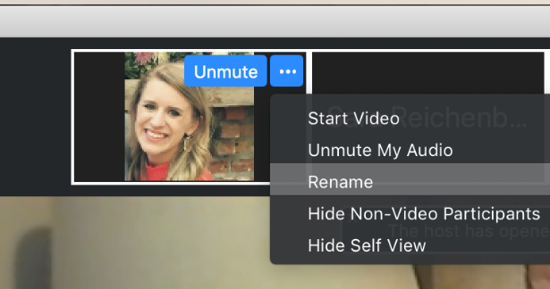
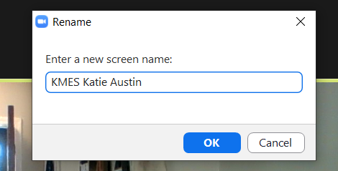
Renaming: School Initials + First and Last Name
To help us put you in breakout rooms with your colleagues today…
1. Click the three dots at the top
right corner of your video square.
2. Rename yourself with your
school initials then first and last name.

Slide 4
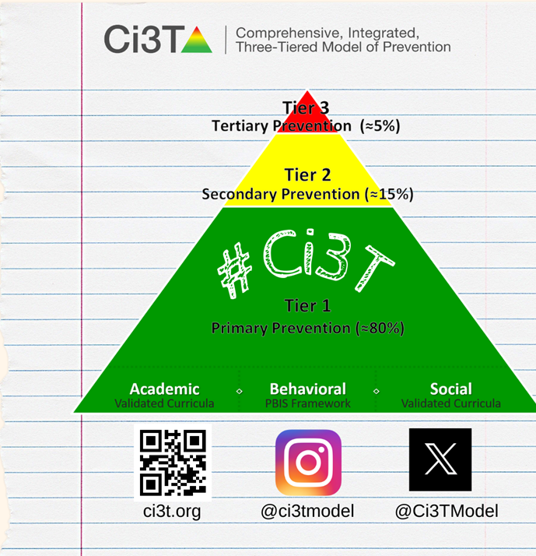
Let’s Connect on Social Media!
Tag us in your Ci3T highlights- we’d love to see Ci3T in action!
Follow us on Twitter or Instagram for updates and links to resources!
  @Ci3TModel

Slide 5
Ci3T Professional Learning Calendar
 | 0 | 1 | 2 | 3 | 4 | 5 | 6 | 7 | 8 | 9 | 10 | 11
 | July | Aug | Sep | Oct | Nov | Dec | Jan | Feb | Mar | Apr | May | Jun
Ci3T Training |  |  |  |  | Ci3T Professional Learning Series Session 1 | Ci3T Professional Learning Series Session 2 | Ci3T Professional Learning Series Session 3 | Ci3T Professional Learning Series Session 4 |  | Ci3T Professional Learning Series Session 5 | Ci3T Professional Learning Series Session 6
Ci3T Implementation Support | Ci3T Implementation Series Prep Session |  | Ci3T Implementation Series Session 1 |  | Ci3T Implementation Series Session 2 |  | Ci3T Implementation Series Session 3 |  | Ci3T Implementation Series Session 4 | Ci3T Implementation Series Session 5
Ci3T EMPOWER |  |  | Ci3T EMPOWER Session 1 | Ci3T EMPOWER Session 2 | Ci3T EMPOWER Session 3 |  | Ci3T EMPOWER Session 4 |  | Ci3T EMPOWER Session 5 | Ci3T EMPOWER Session 6
Ci3T Trainers & Coaches Calls |  | Trainers & Coaches Call Session 1 | Trainers & Coaches Call Session 2 | Trainers & Coaches Call Session 3 | Trainers & Coaches Call Session 4 | Trainers & Coaches Call Session 5 | Trainers & Coaches Call Session 6 | Trainers & Coaches Call Session 7 | Trainers & Coaches Call Session 8 | Trainers & Coaches Call Session 9 | Trainers & Coaches Call Session 10

Slide 6
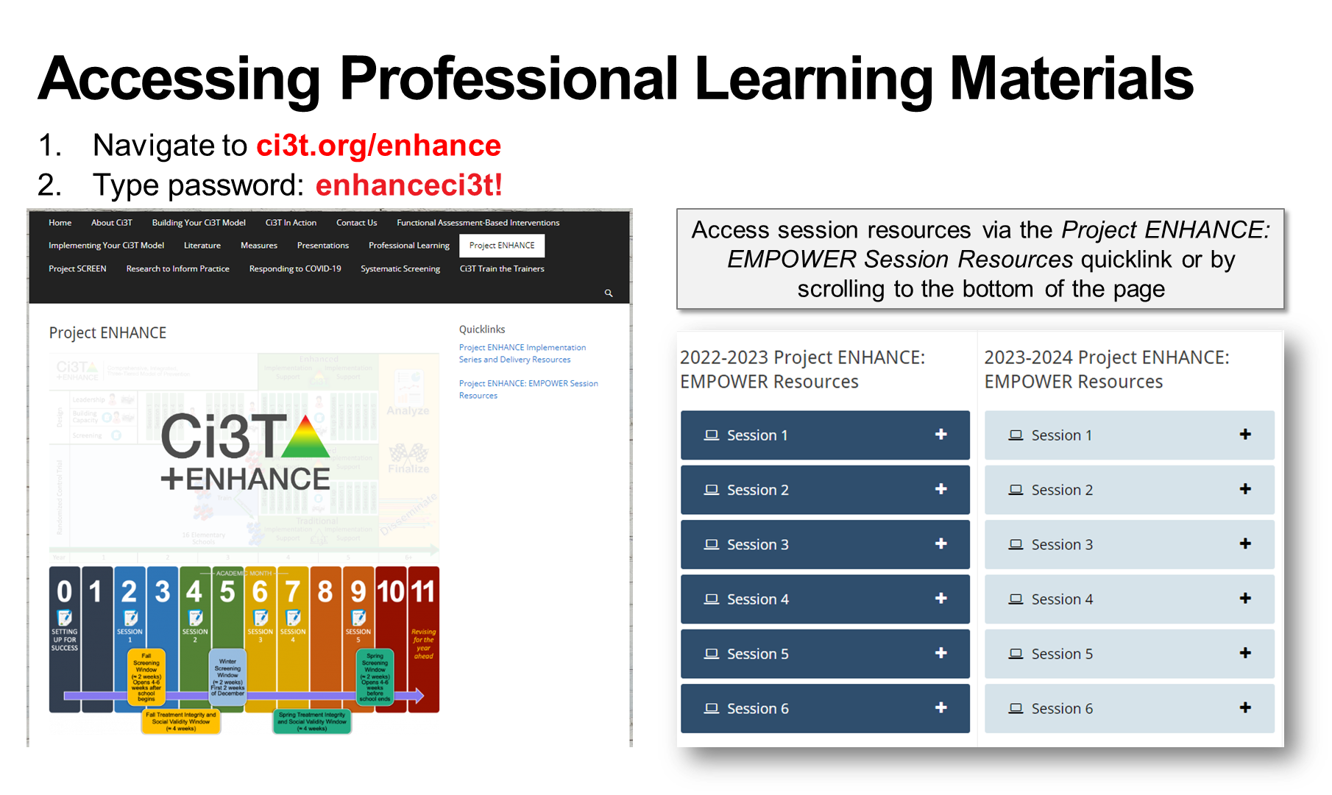

Slide 7
Agenda
Welcome
Overview of Tertiary (Tier 3) Interventions in Ci3T Models: Data-informed Decision-making
Illustrations: Supporting Students with Intensive Intervention Needs
  Supporting students with acting out behaviors
  Supporting students with internalizing issues
Exploring Other Tertiary (Tier 3) Interventions in Ci3T Models
Wrapping Up and Moving Forward

Slide 8
Welcome

Slide 9


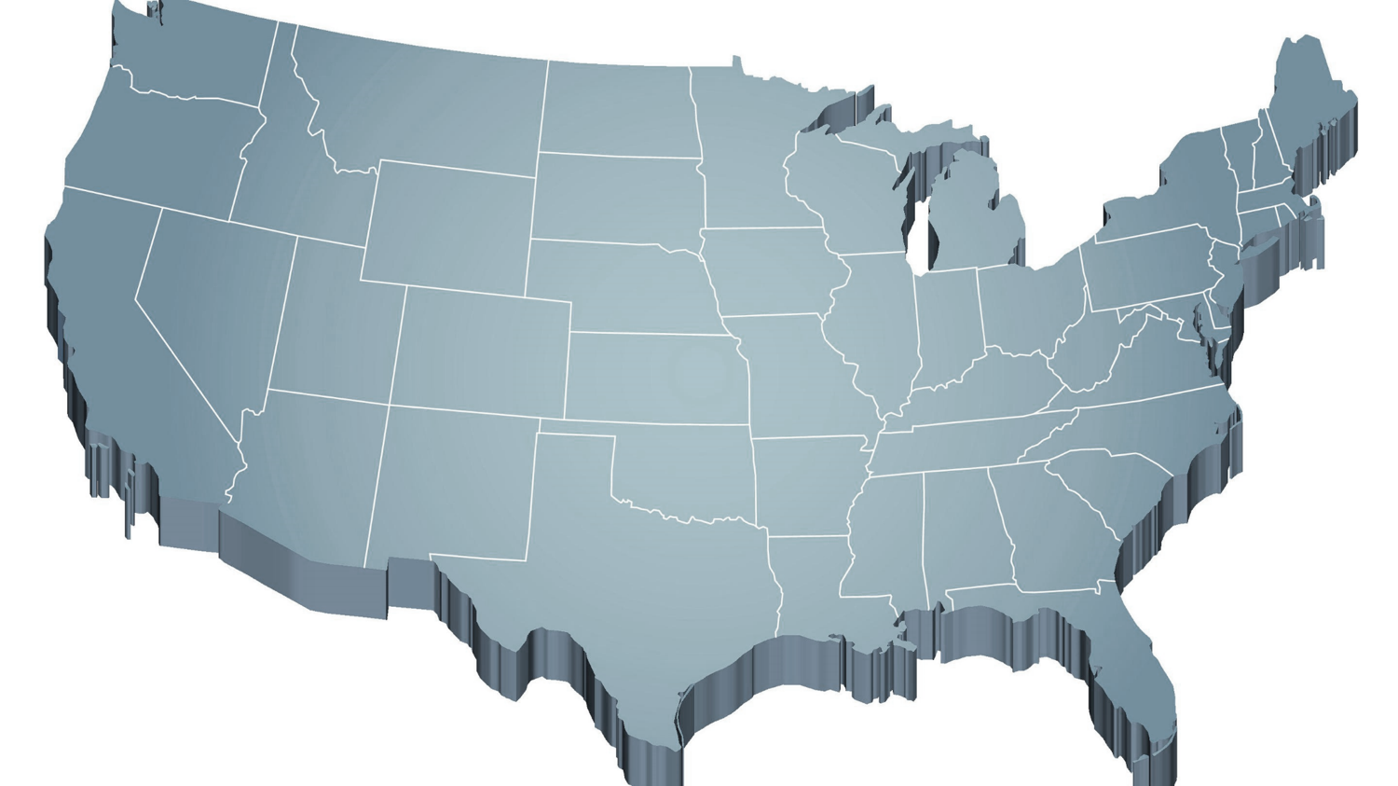


The Journey of Ci3T: Respectful Partnerships
1997
Notes:
CA & AZ start→ Tennessee → North Carolina→ Kansas
Trainings (MO, KANSAS, VERMONT, AZ)
MO, KS, UAB
HI

Slide 11
Overview of Tertiary (Tier 3) Interventions in Ci3T Models: Data-informed Decision-making

Slide 12
Comprehensive, Integrated, Three-Tiered Model of Prevention
(Lane, Kalberg, & Menzies, 2009)
Tier 3
Tertiary Prevention (≈5%)
Tier 2
Secondary Prevention (≈15%)
Tier 1
Primary Prevention (≈80%)
Academic ◇ Behavioral ◇ Social
Validated Curricula PBIS Framework Validated Curricula

Slide 13



Ci3T Implementation Manual

Slide 14
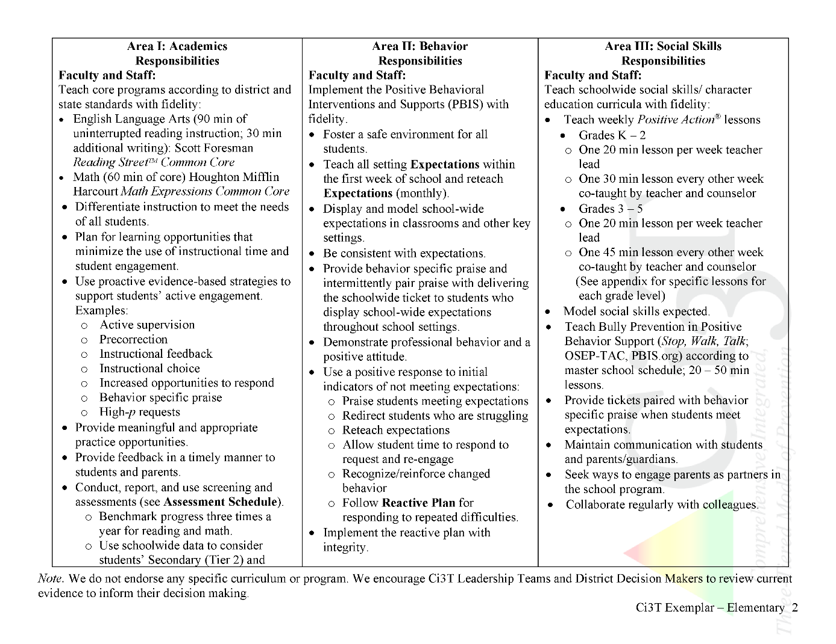
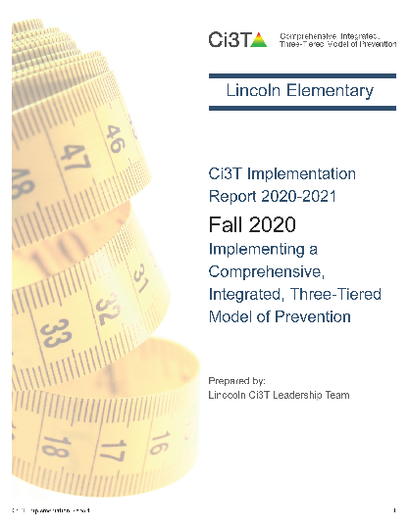
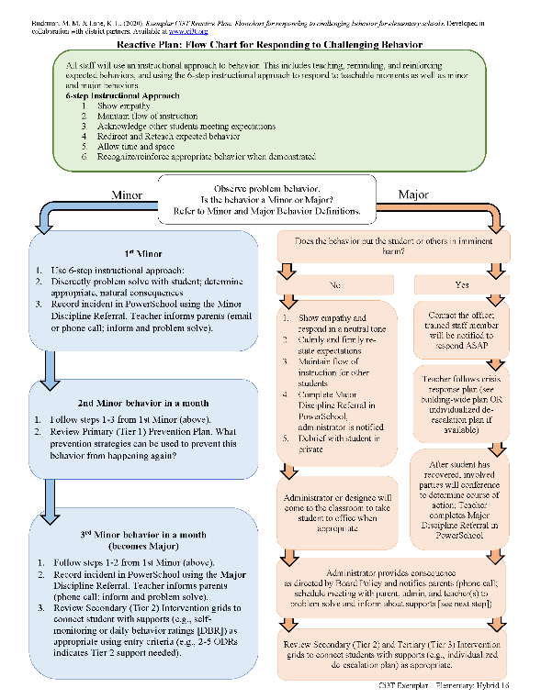
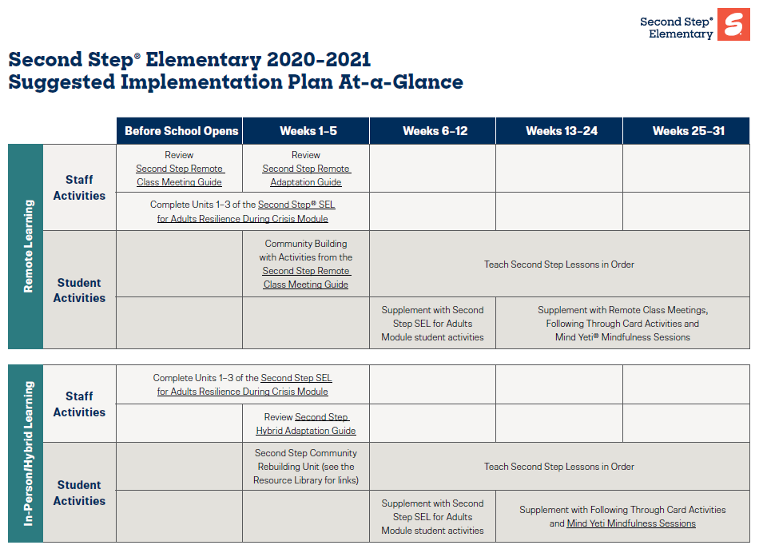

Ci3T Primary Plan: Procedures for Teaching
Opportunities to Respond
Behavior-Specific Praise
Ci3T Primary Plan: Procedures for Reinforcing
Active Supervision
Instructional Feedback
High-p Requests
Ci3T Primary Plan: Procedures for Monitoring
Precorrection
Instructional Choice
Notes:
Continued to keep implementation manuals, which are foundational to Ci3T, updated and current

Slide 15
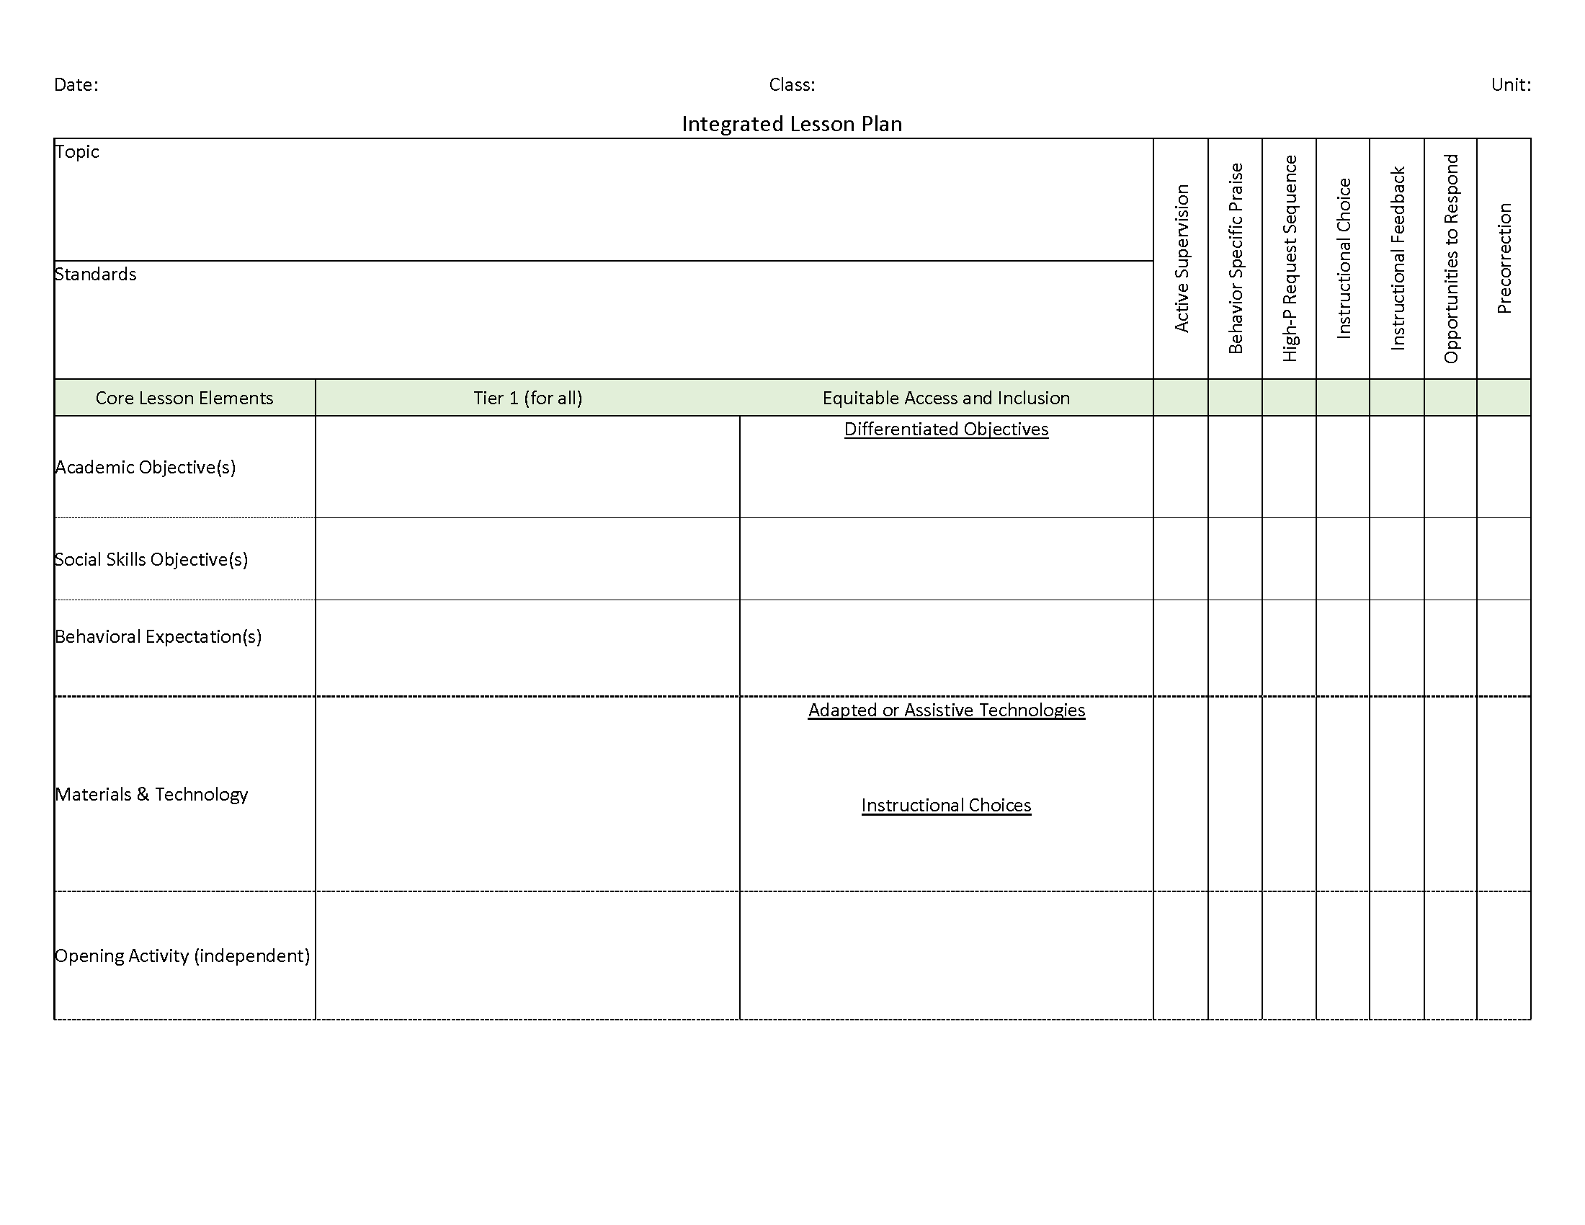
Ci3T: Integrated Lesson Planning

Slide 16
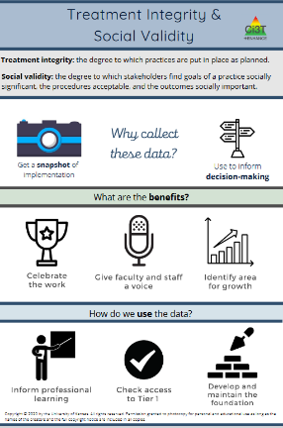

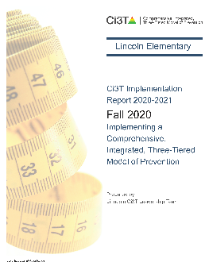
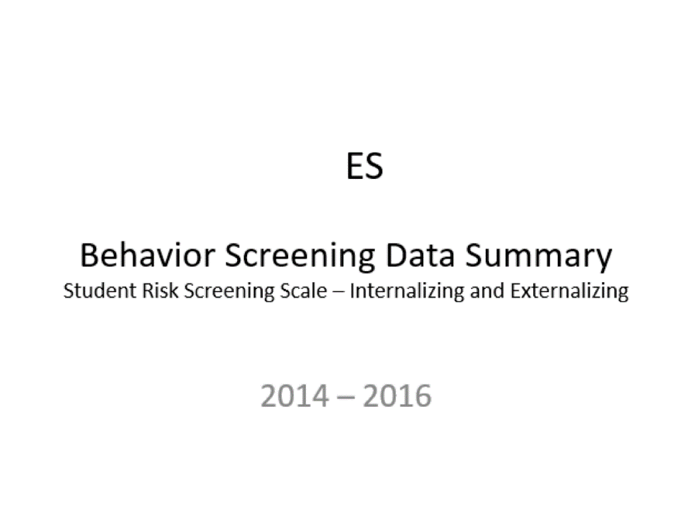
Essential Components of
Primary Prevention Efforts
Social Validity
Systematic Screening
Academic
Behavior
Treatment Integrity
ci3t.org/measures
Notes:
Infographic - https://www.ci3t.org/measures

Slide 17


Slide 18


Slide 19
Comprehensive, Integrated, Three-Tiered Model of Prevention
(Lane, Kalberg, & Menzies, 2009)
Tier 3
Tertiary Prevention (≈5%)
Tier 2
Secondary Prevention (≈15%)
Tier 1
Primary Prevention (≈80%)
Academic ◇ Behavioral ◇ Social
Validated Curricula PBIS Framework Validated Curricula

Slide 20
Winter 2022
SRSS-Externalizing Results – Elementary School Level
n = 66
n = 44
n = 33
n = 35
n = 38
n = 37
n = 2
n = 17
n = 32
n = 32
n = 69
n = 74
n = 128
n = 109
n = 97
n = 92
n = 101
n = 125
n = 305
n = 297
n = 287
n = 332
n = 309
n = 263
n = 294
n = 346
n = 355
Notes:
***note to presenter*** If you would like to feature middle or high school data – hide the elementary slides (20-21) and unhide the middle or high school slides
If you would like to update this slide with data from your school or district- Fill in <year> based on current academic year. This is located in column A of the data sheet. Edit by right clicking and selecting “Edit data”.

Slide 21
Winter 2022
SRSS-Internalizing Results – Elementary School Level
n = 75
n = 46
n = 29
n = 41
n = 35
n = 25
n = 16
n = 40
n = 38
n = 27
n = 65
n = 69
n = 59
n = 48
n = 69
n = 72
n = 87
n = 86
n = 334
n = 337
n = 335
n = 354
n = 354
n = 328
n = 285
n = 346
n = 351
Notes:
If you would like to update this slide with data from your school or district- Fill in <year> based on current academic year. This is located in column A of the data sheet. Edit by right clicking and selecting “Edit data”.

Slide 22
Winter 2022
SRSS-Externalizing Results – Middle School Level
n = 21
n = 27
n = 27
n = 13
n = 6
n = 17
n = 26
n = 47
n = 96
n = 68
n = 71
n = 53
n = 42
n = 54
n = 491
n = 448
n = 383
n = 346
n = 445
n = 518
n = 527
Notes:
If you would like to update this slide with data from your school or district- Fill in <year> based on current academic year. This is located in column A of the data sheet. Edit by right clicking and selecting “Edit data”.

Slide 23
Winter 2022
SRSS-Internalizing Results – Middle School Level
n = 79
n = 52
n = 54
n = 60
n = 23
n = 44
n = 42
n = 41
n = 37
n = 40
n = 32
n = 45
n = 30
n = 31
n = 55
n = 70
n = 306
n = 312
n = 356
n = 342
n = 349
n = 351
n = 432
n = 229
Notes:
If you would like to update this slide with data from your school or district- Fill in <year> based on current academic year. This is located in column A of the data sheet. Edit by right clicking and selecting “Edit data”.

Slide 24
Winter 2022
SRSS-Externalizing Results – High School Level
n = 47
n = 72
n = 36
n = 36
n = 40
n = 8
n = 17
n = 38
n = 119
n = 113
n = 47
n = 137
n = 134
n = 114
n = 90
n = 65
n = 1259
n = 1280
n = 1188
n = 994
n = 447
n = 717
n = 750
n = 920
Notes:
If you would like to update this slide with data from your school or district- Fill in <year> based on current academic year. This is located in column A of the data sheet. Edit by right clicking and selecting “Edit data”.

Slide 25
Winter 2022
SRSS-Internalizing Results – High School Level
n = 165
n = 106
n = 83
n = 99
n = 55
n = 65
n = 52
n = 87
n = 73
n = 65
n = 50
n = 34
n = 59
n =48
n = 56
n = 167
n = 1111
n = 1307
n = 1109
n = 1000
n = 445
n = 691
n = 710
n = 923
Notes:
If you would like to update this slide with data from your school or district- Fill in <year> based on current academic year. This is located in column A of the data sheet. Edit by right clicking and selecting “Edit data”.

Slide 27


Building a Ci3T Tier Library
Teacher Delivered Strategies
Tier 1
Tier 2
Tier 3

Slide 28
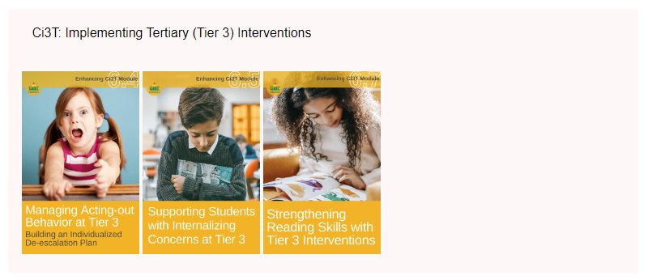

Slide 29
Illustrations: Supporting Students with Intensive Intervention Needs
Supporting students with acting out issues
Supporting students with internalizing behaviors

Slide 30


Illustrations: Supporting Students with Intensive Intervention Needs
Supporting students with acting out issues
Supporting students with internalizing behaviors

Slide 32
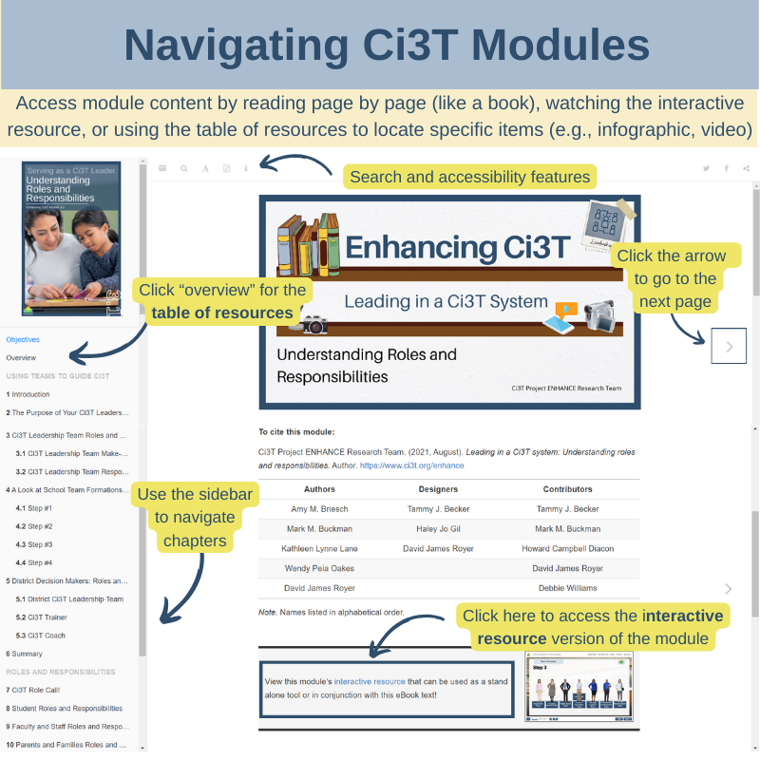

Slide 33
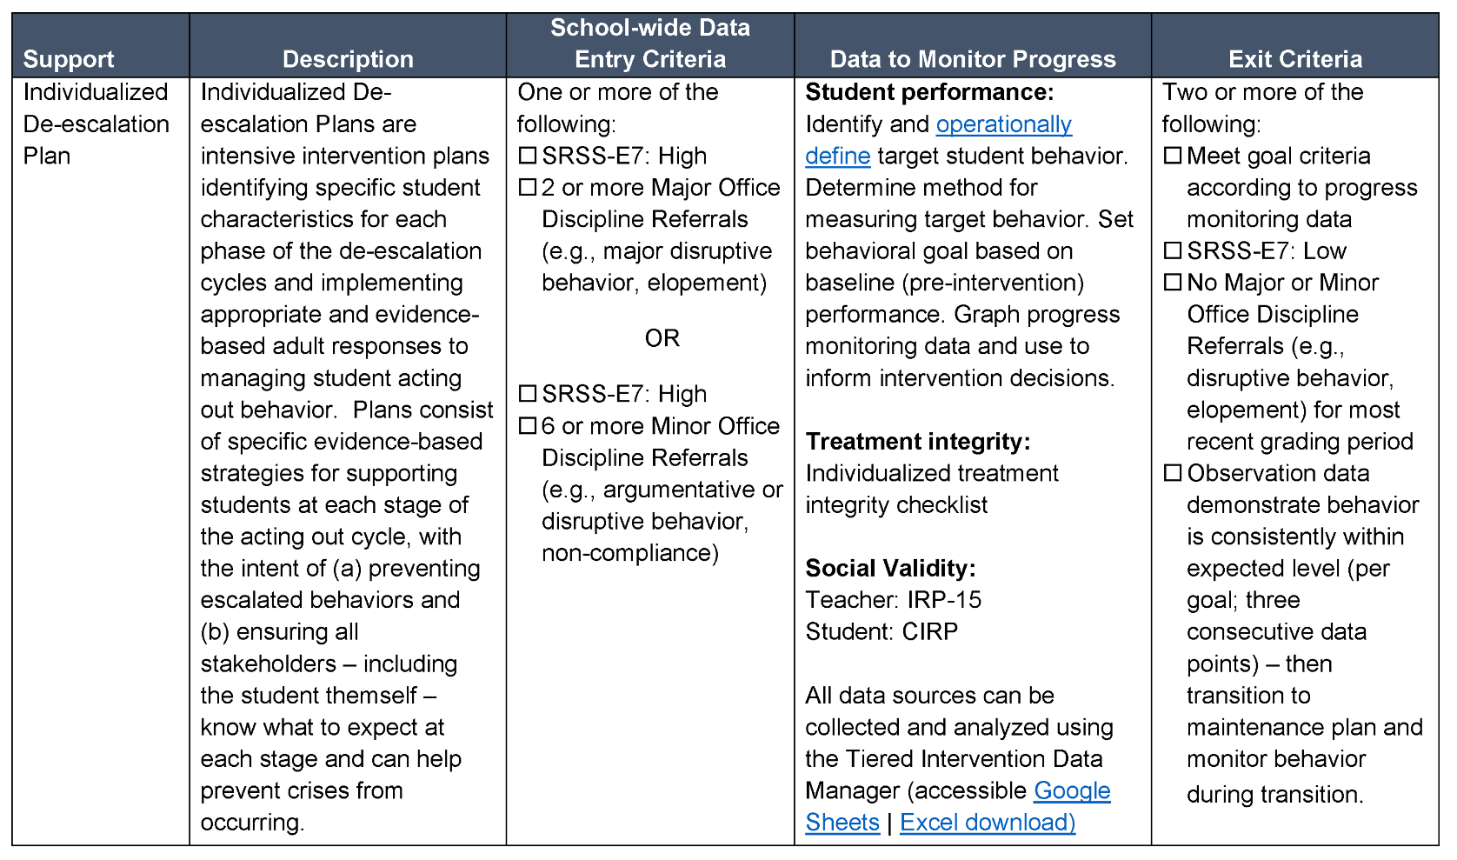
Sample Intervention Grid

Slide 34
Antecedents -Behavior - Consequences
Function!
A
B
C
Precorrection: Identifies predictable contexts that often result in problem behavior and provides students with supports, prompts, and reinforcement for engaging in appropriate behavior

Slide 35
Managing Acting Out Behaviors
ED … <1%
EBD … 12%
Classrooms are becoming increasingly more diverse
  Culturally
  Academically
  Behaviorally
  Social skill sets
  (Lane, Wehby, & Robertson, 2008)
  Students with exceptionalities are accommodated in inclusive settings (MacMillian, Gresham, & Forness, 1996)

Slide 36
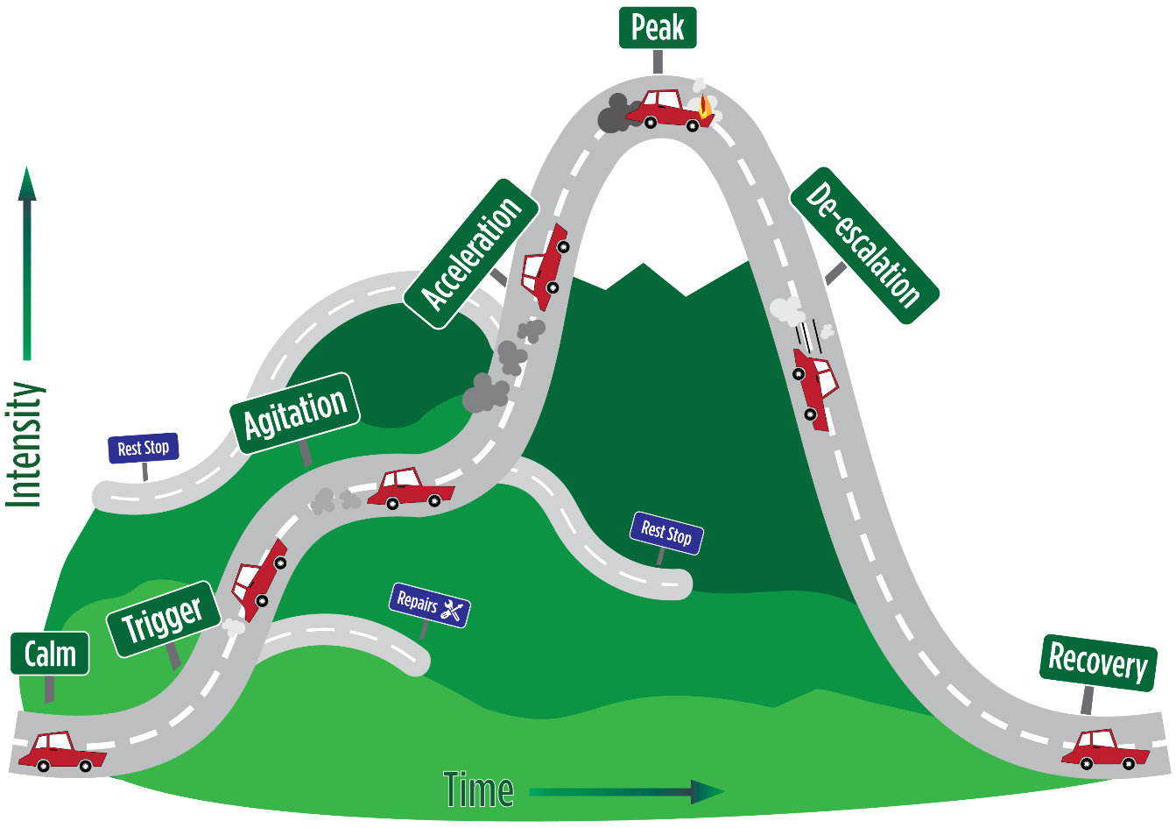
Whether the problem behavior is managed safely or not
or is defused
in a large measure depends on
YOUR INITIAL RESPONSE
-Dr. Geoff Colvin

Slide 37








Behavior Chains
Each ensuing behavior in a given behavior chain becomes more serious than the one preceding it.
(Walker, Ramsey, & Gresham, 2004)

Slide 38


Change the Behavioral Momentum
(Nevin, 1970)
Interrupt the behavioral chain at any time to prevent the occurrence of more serious types of behavior.

Slide 39
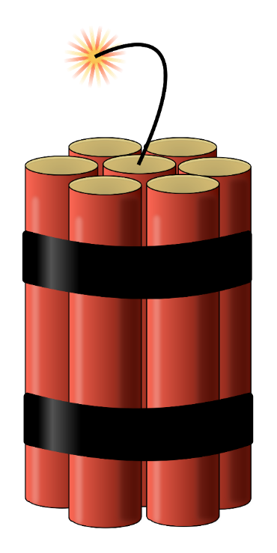
Stages of the Acting Out Cycle
Colvin (1992)
Calm
Triggers
Agitation
Acceleration
Peak
De-Escalation
Recovery

Slide 40

Managing Acting Out Behavior: Seven Phases

Slide 41
Phase 1: Calm

Slide 42

Phase 1: Calm
Overall behavior is cooperative, compliant, and desirable.
Academically Engaged
Following Rules & Expectations
Responsive to Praise and Feedback
Initiates Interactions
Goal Directed Behaviors
Colvin, G., & Scott, T. (2015). Managing the cycle of acting-out behavior in the classroom (2nd Edition). Thousand Oaks, CA: Corwin.

Slide 43
Strategies
Intervention is focused on proactive strategies. Focus on instruction and positive behavior support.
Implement the schoolwide Ci3T plan
Implement low-intensity teacher-delivered strategies (e.g. precorrection, active supervision, behavior specific praise, instructional choice)
Carefully plan instruction with a focus on differentiation and integrated lesson plans
Re-teach expectations and implement clear routines and procedures
Colvin, G., & Scott, T. (2015). Managing the cycle of acting-out behavior in the classroom (2nd Edition). Thousand Oaks, CA: Corwin.

Slide 44
Pitfalls
Teacher hesitation to engage with a student who has a history of explosive behavior (“I’m nervous about saying anything that could set him off”)
Colvin, G., & Scott, T. (2015). Managing the cycle of acting-out behavior in the classroom (2nd Edition). Thousand Oaks, CA: Corwin.

Slide 45
Phase 2: Trigger

Slide 46
Phase 2: Trigger
Overall behavior involve a series of unresolved problems.
School-Based Triggers
Non-School-Based Triggers
Conflicts
Changes in routine
Provoked by peers
Pressure or stress
Limited problem-solving skills
Facing Errors in Instruction
Facing Correction Procedures
Denial of Something Needed
Uncertain home life
Medical and health complications
Food insecurity
Inadequate sleep
Substance abuse
Commitments to gangs or unhealthy peer groups
Colvin, G., & Scott, T. (2015). Managing the cycle of acting-out behavior in the classroom (2nd Edition). Thousand Oaks, CA: Corwin.

Slide 47
Strategies
Intervention is focused on prevention and redirection.
Identify the situation(s) where the behavior is likely to occur
Use low-intensity teacher-delivered strategies to prevent triggers from occurring and/or help students manage triggers effectively
Rehearse the expectations, prompt or remind students as needed, provide specific praise and reinforcement
Consider additional Tier 2 supports to build academic skills, social skills, or other self-regulation skills
Work with families for outside supports of non-school-based triggers
Colvin, G., & Scott, T. (2015). Managing the cycle of acting-out behavior in the classroom (2nd Edition). Thousand Oaks, CA: Corwin.

Slide 48


Slide 49
Pitfalls
Ensure that students’ strengths (as well as areas of concern) are centered when partnering with families
Avoid assigning blame for triggering events or circumstances
Ensure you consider and plan to address all triggers

Slide 50
Phase 3: Agitation

Slide 51
Phase 3: Agitation
Overall behavior is unfocused, off task, and distracted.
Increases in Behavior
Decreases in Behavior
Busy hands (tapping fingers on a desk; rubbing their clothing)
Darting eyes (shifting attention rapidly, looking about with little focus)
Joining and leaving groups
Rapidly moving between being on- and off-task
Non-conversational language (e.g., grunts, very few words used in response to questions)
Staring off (day dreaming, appearing “lost in thought”)
Averting eye contact (looking downward, pulling a hoody sweatshirt over their head)
Contained hands (hands clasped or behind their back)
Social withdrawal
Colvin, G., & Scott, T. (2015). Managing the cycle of acting-out behavior in the classroom (2nd Edition). Thousand Oaks, CA: Corwin.

Slide 52
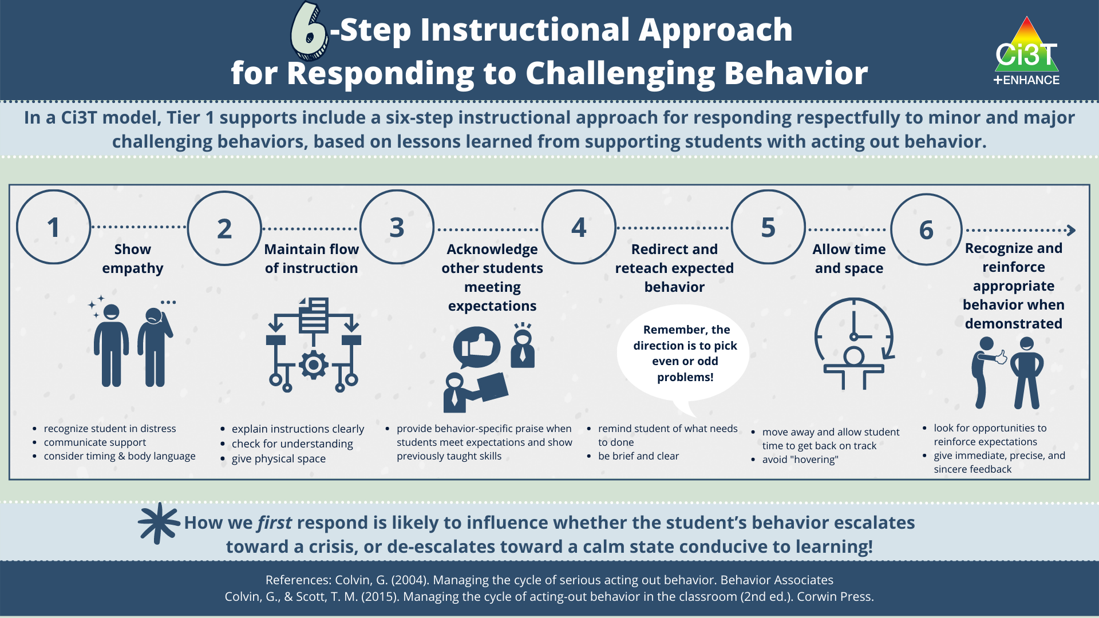
Strategies
Intervention is focused on reducing anxiety.
Follow the 6-Step Instructional Approach for Responding to Challenging Behavior
Colvin, G., & Scott, T. (2015). Managing the cycle of acting-out behavior in the classroom (2nd Edition). Thousand Oaks, CA: Corwin.

Slide 53
Pitfalls
Remember – this is an opportunity for students to practice self-reflection, choice-making, goal setting, and self-regulation
While it might be nerve-wracking – don’t skip step 6 (acknowledging the student when they’re back on track)
Colvin, G., & Scott, T. (2015). Managing the cycle of acting-out behavior in the classroom (2nd Edition). Thousand Oaks, CA: Corwin.

Slide 54
Phase 4: Acceleration

Slide 55
Phase 4: Acceleration
Overall behavior is teacher-engaging.
Argumentative
Non-compliant and defiant
Un-engaged
Provoking peers or teachers
Compliance with accompanying inappropriate behaviors (e.g. completing a worksheet but also writing inappropriate words at the top)
Criterion problems (e.g. marking every answer “I don’t know)
Whining
Avoidance and escape
Threatening
Minor destruction of property
Verbal abuse
Colvin, G., & Scott, T. (2015). Managing the cycle of acting-out behavior in the classroom (2nd Edition). Thousand Oaks, CA: Corwin.

Slide 56
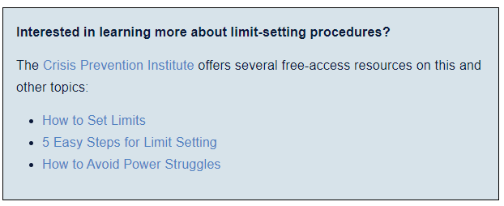
Strategies
Intervention is focused on safety.
Eliminate triggers
Approach the student in a nonthreatening manner
Prompt and then walk away.
  If student complies, provide immediate feedback acknowledging the desired behavior
Maintain calmness, respect, and detachment
Use non-confrontational limit-setting procedures
Notes:
How to Set Limits:
https://institute.crisisprevention.com/Refresh-How-to-Set-Limits.html
5 Easy Steps for Limit Setting:
https://www.crisisprevention.com/Blog/5-easy-tips-for-effective-limit-setting
How to Avoid Power Struggles:
https://www.crisisprevention.com/Blog/How-to-Avoid-Power-Struggles

Slide 57
Pitfalls
Avoid engaging with the student in anything but a neutral manner (e.g. angry, sarcastic, overly cheery)
Remain outwardly neutral, objective, calm, caring, and in control

Slide 58
Phase 5: Peak

Slide 59
Phase 5: Peak
Overall behavior is out of control.
Physical aggression
Hyperventilating
Running away (elopement)
Self-injurious behavior
Major destruction of property
Severe tantrums
Colvin, G., & Scott, T. (2015). Managing the cycle of acting-out behavior in the classroom (2nd Edition). Thousand Oaks, CA: Corwin.

Slide 60
Strategies
Focus on safety only.
Remain calm
Implement your school’s safety plan (e.g., evacuating remaining students, calling a designated person to remove the student)
Colvin, G., & Scott, T. (2015). Managing the cycle of acting-out behavior in the classroom (2nd Edition). Thousand Oaks, CA: Corwin.

Slide 61
Pitfalls
Consider what the student finds reinforcing (e.g., escaping tasks; accessing or avoiding attention) to avoid unintentionally reinforcing the peak behavior
Colvin, G., & Scott, T. (2015). Managing the cycle of acting-out behavior in the classroom (2nd Edition). Thousand Oaks, CA: Corwin.

Slide 62
Phase 6: De-Escalation

Slide 63
Phase 6: De-Escalation
Overall behavior displays confusion.
Disoriented
Denial of what just happened
Eager to make amends
Avoids interacting with others
Colvin, G., & Scott, T. (2015). Managing the cycle of acting-out behavior in the classroom (2nd Edition). Thousand Oaks, CA: Corwin.

Slide 64
Strategies
Intervention is focused on monitoring for re-escalation of behavior and helping the student move forward in a constructive manner.
Provide the student with a space to cool down that is away from other students but not punitive
Engage student in an independent task that they can easily accomplish (e.g. simple worksheet)
Monitor for health / safety of all involved
Colvin, G., & Scott, T. (2015). Managing the cycle of acting-out behavior in the classroom (2nd Edition). Thousand Oaks, CA: Corwin.

Slide 65
Pitfalls
Avoid initiating a conversation with the student that they may perceive as placing blame on them for what has happened
Colvin, G., & Scott, T. (2015). Managing the cycle of acting-out behavior in the classroom (2nd Edition). Thousand Oaks, CA: Corwin.

Slide 66
Phase 7: Recovery

Slide 67
Phase 7: Recovery
Overall behaviors focus on shifting attention away from and moving past the incident.
Eagerness for independent work or activity
Reluctance to interact or discuss the situation that occurred
Subdued behavior
Defensives and not wanting to discuss what happened
Colvin, G., & Scott, T. (2015). Managing the cycle of acting-out behavior in the classroom (2nd Edition). Thousand Oaks, CA: Corwin.

Slide 68
Strategies
Intervention is focused debriefing with the student and helping them transition back to normal activities
Debrief/rehearse problem solving routine
Positively reinforce displays of appropriate behavior
Colvin, G., & Scott, T. (2015). Managing the cycle of acting-out behavior in the classroom (2nd Edition). Thousand Oaks, CA: Corwin.

Slide 69
Debriefing Session
Facilitates transition back to task/activity… not further negative consequence.
Goal is to increase appropriate behavior
Focus on problem solving
Pinpoint events that contributed to the incident
Teach replacement behaviors
Debriefing activities and forms

Slide 70
Pitfalls
Follow through on consequences (e.g., filling out an office discipline referral, notifying a parent) while minimizing disruption to the flow of instruction
Colvin, G., & Scott, T. (2015). Managing the cycle of acting-out behavior in the classroom (2nd Edition). Thousand Oaks, CA: Corwin.

Slide 71
Tier 3: Building a De-escalation Plan

Slide 72
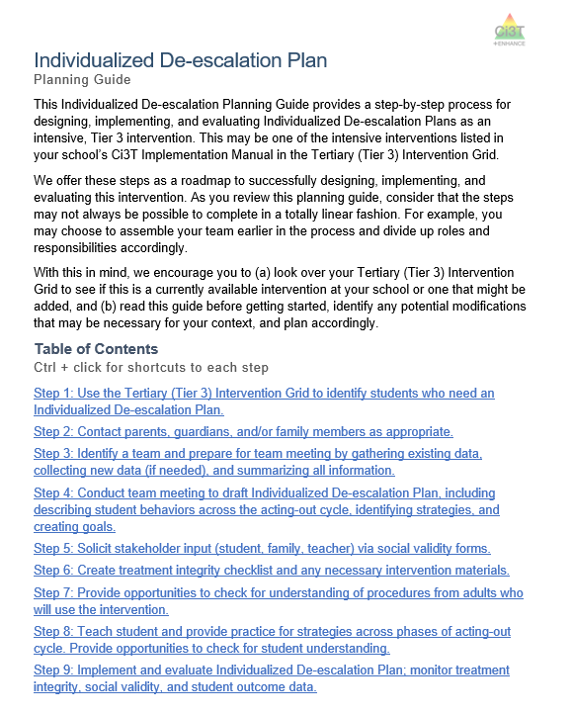
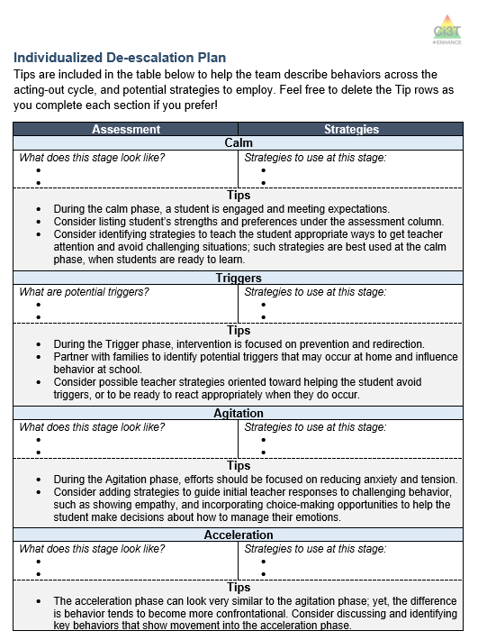
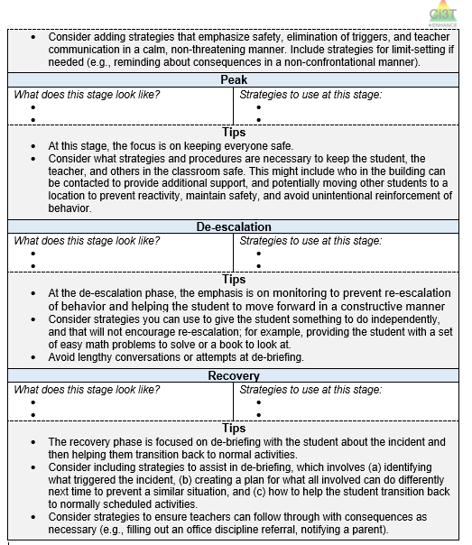
Planning

Slide 73

How do I create an individualized de-escalation plan?
Step 1
Step 3
Step 4
Use the Tertiary (Tier 3) Intervention Grid to identify students who need an Individualized De-escalation Plan
Identify a team and prepare for team meeting by gathering existing data, collecting new data (if needed), and summarizing all information
Conduct team meeting to draft Individualized De-escalation Plan, including describing student behaviors across the acting-out cycle, identifying strategies, and creating goals
Step 2
Contact parents, guardians, and/or family members as appropriate

Slide 74
How do I create an individualized de-escalation plan?
Step 5
Step 6
Step 7
Step 8
Step 9
Solicit stakeholder input (student, family, teacher) via social validity forms
Create treatment integrity checklist and any necessary intervention materials
Provide opportunities to check for understanding of procedures from adults who will use the intervention
Teach student and provide practice for strategies across phases of acting-out cycle. Provide opportunities to check for student understanding
Implement and evaluate Individualized De-escalation Plan; monitor treatment integrity, social validity, and student outcome data

Slide 75
Sample Intervention Grid

Slide 76
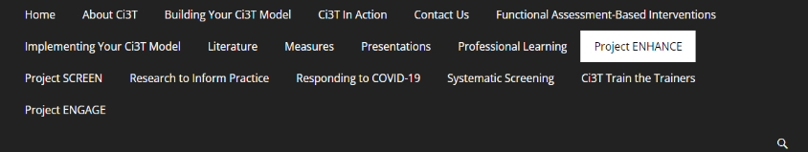












Talk Time
Is this Tier 3 intervention in your Secondary (Tier 3) Intervention Grid?
How might you use this Tier 3 intervention?
How might you share this Tier 3 intervention with others?

Slide 77
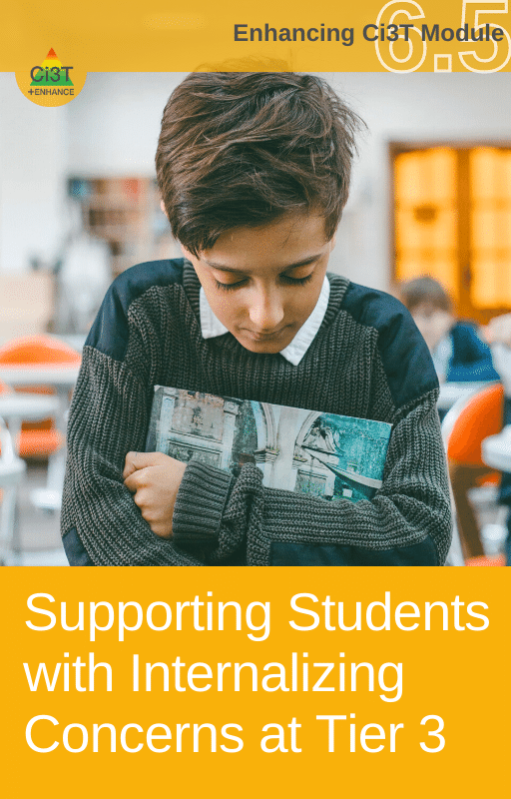

Illustrations: Supporting Students with Intensive Intervention Needs

Slide 78
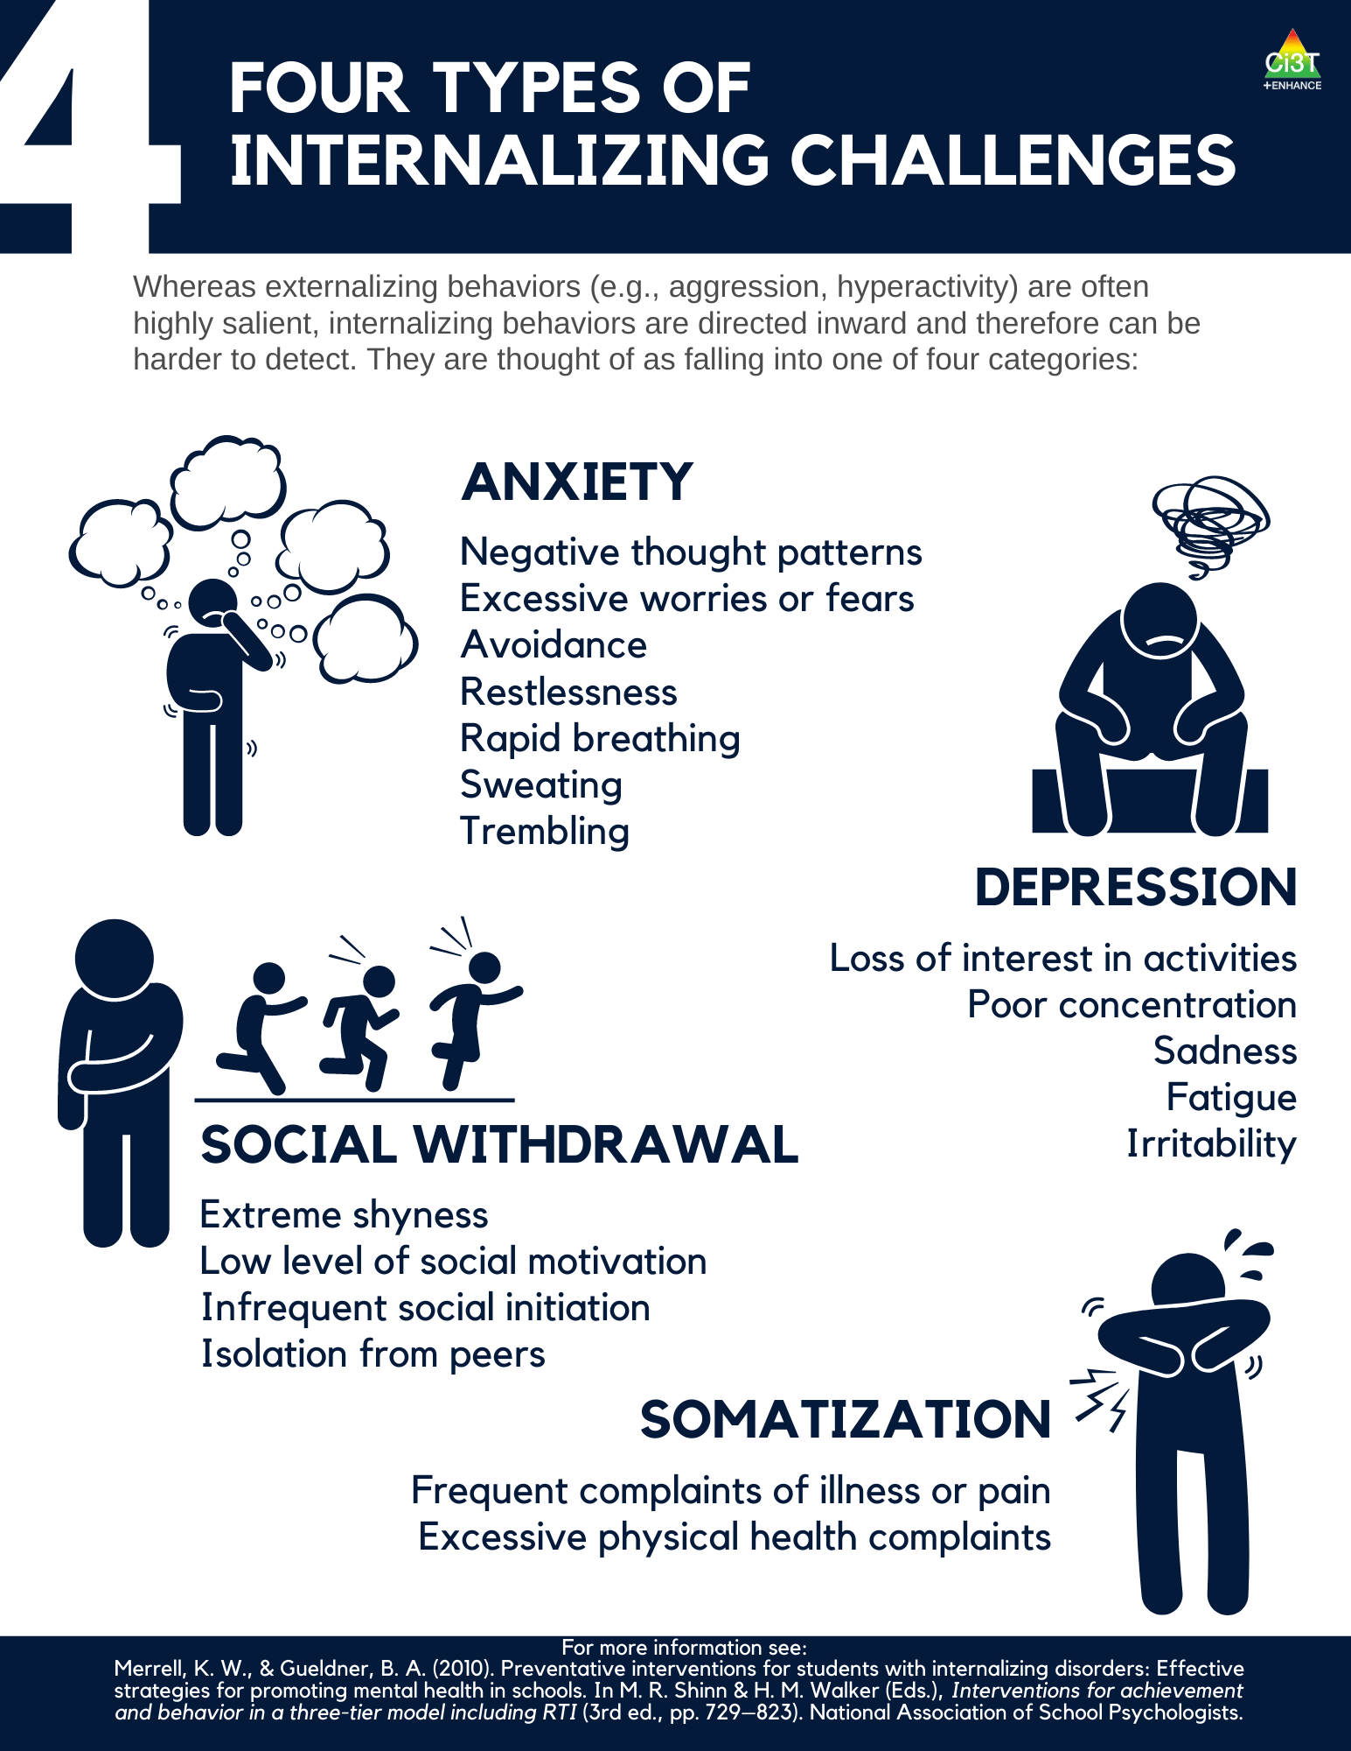
What are Internalizing Behaviors?
A mental health issue as well as a behavioral challenge
Patterns of behavior directed inward, toward the self, rather than outward upon the environment
Social and academic impairments are associated with internalizing behaviors
McIntosh, Ty, & Miller, 2014; Gresham & Kern, 2005; Morris, Shah, & Morris, 2002

Slide 81
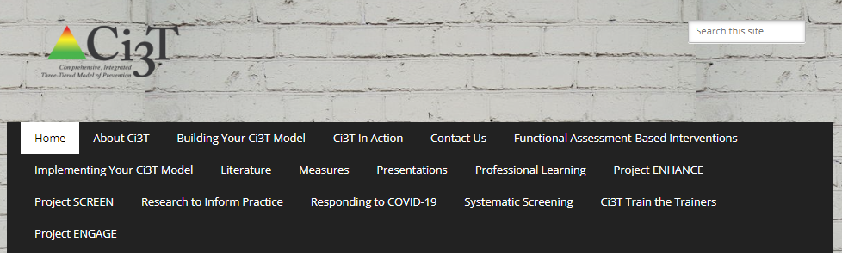
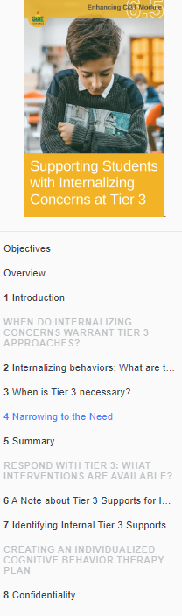
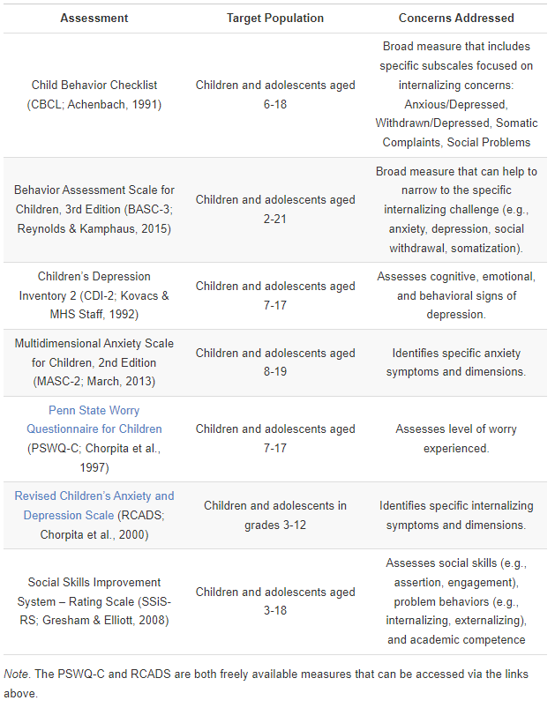
Identifying Tier 3 Supports for
Internalizing Behaviors

Slide 82
Secondary (Tier 2) Intervention Grids

Slide 83
Tertiary (Tier 3) Intervention Grids

Slide 84
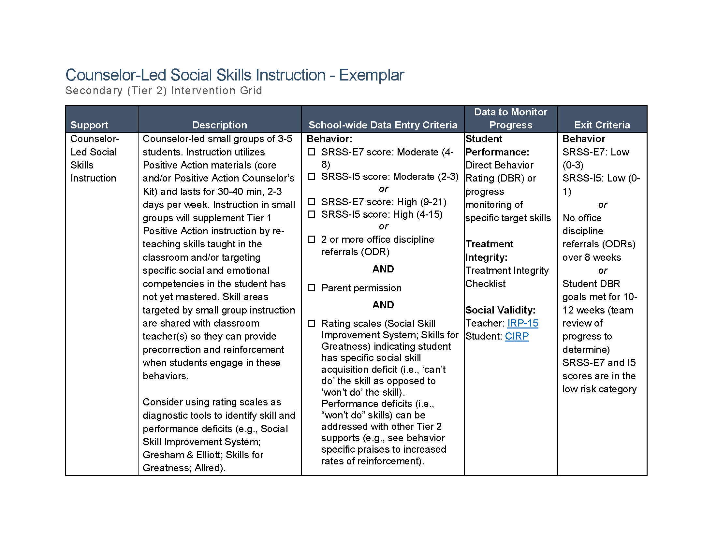
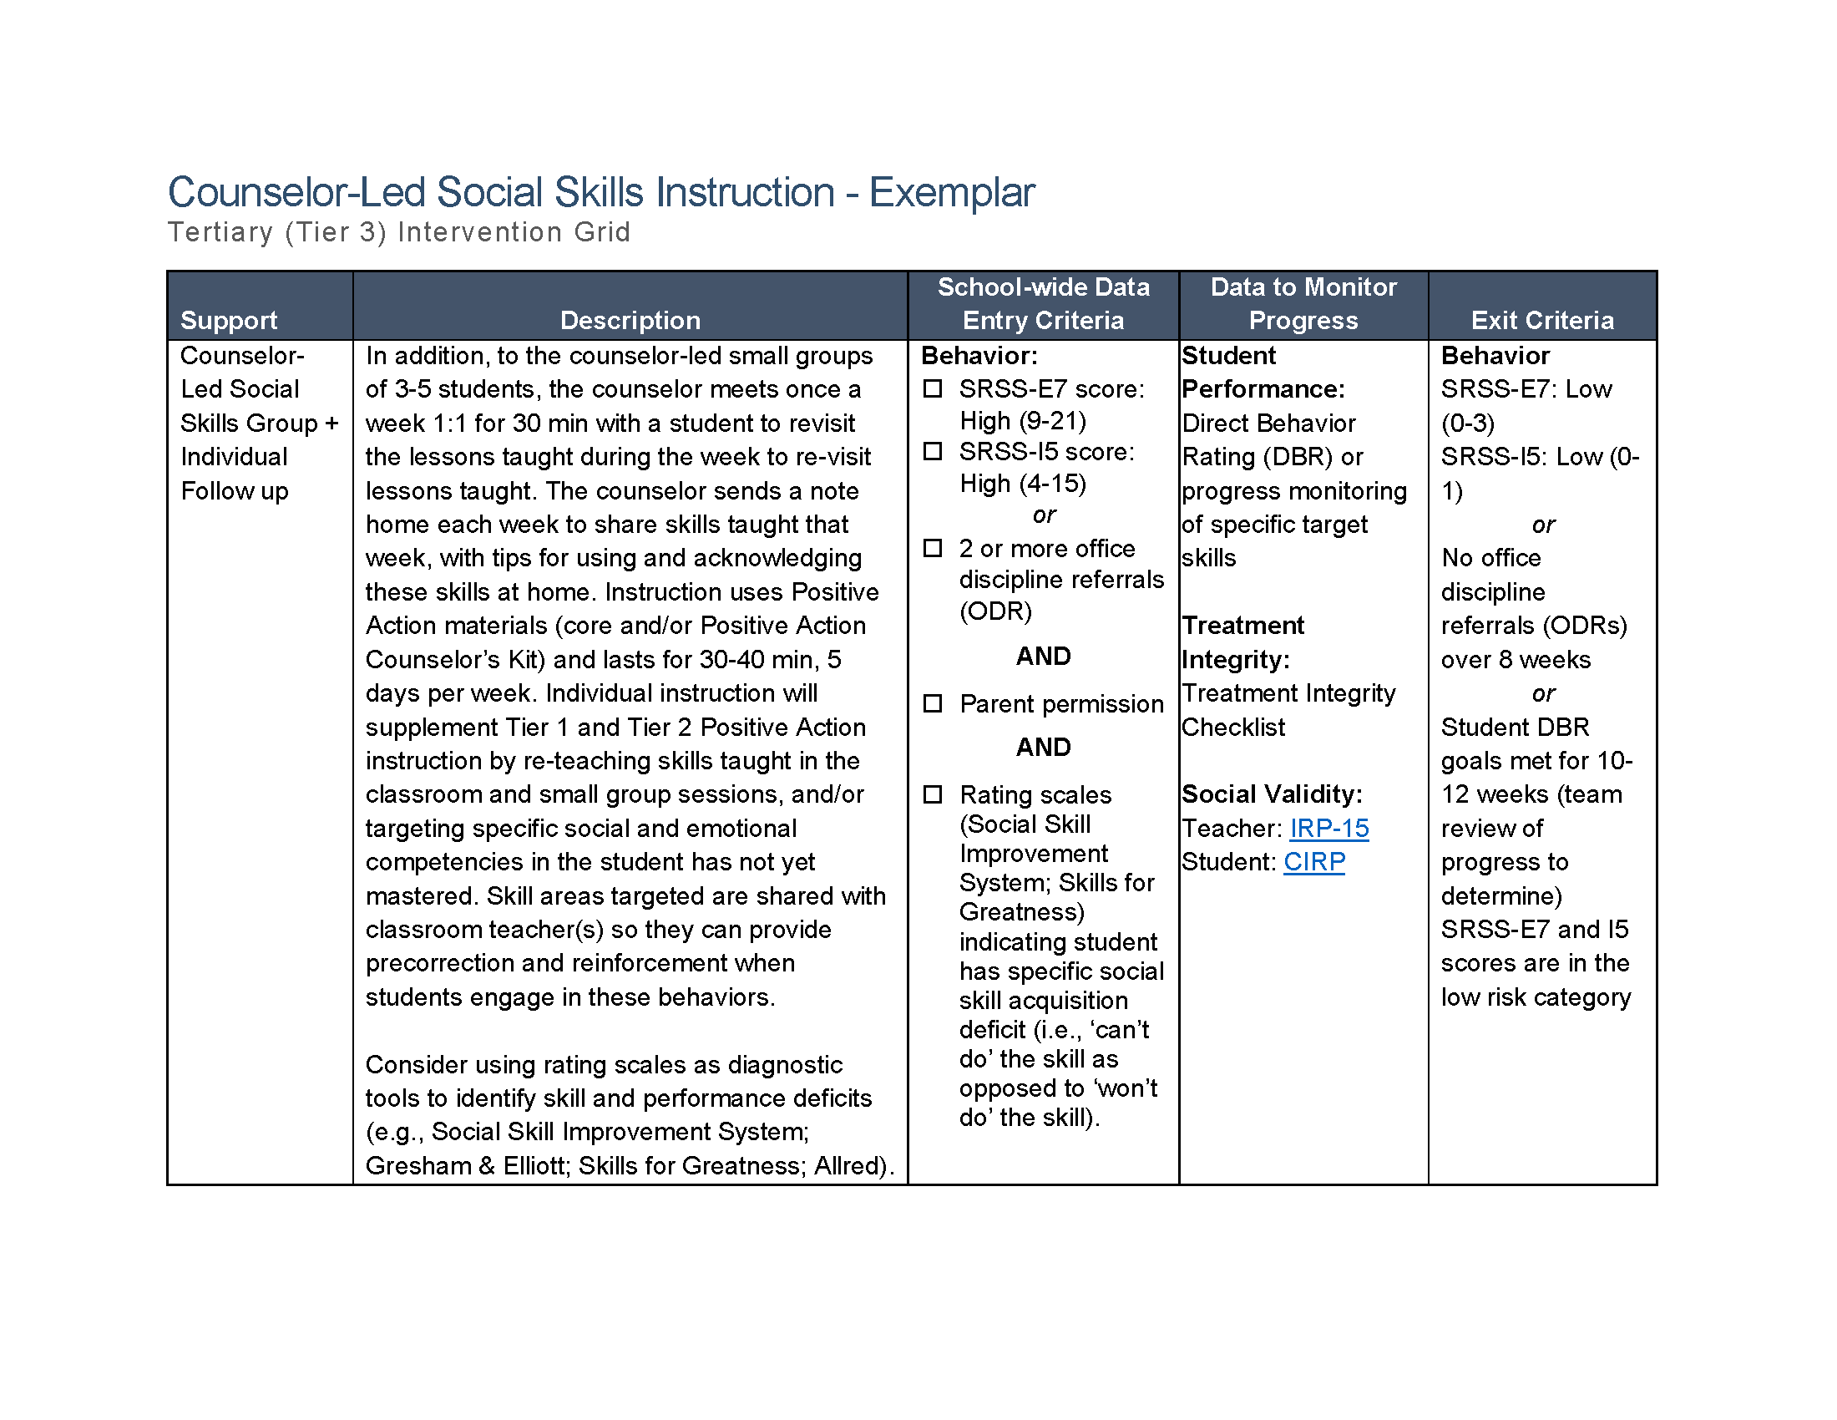

Slide 85
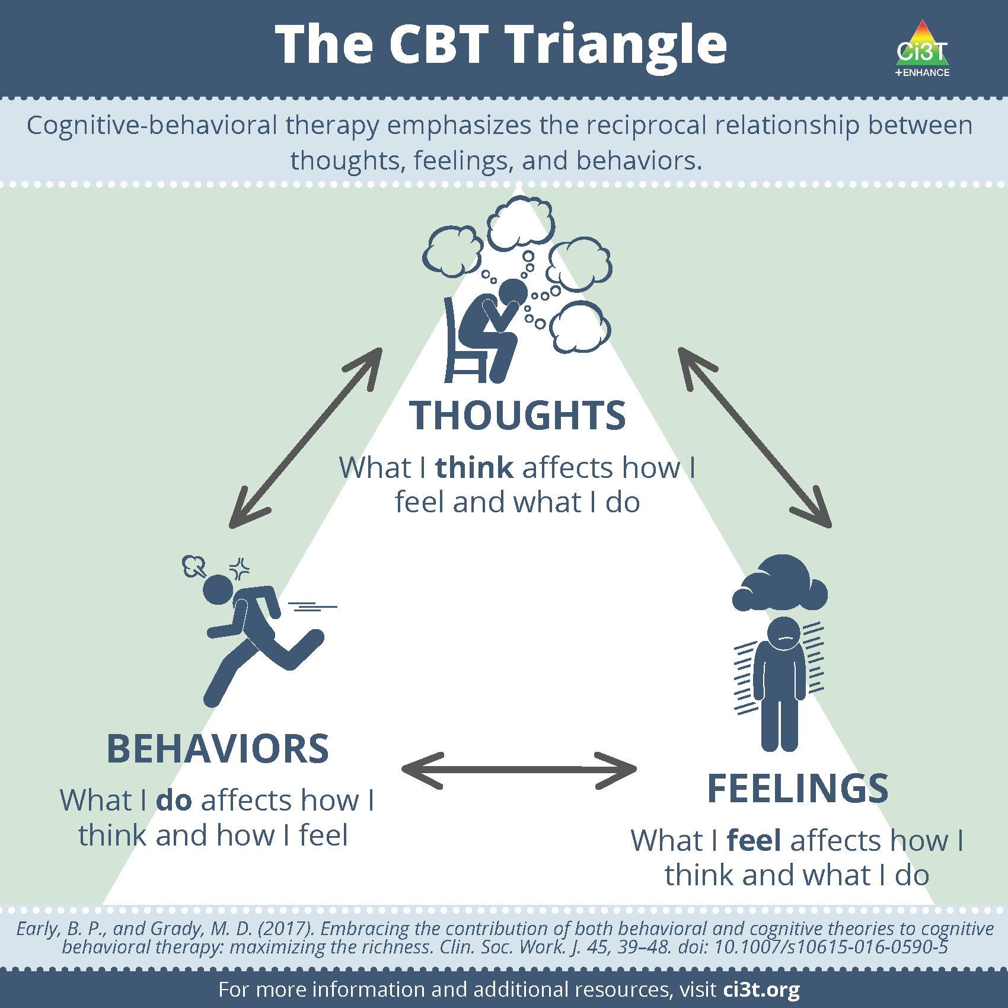

Slide 86
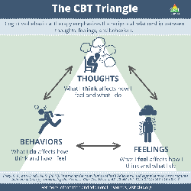
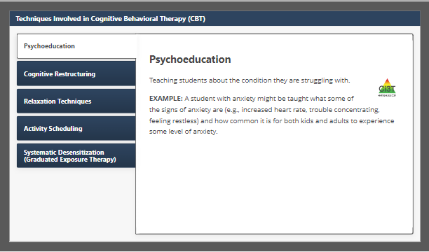

Slide 87

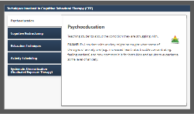

Slide 88
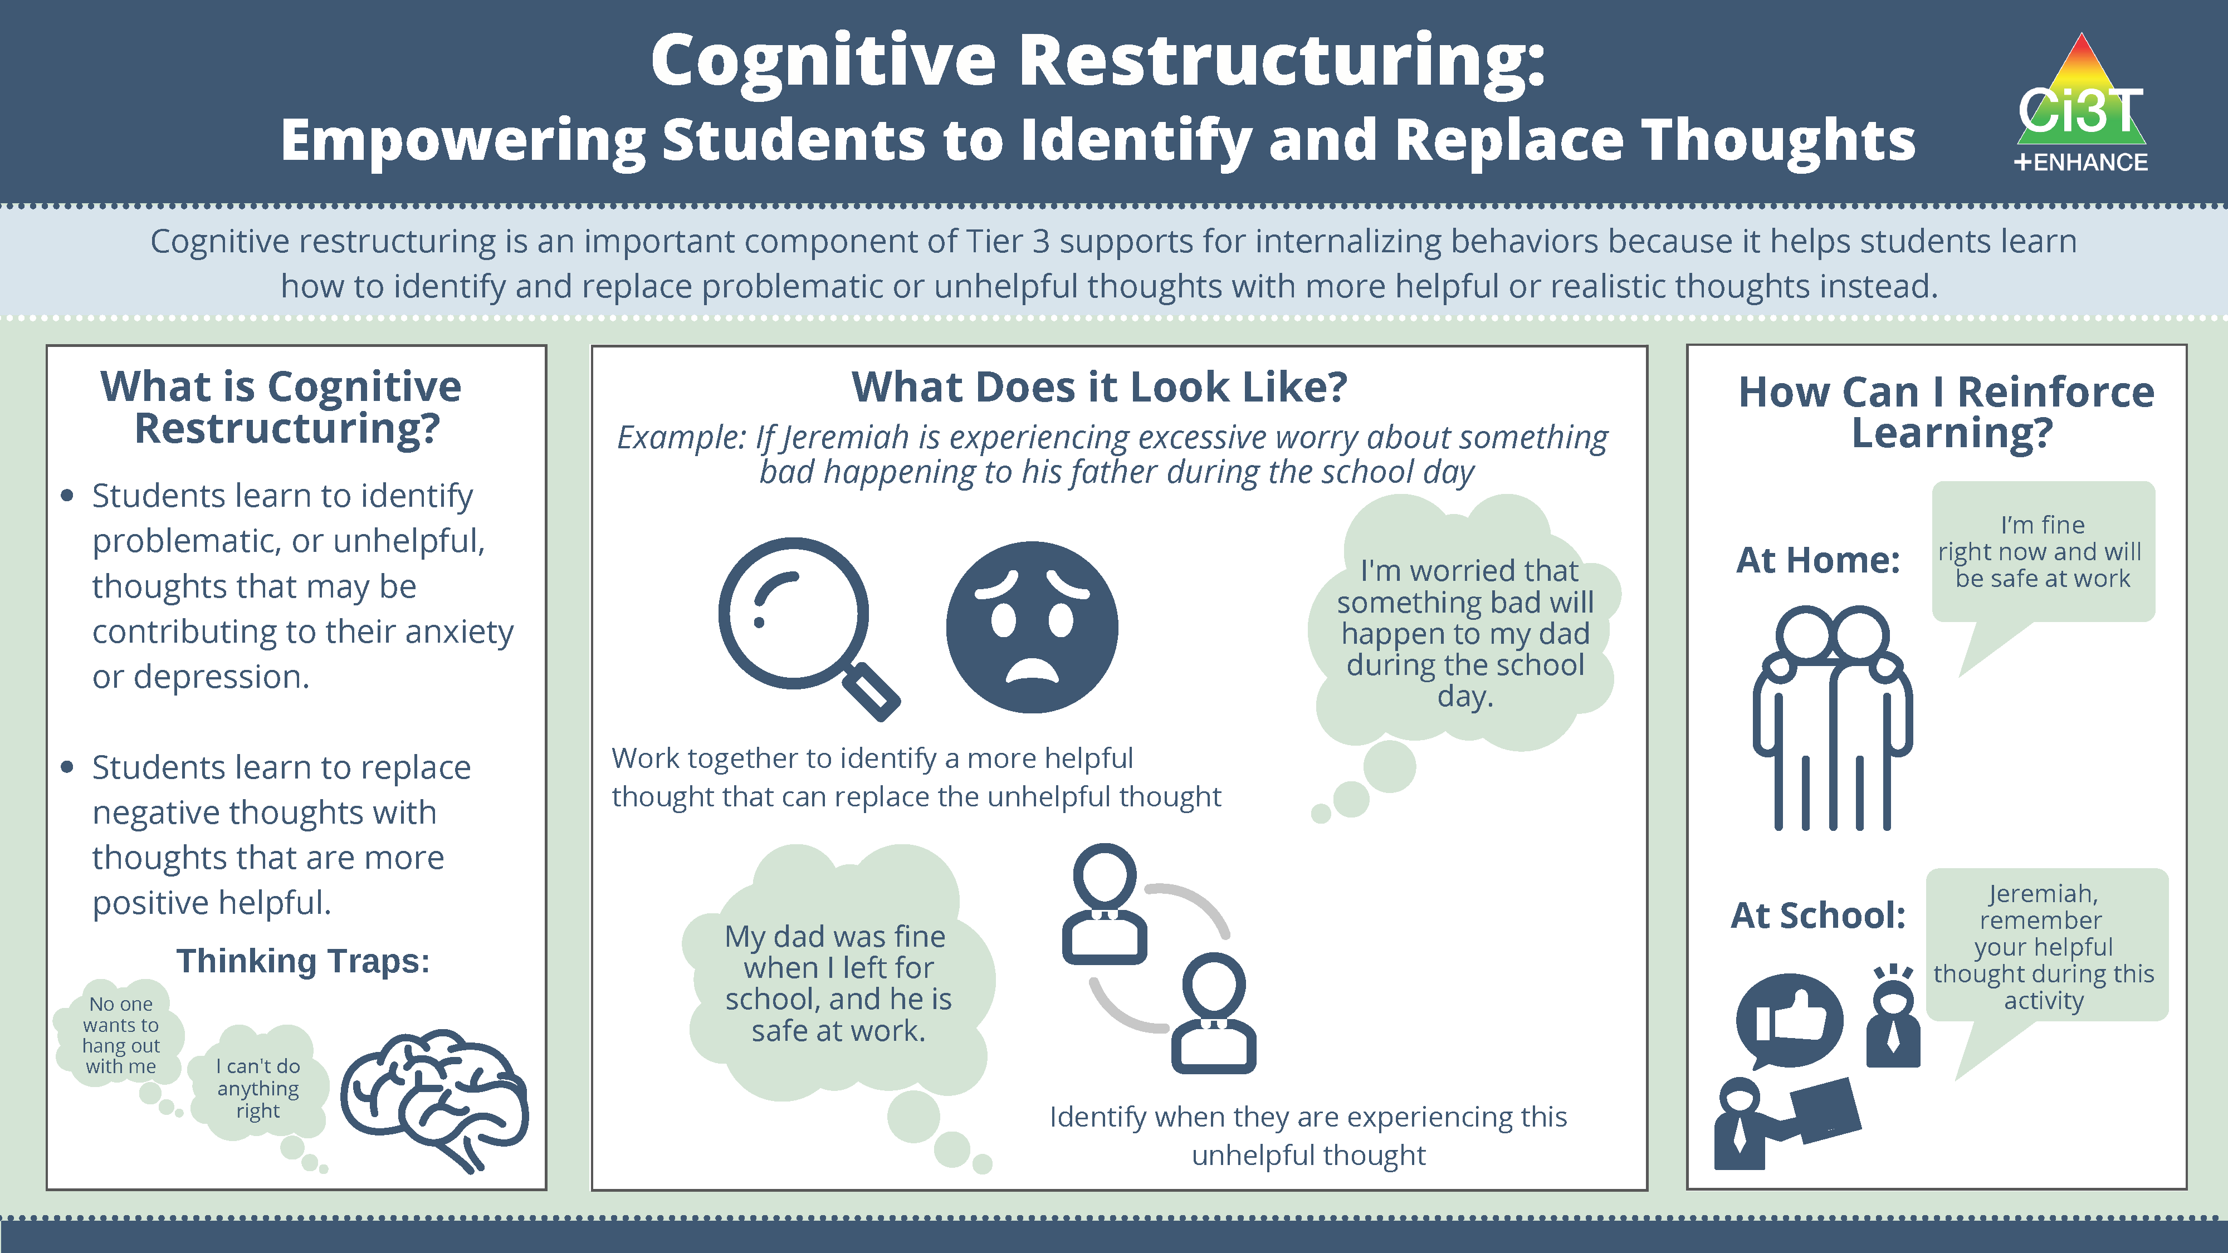
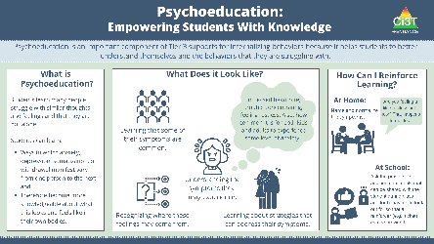

Slide 89
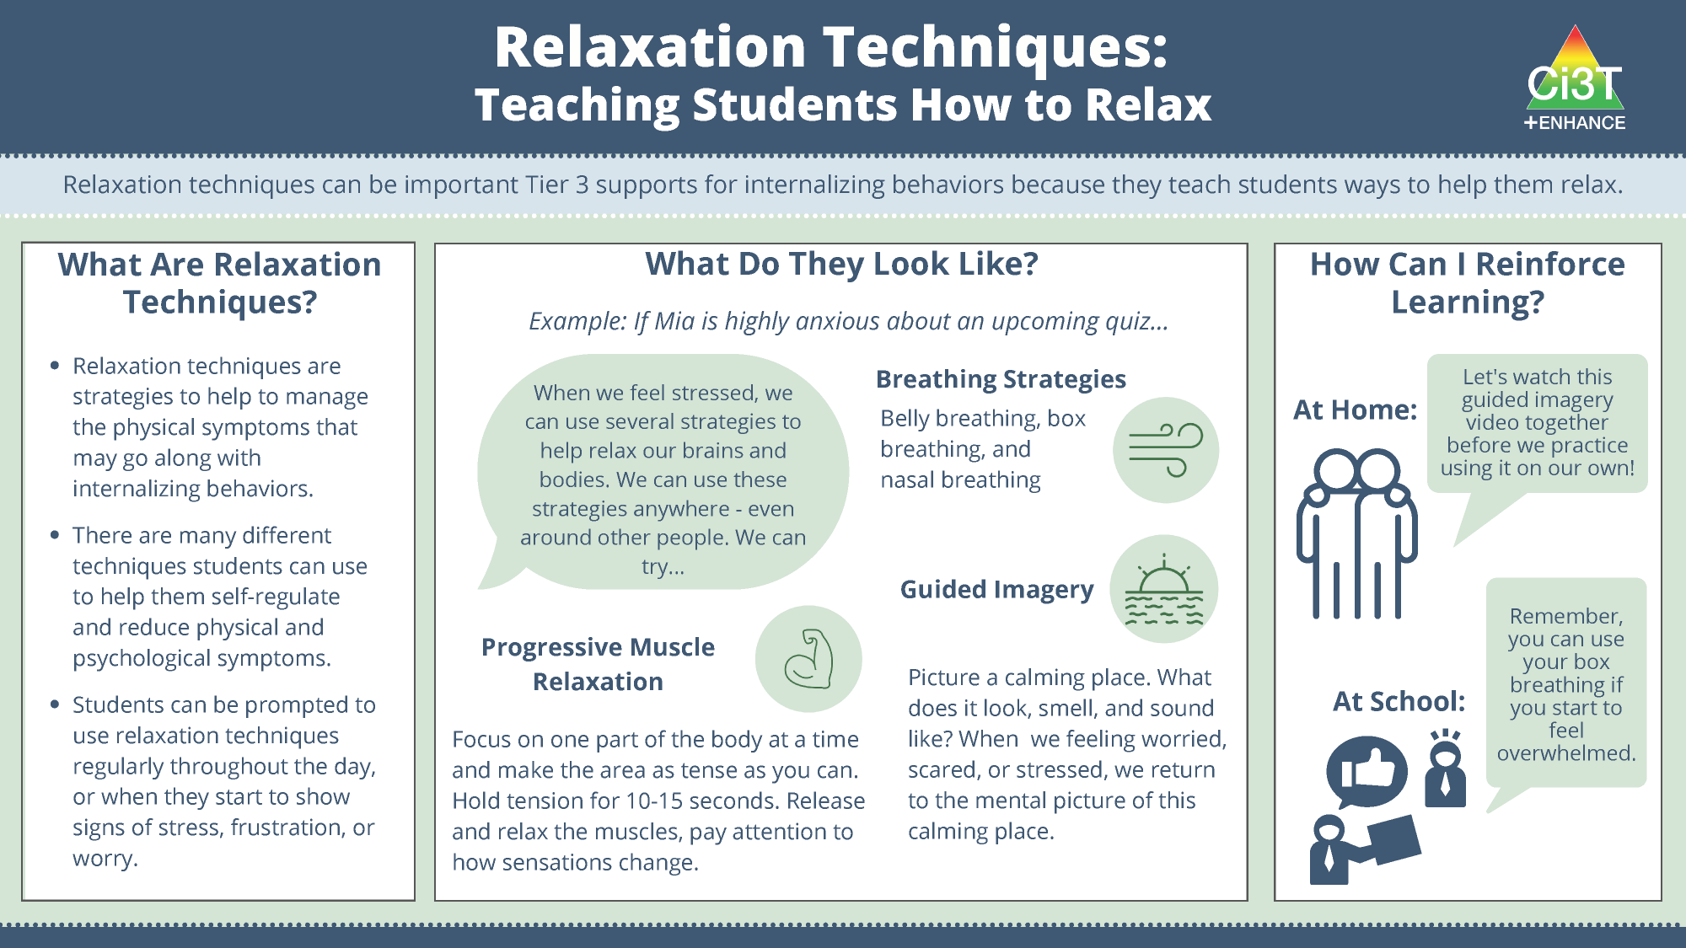
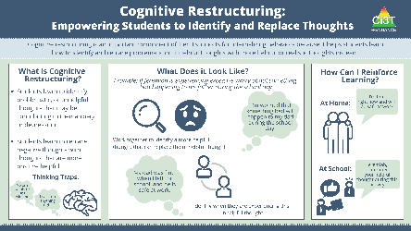

Slide 90
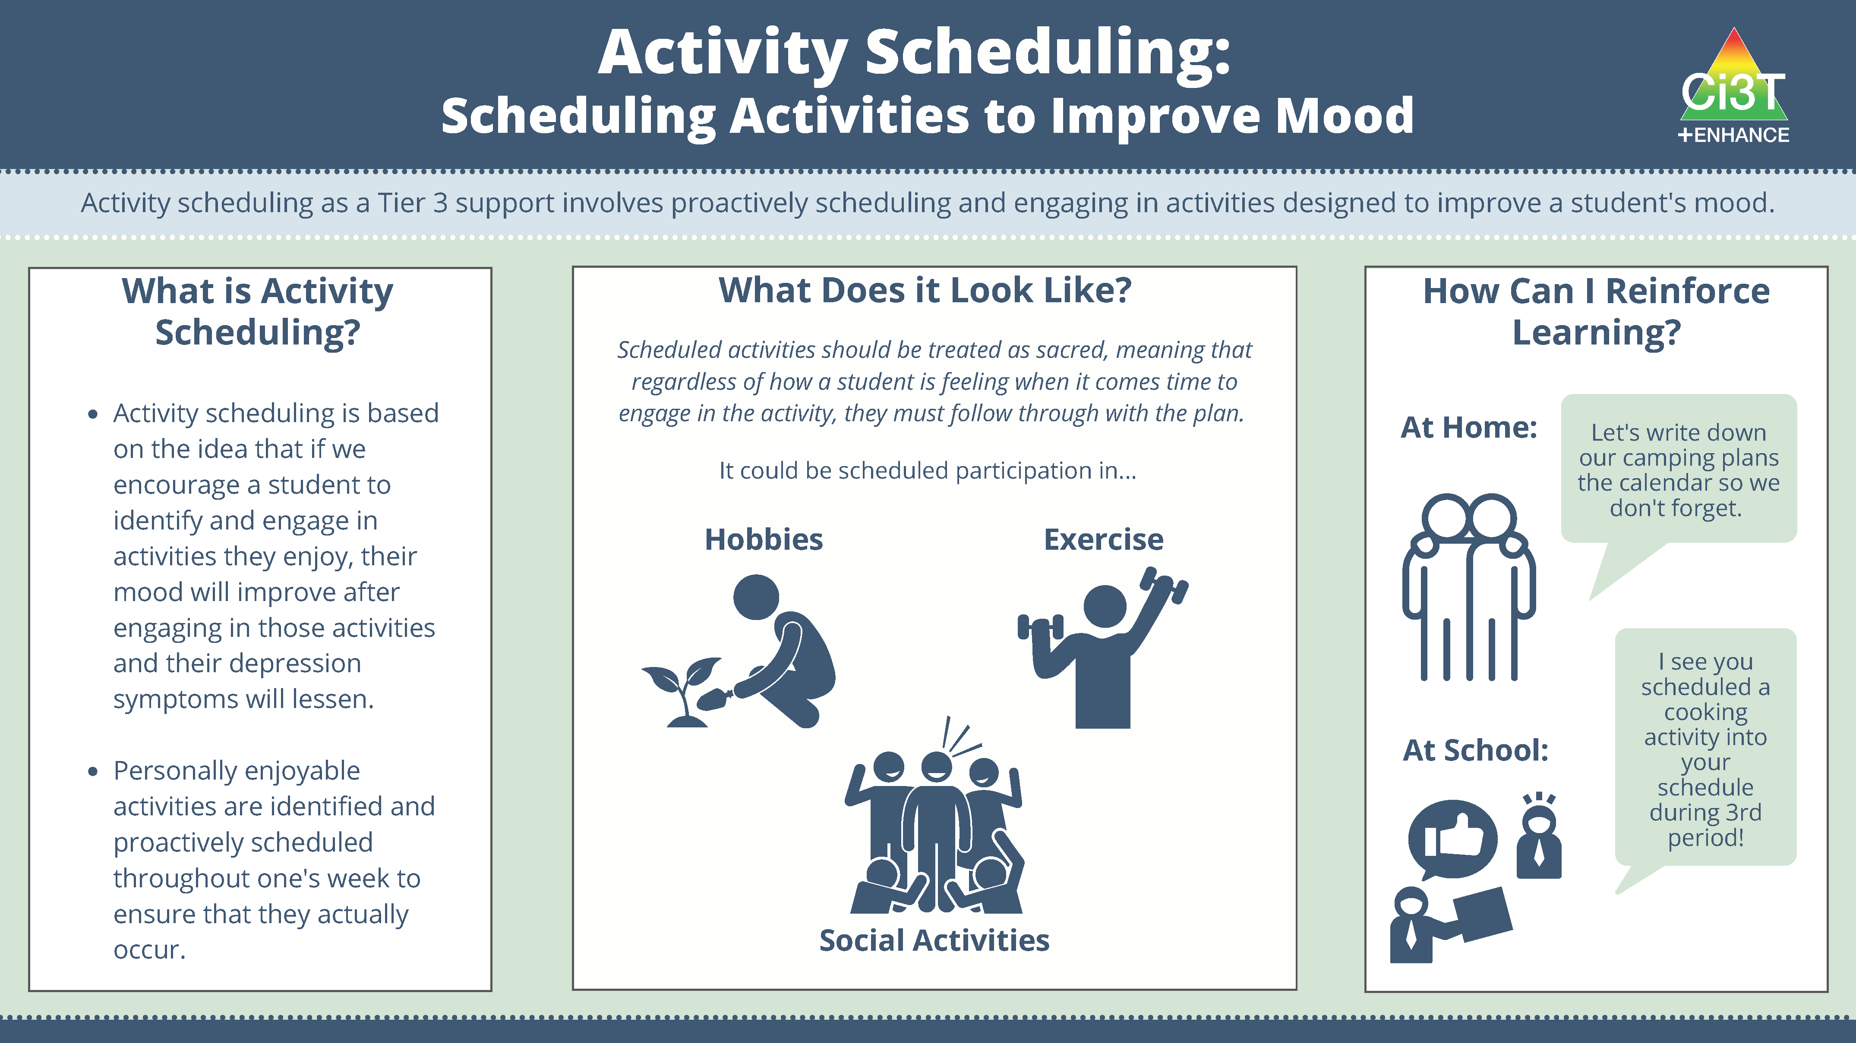
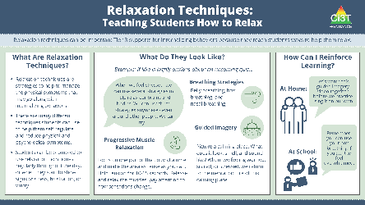

Slide 91
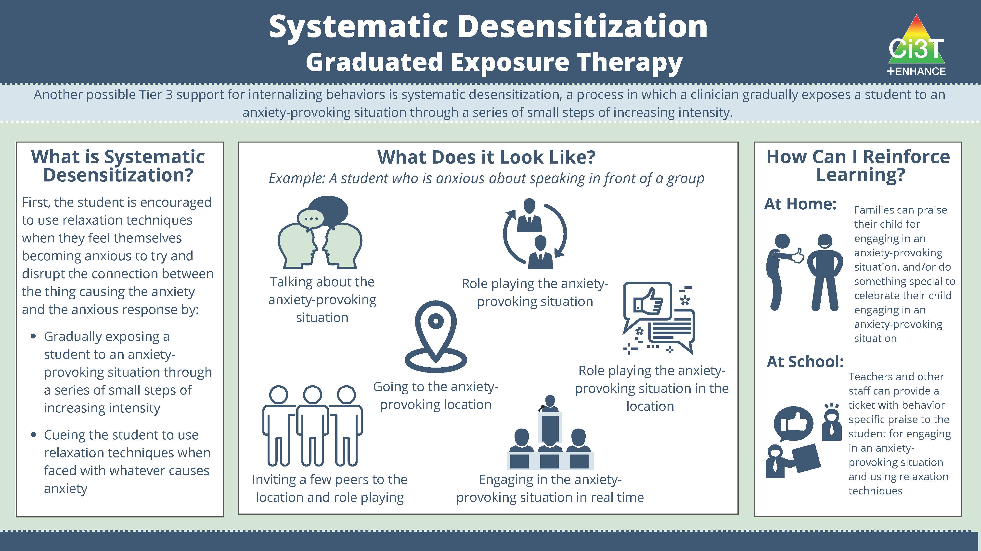
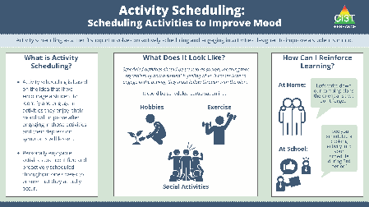
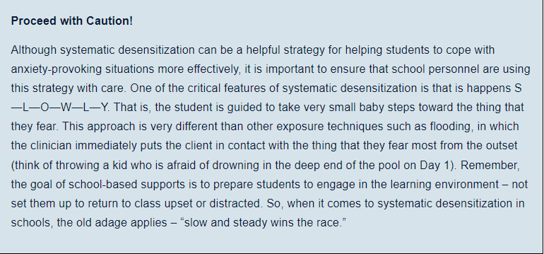

Slide 92
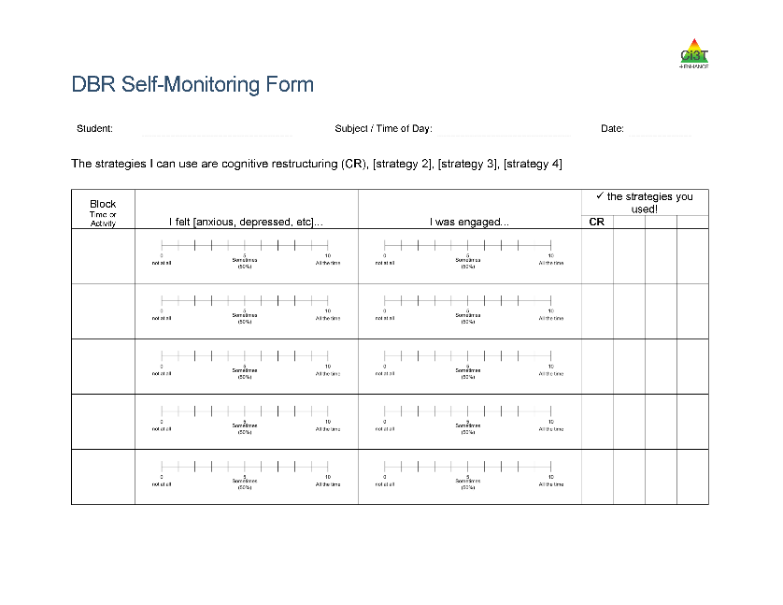
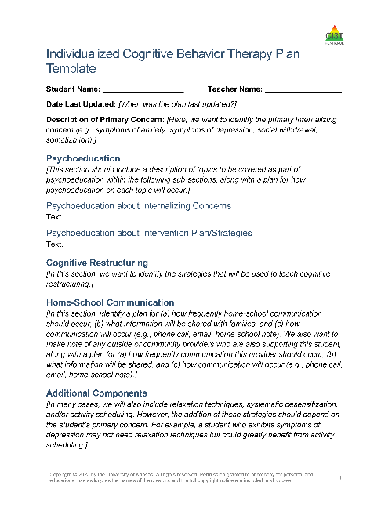
Additional Components
Self-Monitoring Form
Individualized Cognitive Behavior Therapy Plan
(including – safety plan if needed)

Slide 93
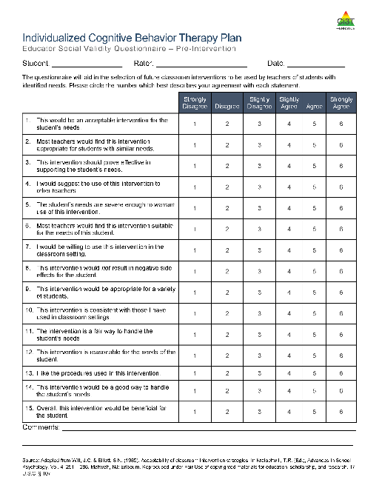
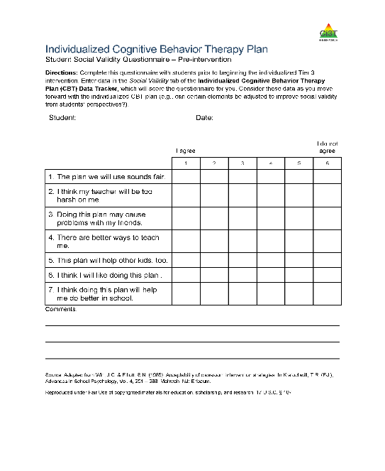
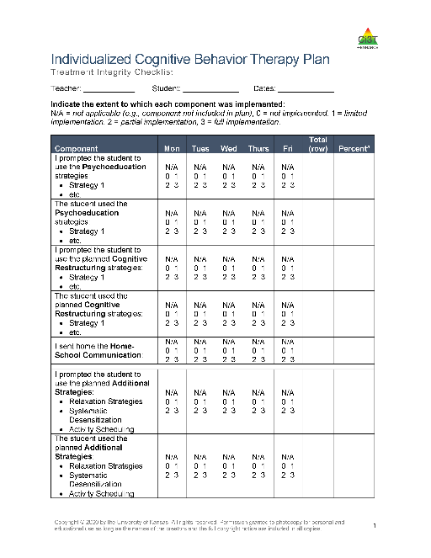
Social Validity & Treatment Integrity

Slide 94
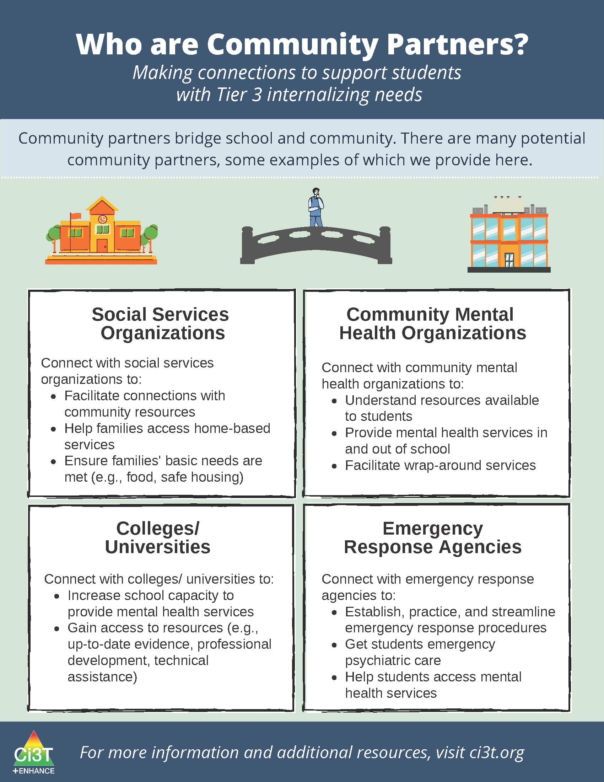

Slide 97



Slide 98




Slide 99
Talk Time
Which strategies would you like to explore
  Tier 2 strategies as Tier 3 supports
  Cognitive Behavioral Therapy (CBT)
  Community Partners
How could you collaborate with families to support students with internalizing concerns?

Slide 100
Exploring Other Tertiary (Tier 3) Interventions in Ci3T Models

Slide 101



Slide 102



Functional Assessment-based Interventions (FABI)
https://www.ci3t.org/fabi

Slide 103



Let’s Chat
What Tier 3 interventions are listed in your Ci3T implementation manual to support students with externalizing behavior needs?
What Tier 3 interventions are listed in your Ci3T implementation manual to support students with internalizing behavior needs?

Slide 104
Wrapping Up and Moving Forward

Slide 105

Project EMPOWER - Enhanced
Ci3T EMPOWER Sessions Location: Remote via Zoom Attended by: School Ci3T Leadership Teams, Ci3T District Trainers and Coaches, Faculty and Staff, Families (adults only). Community Members |  | Times (Pacific) | Times (Central) | Times (Eastern)
1. Setting up for Success​​ | Sep. 21, 2023 (Th)​​ | 3:00 – 5:00 p.m. | 5:00 – 7:00 p.m. | 6:00 – 8:00 p.m.
2. Screening​​ | Oct. 18, 2023 (Wed)​​ | 3:00 – 5:00 p.m. | 5:00 – 7:00 p.m. | 6:00 – 8:00 p.m.
3. Low Intensity Supports (3)​​ | Nov. 28, 2023 (Tu)​​ | 3:00 – 5:00 p.m. | 5:00 – 7:00 p.m. | 6:00 – 8:00 p.m.
4. Tier 2​​ | Jan. 11, 2024 (Th)​​ | 3:00 – 5:00 p.m. | 5:00 – 7:00 p.m. | 6:00 – 8:00 p.m.
5. Tier 3​​ | Mar. 26, 2024 (Tu)​​ | 3:00 – 5:00 p.m. | 5:00 – 7:00 p.m. | 6:00 – 8:00 p.m.
6. Moving Forward​​ | Apr. 25, 2024 (Th)​​ | 3:00 – 5:00 p.m. | 5:00 – 7:00 p.m. | 6:00 – 8:00 p.m.

Slide 106
Ci3T
Comprehensive Professional Learning Plan
Ci3T: Primary Prevention
Session 1:
Overview of Ci3T Prevention Models
Setting a Purpose
Establish team meetings and roles
Session 2:
Mission and Purpose
Establish Roles and Responsibilities
Procedures for Teaching
Procedures for Reinforcing
Reactive Plan
Session 3:
Procedures for Monitoring
Session 4:
Revise Primary Plan using Stakeholder feedback
Prepare presentation
Ci3T: Secondary Prevention
Session 5:
Overview of Teacher focused Strategies
Overview of Student Focused Strategies
Using data to determine which students may need Secondary (Tier 2) supports
Draft the Secondary Intervention Grid based on existing supports
Ci3T: Tertiary Prevention
Session 6:
Final revisions of Ci3T Plan based on stakeholder feedback
Draft Tertiary (Tier 3) Prevention Intervention Grids
Design Implementation Manual and Plan for roll out to faculty, students, and parents
Ci3T Leadership Team Training Sequence
Implementation Stages of Tier 2 and 3 within Ci3T
Additional Professional Development on Specific Topics
Core Content Curriculum
Check In - Check Out
Functional Assessment-based Interventions
Reading, Math, Writing Benchmarking and Progress Monitoring Tools
Interventions, Strategies, & Practices
Additional Tier 3 Supports
Instructional Techniques to Improve Students’ Motivation; Classroom Management Practices;
Low-Intensity Behavior Supports

Slide 107

School Ci3T Implementation Calendar
Sun. | Mon. | Tues. | Wed. | Thurs. | Fri. | Sat.
1 | 2 | 3 | 4 | 5 | 6 Professional learning session: Internalizing | 7
8 | 9 | 10 Ci3T Team Meeting | 11 | 12 Teach Social Skills Lesson | 13 | 14
15 | 16 Faculty meeting with a look at BSP | 17 | 18 | 19 | 20 | 21
22 | 23 | 24 | 25 | 26 Teach Social Skills Lesson | 27 | 28
Schedule time for communication
Notes:
.

Slide 108



Ci3T Trainer and Coaches Calls

Slide 109
Ci3T Professional Learning Calendar
 | 0 | 1 | 2 | 3 | 4 | 5 | 6 | 7 | 8 | 9 | 10 | 11
 | July | Aug | Sep | Oct | Nov | Dec | Jan | Feb | Mar | Apr | May | Jun
Ci3T Training |  |  |  |  | Ci3T Professional Learning Series Session 1 | Ci3T Professional Learning Series Session 2 | Ci3T Professional Learning Series Session 3 | Ci3T Professional Learning Series Session 4 |  | Ci3T Professional Learning Series Session 5 | Ci3T Professional Learning Series Session 6
Ci3T Implementation Support | Ci3T Implementation Series Prep Session |  | Ci3T Implementation Series Session 1 |  | Ci3T Implementation Series Session 2 |  | Ci3T Implementation Series Session 3 |  | Ci3T Implementation Series Session 4 | Ci3T Implementation Series Session 5
Ci3T EMPOWER |  |  | Ci3T EMPOWER Session 1 | Ci3T EMPOWER Session 2 | Ci3T EMPOWER Session 3 |  | Ci3T EMPOWER Session 4 |  | Ci3T EMPOWER Session 5 | Ci3T EMPOWER Session 6
Ci3T Trainers & Coaches Calls |  | Trainers & Coaches Call Session 1 | Trainers & Coaches Call Session 2 | Trainers & Coaches Call Session 3 | Trainers & Coaches Call Session 4 | Trainers & Coaches Call Session 5 | Trainers & Coaches Call Session 6 | Trainers & Coaches Call Session 7 | Trainers & Coaches Call Session 8 | Trainers & Coaches Call Session 9 | Trainers & Coaches Call Session 10

Slide 110


Sustaining and Disseminating Professional Learning
Designate two staff to attend trainings to become on-site coaches
10 min @ next Faculty and Staff meeting
Ci3T Setting Up for Success
Systematic Screening
Low-Intensity Supports
Tier 2
Planning Ahead
Tier 3

Slide 111


Accessing Project EMPOWER Professional Learning
Navigate to ci3t.org/enhance
Type password: enhanceci3t!

Slide 112
Wrapping Up & Previewing Next Session
Today
Next time
Overview of Tertiary (Tier 3) Interventions in Ci3T Models: Data-informed Decision-making
Illustrations: Supporting Students with Intensive Intervention Needs
  Supporting students with acting out behaviors
  Supporting students with internalizing issues
Exploring Other Tertiary (Tier 3) Interventions in Ci3T Models
Overview of Ci3T: Identifying Successes and Areas for Reinforcement
Closing out the School Year: Positive, Productive Learning Environments
Planning for the 2024-2025 Academic Year
Establishing Professional Learning Goals

Slide 113


Comprehensive, Integrated, Three-Tiered Model of Prevention
(Lane, Kalberg, & Menzies, 2009)
Thank you!
Notes:
Tag us in your Ci3T highlights- we’d love to see Ci3T in action! Follow us on Twitter or Instagram for updates and links to resources! @Ci3TModel
You will receive a brief session evaluation – we value your feedback and would greatly appreciate you taking a few minutes to share your thoughts on what you liked about the session and how we can improve

