Slide 1
Closing Out and Moving Forward with Ci3T: Planning for Success
EMPOWER+ - Enhanced Session 6
Presenters and Contributors | Contributors
Allison M. Bernard | Elise Sarasin
Mark M. Buckman | Rebecca L. Sherod
Kathleen Lynne Lane | Stacie Williams
Wendy Peia Oakes

Slide 2
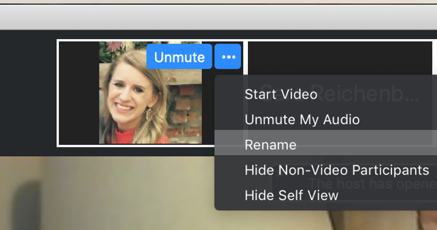
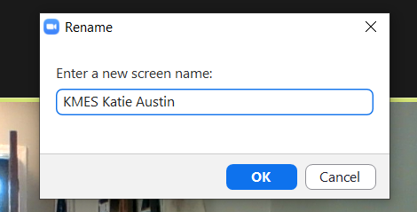
Renaming: School Initials + First and Last Name
To help us put you in breakout rooms with your colleagues today…
1. Click the three dots at the top
right corner of your video square.
2. Rename yourself with your
school initials then first and last name.

Slide 4
Let’s Connect on Social Media!
Tag us in your Ci3T highlights- we’d love to see Ci3T in action!
Follow us on Twitter or Instagram for updates and links to resources!
@Ci3TModel

Slide 5
Ci3T Professional Learning Calendar
 | 0 | 1 | 2 | 3 | 4 | 5 | 6 | 7 | 8 | 9 | 10 | 11
 | July | Aug | Sep | Oct | Nov | Dec | Jan | Feb | Mar | Apr | May | Jun
Ci3T Training |  |  |  |  | Ci3T Professional Learning Series Session 1 | Ci3T Professional Learning Series Session 2 | Ci3T Professional Learning Series Session 3 | Ci3T Professional Learning Series Session 4 |  | Ci3T Professional Learning Series Session 5 | Ci3T Professional Learning Series Session 6
Ci3T Implementation Support | Ci3T Implementation Series Prep Session |  | Ci3T Implementation Series Session 1 |  | Ci3T Implementation Series Session 2 |  | Ci3T Implementation Series Session 3 |  | Ci3T Implementation Series Session 4 | Ci3T Implementation Series Session 5
Ci3T EMPOWER |  |  | Ci3T EMPOWER Session 1 | Ci3T EMPOWER Session 2 | Ci3T EMPOWER Session 3 |  | Ci3T EMPOWER Session 4 |  | Ci3T EMPOWER Session 5 | Ci3T EMPOWER Session 6
Ci3T Trainers & Coaches Calls |  | Trainers & Coaches Call Session 1 | Trainers & Coaches Call Session 2 | Trainers & Coaches Call Session 3 | Trainers & Coaches Call Session 4 | Trainers & Coaches Call Session 5 | Trainers & Coaches Call Session 6 | Trainers & Coaches Call Session 7 | Trainers & Coaches Call Session 8 | Trainers & Coaches Call Session 9 | Trainers & Coaches Call Session 10

Slide 7
Agenda
Welcome
Overview of Ci3T: Identifying Successes and Areas for Refinement
Closing out the School Year: Positive, Productive Learning Environments
Planning for the 2024-2025 Academic Year
Establishing Professional Learning Goals
Wrapping Up and Moving Forward

Slide 8
Welcome

Slide 9
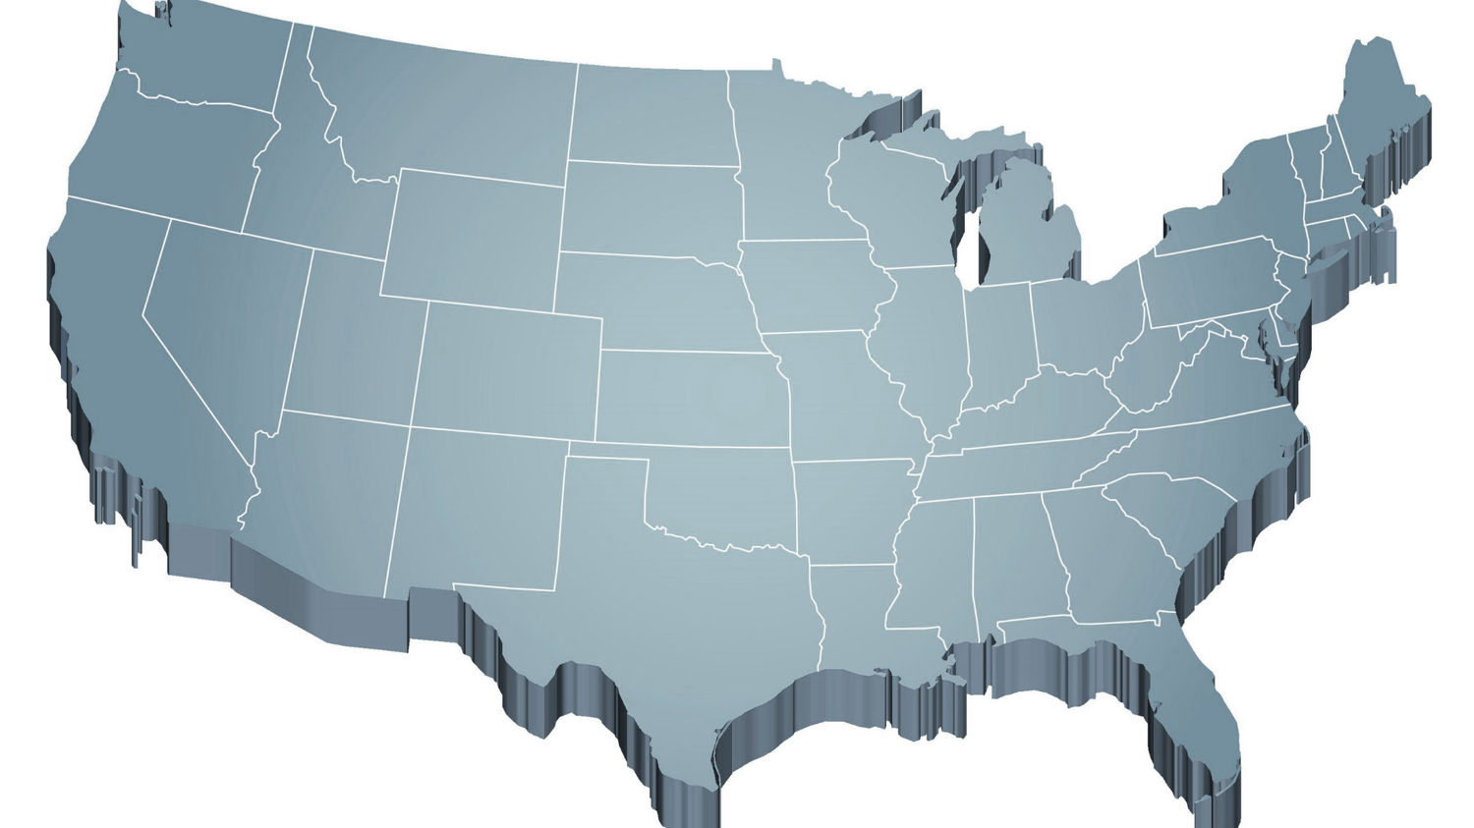
Thank you for your commitment
Shift to a systems level perspective
Internalizing
Externalizing
ED <1%
EBD 12-20%
Source: Forness, S.R., Freeman, S.F., Paparella, T., Kauffman, J.M., & Walker, H.M. (2012). Special education implications of point and cumulative prevalence for children with emotional or behavioral disorders. Journal of Emotional and Behavioral Disorders, 20, 4-18.

Slide 10
The Journey of Ci3T: Respectful Partnerships
1997
Notes:
CA & AZ start→ Tennessee → North Carolina→ Kansas
Trainings (MO, KANSAS, VERMONT, AZ)
MO, KS, UAB
HI

Slide 12
Overview of Ci3T: Identifying Successes and Areas for Refinement

Slide 13
Comprehensive, Integrated, Three-Tiered Model of Prevention
(Lane, Kalberg, & Menzies, 2009)
Tier 3
Tertiary Prevention (≈5%)
Tier 2
Secondary Prevention (≈15%)
Tier 1
Primary Prevention (≈80%)
Academic ◇ Behavioral ◇ Social
Validated Curricula PBIS Framework Validated Curricula

Slide 14
Ci3T Implementation Manual

Slide 15
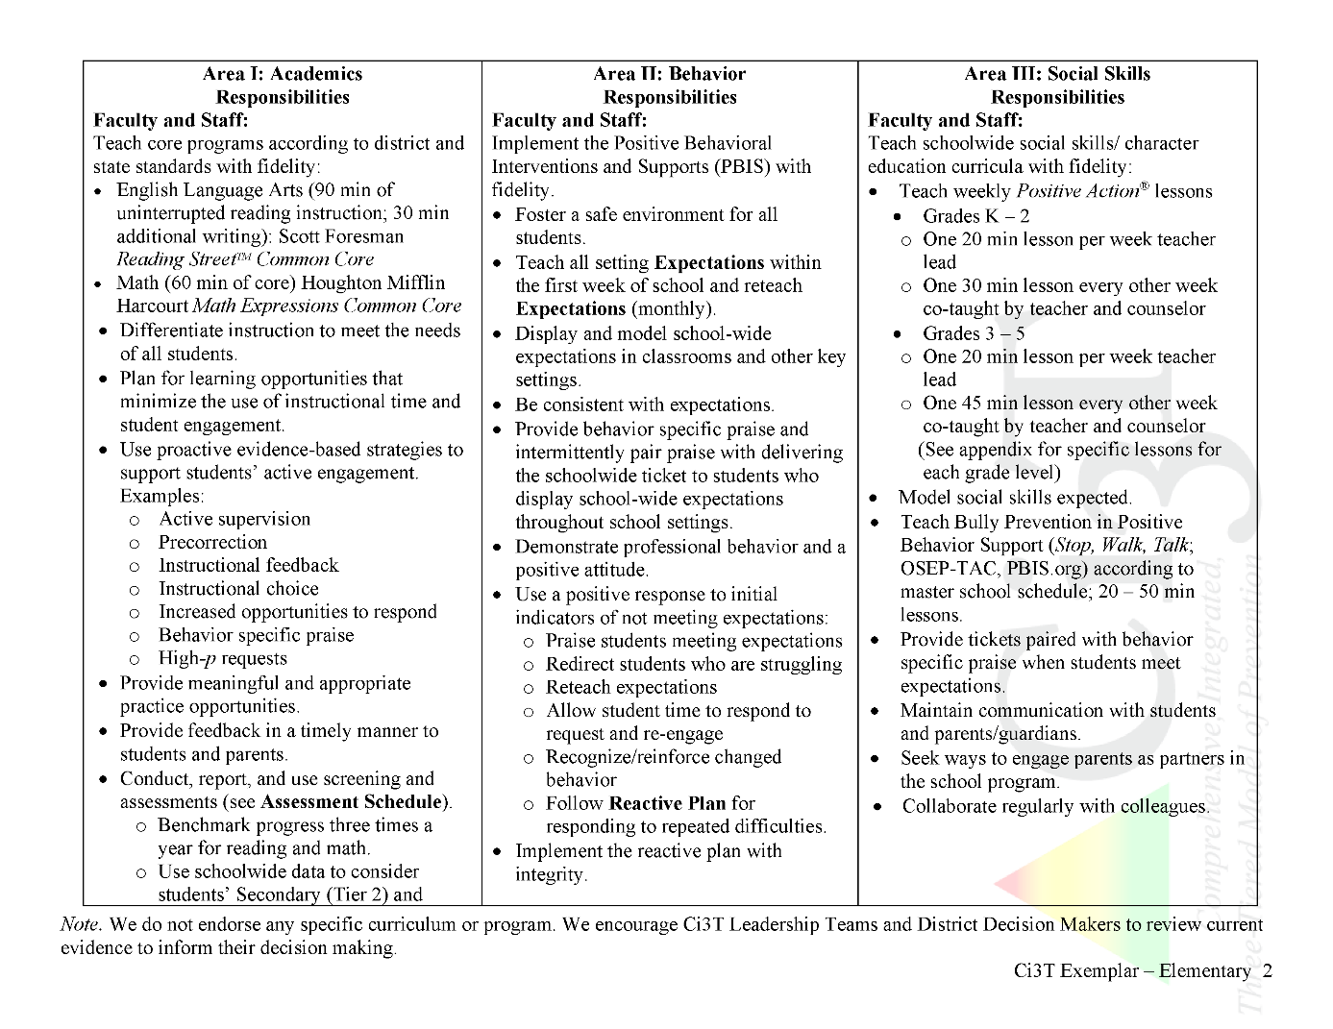
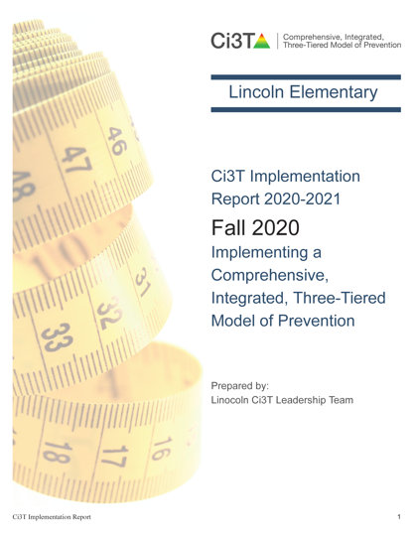
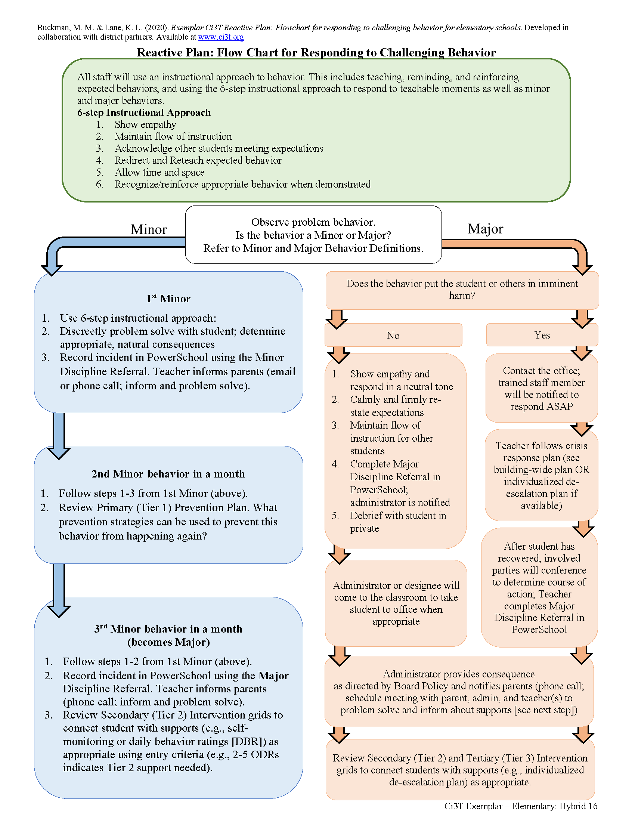
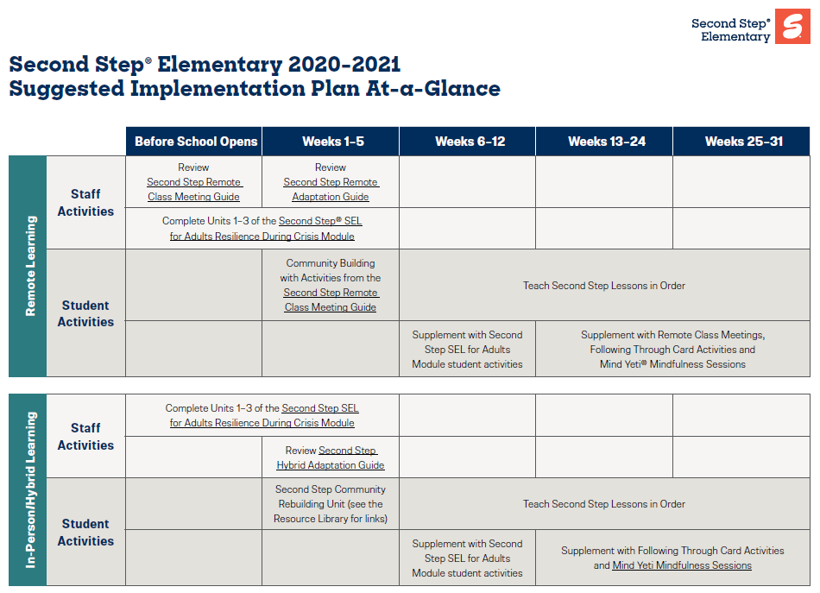
Ci3T Primary Plan: Procedures for Teaching
Opportunities to Respond
Behavior-Specific Praise
Ci3T Primary Plan: Procedures for Reinforcing
Active Supervision
Instructional Feedback
High-p Requests
Ci3T Primary Plan: Procedures for Monitoring
Precorrection
Instructional Choice
Notes:
Continued to keep implementation manuals, which are foundational to Ci3T, updated and current

Slide 16
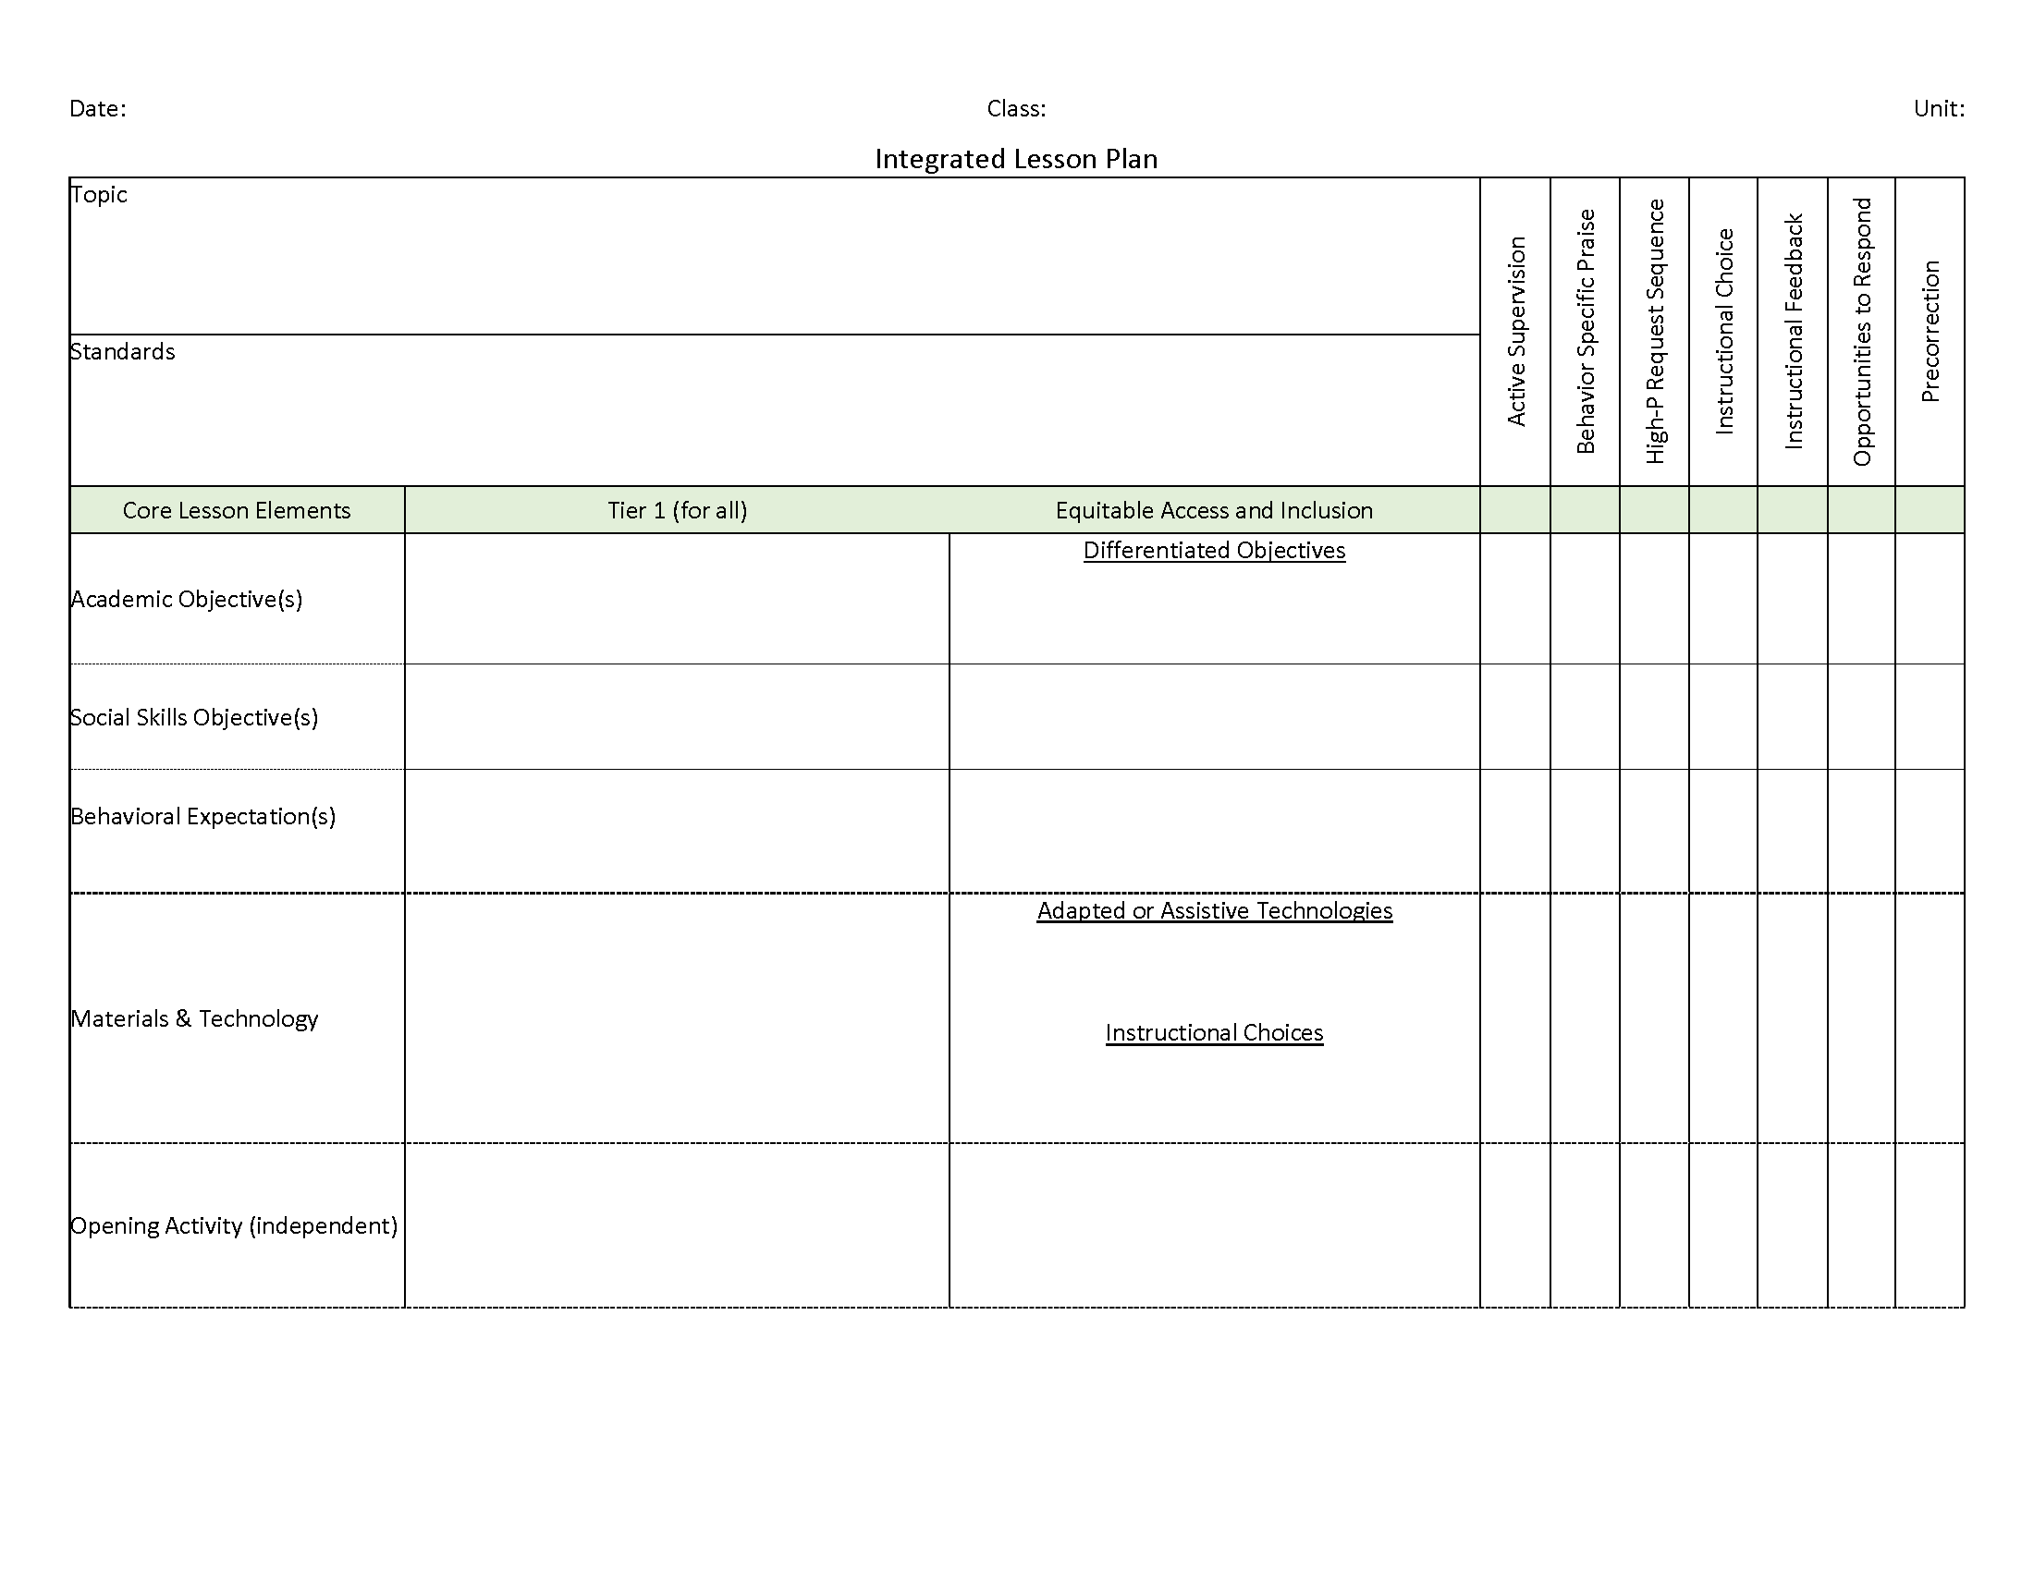
Ci3T: Integrated Lesson Planning

Slide 17
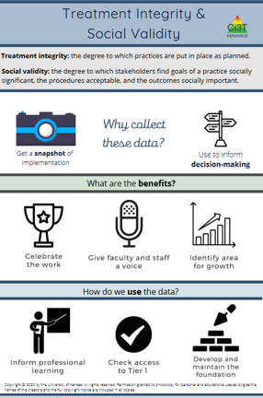
Essential Components of Primary Prevention Efforts
Social Validity
Systematic Screening
Academic
Behavior
Treatment Integrity
ci3t.org/measures
Notes:
Infographic - https://www.ci3t.org/measures

Slide 20
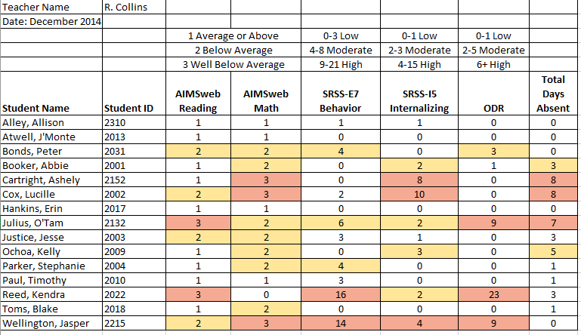
Examining Academic and Behavioral Data
Lane, K. L., Menzies, H. M., Ennis, R. P., & Oakes, W. P. (2015). Supporting Behavior for School Success: A Step-by-Step Guide to Key Strategies. Guilford Press.
Notes:
Lane, K. L., Oakes, W. P., Ennis, R. P., & Hirsch, S. E. (2014). Identifying students for secondary and tertiary prevention efforts: How do we determine which students have Tier 2 and Tier 3 needs? Preventing School Failure, 58, 171-182, DOI: 10.1080/1045988X.2014.895573

Slide 21
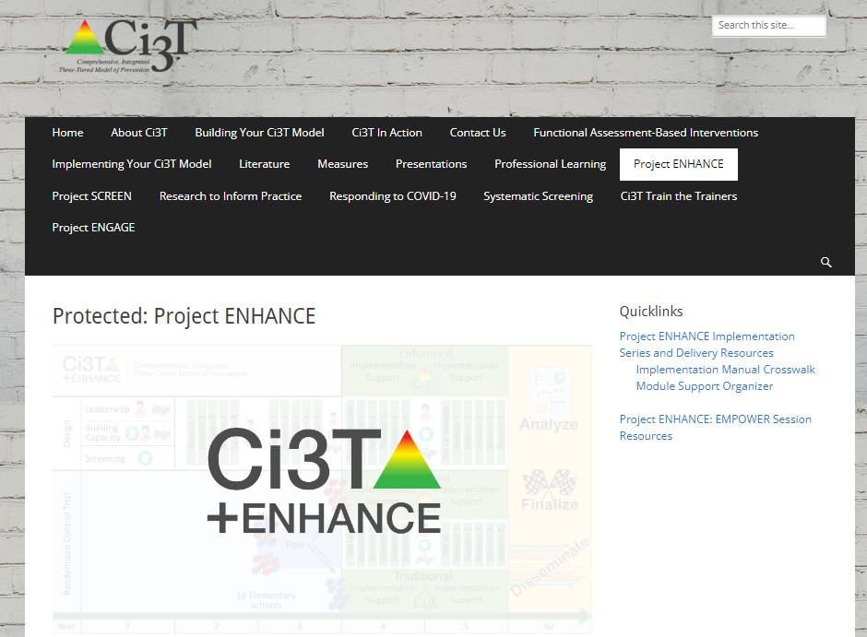
Low-Intensity Strategies for Academics and Behavior

Slide 22
Low-Intensity Strategy | Franklin High School On-Site Expert
Behavior-Specific Praise: Identifying the specific expectation the student met. “Niama, I noticed you outlined your paper and used the graphic organizer to draft your essay. Well done!” “Justice, thank you for pushing in your chair to keep the walkway safe.” | Eric Common, Behavior Specialist Mark Buckman, Special Education Grant Allen, Parent Volunteer Paloma Pérez-Clark, School Psychologist
Opportunities to Respond: Providing 4-6 opportunities per minute for students to respond individually, choral, verbal, written, gesture, or symbol. “Show me thumbs or thumbs down if...” “Show me on your white board what…” “Turn to your elbow partner and say…” “All together now, what is…” | David Royer, Administration Emily Cantwell, 12th Grade Scarlett Lane, 11rd Grade Mallory Messenger, Counselor
Instructional Choice: Providing within-task or between task choices to increase academic engaged time and motivation. “Ronaldo, our of our 3 learning objectives today, which would you like to work on first?” “Suzy, do you want to work on the laptop, or handwrite your answers for this assignment?” | Abbie Jenkins, 10th Grade Scarlett Lane, 11th Grade José Sousa, PE Liane Johl, 9th Grade

Slide 23
Building a Ci3T Tier Library
Teacher Delivered Strategies
Tier 1
Tier 2
Tier 3

Slide 24
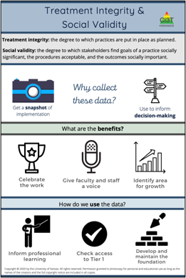
Essential Components of Primary Prevention Efforts
Social Validity
Systematic Screening
Academic
Behavior
Treatment Integrity
ci3t.org/measures
Notes:
Infographic - https://www.ci3t.org/measures

Slide 25
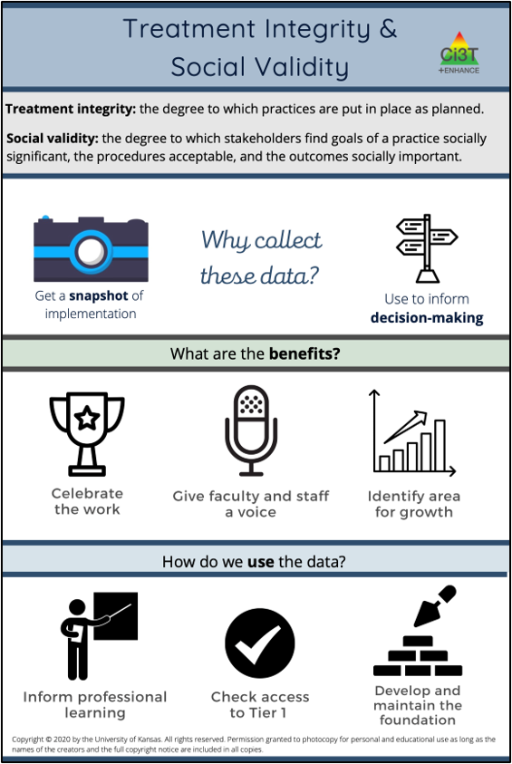

Slide 27
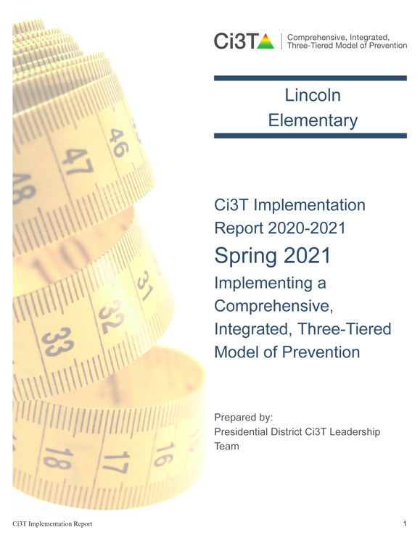
Example- Using Treatment Integrity and Social Validity Data to Revise your Ci3T Plan

Slide 28
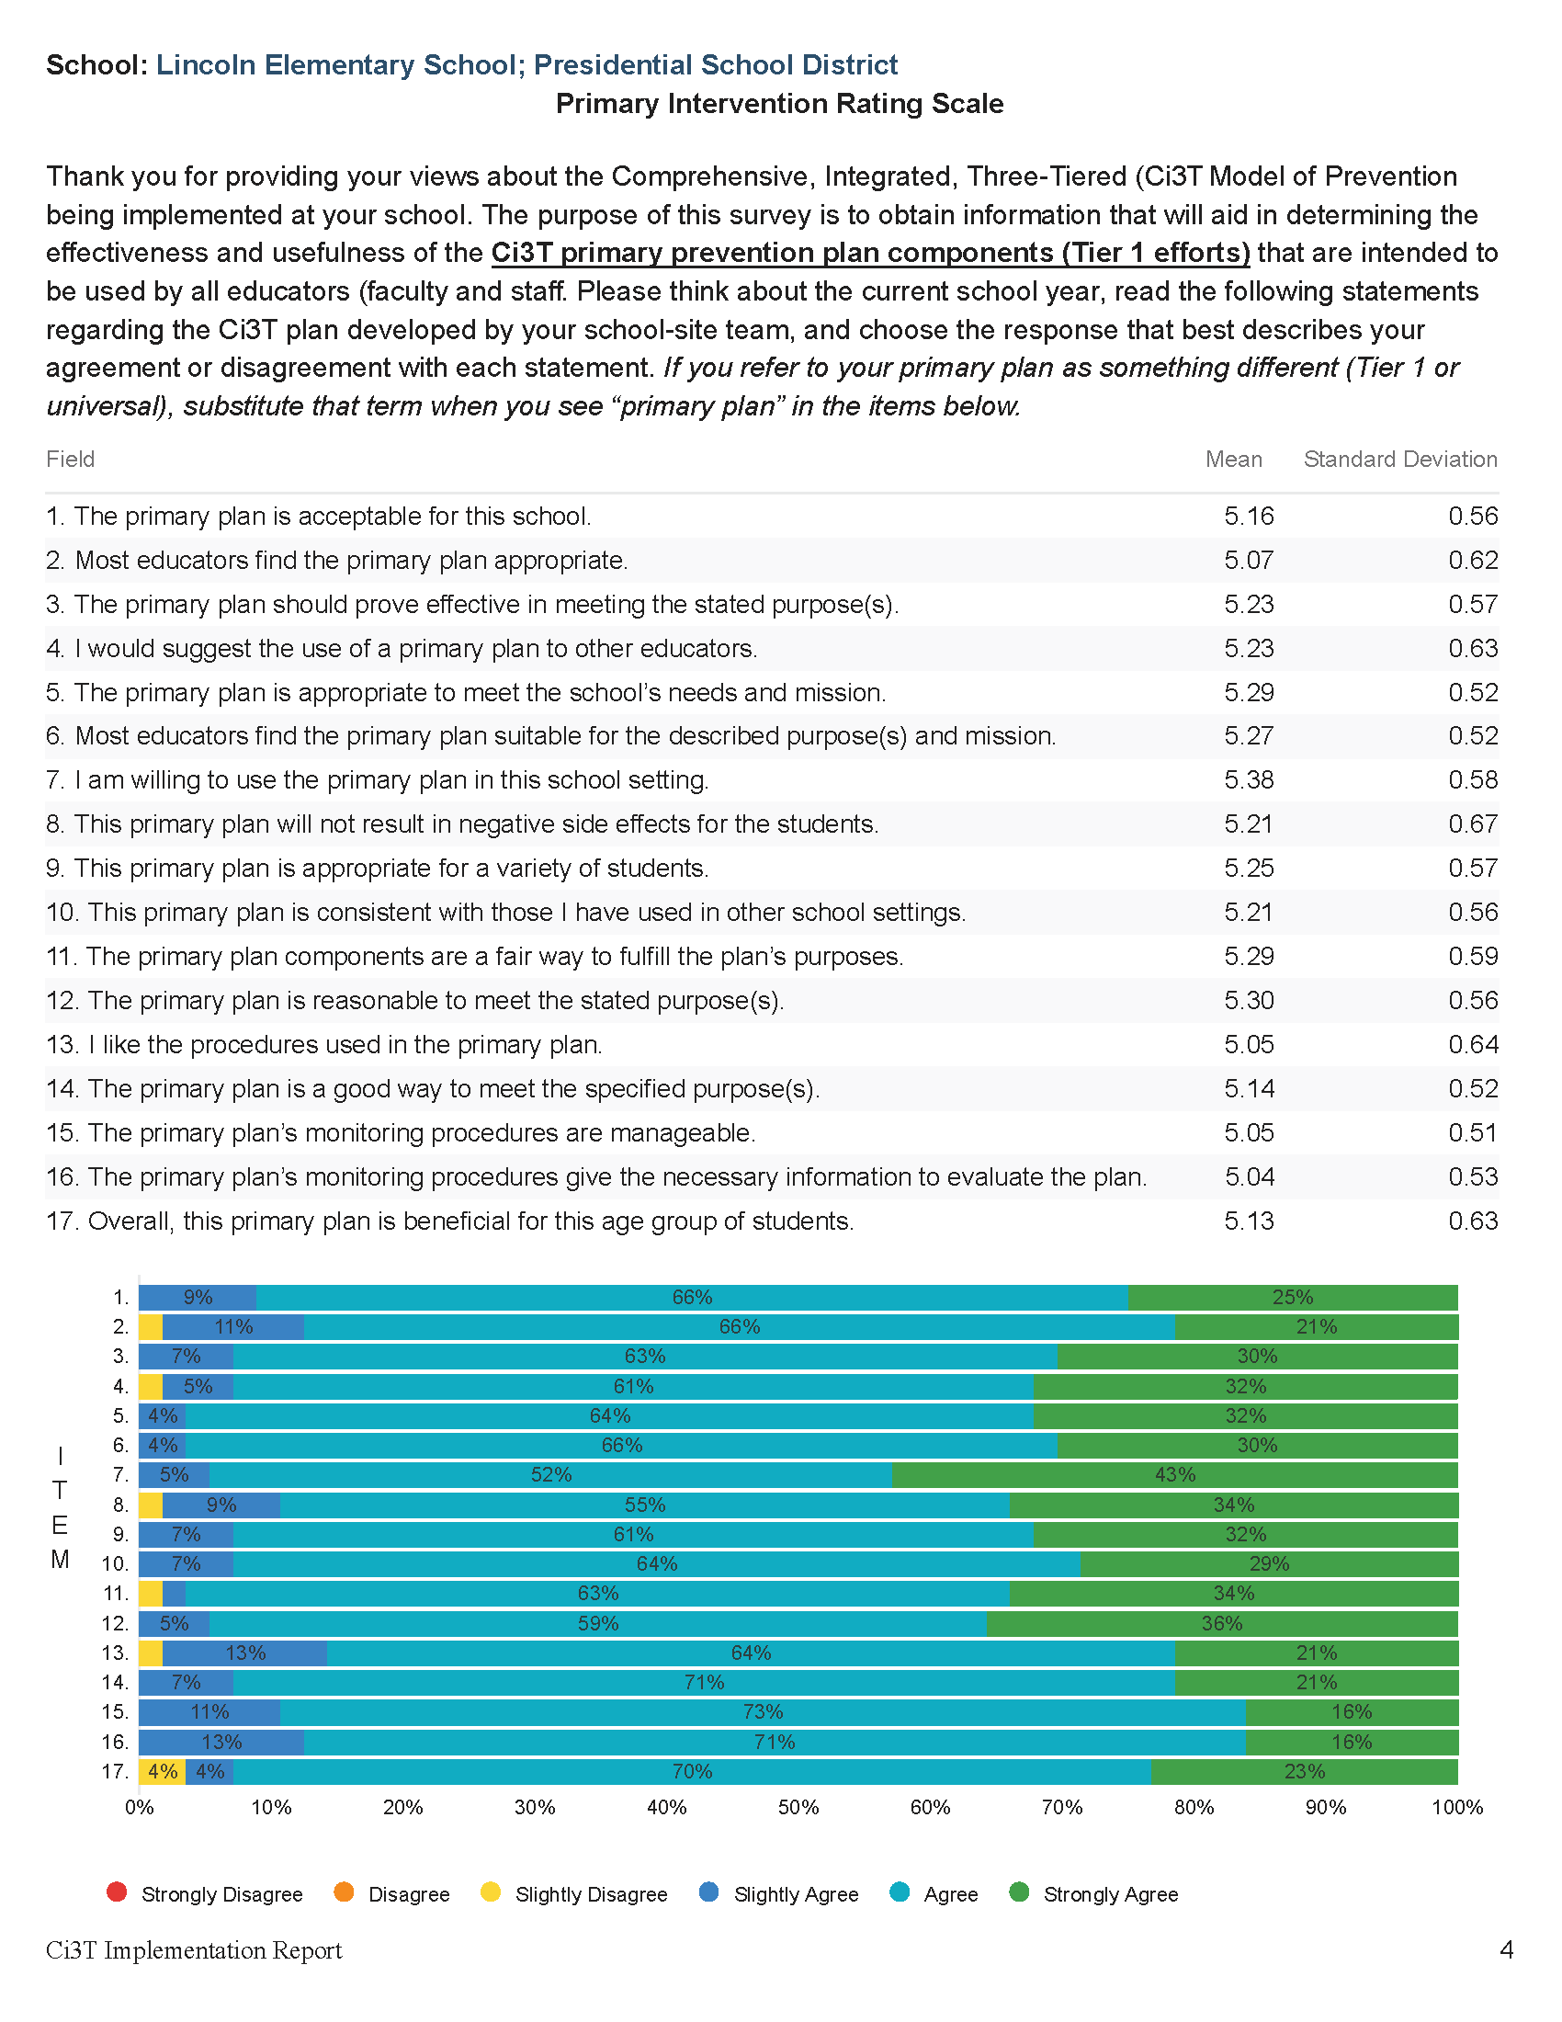
What changes could we make to our monitoring procedures to make them more manageable?
Notes:
Potential solutions:
Schedule next year’s windows to avoid overlap with other deadlines
Extend the data collection windows for next year (e.g. 7 days -> 10 days)
Build time into existing PD for staff to complete their surveys

Slide 29
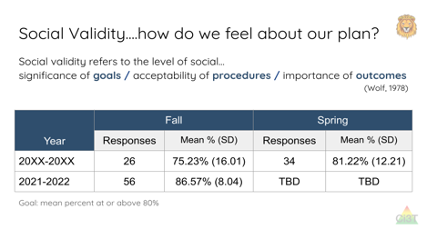
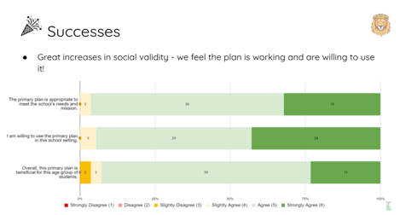
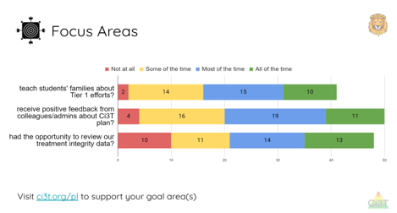
How can we more effectively share our monitoring data to help staff see the connection between the data and the changes we’re making?

Slide 30
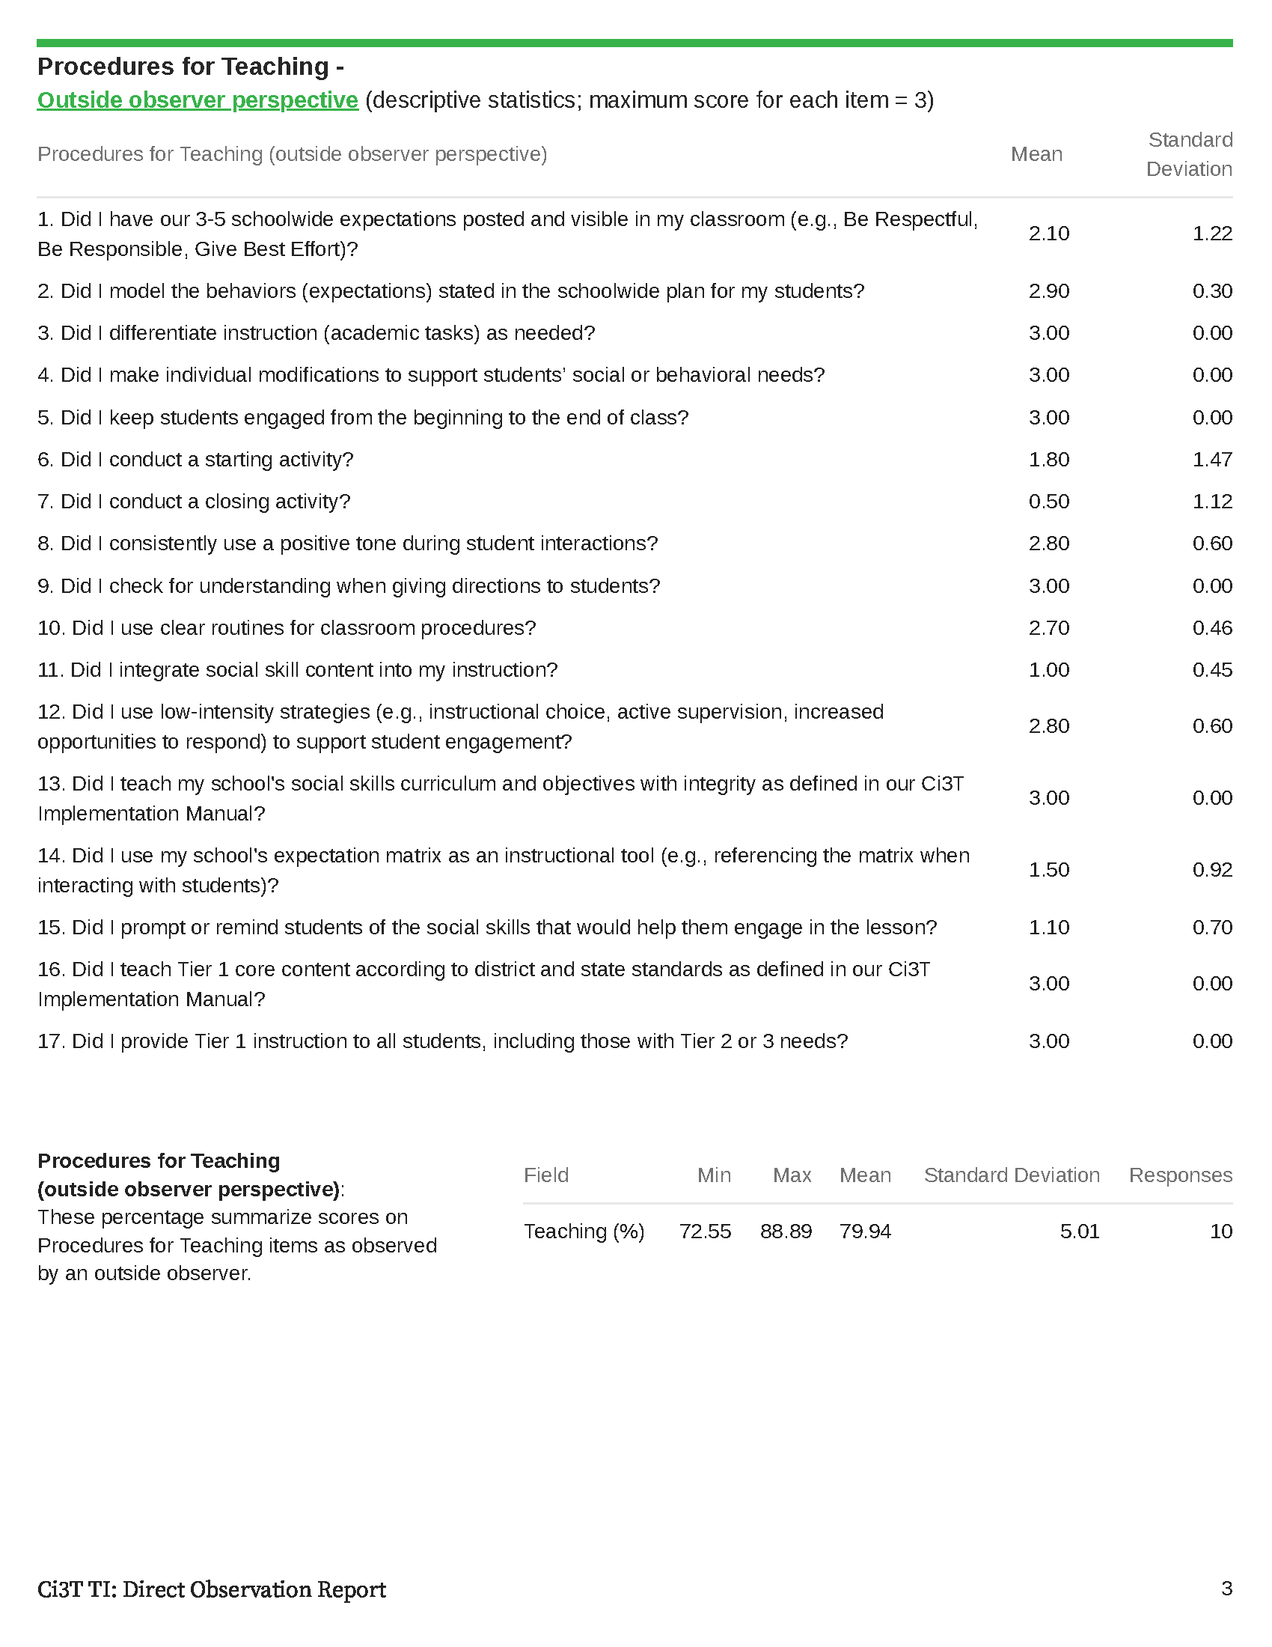

Slide 31
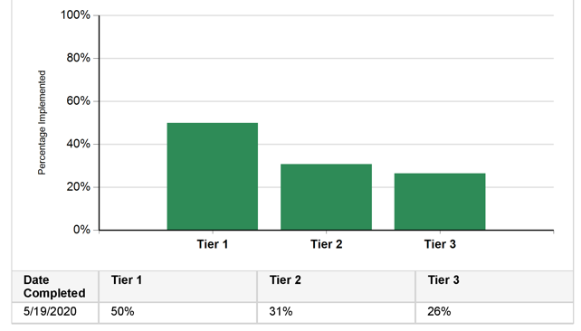
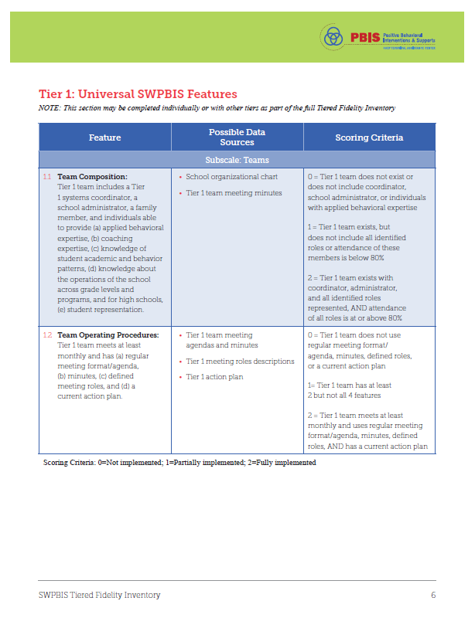
Tiered Fidelity Inventory (TFI)

Slide 32
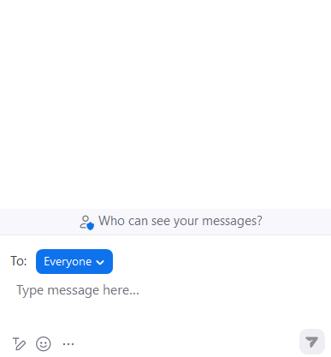
Identifying Successes and Areas for Refinement
Looking back at 2023-2024, post in the chat:
a success
an area for refinement

Slide 33
Closing out the School Year: Positive, Productive Learning Environments

Slide 34
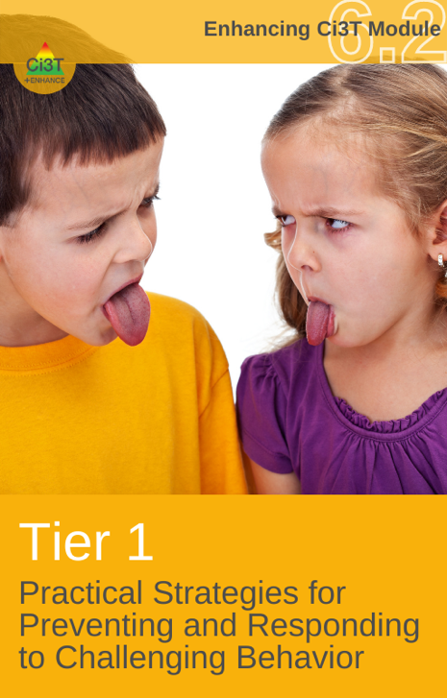
Enhanced Ci3T Professional Learning Modules
Notes:
These three modules highlight effective practices you can leverage as you close out the school year

Slide 35
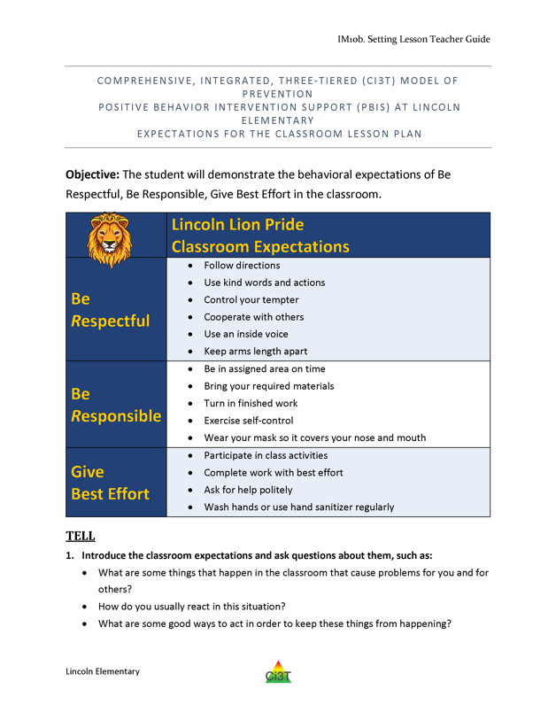
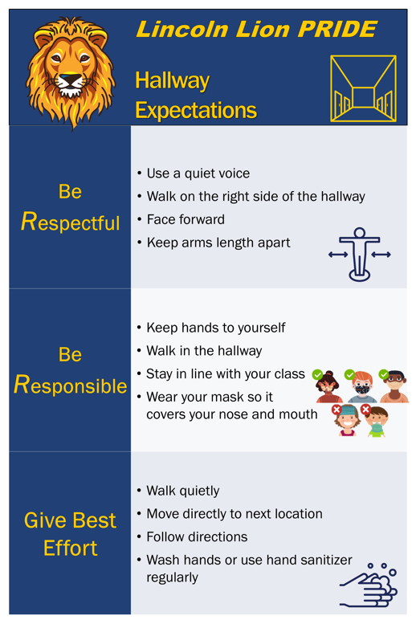
Behavioral
Area II: Academics Responsibilities Faculty and Staff: Teach core programs according to district and state standards with integrity: Use teacher-delivered, low-intensity strategies to support students’ active engagement | Area II: Behavior Responsibilities Faculty and Staff: Implement Positive Behavioral Interventions and Supports (PBIS) with integrity. Teach all setting Expectations within the first week of school and reteach Expectations (monthly). Display and model school-wide expectations in classrooms and other key settings. Implement the reactive plan with integrity. | Area II: Social Responsibilities Faculty and Staff: Teach schoolwide social skills/ character education curricula with integrity: Teach daily Second Step ® lessons (link to grade level instructional schedules) Seek ways to engage parents as partners in the school program
Notes:
Your Ci3T Implementation Manual features proactive components that set the stage for positive, productive learning environments. As you close out the school year, consider:
Reteaching expectations
Leveraging expectation matrix as an tool to display and model school-wide expectations in classrooms and other key settings
Responding consistently with your school’s reactive plan

Slide 36
Notes:
The plan begins with 6-Step Instructional Approach, providing guidance for responding to behavior using a respectful and instructional approach. An instructional approach is a way of responding aimed at teaching students what to do rather than focusing solely on what not to do.
The remainder of the flow clarifies what behaviors are teacher-managed (often referred to as minors) and what behaviors are office-managed (often referred to as majors

Slide 38
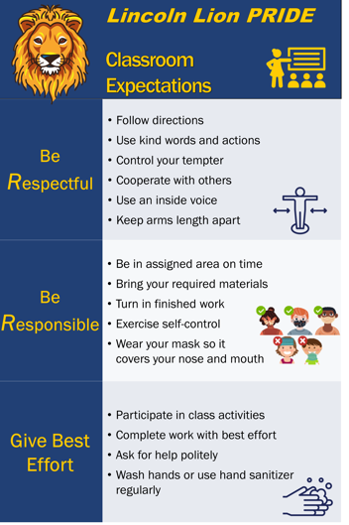
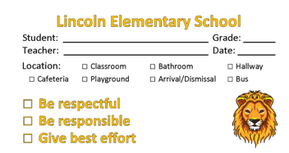
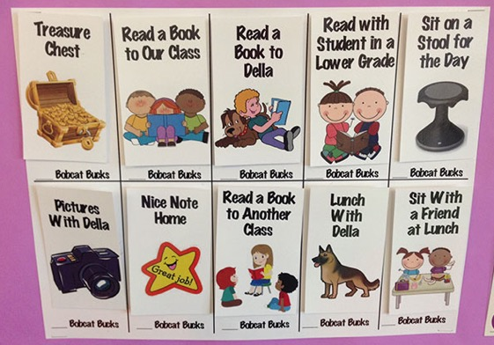
Universal Reinforcement System
Notes:
The end of the school year is an opportune time maximize the universal reinforcement system. Be sure to acknowledge students for meeting expectations using a universal reinforcement system (ticket) and use a high rate of reinforcement

Slide 39
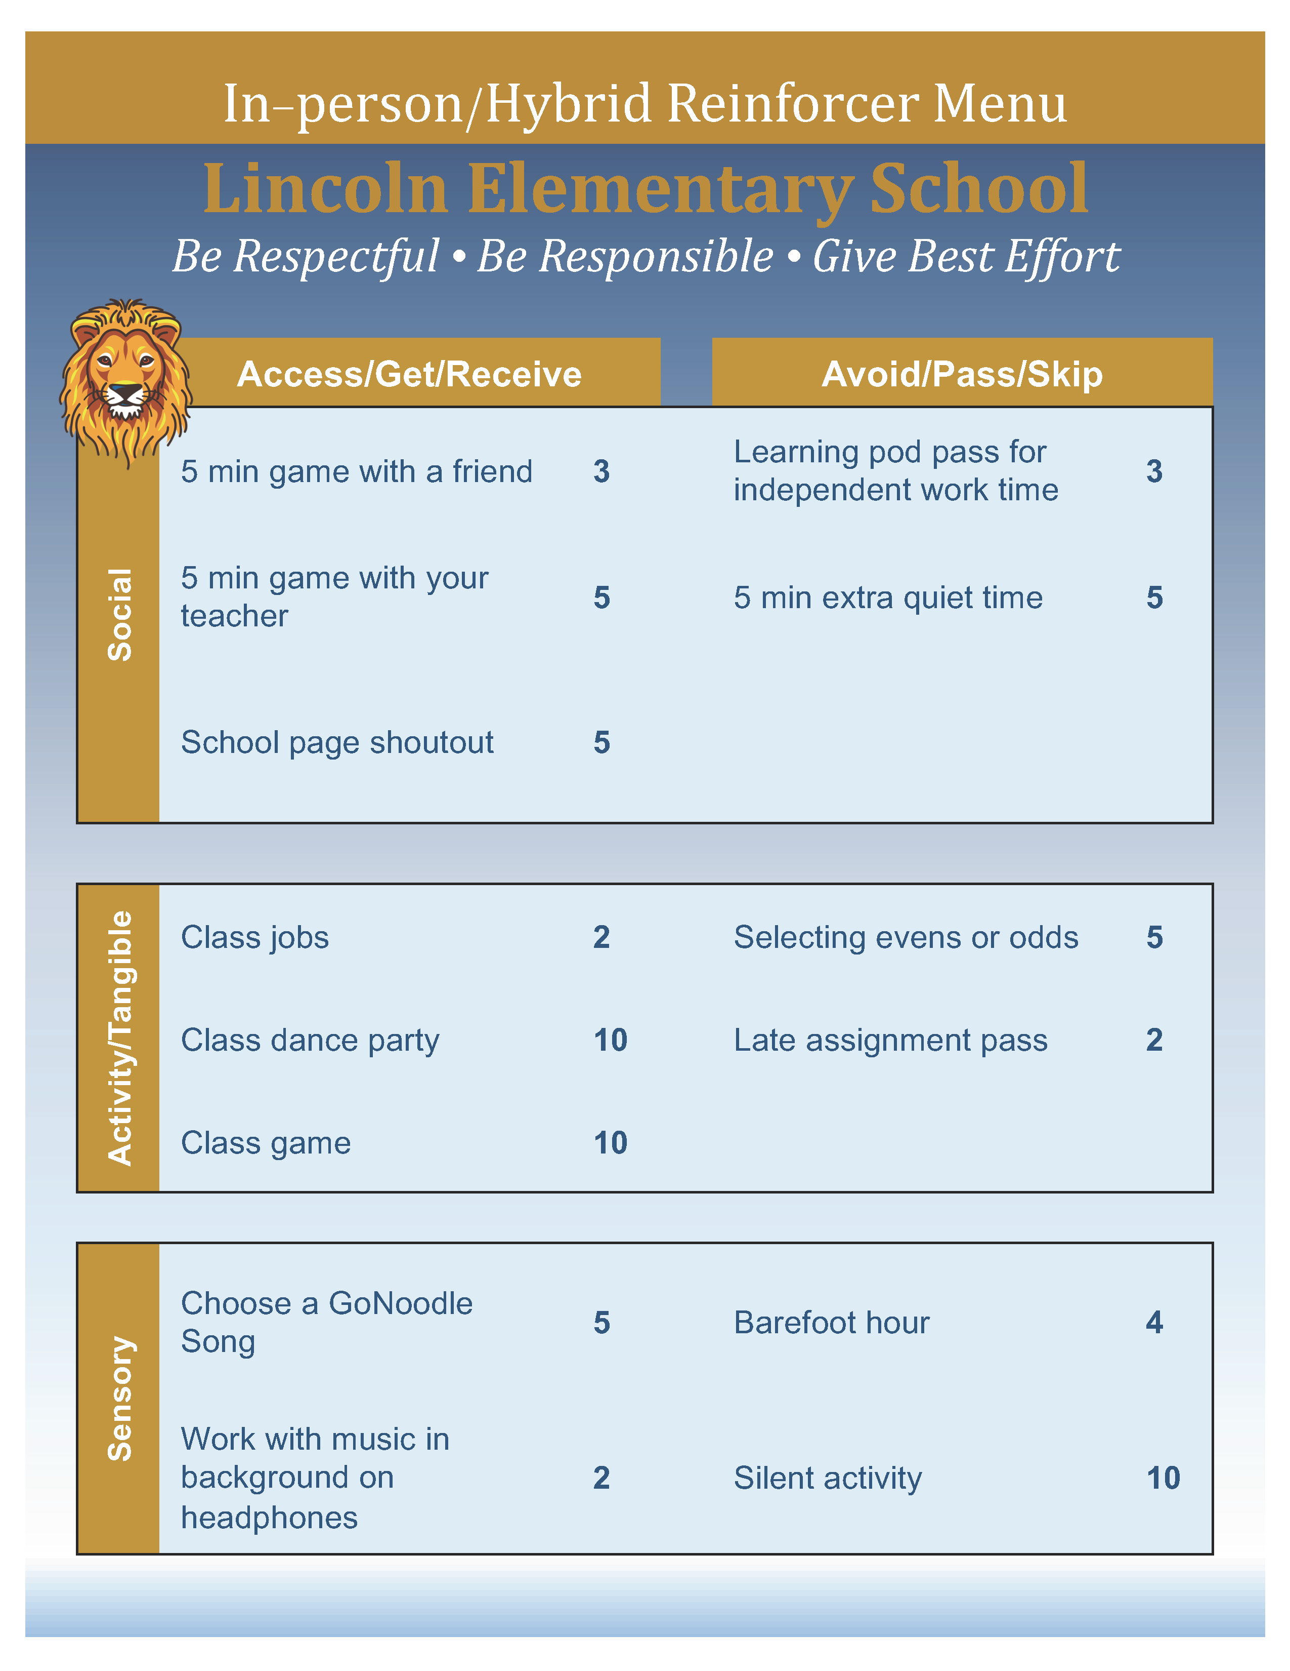
Notes:
When building your menu – be sure to include a range of reinforcers to help capture the attention, interest, and motivation of all students to follow expectations. This reinforcer menu highlights reinforcers that the student can access (positive reinforcement) or avoid (negative reinforcement) and considers three primary functions of behavior – attention, activities / tangibles, and sensory.
Consider what end-of-year reinforcers you might be able to offer. For example – auctioning off or selling classroom posters, books from classroom library, extra supplies.

Slide 40
Let’s Chat!
What is the most unique reinforcer you have offered?
OR
What is the most popular reinforcer on your menu?

Slide 41
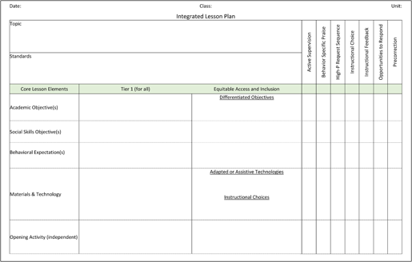
Embedding Low-Intensity Strategies
Notes:
High-quality instruction is one of the most valuable methods to support all students and promote positive and productive learning environments. Good instruction is structured, fast-paced, interactive, developmentally appropriate, and provides students with a variety of ways to interact with the content presented. Additionally, teachers can integrate low-intensity supports to proactively support student engagement.

Slide 42
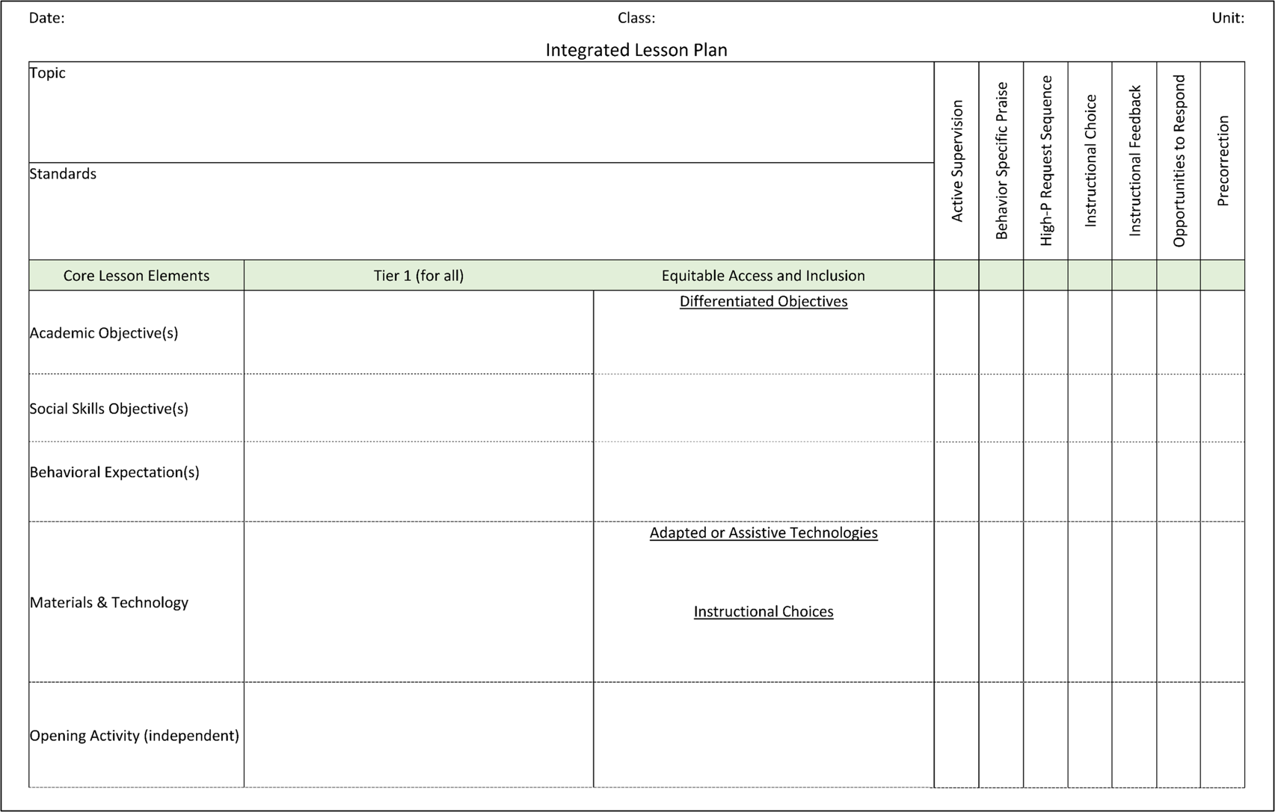

Slide 43
Notes:
Play video - 2:45 mins [illustration of embedding LIS into daily routines e.g., moving to carpet, using response cards]

Slide 44
Talk Time
How can you leverage Ci3T implementation to maintain a positive, productive learning environment as you close out the school year ? Consider opportunities for: Integrated lesson planning Universal reinforcement system Low-intensity, teacher delivered supports Using Tier 2 and Tier 3 Intervention Grids to connect students with supports
Notes:
10-min timer

Slide 45
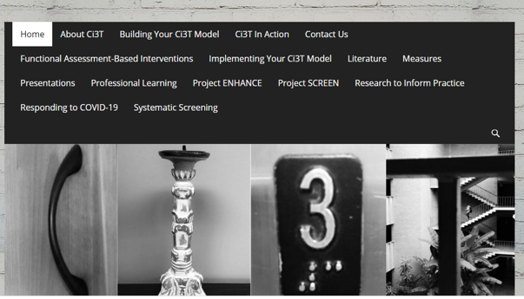
Planning for the 2024-2025 Academic Year

Slide 46
Ci3T Implementers Symposium
Monday June 24, 2024
7:30 a.m. – 1:30 p.m. (Pacific)
9:30 a.m. – 3:30 p.m. (Central)
10:30 a.m. – 4:30 p.m. (Eastern)

Slide 47
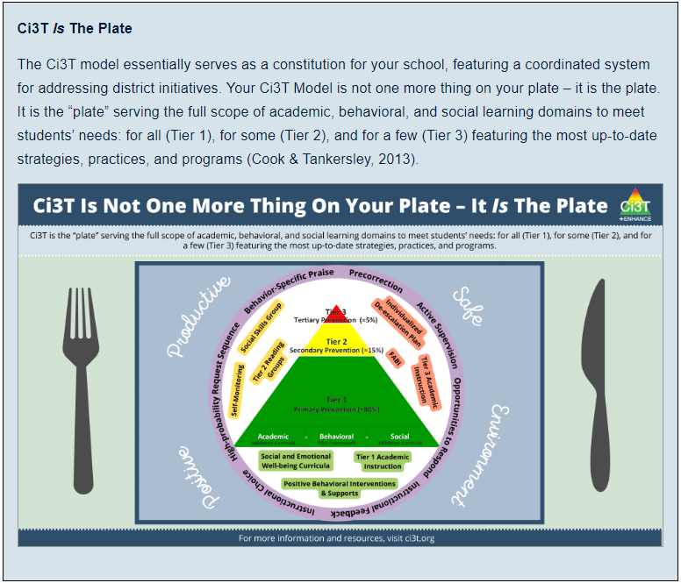

Slide 48
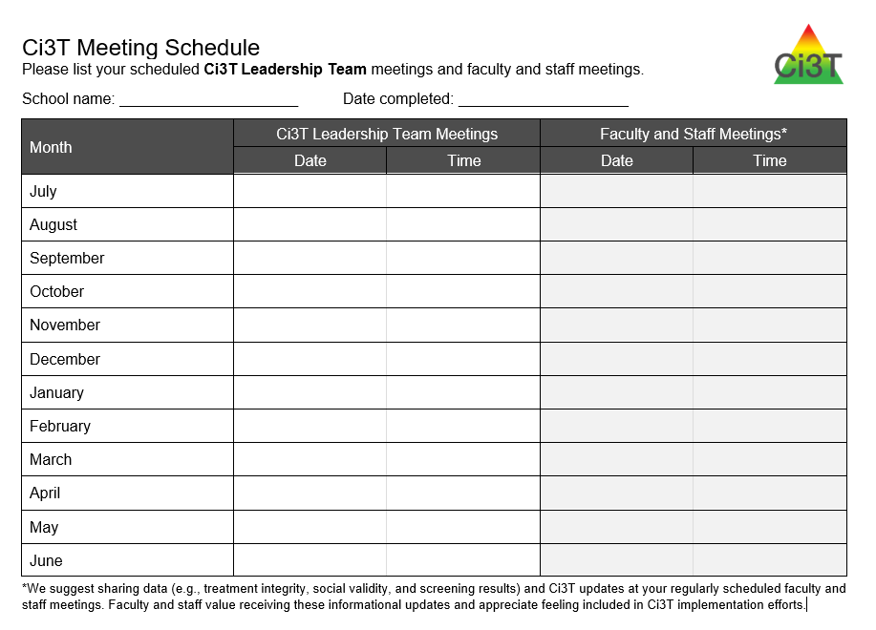
Outcome 1: Building your 2024-2025 Ci3T Implementation Calendar
Schedule Ci3T Leadership Team Meetings
Schedule faculty & staff meetings
Schedule professional learning opportunities
Schedule professional learning to support data collection and data-informed decision making
Notes:
Your district in engaging in long-term planning to identify assessment windows, treatment integrity and social validity windows, and their professional learning offerings.
You can use those dates as a springboard when building your 2024-2025 Implementation Calendar.

Slide 49
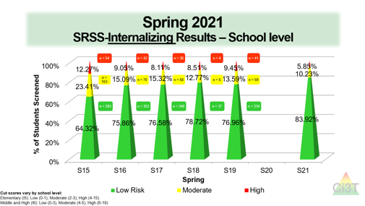
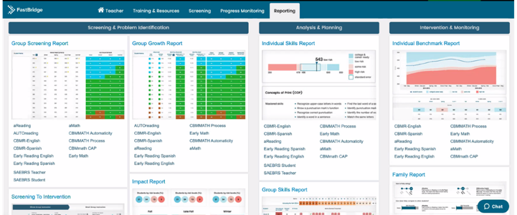
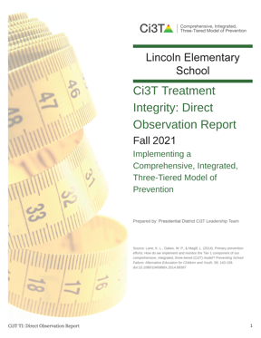
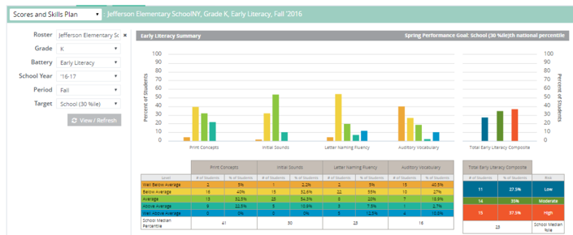
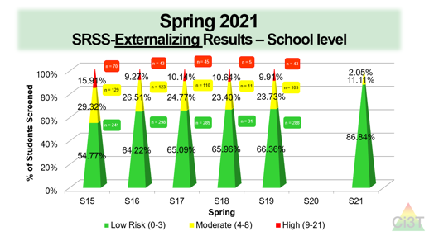
Responding to Spring Data
What professional learning is necessary to respond to screening, treatment integrity, and social validity data?

Slide 50
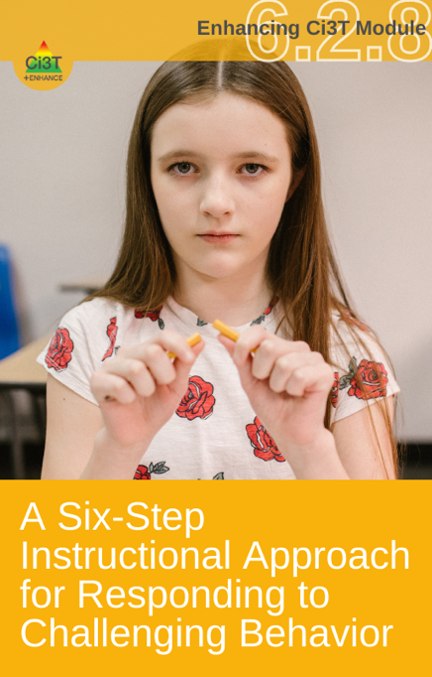
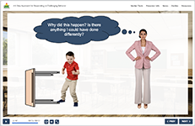
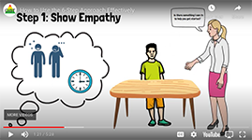
Stand Alone PD
Notes:
Leverage module content when designing professional development. You can:
Play a portion of the Interactive Resource
Play the video highlighting the steps
Many modules include a PowerPoint presentation with key information that you can download and personalize
Many modules include activities that you can facilitate with your staff such as scavenger hunts or simulations and discussion guides

Slide 51
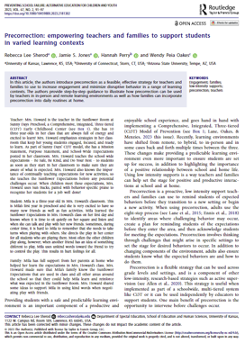
Book / Module / Article Study
Click here to access free open access articles on active supervision, behavior specific praise, instructional choice, and pre-correction!
Notes:
In PLCs or as an opt-in professional learning opportunity

Slide 52
Standing Agenda Item
10 Minute Tip for Success
Highlight & Celebrate Staff
Share Monthly Data

Slide 53
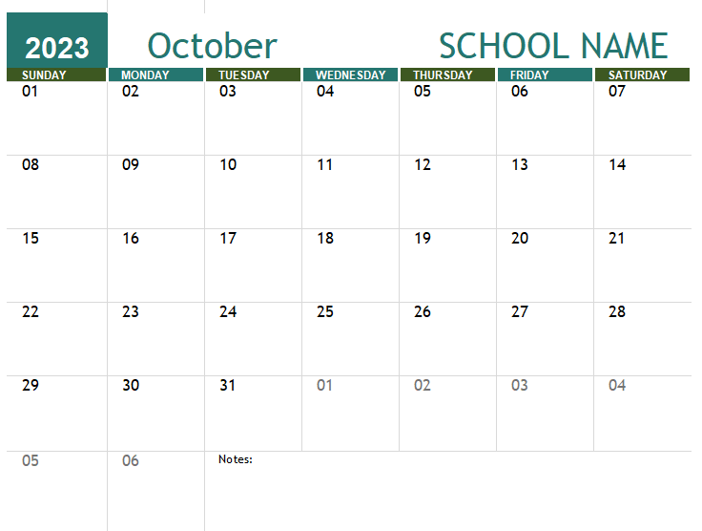
Professional Learning to Support Data Collection and Data-informed Decision Making
Add academic and behavior screening windows and treatment integrity and social validity windows to your calendar
Then, use this these windows to backwards plan:
Agenda items for Ci3T Leadership Team Meeting
Faculty & Staff Meetings
Additional Professional Learning
Notes:
For example, after noting your fall treatment integrity and social validity window you will want to:
Make a plan to preview the measures and share “the why” – this could be an email, 10 mins at a staff meeting
Coordinate direct observation training and schedule
Allocate time during a faculty and staff meeting for staff to complete the measures
Allocate time during a Ci3T Leadership Team to complete the Tiered Fidelity Inventory (TFI)
Allocate time during a Ci3T Leadership Team to review data once reports are available
Allocate time during a faculty and staff meeting to share results

Slide 54
Outcome 2: Setting up for the year ahead
Plan a beginning of year roll out to welcome faculty, staff, families, and students and share key information from your school’s Ci3T Implementation Manual

Slide 55
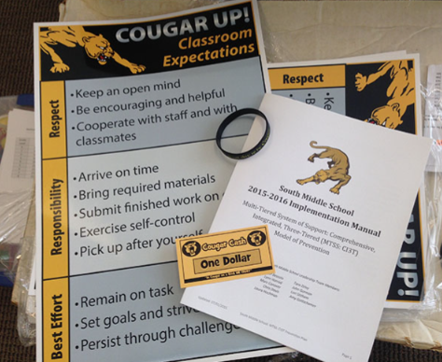
Beginning of year rollout for staff
Locate in your Ci3T Implementation Manual

Slide 56
Beginning of year rollout for students
Locate in your Ci3T Implementation Manual

Slide 57
Beginning of year rollout for families
Locate in your Ci3T Implementation Manual

Slide 58
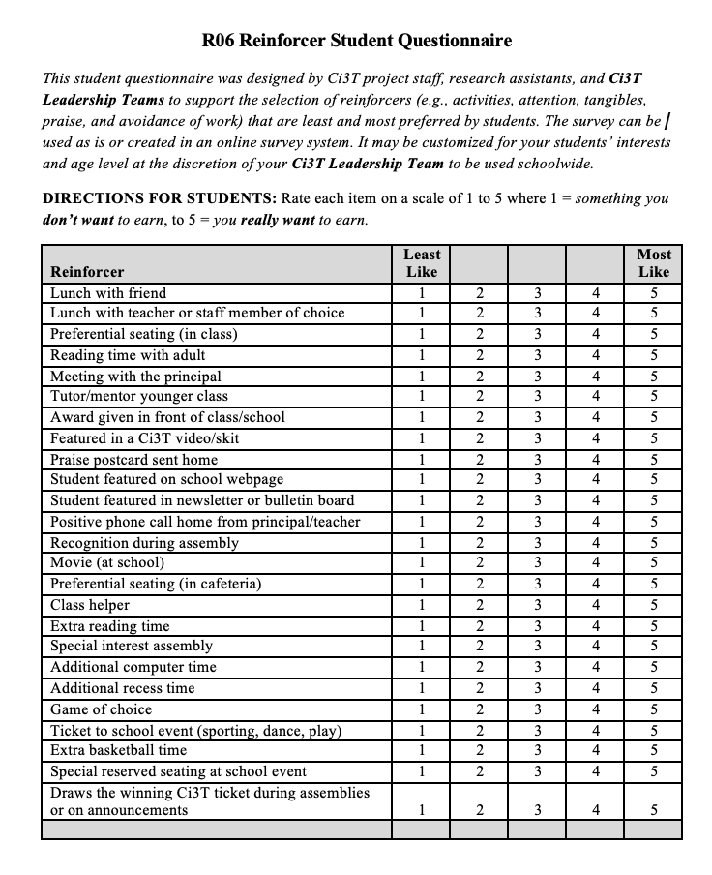
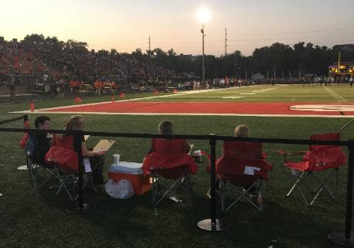
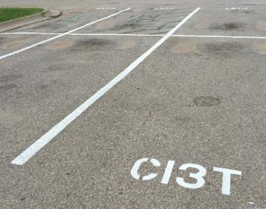
Procedures for Reinforcing - Students
Locate in your Ci3T Implementation Manual

Slide 59
Procedures for Reinforcing – Staff
Locate in your Ci3T Implementation Manual
(1) day of recess coverage

Slide 60
Talk Time
How can you use feedback from Treatment Integrity and Social Validity data to revise your school-wide plan? Which professional learning opportunities could be helpful in preparing for Ci3T implementation next year?
Notes:
10-min timer

Slide 61
Establishing Professional Learning Goals

Slide 62
School Ci3T Implementation Calendar
Sun. | Mon. | Tues. | Wed. | Thurs. | Fri. | Sat.
1 | 2 | 3 | 4 | 5 | 6 Professional learning session: Internalizing | 7
8 | 9 | 10 Ci3T Team Meeting | 11 | 12 Teach Social Skills Lesson | 13 | 14
15 | 16 Faculty meeting with a look at BSP | 17 | 18 | 19 | 20 | 21
22 | 23 | 24 | 25 | 26 Teach Social Skills Lesson | 27 | 28
Notes:
.

Slide 63
Ci3T Professional Learning Calendar
 | 0 | 1 | 2 | 3 | 4 | 5 | 6 | 7 | 8 | 9 | 10 | 11
 | July | Aug | Sep | Oct | Nov | Dec | Jan | Feb | Mar | Apr | May | Jun
Ci3T Training |  |  |  |  | Ci3T Professional Learning Series Session 1 | Ci3T Professional Learning Series Session 2 | Ci3T Professional Learning Series Session 3 | Ci3T Professional Learning Series Session 4 |  | Ci3T Professional Learning Series Session 5 | Ci3T Professional Learning Series Session 6
Ci3T Implementation Support | Ci3T Implementation Series Prep Session |  | Ci3T Implementation Series Session 1 |  | Ci3T Implementation Series Session 2 |  | Ci3T Implementation Series Session 3 |  | Ci3T Implementation Series Session 4 | Ci3T Implementation Series Session 5
Ci3T EMPOWER |  |  | Ci3T EMPOWER Session 1 | Ci3T EMPOWER Session 2 | Ci3T EMPOWER Session 3 |  | Ci3T EMPOWER Session 4 |  | Ci3T EMPOWER Session 5 | Ci3T EMPOWER Session 6
Ci3T Trainers & Coaches Calls |  | Trainers & Coaches Call Session 1 | Trainers & Coaches Call Session 2 | Trainers & Coaches Call Session 3 | Trainers & Coaches Call Session 4 | Trainers & Coaches Call Session 5 | Trainers & Coaches Call Session 6 | Trainers & Coaches Call Session 7 | Trainers & Coaches Call Session 8 | Trainers & Coaches Call Session 9 | Trainers & Coaches Call Session 10

Slide 64
ENHANCE Ci3T Implementation Professional Learning Series
Ci3T Implementation Professional Learning Series Location: Remote via Zoom Attended by: School Ci3T Leadership Teams Sessions A and B available: Ci3T Leadership Teams can select which they would like to attend.
Session | Date | Times (Session A and B)
 |  | Pacific | Central | Eastern
Summer Session | June. 24, 2024 (Mon) | 07:30 am – 01:30 pm | 09:30 am – 03:30 pm | 10:30 am – 04:30 pm
Session 1 | Sept. 10, 2024 (Tues) | 09:00 am – 11:00 am | 11:00 am – 01:00 pm | 12:00 pm – 02:00 pm
 |  | 02:30 pm – 04:30 pm | 04:30 pm – 06:30 pm | 05:30 pm – 07:30 pm
Session 2 | Nov. 12, 2024 (Tues) | 09:00 am – 11:00 am | 11:00 am – 01:00 pm | 12:00 pm – 02:00 pm
 |  | 02:30 pm – 04:30 pm | 04:30 pm – 06:30 pm | 05:30 pm – 07:30 pm
Session 3 | Jan. 14, 2025 (Tues) | 09:00 am – 11:00 am | 11:00 am – 01:00 pm | 12:00 pm – 02:00 pm
 |  | 02:30 pm – 04:30 pm | 04:30 pm – 06:30 pm | 05:30 pm – 07:30 pm
Session 4 | Mar. 04, 2025 (Tues) | 09:00 am – 11:00 am | 11:00 am – 01:00 pm | 12:00 pm – 02:00 pm
 |  | 02:30 pm – 04:30 pm | 04:30 pm – 06:30 pm | 05:30 pm – 07:30 pm
Session 5 | Apr. 15, 2025 (Tues) | 09:00 am – 11:00 am | 11:00 am – 01:00 pm | 12:00 pm – 02:00 pm
 |  | 02:30 pm – 04:30 pm | 04:30 pm – 06:30 pm | 05:30 pm – 07:30 pm

Slide 65
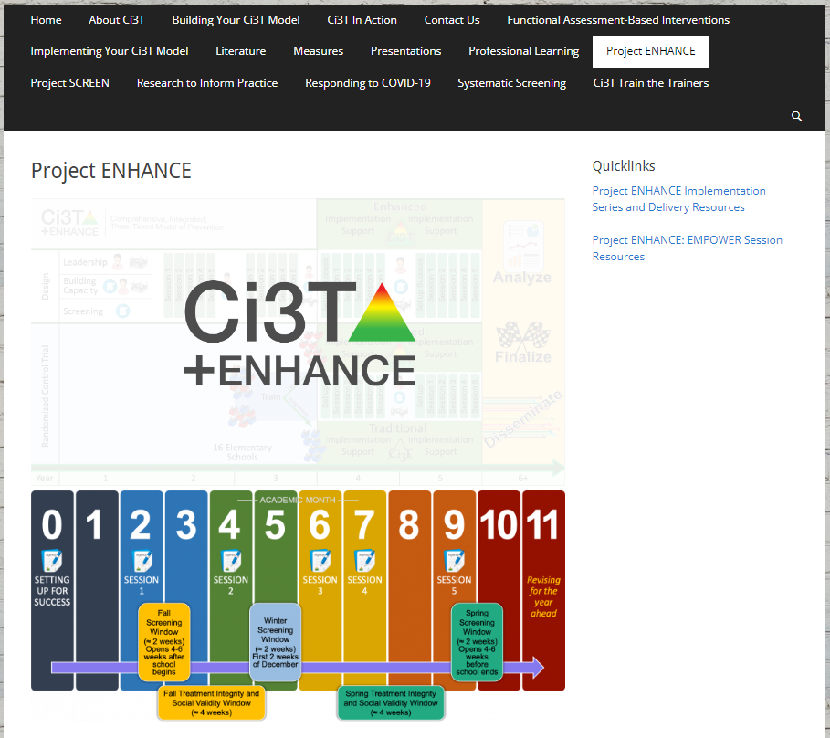
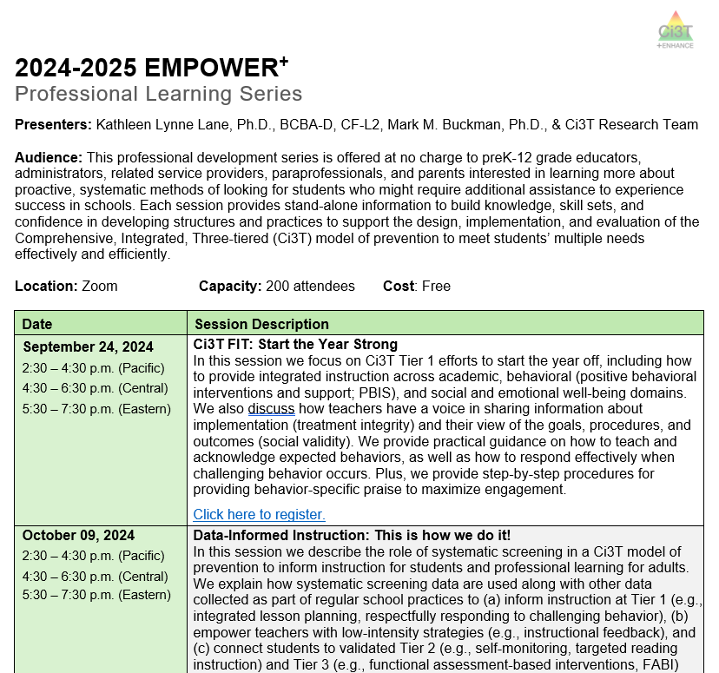
Building Capacity & Supporting Sustainability Professional Learning Offerings for 2023-2024
Sign up now for 2024-2025 EMPOWER sessions!

Slide 66
Project EMPOWER +
Ci3T EMPOWER⁺ Sessions Location: Remote via Zoom Attended by: School Ci3T Leadership Teams, Ci3T District Trainers and Coaches, Faculty and Staff, Families (adults only). Community Members
Session | Date | Times
1. Ci3T FIT: Start the Year Strong | Sep. 24, 2024 (Tues) | 2:30 - 4:30 p.m. (Pacific) 4:30 - 6:30 p.m. (Central) 5:30 - 7:30 p.m. (Eastern)
2. Data-Informed Instruction: This is how we do it! | Oct. 9, 2024 (Wed) | 2:30 - 4:30 p.m. (Pacific) 4:30 - 6:30 p.m. (Central) 5:30 - 7:30 p.m. (Eastern)
3. Practical, Low Intensity Strategies to Maximize Engagement and Limit Disruption: Part 1 | Precorrection & Active Supervision | Nov. 19, 2024 (Tues) | 2:30 - 4:30 p.m. (Pacific) 4:30 - 6:30 p.m. (Central) 5:30 - 7:30 p.m. (Eastern)
4. Practical, Low Intensity Strategies to Maximize Engagement and Limit Disruption: Part 2 | Instructional Choice and Increased Opportunities to Respond | Jan. 22, 2025 (Wed) | 2:30 - 4:30 p.m. (Pacific) 4:30 - 6:30 p.m. (Central) 5:30 - 7:30 p.m. (Eastern)
5. Tier 2: Behavior Contracts | Feb. 11, 2025 (Tues) | 2:30 - 4:30 p.m. (Pacific) 4:30 - 6:30 p.m. (Central) 5:30 - 7:30 p.m. (Eastern)
6. Tier 2: Direct Behavior Ratings (DBR) | Mar. 26, 2025 (Wed) | 2:30 - 4:30 p.m. (Pacific) 4:30 - 6:30 p.m. (Central) 5:30 - 7:30 p.m. (Eastern)
7. Tier 3: Functional Assessment-based Interventions (FABI) | Apr. 29, 2025 (Tues) | 2:30 - 4:30 p.m. (Pacific) 4:30 - 6:30 p.m. (Central) 5:30 - 7:30 p.m. (Eastern)

Slide 67
Ci3T Trainers and Coaches Calls
2024-2025 Ci3T Trainers and Coaches Call information will be posted online after the last call this year!

Slide 68
Ci3T Trainers and Coaches Calls
Ci3T EMPOWER⁺ Sessions Location: Remote via Zoom Attended by: School Ci3T Leadership Teams, Ci3T District Trainers and Coaches, Faculty and Staff, Families (adults only). Community Members
Session | Date | Times (Central
Ci3T Trainers and Coaches Call | Aug. 21, 2024 (Wed) | 4:00 – 5:00 p.m.
Ci3T Trainers and Coaches Call | Sept. 04, 2024 (Wed) | 4:00 – 5:00 p.m.
Ci3T Trainers and Coaches Call | Oct. 01, 2024 (Tues) | 4:00 – 5:00 p.m.
Ci3T Trainers and Coaches Call | Nov. 06, 2024 (Wed) | 4:00 – 5:00 p.m.
Ci3T Trainers and Coaches Call | Dec. 03, 2024 (Tues) | 4:00 – 5:00 p.m.
Ci3T Trainers and Coaches Call | Jan. 23, 2025 (Thurs) | 4:00 – 5:00 p.m.
Ci3T Trainers and Coaches Call | Feb. 18, 2025 (Tues) | 4:00 – 5:00 p.m.
Ci3T Trainers and Coaches Call | Mar. 11, 2025 (Tues) | 4:00 – 5:00 p.m.
Ci3T Trainers and Coaches Call | Apr. 16, 2025 (Wed) | 4:00 – 5:00 p.m.
Ci3T Trainers and Coaches Call | May 14, 2025 (Wed) | 4:00 – 5:00 p.m.

Slide 74
Talk Time
In thinking about your successes and challenges from this school year, consider setting goals for yourself in the areas of: Tier 1 (Procedures for Teaching, Reinforcing, and Monitoring) Tier 2 and Tier 3 (Use of data for decision-making; intervention implementation)
Notes:
10-min timer

Slide 75
Wrapping Up and Moving Forward

Slide 76
Ci3T
Comprehensive Professional Learning Plan
Ci3T: Primary Prevention
Session 1:
Overview of Ci3T Prevention Models
Setting a Purpose
Establish team meetings and roles
Session 2:
Mission and Purpose
Establish Roles and Responsibilities
Procedures for Teaching
Procedures for Reinforcing
Reactive Plan
Session 3:
Procedures for Monitoring
Session 4:
Revise Primary Plan using Stakeholder feedback
Prepare presentation
Ci3T: Secondary Prevention
Session 5:
Overview of Teacher focused Strategies
Overview of Student Focused Strategies
Using data to determine which students may need Secondary (Tier 2) supports
Draft the Secondary Intervention Grid based on existing supports
Ci3T: Tertiary Prevention
Session 6:
Final revisions of Ci3T Plan based on stakeholder feedback
Draft Tertiary (Tier 3) Prevention Intervention Grids
Design Implementation Manual and Plan for roll out to faculty, students, and parents
Ci3T Leadership Team Training Sequence
Implementation Stages of Tier 2 and 3 within Ci3T
Additional Professional Development on Specific Topics
Core Content Curriculum
Check In - Check Out
Functional Assessment-based Interventions
Reading, Math, Writing Benchmarking and Progress Monitoring Tools
Interventions, Strategies, & Practices
Additional Tier 3 Supports
Instructional Techniques to Improve Students’ Motivation; Classroom Management Practices;
Low-Intensity Behavior Supports

Slide 77
Wrapping Up & Next Steps
Today
Next Year
Overview of Ci3T: Identifying Successes and Areas for Refinement
Closing out the School Year: Positive, Productive Learning Environments
Planning for the 2024-2025 Academic Year
Establishing Professional Learning Goals
Ci3T Implementation Professional Learning Series 2024-2025
Ci3T EMPOWER Sessions 2024-2025
We hope you have a wonderful conclusion to the school year!

Slide 78
Comprehensive, Integrated, Three-Tiered Model of Prevention
(Lane, Kalberg, & Menzies, 2009)
Thank you!
Notes:
Tag us in your Ci3T highlights- we’d love to see Ci3T in action! Follow us on Twitter or Instagram for updates and links to resources! @Ci3TModel
You will receive a brief session evaluation – we value your feedback and would greatly appreciate you taking a few minutes to share your thoughts on what you liked about the session and how we can improve

