Slide 1
Wouldn’t it be great if …
Systematic Screening in Comprehensive, Integrated, Three-tiered (Ci3T)
Models of Prevention
April 3, 2024
Kathleen Lynne Lane, Ph.D., BCBA-D, CF-L2
University of Kansas
Roy A. Roberts Distinguished Professor
Associate Vice Chancellor for Research

Slide 2


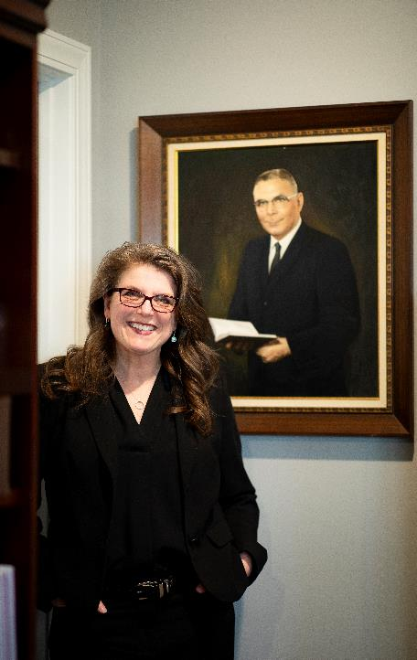

With sincere gratitude
Image … the Journey
The Journey

Slide 3
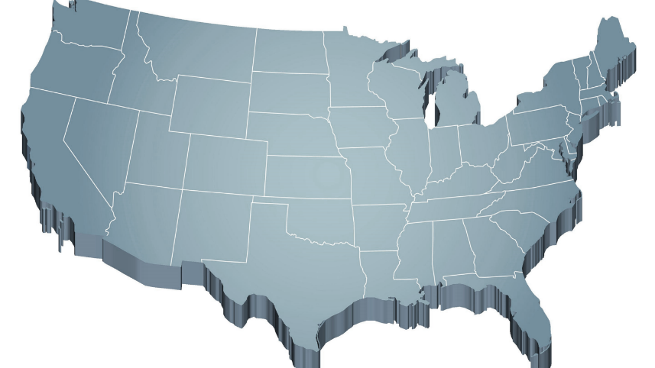






The Challenge …
Internalizing
Externalizing
ED <1%
EBD 12-20%
Source: Forness, S.R., Freeman, S.F., Paparella, T., Kauffman, J.M., & Walker, H.M. (2012). Special education implications of point and cumulative prevalence for children with emotional or behavioral disorders. Journal of Emotional and Behavioral Disorders, 20, 4-18.

Slide 4
Agenda
The Ci3T Journey of Ci3T: Partnerships Appreciated
The Importance of Systematic Screening
  to inform instruction at Tier 1
  to empower educators with low-intensity strategies
  to connect students with Tier 2 and Tier 3 interventions
The Gifts of Funded Inquiry
  Practitioner-Researcher Partnership
  Project SCREEN: The Role of Systematic Screening
  Project ENHANCE: Building Implementation Capacity
  Project ENGAGE: Pandemic Impact
Next Steps & Gratitude

Slide 6

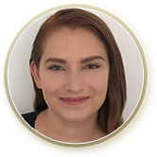







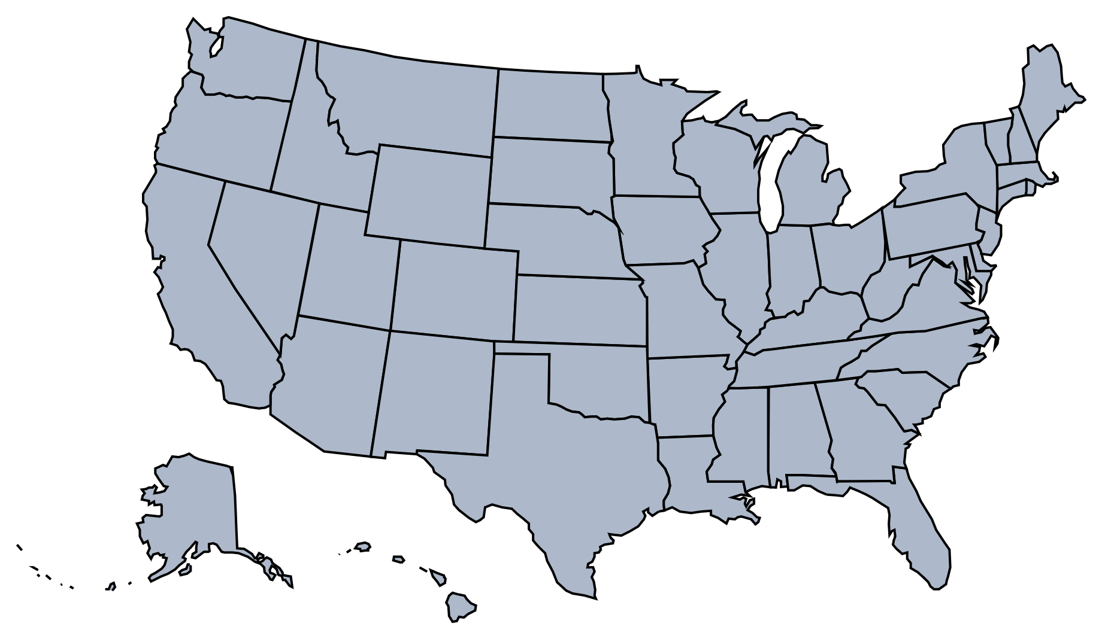

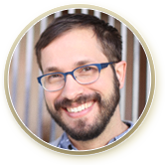


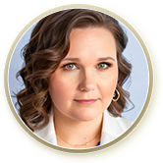






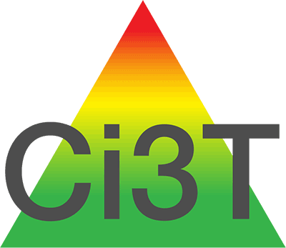
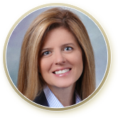








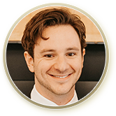







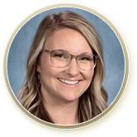
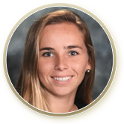

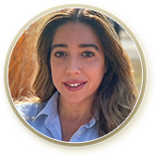


The Journey of Ci3T
1996
Notes:
CA & AZ start→ Tennessee → North Carolina→ Kansas
Trainings in MO, KS, VT, AZ
More trainings and grants: MO, KS, AL, SC, HI, KY

Slide 7
Comprehensive, Integrated, Three-Tiered Model of Prevention
(Lane, Kalberg, & Menzies, 2009)
Tier 3
Tertiary Prevention (≈5%)
Tier 2
Secondary Prevention (≈15%)
District & State Standards
High Quality Instruction
Tier 1
Primary Prevention (≈80%)
Academic ◇ Behavioral ◇ Social
Validated Curricula PBIS Framework Validated Curricula

Slide 8
Comprehensive, Integrated, Three-Tiered Model of Prevention
(Lane, Kalberg, & Menzies, 2009)
Tier 3
Tertiary Prevention (≈5%)
Tier 2
Secondary Prevention (≈15%)
Positive Behavior Interventions and Supports (PBIS)
Tier 1
Primary Prevention (≈80%)
Academic ◇ Behavioral ◇ Social
Validated Curricula PBIS Framework Validated Curricula

Slide 9
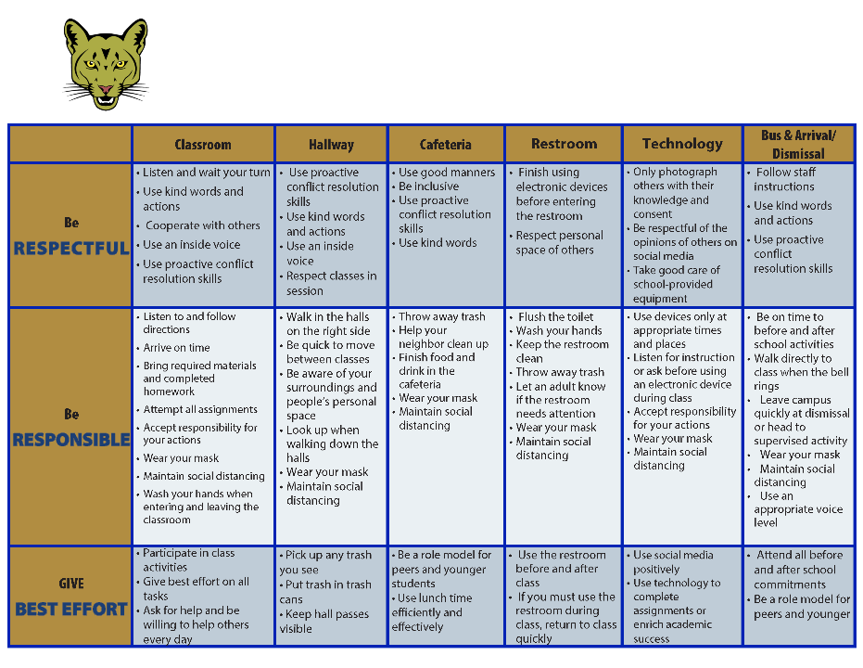
Coolidge Middle School
Expectation Matrix
Establish, Clarify, Define Expectations

Slide 10
Comprehensive, Integrated, Three-Tiered Model of Prevention
(Lane, Kalberg, & Menzies, 2009)
Tier 3
Tertiary Prevention (≈5%)
Tier 2
Secondary Prevention (≈15%)
Tier 1
Primary Prevention (≈80%)
Academic ◇ Behavioral ◇ Social
Validated Curricula PBIS Framework Validated Curricula

Slide 11
Comprehensive, Integrated, Three-Tiered Model of Prevention
(Lane, Kalberg, & Menzies, 2009)
Tier 3
Tertiary Prevention (≈5%)
Tier 2
Secondary Prevention (≈15%)
Tier 1
Primary Prevention (≈80%)
Academic ◇ Behavioral ◇ Social
Validated Curricula PBIS Framework Validated Curricula

Slide 12
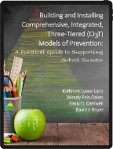

Slide 13

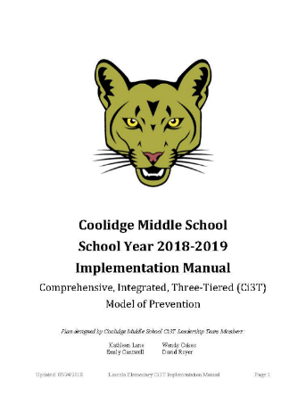

Ci3T Implementation Manual
Notes:
- Ci3T leadership teams build an implementation manual
- over the course of a year, feedback from faculty and staff along the way
- outlines what is taking place within the school

Slide 14
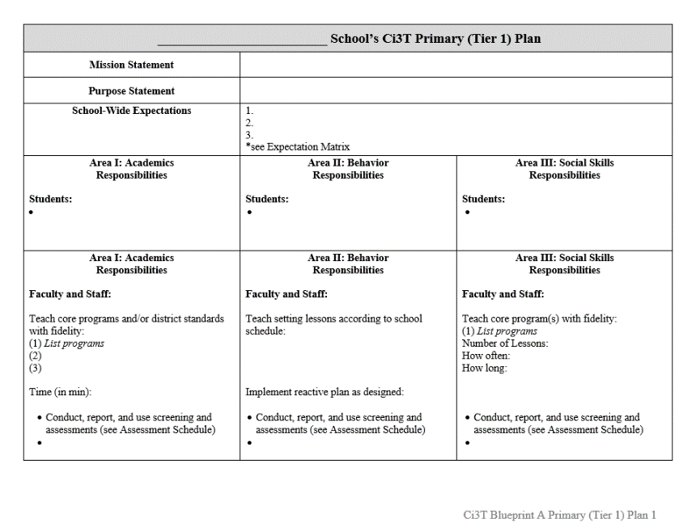
Ci3T Implementation Manual Primary (Tier 1) Plan
What are ALL students accessing?

Slide 15
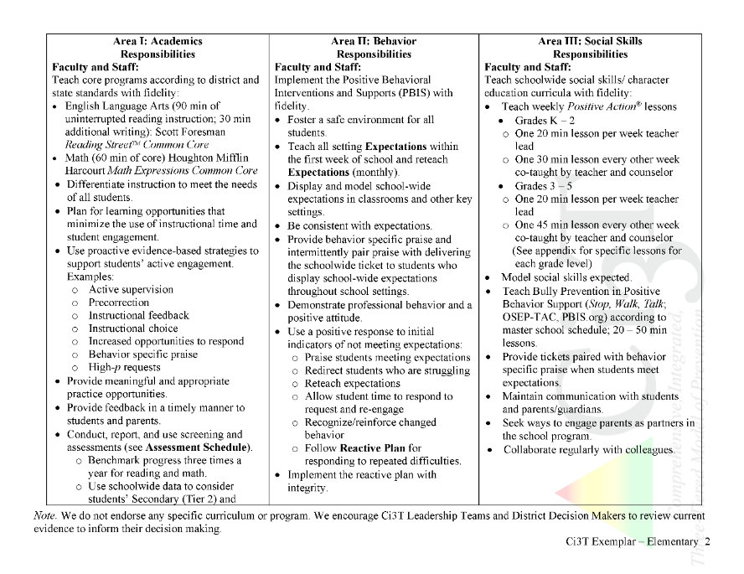
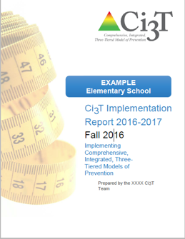
Ci3T Primary Plan: Procedures for Teaching
Ci3T Primary Plan: Procedures for Reinforcing
Ci3T Primary Plan: Procedures for Monitoring

Slide 16
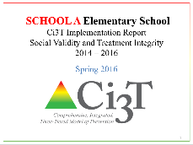
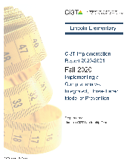
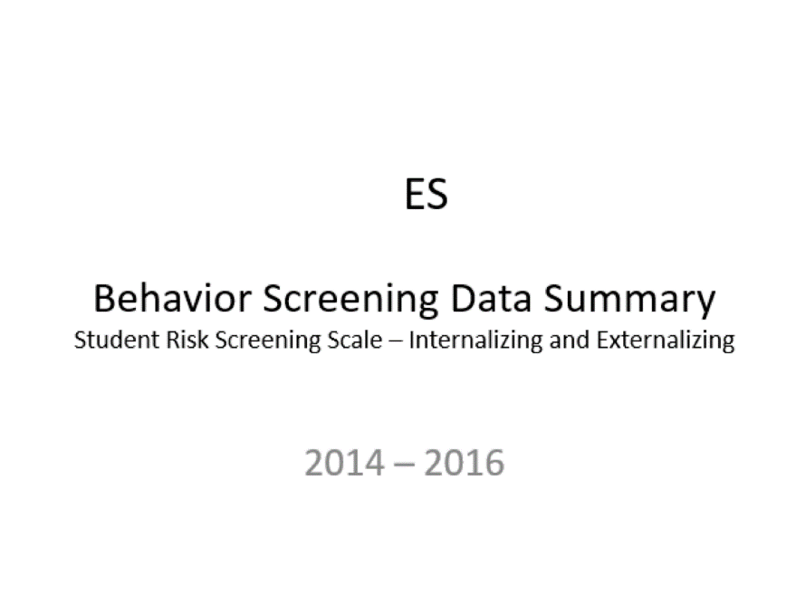
Essential Components of
Primary Prevention Efforts
Social Validity
Systematic Screening
Academic
Behavior
Treatment Integrity
Notes:
We support our school partners in administering surveys to their faculty and staff to garner understanding of social validity, conduct observations and self-reports to assess treatment integrity, and support systematic screening of all students for academics and behavior. We believe that schools thrive when faculty and staff are keenly aware of their school-wide data (show the next three slides)

Slide 17

Secondary (Tier 2) Intervention Grids

Slide 18

Tertiary (Tier 3) Intervention Grids

Slide 19
Implementation Science
Adapted from Fixsen & Blasé, 2005
Exploration & Adoption
Installation
Initial Implementation
We think we know what we need so we are planning to move forward (evidence-based)
Let’s make sure we’re ready to implement (capacity infrastructure)
Let’s give it a try & evaluate (demonstration)
Full Implementation
Let’s make it our way of doing business (institutionalized use)
Sustainability & Continuous Regeneration
That worked, let’s do it for real (investment)

Slide 20
Transparency, Access, &
Collaboration
Benefits of Ci3T Models

Slide 21

The Importance of
Systematic Screening
Wouldn’t it be great if … students could be detected
at the first sign of concern?

Slide 22

Systematic Screening … Logistics
Fall
Winter
Spring
Selecting
Installing
Analyzing

Slide 23

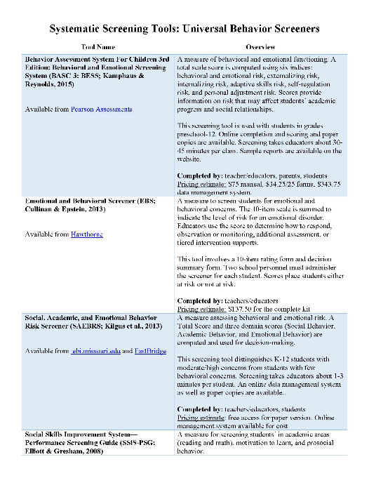
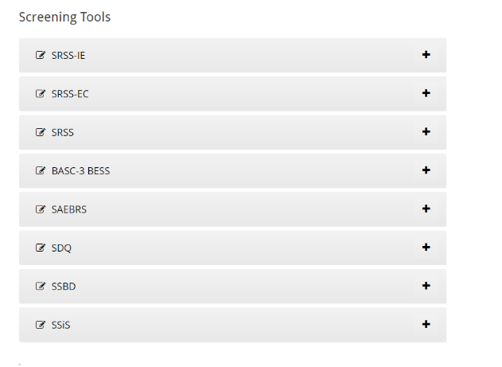
Learning More About Options
Psychometrically Sound
Socially Valid

Slide 24

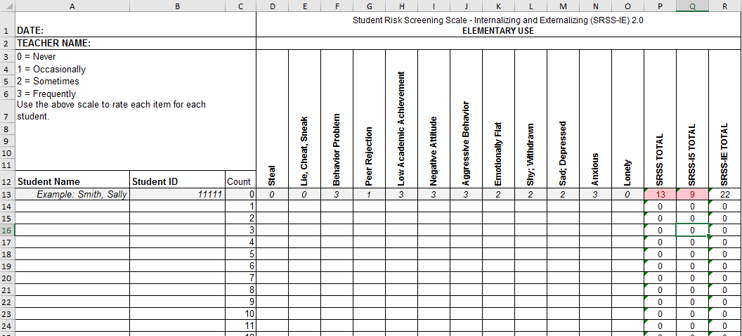
Student Risk Screening Scale for
Internalizing and Externalizing
(SRSS-IE; Drummond, 1994; Lane & Menzies, 2009)

Slide 25
SRSS-IE: Cut Scores
Elementary School |  | Middle and High School
SRSS-E7 | SRSS-I5 | SRSS-E7 | SRSS-I6
Items 1-7 | Items 8-12 | Items 1-7 | Items 4, 8-12
0-3 = low risk 4-8 = moderate risk 9-21 = high risk | 0-1 = low risk 2-3 = moderate risk 4-15 = high risk | 0-3 = low risk 4-8 = moderate risk 9-21 = high risk | 0-3 = low risk 4-5 = moderate risk 6-18 = high risk
Elementary School Level:
Lane, K. L., Oakes, W. P., Swogger, E. D., Schatschneider, C., Menzies, H., M., & Sanchez, J. (2015). Student risk screening scale for internalizing and externalizing behaviors: Preliminary cut scores to support data-informed decision making. Behavioral Disorders, 40, 159-170.
Middle and High School Levels:
Lane, K. L., Oakes, W. P., Cantwell, E. D., Schatschneider, C., Menzies, H., Crittenden, M., & Messenger, M. (2016). Student Risk Screening Scale for Internalizing and Externalizing Behaviors: Preliminary cut scores to support data-informed decision making in middle and high schools. Behavioral Disorders, 42(1), 271-284

Slide 26
Spring 2023
SRSS-Externalizing Results – Elementary School level
n = 70
n = 43
n = 45
n = 5
n = 43
n = 7
n = 25
n = 31
n = 38
n = 87
n = 95
n = 129
n = 123
n = 110
n = 11
n = 103
n = 241
n = 298
n = 289
n = 31
n = 288
n = 297
n = 314
n = 330
Notes:
Fill in <year> based on current academic year. This is located in column A of the data sheet. Edit by right clicking and selecting “Edit data”.

Slide 27
Spring 2023
SRSS-Internalizing Results – Elementary School Level
n = 54
n = 42
n = 36
n = 103
n = 70
n = 68
n = 283
n = 352
n = 340
Cut scores vary by school level:
Elementary (I5): Low (0-1), Moderate (2-3), High (4-15)
Middle and High (I6): Low (0-3), Moderate (4-5), High (6-18)
Notes:
Fill in <year> based on current academic year. This is located in column A of the data sheet. Edit by right clicking and selecting “Edit data”.
IMPORTANT NOTE: The INTERNALIZING subscale and CUT SCORES are specific to school level.
Elementary: SRSS-I5, Items 8-12, 0-1 = low risk, 2-3 = moderate risk, 4-15 = high risk
Middle and High: SRSS-I6, Items 4, 8-12, 0-3 = low risk, 4-5 = moderate risk, 6-18 = high risk

Slide 28
Spring 2023
SRSS-Internalizing Results – Elementary Grade Level
Grade Level | N Screened | Low n (%) | Moderate n (%) | High n (%)
3 | 62 | 51 (82.26%) | 11 (17.74%) | 0 (0.00%)
4 | 81 | 62 (76.54%) | 13 (16.05%) | 6 (7.41%)
5 | 90 | 64 (71.11%) | 13 (14.44%) | 13 (14.44%)

Slide 29
Student Risk Screening Scale
Fall 2004-2012 • Middle School
Source: Lane, K. L., Oakes, W. P., & Magill, L. M. (2014). Primary prevention efforts: How do we implement and monitor the Tier 1 component of our comprehensive, integrated, three-tiered model of prevention? Preventing School Failure, 58, 143-158. doi: 10.1080/1045988X.2014.893978 [Figure 4. Middle school behavior screening data over time at the fall time point. Adapted from Figure 4.6 p. 127 Lane, K. L., Menzies, H. M, Oakes, W. P., & Kalberg, J. R. (2012). Systematic screenings of behavior to support instruction: From preschool to high school. New York, NY: Guilford Press.]

Slide 30
Middle School
Behavior & Academic Characteristics of SRSS Risk Groups
Variable |  | Risk
 | Low (n = 422) M (SD) | Moderate (n = 51) M (SD) | High (n = 12) M (SD) | Significance Testing
ODR | 1.50 (2.85) | 5.02 (5.32) | 8.42 (7.01) | L<M<H
In-School Suspensions | 0.08 (0.38) | 0.35 (1.04) | 1.71 (2.26) | L<M<H
GPA | 3.35 (0.52) | 2.63 (0.65) | 2.32 (0.59) | L>M, H M=H
Course Failures | 0.68 (1.50) | 2.78 (3.46) | 4.17 (3.49) | L<M, H M=H
(Lane, Parks, Kalberg, & Carter, 2007)

Slide 31
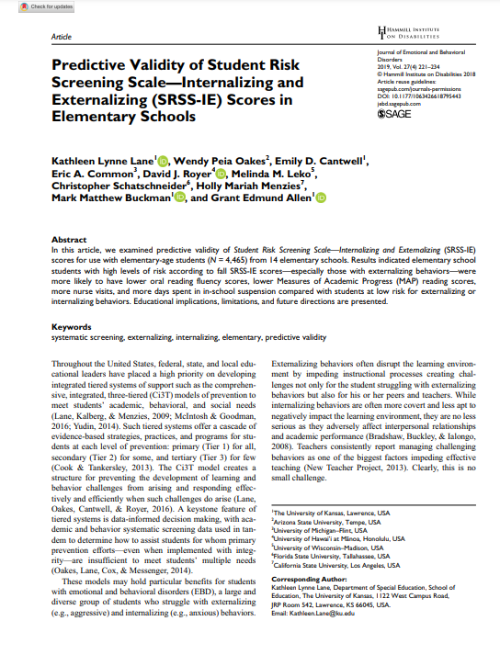
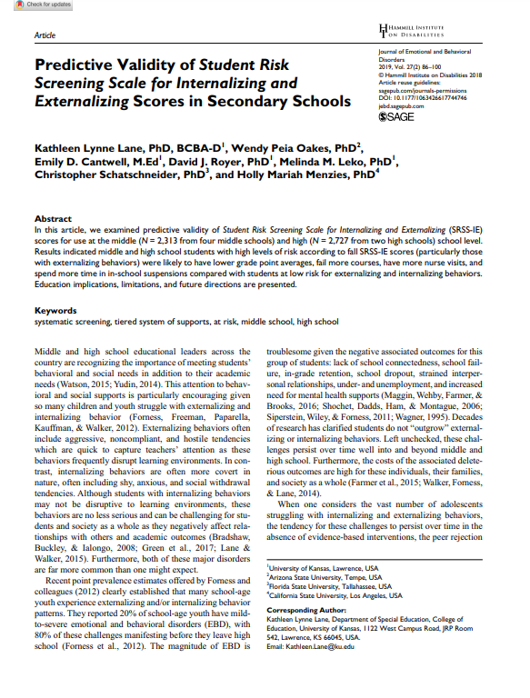
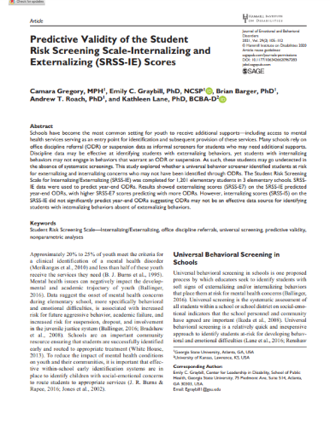
SRSS-IE Scores Predict Student Outcomes
Fall
Winter
Year End
ODR Suspensions
Nurse Visits
Course Failures

Slide 32





Slide 33
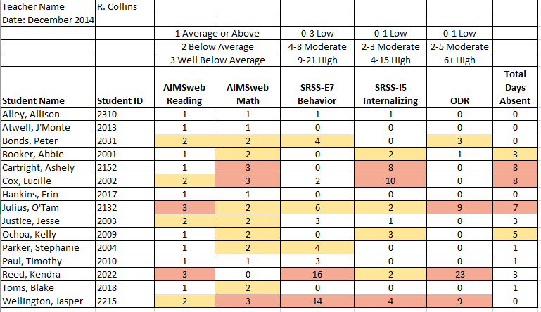
Examining Academic and Behavioral Data
Lane, K. L., Menzies, H. M., Ennis, R. P., & Oakes, W. P. (2015). Supporting Behavior for School Success: A Step-by-Step Guide to Key Strategies. Guilford Press.
Notes:
Lane, K. L., Oakes, W. P., Ennis, R. P., & Hirsch, S. E. (2014). Identifying students for secondary and tertiary prevention efforts: How do we determine which students have Tier 2 and Tier 3 needs? Preventing School Failure, 58, 171-182, DOI: 10.1080/1045988X.2014.895573

Slide 34

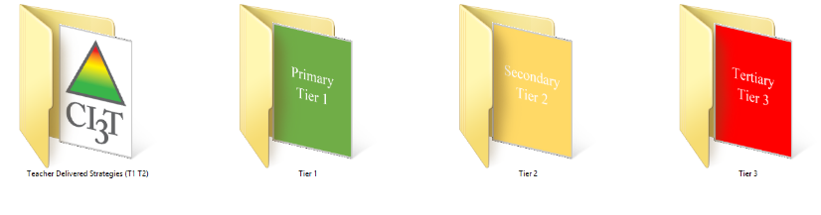
Building a Ci3T Tier Library
Teacher Delivered Strategies
Tier 1
Tier 2
Tier 3

Slide 35
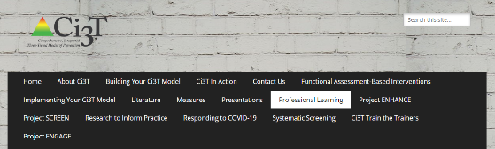
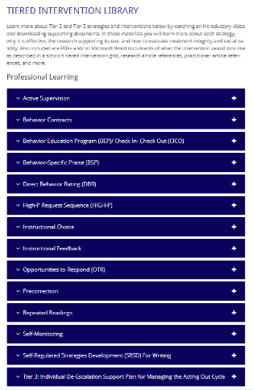

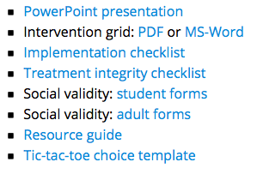
Low Intensity Strategies
https://www.ci3t.org/pl

Slide 36
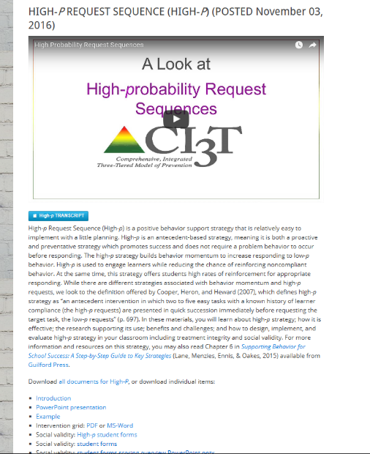
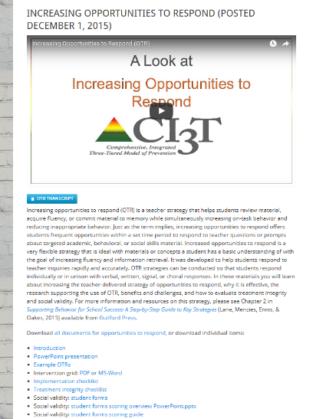
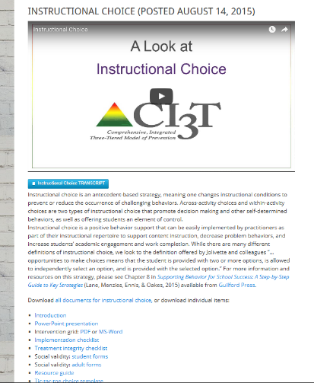
ci3t.org
Professional Learning tab

Slide 37
Low-Intensity Strategy | Franklin High School On-Site Expert
Behavior-Specific Praise: Identifying the specific expectation the student met. “Niama, I noticed you outlined your paper and used the graphic organizer to draft your essay. Well done!” “Justice, thank you for pushing in your chair to keep the walkway safe.” | Eric Common, Behavior Specialist Mark Buckman, Special Education Grant Allen, Parent Volunteer Paloma Pérez-Clark, School Psychologist
Opportunities to Respond: Providing 4-6 opportunities per minute for students to respond individually, choral, verbal, written, gesture, or symbol. “Show me thumbs or thumbs down if...” “Show me on your white board what…” “Turn to your elbow partner and say…” “All together now, what is…” | David Royer, Administration Emily Cantwell, 12th Grade Scarlett Lane, 11rd Grade Mallory Messenger, Counselor
Instructional Choice: Providing within-task or between task choices to increase academic engaged time and motivation. “Ronaldo, our of our 3 learning objectives today, which would you like to work on first?” “Suzy, do you want to work on the laptop, or handwrite your answers for this assignment?” | Abbie Jenkins, 10th Grade Scarlett Lane, 11th Grade José Sousa, PE Liane Johl, 9th Grade

Slide 38
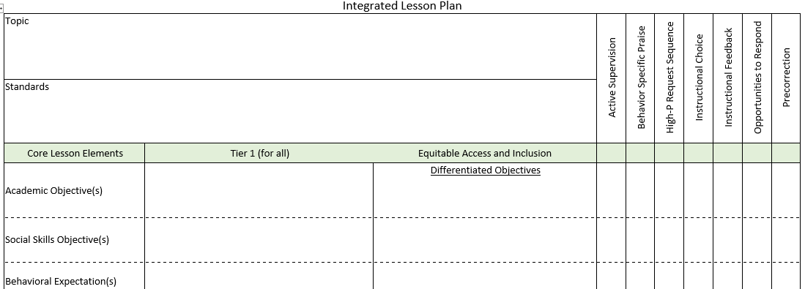
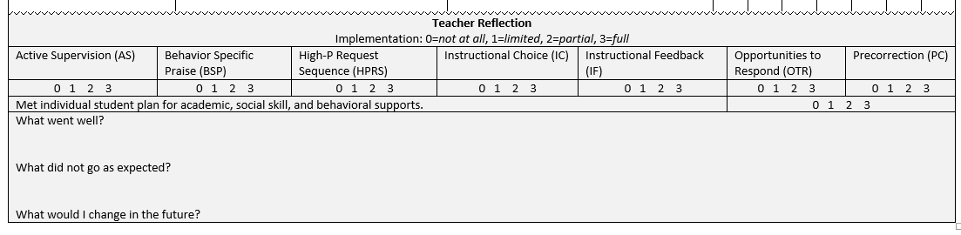
Planning for Integrated Instruction

Slide 39
Comprehensive, Integrated, Three-Tiered Model of Prevention
(Lane, Kalberg, & Menzies, 2009)
Tier 3
Tertiary Prevention (≈5%)
Tier 2
Secondary Prevention (≈15%)
Tier 1
Primary Prevention (≈80%)
Academic ◇ Behavioral ◇ Social
Validated Curricula PBIS Framework Validated Curricula

Slide 40
Secondary (Tier 2) Intervention Grids

Slide 41
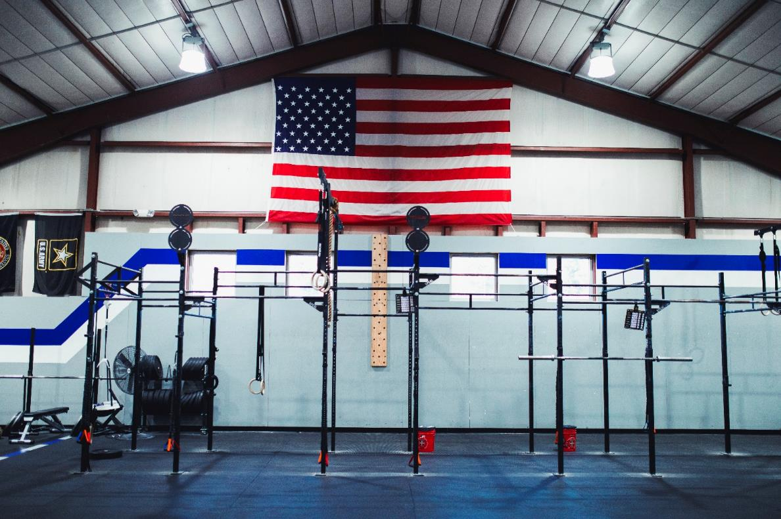


Slide 42
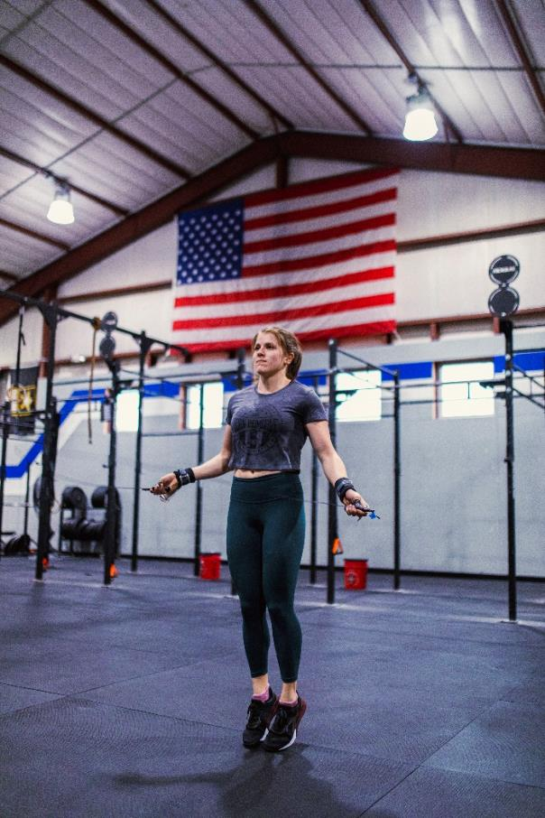
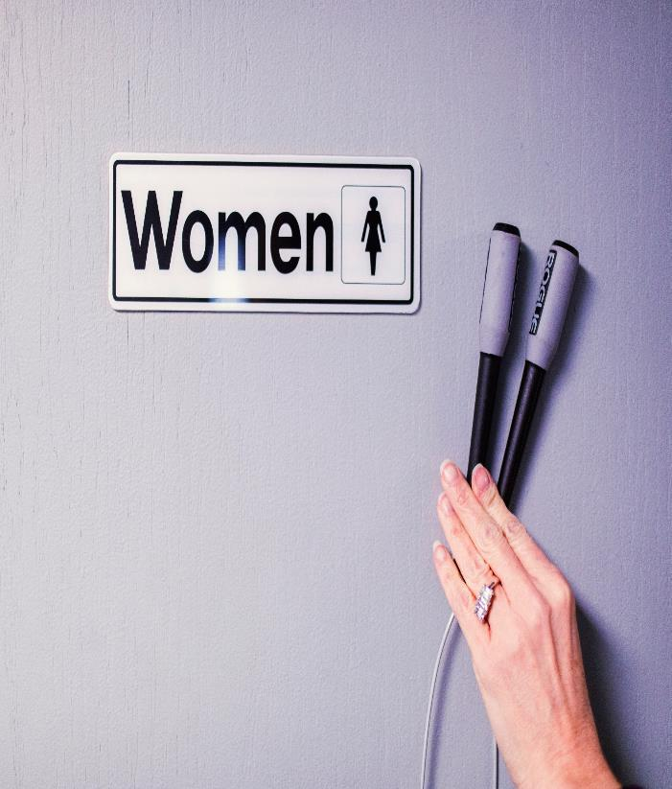

Slide 43

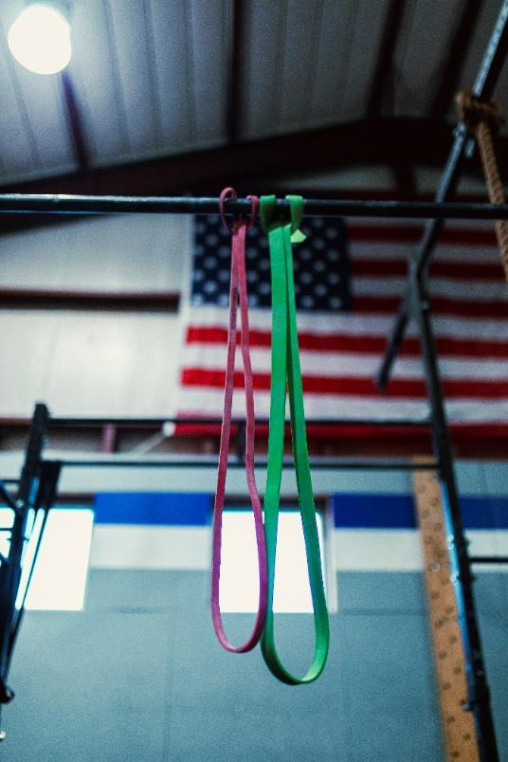
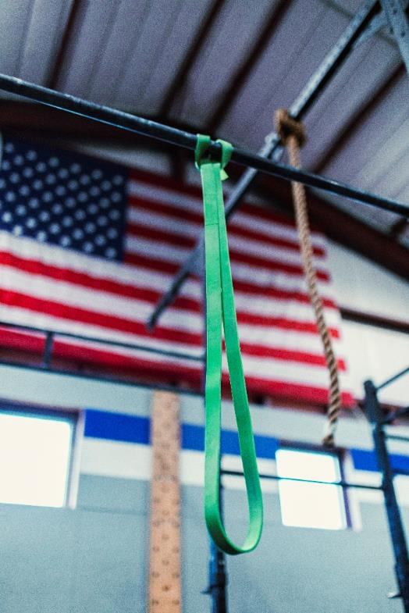

Slide 44
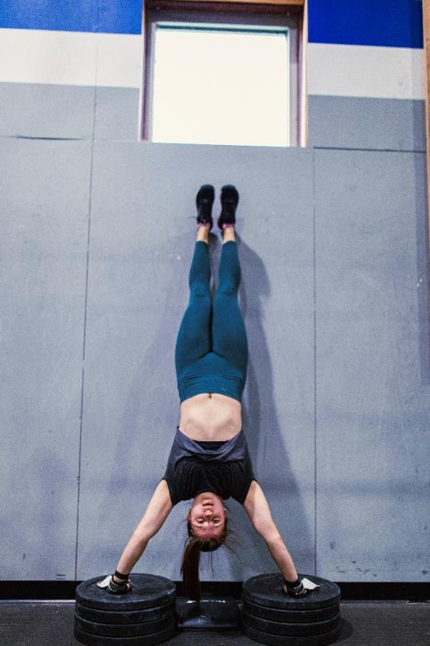
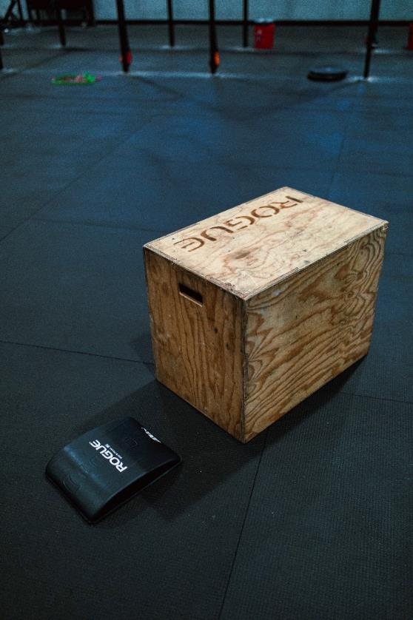

Slide 45
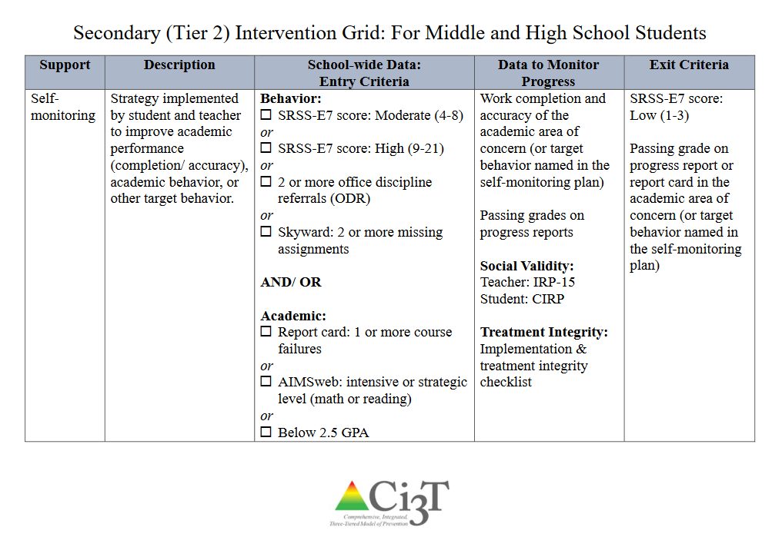

Slide 46
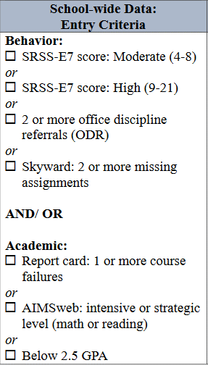
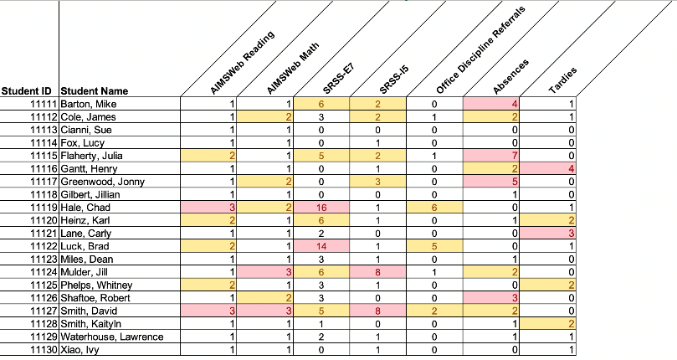
Data in action

Slide 47
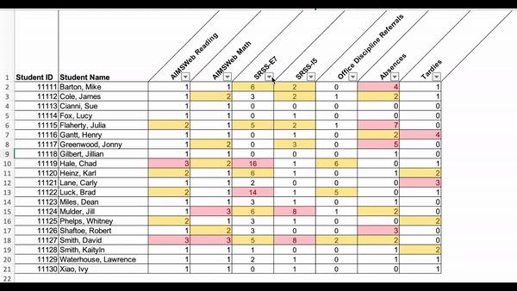
Data in action

Slide 48
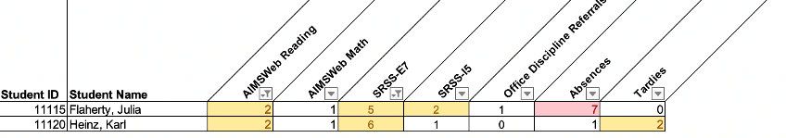
Data in action
Other Tier 2 options…
Precorrection
Behavior Contracts
Behavior-Specific Praise
Instructional Choice

Slide 49
Secondary (Tier 2) Intervention Grid
Support | Description | Schoolwide Data: Entry Criteria | Data to Monitor Progress | Exit Criteria
Self-Regulated Strategy Development (SRSD; Harris & Graham, 1996) Project WRITE | Teaching narrative and opinion writing strategies using the Self-Regulated Strategies Development approach to help students plan and write essays and stories | Behavior: SRSS – at risk (9 – 21) and/or SSBD – exceed normative criteria Internalizing or Externalizing And Academic: TOWL 3- score below the 25th percentile | Weekly writing probes scored on number of functional strategy elements- having each piece of WWW, What=2, How=2 or TREE in the writing | Completion of intervention curriculum.

Slide 50
Phase 1 Fall 07:
Screening & Assessment
Phase 2 Nov 07 – Feb 08: Intervention
Academic:
-TOWL (≤25% and 10-50 words)
Behavioral:
-SSRS (moderate, 4-8; or high, 9+)
-SSBD (“TREE” in or 1+ Critical Event)
Experimental
Treatment
SRSD for Writing
n = 24
n = 23
61 Second Graders
49 Participants
2nd grade Students
5 Elementary schools
Control
Regular School Practices
n = 25
n = 21

Slide 51

Intervention
Self-Regulated Strategy Development
(SRSD; Harris & Graham, 1996)
Behavioral Component
3 days a week; 30-min sessions delivered 1:1 by a research assistant
Fidelity collected more than 33% of sessions
Lane, K. L., Harris, K., Graham, S., Driscoll, S. A., Sandmel, K., Morphy, P., Hebert, M., House, E., & Schatschneider, C. (2011). Self-regulated strategy development at tier-2 for second-grade students with writing and behavioral difficulties: A randomized control trial. Journal of Research on Educational Effectiveness, 4, 322 – 353.
Notes:
51

Slide 52
Support | Description | School-wide Data: Entry Criteria | Data to Monitor Progress | Exit Criteria
Direct Behavior Rating (DBR) | DBR is typically completed daily following specified observation period(s) (e.g., math intervention; ELA core instruction). The most appropriate rater is a person who can directly observe the student during the observation period, typically the teacher. DBR is used to monitor specific behaviors identified as relevant for the student and setting. For example, many DBRs monitor academic engagement, respect, and disruption as core school-based behavioral competencies, and may adapt or add a behavior based on the student’s specific needs. After each observation period, the rater uses the provided scale to indicate the degree to which the student displayed each behavior. When used as part of a Tier 2 intervention, the rater reminds the students of the expected behaviors prior beginning the observation. At the conclusion of each observation, the rater uses the provided scale to indicate the degree to which the student displayed each behavior. The rater meets briefly with the student to share the DBR rating, providing behavior specific praise and instructional feedback. Home-school communication procedures may be established (e.g., information is shared with parent/caregiver daily, with return acknowledgement and possible home consequences). | Behavior SRSS-E7 score: Moderate (4-8) and/or SRSS-I5 score: Moderate (2-3) AND Evidence of teacher implementation of Ci3T primary (Tier 1) plan [treatment integrity: direct observation] AND Parent permission, in accordance with district policy | Student measures Direct Behavior Rating (DBR; daily) Social validity Teacher: IRP-15 Student: DBR Student Social Validity form/interview Treatment integrity DBR treatment integrity measure | Student goals met for 10-12 weeks (team review of progress to determine) SRSS-E7 and I5 scores are in the low risk category

Slide 53
Tertiary (Tier 3) Intervention Grids

Slide 54
Tertiary (Tier 3) Intervention Grid: For Middle and High School Students
Support | Description | Schoolwide Data: Entry Criteria | Data to Monitor Progress | Exit Criteria
Functional Assessment-based Intervention | FABIs are interventions based on the function of the target behavior, as determined by the functional assessment and determined with the aid of the Function Matrix. The Function-Based Intervention Decision Model is used to determine the intervention focus, including Method 1: Teach the replacement behavior; Method 2: Improve the environment; Method 3: Adjust the contingencies; and a combination of Method 1 and Method 2. A package intervention is designed and implemented, including antecedent adjustments, reinforcement adjustments, and extinction procedures directly linked to the function of the target behavior. | One or more of the following: Behavior: SRSS-E7: High (9-21) SRSS-I6: High (6-18) Office discipline referrals (ODRs) 6 or more within a grading period AND/OR Academic: Progress report: 1 or more course failures Missing Assignments 5 or more within a grading period AIMSweb: intensive level (math or reading) Below 2.5 GPA | Student behavior targeted for improvement (e.g., target or replacement behavior) using direct observation Treatment integrity FABI Step checklists Treatment integrity checklist Social validity IRP-15 (teacher) CIRP (student) | The FABI will be faded once a functional relation is demonstrated using a validated single-case research design (e.g., withdrawal) and behavior objective for the student is met (See Behavior Intervention Plan [BIP]).

Slide 55



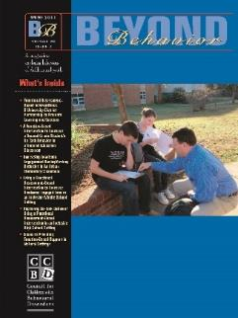



Changes in Harry’s Behavior
Cox, M., Griffin, M. M., Hall, R., Oakes, W. P., & Lane, K. L. (2012). Using a functional assessment-based intervention to increase academic engaged time in an inclusive middle school setting. Beyond Behavior, 2, 44 – 54.

Slide 56









Slide 57
Implementation Science
Adapted from Fixsen & Blasé, 2005
Exploration & Adoption
Installation
Initial Implementation
We think we know what we need so we are planning to move forward (evidence-based)
Let’s make sure we’re ready to implement (capacity infrastructure)
Let’s give it a try & evaluate (demonstration)
Full Implementation
Let’s make it our way of doing business (institutionalized use)
Sustainability & Continuous Regeneration
That worked, let’s do it for real (investment)

Slide 58
Wouldn’t it be great if … each school had a comprehensive, integrated, three-tiered model to meet students’ multiple needs?

Slide 59





Respectful, Responsible Partnerships
1997

Slide 60








A Strong, Respectful Partnership…
USD 497 Lawrence Public Schools
University of Kansas
Arizona State University
Florida State University
California State University, Los Angeles

Slide 61
Ci3T Training & Implementation at Lawrence Public Schools
Phase |  |  |  | Year
 | 2013-14 | 14-15 | 15-16 | 16-17 | 17-18 | 18-19 | 19-20
Elementary School
Ci3T Training
Implementation Year 1
Implementation Year 2
Sustain and Develop Practices
Middle and High Schools
Ci3T Training
Implementation Year 1
Implementation Year 2
Sustain and Develop Practices
College and Career Center
Ci3T Training
Implementation Year 1
Implementation Year 2
Sustain and Develop Practices

Slide 62


Celebrate Your Success!
USD 497 MTSS-CI3T Model of Support
High
≈5%
Tertiary Support
(Tier 3)
≈15%
Secondary Support
(Tier 2)
Differentiation
Positive Behavioral Interventions and Supports (PBIS) Framework
Support Intensity
Personalized Learning
Validated Core Resource
Blended Learning Environments
ELA
Math
≈80%
Culturally Responsive Teaching
Validated Curricula
Primary Support
(Tier 1)
Academic Behavioral Social
Low
excellence • equity • engagement
CI3T – Comprehensive Integrated 3-Tiered Model of Prevention
(Lane, Kalberg, & Menzies, 2009)
USD 497 School Board Priorities: The Foundation
Notes:
Benefits
Structure – builds efficiencies,
Structure – supports transparency
Structure – facilitates collaboration between general and special education teachers, and all those who support students’ educational experience
Remain focused on creating, positive, productive, effective, and efficient learning environments
We remain committed to graduating self-regulated, life long learners with the full set of skills – needed to be college and career ready

Slide 63








Communication and Continuous Improvement
Effective
Teams
Ci3T District Leadership Team
Ci3T School Leadership Team
College & Career
Ci3T School Leadership Team
Ci3T School Leadership Team
Ci3T School Leadership Team
Ci3T School Leadership Team
Ci3T School Leadership Team
Ci3T School Leadership Team
Ci3T School Leadership Team
Ci3T School Leadership Team
Ci3T School Leadership Team
Ci3T School Leadership Team
Ci3T School Leadership Team
Ci3T School Leadership Team
Ci3T School Leadership Team
Ci3T School Leadership Team
Ci3T School Leadership Team
Ci3T School Leadership Team
Ci3T School Leadership Team
Ci3T School Leadership Team
Ci3T School Leadership Team
Middle
Ci3T School Leadership Team
High
Elementary
Notes:
Structure for positive, productive discussions
Data-informed professional development

Slide 64









Slide 65



Teachers Outcome in Ci3T Models

Slide 66

Project SCREEN
Wouldn’t it be great if … students could be detected at the first sign of concern?
Institute of Education Sciences, U.S. Department of Education
R324A190013 University of Kansas

Slide 67






Slide 68

Installing a Universal Behavior Screening Tool: Questions to Consider
Guiding Questions around
Setting Up Screening Structures
Providing Professional Learning
Before your Screening Window Opens
During your Screening Window
After your Screening Window
Technical Assistance Center on Positive Behavior Interventions and Supports V – Subcontract. ($110,000 annually; $550,000 estimated total if incrementally funded). Subaward No. 282070J to University of Kansas. Prime Award No. H326S180001 to University of Oregon.

Slide 69
Project ENHANCE Overview
Enhanced Ci3T Implementation Series and Delivery:
Educators’ Views of Professional Learning Resources
IES Project Number R324N190002

Slide 71



Slide 72




District and School Leadership
Resources Needs
Top Leadership Needs
Onboarding and training
Communicating the vision of Ci3T
Providing professional learning for faculty and staff
Royer, D. J., Oakes, W. P., Briesch, A. M., Chafouleas, S. M., Lane, K. L., Buckman, M. M., Sherod, R. L., & Common, E. A. (2021). Ci3T Leadership Team members’ perceived facilitators and barriers to implementation. Journal of School Leadership, 32(6).https://doi.org/10.1177/10526846221095753

Slide 73



Building Capacity
Supports for students with internalizing behavior patterns
Social skill instruction
De-escalation techniques
Top Professional
Learning Needs
Common, E. A., Buckman, M. M., Lane, K. L., Oakes, W. P., Royer, D. J., Chafouleas, S., Briesch, A., & Sherod, R. (2021). Project ENHANCE: Assessing Professional Learning Needs for Implementing Comprehensive, Integrated, Three-Tiered (Ci3T) Models of Prevention. Education and Treatment of Children. https://doi.org/10.1007/s43494-021-00049-z

Slide 74



Building Capacity
Preferred Professional
Learning Avenues
In-district workshops
(during school hours)
Online courses for college credit
Teacher collaborative networks
Asynchronous opportunities
(e.g., web-based modules, webinars)
Common, E. A., Buckman, M. M., Lane, K. L., Oakes, W. P., Royer, D. J., Chafouleas, S., Briesch, A., & Sherod, R. (2021). Project ENHANCE: Assessing Professional Learning Needs for Implementing Comprehensive, Integrated, Three-Tiered (Ci3T) Models of Prevention. Education and Treatment of Children. https://doi.org/10.1007/s43494-021-00049-z

Slide 75

Screening
Top Screening Needs
Enhancing Behavior Screening
Knowledge on integrating multiple sources of data
Increase buy-in and consistency of administration
How to make intervention decisions based on screening data
Develop systems for coordinated data use
Professional learning through in-service workshops
Resources to address behavior concerns
Briesch, A. M., Lane, K. L., Common, E. A., Oakes, W. P., Buckman, M. M., Chafouleas, S. M., Iovino, E. A., Sherod, R. L., Abdulkerim, N., & Royer, D. J. (2022). Exploring views and professional learning needs of Ci3T leadership teams related to universal behavior screening implementation. Education and Treatment of Children, 45, 245-262. https://doi.org/10.1007/s43494-022-00080-8
Briesch, A. M., Chafouleas, S. M., Iovino, E. A., Abdulkerim, N., Sherod, R. L., Oakes, W. P., Lane, K. L., Common, E. A., Royer, D. J., & Buckman, M. M. (2022). Exploring directions for professional learning to enhance behavior screening within a Ci3T model of prevention. Journal of Positive Behavior Interventions, 24(4), 278-288. https://doi.org/10.1177/10983007211050424
Notes:
Screening survey: 165 Ci3T leadership team members, 27 elem schools from 5 districts, midwest northeast west
Screening interviews and focus groups: Ci3T leadership team members = 21 interviews and 17 ppl in focus groups, 25 elem schools 5 districts, midwest northeast west

Slide 77















Project ENHANCE Coaching Support

Slide 78




Initial Plan for Eight Modules
3
4
5
6
7
8
1
2
Notes:
Based on Year 1 results we conceptualized 8 modules in three domains: leadership, building capacity, and behavior screening

Slide 79

Project ENHANCE
What Comes Next

Slide 80

Project ENHANCE
What Comes Next

Slide 81
Notes:
But now we back up to Year 2 and look at results from our rapid iterative process.
This is an example timeline of Module 6.3.2.6, one section of our originally conceived mega Module 6.

Slide 82



Module 7
Module 6.3.1
Module 6.3.2.6

Slide 83







Objective 2: Embedding and Integrating Ci3T Domains During Daily Instruction

Slide 84

Module 7
Module 6.3.1
Module 6.3.2.6

Slide 86







Slide 87
Module 7
Module 6.3.1
Module 6.3.2.6

Slide 89







Slide 90



Slide 91


Slide 93







Enhanced Ci3T Modules
Notes:
But we are currently at 33 modules (January 2024, approaching end of Year 5) after our rapid iterative process stakeholder feedback indicated initial modules were amazingly full of an overwhelming amount of information.
2 screening modules forthcoming
FABI

Slide 95
Notes:
We approach the end of a 2-year RCT and we continue to build new modules and revise existing modules.
Public release date is June 24, 2024.

Slide 98
Project ENHANCE:
A Comparison of Enhanced and Traditional Professional Learning Offerings
Aims
Examine Ci3T Leadership Teams’ feasibility, usability, integrity, and knowledge
Determine impact of E-Ci3T and T-Ci3T Implementation Series and Delivery on teacher outcomes
Determine impact of E-Ci3T and T-Ci3T Implementation Series and Delivery on student outcomes
Conduct Cost Feasibility Analysis (CFA) of E-Ci3T and T-Ci3T

Slide 99


Open Science Framework Preregistration
Supporting Ci3T Implementation: A Comparison of Enhanced and Traditional Professional Learning Offerings
https://osf.io/gtkax

Slide 100
Project Engage
Aim 1: Examine Pandemic Impact
Aim 2: Test a Tier 2 Intervention to Manage Anxious Feelings:
Recognize. Relax. Record.
Notes:
Wouldn’t it be great if we could support students managing anxious feelings as they navigate through the pandemic?

Slide 101


Slide 102



Enhancing CI3T module:
Recognize. Relax. Record.

Slide 103
Support | Description | School-wide Data: Entry Criteria | Data to Monitor Progress | Exit Criteria
Recognize. Relax. Record. (Project ENGAGE) | This self-monitoring intervention package occurs in an educator-led small group (2-4 students) or one-to-one. If an adult other than the classroom teacher leads this intervention, all activities and materials are shared with and used in the classroom setting. Students learn and practice the three components of Recognize. Relax. Record. in a series of four to ten 15-20 min sessions. Recognize: Students learn to identify thoughts and feelings related to being anxious—a key component of self-awareness. (2-3 sessions). Relax: Students learn relaxation strategies to support self-regulation. Students select 2-3 relaxation strategies from a menu of: breathing techniques, progressive muscle relaxation, guided imagery, self-talk. (2-6 sessions depending on number of strategies and need for booster sessions) Record: Students learn to self-monitor their thoughts and feelings, use of their selected Relax strategies, and engagement (academic or social; 2-3 sessions). The teacher develops an easy-to-follow self-monitoring form for the student to use, and selects a time of day (e.g., instructional block) when the student could benefit from self-monitoring (see Record). Teachers collect data throughout the intervention using Direct Behavior Rating to monitor progress. | Behavior* SRSS-I5 score: Moderate (2-3), or SRSS-I5 score: High (4-15) Attendance Missing no more than 5 days in the first 6 weeks of school Grade Level Third-, fourth, or fifth-grade *Students with moderate or high-risk for externalizing comorbidities will be considered for inclusion | Student Performance Use of selected relaxation strategies and level of goal behavior (academic or social engagement) named in the self-monitoring plan. Progress reports of work completion (if used as entry criteria) Social Validity Teacher: IRP-15 Student: CIRP Treatment Integrity Implementation checklist Treatment integrity checklist | SRSS-I5 score: Low (1-2) Demonstrated independent use of strategy (team set expected level of improvement: trend or level). Increased student report of replacement behavior. Report card indicating work completion meets expectations (if used as entry criteria)

Slide 104

Rigor. Relevance. Reach.
Positive, Productive, Respectful
Playing Fields for Future Inquiry…

Slide 105
Comprehensive, Integrated, Three-Tiered Model of Prevention
(Lane, Kalberg, & Menzies, 2009)
Tier 3
Tertiary Prevention (≈5%)
Project Function
Project ENHANCE
Project SCREEN
Tier 2
Secondary Prevention (≈15%)
Project Engage:
Recognize. Relax. Record.
Project EPIC
OSEP Personnel Preparation
KU RITE
Tier 1
Primary Prevention (≈80%)
Academic ◇ Behavioral ◇ Social
Validated Curricula PBIS Framework Validated Curricula

Slide 106





Top 10 Pageviews
/screening
6,000 –
4,000 –
2,000 –
| | | |
2020 2021 2022 2023
2020 2021 2022 2023
ci3t.org/screening pageviews March 1, 2020 to June 30,2023

Slide 107


ci3t.org users
March 1, 2020 to June 30,2023

Slide 108



Slide 109




Notes:
Respectful, Responsible Inquiry
Micro-credentials
Ci3T website
June 24, 2024
Reach:
Maps from the website – US and Global
Comments from Educators
SRSS-IE – next steps

Slide 110



Thank you Kathleen.Lane@ku.edu
Dream the life you want to live and the contributions you want to make … then arrange the contingencies to fulfill your dreams (Lane, 2017).

